Slide 1
Applying for tertiary study in 2022

Slide 2




What is VTAC?
The Victorian Tertiary Admissions Centre (VTAC) is the central point for applications to Victorian universities, TAFEs, and Independent Tertiary Colleges.
VTAC also calculates the Australian Tertiary Admission Rank (ATAR) for Victorian Year 12 students.
Connect with VTAC today to receive updates, tips, and timely reminders:
  Facebook: facebook.com/vtacguide
  Twitter: @vtacguide
Notes:
Victorian Tertiary Admissions Centre (VTAC) is the central point for applications to Victorian universities, TAFEs, and Independent Tertiary Colleges.
VTAC also calculates the Australian Tertiary Admission Rank (ATAR) for Victorian Year 12 students.
Students won’t be applying individually to each institution when in year 12, but instead submitting one application through VTAC for up to 8 course preferences.

Slide 3
In this session
Finding courses
Getting an offer
Applying for courses
SEAS and Scholarships
Scaling and the ATAR

Slide 4
The VTAC application process – key dates
2 August
Applications open
30 September
Timely applications close
8 October
SEAS and Scholarships applications close
13 December
Victorian ATAR released
14 January
January offers
released
1-18 February
further offer rounds
14 December
Change of preference deadline for December offers
20 December
December offers
released
Notes:
Here’s a “bird’s eye view” of when you need to apply, meet deadlines, and receive your offer.
All these dates are available on the VTAC website.
You’ll still have the chance to change your preferences after receiving your ATAR.

Slide 5
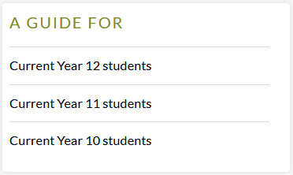
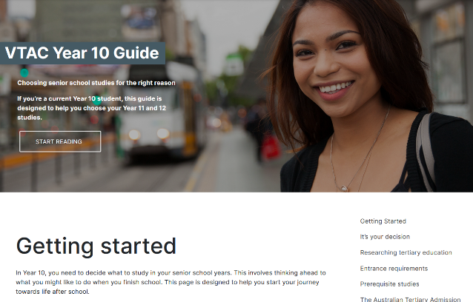
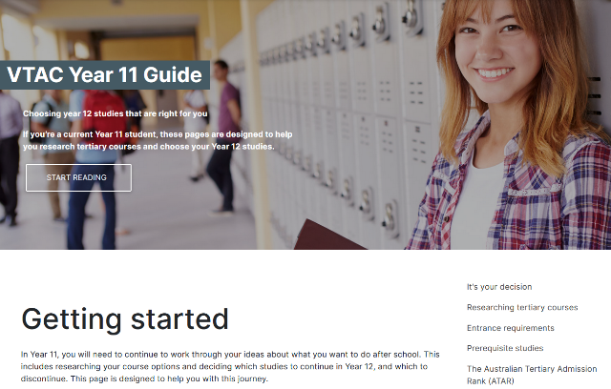
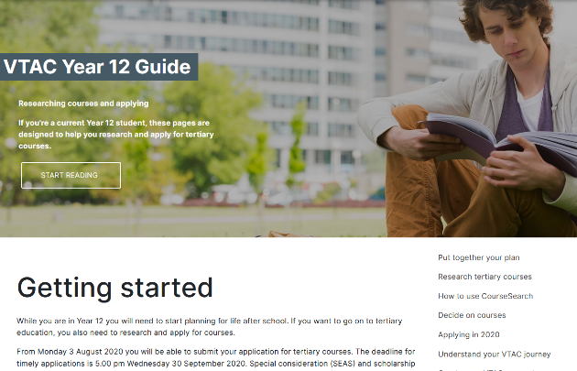
VTAC guides
vtac.edu.au
Notes:
Online Guides for each year level – you can get more detailed information about everything you’re hearing in this presentation by going to vtac.edu.au and clicking on the Guide for your year level.

Slide 6
Finding courses

Slide 7
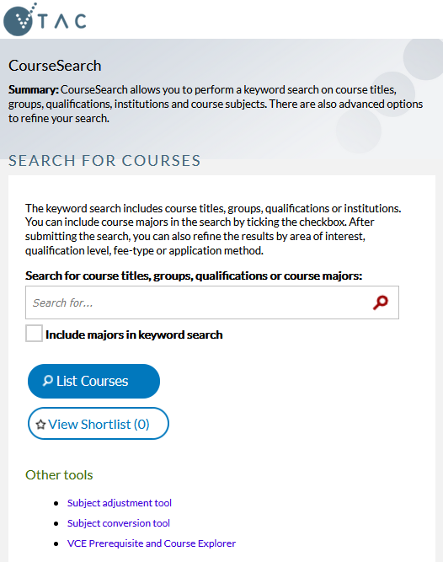
CourseSearch
Compare course information for all tertiary institutions in Victoria
Advanced search options include filtering by institution, area of interest, and qualification level
Available at vtac.edu.au
Notes:
CourseSearch lets you search across all the institutions at once – good for comparing courses
Information displayed in CourseSearch is provided by the institution offering the course
2022 CourseSearch available from late July

Slide 8
Different types of tertiary courses
VET
Cert II-IV
Diploma
Higher Education
Advanced Diploma
Advanced Diploma
Associate Degree
Bachelor Degree
Graduate courses
Notes:
You can list both VET and Higher Ed courses on your VTAC preferences
Current Year 12 students not eligible for Graduate courses
What is a higher education course?
Higher education courses provide professional qualifications with an emphasis on knowledge, theory, personal attributes, and the development of professional and transferable skills. Some courses have fixed vocational outcomes, leading to careers in specific areas, such as accountancy or nursing, while others are ‘generalist’ with more flexible career goals, such as business or science.
Higher education qualifications include:
Bachelor degrees, which take three to four years to complete on a full-time basis.
Associate degrees or Diplomas, which generally require between one and two years full-time study, although some offer an accelerated one-year program. Diplomas may also provide a clear pathway into a degree course.
Postgraduate studies, which can be studied after a Bachelor degree is completed. These include postgraduate degrees, honours, Masters degrees and Doctorates (PhDs).
What is a vocational education and training course (VET)?
Vocational education and training (VET) courses provide trade, para-professional and professional qualifications with an emphasis on practical skills, capabilities and associated knowledge in specific industry areas. You apply for some VET courses through VTAC, while others, like apprenticeships, follow a different process. Visit www.skills.vic.gov.au for additional information on VET courses.
VET qualifications
» Certificates I-II are the most basic qualifications and introduce learners to a vocational field. These courses can also provide a pathway to further learning, particularly for those who have not completed a Year 12 certificate.
» Certificate III-IV courses include trade-level certificates and can lead to skilled employment. Certificate IV courses can be used as a pathway to Diploma level training or higher education courses.
» Diplomas and Advanced Diplomas provide deeper level training and equip learners to undertake advanced skilled or paraprofessional work. They also provide a pathway to higher education and can sometimes provide credit towards an undergraduate degree.
Look out for pathways, e.g. a Diploma which leads on to a Bachelor degree.

Slide 9
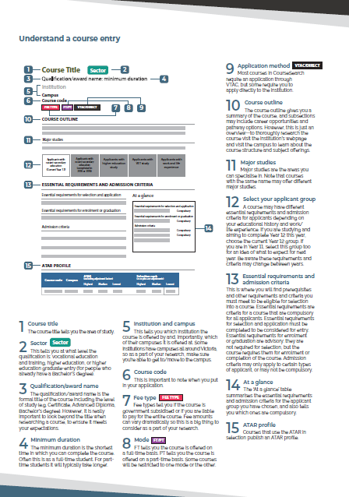
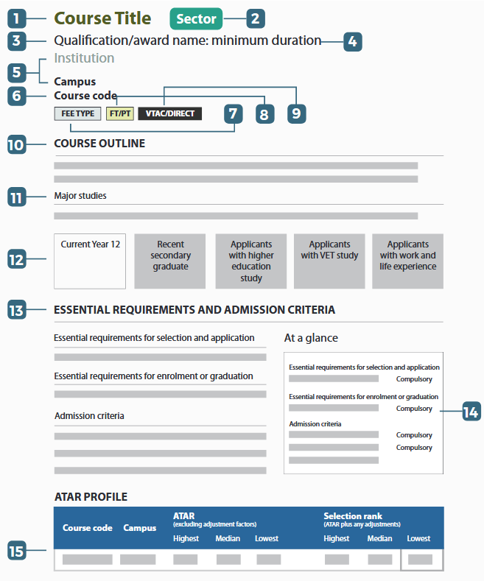
CourseSearch: areas of interest
‘How to use CourseSearch’
fact sheet available at vtac.edu.au
Essential Requirements and Admission Criteria
“What do I have to do to get in?”
ATAR Profile
“How competitive is it to get in?”
Notes:
When you open a course page in CourseSearch, a lot of the information you see is fairly self-explanatory, like the name of the course, which campus it runs at, and so on.
CLICK you can download a fact sheet from the VTAC website which explains all the information in detail.
CLICK but there’s two sections we’ll discuss today: first, the Essential Requirements and Admission Criteria
CLICK secondly, the ATAR profile

Slide 10
What requirements might exist?
Prerequisites
Any VCE subjects you must complete to be eligible for an offer
Interview
Audition
Personal statement
Folio presentation
CASPer test
Online test needed for most teaching courses
Subject adjustments
Extra points for completing VCE subjects relevant to the course
SEAS
Special consideration
Notes:
There’s a whole range of things you might see listed under the Essential Requirements and Admission Criteria.
Whatever the requirements are for a course, you’ll always see these listed in VTAC CourseSearch. Here are some of the most common ones:
CLICK to spotlight in order:
Prerequisites
Explain that prerequisites exist for all higher ed courses
CLICK CASPer test
Compulsory online test needed for most teaching and some nursing courses in Victoria
CLICK Subject adjustment
Explain the concept and that these are applied automatically if specified in the course description
CLICK to show all categories again
Information about how to organise e.g. auditions and interviews is found in each course description. Contact the institution if it’s unclear how to complete a requirement.
We’ll talk about SEAS in a bit.

Slide 11
Two types of essential requirements
You need to complete these to apply and receive an offer
Essential requirements for selection and application
Prerequisites
Essential requirements for enrolment or graduation
Immunisations
Police check
Working with Children Check
Interview
Audition
Pre-selection kit
You don’t need to complete these until you have successfully received an offer
Notes:
These are just some examples of each type and there may be other requirements under these headings

Slide 12

Ranking applicants
ATAR
1 | Mel | 95.00 ATAR
2 | Geri | 90.00 ATAR
3 | Victoria | 85.00 ATAR
4 | Emma | 80.00 ATAR
5 | AJ | 75.00 ATAR
6 | Howie | 70.00 ATAR
 | Selection rank
1 | Mel | 95.00 ATAR = 95.00 selection rank
2 | Geri | 90.00 ATAR +subject adjustment = 94.00 selection rank
3 | AJ | 75.00 ATAR + SEAS + subject adjustment = 86.00 selection rank
4 | Victoria | 85.00 ATAR = 85.00 selection rank
5 | Emma | 80.00 ATAR = 80.00 selection rank
6 | Howie | 70.00 ATAR = 70.00 selection rank
Notes:
Every course has some way of ranking applicants. In this example, they are using the ATAR but also taking into account special consideration and subject adjustments. For a different course they might be starting with e.g. the score from an audition, rather than ATAR.
Let’s go through all six applicants in turn.
CLICK Mel did not receive any adjustments, so her selection rank is the same as her ATAR, 95.00.
CLICK Geri received a subject adjustment for completing a relevant VCE subject, so her selection rank is higher than her ATAR: 94.00
CLICK Victoria did not receive any adjustments, so her selection rank is the same as her ATAR
CLICK Emma did not receive any adjustments, so her selection rank is the same as her ATAR
CLICK AJ received a subject adjustment like Geri but also special consideration through SEAS, so his selection rank is a fair bit higher than his ATAR.
CLICK Howie did not receive any adjustments, so his selection rank is the same as his ATAR
This course had 4 places available for the 6 people applying, so who got the offers?
CLICK the offers went to the applicants with the highest selection rank
If we copy these same offers across to the ATAR list (CLICK), we can see that the people with the highest selection rank were not completely the same as the people with the highest ATAR.

Slide 13
Publishing information (ATAR-based selection only)
ATAR
1 | Mel | 95.00 ATAR
2 | Geri | 90.00 ATAR
3 | Victoria | 85.00 ATAR
4 | Emma | 80.00 ATAR
5 | AJ | 75.00 ATAR
6 | Howie | 70.00 ATAR
 | Selection rank
1 | Mel | 95.00 ATAR = 95.00 selection rank
2 | Geri | 90.00 ATAR +subject adjustment = 94.00 selection rank
3 | AJ | 75.00 ATAR + SEAS + subject adjustment = 86.00 selection rank
4 | Victoria | 85.00 ATAR = 85.00 selection rank
5 | Emma | 80.00 ATAR = 80.00 selection rank
6 | Howie | 70.00 ATAR = 70.00 selection rank
Lowest ATAR to receive an offer
Lowest selection rank to receive an offer
Notes:
So what information gets published about this course to tell you how competitive it was to get in?
CLICK first, the lowest ATAR to successfully receive an offer
CLICK second, the lowest selection rank to successfully receive an offer
Explain why lowest sel. rank is the best number to look at
Remember it’s last year’s data, might change for next year.

Slide 14
Steps to apply

Slide 15
Create a VTAC account
All VTAC applications are completed online using the same VTAC ID and PIN
Creating an account is a simple process which you can do from Monday 2 August
All you need is your personal details, including student number and USI:
  If you’re a current Year 12 student, make sure you enter your student number so that we can access your results later in the year
  You will need to have a USI (unique student identifier) before you can create an account
    Create a new (or retrieve a forgotten) USI at usi.gov.au
Notes:
One registration only
To correct errors, change the details online or call VTAC. Do not create another registration.
For current Year 12 applicants, use a personal, not school email address
Some school email addresses are deactivated by the time offer emails are sent
Four digit PIN
Lost PINs can be retrieved from the log in form.
Nominate a proxy if needed
VTAC cannot discuss your application with anyone except you (not even your parents) unless you have specified an authorised nominee when registering.

Slide 16
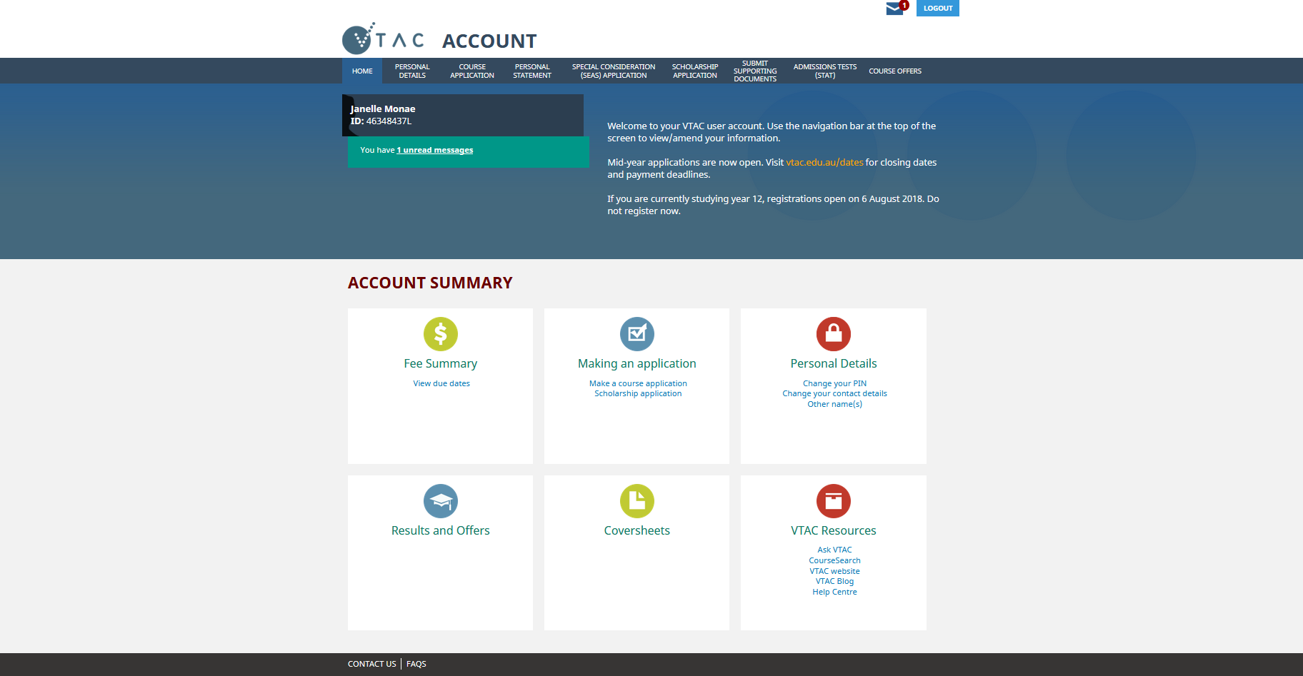
VTAC account
Notes:
Highlight location of message inbox – a copy also sent to email
CLICK once you have a VTAC account, you can go straight on and press “make a course application”

Slide 17
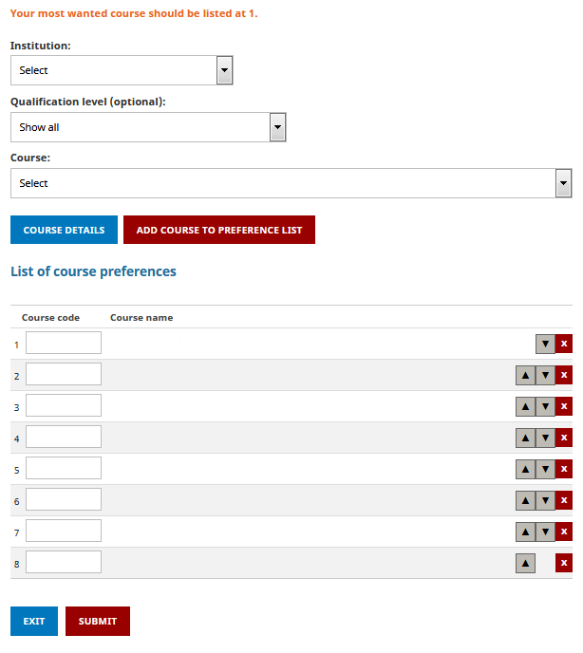
Applying for courses
List up to eight courses/institutions
Preference order – always list courses in the order you want to get into them
To add course preferences: Select institution and/or course or type in the course code.
To move a course on the preference list use the up/down buttons.
To delete a course use the x button.
Notes:
Explain why preference order matters – you won’t find out about lower preference courses
YOU MUST LIST COURSES IN THE ORDER YOU MOST WANT TO STUDY THEM
Be careful with X button – if a course has an early closing date and it is removed after that closing date, it can’t be re-added

Slide 18




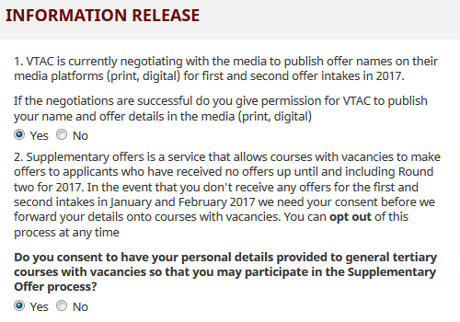


Supplementary offers
No offers in
the earlier rounds
Your details released to institutions with places available
If interested, enrol for the course with the institution
They may contact you to suggest a course you hadn’t applied for
Notes:
The supplementary offer process allows courses with vacancies to make offers to certain VTAC applicants who have not previously applied for the course, if they have not received a preference offer by the second offer round.

Slide 19

Change of Preference
After applying, you can change your course preferences free-of-charge as many times as you like while Change of Preference is open
Check the deadlines carefully prior to the start of each round
The first deadline is for the December offer round, at 4pm on Tuesday 14 December 2021
  Get your preferences in the order you want by this date to maximise your chance of getting the offer you want
Notes:
No limits or extra fees for change of preference.

Slide 20
SEAS (special consideration) and
Scholarships

Slide 21
Special Entry Access Scheme (SEAS)
SEAS is the special consideration program used by most tertiary institutions in Victoria
Filling out a single SEAS application will cover all of your eligible preferences
Relates to circumstances beyond your control which have negatively affected your education
  Also includes: Category 1 (Personal Information and Location) – everyone should apply
SEAS allows selection officers at institutions to grant special consideration for course entry to applicants.
Notes:
A single application for all eligible preferences

Slide 22
What can SEAS do?
Applicants in ATAR order
1 | Mel | 95.00 ATAR = 95.00 selection rank
2 | Geri | 90.00 ATAR +subject adjustment = 94.00 selection rank
3 | Victoria | 85.00 ATAR = 85.00 selection rank
4 | Emma | 80.00 ATAR = 80.00 selection rank
5 | AJ | 75.00 ATAR + SEAS + subject adjustment = 86.00 selection rank
6 | Howie | 70.00 ATAR = 70.00 selection rank
SEAS does not exempt you from completing essential requirements and compulsory admission criteria.
  You must study course prerequisites, attend all interviews, sit any required tests, and submit all required folios and forms.
SEAS is not a guaranteed entry scheme or reserved quota, but may allow you to gain entry to a course with a lower ATAR than otherwise
Notes:
Show how in the example from earlier, special consideration through SEAS allowed AJ to get an offer ahead of Emma, even though AJ’s ATAR was lower.

Slide 23
SEAS categories
Category 1: Personal information and location
    As simple as ticking a box
    All applicants should apply for this category
Category 2: Disadvantaged financial background
Category 3: Disability or medical condition
Category 4: Difficult circumstances
    E.g. disruption to living situation, affected by illness or death of relative/friend, natural disaster, refugee status, impact of COVID-19 remote learning
Notes:
Apply for as many categories as relevant to your circumstances, but do not claim the same circumstances under multiple categories
Explain the categories:
Category 1: Personal information and location. This category includes age, living or school location, under-representation of a gender in a course or field of study, recognition as an Indigenous Australian, recognition for being from a non-English speaking background and recognition for being the first in your family to attend tertiary study. Everyone should tick this box.
Category 2: Disadvantaged financial background
Category 3: Disability or medical condition
Category 4: Difficult circumstances: anything else beyond your control which has negatively affected your education and is not already covered by a previous category
For category one no additional information is required, just the tick box.
The other three categories do require additional documentation. We’ll go through the evidence requirements for these now.

Slide 24
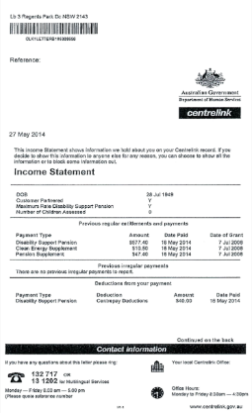


Financial documentation
Documentary evidence of benefit or family tax benefit received by parent/guardian
123456789A
(applicant’s own CRN)
Impact statement
OR
OR
Statement
of support
Notes:
CRN only possible if it’s in the applicant’s name
OR documentary evidence if it’s in a parent’s name
OR impact statement and statement of support
Evidence must be no older than 3 months at the time of applications opening.

Slide 25
SEAS documentation – categories 3 & 4
Specific processes for: sexual assault, family violence, homelessness, formal out-of-home care, refugees/asylum seekers, bushfires, and COVID-19 remote learning. Follow the instructions on the SEAS application form.
All other conditions/circumstances:
Impact statement – written by applicant
Statement of support – written by health practitioner or relevant responsible person
Impact statements without an accompanying statement of support will not be considered.
For more information about SEAS documentation, visit www.vtac.edu.au
Notes:
For the specific circumstances you can see on the screen , there is more information on the VTAC website about the specific processes and evidence requirements for these.
There is also a specific process this year for the impact of COVID-19 remote learning, which includes disruption experienced last year.
For all other circumstances and/or medical conditions written statements are required. Check the VTAC website for more information about what to include in these .
More information and examples online

Slide 26

Scholarships
VTAC collects scholarship applications for many institutions
  One application, many institutions
Scholarships are not just for academic performance
Many equity scholarships have similar documentation requirements to SEAS
  Statements must be submitted separately for each using the correct coversheet.
List of scholarships available on the VTAC website
  Including some scholarships which require their own separate application
Notes:
Scholarships are not just for 99.95 students! Everyone should apply.

Slide 27
Results and offers

Slide 28

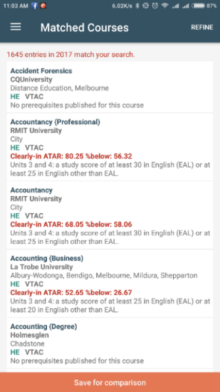
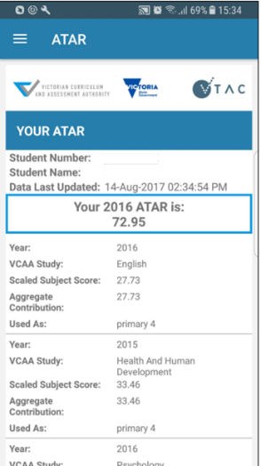


ATAR and VCE Results released
7am, Monday 13 December 2021
Online
Results app
Mail
Free online access at resultsandatar.vic.edu.au
Free download of joint VCAA/VTAC app: ‘Results and ATAR’
Paid VTAC applicants will receive a printed ATAR statement
Registration required
VCAA student number
Password
Notes:
Registration for the results service (choosing a secure password to access your results) is separate from the VTAC account and will be available from Monday 2 August.
Year 11 students wishing to access a result for a year 12 subject they have completed this year do not need to create a VTAC account. They can simply register for the Results and ATAR service.

Slide 29
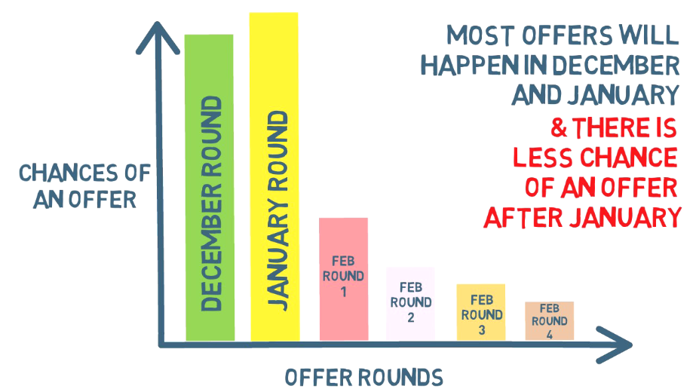
Six offer rounds
Notes:
The majority of offers are made in the earlier rounds, especially in January.
This is why the 14 December COP deadline is so important, even though you can keep changing your preferences between rounds.

Slide 30






Offer advice
From: VTAC
Enrolment instructions
From: Institution
2pm
Accept
Defer
Reject
Next day
Notes:
When offer advice is released, you will receive an email from VTAC which tells you what course you've been offered.
CLICK The same information will also be available online from 2:00 PM. if you gave permission when you applied, it will be in the newspaper the next day
A second email will come straight from the course with instructions on how to CLICK accept (explain), CLICK defer (explain), CLICK or reject (explain).
Advise students to check enrolment deadlines carefully. These are set by institutions so are not all the same.
Enrolment/deferment is done with the institution, not VTAC

Slide 31
Always accept an offer
Reject
The offer process will continue
regardless of whether you have accepted or rejected your offer.
Notes:
We strongly advise students to always accept an offer, unless they don’t want it even as a back-up option.

Slide 32
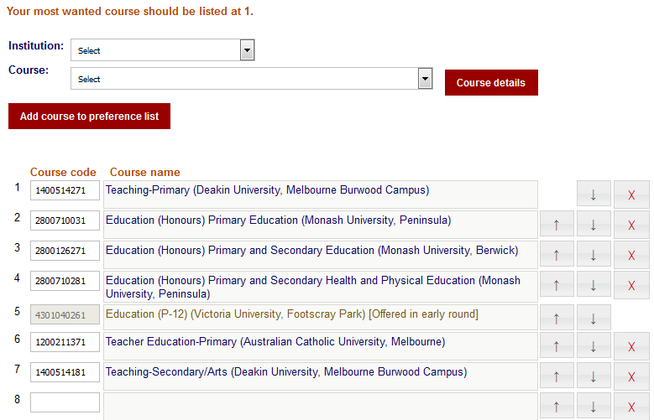
You will be automatically considered for any higher preferences
Higher preference courses. Automatically considered in future rounds.
Offered course – can’t be removed but can be moved
Lower preferences. Not considered unless moved above offered course.
Notes:
If they are happy with their preferences, they can just leave them alone and they will be automatically considered for any higher preferences.
Otherwise, make sure any new or changed preferences are listed above an offer already received

Slide 33
Scaling and the ATAR

Slide 34
Australian Tertiary Admission Rank (ATAR)
What is it?
How is it calculated?
VTAC receives your study scores from VCAA and scales them for fairness
A tool for tertiary selection based on relative performance in the VCE
It’s a rank, not a score
Your aggregate is calculated from the highest permissible combination of your subjects
The aggregates for everyone are placed in order for conversion to the ATAR, which is a percentile scale
Notes:
The ATAR is just one of many tools used to decide who gets into a course.
It’s not a score for the VCE. You must pass the VCE to be eligible for an ATAR of any number.
We’ll go through these three steps on the following slides.

Slide 35
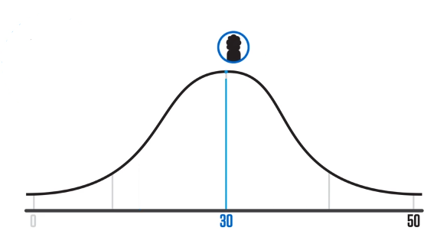



Scaling
Why?
Study scores received from the VCAA are a rank for that particular subject
30 is the average for every study, regardless of how competitive the cohort
How?
By looking at the students undertaking the study this year, and their performance in their other studies
For what?
Scaled scores are used only for the calculation of the ATAR
Prerequisites and subject adjustments are based on raw study scores
Notes:
Scaling:
Is not about difficulty, it is about the strength of competition within the subject
Is based on the results of all Victorian students doing that study this year (not by school, not by class)
Is done fresh every year (scaling report on the VTAC website shows it is relatively stable from year to year)
CLICK to pop up study score normal distribution diagram

Slide 36

The scaling process
Results for all Chemistry students in Victoria:
English | 31.35
Music Performance | 36.62
Further Mathematics | 33.45
Psychology | 28.51
Politics | 34.11
Biology | 33.72
Etc. | 31.52
Average for all studies | 32.75
Chemistry
Raw study score average: 30
Chemistry
Scaled study score average: 32.75
Notes:
For example, to scale Chemistry, we start off with the raw score of 30, which is the average VCAA score for all subjects when VTAC receives them.
How hard was it to get that 30? (i.e. the average mark in this particular subject)
CLICK To find out, we look at the results of everyone doing Chemistry, and find the average of their results in all their studies, not just Chemistry.
CLICK In this example, Chemistry students performed above average in all their subjects, showing that Chemistry was more competitive – therefore Chemistry scales up this year.
The scaling process is purely about how the students in that subject performed in this particular year. It is not about how hard or how easy the curriculum of that subject is.

Slide 37
Composition of the aggregate
Highest eligible English group subject
Next highest eligible subject
Next highest eligible subject
Next highest eligible subject
10% of next highest (or other increment)
10% of next highest (or other increment)
The “Primary 4” subjects (required to receive an ATAR)
Increments (only if available)
Notes:
You must pass the VCE and have at least four scored subjects including English to qualify for an ATAR.
If available, we will also use up to two more subjects as increments.
If there are seven or more subjects completed, we will use the highest allowable six.
The sum of all of these contributions is called the “aggregate” (total).

Slide 38
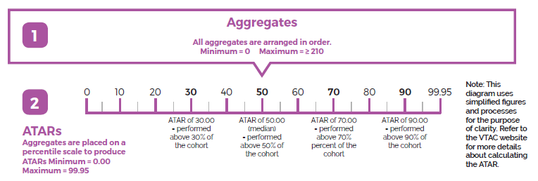
Calculating the ATAR
Notes:
The last step is to calculate the ATAR, which is a percentile rank based on the aggregate.
So an ATAR of 50.00 means you have performed better than 50% of the Year 12 age group.

Slide 39
Remember: the ATAR isn’t everything
It’s just a tool for getting into (some) tertiary courses
Many courses use criteria instead of, or in addition to, the ATAR
Your selection rank for a particular course may be higher than your ATAR due to published adjustment factors.

Slide 40
Getting support:
At school? Talk to your careers practitioner
Instructions, videos, and fact sheets on the VTAC website: vtac.edu.au
Call VTAC on (03) 9926 1020
Email us through your VTAC account
Send VTAC a Facebook message
Notes:
Edit this slide to include any school-specific contact information

