Slide 1
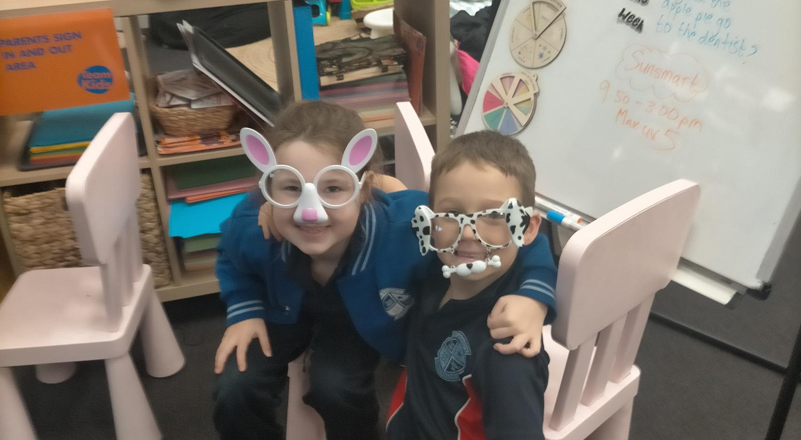
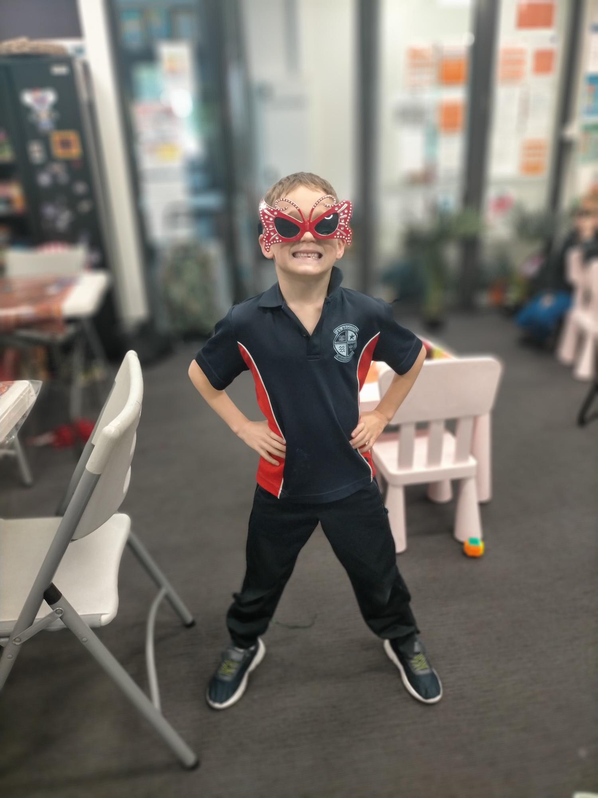
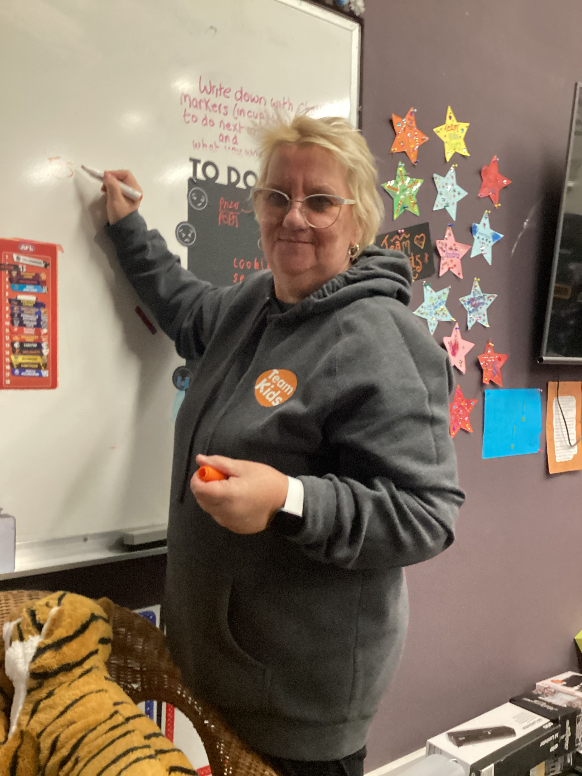
Hello from Team Kids ☺
We have been celebrating a lot of activities here in Team Kids this term, we have had pyjama day which was a great success with our yummy pancakes and hot chocolate and heaps of party games in the hall including Pin the tail on the donkey, pass the parcel and musical statues! We danced and sang to music and generally had a great time. This week is Science Week and we are all going to turn into mad scientists and do some interesting science experiments, learn a bit about the planets and explore magnets. The children are currently enjoying our new Hot wheels race track and the skateboarding ramp set up. We continue to have some awesome team games in the hall with dodge ball still being the number one favourite!
Please book into our next activity day on Wednesday 6th September we have Crazy Hair day and have a fun day planned in the morning and afternoon.
Epic Sports Club
Stem Club
Stem Club
Stem Club
21st to 25th August Book Week
Dress up as your favourite character
6th September Crazy Hair Day
Pack a wig or hair accessories
0436287094
StBrigidsPSMordialloc@teamkids.com.au
1300 035 000
info@teamkids.com.au

