Slide 1
St Patrick’s Primary
Parent Information Night
Tuesday 18th February 2025

Slide 2
Acknowledgement of Country
As we gather today, let us acknowledge the traditional custodians of this land, the local Dunghutti People and the Aboriginal and Torres Strait Islander people participating in this event.
Let us acknowledge this living culture and its unique role in the life of Australia today.
We pay our respects to Elders past and present and recognise and celebrate the diversity of Aboriginal peoples and their ongoing cultures and connections to the lands and waters of Australia.

Slide 3
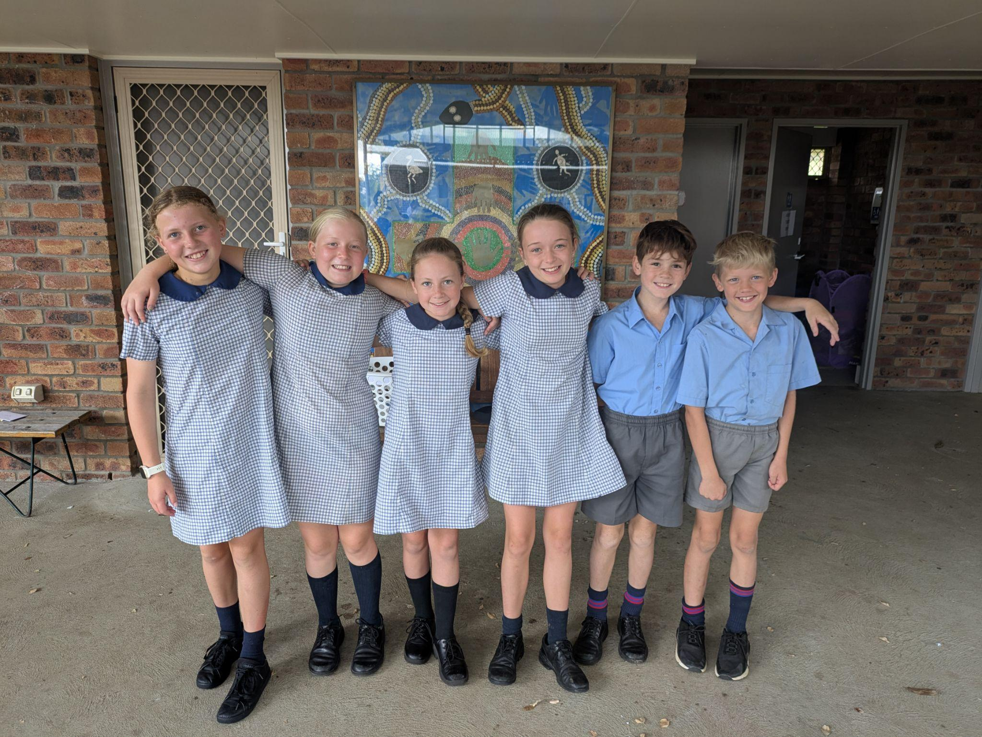
A Reflection To Begin This Meeting
What makes St Patrick’s Primary great?

Slide 4
Dedicated and Passionate Staff
Strong Sense of Community
Academic Excellence
Character Development
Supportive Learning Environment
Leadership Opportunities
Focus on Wellbeing (Living Well Learning Well)
Community Engagement
Innovative Learning Practices
Long Standing Reputation

Slide 5
We would like to extend our heartfelt thanks for an outstanding year in 2024! Together as a school community, we have celebrated many successes across a range of areas, including academics, sports, performing arts, and more.

Slide 6
To achieve even greater success, it is crucial for us to adapt to the constantly changing times. Our main goal is to guide and prepare our students with the skills needed for careers that may not yet exist. At the same time, we must continue to foster the sense of belonging, community, and family atmosphere that sets us apart—something many other schools strive to create.

Slide 7
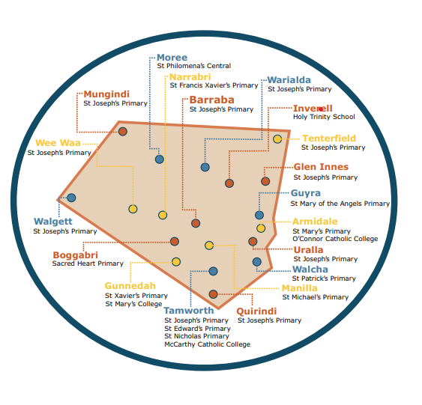
St Patrick’s is a small cog in a large educational system.

Slide 8
This concept that is the groundwork of all schools in our system is a rationale document justifying a model of student support that considers learning, wellbeing, school connection, behaviour, family-school partnerships and similar domains as inseparable and interrelated elements in the lives of children and young people and in the complex community that is the contemporary school.

Slide 9
We know if we are applying this document well is that:
Do I feel safe?
Do I feel valued as part of a team?
Do I feel respected?
Am I a respected learner?
Am I impacting others from their learning?

Slide 10
To achieve even greater success, it is crucial for us to adapt to the constantly changing times. Our main goal is to guide and prepare our students with the skills needed for careers that may not yet exist. At the same time, we must continue to foster the sense of belonging, community, and family atmosphere that sets us apart—something many other schools strive to create.

Slide 11
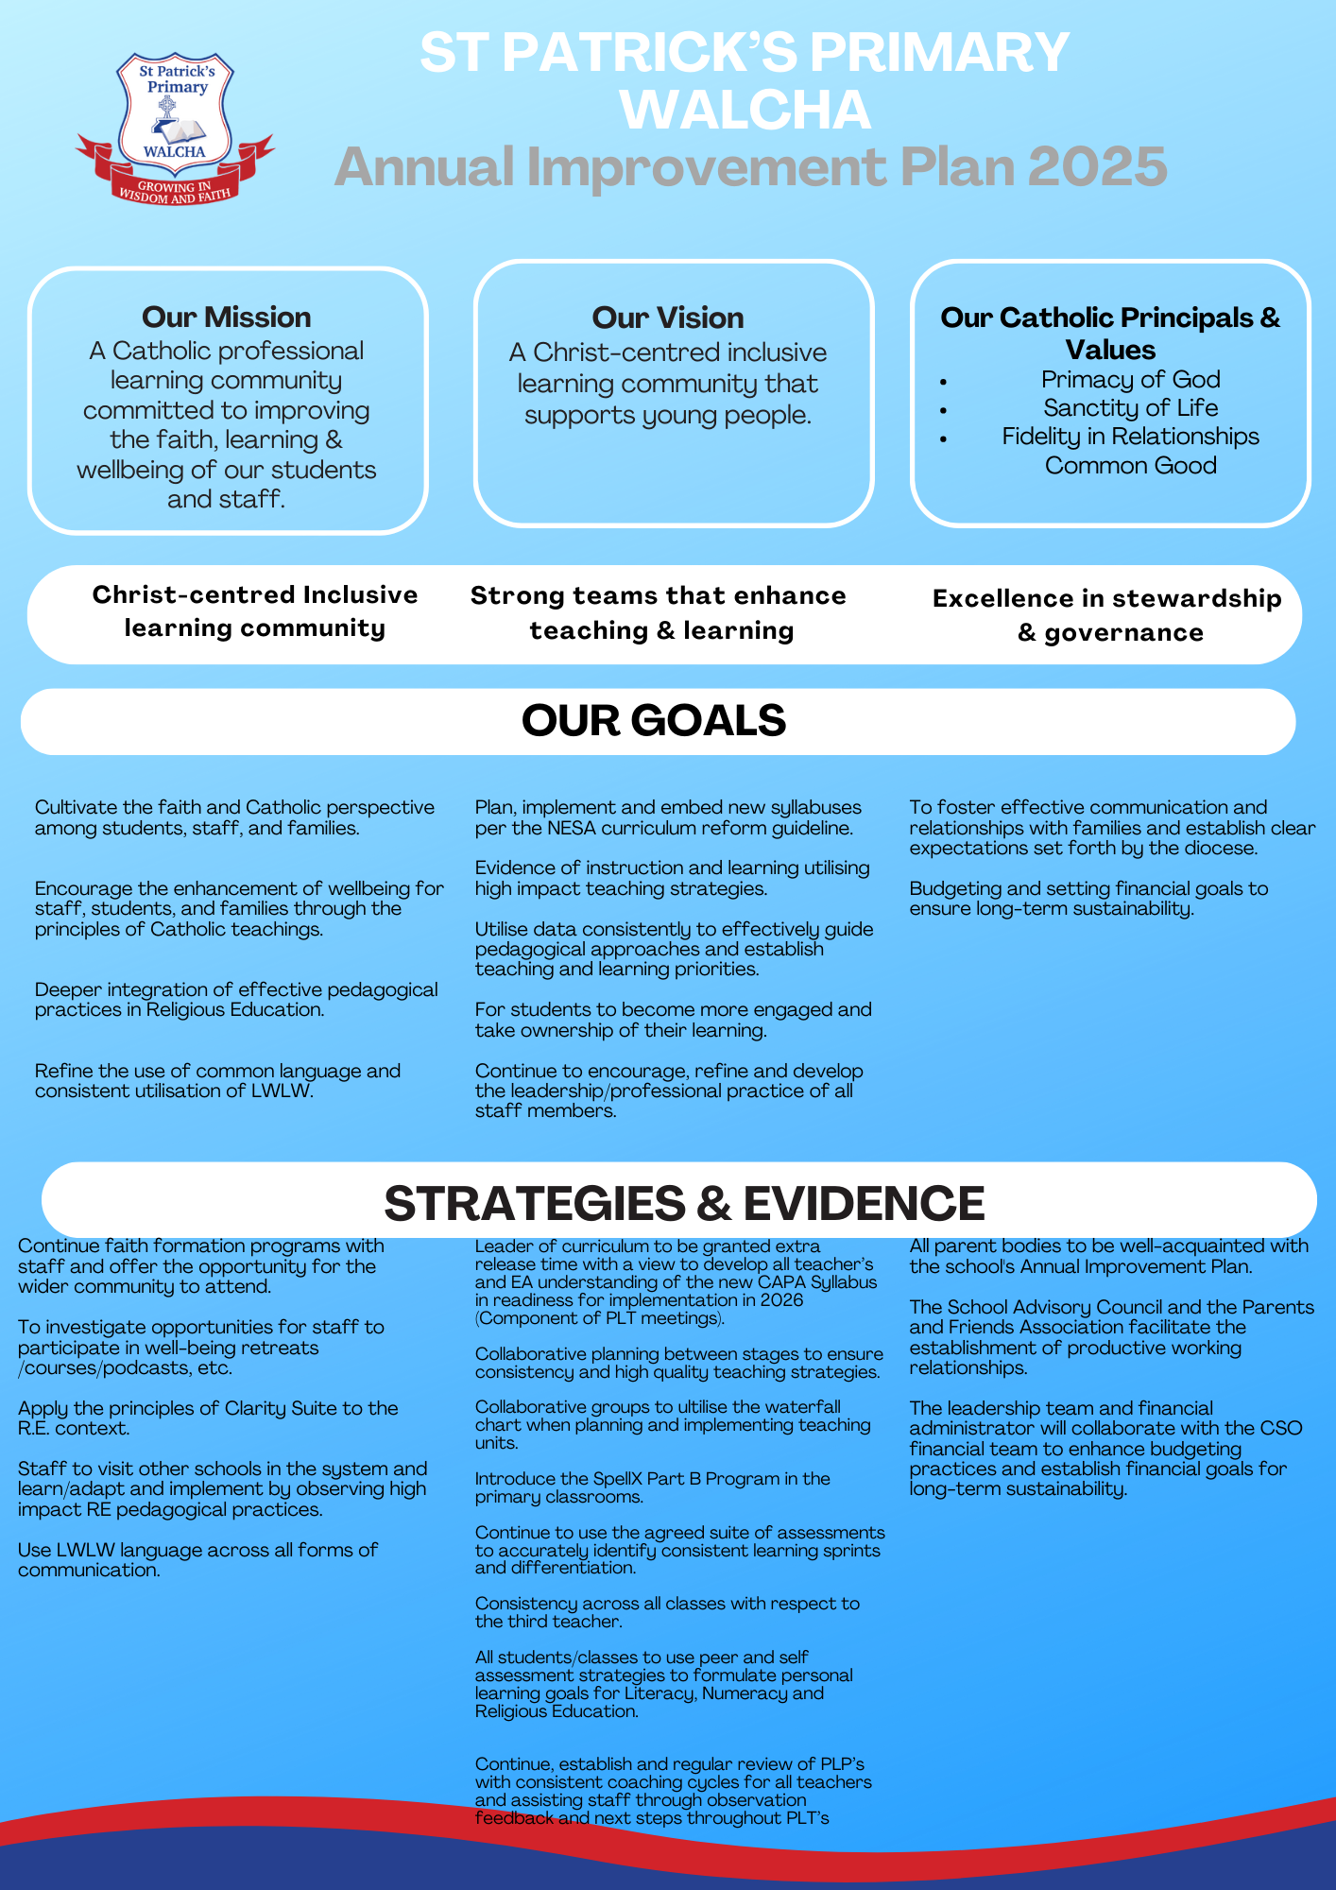
To achieve even greater success, it is crucial for us to adapt to the constantly changing times. Our main goal is to guide and prepare our students with the skills needed for careers that may not yet exist. At the same time, we must continue to foster the sense of belonging, community, and family atmosphere that sets us apart—something many other schools strive to create.

Slide 12
Let’s break this down in more parent friendly language!
System wise: Attendance, Attendance, Attendance!

Slide 13
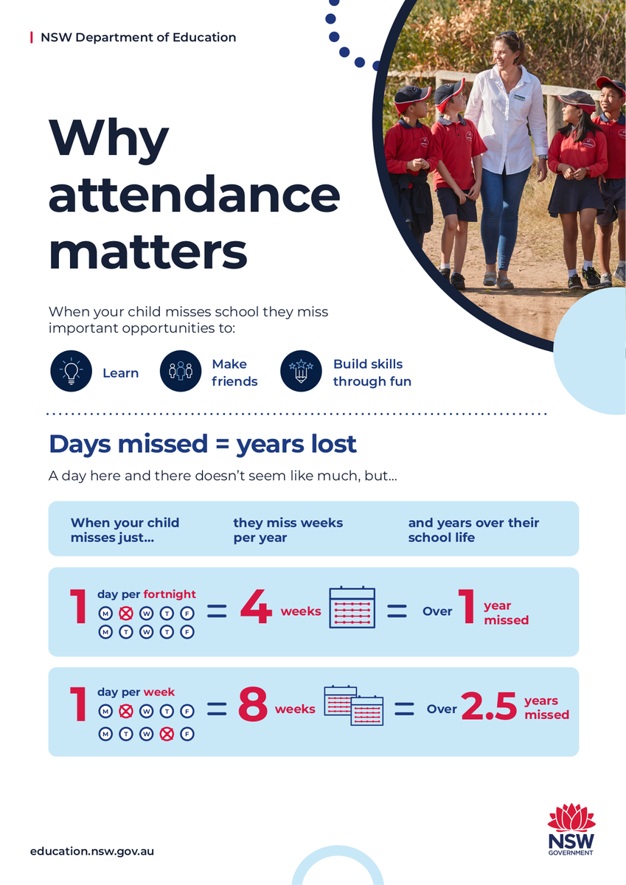
To achieve even greater success, it is crucial for us to adapt to the constantly changing times. Our main goal is to guide and prepare our students with the skills needed for careers that may not yet exist. At the same time, we must continue to foster the sense of belonging, community, and family atmosphere that sets us apart—something many other schools strive to create.

Slide 14
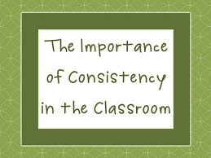
From our AIP, the big theme is ‘Consistency’
Uniformity across all classrooms.

Slide 15
What would this look like in all classrooms?
Consistent language from the LWLW framework applied.
Learning intentions and success criteria easily accessed for all subjects.
Every child have their own achievable/visual learning goals for literacy and numeracy.
Consistent structure of literacy and numeracy blocks.
Application of a whole school spelling program.

Slide 16
MORE GOALS FOR 2025
Continue fostering relations between ourselves and Walcha Central (sporting challenges)
A big focus on having uninterrupted time for our literacy and maths learning block (changes have been made with band, and the day this will be implemented.)
Continuing to ensure all staff and students utilise up to date IT resources on a daily basis.
Development of faith formation between all members of the school and parish.
Lunch time clubs- ie, gardening, sporting competitions
Continue participating in mind challenge tournaments like Brain Olympia and the Da Vinci Decathlon at TAS
Continuation of our weekly ‘Uniform with Pride’ Awards.
Commencement of Attendance Awards.

Slide 17
WEEKLY EVENTS
Sports uniform (Wednesday and Friday)
Canteen (Monday and Friday)
Library lessons for all classes will be conducted on Friday.
Band for Years 3-6 students (Friday)-commences at the end of this week.
Mini Minstrels-(Every Second Thursday)-continues next week.
Dates have been announced for School Assembly
Centacare (counselling services) every second Thursday

Slide 18
What Else is Happening?
Excursions:
Year 5-6: Coffs Harbour (3 nights in Term 4)
Year 3-4: Thalgarrah (1 night excursion-Term 4)
K-2- To be announced
Kindergarten-Teddy Bears Picnic at Thalgarrah

Slide 19
Initialit /SpellEx Programs, Assessment and Homework
Libby Makeham

Slide 20
InitiaLit and Spellex
InitiaLit and Spellex is an evidence-based whole-class literacy and spelling program which provides all children with the essential core knowledge and strong foundations to become successful readers, writers and spellers
InitiaLit is a three-year program, covering the first three years of school (typically Kindergarten to Year 2).
Spellex is a spelling program designed for primary students. Students are tested and placed on either Spellex A or B according to their needs. The primary classes will be mixed for spelling. Spellex follows the same methodologies as InitiaLit and will be taught four days a week.
The delivery of these programs are systematic, consistent and they work.

Slide 21
Assessment
Assessment can be formal (pen and paper) and informal (observation, questioning etc)
We assess for three purposes only:
Assessment For Learning (Pre – testing)
Assessment As Learning occurs
Assessment of Learning (NAPLAN type testing)
Assessment happens everyday in a variety of ways and it is CRUCIAL to ensuring the academic growth of students.
Once we have collected assessment data our teachers work together to analyse and evaluate each student’s results.
It is through these discussions that we are able to diagnose issues and case manage those students who may need support and those who need extension.
Assessment is fundamental to the teaching and learning cycle.

Slide 22
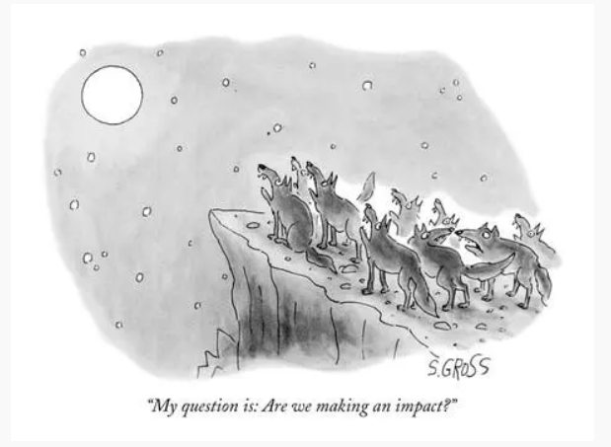
Why teachers need assessment…

Slide 23
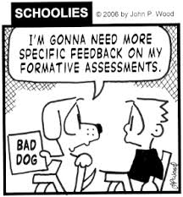
Why different forms of assessment are needed…

Slide 24
Homework Expectations
*Home reading is crucial for developing fluency and accuracy in your child’s reading. Fluency and accuracy are fundamental to comprehension.
*Regular homework builds good study routines and habits needed for academic success in high school.
Kindergarten | 1/2 | 3/4 | 5/6
*Reading nightly *Sounds and tricky words (As introduced) *Show and tell (Weekly topic) | *Reading nightly *Oral counting *Optional reading and mathematic booklet (Sent home Monday and returned Friday) | *Weekly maths and english homework sheets. (Sent home Monday and returned Friday) *Practice instrument | **Reading Journal - nightly *Weekly maths and english homework sheets (Sent home Monday and returned Friday) *Practice instrument.

Slide 25
Thank you for coming.
Teachers are available for informal queries / chats in their classrooms for the next 15 minutes.
*Home reading is crucial for developing fluency and accuracy in your child’s reading. Fluency and accuracy are fundamental to comprehension.
*Regular homework builds good study routines and habits needed for academic success in high school.

