Slide 1
MGC’s 2023 Musical Production is…..
(drumroll)

Slide 3
PERFORMANCE DATES: WEEK 5 TERM 3.
TUESDAY 8tH August-FRIDAY 11th August
4 EVENING PERFORMANCES @MGC’s new PAC!
7.30pm
CAST 1: TUESDAY 8th August AND THURSDAY 10TH AUGUST
CAST 2: WEDNESDAY 9TH AUGUST AND FRIDAY 11th
AUGUST

Slide 4
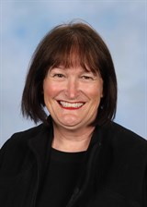
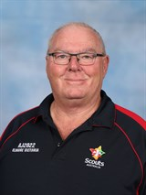
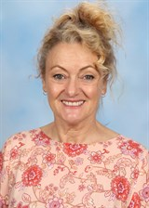
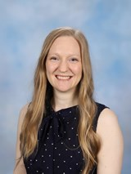
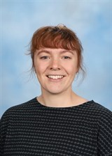
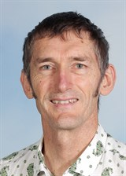
The Team
Ms Corry
Producer &
Co-Director
Ms Mummé
Co-Director
Mr Howlett Technical Director
(hopefully!)
Mr Hicks-Musical Director
Vocal Coach
Ellyce Calder
Choreographer
Georgia Culvenor

Slide 5
TERM 1 TIMELINE OVERVIEW
LEARN AUDITION SONG & DANCE ROUTINE
BEGIN AUDITIONS
CALLBACKS
CASTING TO BE COMPLETED AND ANNOUNCED BEFORE HOLIDAYS!

Slide 6
Term 2 REHEARSALS
THURSDAYS AFTERSCHOOL-3.30-4.30PM
(CAST & Chorus)
MONDAYS AFTERSCHOOL-3.30-4.30
(Leads)
LUNCHTIMES FOR Soloists AS REQUIRED & Specialist Dancers
TERM 3= BOTH MONDAY & THURSDAY AFTERCHOOL FOR RUN THROUGHS

Slide 7
TERM 3 PUTTING IT ALL TOGETHER
WEEK 1- REVISION
WEEK 2- RUN THROUGH OF ACT 1
WEEK 3- RUNTHROUGH OF ACT 2
WEEK 4- TECHNICAL REHEARSAL
WEEK 5
PRODUCTION WEEK

Slide 8
Term 1 AUDITIONS Thursdays
You will all be required to sing an audition song (by yourself) to Ms Corry or Ms Calder only.
In Musicals you need to be prepared to sing, dance and act- be a triple threat!
All students who audition will get in!
Call backs are for lead roles only

Slide 9
Characters in Order of Appearance
CAST OF CHARACTERS DANNY: The leader of the T-Birds with an air of cool easygoing charm. Strong and confident.
SANDY: Danny’s love interest. Sweet, wholesome, naïve, cute, like Sandra Dee of the “Gidget” movies.
THE “PINK LADIES”: The club-jacketed, gum-chewing, hip-swinging girls’ gang that hangs around with the “Burger Palace Boys.
RIZZO: Leader of the Pink Ladies. She is tough, sarcastic and outspoken but vulnerable.
FRENCHY: A dreamer. Good-natured. Heavily made-up, fussy about her appearance— particularly her hair. She can’t wait to finish high school so she can be a beautician.
MARTY: Looks older than the other girls. Tries to act sophisticated.
JAN: Loud and confident with the girls, but shy with boys.
THE T Birds: A super-cool, D.A.-haired, hard-looking group of high school wheeler-dealers… or so they think.
KENICKIE: Second-in-command of the T-Birds. Tough-looking, tattooed, surly, avoids any show of softness. Has an off-beat sense of humor.
DOODY: Youngest of the guys. Small, boyish, open, with a disarming smile and a hero worshipping attitude toward the other guys. He also plays the guitar.
ROGER: The “anything-for-a-laugh” stocky type. Full of mischief, half-baked schemes and ideas. A clown who enjoys putting other people on.
SONNY: Italian-looking, with shiny black hair and dark oily skin. A braggart and wheeler-dealer who thinks he’s a real lady-killer.
JOHNNY CASINO: Leads a rock ‘n’ roll band and likes to think of himself as a real rock ‘n’ roll idol.
TEEN ANGEL: A singer who would have caused girls to scream and riot back in 1958.
Non Singing ROLES
PATTY: A typical cheerleader at a middle-class American public high school. Aggressive, sure of herself, given to bursts of disconcerting enthusiasm. Catty, but in an All American Girl sort of way. She can also twirl a baton.
CHA-CHA: A Blind date. Takes pride in being “the best dancer at St. Bernadette’s.”
EUGENE: The class valedictorian. Physically awkward. Stereotypical “nerd”
VINCE FONTAINE: A typical “teen audience” radio disc jockey. Slick, egotistical, fast-talking.
MISS LYNCH: English teacher/principal
Coach
Blanche: Assistant to Miss Lynch

Slide 10
LEAD FEMALE ROLES and their audition song
Sandy
Audition Song- Hopelessly Devoted to You
Rizzo
Audition Song- There Are Worse Things I Could Do
or
Sandra Dee
Marty
Audition Song: Freddy My Love
Frenchy, Jan and other Pink Ladies
Audition Song: Summer Loving or Sandra Dee
Non Singing roles
Patty Simcox and other Cheerleaders
Miss Lynch and Assistant Blanche

Slide 11
LEAD “MALE” ROLES
Danny
Audition Song: Sandy
Kenickie
Audition Song:
Greased Lightning
Sonny, Doody and other Thunderbirds
Audition Song:
Those Magic Changes
Non Singing roles:
Vince Fontaine
Eugene
Coach
Johnny Casino (Dance Competition Band Leader) Audition Song: Born to Hand Jive
Teen Angel
Audition Song: Beauty School Dropout

Slide 12
NON PERFORMING ROLES
CHOREOGRAPHER
BACKSTAGE CREW
PUBLICITY/LOGO
SET/PROP DESIGN & CONSTRUCTION
HAIR/MAKEUP
COSTUME CONSTRUCTION
PHOTOGRAPHY/VIDEO
FRONT OF HOUSE-USHERS, PROGRAM SELLERS

Slide 13
FAQ
Does a Year 7 have as much chance as a Year 12 to get a main part?
Definitely!
Do we work with a boys’ school to do the boy parts?
No. We put our best actresses in these roles!
Do I have to sing solo?
Only for your first audition

Slide 14
What Can I Do to Prepare?
Watch the film Grease or any performances of the Musical on You Tube
Attend the learn the audition songs workshops afterschool
Submit your expression of interest application form to the box outside the Performing Arts staffroom in the new PAC.
Clear your schedule so you can attend Tuesdays and/or Thursdays afterschool when required

Slide 15
Remember….
There is no such thing as a small role, only small actors!
The chorus is just as much fun, without the stress of a main role!
You have to start off small and show your commitment.
Musicals are only every 2 years- don’t miss out!
Looks good on your resume for Leadership positions!
(essential for potential Arts Captains to be involved)

Slide 16
Expression of Interest
Check the performance and rehearsal dates and times with your family before committing.
1
If no clashes, complete the application form and return to the collection box outside the Performing Arts Staffroom in the new PAC.
2
Please DO NOT email Ms Corry your form.
3

Slide 17
Audition Overview
Crew don’t need to attend the term 1 auditions, just complete and return the expression of interest form
(you may wish to leave the meeting now as the rest of the time will be going over the audition process and timeline)

Slide 18
Week 2 Information Meeting and LEARN AUDITION SONG/S
Week 2
Tuesday afterschool:
Information Meeting PAC
(and repeated Thursday for Year 7’s on Camp)
Thursday afterschool: Learn Audition Songs
Years 8-11

Slide 19
Weeks 3 LEARN AUDITION SONG/S continued
Week 3
Thursday afterschool: Year 12 & Year 7 Learn audition songs

Slide 20
Week 4 AUDITIONS BEGIN
Week 4
Monday Period 1:
Year 11
Thursday afterschool:
Year 10 & Catchups

Slide 21
Week 5 AUDITIONS continued
Week 5
Thursday afterschool:
Year 8’s & Year 9’s

Slide 22
Week 6 AUDITIONS continued
Week 6
Thursday afterschool:
Year 7’s

Slide 23
WEEK 7 CALLBACKS AND FINALE DANCE
Monday afterschool-
Callbacks- Singing
Callbacks
Script
Thursday afterschool

Slide 24
WEEK 8 CALLBACKS # 2 AND FINALE DANCE
Monday afterschool-
Callbacks
Thursday afterschool
Callbacks cont

Slide 25
WEEK 9 CALLBACKS # 3 AND FINALE DANCE
Monday
Thursday
Final Callbacks
(if necessary)

Slide 26
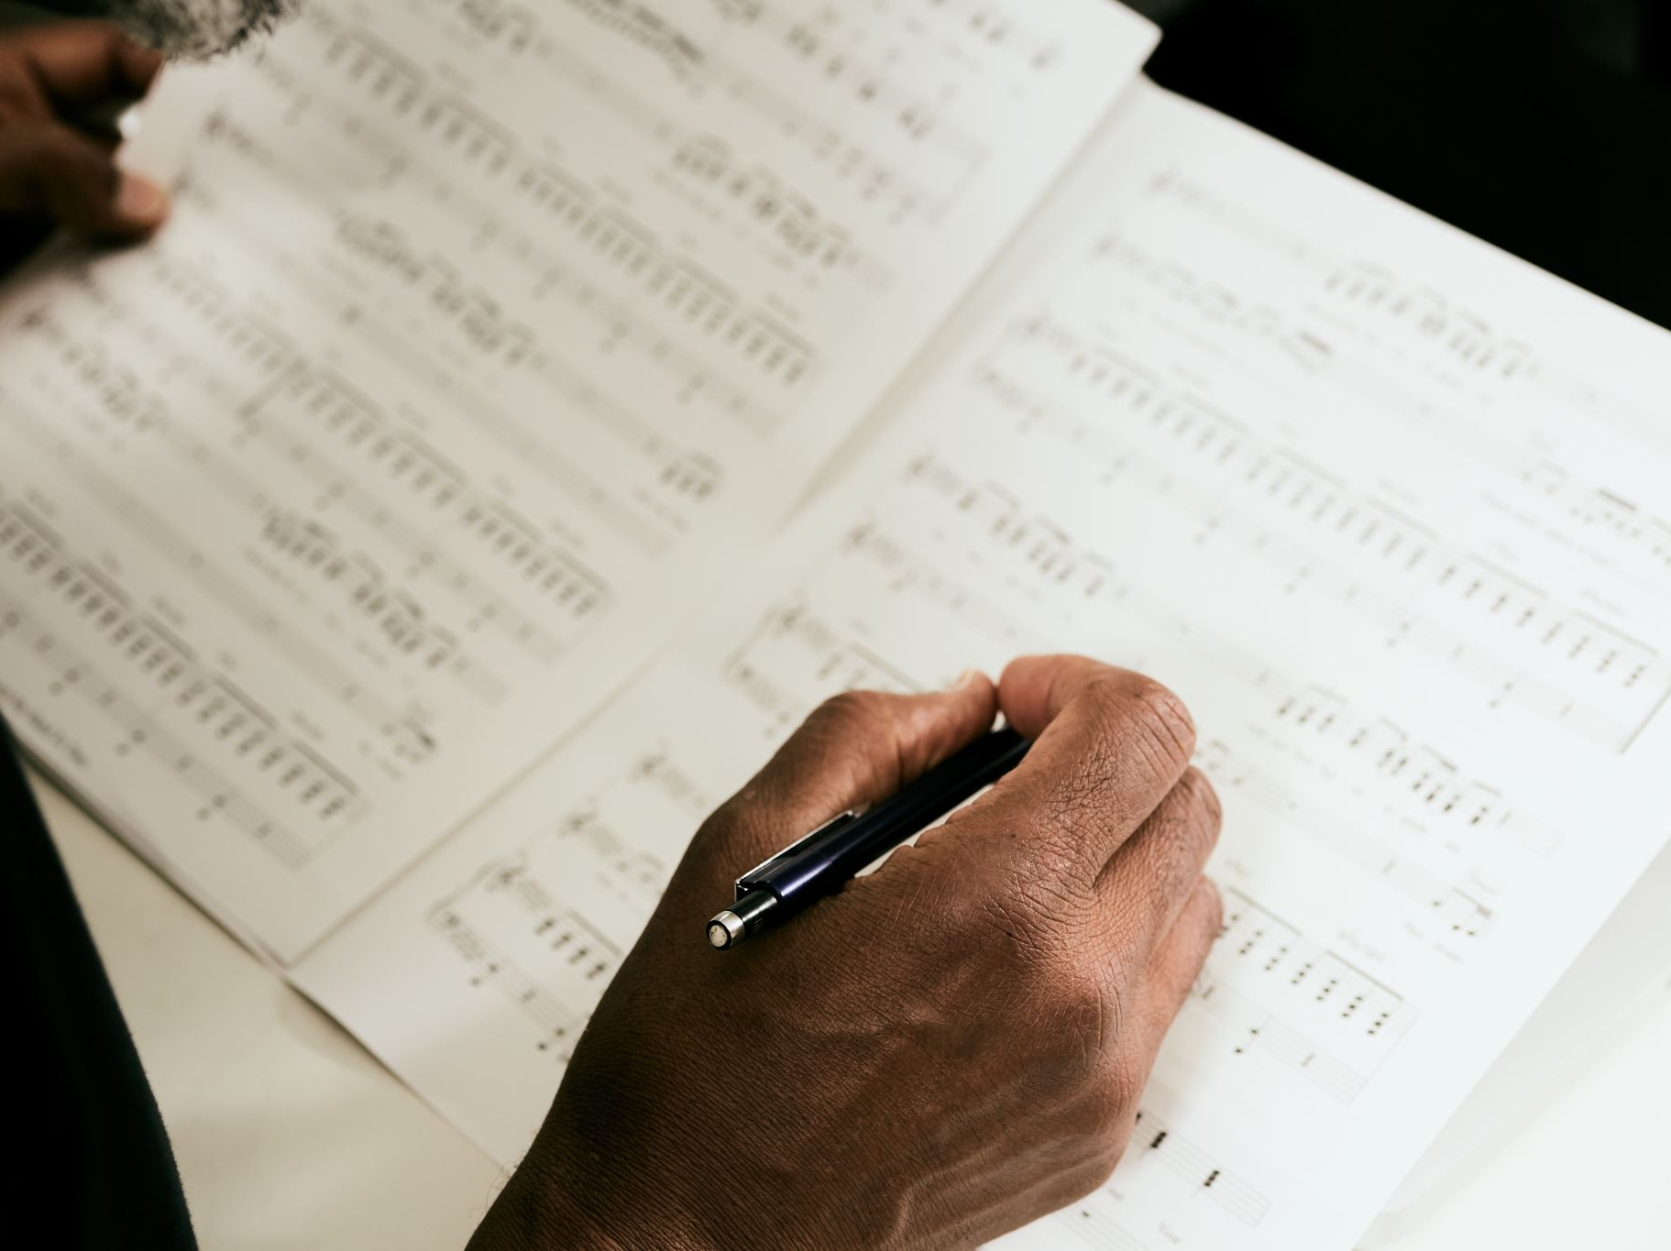
WEEK 10 CASTING ANNOUNCED
Announcement of Cast/s
Cast Meet and Greet and collection of scripts

Slide 27
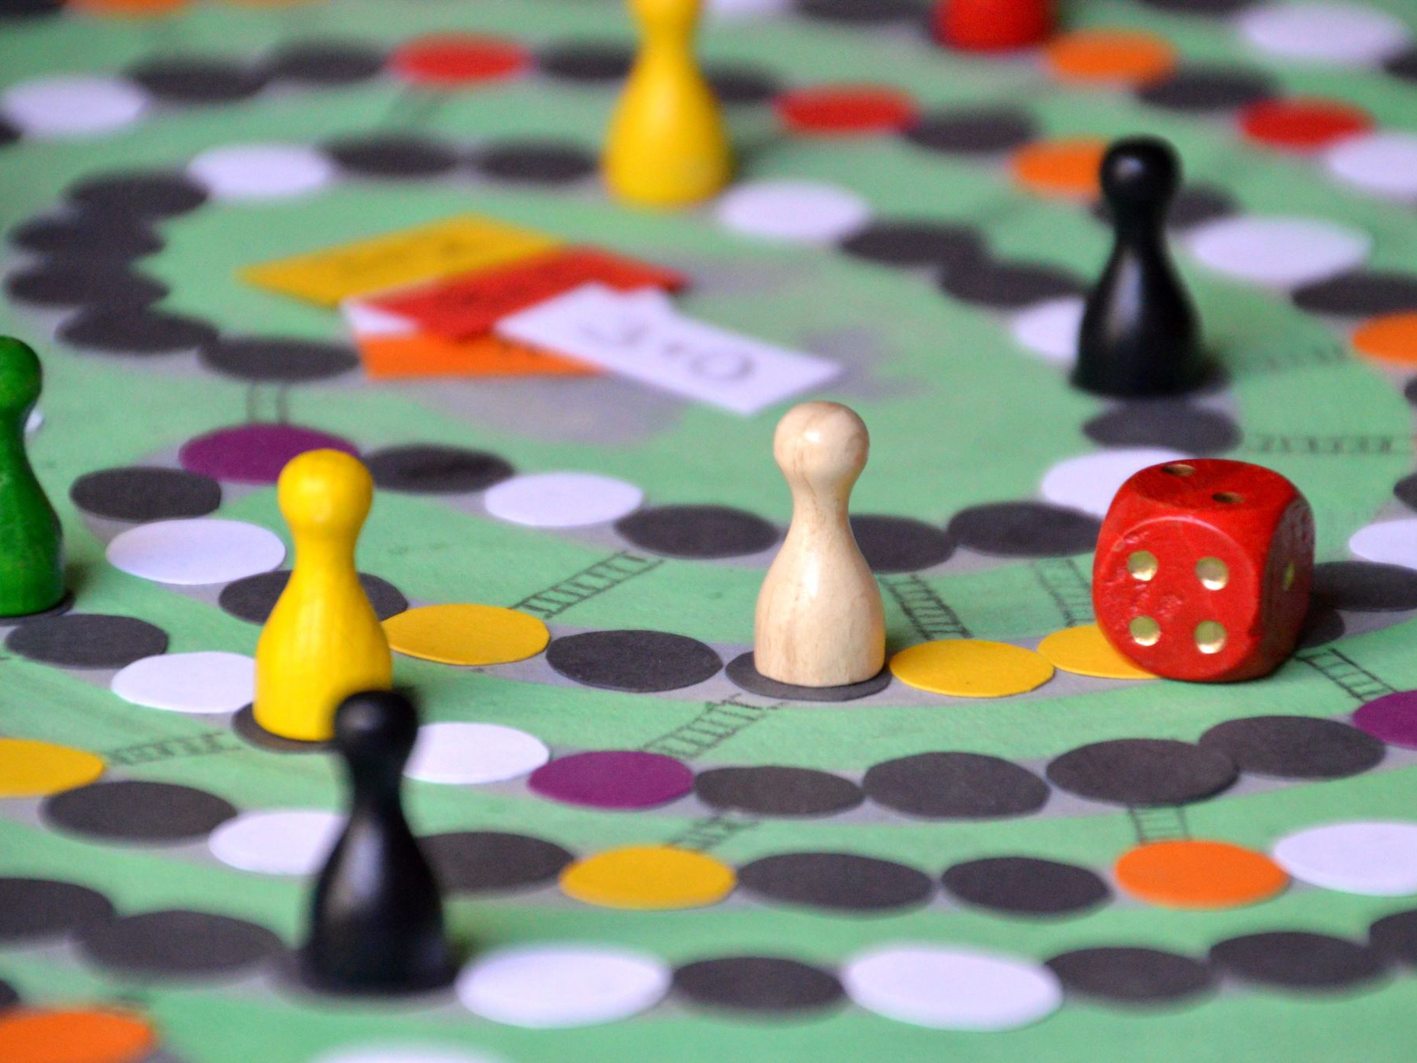
CHOOKAS! ☺

