Slide 1
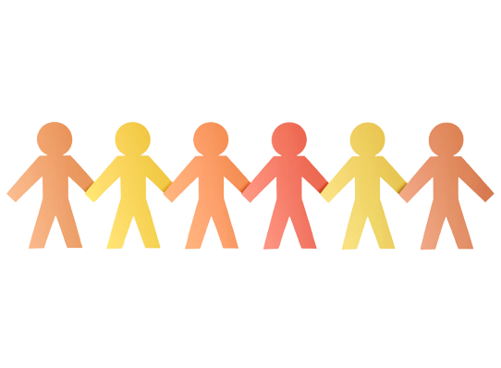
HARMONY Week
CANTERBURY GIRLS HIGH SCHOOL

Slide 2
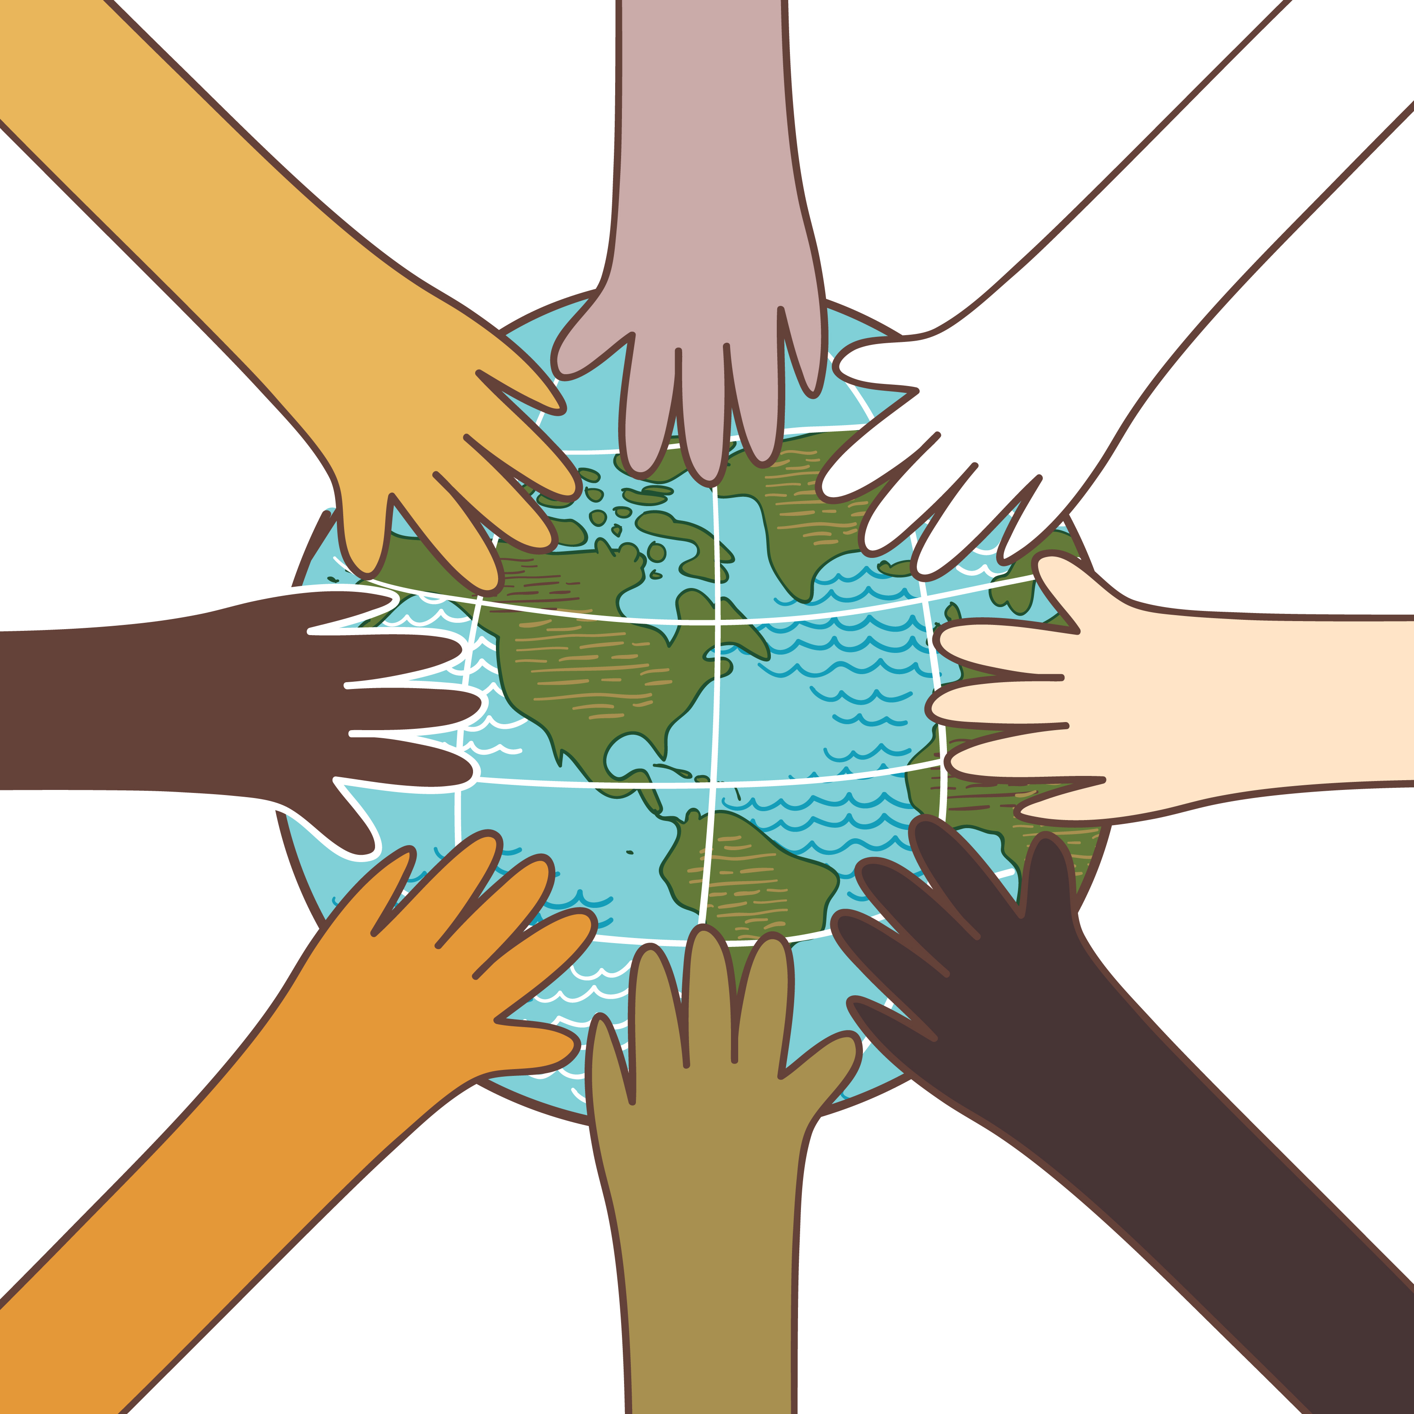
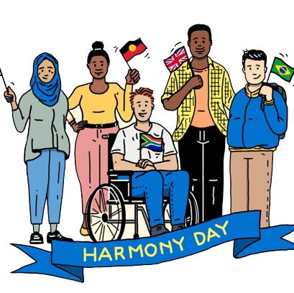
What is Harmony Week?
It is a time to celebrate Australian multiculturalism, and the successful integration of migrants into our community.
Australia is one of the most successful multicultural countries in the world and we should celebrate this and work to maintain it.
Harmony Week is about inclusiveness, respect and belonging for all Australians, regardless of cultural or linguistic background, united by a set of core Australian values.

Slide 3
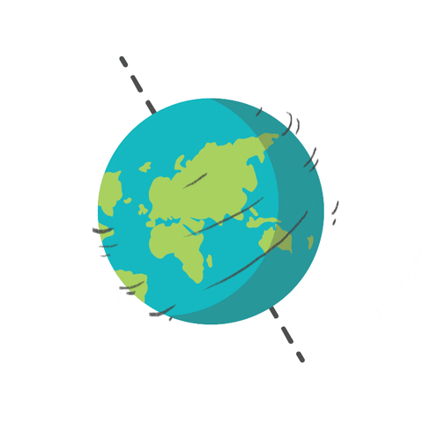
~ FUN FACTS ~
Nearly half (49 per cent) of Australians were born overseas or have at least one parent who was
We identify with over 300 ancestries
Since 1945, more than 7.5 million people have migrated to Australia
85 per cent of Australians agree multiculturalism has been good for Australia
Apart from English, the most common languages spoken in Australia are Mandarin, Arabic, Cantonese, Vietnamese, Italian, Greek, Tagalog/Filipino, Hindi, Spanish and Punjabi
More than 70 Indigenous languages are spoken in Australia

Slide 5
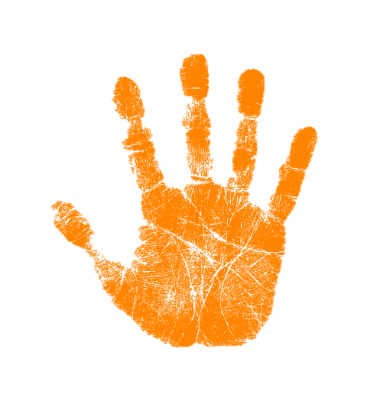
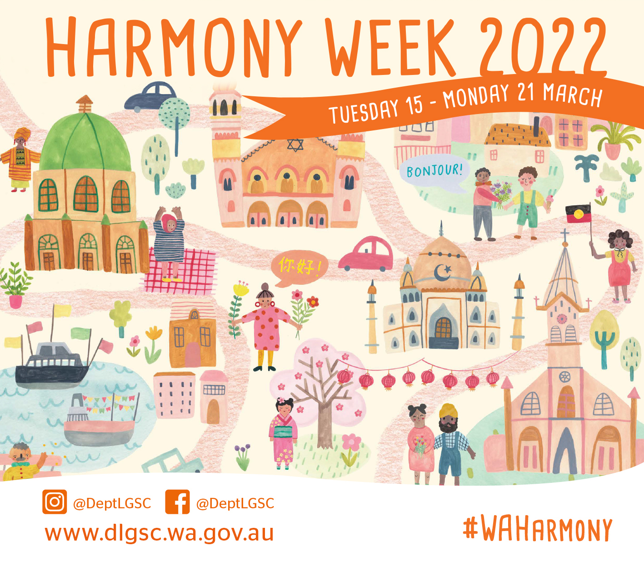
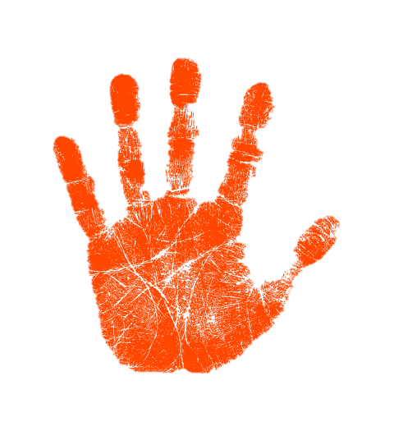

Slide 6
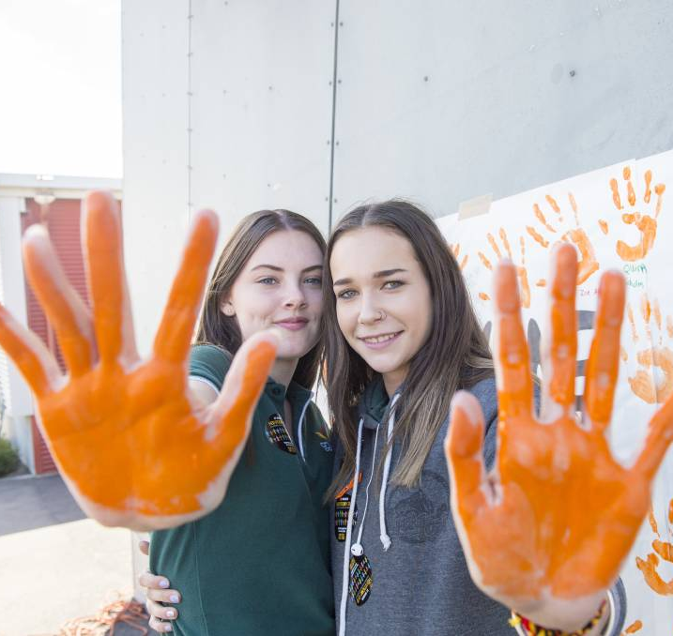
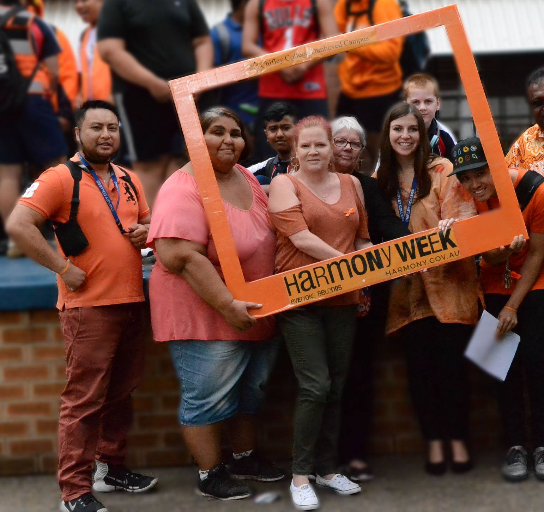
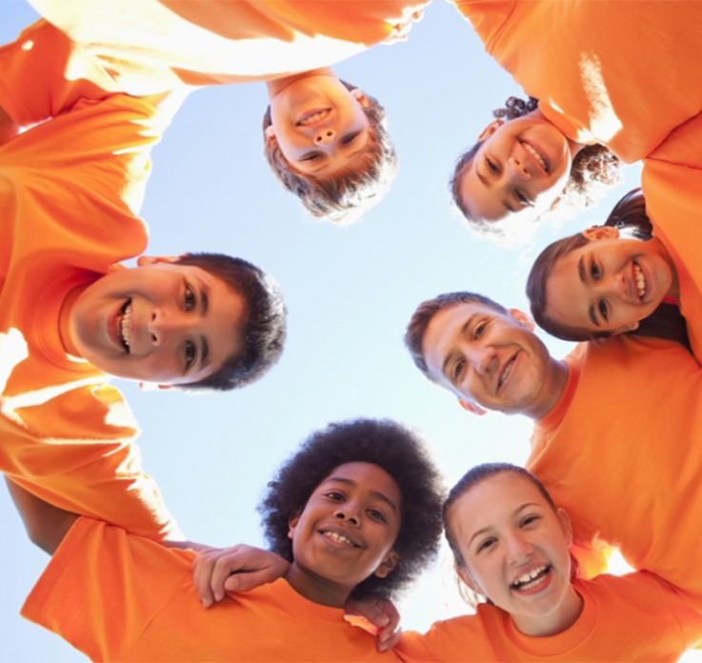
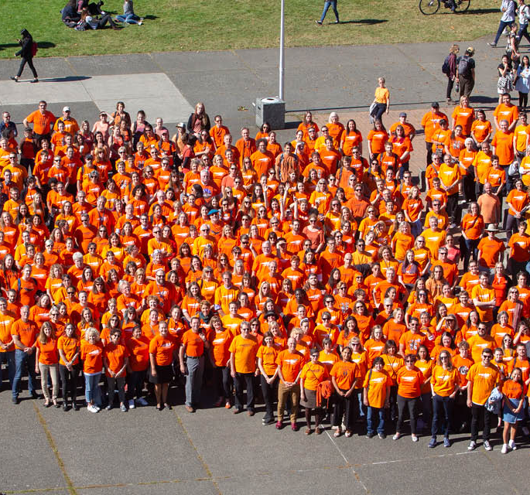
ORANGE IS THE COLOR WORN ON THIS DAY AS IT SYMbOLISES SOCIAL COMMUNICATION AND MEANINGFUL CONVERSATIONS

Slide 7
Harmony Day's 2022 THEME is…
#everyone belongs

Slide 8
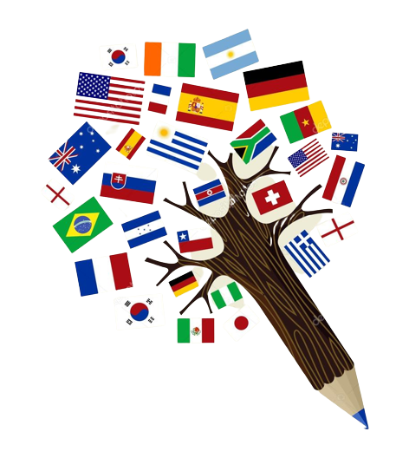
DID YOU KNOW THAT…
‘EAL/D’ stands for English as an additional language/dialect (these are people whose first language is one other than English)
‘LBOTE’ stands for Language Background other than English (these are people whose parents or grandparents were born overseas and who speak another language)

Slide 10
STORIES FROM CGHS STUDENTS

Slide 11
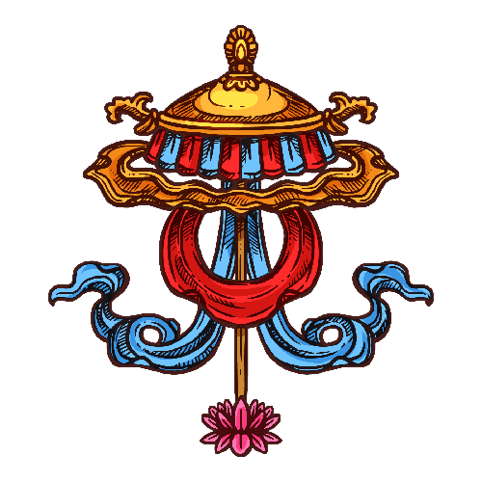
STORY 1
I was born in Bhutan and moved to Australia on the 15th of February 2017. When I arrived in Australia, I didn’t go straight to high school but instead went to an IEC (an Intensive Language Centre) to learn English. I was there for three terms before moving to Canterbury Girls High School.
In Bhutan, we speak Dzongkha, which is the main language in Bhutan. I can also speak a dialect from an area called Shashop. There are many great things about Bhutan:
The education, health care etc. is free
The people are kind
Buddhism is the main religion in Bhutan, although a lot of young people are atheist
We like eating emad datshi (a chilli and cheese dish)
However, we moved to Australia as there were better opportunities here. I like Australia because I have a lot of fun and the people are really interesting.

Slide 12
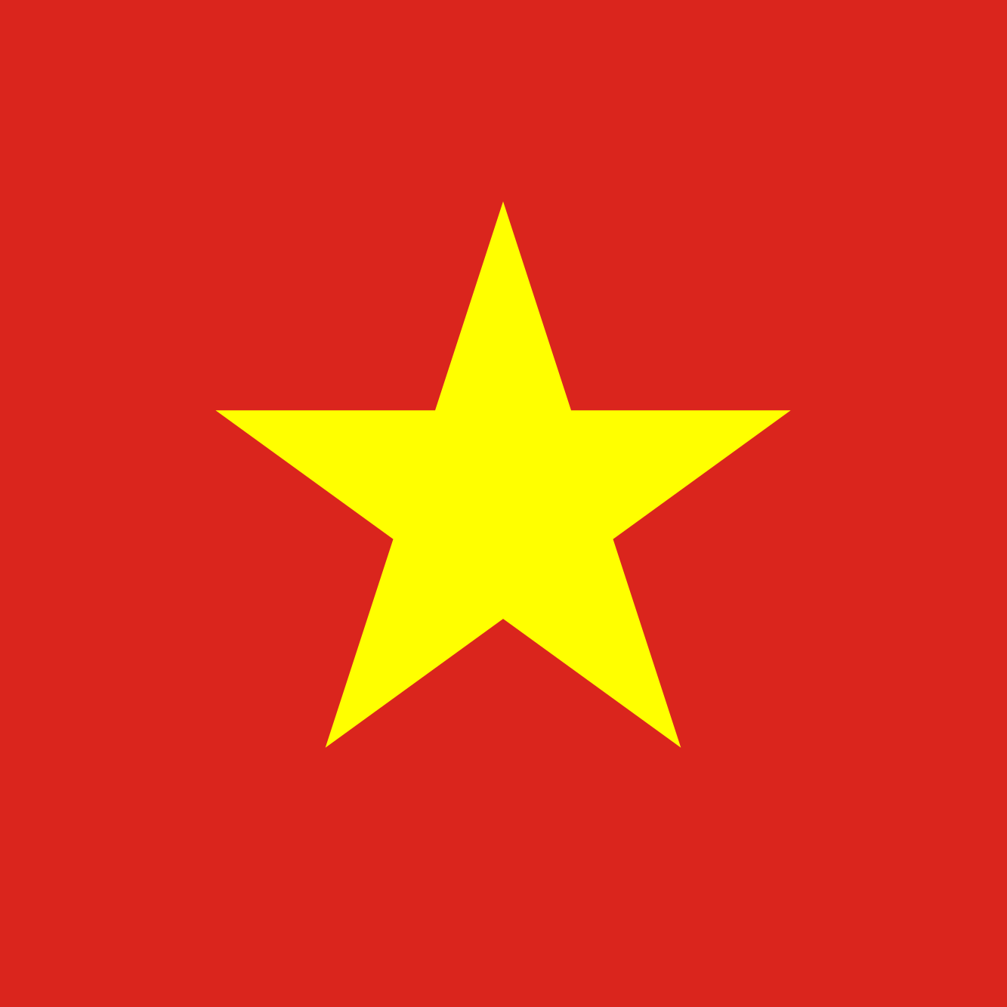
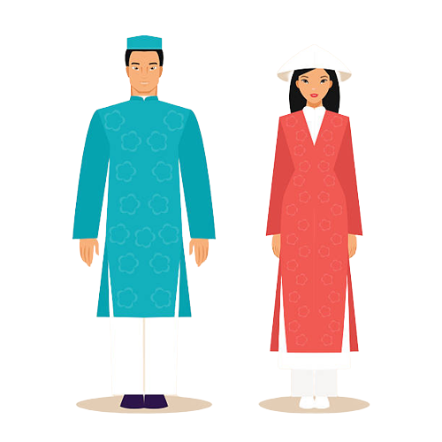
STORY 2
I was born in Vietnam and moved to Australia in 2019. When I arrived in Australia, I didn’t go straight to high school but instead went to an IEC to learn English. I was there for a year before moving to Canterbury Girls High School.
I speak Vietnamese. Some things you could know about Vietnam:
The people are very hard workers
Pho is our most well recognised dish
It is very difficult to travel around Vietnam
I moved to Australia to study. I have found that school is easier here and many other things, like public transport and work are easier to access in Australia.

Slide 13
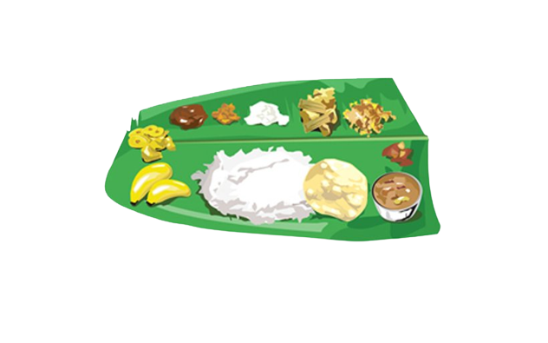
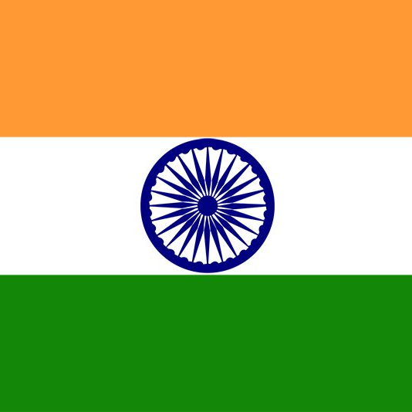
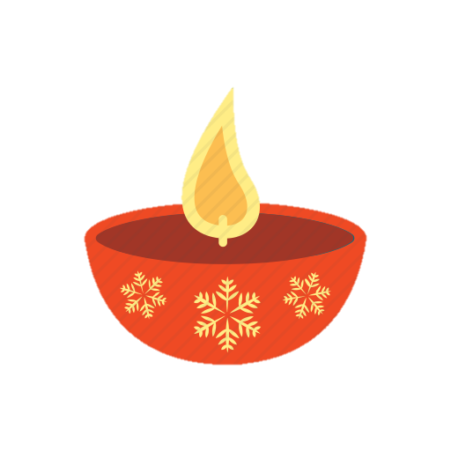
STORY 3
I was born in the south of India and moved to Australia in 2019.
I speak Tamil which is a language in India.
Some things I love about India are:
The cultural festivals -> they are very colourful, you get to have lots of sweets and spend important time with family
Places of worship are very important to Indians
We have great food -> in the south we make things with banana leaf and then have curries, rice and vegetables
My whole family moved to Australia so that I could go to university. There are so many great things about Australia including:
You have the opportunity to learn about many different cultures
The environment
You develop skills, ideas and are able to pursue things that you are interested in. As a result, I think I found my identity here
Express your emotions more freely as people are less conservative

Slide 14
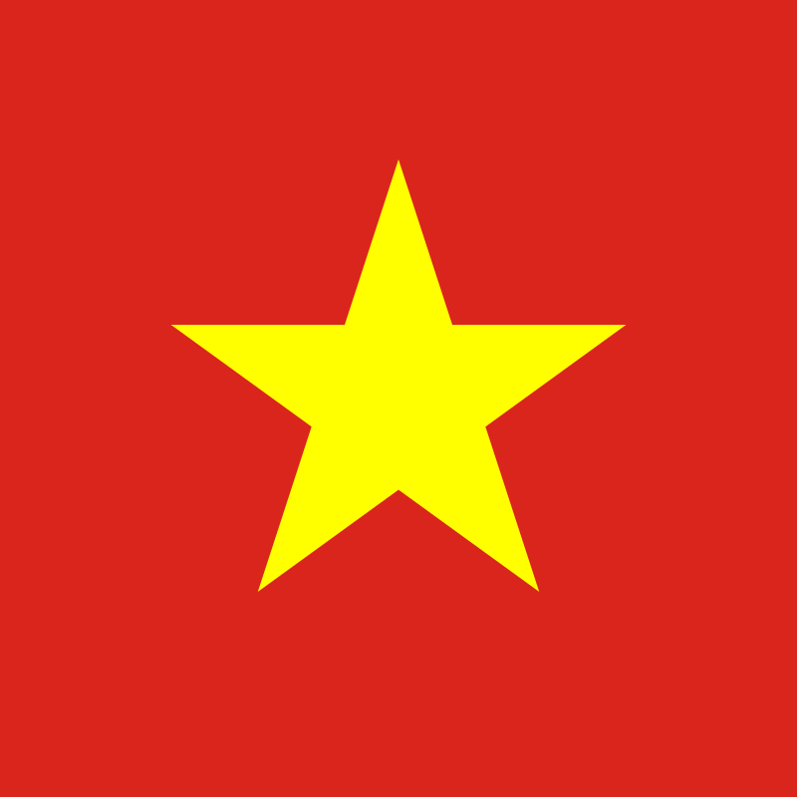
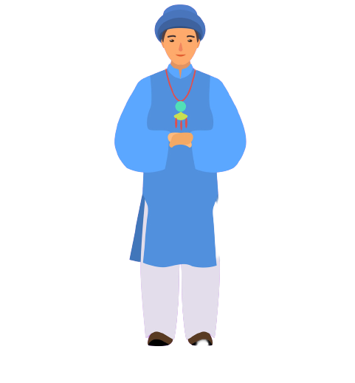
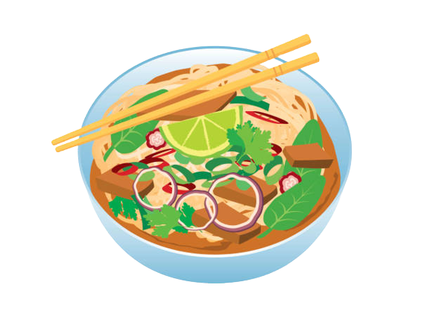
STORY 4
I was born in Vietnam and lived in Ho Chi Minh City. I moved to Australia in 2018 and went to Marrickville IEC for a year before moving to Canterbury Girls High School. I speak Vietnamese and English.
The great things about Vietnam are:
The food: we have great dishes like pho, banh mi, spring rolls, rice paper rolls
The clothing: the traditional clothing is a long dress that is worn with pants. We usually wear this to festivals, but teachers have to wear it to school (almost like a uniform)
I moved to Australia to gain a better education. The things I like about Australia are:
That it is a modern society
That there are so many educational opportunities
The health care is great
However, there are some things that I find difficult. It is very expensive to live here, and many people still experience discrimination here.

Slide 15
Everyone SMILES in the same LANGUAGE
George Carlin ☺

Slide 16
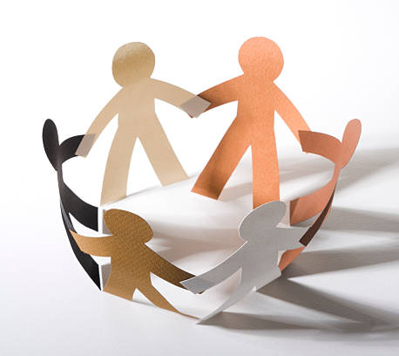
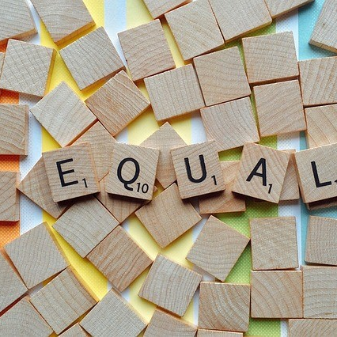
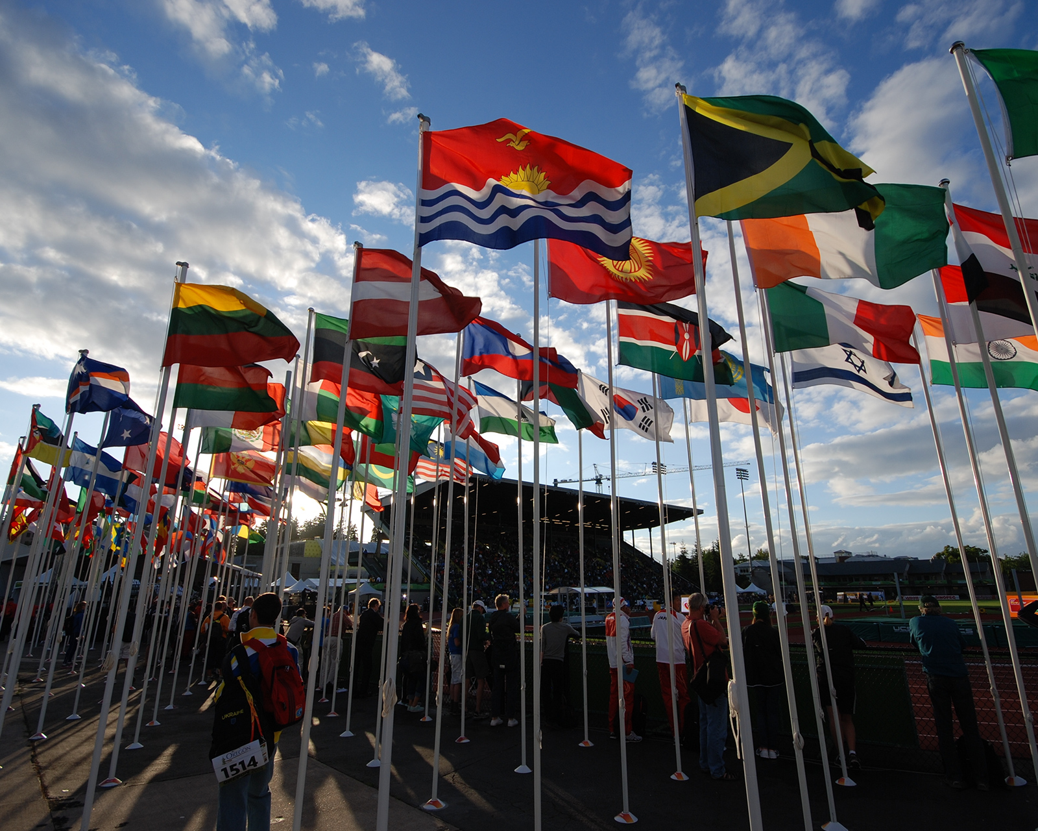
HAPPY HARMONY DAY

