Slide 1
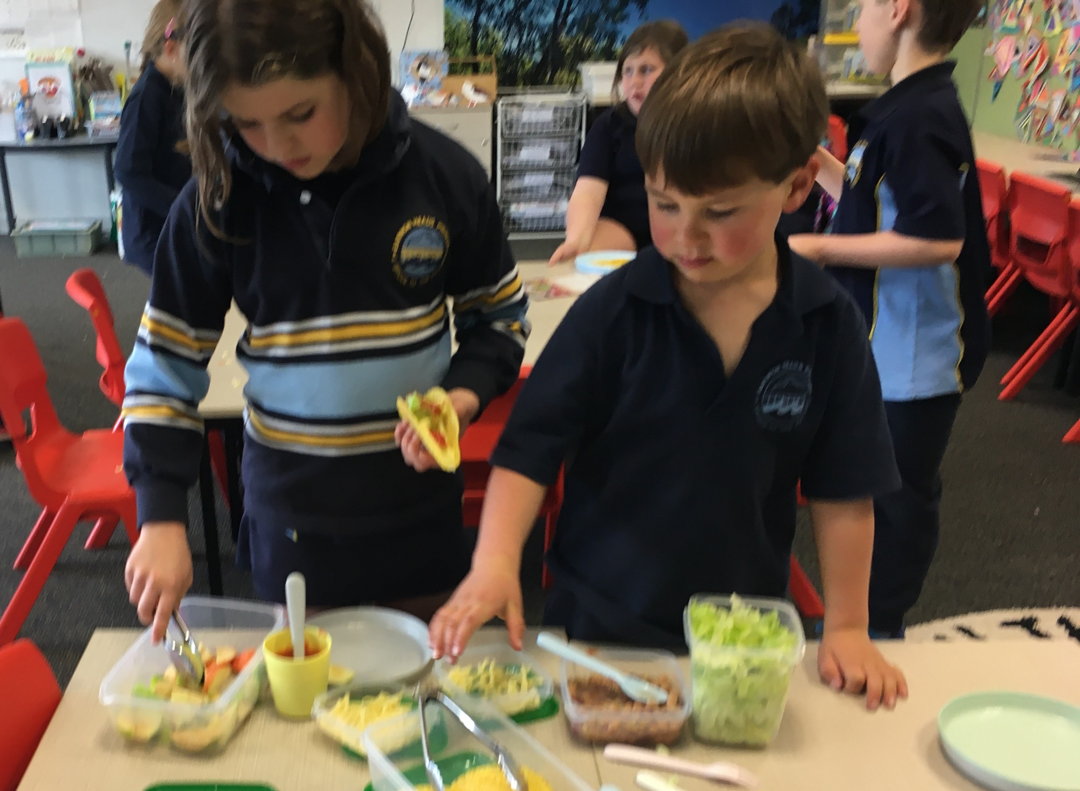
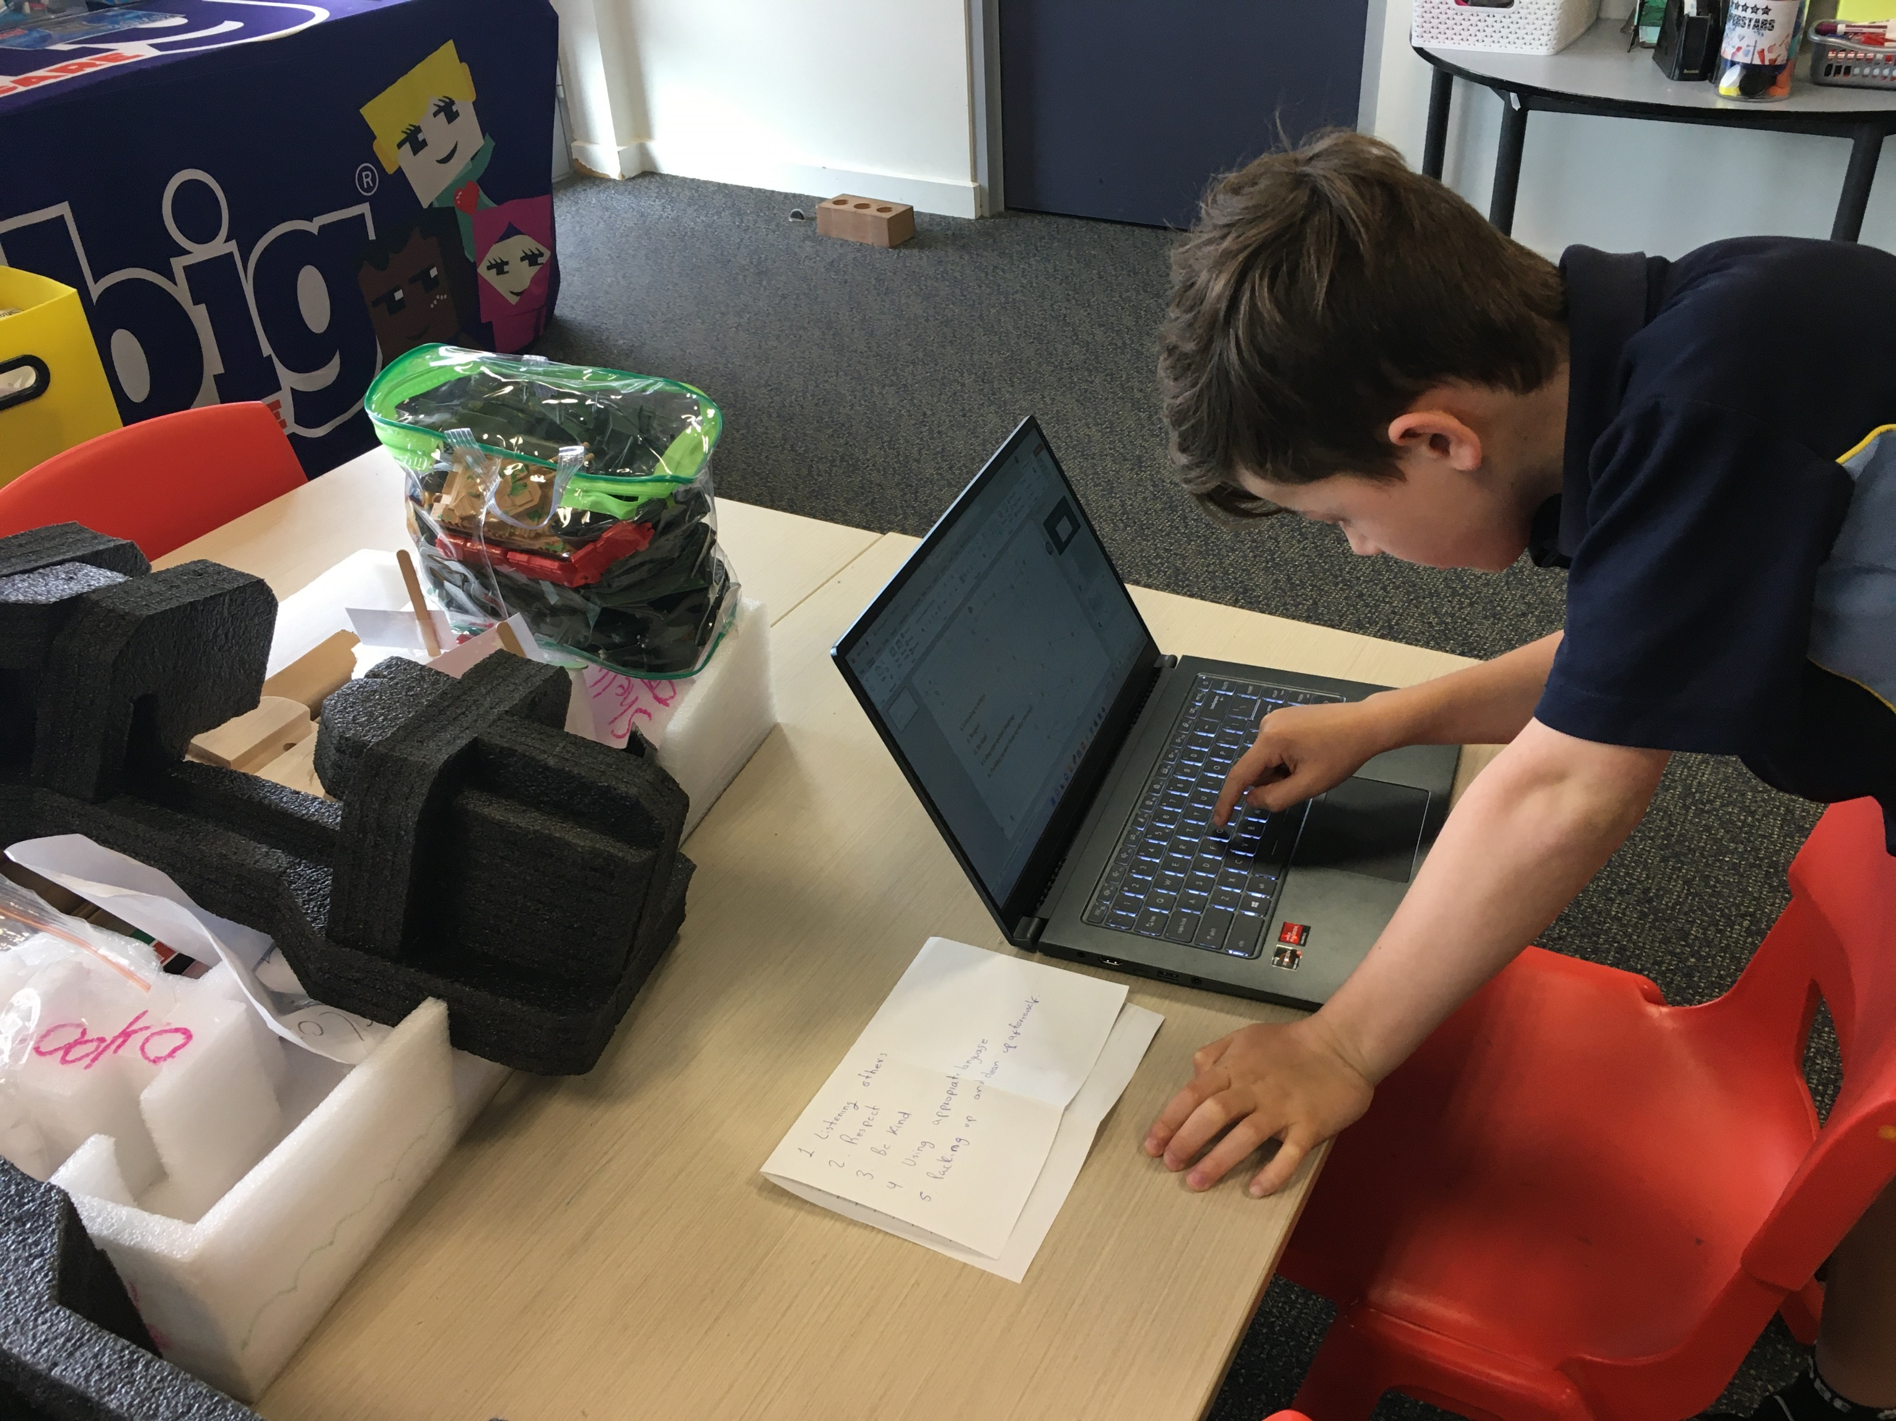
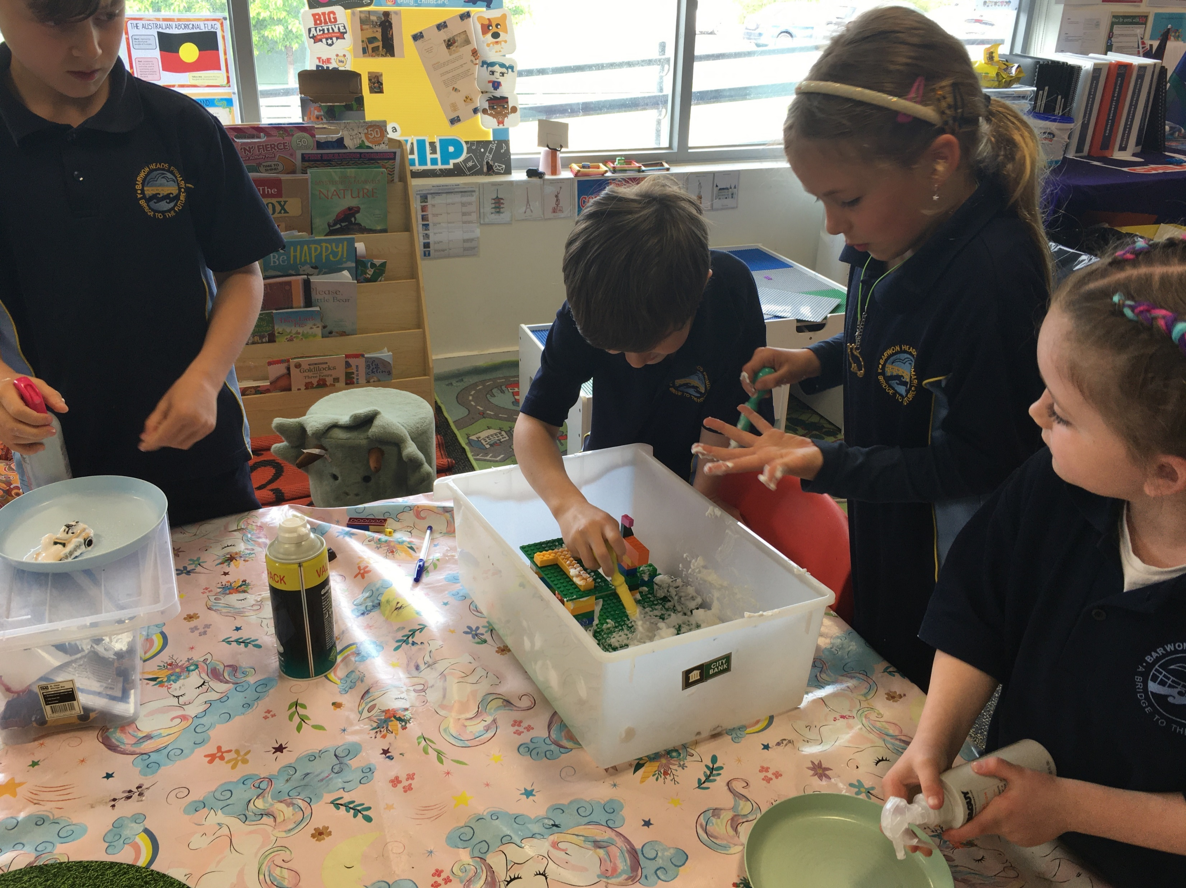
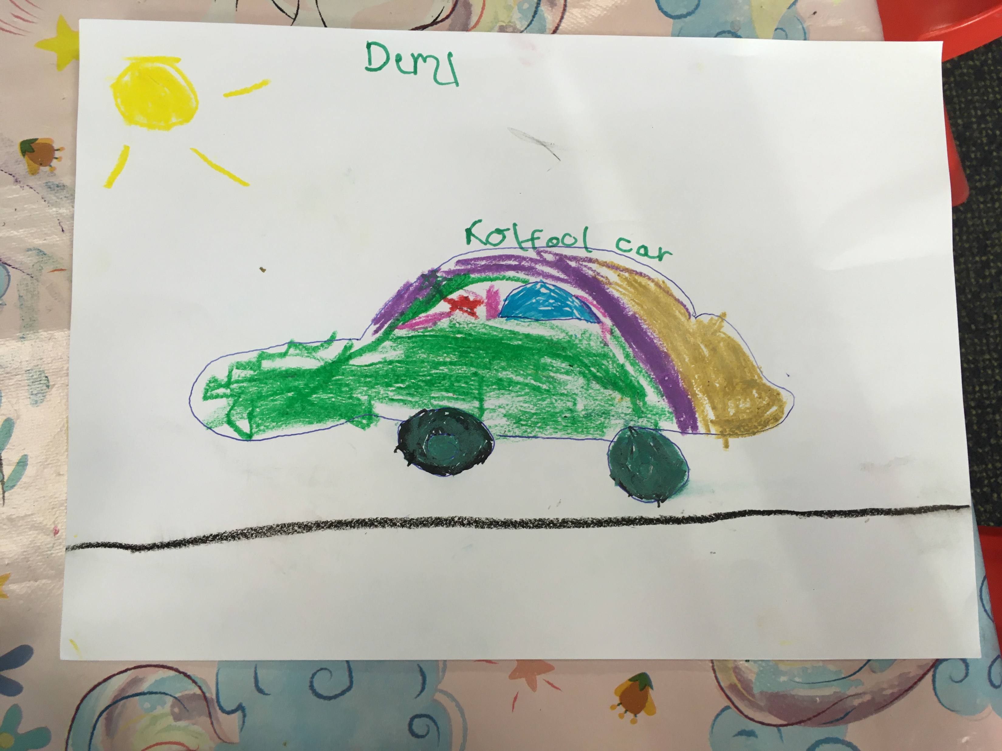
What a fabulous back to school!
To receive the children with an enjoyable welcome, we decided to celebrate each day and week with a relevant theme for them.
Children enjoyed our Car’s Day Celebration. They learned that if you don’t wash a car in Russia, you can receive a ticket.
Children were participating in different experiences that taught them about Mental Health. What they could do to keep their minds healthy and happy.
Children have been preparing their own lunch. They love to make tacos.
Children have been exploring technology by creating the expectation of our program with power point and using our electronic dinosaur.
Friendly Reminders
Please advise us 48hrs in advance to cancel a booked session to avoid still being charged
Please make your booking with tow days in advance so we can provide children with enough resources and experiences.
Help us provide the best service for your children by adhering to our policies.
In Big Childcare Barwon Heads, we offer Summer Holiday Care but in Mirrrapoa Primary School. The address is 80 Unity Drive Mount Duneed 3217. Our brochures will be out shortly!
Once available, please book your children in as soon as possible to secure a spot and allow us to have adequate resources and staffing in place.
If you have a child starting Prep in 2022 – booking them into the Summer Holiday Care is a great way of easing their transition.
We will have a bunch of incursions and excursions! Some of the planned themes are:
Lesuire Link
Melbourne Aquarium
Geelong Water Front
Contact Details
Centre Manager: Azuna Sanchez
Email: barwonheads@bigchildcare.com
Phone: 0434 557 352

