Slide 1
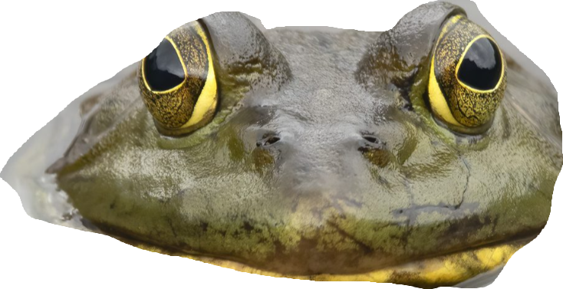
FROG
hi
Ana ☺

Slide 2
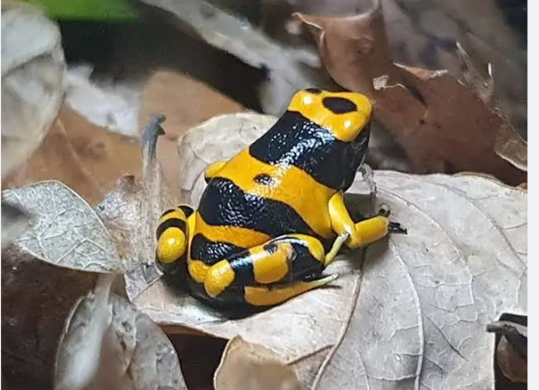
The types
There are many different types of frogs but the most popular type of frog is the green tree frog. Frogs can also be dangerous like the poison dart frog and the NeoBatrachia

Slide 3
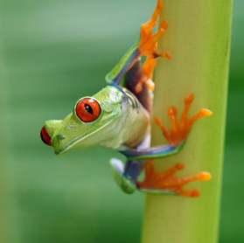
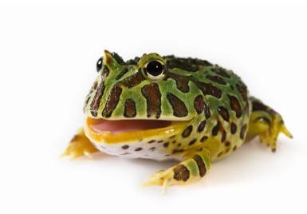
COLOURFUL COLOURS
Frogs don’t have to have only one (1) colour on them but they can have multiple
Colours like the big eye green tree frog, it has green orange and a bit of white. Frogs may also grow pattens it can be spotty or stripy
Hello I’m a Pacman frog

Slide 4
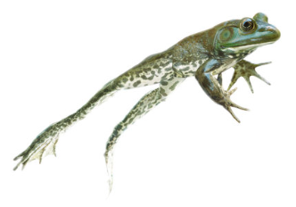
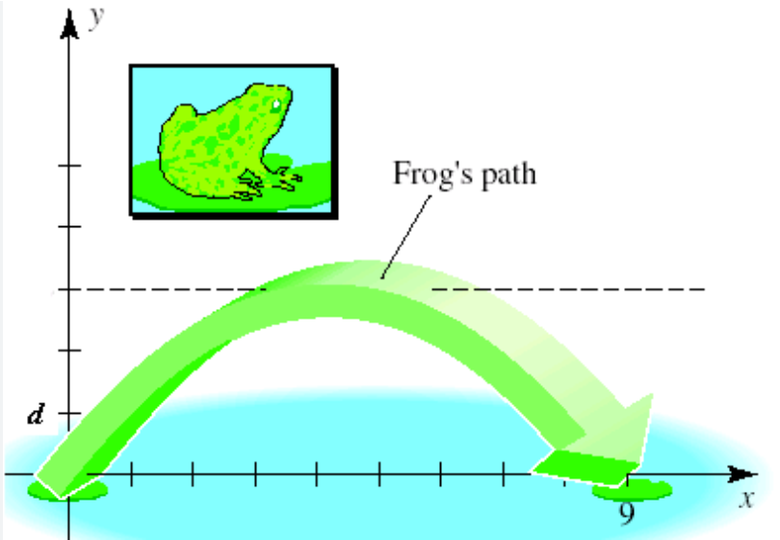
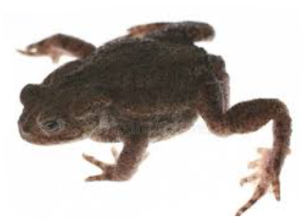
TOAD V.S FROG
Frogs and toads may seem to have a lot of similarity’s but here are the differences of the frog and the toad. Toads skin are lumpy and bumpy like you’re running your hand on rocks meanwhile frogs skin is much smooth. HOP HOP, HOP, goes the frog like it could reach the sky but all toads are trying to reach is a new step meter number, frogs like to jump high in the sky and toads crawl around instead of jumping.

Slide 5
PREDATORS OF FROGS
Snakes are predators to frogs, so are lizards and water shrews. Herons, hawks, crows and storks are the main birds that would hunt a yummy frog. sometimes frogs can eat other frogs for nutrients same with tadpoles. Racoons, otters, skunk’s and badgers as well as wild pigs like to munch on frogs.

Slide 6
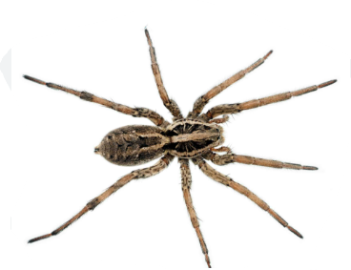
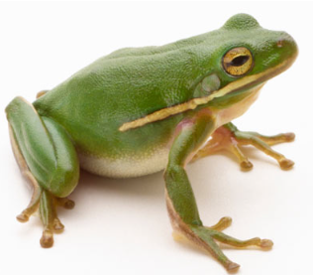
PREY OF FROGS
Frogs mostly eat bugs like worms or spiders but they can also eat mice but in the wild anything smaller than them they will it if it comes in its way.
Please don’t eat me

Slide 7
BEHAVOUR
They use there stivky

Slide 8




Information from
Burk museum
Kiddle
A-Z animals
the spruce pets

