Slide 1

School Strategic Plan
Parent Information Night

Slide 2

Ironside State School acknowledges the traditional owners of the land on which we are gathered, elders past present and emerging, The Yuggera and Turrbal People.

Slide 3
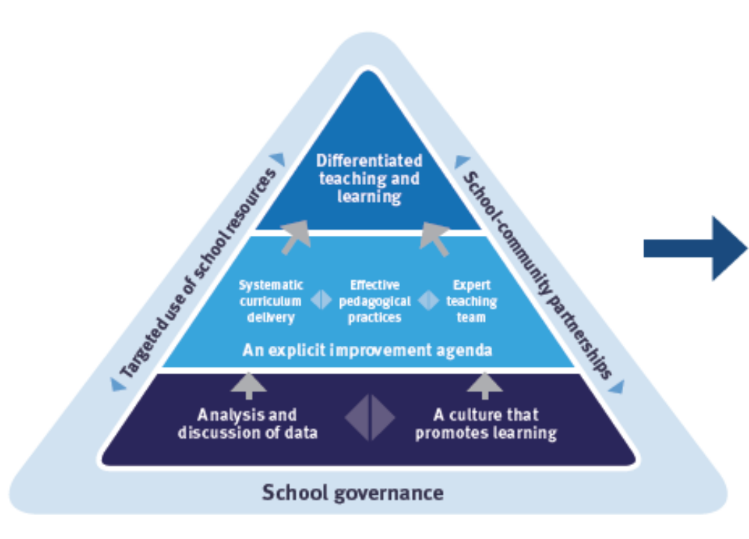
School Review Feedback

Slide 4
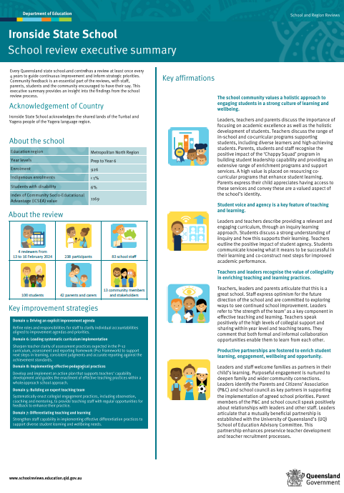
5 Key Recommendations
Refine roles and responsibilities for staff to clarify individual accountabilities aligned to improvement agendas and priorities. Sharpen teacher clarity of assessment practices expected in the P–12 curriculum, assessment and reporting framework (P-12 Framework) to support next steps in learning, consistent judgments and accurate reporting against the achievement standards. Develop and implement an action plan that supports teachers’ capability development and guides the enactment of effective teaching practices within a whole-approach school approach. Systematically enact collegial engagement practices, including observation, coaching and mentoring, to provide teaching staff with regular opportunities for feedback to enhance their practice. Strengthen staff capability in implementing effective differentiation practices to support diverse student learning and wellbeing needs.

Slide 5
Quadrennial School Review
Feedback from
- children
- families
- staff (low morale, lacking PD & Clarity)
- available data

Slide 6

Focus Areas
Curriculum
Pedagogy
Collegial Engagement

Slide 7
Annual Implementation Plan 2025 Goals
Curriculum - Teachers can collaboratively plan and enact Mathematics V9. Leadership Team will oversee strategic planning to facilitate collaboration to prepare for V9 Mathematics Curriculum.
Pedagogy - All teachers confidently and consistently across all year levels, delivering effective, differentiated pedagogy using V9 AC to support diverse student learning and wellbeing needs.
Collegial Engagement - Roles and responsibilities of all staff refined and defined, to clarify individual accountabilities aligned to the school improvement agendas and priorities.

Slide 8
Current Collegial Engagement
We are coming together each week as year level teams to unpack the Australian Curriculum and look at research-based, evidence supported, best practice pedagogy.
We are looking at
Writing exemplars of A, B & C Standard work based on the assessment tasks
Marking Guides
Designing teaching and learning sequences to ensure children have the best opportunity to reach their personal potential.

Slide 9
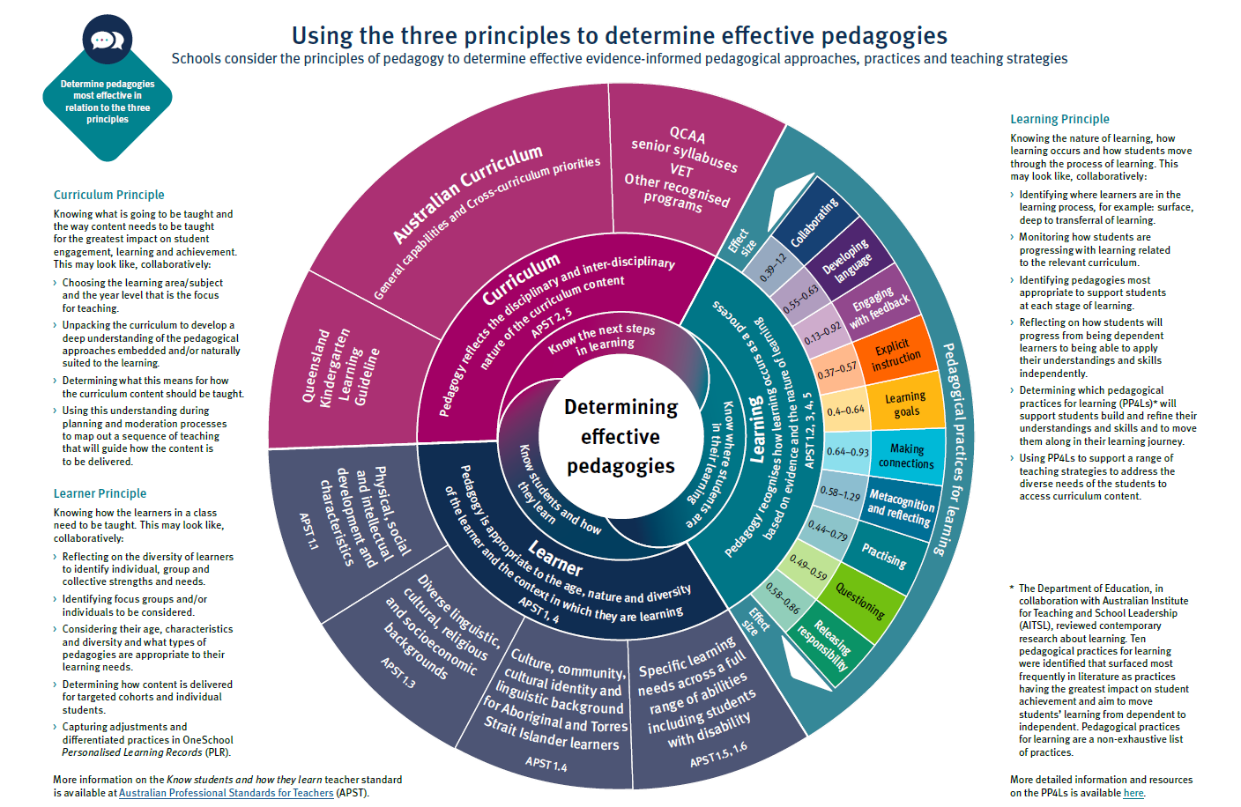
The teaching at Ironside State School is based on the effective pedagogy wheel.

Slide 10
Parts of a Lesson | Effect Size
Warm –Up/Daily Review - recite, recall, apply | Metacognition & Reflecting (0.58-1.29) Questioning (0.39-1.2) Making connections (0.64-0.93) Developing Language (0.55-0.63)
Orientation/hook/pre-teaching | Collaboration (0.39-1.2)
Lesson Intentions, Success Criteria, Purpose - WALT,WILF, TIB. | Learning Goals (0.4-0.64)
I DO - teacher models the steps to successfully complete the task | Explicit Instruction (0.37-0.57)
WE DO - teacher co-constructs task with the children to develop their understanding | Releasing Responsibility (0.58-0.86)
YOU DO - teacher releases children to complete individual work when students have shown they are ready. Teacher supports children and gives feedback. Individual work available is C, B, A and HOTS challenges (Higher Order Thinking Strategies) | Practising (0.44-0.79)
Lesson Review - 5 questions for students. What are you learning? How are you going? How do you know? How can you improve? Where can you go to for help? | Engaging with Feedback (0.13-0.92)
We are currently concentrating on the English Block:
- oral language
- handwriting
- grammar & punctuation
- spelling
- reading
- daily writing
- genre work

Slide 11
Thank you so much for coming. General questions can be asked now if time permits. Please see me at the end of the evening with individual questions.

