Slide 1
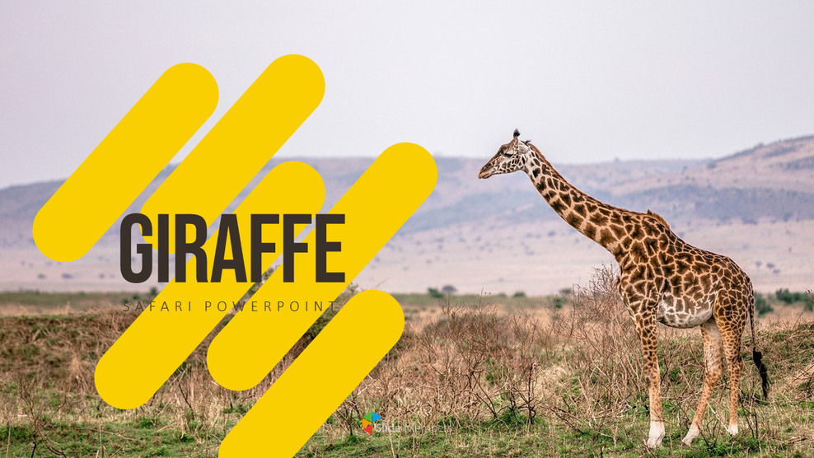
1

Slide 2
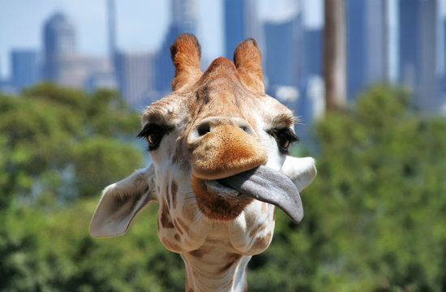
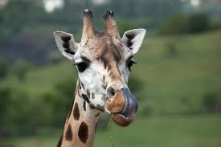
Appearance
Giraffes have short dense fur to help them stay cool in the African savannahs. They have long legs to help them reach tall trees. They have a slopping back to hold up there long necks. They also have a black white and brow patch like pattern on themselves to help camouflage. They have a long blueish black tongues to act as sunscreen because they spend more that 12 hours eating in the African sun.

Slide 3
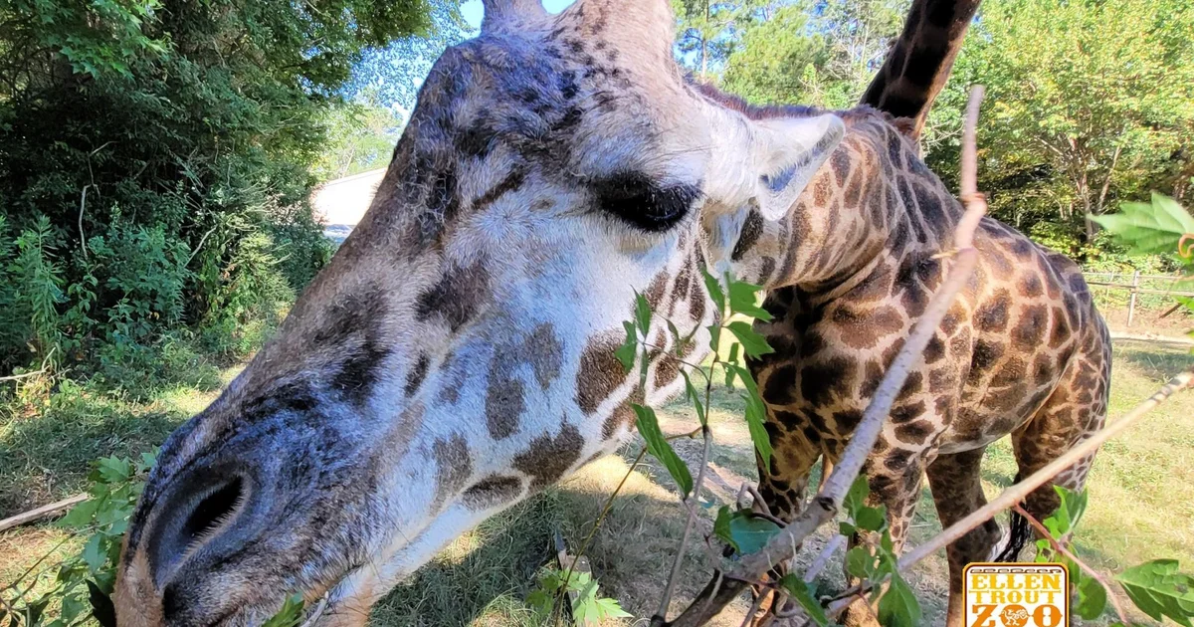
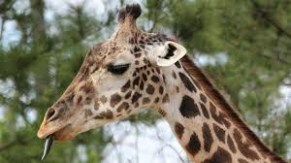
Habitat and where to find me
Giraffes are most commonly found in savannahs grasslands open woodlands and zoos. Giraffes mostly like areas that are rich in acacia trees and warm whether. most giraffes are found in Africa or in zoos.
Giraffes that live in captivity normally live up to 20 to 30 years old but in the wild they live up to 20 to 25 years old but the oldest giraffe to ever live was called Twiga she was 31 years and 9 month old but died in late 2023
Twiga

Slide 4
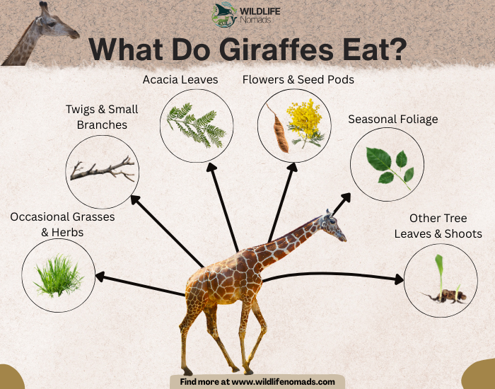
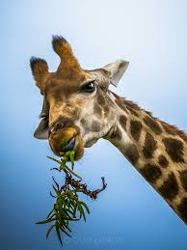
Diet
Giraffes eat leaves, buds, acacia trees and twigs, of they eat about 75kg. using their 20-inch, thick dark-coloured tongues to eat thorns and other spikey plants. They also eat fruits, flowers, and herbs, and rarely consume grass.

Slide 5
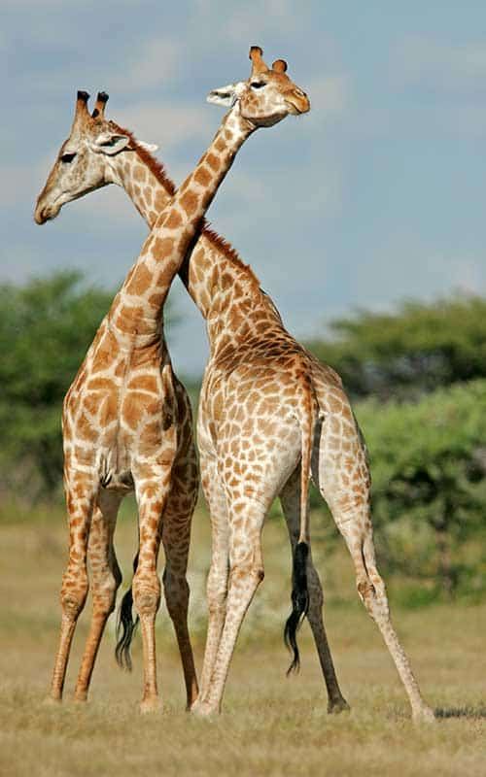
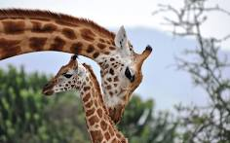
Behaviour
Giraffes are very social. They often separating into female (calf) groups and male groups (bulls) they spend most of the day eating particularly acacia leaves. There most done behaviours are fighting eating licking running short distances neck twisting and in winter they lick the frost or ice off trees.

Slide 6
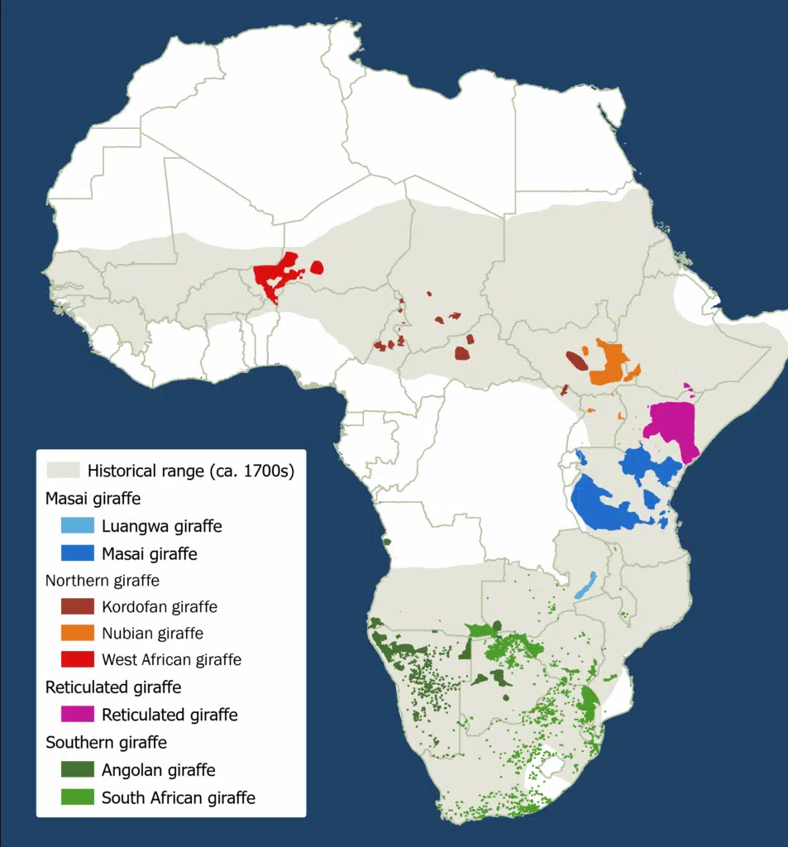
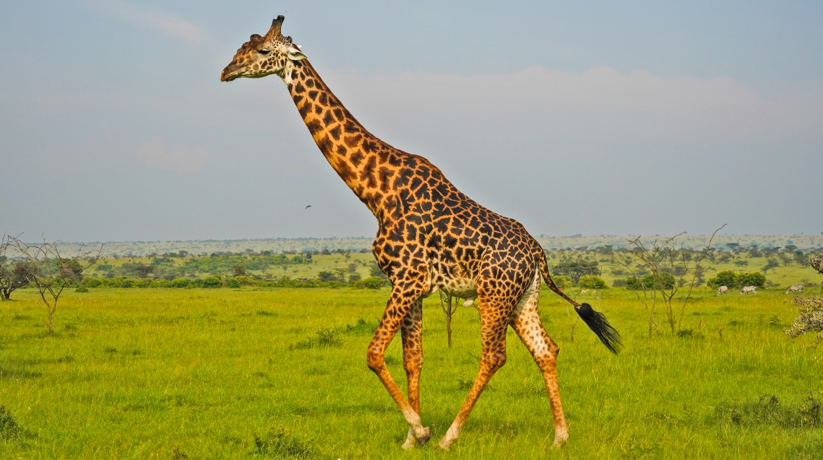
types
Northern giraffe
Southern giraffe
Reticulated giraffe
Masai giraffe
masai giraffe

Slide 7
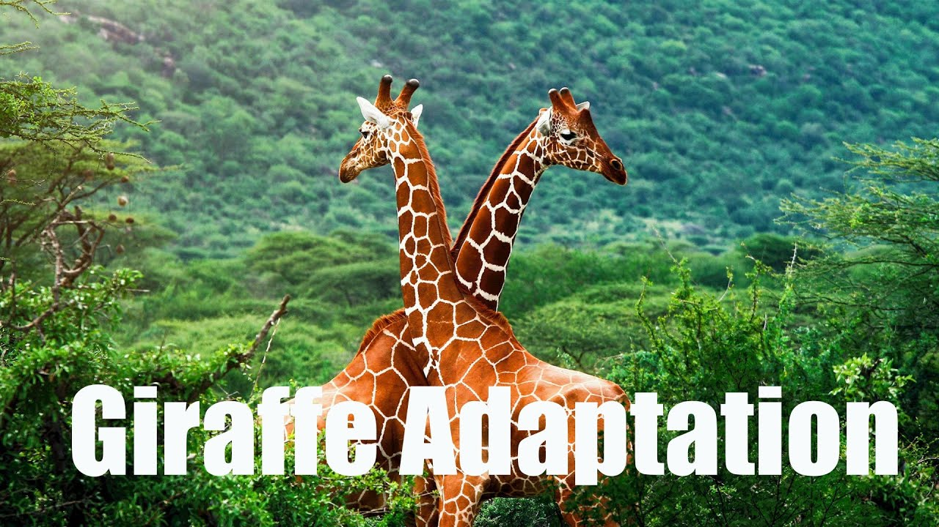
Adaptations
Giraffes adapt to the African savanna by using their really long necks to eat acacia leaves on high trees they use there 20-inch, dark tongues to grab leaves without sunburn unique patch patterns for camouflage and heat regulation they also use there long legs to run fast from predators.
video

Slide 8
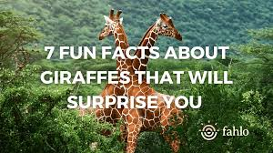
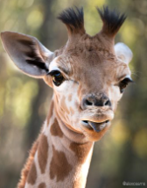
Fun facts
There unique spot patterns similar to human fingerprints always different.
Giraffes are the world's tallest mammals
They can run as fast as 35 miles (56 kilometres an hour over short distances
There known for their long necks
Their legs alone are taller than many humans (they sleep standing up)
Being tall helps them see there predators from far away

