Slide 1
Keilor St Albans Network
Tuesday 29 July 2025

Slide 2
Acknowledgement of Country

Slide 3
Learning objectives
Re-engage with the model of learning underpinning the Victorian Teaching and Learning Model to develop our shared understanding of high-quality instructional practice
Explore opportunities to leverage this model of learning and strengthen Tier 1 practices by interrogating Keilor St Albans network data
Consider opportunities to strengthen your AIP and implementation of the VTLM through implementation science research
Understand and reflect on implementation science research including:
  Implementation stages
  Implementation outcomes
  Enablers and barriers to implementation
  Implementation strategies
Notes:
9-11am

Slide 4

The extraordinary task of causing learning
Notes:
The title of the session is ‘Explicit teaching’ but we’re not going to start there, because explicit teaching has a brand problem. Our job is to create conversations with our colleagues and staff that are going to give us the best chance of engagement, of positive professional discourse, so we want to find some common ground. Something that will ignite curiosity and also elevate our professionalism.
So we’re going to start with this – learning. One way or another, we’re all invested in this – the extraordinary task of causing learning.
And it is extraordinary – let’s just reflect for a minute of how remarkable it is.
Often teaching is compared to medicine, being a doctor. Can anyone suggest who might be at the pinnacle of medicine – what type of doctor or surgeon might be considered the most highly trained, sophisticated.

Slide 5


Neurosurgery
Teaching
Restructuring something we can’t even see
On tens of people at a time (each with a different starting point)
With only words and images as our tools
Restructuring parts of the brain that you can see
On one patient at a time
With sophisticated tools and a multi-person support team by your side
Peps Mccrea, The teacher expertise paradox
Notes:
Classroom teaching is one of the hardest tasks ever devised (waaay harder than brain surgery).
First up, this is not about disrespecting the skill of brain surgeons. It's just that... you are tasked with:
Restructuring parts of the brain that you can see…
On only one patient at a time…
With sophisticated tools and a multi-person support team constantly by your side.
By contrast, teachers are tasked with:
Restructuring something invisible (student knowledge)…
On tens of people at a time, each with a different starting point, and some who don't even want to be there…
With ONLY WORDS AND IMAGES AS OUR TOOLS 🤯
The teacher expertise paradox

Slide 6

Evidence can supercharge teaching practice
Notes:
So given the complexity of the task, our proposition with any resources ever produced in the system is simple – that evidence can supercharge teaching practice.

Slide 7
Activity to use with your team
Write your own simple definition of learning:
Learning is…
Notes:
Has your definition of learning shifted?
Has anyone tried this?

Slide 8
Learning is “a change in long-term memory …… The aim of all instruction is to alter long-term memory. If nothing has changed in long-term memory, nothing has been learned.”
Kirschner, Sweller, & Clark, 2016 p. 77
Notes:
So… back to our definition of learning.

Slide 9
“All models are wrong,
but some are useful.”
      George E. P. Box, British Statistician
Notes:
I’m going to put up a model on the next slide and we’re going to use that model to think more deeply about learning, and again, I think it’s worth saying this. I hope you’ll find this useful.

Slide 10
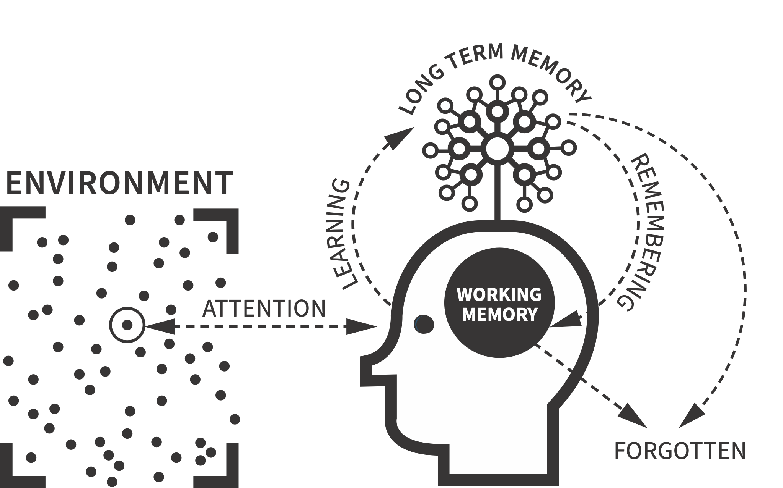
The Learning Model: Human cognitive architecture
Teaching is challenging when working with an individual…
Notes:
11.50
So this is Ollie Lovell’s model to describe what is meant by the body of evidence we sometimes call the science of learning.
I’m only going to speak to this very briefly as most of you will have seen it.
The first part of the model speaks to attention – if you want to cause learning, you have to get the learners attention.
The second part is working memory – this is the part of the brain where active sorting, storing, retrieving information occurs. The key thing about working memory is that it is limited – and this limit is different for different people, particularly if there are experience of trauma, or a learning difficulty
- the final key part is the long term- if we want students to learn anything, the knowledge (which might be information or skills) must move to long term memory.
We can forget things, but the good news is that the more we retrieve and rehearse knowledge, the more likely we are to remember it and be able to draw on long-term memory.
Knowledge sticks to knowledge, so if we have schemas in our long-term memory that new knowledge can connect with, learning can happen more quickly.
So we have to get the students attention, break down and scaffold the learning to provide just the right about of engagement with working memory, then provide enough opportunities to practice the knowledge so that long term memory is changed.
Easy right… it’s hard enough for one student…

Slide 11
Or just three students…
Notes:
Pretty tricky for three

Slide 12
In a classroom we are often doing this for 25+ students at the same time…
Tier 1 instruction – 80% of our students, including 80% of each cohorts
Notes:
But teachers are doing this for around 25 students at any given time.
I’m not going to talk about planning too much today, but the VTLM does includes MTSS, and for those of you who are familiar with MTSS, it is here you can start to see the power of it. And if we get time we can come back to this.

Slide 13


Always start with how students learn
“The mechanisms of learning are the same for all students. Some students experience persistent difficulties or differences in processing information that necessitate more frequent, intense, and sustained scaffolding and support but all students benefit from evidence-based practices that align with the processes of acquiring, retaining, retrieving, and consolidating learning.”
Notes:
If you’ve have debates about instruction, go back to how students learn?
If you don’t have agreement about how students learn, stick with the blue?
You will be familiar with this model by now – a representation of how learnings happens.
The VTLM 2.0 begins with how students learn intentionally
It synthesises evidence from cognitive science, neuroscience and applied (classroom studies)
2 minutes to explain the model –explaining the arrows, the words, to processes you think this models represents
Draw back – really what we’re trying to provoke is an honest reflection about how well we know this
Share quote- let people read it
Mechanisms of learning are the same but what will differ is what the students brings: their prior knowledge, their early childhood, their anxiety, what happened at before schools which might affect their attention, whether they’ve had breakfast
This does imply that our practices won't be adjusted, responsive and differentiated to the needs of the students
So encourage you to take seriously how you develop your own knowledge about how students learn

Slide 14
Evaluating opportunities to improve instructional practice
5. Gather and give feedback
Is the teacher assessing student learning and responding appropriately?
4. Drive thought
Is the teacher pushing students to think hard about ideas?
6. Ensure consolidation
Is the teacher supporting the student to consolidate their learning?
1. Select curriculum
Has the teacher selected the right ideas to teach?
2. Secure attention
Has the teacher got the students’ attention?
3. Optimise communication
Is the teacher presenting ideas in a way that is manageable for students?
‘Six fundamental problems of teaching’
Responsive coaching, Goodrich
Notes:
How can the VTLM support us in our work?
So this is Ollie Lovell’s model to describe what is meant by the body of evidence we sometimes call the science of learning.
I’m only going to speak to this very briefly as most of you will have seen it.
The first part of the model speaks to attention – if you want to cause learning, you have to get the learners attention.
The second part is working memory – this is the part of the brain where active sorting, storing, retrieving information occurs. The key thing about working memory is that it is limited – and this limit is different for different people, particularly if there are experience of trauma, or a learning difficulty
- the final key part is the long term- if we want students to learn anything, the knowledge (which might be information or skills) must move to long term memory.
We can forget things, but the good news is that the more we retrieve and rehearse knowledge, the more likely we are to remember it and be able to draw on long-term memory.
Knowledge sticks to knowledge, so if we have schemas in our long-term memory that new knowledge can connect with, learning can happen more quickly.
So we have to get the students attention, break down and scaffold the learning to provide just the right about of engagement with working memory, then provide enough opportunities to practice the knowledge so that long term memory is changed.
Easy right… it’s hard enough for one student…

Slide 15
Table activity: our knowledge about the elements of learning
Is this statement…. | True, False, It’s Complicated?
Retrieval practice is only useful for assessing knowledge, not for strengthening memory
We should aim to reduce cognitive load to help students learn more effectively
All students learn differently so teaching using preferred learning styles (e.g., visual, auditory) improves student outcomes
Spacing out learning over time leads to better retention than cramming
Background knowledge plays a key role in reading comprehension
Providing students with immediate feedback is always better than delayed feedback
Students learn better when they struggle slightly to recall information
Giving students more choices in their learning always improves motivation and performance
Students can hold an unlimited amount of information in their working memory at once
Visual clutter on slides and worksheets can hinder student learning
Review the statements on your table.
There are ten to review and explain with your reasons.
Can your table agree?
Notes:
10.55 – 5 mins

Slide 16



Table activity: our knowledge about the elements of learning
Is this statement…. | True, False, It’s Complicated?
Retrieval practice is only useful for assessing knowledge, not for strengthening memory
We should aim to reduce cognitive load to help students learn more effectively
All students learn differently so teaching using preferred learning styles (e.g., visual, auditory) improves student outcomes
Spacing out learning over time leads to better retention than cramming
Background knowledge plays a key role in reading comprehension
Providing students with immediate feedback is always better than delayed feedback
Students learn better when they struggle slightly to recall information
Giving students more choices in their learning always improves motivation and performance
Students can hold an unlimited amount of information in their working memory at once
Visual clutter on slides and worksheets can hinder student learning
Review the statements on your table.
There are ten to review and explain with your reasons.
Can your table agree?

Slide 17

Pause and reflect
Is there a shared understanding of high-quality instructional practice in your school?
Is everyone working toward the same thing?

Slide 18
Network data
What can your data tell us about the learning occurring in your schools?
What are the opportunities for improving learning (and wellbeing?

Slide 19
DSPM
Learning domain
Notes:
DSPM_Domain: Complete
For the learning domain, KSA doing pretty well – fewer schools in the developing category but also fewer in the High category

Slide 20
DSPM
Wellbeing domain
Notes:
DSPM_Domain: Complete
Really flying on wellbeing

Slide 21
DSPM
Overall performance
Notes:
DSPM_Domain: Complete
Doing really well overall particularly against similar schools – congratulations

Slide 22
NAPLAN Reading
% of students by proficiency level, 2023-2024
66%
56%
Notes:
When we look at reading, and apply the tiered logic from multi-tiered systems of support, ideally we would like to see around 80% of our cohort getting the desired curriculum level. In this instance, I’m using strong and exceeding as a proxy for that.
You can see that you’re not getting quite that number across the line.

Slide 23
NAPLAN Reading
% of disadvantaged and non-disadvantaged students* by proficiency level, 2023-2024
60%
75%
Who are these learners?
* Excludes specialist schools
Notes:
When we look at the picture with some breakdowns by cohort, we can start to see that our tier 1 practices are even less likely to be serving our disadvantaged learners – we’re nrealy up to out 80% mark for non-disadvantaged learners, but only 60% of our disadvantaged learners are meeting the expected level.

Slide 24
NAPLAN Reading
% of students by interim relative growth, 2023-2024

Slide 25
NAPLAN Numeracy
% of students by proficiency level, 2023-2024
58.6%
55.4%
Notes:
Similar story for numeracy

Slide 26
NAPLAN Numeracy
% of disadvantaged and non-disadvantaged students by proficiency level, 2023-2024
51%
69%
Who are these learners?
Notes:
Similar story for numeracy but not quite as positive for our non-disadvantaged learners.
When we think about the VTLM, the model of learning and opportunities to improve instructional practice, what are the opportunities for our disadvantaged learners?
And with these numbers, we likely can’t address this efficiently with tier 2 and 3 supports – we need to look at what’s going on at tier 1.

Slide 27
NAPLAN Numeracy
% of students by interim relative growth, 2023-2024

Slide 28
Senior secondary:
VCE Completion rates / Mean study scores (All studies; English)
 | % of VCE or VCE VM completions |  |  | All studies: Mean Study Score |  |  | English: Mean Study Score |  |  | English: % 37 or more score
Network | 2022 | 2023 | 2024 | 2022 | 2023 | 2024 | 2022 | 2023 | 2024 | 2022 | 2023 | 2024
Deer Park - Sunshine | 96.0% | 98.1% | 98.7% | 27.9 | 27.5 | 27.9 | 28.1 | 29.3 | 29.3 | 15.3% | 8.6% | 11.9%
Keilor - St Albans | 97.2% | 95.6% | 95.2% | 28.6 | 28.6 | 29.5 | 28.3 | 29.7 | 28.5 | 8.6% | 10.5% | 10.5%
Melton | 93.3% | 94.5% | 93.9% | 26.2 | 26.0 | 26.0 | 26.0 | 25.7 | 26.5 | 5.5% | 5.5% | 4.0%
Brimbank Melton | 95.7% | 95.5% | 95.2% | 27.6 | 27.4 | 28.0 | 27.3 | 28.2 | 27.9 | 8.2% | 8.2% | 8.2%
SWVR Total | 96.2% | 96.2% | 96.4% | 28.4 | 28.4 | 28.3 | 28.3 | 28.3 | 28.3 | 10.9% | 10.6% | 10.5%
Notes:
Your completions are just a little shy of SWVR and your mean study scores just a little better or on par with SWVR but are we happy with these results?

Slide 29
Chronic absence:
% of students with 10 or more days of absence, Semester 1 2023-2025

Slide 30
Attendance rates:
Semester 1 2023-2025
Notes:
Overall attendance rates largely strong.

Slide 31
Attitudes to School Survey:
Emotional awareness and regulation
Notes:
MM is the bar. WM is the triangle and the light square is the region
We can start to see a gap emerge for 4-6 and 7-9 for emotional regulation

Slide 32
Attitudes to School Survey:
Managing bullying
Notes:
The gap around managing bullying is particularly significant in 4-6 but is still present in 7-9 (and overall low)

Slide 33
Attitudes to School Survey:
Sense of connectedness
Notes:
You’ve got the same challenges as everyone around declining sense of connectedness in 7-9 but doing a little better in 4-6. Who are the students who do not have a sense of connectedness to their school?

Slide 34
Attitudes to School Survey:
Stimulated learning
Notes:
The gap widens further in relation to stimulated learning in both 4-6 and 7-9

Slide 35
Attitudes to School Survey:
Student voice and agency
Notes:
Similar story for Student voice and agency.

Slide 36
Attitudes to School Survey:
Not experiencing racism
Notes:
Some great results here

Slide 37
School Staff Survey:
Collective efficacy
Notes:
Pretty high levels of self-efficacy among your teachers or at least similar to SWVR.

Slide 38
School Staff Survey:
Academic emphasis
Notes:
Strong academic emphasis.

Slide 39
School Staff Survey:
Instructional leadership
Notes:
Pretty positive views about instructional leadership.
A challenge for you is how to match these views with those achievement issues we have discussed.

Slide 40
Investigating the wellbeing experiences for students and how these are impacting on learning
Understanding the learning and wellbeing experience for disadvantaged learners
Exploring opportunities for mastery in numeracy and mathematics
Challenging the practices and expectations of teachers
Reflecting on opportunities to engage students in Years 4-6 and 7-9
Demonstrate and deepen instructional leadership in specific practices
Pause and reflect
What are the opportunities to strengthen learning and wellbeing in your network?

Slide 41
Strengthening implementation of the VTLM in our AIPs

Slide 42

Check for understanding
What was one key insight on implementation of the VTLM – for you as an instructional leader – that came out of your AIP mid-year monitoring?
Notes:
Were you able to get useful insights?
Did they inform your decision making?
Did you change course or adjust?

Slide 43
Check for understanding
Why do we prepare an AIP?
Notes:
Were you able to get useful insights?
Did they inform your decision making?
Did you change course or adjust?

Slide 44
Implementation science
Implementation science = getting evidence into practice
closing the gap between what we know and what we do
specific methods, strategies, systems and processes
Emina McLean, 2025
Notes:
Implementation is a process, not an event.
• Schools should make fewer, but more strategic choices, and pursue
those diligently. Do less, better.
• It usually takes three to five years to see results of school improvement
initiatives.
• It doesn’t matter how great an idea or intervention is in principle; what
really matters is how it manifests itself in the day-to-day work of people
in schools.

Slide 45

Implementing well in schools (thanks to AERO)
Stages of implementation (which stage are we in)
Enablers and barriers (what is helping or hindering)
Strategies (what will we do to support/ensure success)
Implementation outcomes (monitoring, success metrics)

Slide 46
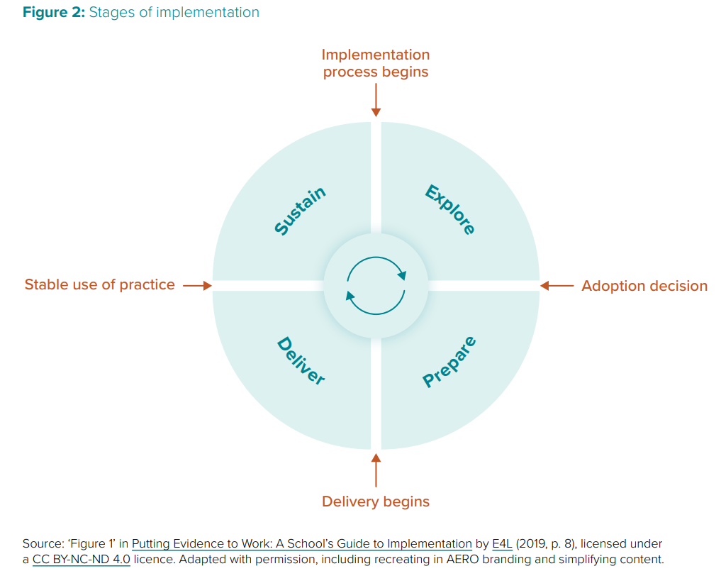
Understanding implementation
What stage are you at with implementation of your KIS (or with implementation of the VTLM)?
Do actions and activities (implementation strategies) in your AIP reflect this stage?
What information will you need to collect to know implementation is progressing as expected and to make key decisions?
Notes:
Key decision points
Differences/complementarity to FISO improvement cycle
Teachers don’t do anything in the explore and prepare phase.
Common pitfalls:
Firstly we try to do too much without sufficient resourcing or roles and responsibilities
We do all activities across all terms
Skip explore and prepare
Don’t include explore and prepare activities in AIPs – we think there are only really delivery type activities
Mis-match implementation strategies to stage of implementation
Success indicators collected don’t support key decision points
We look for sustainability indicators too early

Slide 47
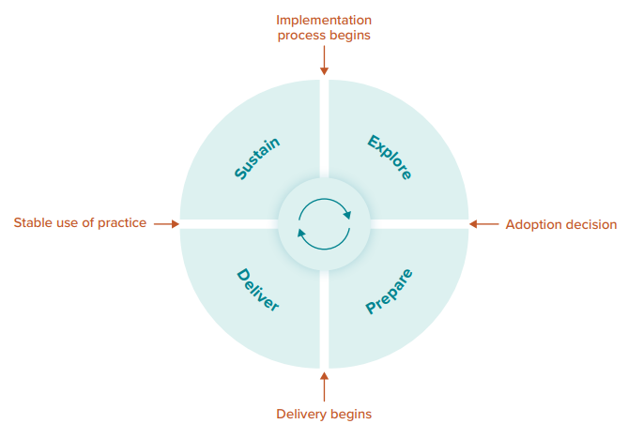
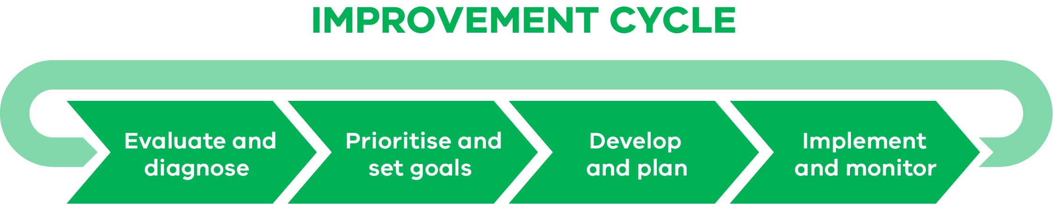
FISO Improvement Cycle and AERO Implementation Framework
Complementary but with distinct purposes
Cycle of improvement
Describes the common improvement process used in Victorian government schools to use data and evidence to identify opportunities to improve student learning and wellbeing
Works across each layer of our improvement architecture
4 yearly SSP
Annual AIP
Shorter cycle PLCs
Cycle of implementation to enable improvement
Describes the process for introducing a new evidence-based practice
Helps us to understand the role of leadership in change
Draws attention to areas that are often missed in implementation
Can assist us to understand what types of activities should be in our plan and key decision points on our implementation journey

Slide 48
Sample success indicators for your network
Monitoring data at a PLC level - evidence of adjustments/differentiation in planning documents and evidence of learning growth documented assessment schedule evidence of teachers inputting data (cohort data spreadsheet) and moderating assessments Differentiated curriculum documents Track and monitor the following students who have chronically low attendance- see files uploaded for targeted students Pre & Post units of study results to be documented and regularly analysed to inform planning. Student IEP's will demonstrate short term goals and progress achieved through adjustments and interventions implemented Evidence of progress reflected in SWPBS and RR Action Plan enhanced understanding of the VTLM 2.0, Literacy 2.0, Maths 2.0 and Phonics new reading instructional model teacher work programs phonics testing data New SWPBS Matrix displayed across the College Reduction in school suspensions | Practice NAPLAN assessment data Student focus groups and interviews Documentation of wellbeing resources, policies, initiatives and structures Streamline approach to teaching phonics Foundation to Year 2 and intervention Year 3-6 Students will articulate what they are learning rather than what they are doing 70% of the time by the end of the year Increased growth in Naplan reading in particular students in strong and exceeding reflect at least 2 years growth Observations of changes to classroom practices through student observation and feedback. Students will know how lessons are structured and how this supports their learning Effective PLCs and PLTs updated curriculum documents reflecting the changes to VTLM 2.0, Literacy 2.0 and Maths 2.0 Students have taken on leadership roles, organising events, and advocating the school and partaking in the grade prep Buddies program | Classroom observations and learning walks Evidence of impact of coaching Student feedback in Terms 1 & 2 (pre and post-surveys) 80% of Foundation to Year 2 at recommended phonics level by the end of the year based on the LLARS Student workbooks will show the feedback given by teachers and the goals set by students as a result of the feedback Students are able to articulate their next steps for learning to staff during learning walks Victorian Curriculum teacher judgements will show increased learning growth in reading and mathematics Enhanced teacher capacity to differentiate and respond to student social, emotional and academic needs Shared understanding on how to prevent and respond to escalated student behaviour Increase the percentage (use 2024 percentage as bench mark) of positive entries for students on Compass Mental health first aid sessions delivered Teachers report use of the Pedagogy Toolkit through surveys and/or the PDP conversations
Notes:
Observations
Many schools considering early and late
Some schools showing evidence of MTSS
Some schools thinking about whole-school, classroom, and individual levels
Still some success indicators that sound like actions e.g. moderation of teacher termly and weekly lesson plans
Definitely not always clear what the measurement would be e.g. how would you determine ‘shared understanding’ or ‘effective’
A big focus on students behaviours, which is great, but don’t forget your delivery chain – if students do something different, it’s because the adults did something different – so if they don’t, what were the adults doing?
Some of you are nailing being really clear about what you are measuring, how you are measuring it, and what the decision rule is to know if you were successful.
If you’re looking at learning or wellbeing outcomes on NAPLAN, ATOSS, you’re not measuring implementation. If you’re ticking off a task – you’re also probably not measuring implementation outcomes.

Slide 49
Using implementation science research to strengthen our monitoring
Implementation outcomes are different from effectiveness outcomes, which focus on the impact on student learning, but they do work together – strong implementation outcomes are a good indicator of future impact on student learning outcomes. While improving student learning outcomes is the ultimate goal of implementation, monitoring implementation outcomes is a valuable exercise to understand what factors might affect the likelihood of achieving that goal.
AERO Explainer – Monitoring implementation outcomes

Slide 50
Implementation Outcomes
Outcome | Definition | Questions
Acceptability | The perception among stakeholders (e.g., teachers, students, families, community) that a given evidence-based practice is agreeable, palatable or satisfactory | How will we know the evidence-based practice is valued by teachers? How will we support teachers in understanding the practice and its relevance for our school? How will changes in staff’s attitudes towards the practice be measured, and tracked over time?
Feasibility | The extent to which the evidence-based practice can be successfully used or carried out within a given school. | To what degree does our school have the time and resources to dedicate to implementing this evidence-based practice? What might need to change to ensure teachers are supported by systems and structures during this period of change (i.e., timetabling, release time, resource availability, access to coaching, etc.)? How will we check what staff think may need to change?
Fidelity | The degree to which an intervention or practice is implemented as intended, especially in terms of: • adherence to the description of the practice • dose • quality of use of the practice. | What will the evidence-based practice look like in classrooms in our school? How will teachers be supported with this? How will we know the practice is happening consistently?
Sustainability | The extent to which the evidence-based practice is maintained and embedded within a school’s ongoing operations. | What school documents and processes will the evidence-based practice be reflected in? How will staff know about these, and how will we support them in enacting these policies and processes
Notes:
Implementation outcomes are different from effectiveness outcomes, which focus on the impact on student learning, but they do work together – strong implementation outcomes are a good indicator of future impact on student learning outcomes. While improving student learning outcomes is the ultimate goal of implementation, monitoring implementation outcomes is a valuable exercise to understand what factors might affect the likelihood of achieving that goal. AERO Explainer – Monitoring implementation outcomes

Slide 51

Why all implementation outcomes matter
Acceptability
Feasibility
Fidelity
Sustainability
Success
Acceptability
Feasibility
Fidelity
Sustainability
Rejection
Acceptability
Feasibility
Fidelity
Sustainability
Too hard
Acceptability
Feasibility
Fidelity
Sustainability
Something changed, but not what’s intended

Slide 52
Activity 1
Use the handout
Sort the sample success indicators into implementation outcomes – which outcome do they tell you about?
What might the spread and balance of implementation outcomes tell us about our evidence-informed decision making at mid-year monitoring?
What do you notice about gaps or opportunities to strengthen your monitoring of implementation outcomes?
Implementation Outcomes ​
Acceptability​
Feasibility​
Fidelity​
Sustainability​

Slide 53
Monitoring indicators organised by implementation outcome
Acceptability | Feasibility | Fidelity | Sustainability
Survey responses from an initial knowledge check of explicit instruction (from a survey created and conducted by AERO) Enablers and barriers data and notes from discussions Observations during professional learning sessions on explicit instruction, and conversations following modelling Responses to reflection prompts in term reports. | Readiness for change discussions during the Explore and Prepare stages Enablers and barriers data and notes from discussions Observations from professional learning sessions on explicit instruction Notes from group reflective conversations | Formative notes from learning walks and informal observations Feedback using practice-specific coaching proformas that clearly scaffold core elements of practice Notes from group reflective conversations Reviewing lesson planning Rubric of explicit instruction used to guide practice | Teachers’ lesson plans Observations from learning walks Reflections from staff induction Responses from staff surveys School pedagogical approach reflects the evidence-based practice. School systems, policies and processes have the evidence-based practice embedded.
Notes:
Observations
Only a small number of schools delineated between early and later indicators
Many of the monitoring indicators do not tell us about the fidelity of a practice – we tend to move from ‘did a thing get done?’ to ‘did it have the impact we wanted?’
Feasibility
- Piloting/trialling

Slide 54

Applying our learning – monitoring VTLM implementation
New resource:
VTLM 2.0 - Elements of teaching reflection tool | Resource | Arc

Slide 55
Activity 2
If you were implementing practices associated with an element of the VTLM as part of your AIP, what evidence would you need to monitoring implementation outcomes?
Select one practice within the VTLM
Use the handout to record possible evidence for acceptability, feasibility, fidelity and sustainability?
Implementation Outcomes ​
Acceptability​
Feasibility​
Fidelity​
Sustainability​

Slide 56
Enablers and barriers to implementation
There’s great value in all teachers and staff who are involved in implementation discussing and suggesting actions to address current barriers and strengthen enablers.
Enablers and barriers can be assessed during different stages of implementation and linked with implementation strategies and implementation outcomes.
‘Enablers and barriers show what’s working well and what’s getting in the way when implementing evidence-based practices.’
AERO Explainer – Addressing enablers and barriers to implementation

Slide 57
Enablers and barriers to implementation
Domain | Domain Example determinants with short description | Example considerations for schools
Evidence-based practice | • Evidence strength and quality: Stakeholders’ perceptions of the quality and validity of evidence supporting the belief that the practice will have desired outcomes. • Complexity: Perceived difficulty of implementing the practice. | • How has the potential benefit and impact of the evidence-based practice been explained, including the underlying evidence to support it? • To what extent have the key steps required to implement the practice been explained and made available to staff?
Process | • Planning: The degree to which implementation activities are planned, and the quality of the activities. • Reflecting and evaluating: Feedback about the progress and quality of implementation, and regular debriefing about progress and experience. | • How well-described and understood are the implementation actions and activities? • How is feedback about implementation captured and discussed among staff? How is this information used to strengthen implementation?
System and community | • Student needs and resources: The extent to which student needs are accurately known and prioritised. • External policy and incentives: Alignment between the evidencebased practice and policy settings (e.g., government or system policies, guidelines, support materials). | • What data do we have (e.g., from students, their work, their families, teacher observations) about student needs, and how will the practice address these? • How is the evidence-based practice reflected in external policies and guidance?
Notes:
AERO Explainer – Addressing enablers and barriers to implementation

Slide 58
Enablers and barriers to implementation
Domain | Domain Example determinants with short description | Example considerations for schools
School | • Implementation climate: The capacity for, and structures to, support change within a school. • Available resources: The level of resources dedicated to implementation, including money, training, physical space and time. | • What systems and structures will support changing practice in our school (e.g., an established coaching system)? • How can we reprioritise existing resources to support implementation?
Individuals | • Knowledge and beliefs about the intervention: Individuals’ attitudes toward and value placed on the practice, as well as knowledge of the practice. • Self-efficacy: Individual belief in their own capabilities to take action to achieve implementation goals. | • To what degree do staff believe in the evidence-based practice, and its role in addressing a challenge that’s relevant to the school? • Are staff ready for, and supported to, change their practice?
Notes:
AERO Explainer – Addressing enablers and barriers to implementation

Slide 59
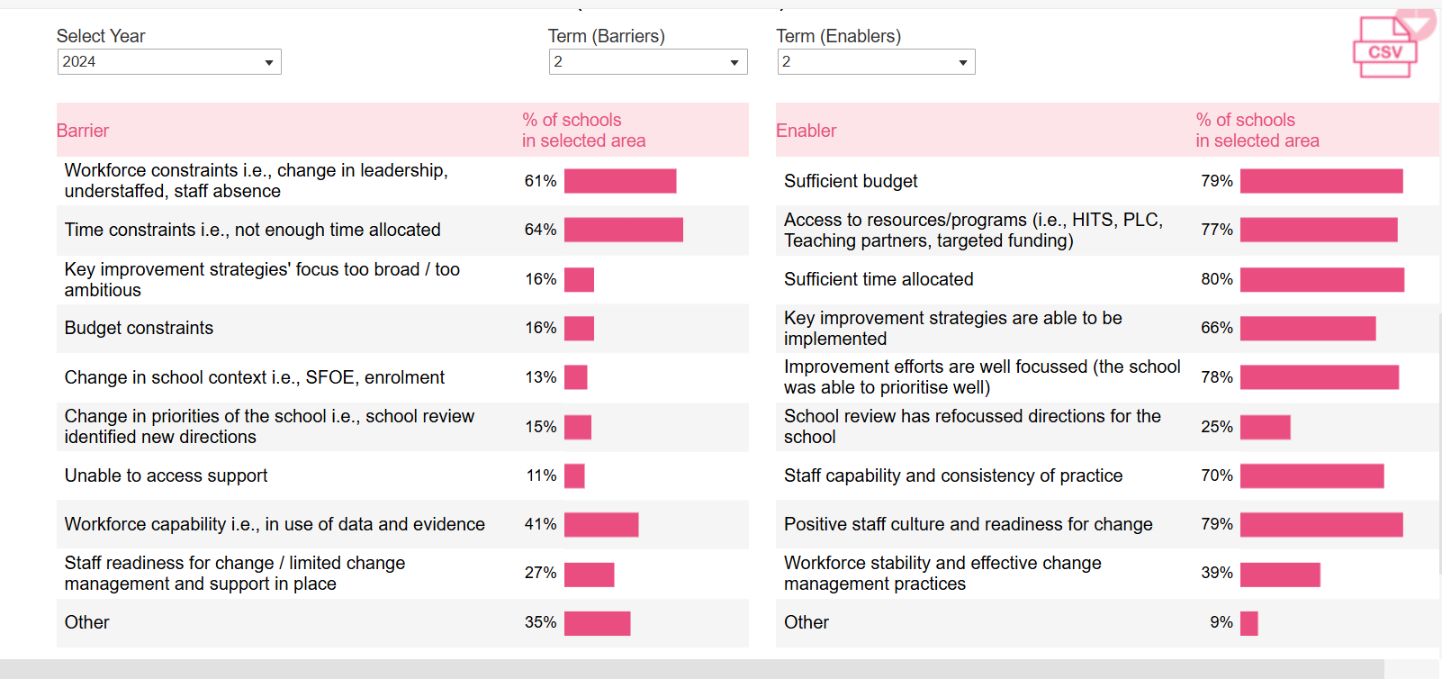
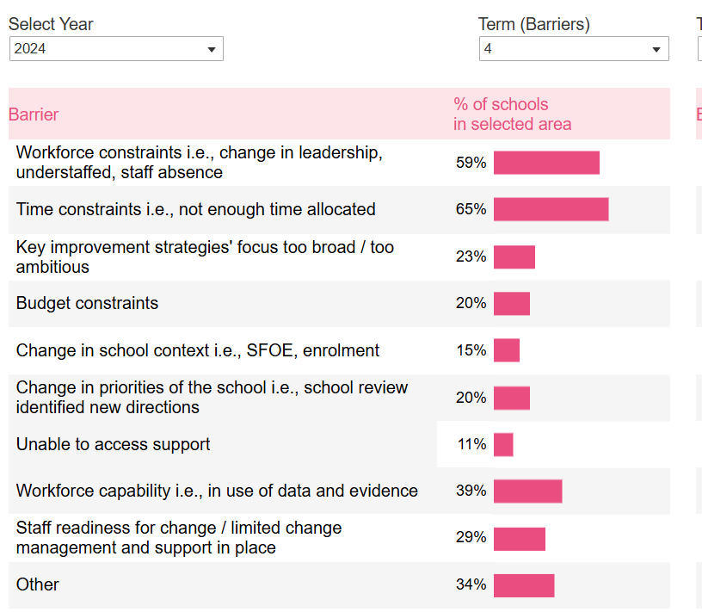
SWVR 2024 Term 2 & 4 AIP Barriers
Notes:
The enablers and barriers data indicates the Barriers as determined by the schools in our region both terms 2 and 4.
Barriers don’t change
Barriers worsen over the year
Staff readiness, limited change management and support in place , workforce capability including use of data and evidence, time constraints. A ll linked to MTSS and all linked to Implementation components
CHALLENGE
How do you help schools to prioritise their KIS, Activities, actions?
Effort Impact Matrix
Fishbone – problem analysis
5 Whys

Slide 60

Turn and Talk
How might a better understanding of enablers and barriers support your team with the implementation process?

Slide 61
Enabler – planning processes example
Year 1 |  |  |  | Year 2
Explore
Prepare
Deliver
Sustain
Explore
Prepare
Deliver
Explore
Year 3 |  |  |  | Year 4
Sustain
Adapted from Simon Breakspear

Slide 62

Enabler – collecting feedback about implementation
Discuss
How regularly do you collect feedback about implementation in your school?
How reliable is the information?
If you don’t understand the level of acceptance in your staff and students, you are missing a foundational enabler or barrier.
Regular surveys, exit tickets etc. to understand staff and student perceptions at each phase of implementation.
Notes:
This is where you pick up whether you have passive resisters, or if you have the foundation to move faster.

Slide 63
Implementation strategies
Not all actions and activities are created equal.
Implementation strategies are the main ‘how to’ element of turning research into practice (Proctor et al., 2013).
… implementation strategies are the different methods or techniques used to enhance the adoption, implementation and sustainment of an evidence-based practice (Lyon et al., 2019).
AERO Explainer – Using implementation strategies

Slide 64
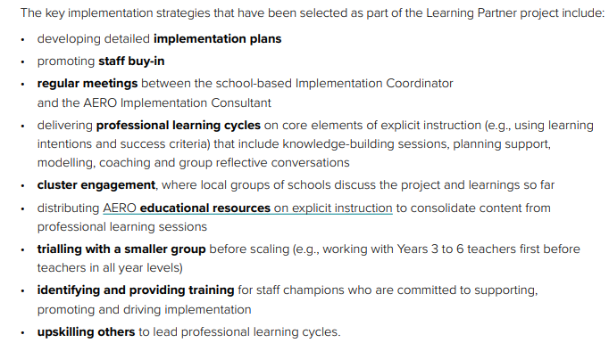
Implementation strategies
Discuss
Which strategies are best suited to each implementation stage?

Slide 65
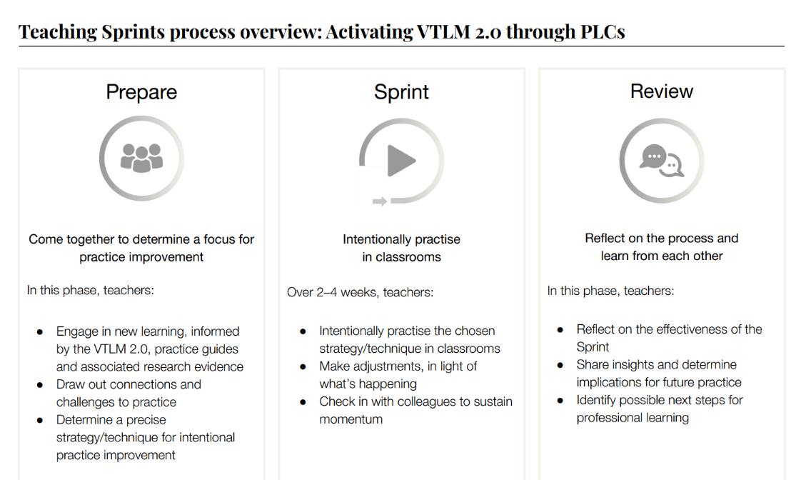
Implementation strategies – making connections

Slide 66

De-implementation – More is not more
An important part of our implementation journey is stopping or reducing those practices that are no longer adding value or are low value.
Stopping something requires as much thoughtful planning as starting something.
Four types of de-implementation:
  Partial reduction
  Complete reversal/discontinuation (significant risks to manage – confirmation bias and loss aversion)
  Related substitution
  Unrelated substitution (significant risks to manage – confirmation bias and loss aversion)
Reflect
What is the approach to de-implementation in your school?
When has de-implementation gone well? Gone badly?
Emina McLean, 2025
Notes:
Priorities practice for de-implementation that are:
Not effective
Less effective than other practices
Cause harm
Unnecessary or no longer necessary
More is not more.
• Initiatives are carefully considered before implementation.
• We give equal attention to what can be added and removed.
• Learning is our focus. We can justify the value/impact of everything we do.
• Anything implemented is likely to improve learning. Implementation is planned and
supported.
• Anything de-implemented was not adding value for learning. It was replaced or removed in a
planned and supported way.
• Less, done well, is more.
• What can schools stop doing?

Slide 67
Features of an effective AIP (implementation plan)
Be sharp and narrow in focus and is cognisant of resourcing and implementation capacity
Reflects a clear improvement narrative for the year and as part of a longer plan
Responds to school readiness and stage of implementation
Leverages high-impact implementation strategies appropriate for the stage of implementation
Actions and activities are clearly sequenced with clear accountability
Success indicators provide information about implementation outcomes across acceptability, feasibility, fidelity and sustainability

Slide 68
Key takeaways
Spend the time to be clear as leaders about evidence-based practice
You have great strengths but there are also opportunities for improvement within your network – these can help you drive your implementation narrative
An understanding of implementation research can help you refine your AIP – and get you to success faster, with more precise effort
Don’t tackle the VTLM without the above
Further reading: Taking an evidence-informed approach to implementation | Australian Education Research Organisation

Slide 69

Questions
Questions?

