Slide 1
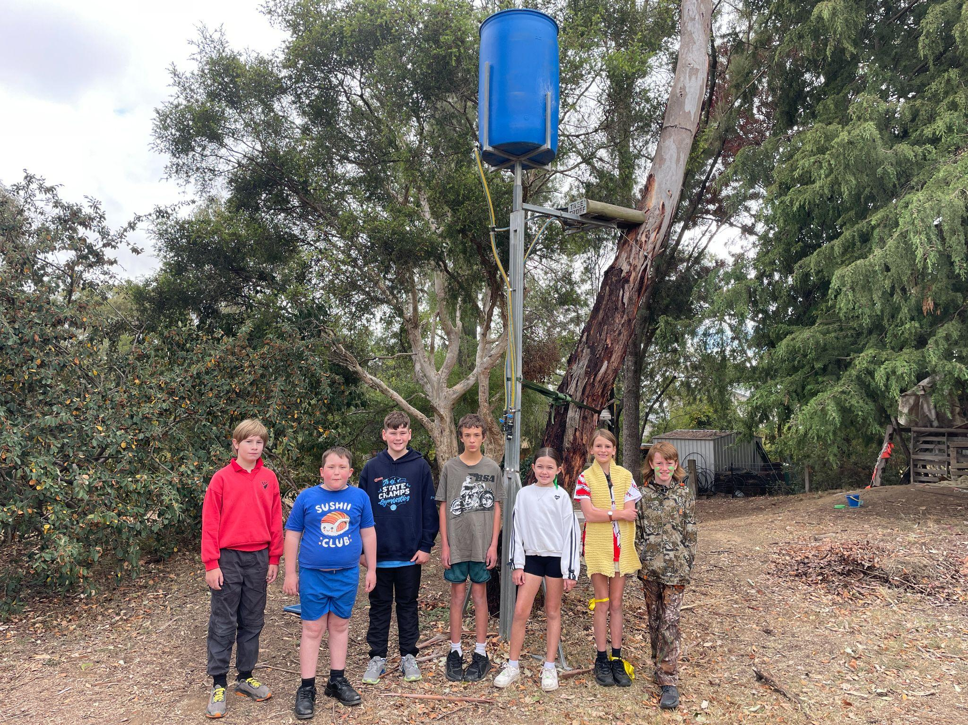
Martins Gully Koalas and Others: A Schoolyard and Community Biodiversity Report
Semester 1, 2026

Slide 2
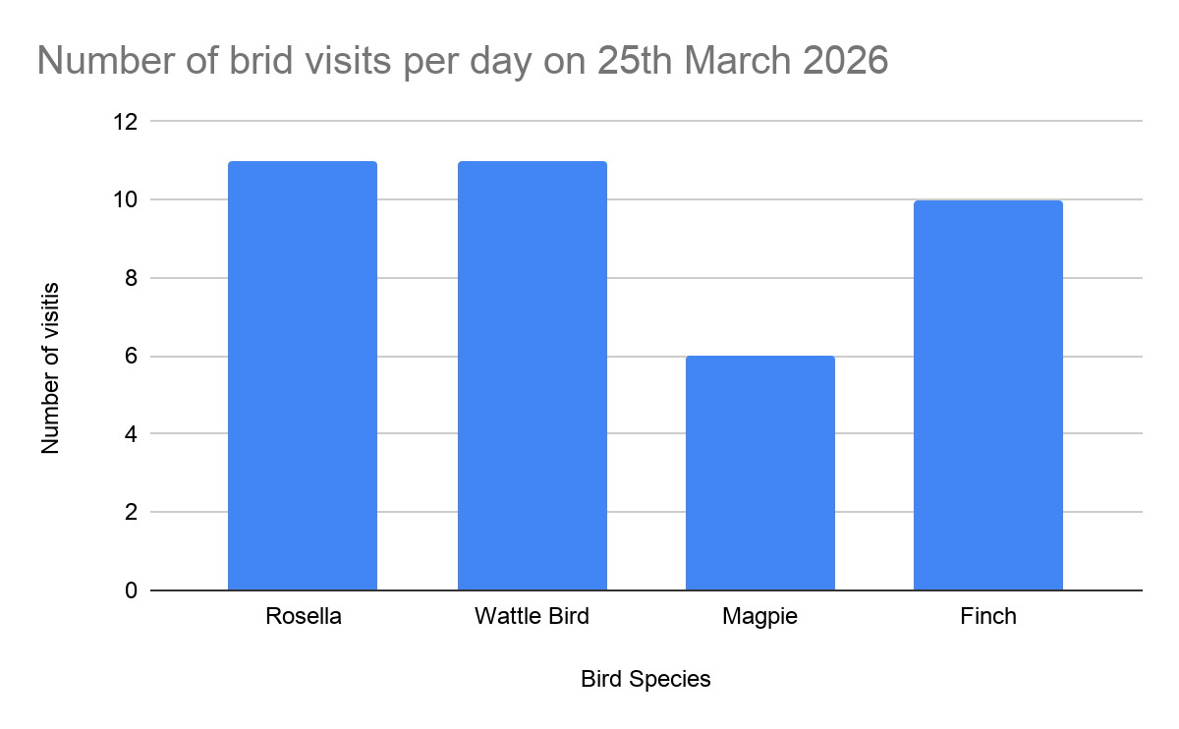
Interesting analysis of our choice - Bird species visits over one day
Species of bird | Number of visits | Time of day pm
Rosella | 11 | 2:00 - 4:00
Wattle Bird | 11 | 4:00 - 6:00
Magpie | 6 | 4:00 - 7:00
Finch | 10 | 3:00 - 6:00
Our observations have shown that more birds have come to our tree troff to drink since the pond near our Tree Troff has dried up completely as we are in the middle of a drought!

Slide 3
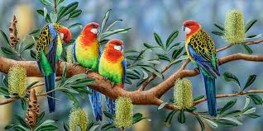
Eastern Rosellas -The Aaewan name fo rosella is lena
Rosella video.MOV
Video
The Rosellas manly visit in the afternoon between 2:32 pm and 6:42 pm
One for rosella favourite foods is the nectar, seeds and flowers of an Iron Bark tree.
Eastern Rosellas have a population of ten thousand plus in the Northern Tablelands but sadly they are facing the consequences of a drought which may affect breeding

Slide 4
Wattle birds
Lots of bird its been very dry lately.
Wattle birds eat nectar mostly from flowering trees. So far we've seen 11 wattle birds visit our tree troff. The Wattle birds have been coming either before or aftes including wattle birds have been coming to our tree troft becausernoon and some between 8 and 7 am.
There found at urban parks,gardens,and suburbs particularly where nectar producing native plants around australia
All common species of wattle birds are large noisy and aggressive birds.wattle birds can actually mimic other birds calls they mimic sounds from black cockatoos,corellas,kookaburras,lorikeets bower birds,and even dog barks and sirens
Wattle birds normally breed between july and january and normally lay around 2 to 3 eggs wattle birds eggs are most likely a salmon pink or pale purple brown with blotches
Wattle Bird video.MOV
Video
\\

Slide 5
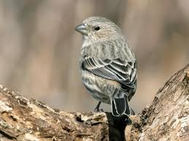
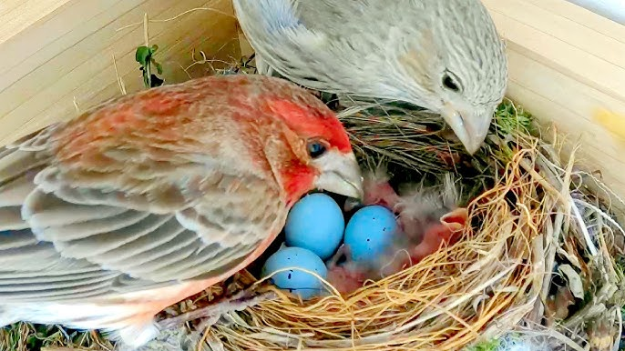
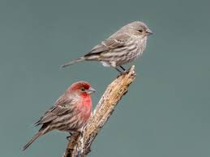
House Finch
Roselle and Finch video.MOV
Video
Almost all of the House Finches diet is vegetable matter. Feeds mainly on weed seeds. Other important items include buds and flower parts in spring, berries and small fruits in late summer and fall. House Finch Behavior: Social and Sweet
They're not aggressive and tend to get along well with other birds at feeders. Their song is a cheerful, warbling tune that's easy to recognize once you've heard it a few times The house finch (Haemorhous mexicanus) is a small, common North American bird, 12.5–15 cm long with a 20–25 cm wingspan. Males feature red coloration on their head and breast, while females are streaked with brown. Originally from the West, they are now widespread in urban/suburban areas, often feeding on seeds
The house finch is sadly not a native bird in australia
Most of our house finches have been visiting the tree through 3:50pm to 5:20pm
Both male and female House Finch display a strong tendency to return to the same area to breed, often occupying the same nest site as the previous year.

Slide 6
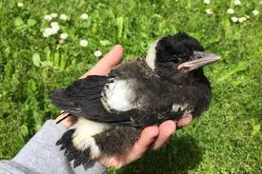
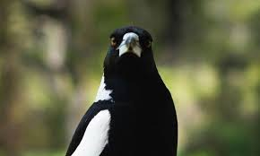
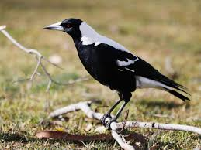
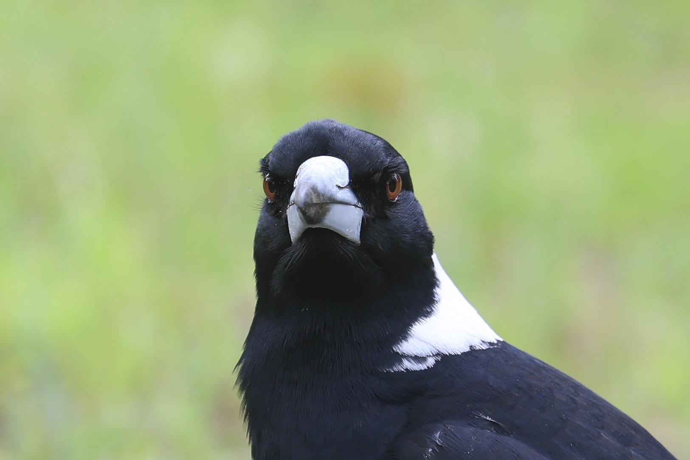
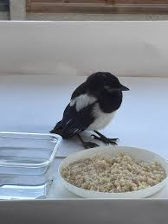
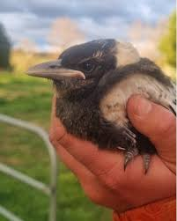
Magpies
The word for magpie in Anewan is mbawta.
Magpie video.MOV
Video
So far we found 4 magpies at 4:48 pm 6:17am 6:24 pm and 8:17am. Magpies like to hang around mostly in the afternoon.
Humans have inadvertently created ideal magpie habitats by building parks and golf courses that mimic their natural environment. When people grow high trees and trim grasses in their yards or gardens, they select the best places to live or seek food. Therefore, you can see them in many areas close to humans.
Magpies can recognize up to 100 human faces and remember them for up to five years.
Magpies are omnivorous ground-foragers that primarily eat insects, larvae, spiders, earthworms, and small animals like lizards and frogs.

Slide 7

What’s our SMART Goal for Semester 1, 2026
Angle our camera stand to try and get clearer images, minimise blur and provide greater quantitative data
We are working with the Stage 2 classes who have received a grant to improve the vegetable garden and nature area around our Tree Troff.
The following two dot points are lplans over the next 12 months
We aim to remove the obnoxious weeds and replace with flowering natives which we know our native birds and gliders love.
Erect a greenhouse to protect vegetables from Armidale’s extreme weather such as drought, frost and wind.

