Slide 1
TEENAGERS AND SLEEP
Information taken from Better Health Victoria

Slide 2
SLEEP – How much should you get?
Sleep researchers say teenagers should be getting 8-10 hours sleep a night
Many teenagers only get 6.5-7.5 hours a night

Slide 3
What happens when you don’t get enough sleep ☹
mentally ‘drifting off’ in class
shortened attention span
Concentration difficulties | Mentally ‘drift off’ in class
Shortened attention span | Memory impairment
Poor decision making | Lack of enthusiasm
Moodiness and aggression | Depression

Slide 4
What happens when you don’t get enough sleep ☹
Risk-taking behaviour | Slower physical reflexes
Clumsiness, which may result in physical injuries | Reduced sporting performances
Reduced academic performance | Increased sick days and truancy

Slide 5
Factors that affect sleep
hormonal time shift – puberty hormones shift the teenager’s body clock forward by about one or two hours, making them sleepier one to two hours later.
using screen based devices – smart phones and other devices used around bed time reduce sleep time. Teens who put down their smart-phones an hour before bed gain an extra 21 minutes sleep a night, (that's one hour and 45 minutes over the school week) according to a study by Vic Health and the Sleep Health Foundation

Slide 6
Factors that affect sleep
leisure activities – the lure of stimulating entertainment such as television, the internet and computer gaming can keep a teenager out of a good bedtime routine.
light exposure – light cues the brain to stay awake. In the evening, lights from televisions, mobile phones and computers can prevent adequate production of melatonin, the brain chemical (neurotransmitter) responsible for sleep
vicious circle – insufficient sleep causes a teenager’s brain to become more active. An over-aroused brain is less able to fall asleep.
social attitudes – in Western culture, keeping active is valued more than sleep

Slide 7
Other things that could affect your sleep
A noisy road
Barking dogs
Noisy neighbours
Certain food and drinks
The rubbish truck
Emergency sirens
See your GP if your are concerned about your nightly sleep quota.

Slide 8
Emotions that can affect your sleep
Worry – do you feel comfortable to talk to a parent or school staff member about your concerns?
Anxiety – can you identify what is making you feel uneasy or uncertain?
Depression – while some people who have depression increase their sleep hours, others are unable to get to sleep or stay asleep.
Anger – do you toss and turn thinking angry thoughts unable to let them go?
Uncertainty / out of control – we live in very uncertain times and most people find things very unsettling at present due to the amount of change that they are having to deal with.
Stressed or pressured – who has trouble sleeping before some important day or event?
Sadness – given the bushfires, floods, and covid many people are feeling sad as they have been unable to do the things they normally do, and haven’t seen people they care about. Many people have struggled to deal with the rapid and constant change.

Slide 9


Those pesky worries
Write down any concerns that you are worrying about and work out which worries you need to talk to a trusted adult about.

Slide 10
SO WHAT CAN YOU DO:
See your Wellbeing team – did you known the Wellbeing team consists of counsellors, youth workers, chaplains, a mental health practitioner, a school nurse.
GP’s in school - students can make an appointment via the hub or wellbeing to see a doctor during school hours.
Breakfast club is over in Wellbeing – come and get a feed!

Slide 11

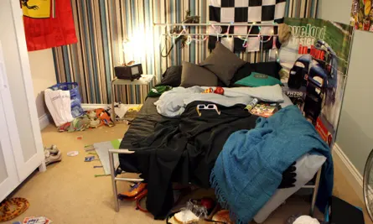
Is your room organised and calm?
Which room makes you feel calmer? Can you find everything you need in your bedroom? Having a messy space can make you feel more scattered and less focussed.

Slide 12

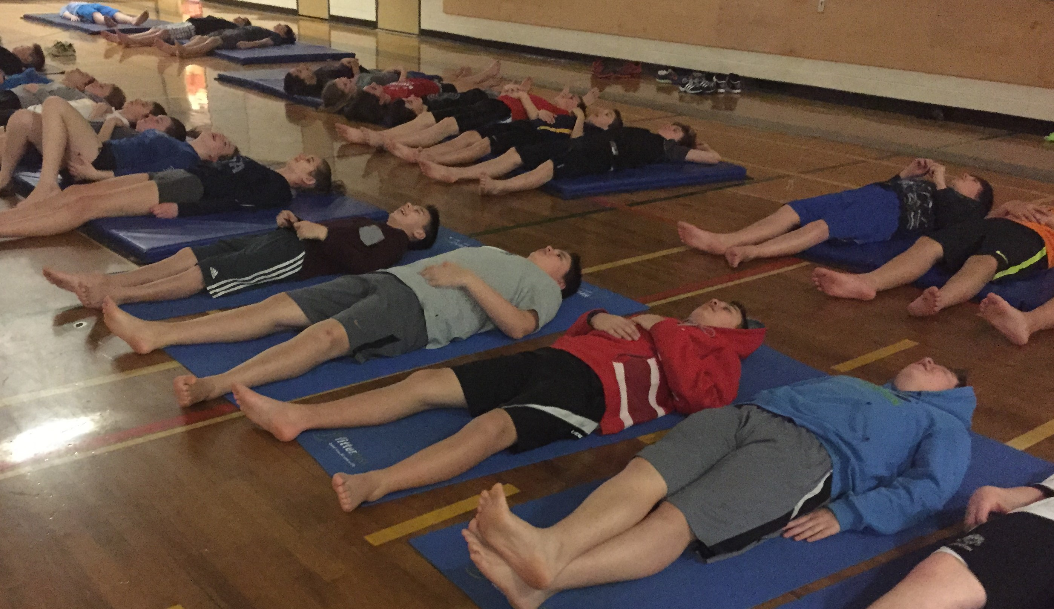
Meditation Yoga can help
Progressive muscle relaxation
Yoga
Meditation
All great ways to relax. Look up videos on You Tube and find one that suits you!

Slide 13



A relaxing bedtime routine
What time do you want to be asleep by?
Is everything organised for the morning?
Is your alarm set?
Are your devices turned off along with notifications?

Slide 14


New sleep routine
Keep your bedroom dark at night.
Your brain’s sleep–wake cycle is largely set by light received through the eyes.
Try to avoid watching television or using smart phones right before bed.
In the morning, expose your eyes to lots of light to help wake up your brain.
Continue your new bedtime routine of going to bed 10 minutes earlier, every night for at least four weeks.
You can then increase this by another 10 minutes after four weeks.

Slide 15

Sleep routine – how to:
Get to bed an 30 minutes every night for a week until you have reached your desired bedtime.
Get active during the day so you are more physically tired at night.
Set up a comfortable sleep environment.
Set up a regular wake-up time.
Avoid staying up late on the weekends. Late nights will undo your hard work.
Remember that even 30 minutes of extra sleep each night on a regular basis makes a big difference. However, it may take about six weeks of getting extra sleep before you feel the benefits.

