Slide 1
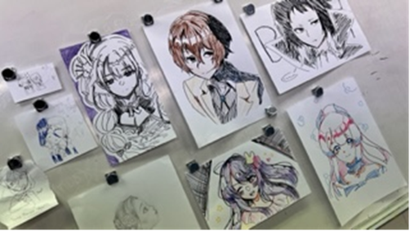
Arts and Anime Club
Term 2 2023
EDSC

Slide 2
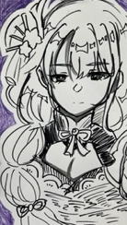

Slide 3
