Slide 1
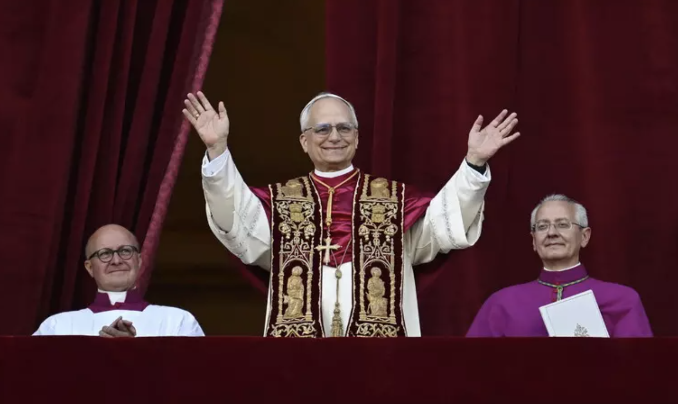
“Habemus Papam” - We have a new Pope!

Slide 2
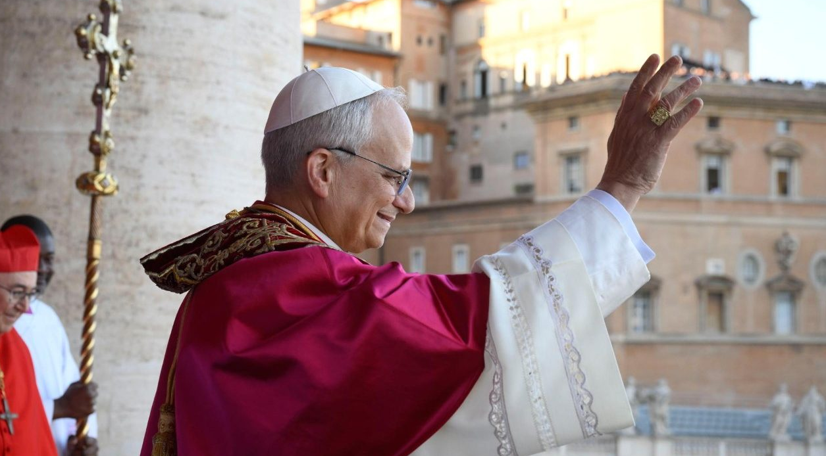
Cardinal Robert Francis Prevost is the 267th Pope. He has taken the name Pope Leo XIV.

Slide 3
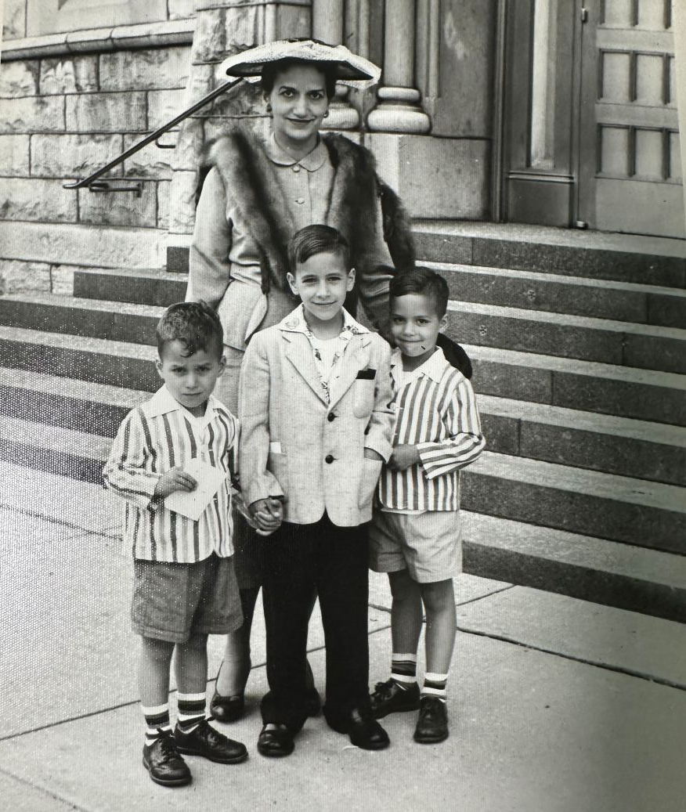
Robert Prevost was born on September 14th 1955 in Chicago, Illinois.
He grew up in the Dalton, Illinois.
Robert on the left with his mother Mildred and two brothers, John and Louis.

Slide 4
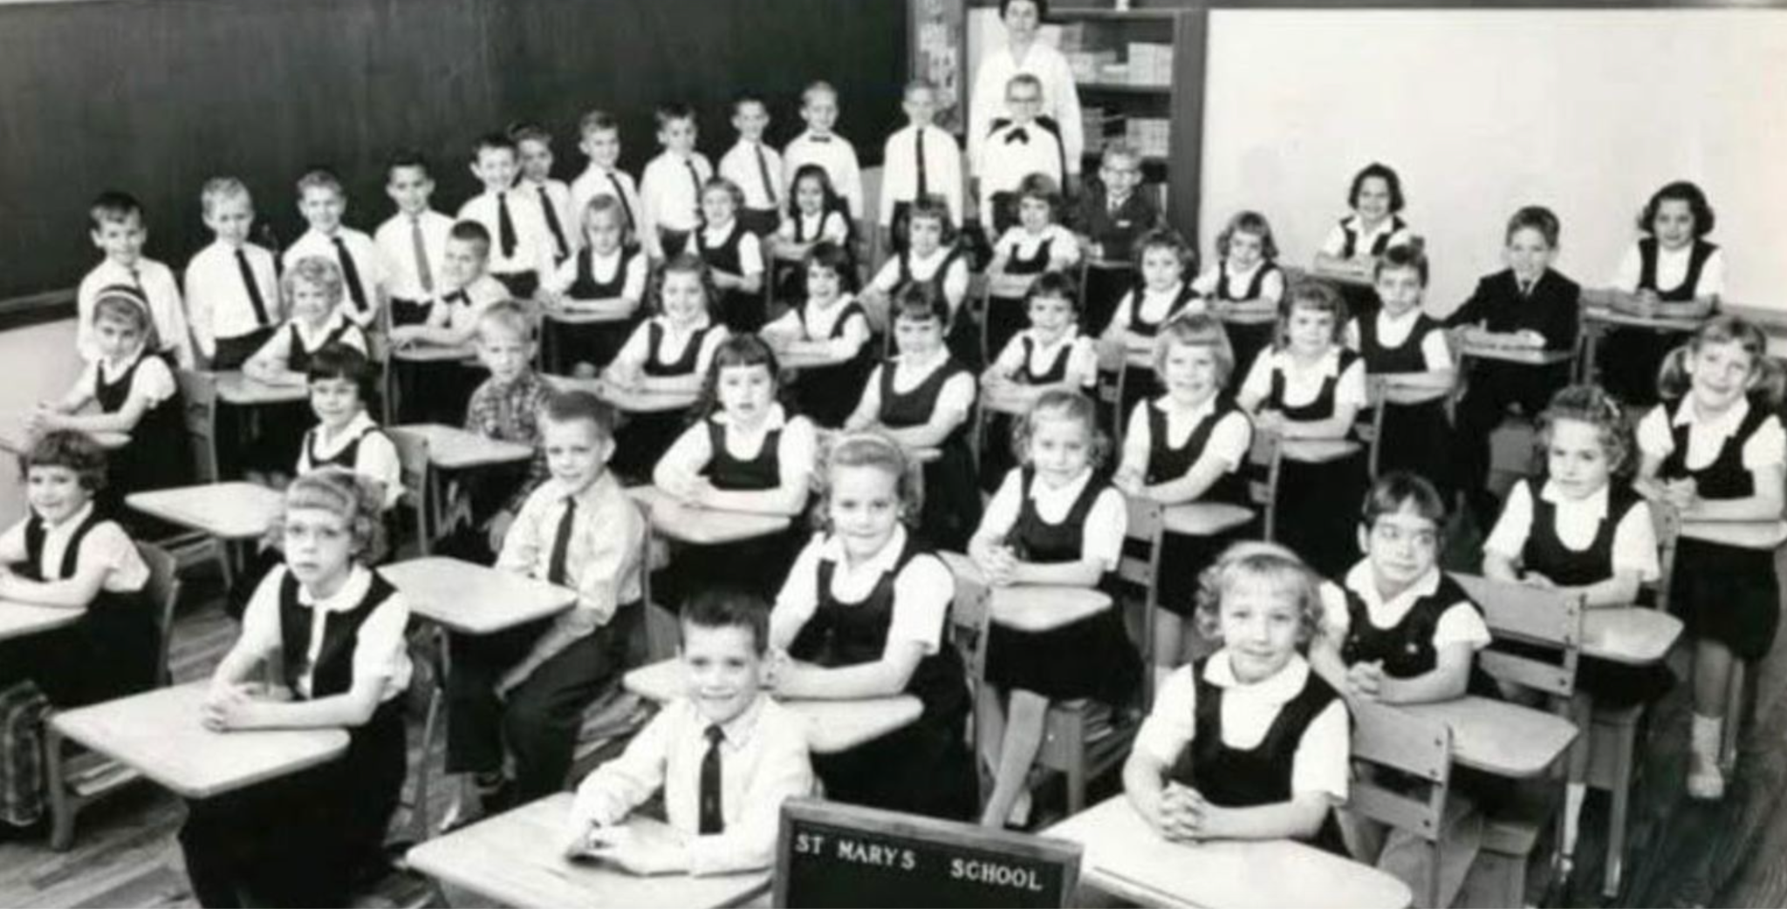
He went to primary school at St Mary of the Assumption.
Pope Leo is standing, fourth from left, in this classroom photo.

Slide 5
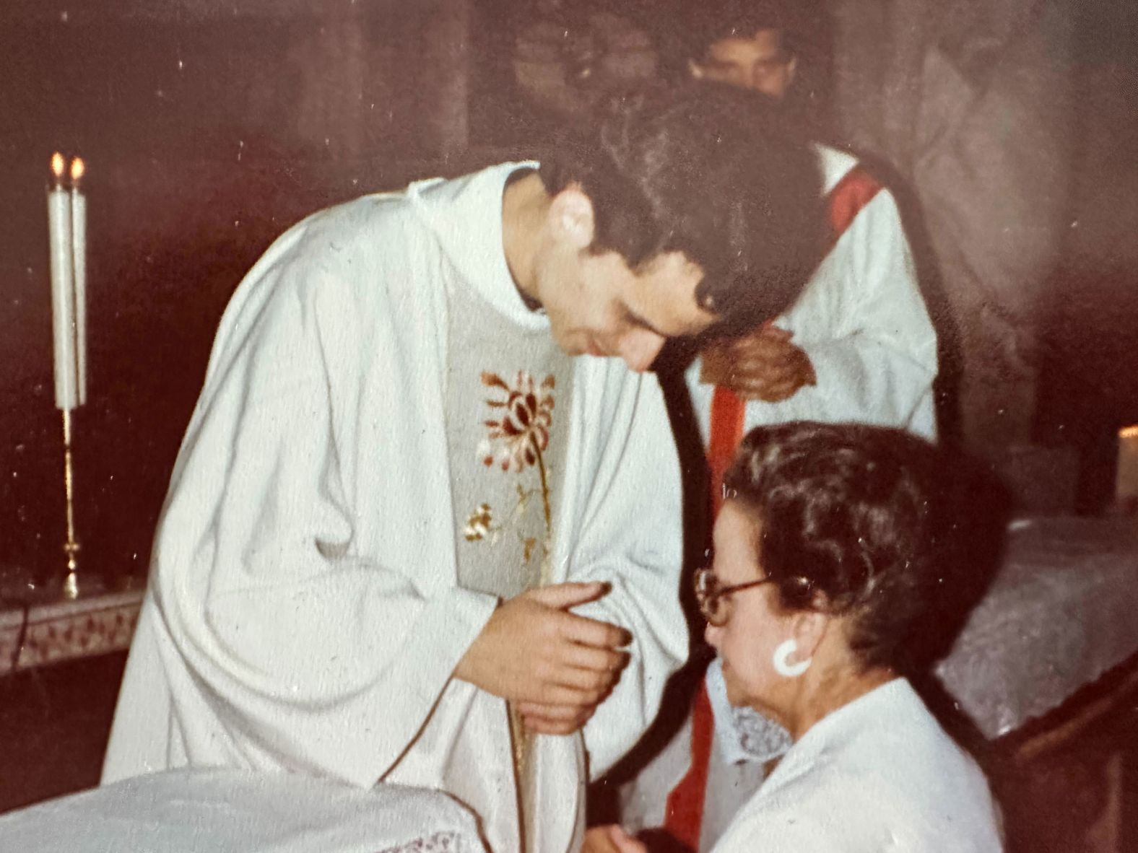
Robert Prevost became a friar in the Order of Saint Augustine as a young man and was ordained a priest in 1982.
Robert blesses his mother after being ordained as a priest.

Slide 6
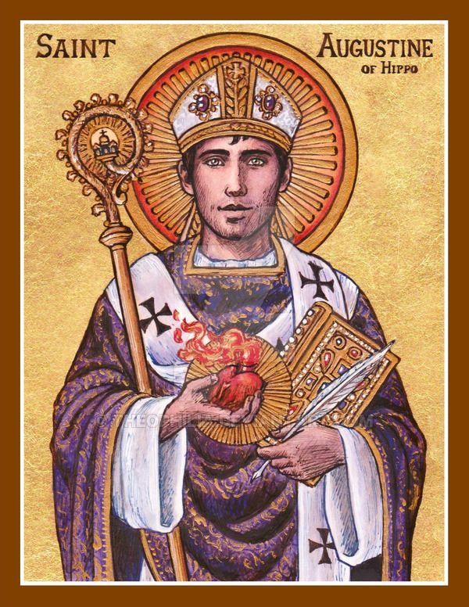
The Augustinian Order, officially the Order of Saint Augustine (OSA), is a mendicant religious order in the Catholic Church founded in 1244.
It's based on the Rule of St. Augustine, written by Augustine of Hippo in the 5th century. The order emphasises community, friendship, and service to God and all people.
Mendicant orders are Roman Catholic religious orders known for their vow of poverty, traveling, and living in urban areas to preach, evangelize, and minister, especially to the less wealthy. Members, called friars, rely on the generosity of the people they serve for their livelihood.

Slide 7
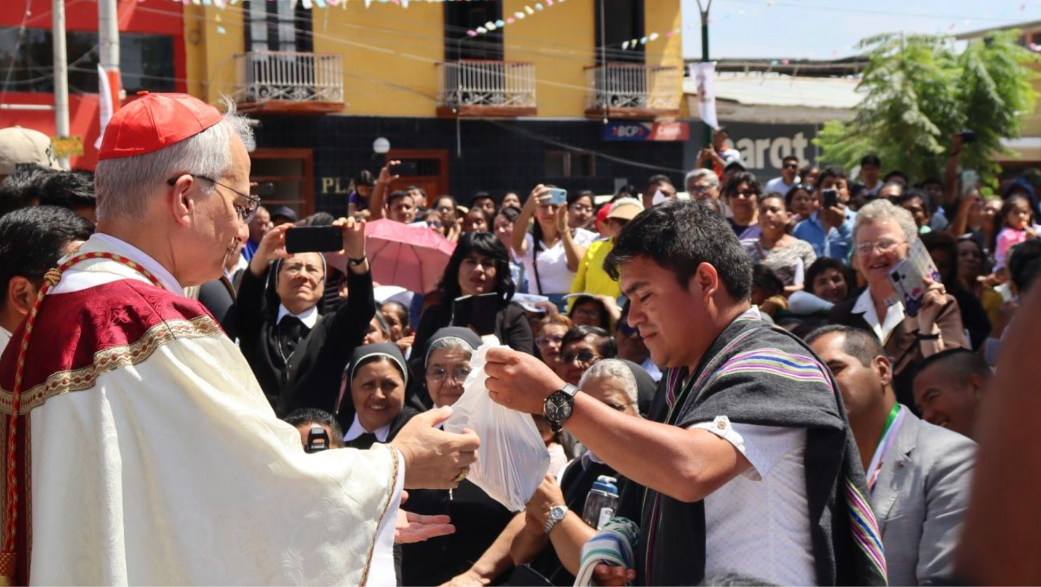
Bishop Robert was bishop of Chiclayo in Peru between 2015 and 2023.

Slide 8
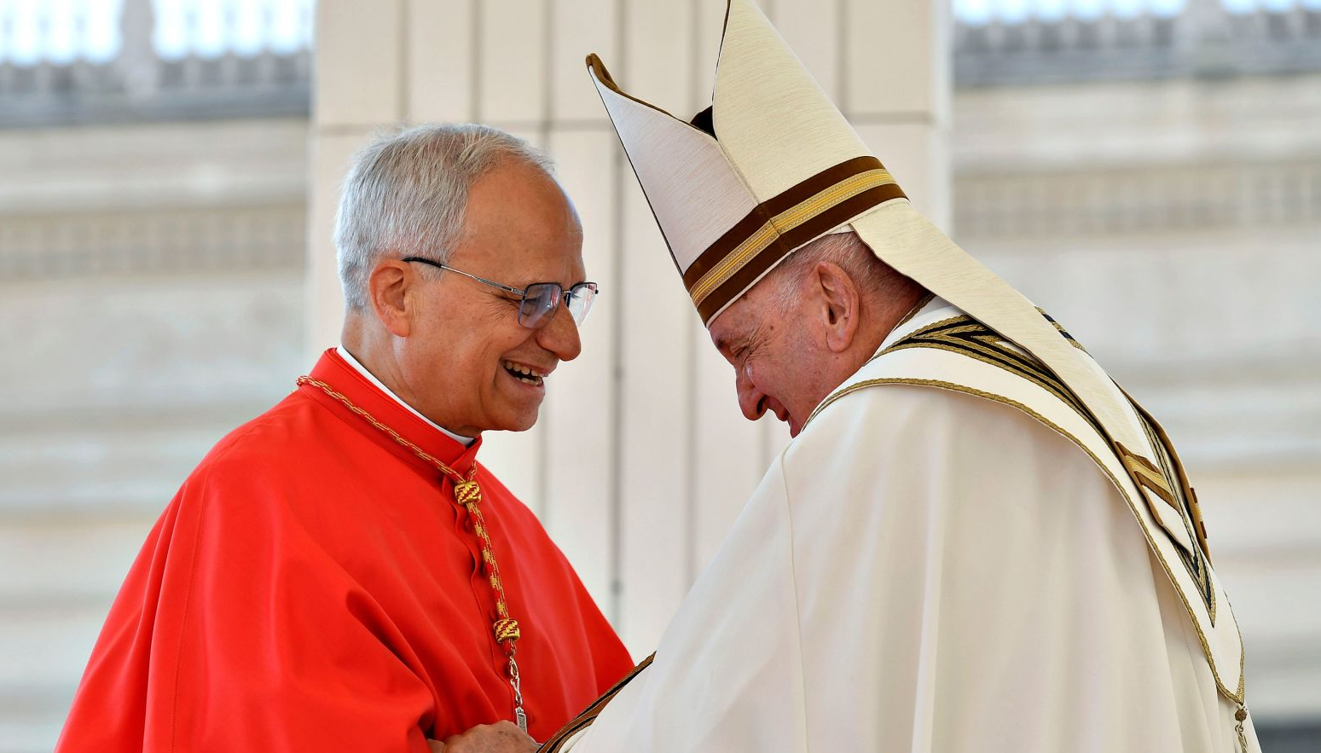
Pope Francis appointed Bishop Robert a cardinal at St. Peter's Square in 2023.

Slide 9
“Habemus Papam” - We have a new Pope!

Slide 10
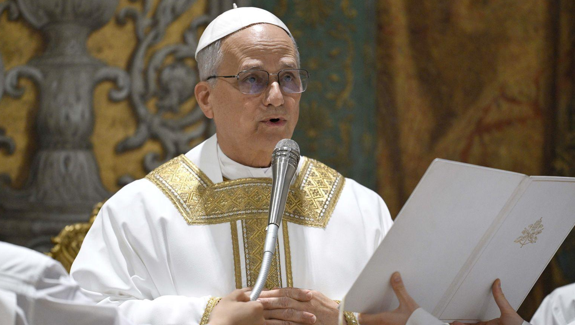
Why did Pope Leo XIV choose the name Leo?

Slide 11
Cardinal Robert Prevost chose the name Leo XIV—and declared his hope to the world for continuing the legacy of Pope Leo XIII.
To choose Leo is to take a stand.
Leo XIII was the first pope to really engage with modernity—and the first to lay the foundation for the Church’s social teaching that stands as a wall against injustice everywhere.
Notes:
To read more look here

Slide 12
Pope Leo XIV: Greetings to Rome and to the world
Peace be with you all!
Dear brothers and sisters, these are the first words spoken by the risen Christ, the Good Shepherd who laid down His life for God’s flock. I would like this greeting of peace to resound in your hearts, in your families, among all people, wherever they may be, in every nation and throughout the world. Peace be with you!

Slide 13
It is the peace of the risen Christ. A peace that is unarmed and disarming, humble and persevering. A peace that comes from God, the God who loves us all, unconditionally.
We can still hear the faint yet ever courageous voice of Pope Francis as he blessed Rome, the Pope who blessed Rome, who gave his blessing to the world, the whole world, on the morning of Easter.

Slide 14
Allow me to extend that same blessing: God loves us, God loves you all, and evil will not prevail! All of us are in God’s hands. So, let us move forward, without fear, together, hand in hand with God and with one another other! We are followers of Christ. Christ goes before us. The world needs his light. Humanity needs him as the bridge that can lead us to God and his love. Help us, one and all, to build bridges through dialogue and encounter, joining together as one people, always at peace. Thank you, Pope Francis!

Slide 15
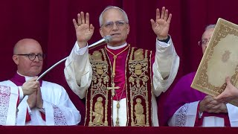

Slide 16
Pope Leo XIV

Slide 17
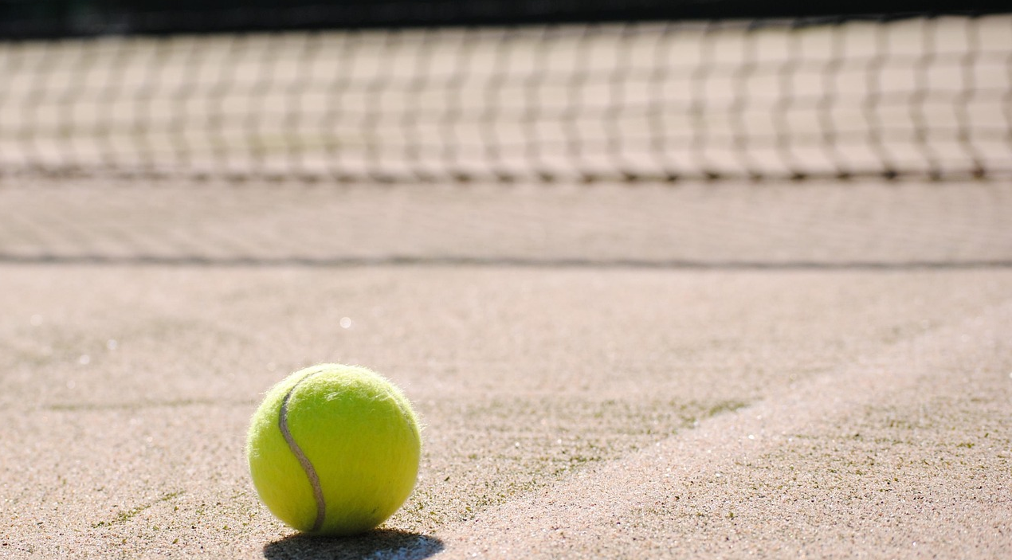
Did you know?
Pope Leo’s favourite sport is tennis!

Slide 18

Pope Leo has dual citizenship in Peru and America.

Slide 19

Pope Leo loves to play Wordle.

Slide 20
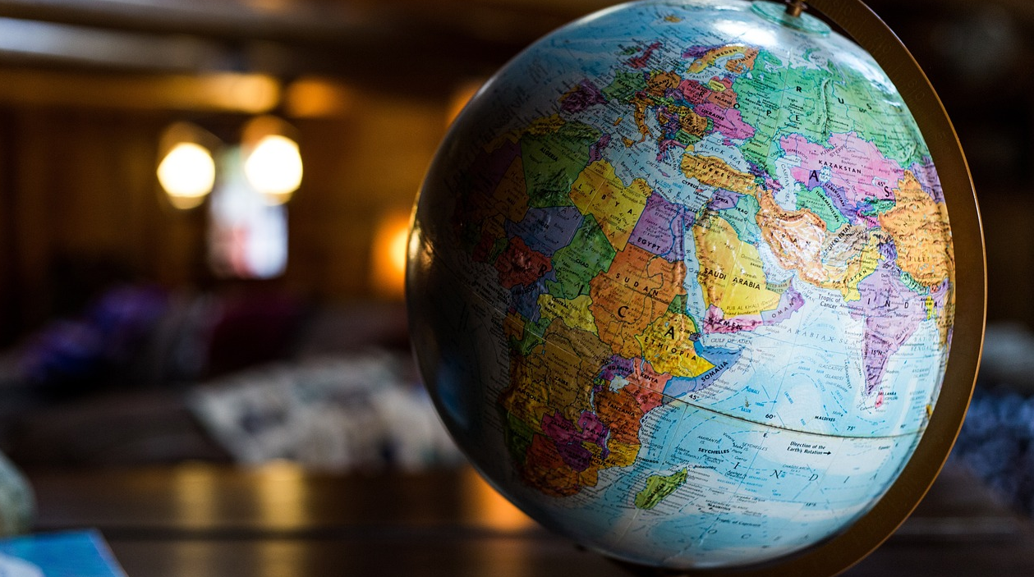
Pope Leo’s native language is English.
He can speak Spanish, Italian, French and Portuguese.
He can read Latin and German, two important theological languages.

Slide 21
“Habemus Papam” - We have a new Pope!

