Slide 1
The easter vigil Symbols

Slide 2
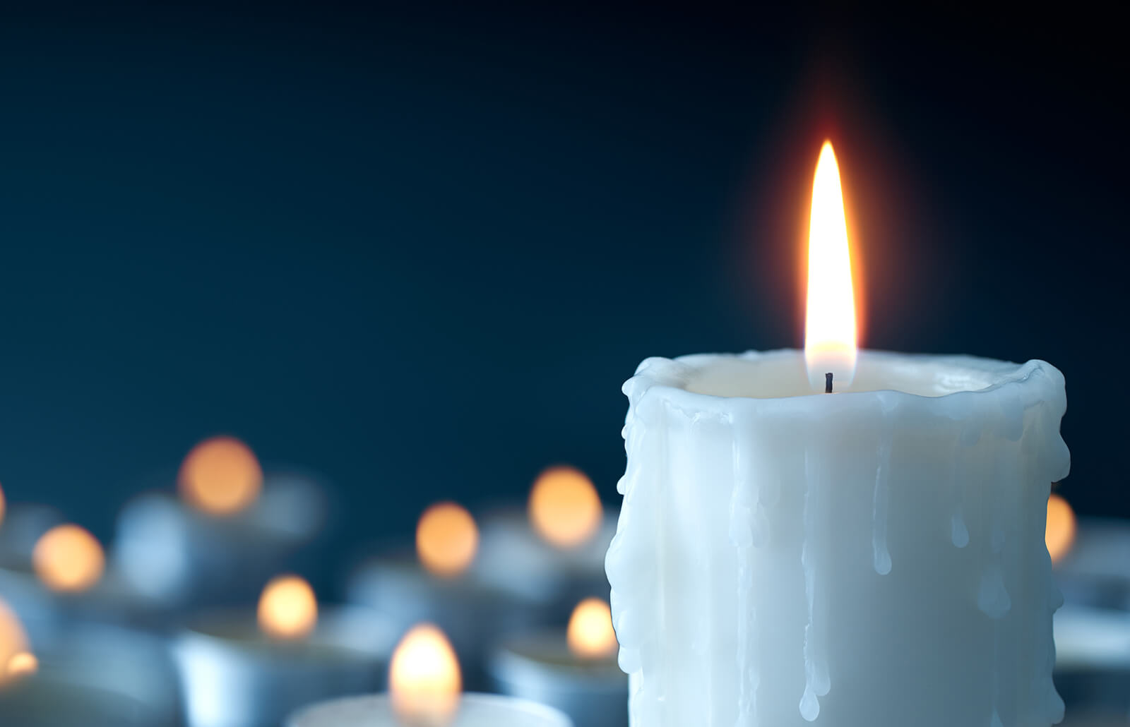
Light/Candle
We use light because it represents ‘’New Fire’ and it also represents the risen of christ. the light is the life the darkness is the death.
As the candle moves along through the church the small candle is lit by the Paschal Candle.

Slide 3
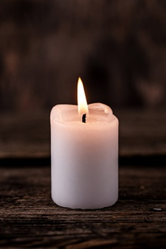
What the Light/Candle Symbolises
The candle symbolizes light of life and individual life. The candle is a symbol of holy radiance of spirit and truth. The candle represents christ and the light.

