Slide 1
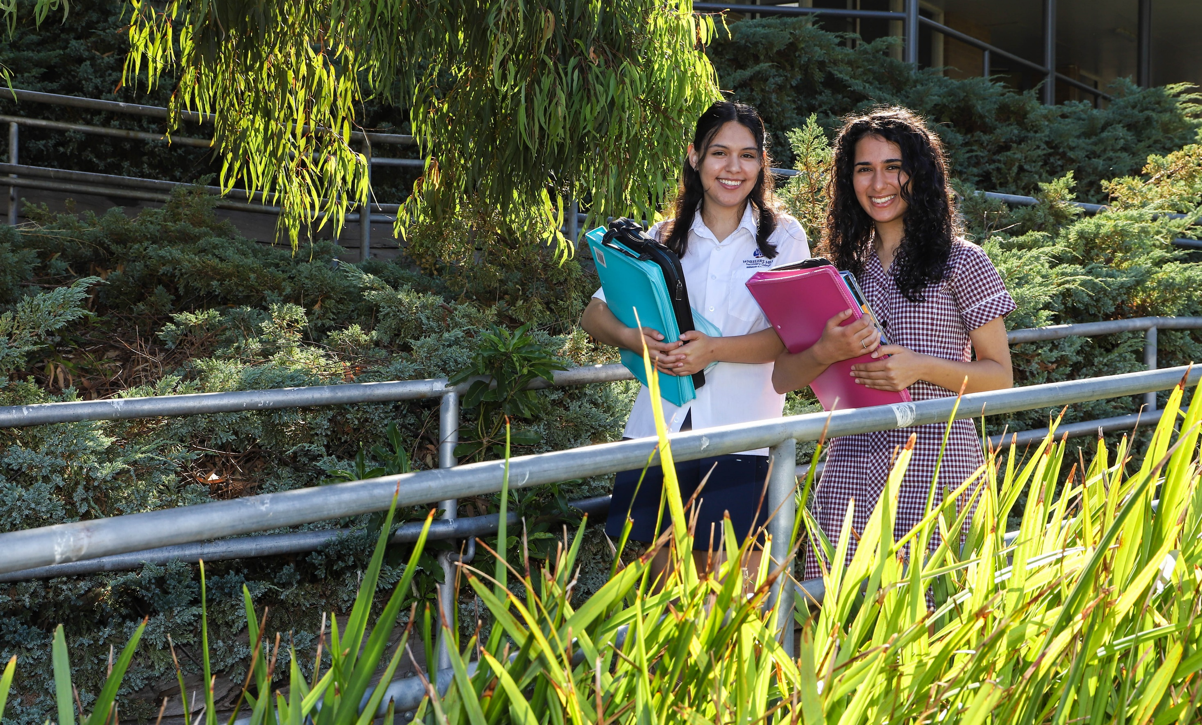
Foundation Mathematics

Slide 2
WHAT IS FOUNDATION MATHEMATICS?
In Units 1 and 2 Foundation Mathematics, students learn about essential mathematical concepts such as,
Basic algebra
Data analysis
Probability
Statistics
Discrete mathematics, and
Measurement
This course helps students develop their problem-solving skills and enables them to apply mathematical techniques in practical situations. By fostering critical thinking, Foundation Mathematics empowers students to use mathematics effectively in real-world contexts.

Slide 3
PRIOR KNOWLEDGE AND SKILLS
Students may choose to undertake Foundation Mathematics in Year 11.
It may be taken as part of their Vocational Major.
It may be taken as part of their VCE subject selections.
If a student chooses to take this subject, then this is the ONLY mathematics subject that they are completing.
Year 10 students may undertake this subject as an alternative to Year 10 General Mathematics. A student needs to be recommended into this pathway by their Year 9 teacher.

Slide 4
UNIT 1 & 2: ASSESSMENT
All assessments at Units 1 and 2 are school-based.
Demonstration of outcomes are based on the student's performance on a selection of the following assessment tasks:
• Assignments
• Tests
• Solutions to sets of worked questions
• Summary notes or review notes.

Slide 5
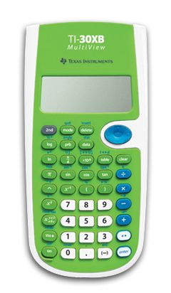
a+b=c
Foundation mathematics DOES NOT require a CAS calculator, unlike all of the other mathematics subjects.
As the focus of this subject is practical mathematics for everyday use students use a scientific calculator.

Slide 6
LEADS TO…
This subject can contribute to either your VCE study or Vocational major.
Foundation Mathematics could lead to:
TAFE
Apprenticeship
University for example Bachelor of Arts
It will also provide useful skills to any student entering the workforce immediately after secondary school.

Slide 7
FURTHER INFO…
You can find more information on the study design.
Click here to visit the Foundation Mathematics page on the VCAA website.

Slide 8
CONTACT US…
Senior School Leader/Learning Area Leader (VM): Felicity Graham-Prowse
(felicity.graham-prowse@education.vic.gov.au)
Learning Area Leader (Mathematics): Laura McClure (laura.mcclure@education.vic.gov.au)
Numeracy Specialist: Andrew Steele (andrew.steele@education.vic.gov.au)
School Contact:
Wheelers Hill Secondary College
2-28 Raphael Drive, Wheelers Hill 3150
Phone: (03) 9561 5811
General Office Enquiries: wheelers.hill.sc@education.vic.gov.au

