Slide 1
MGC’s 2024 Musical Production is…..
(drumroll)

Slide 2
The Sound of Music

Slide 3
PERFORMANCE DATES: WEEK 5 TERM 3.
TUESDAY 13th August-FRIDAY 16th August
4 EVENING PERFORMANCES @MGC’s PAC!
7.30pm
CAST 1: TUESDAY 13th August AND THURSDAY 15th AUGUST
CAST 2: WEDNESDAY 14TH AUGUST AND FRIDAY 16th AUGUST
Chorus, Crew & Orchestra- all 4 evenings

Slide 4
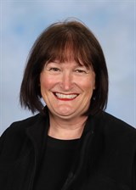
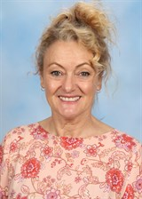
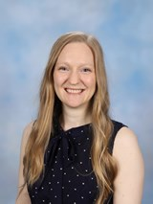
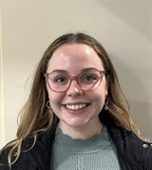
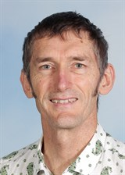
The Team
Ms Corry
Producer &
Co-Director
Ms Mummé
Co-Director
& Technical Director
Mr Hicks-Musical Director
Vocal Coach
Ellyce Calder
Choreographer
Siobhan Judge

Slide 5
Characters in Order of Appearance (singing roles)
Maria Rainer
Sister Berthe
Sister Margaretta
The Mother Abbess
Sister Sophia
Captain Georg von Trapp
Liesl von Trapp, aged 16
Friedrich von Trapp, aged 14
Louisa von Trapp, aged 13
Kurt von Trapp, aged 10
Brigitta von Trapp, aged 9
Marta von Trapp, aged 7
Gretl von Trapp, youngest
Rolf Gruber, 17
Baroness Elsa Schraeder*
Max Detweiler*

Slide 6
Non Singing Roles
Franz, the Butler
Frau Schmidt, the housekeeper
Herr Zeller (Nazi)
Baron Elberfeld
Admiral von Schreiber
Priest
Festival Acts

Slide 7
TERM 1 TIMELINE OVERVIEW (Only a 9 week term!)
LEARN AUDITION SONG & DANCE ROUTINE
BEGIN AUDITIONS
CALLBACKS
CASTING TO BE COMPLETED AND ANNOUNCED BEFORE HOLIDAYS!

Slide 8
Term 2 REHEARSALS
THURSDAYS AFTERSCHOOL-3.30-4.30PM
MONDAYS AFTERSCHOOL-3.30-4.30
LUNCHTIMES FOR Soloists AS REQUIRED & Specialist Dancers (Tuesdays)
TERM 3= BOTH MONDAY & THURSDAY AFTERCHOOL FOR RUN THROUGHS
CAST & Chorus
Leads

Slide 9
TERM 3 PUTTING IT ALL TOGETHER
WEEK 1- REVISION
WEEK 2- RUN THROUGH OF ACT 1
WEEK 3- RUNTHROUGH OF ACT 2
WEEK 4- TECHNICAL REHEARSAL
WEEK 5
PRODUCTION WEEK!!

Slide 10
Orchestra
The Orchestra will rehearse on Wednesdays before school, led by Mr Hicks.

Slide 11
Student Choreographers
We have a strong tradition of student choreographers at MGC.
Please express your interest and experience on your application form.

Slide 12
Crew This year will be our Year 10 Event Management students and Arts Captains
BACKSTAGE CREW
PUBLICITY/LOGO
SET/PROP DESIGN & CONSTRUCTION
HAIR/MAKEUP
COSTUME CONSTRUCTION
PHOTOGRAPHY/VIDEO
FRONT OF HOUSE-USHERS, PROGRAM SELLERS

Slide 13
FAQ
Does a Year 7 have as much chance as a Year 12 to get a main part?
Definitely!
Do we work with a boys’ school to do the boy parts?
No. We put our best actresses in these roles!
Do I have to sing solo?
Only for your first audition
Can Year 12’s be involved?
Of course, with parent permission…
Our MGC Dux’ have also had a lead role in Musical Productions over the years.

Slide 14
What Can I Do to Prepare?
Watch the film “The Sound of Music” or any performances of the stage musical on You Tube
Attend the learn the audition songs workshops afterschool
Submit your expression of interest application form to the box outside the Performing Arts staffroom in the new PAC.
Clear your schedule so you can attend Mondays and/or Thursdays afterschool when required

Slide 15
Remember….
There is no such thing as a small role, only small actors!
The chorus is just as much fun, without the stress of a main role!
You have to start off small and show your commitment.
Musicals are only every 2 years- don’t miss out!
Looks good on your resume for Leadership positions!
(essential for potential Arts Captains to be involved)

Slide 16
Expression of Interest (distribute forms)
Check the performance and rehearsal dates and times with your family before committing.
1
If no clashes, complete the application form and return to the collection box outside the Performing Arts Staffroom in the new PAC.
2
Please DO NOT email Ms Corry your form.
3

Slide 17
Non singing students may now leave
If you know you want to be in the orchestra, crew or a non singing part, you can now leave as we outline the process of the singing auditions…

Slide 18
Term 1 AUDITIONS Thursdays Afterschool
You will all be required to sing an audition song (by yourself) to Ms Corry or Ms Calder only.
In Musicals you need to be prepared to sing, dance and act- be a triple threat!
All students who audition will get in!!!!!!!!!!!!!!!!!!!!!!!!!!!!!!
Call backs are for lead roles only

Slide 19
General Audition Song and/or Von Trapp Children (except Leisl)
Do Ray Mi

Slide 20
LEAD FEMALE ROLES and their audition song
Maria Rainer- The Hills are Alive
Lead Nuns- How Do You Solve A Problem Like Maria?
Leisl- 16 Going on 17
The Mother Abbess- Climb Every Mountain
Baroness-How Can Love Survive?

Slide 21
LEAD “MALE” ROLES and their audition song
Captain von Trapp- Edelweiss
Rolf Gruber- 16 Going on 17
Max Detweiler- No Way to Stop it

Slide 22
Week 2 Information Meeting and LEARN AUDITION SONG/S
Week 2
Monday Lunchtime:
Information Meeting PAC
Thursday afterschool: Learn Audition Songs
Years 8-11

Slide 23
Weeks 2 & 3 LEARN AUDITION SONG/S
Monday afterschool
Week 3
Year 12 & Year 7 Maris and Melba students Learn audition songs
Thursday afterschool:
Week 2
Years 8-11
Week 3
Year 7 Chisholm and Lyons students learn audition songs continued

Slide 24
Week 4 AUDITIONS BEGIN
Week 4
Monday Afterschool
Year 10
Thursday afterschool:
VCE’s

Slide 25
Week 5 AUDITIONS continued
Week 5
Monday afterschool: Year 8’s
Thursday afterschool:Year 9’s

Slide 26
Week 6 AUDITIONS continued
Week 6
Monday afterschool: Year 7’s A-K
Thursday afterschool:
Year 7’s L-Z

Slide 27
WEEK 7 CALLBACKS # 1 Thursday 14th March
(Monday is a public holiday)

Slide 28
WEEK 8 CALLBACKS # 2
Monday afterschool-
Callbacks
Thursday afterschool
Callbacks cont

Slide 29
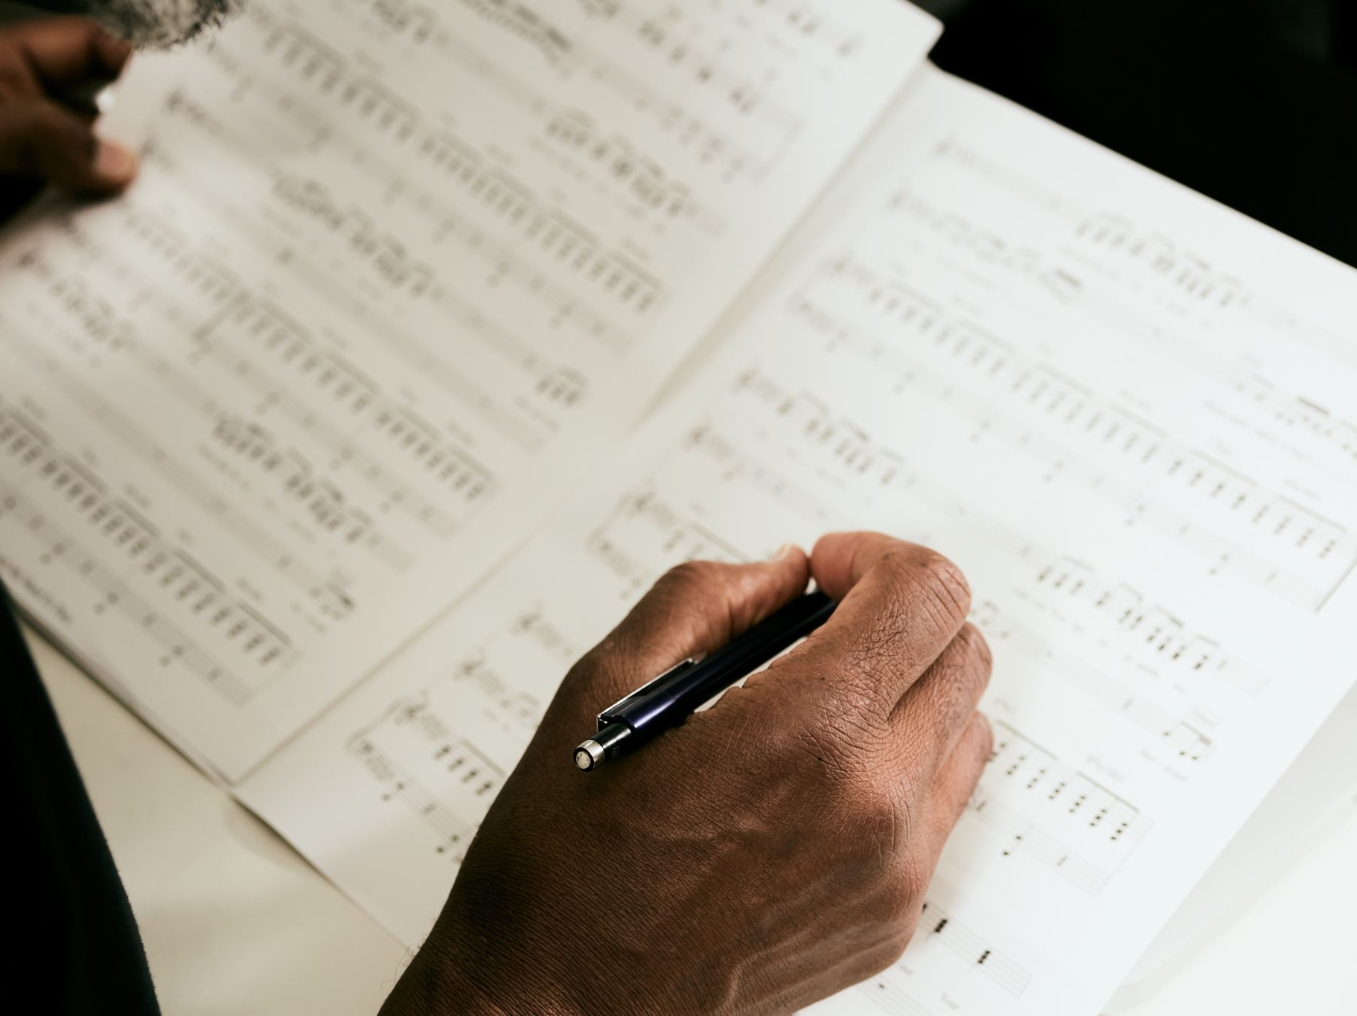
WEEK 9 CASTING ANNOUNCED
Announcement of Cast/s
Cast Meet and Greet and collection of scripts

Slide 30
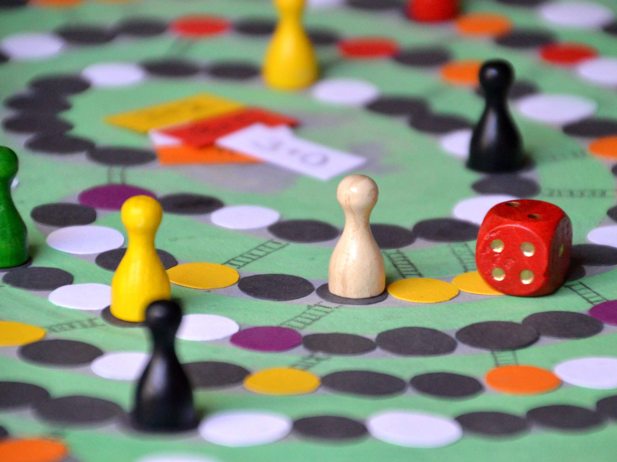
CHOOKAS! ☺

