Slide 1
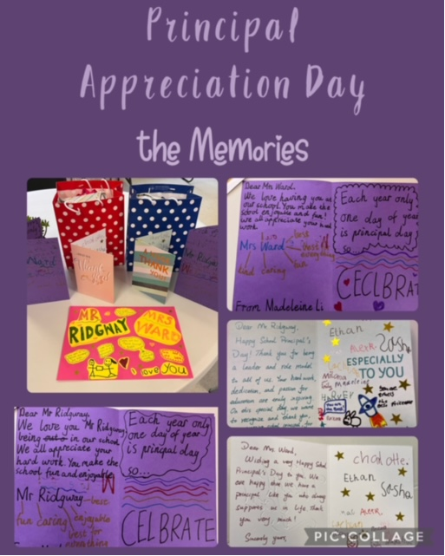
Cheltenham East Team Kids
Dear Parents and Guardians,
We have some exciting updates and upcoming events to share with you this week.!
Principal Appreciation Day A big thank you to all the children who made Principal Appreciation Day an enormous success! Your heartwarming Thank You cards, thoughtful gifts, and love sent to our principals were truly heartening. Not only did this day bring smiles to their faces, but it also taught our children the value of appreciation and gratitude
Keep Australia Beautiful Week This week, we are participating in "Keep Australia Beautiful Week." Our little ones will transform into busy bees, actively contributing to keeping the environment clean and green. Through various activities and initiatives, we aim to instill a sense of responsibility towards our surroundings.
International Day of the World's Indigenous People On this special day, our children will celebrate the rich cultural diversity and heritage of the world's indigenous peoples. We have prepared engaging activities that will help our young learners appreciate and respect the different cultures and traditions that exist around the globe.
World Lion Day For all the animal lovers out there, get ready to roar on World Lion Day! We will delve into the wild world of lions and discover some fun and fascinating facts about these majestic creatures. Our children will learn about the importance of wildlife conservation and why it's vital to protect these magnificent animals and their habitats.
If you have any questions or suggestions, please don't hesitate to reach out to us.
Warmest regards,
Eric
5
Cooking Club
Origami Club
Game Club
Cooking Club
Origami Club
Monday 07th - Friday 11th August
Keep Australia Beautiful Week
Monday 07th August
International Day of the World's Indigenous People
Thursday 10th August
World Lion Day
0432 299 468
CheltenhamEastPS@teamholiday.com.au
1300 035 000
info@teamkids.com.au

