Slide 1
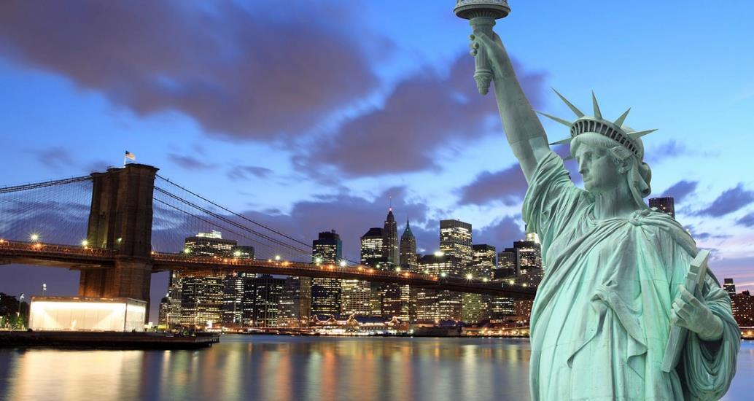
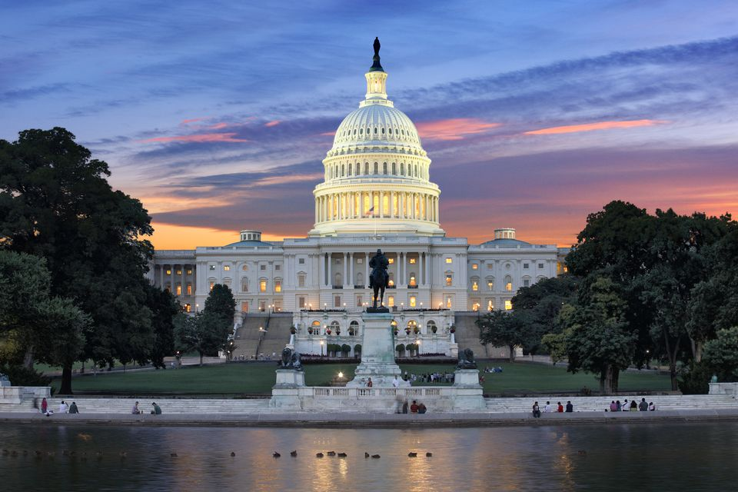
Art and Design USA Trip
Northcote High School
31 March 2019

Slide 2
About Educating adventures
Specialise in school travel.
Focus on safety, education and fun.
Sending schools to the USA for over 10 years.
Send over 20 schools to the USA every year.
4th time NHS have run this trip.

Slide 3
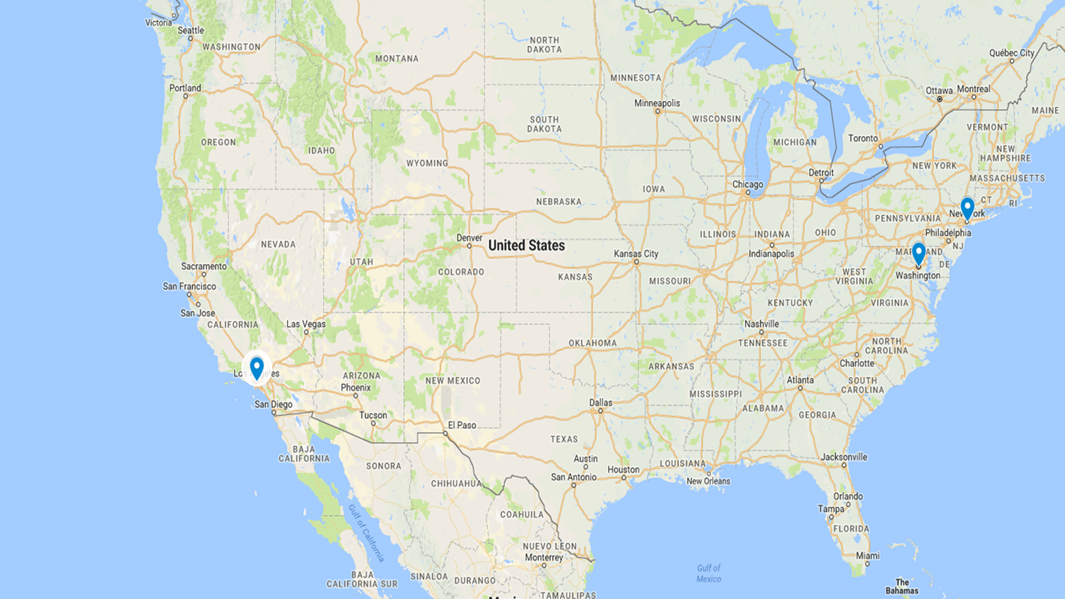
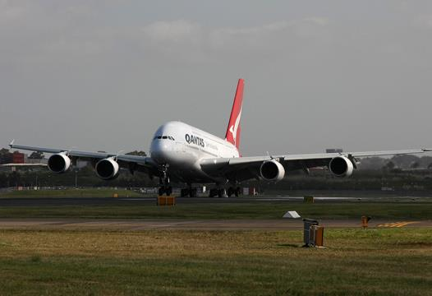
Day 1 Melbourne to New York
Depart from Melbourne Airport and fly to New York.
On you will be meet and transferred to your accommodation Wellington Hotel (3 blocks from Central Park)
Guide to talk to you about NY and give you your Metro Tickets.

Slide 4
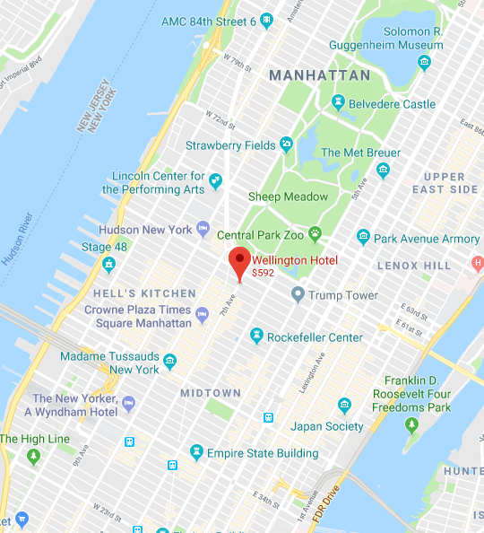

Day 2 New York
Breakfast at your hotel
Rooms triples – 2 double beds and one sofa bed/rollway
Travel on the subway
Cooper Hewitt Design Museum – Workshop and Guided Tour
Guided Tour of the Met
Basketball Game –subject to availability
Notes:
The Cooper Hewittt Design Museum is the only museum in the US dedicated to both historical and contemporary design. It’s collections and exhibitions explore about 240 years of design and creativity. Take part in a Design Field Trip which enriches your students’ museum experience by giving them the opportunity to review concepts that will be explored during the Design Field Trip. The Design Field Trip is a 90-minute program includes an interactive tour and hands-on workshop. Students will explore 5-6 objects and participate in a design focused workshop.
The Met presents over 5,000 years of art from around the world for everyone to experience and enjoy. The Museum lives in three iconic sites in New York City—The Met Fifth Avenue, The Met Breuer, and The Met Cloisters. Millions of people also take part in The Met experience online.
Since it was founded in 1870, The Met has always aspired to be more than a treasury of rare and beautiful objects. Every day, art comes alive in the Museum's galleries and through its exhibitions and events, revealing both new ideas and unexpected connections across time and across cultures.

Slide 5
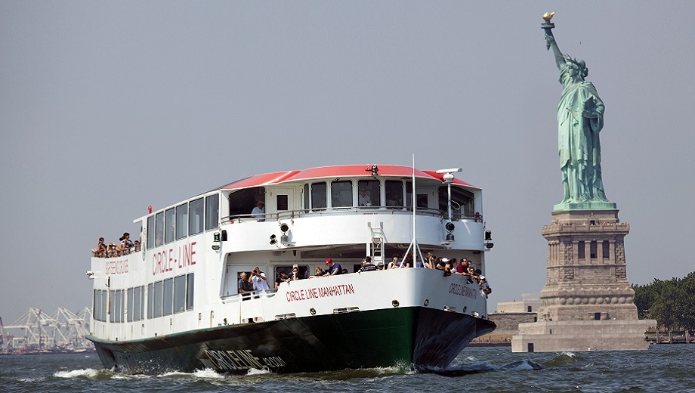
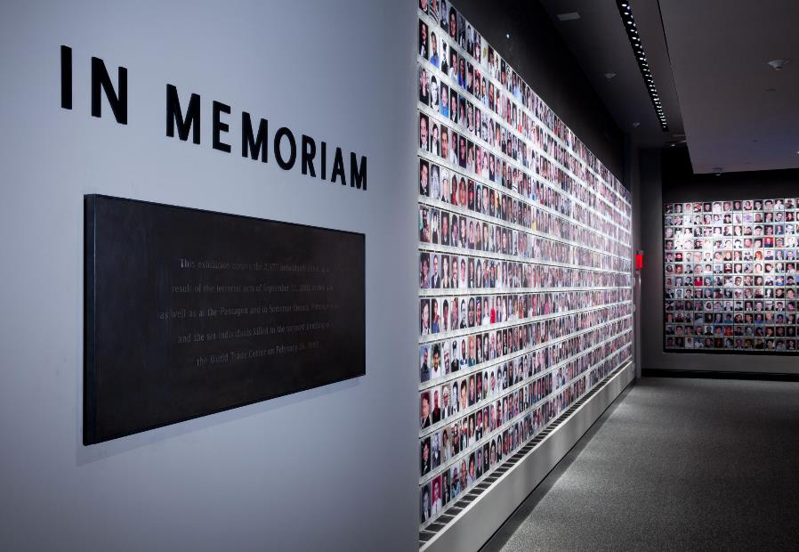
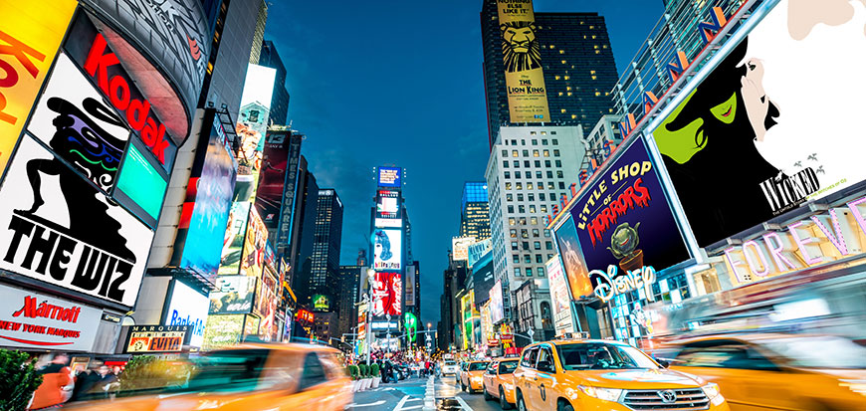
Day 3 New York
Notes:
Manhattan Island tour, and our Best of NYC cruise is the only way to see all five boroughs – Brooklyn, Queens, Manhattan, Staten Island and the Bronx – in one trip. Plus, you’ll see all three NYC rivers, all the major bridges and the rest of the city’s best sights, including the full Manhattan skyline, the growing Brooklyn waterfront, the legendary Yankee Stadium, the hip Harlem Heights waterfront, the lush greenery of upper Manhattan and the stately George Washington Bridge
The 9/11 Memorial Museum is the principal memorial and museum commemorating the September 11 attacks of 2001 almost 3000 died.
It is also interesting from an architectural point of view with the masterplan being designed by Daniel Liebeskind and the Pavilion by Danish architecture firm SNØHETTA who have won numerous international awards including the Mies van der Rohe European Prize for Architecture, the Aga Kahn Prize and has twice won the World Architecture Award for Best Cultural Building.
Broadway…..

Slide 6
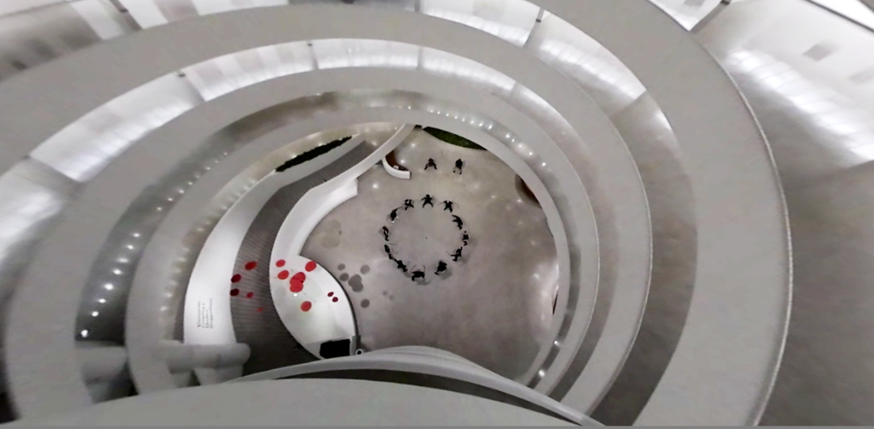
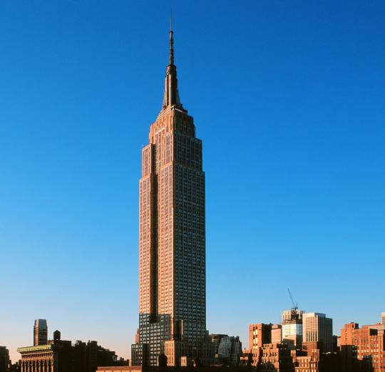
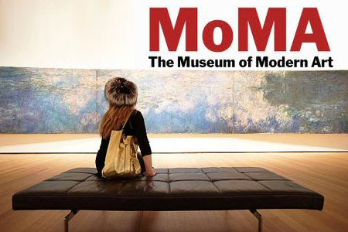
Day 4 New York
Notes:
The Guggenheim is the permanent home of a renowned and continuously expanding collection of Impressionist, Post-Impressionist, early Modern and contemporary art and also features special exhibitions throughout the year.
Designed by Frank Lloyd Wright, the cylindrical museum building, wider at the top than the bottom, was conceived as a "temple of the spirit" and is one of the 20th century's most important architectural landmarks.
Founded in 1929, the Museum of Modern Art in midtown Manhattan was the first museum devoted to the modern era. Today MoMA's rich and varied collection offers a panoramic overview of contemporary art, from the innovative European painting and sculpture of the 1880s to today's film, design and performance art.
Take an evening trip to the top of this New York City landmark which soars more than a quarter of a mile into the atmosphere above the heart of Manhattan. Located on the 86th floor, 1,050 feet (320 meters) above the city's bustling streets, the Observatory offers panoramic views from within a glass enclosed pavilion and from the surrounding open-air promenade

Slide 7
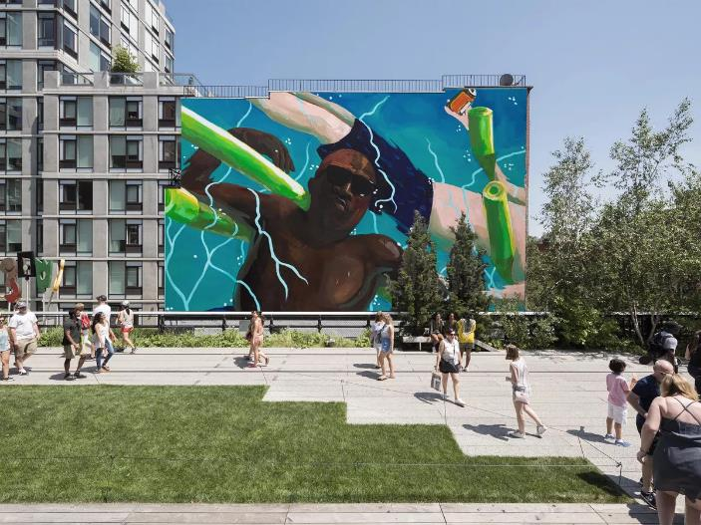
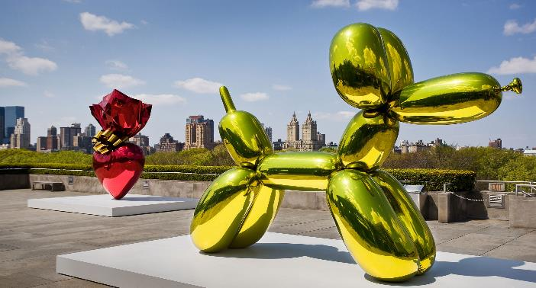
Day 5 New York
Whitney Museum of Modern Art
Guided Tour such as “Artist as a storyteller”
Afternoon free to discover public art.
Sometime to shop
New York changing all the time - Lowline
Notes:
The Whitney focuses on 20th- and 21st-century American art. Its permanent collection comprises more than 21,000 paintings, sculptures, drawings, prints, photographs, films, videos, and artifacts of new media by more than 3,000 artists. It places a particular emphasis on exhibiting the work of living artists for its collection as well as maintaining an extensive permanent collection containing many important pieces from the first half of the last century.

Slide 8
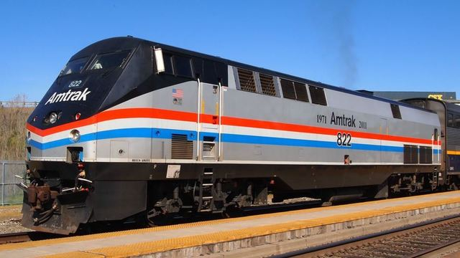
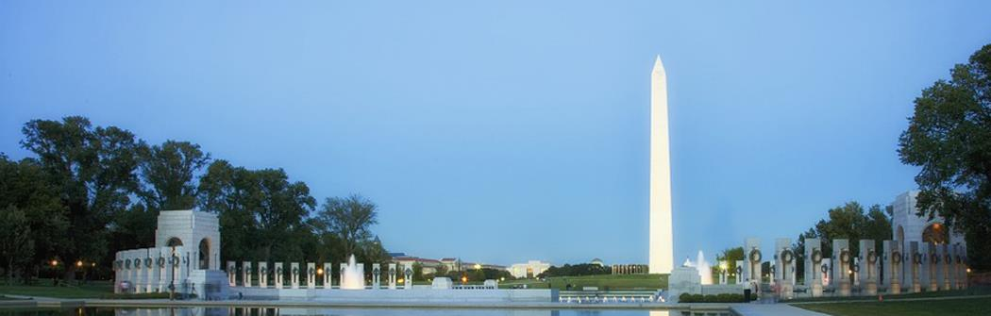
Day 6 New York - Washington
After breakfast transfer to Penn Station
Take the Amtrak train to Washington
On arrival transfer to your accommodation
Bike Nite Tour of Washington Monuments
Accommodation Holiday Inn Rosslyn – In Arlington

Slide 9
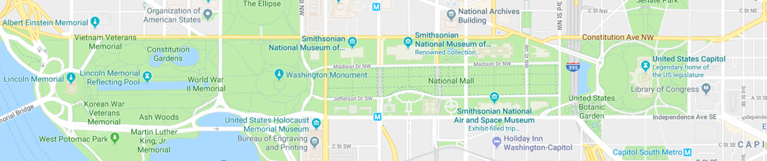
Day 7-9 Washington
Smithsonian Museums
Guided Tour around the Hirschhorn Museum
Tour of the Renwick Gallery Part of the American Art Museum
National Gallery of Art – Renaissance
National Portrait Gallery
Holocaust Museum
Notes:
The Hirshhorn Museum and Sculpture Garden - is an art museum beside the National Mall, in Washington, D.C., the United States
Renwick Gallery – Steps away from the White House.
National Gallery of Art - Explore thousands of the most significant works of art from the Renaissance to the present day. The collection includes European and American masterpieces in every medium. Browse the collection and make connections between the objects you know and newly discovered gems
Smithsonian’s National Portrait Gallery continues to narrate the multi-faceted and ever-changing story of America through the individuals who have shaped its culture Through the visual arts, performing arts, and new media, the Portrait Gallery presents poets and presidents, visionaries and villains, actors and activists whose lives form our national identity.

Slide 10
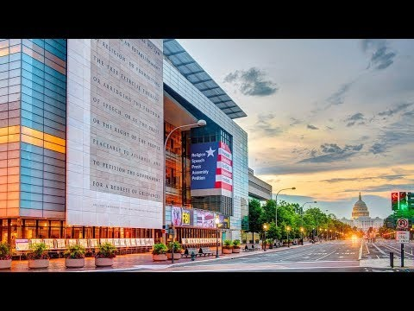
Day 7-8 Washington

Slide 11
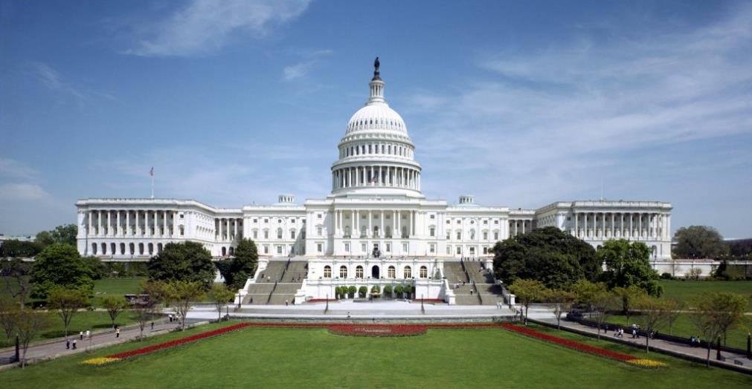
Days 10 Washington – L.A.
Head to the Capital Vistor Centre.
13 minute video
Crypt, The Rotunda, and The National Statutory Hall
Fly to Los Angeles
Check into your hotel

Slide 12
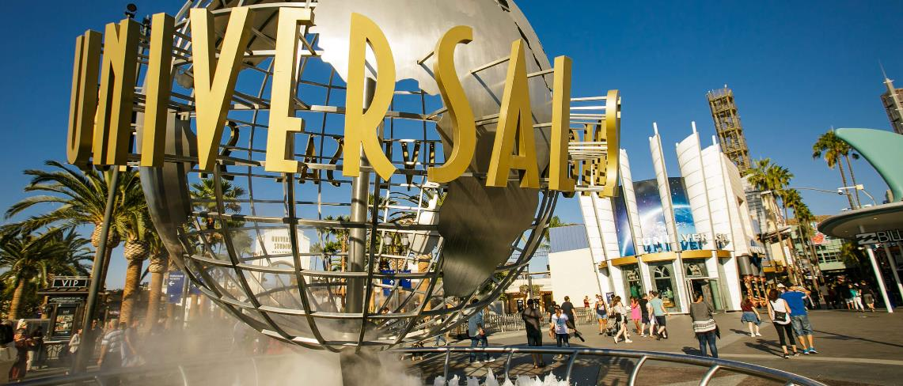
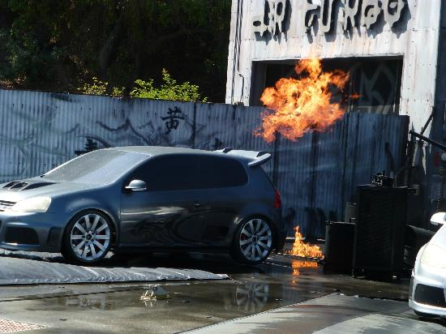
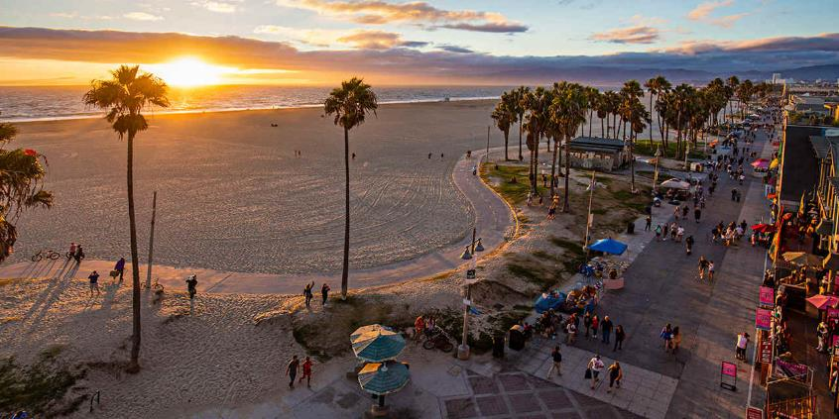
Day 11 Los Angeles and Fly Home
Notes:
Students will experience some of the technical secrets of Hollywood, such as green screen effects, stop motion photography and digital imagery. Working industry professionals take you through the technology behind some of your favorite box office hits!

Slide 13
Day 12-13 Cross the dateline
Takes two days to get home as you fly across the international date line.
Arrive home on day 13 – Remember a present for your parents.

Slide 14
learning outcomes And benefits
Global citizenship
Team Work and Critical Thinking
Make friends for life
Experiential learning

Slide 15
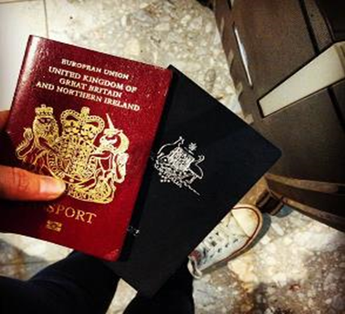
Passport information
Each passenger must have a valid passport
Your passport must not expire within 6 months of the date of return
A photocopy of the details page of each passenger’s passport is required
Australia Passport holders can apply for an ESTA which is approximately $14USD
If you are travelling on anything other than an Australian passport, advise the school immediately.

Slide 16
What is included?
Travel insurance through Department of Education
All flights and relevant taxes
Accommodation
All entrances listed on the itinerary plus workshops and guided tours
Broadway Show
Basketball – subject to availability
All coach transport
Subway tickets
Universal entrance plus workshop
Breakfast and dinners (20 USD)
All tips that we can prepay

Slide 17
What isn’t included?
Lunches - Allow for about $10-15 per lunch
Souvenirs
Snacks and some drinks
Tipping
Spending money – Best to take some USD and a bank travel card
ESTA for the USA – about 14USD

Slide 18
What is the cost?
Cost is $6500 per person based on 24 students and 3 teachers.
Confirm the cost once we know the numbers and can confirm the flights which are subject to availability.
When we take payment of the deposits we hedge the currency to prevent again future fluctuations

Slide 19
What’s Next?
Payment Schedule – NHS to discuss.

Slide 20
  Any questions?

