Slide 1
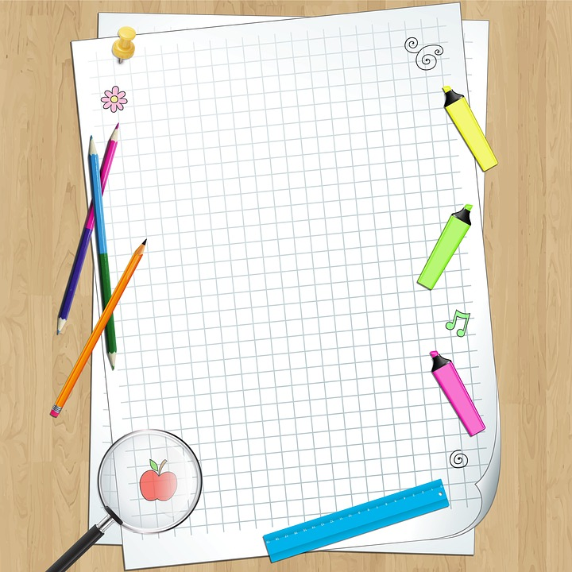
Anderson’s Creek Primary School
3/4 NEWS Term 2, 2022
Welcome back to Term 2! We are all looking forward to a very busy, but exciting term. A very warm welcome to all students and their families.
With a busy (aren’t they all!) term ahead, we wanted to give you a rundown of the teaching and learning that will be happening in all of the 3/4 classrooms this term. As you know, the first day of the term was ANZAC Day. We hope everyone had a wonderful holiday break! Please email us if you need to make a time to see us. However, for those who can, a reminder that we are available anytime from 8:45-9:00 in the morning and 3:30-3:45 in the afternoon, outside our rooms.
Literacy
Key Learning Focus
Reading: Reader’s Workshop includes a teacher explicit focus lesson and sets of mini-lessons that focus on skills and strategies students are expected to use when reading independently. This model develops comprehension skills and fosters a love of reading. It also involves guiding students to choose their own books as well as providing significant amounts of time for them to read independently.
Writing:
In Term 2 our focus in Writing will shift towards Biography and writing. We will look at the structure and features of the genres. Students will present factual information to inform the reader about an influential person. Our students will be learning about the 6 key characteristics that define quality writing. The six traits of writing are: IDEAS, WORD CHOICE
ORGANISATION, SENTENCE FLUENCY, VOICE, CONVENTIONS
PRESENTATION - is also included, and then the technique is
called six + one trait writing.
.
Mathematics
In Maths this term we will be focusing on establishing a solid understanding of all four operations (addition, subtraction, multiplication and division). We will also look at worded problems to explore how mathematics operates in the real world. Measurement and Geometry will also feature prominently this term with students investigating the features and properties of 2D and 3D shapes, solids and the different types of angles.
NAPLAN: NAPLAN is coming up for the Year 3s in Week 3- 4 and we are preparing them as best as we can with some strategies that enable them put their best foot forward during the testing sessions. Please have a discussion with your child’s teacher if you have any concerns in the lead up to NAPLAN.
Speaking and Listening:
Students will continue to use language in social interactions when engaging with tasks required to develop content knowledge and skills

Slide 2
HOMEWORK
Children in years 3 and 4 are encouraged to do five 30 minute sessions of homework over seven days. 20 minutes of this time is to be spent reading and recording what they have read in a reading log. The other 10 minutes is for Maths, Spelling or Information collecting. Keep an eye out for the homework (starting in week 2) and we encourage you to chat to your child about how they will get the tasks done in the required amount of time. This term, students will continue to work through the SMART Spelling program.
Inquiry
This term our Inquiry Unit is: First Fleet.
The following questions will be investigated: Why did the great journeys of exploration occur?, Why did the Europeans settle in Australia?, What were the effects as a result of European exploration to indigenous and European settlement?,
What challenges did European explorers experience? Initially, students will investigate when, why, where and how people explored Australia. Students will choose an explorer to investigate and gather information about them which will then be presented as a Biography Project. Students will research and gather information using a range of resources including books and technology.
Giggle Corner
Q: Why didn't the two 4's want any dinner?
A: Because they already 8!
Student Learning Diaries
We will be sending hard copy SLDs with our 3/4 student reports this term. The 3/4 teachers will be working towards teaching and learning with the students at how we do SLDs via compass in the future.
MultiLit
ACPS will continue to run MultiLit for students from Grade 3 - 6 who are needing a significant boost in reading progress. You can be a reading tutor with just a spare 40 minutes a week. If you are interested please speak to your classroom teacher
Teacher Emails
Linda.zanatta@education.vic.gov.au
Sian.Gladman@education.vic.gov.au
julian.fussell@education.vic.gov.au

