Slide 1
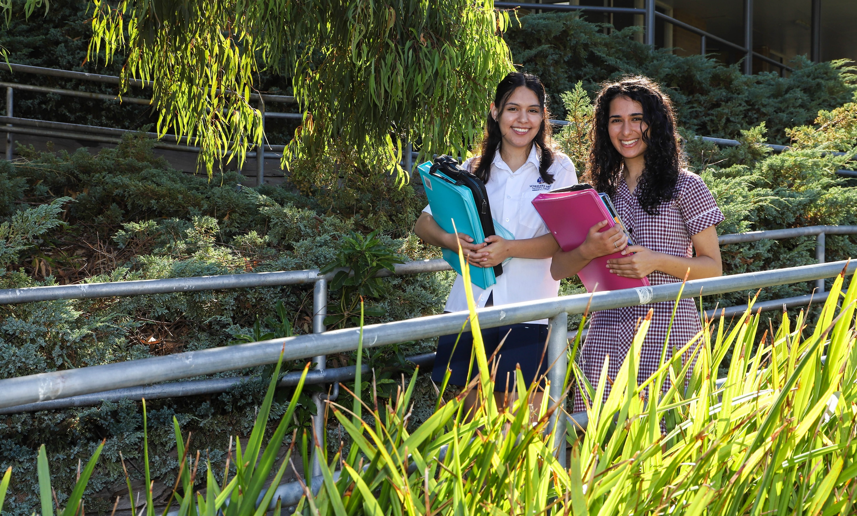
VCE Physics

Slide 2
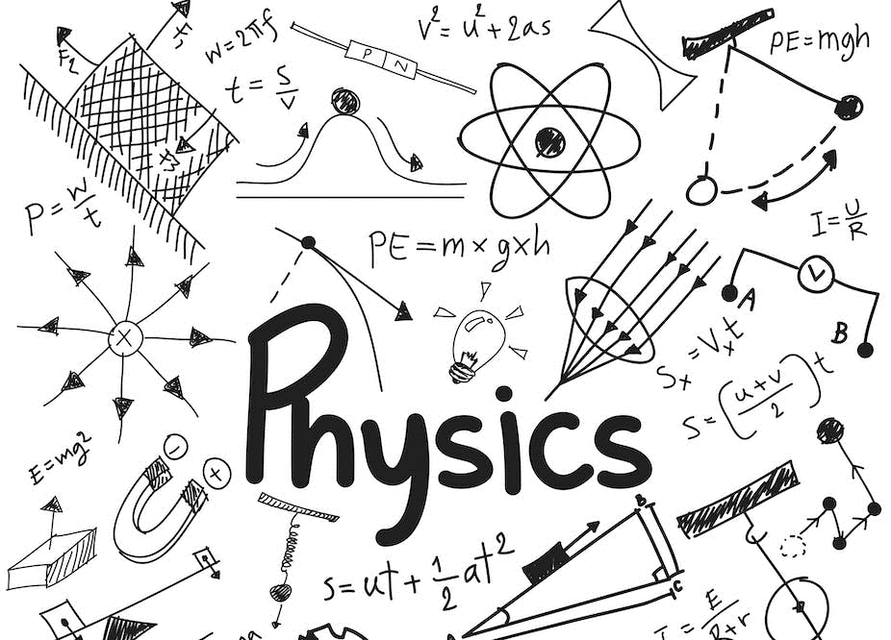
VCE SUBJECT INFO
By definition, Physics is the study of the natural world.
School Office
Gymnasium
Sports grounds outside Gym
Sports grounds

Slide 3
INTRO
* Motion – Things that move and interact with or without contact.
* Special Relativity – What occurs to time and length when things move fast.
* Fields – electric/magnetic and gravitational.
* Electricity – How to make it and get it to move over distances without losing any.
* Waves – Transverse and Longitudinal wave behavior and properties.
* Wave /Particle duality – is light a wave or a particle.
* Heisenberg's uncertainty – finding and measuring photons.
* Measurement uncertainty.

Slide 4
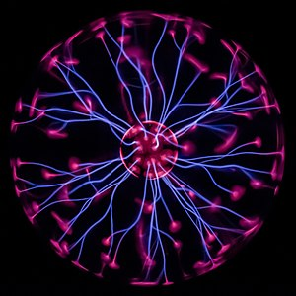
VCE SUBJECT INFO
Unit 1: Physics
Unit 1: How is Energy useful to society
Electromagnetism.
Reflection and Refraction.
Light.
Thermodynamics.
Energy
Climate
Nuclear Physics
Electricity
Gymnasium
School Office
Sports grounds outside Gym
Sports grounds

Slide 5
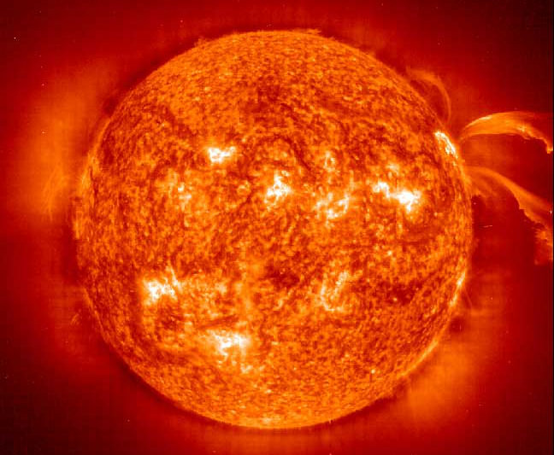
VCE SUBJECT INFO
Unit 2: Physics
Unit 2: How does Physics help us understand the world
Kinematics.
Force and motion.
Conservation of energy.
Scientific investigation.
School Office
Gymnasium
Sports grounds outside Gym
Sports grounds

Slide 6
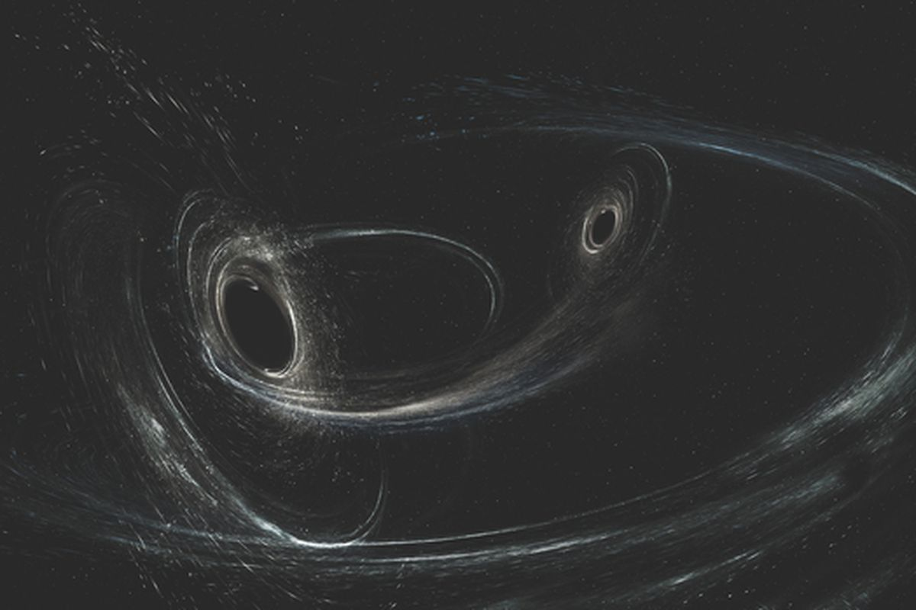
VCE SUBJECT INFO
Unit 3: Physics
Unit 3: Motion and Electricity
Fields - Electrical
- Mechanical
- Gravitational
Electricity Generation and Transmission.
Newtons Laws of motion.
Special Relativity.
School Office
Gymnasium
Sports grounds outside Gym
Sports grounds

Slide 7
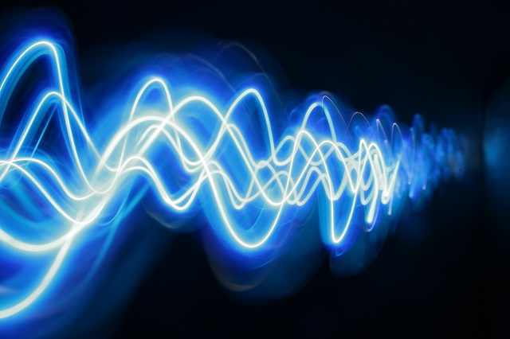
VCE SUBJECT INFO
Unit 4: Physics
Unit 4: Wave Particle Duality
Mechanical Waves
Light as a Wave
Light as a Particle.
Practical Investigation.
School Office
Gymnasium
Sports grounds outside Gym
Sports grounds

Slide 8
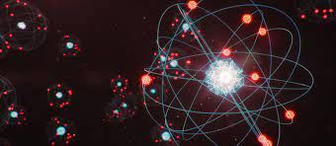
VCE SUBJECT INFO
Unit 1 & 2 Assessment
Unit 1: Energy
Electromagnetism
Thermodynamics.
Nuclear Physics
Electricity
Unit 2: Movement
Motion
Energy
Science Investigation
School Office
Gymnasium
Sports grounds outside Gym
Sports grounds

Slide 9
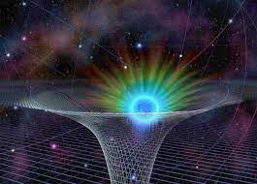
VCE SUBJECT INFO
Unit 3 & 4 Assessment
Unit 3: Movement and motion
Relativity
Fields
Electricity Transmission and Generation
Motion
Unit 4: Wave Particle Duality
Waves
Particles
Practical Investigation
School Office
Gymnasium
Sports grounds outside Gym
Sports grounds

Slide 10
VCE SUBJECT INFO
Prerequisites – Strong background in mathematics and science
Corequisites – Mathematics preferably methods and specialist.
School Office
Gymnasium
Sports grounds outside Gym
Sports grounds

Slide 11
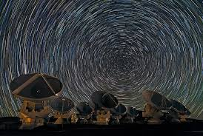
VCE SUBJECT INFO
LEADS TO…….
Further study options related to this subject are:
Engineering.
Aviation.
Mathematics.
Theoretical and Experimental Physics.
Medical (imaging and nuclear medicine).
Astronomy.
Meteorology.
Astrophysics.
Nuclear Physics.
Aerospace Engineering.
School Office
Gymnasium
Sports grounds outside Gym
Sports grounds

Slide 12
VCE SUBJECT INFO
Career pathways associated with this subject are:
Pilot (Civil or Military), F1, Aerospace engineering, research science, research medicine, nuclear physics, electrical engineering, mechanical engineering, civil engineering, actuary, Theoretical Physics, Experimental Physics, Data Logging, Astronaut, x-ray crystallographer, Climate change scientist, meteorologist, Astronomer, Astrophysicist, Mathematician, geothermal engineer, tidal engineer, military constructions, weapons engineer.
School Office
Gymnasium
Sports grounds outside Gym
Sports grounds

