Slide 1
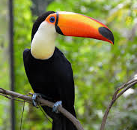
TOCO TOUCANS
By Hazel Kelly

Slide 2
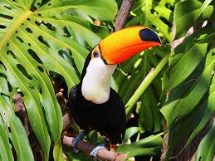
Contents
Meet the Toco Toucan
Where to find them
A toco toucan’s favourite snack
Reproduction
Beware: Dangers
Adaptations

Slide 3
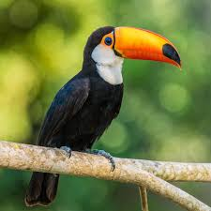
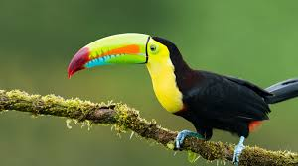
Meet the toco toucan!
Toco Toucans (or Ramphastos toco, pronounced ram-fas-tus toh-coh) are the largest species of toucan and are well known for their vibrant, bright, colourful beak. They are certainly birds, but often hop from tree to tree, rather than flying. They are very social birds and love to have company!

Slide 4
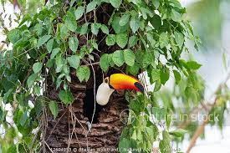
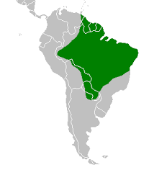
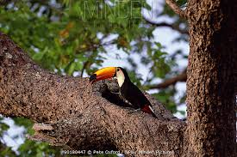
Where to find them!
Toco toucans live in central and south American rainforests and trees. They prefer a warm, tropical or humid climate. Toco Toucans nest inside holes in trees made other birds.

Slide 5
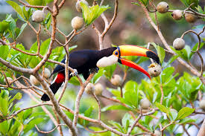
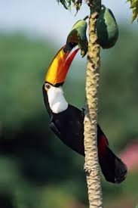
A TOCO TOUCAN’S favourite snack!
Toco toucans are fruit lovers, and mostly eat fruit, although they will occasionally snack on insects, frogs, lizards, berries or other bird’s eggs! They reach fruit by using their long beaks so they don’t have to move their body too much. They also eat by using a long flat tongue, the same length as the beak to catch frogs, lizards or insects and then throw their head back and swallow.
Yummmm!!!

Slide 6

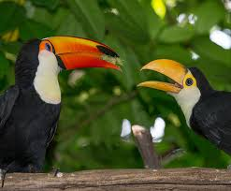
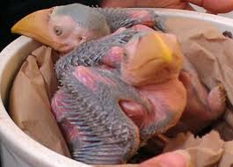
reproduction
Toco toucans lay eggs more than once a year, with up to 4 eggs in a nest. They keep the eggs warm and then they will hatch after 16 days. Both parents care for their young and will bring them food for the first few weeks of their lives. At 6-8 weeks they are taught to find their own food and fly. When born the toucans have no feathers but by two weeks old, they will be covered in small bumps. Each bump will grow into one feather and by 5 weeks old all their feathers will have grown. Toucans can then live for up to 20 years.

Slide 7
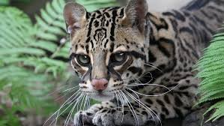

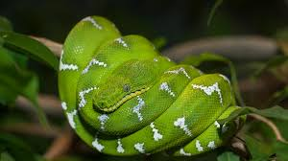
BEWARE: Dangers
The predators of a toco toucan are large birds, snakes (like boa constrictors), ocelots, jaguars and margays. They are also threatened by the habitat loss of South American rainforests. Luckily, toco toucans are not endangered, with an estimated 10,000 in the wild. Phew!

Slide 8
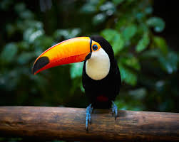
Adaptions
One of the adaptations of a toco toucan is their big beak. The toco toucan has the largest beak to body ratio of any bird in the world. Their beak was adapted to be able to reach fruit high in the trees easily. Toco toucans aren’t great fliers, but to make up for that their toes and legs have adapted to be very strong. They have four toes on each foot, the first and fourth toes face backwards. This makes it easier for them to cling on to branches as their toes wrap around both sides. Their beak and feathers were adapted to blend into the canopy and surroundings and their beak is often mistaken for a flower or piece of fruit. Their feathers also blend in with the dark tree holes they live in.

Slide 9
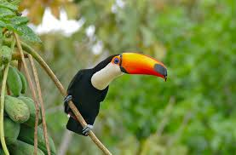
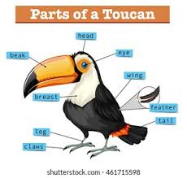
Description and Diagram
Toco toucans have large, long, colourful beak with a black tip, long, flat tongue, blue skin around its eyes, a white throat/chest and black feathers.

Slide 10
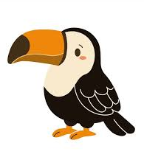
Thank you for listening!
I hope you have enjoyed learning all about toco toucans!

