Slide 1
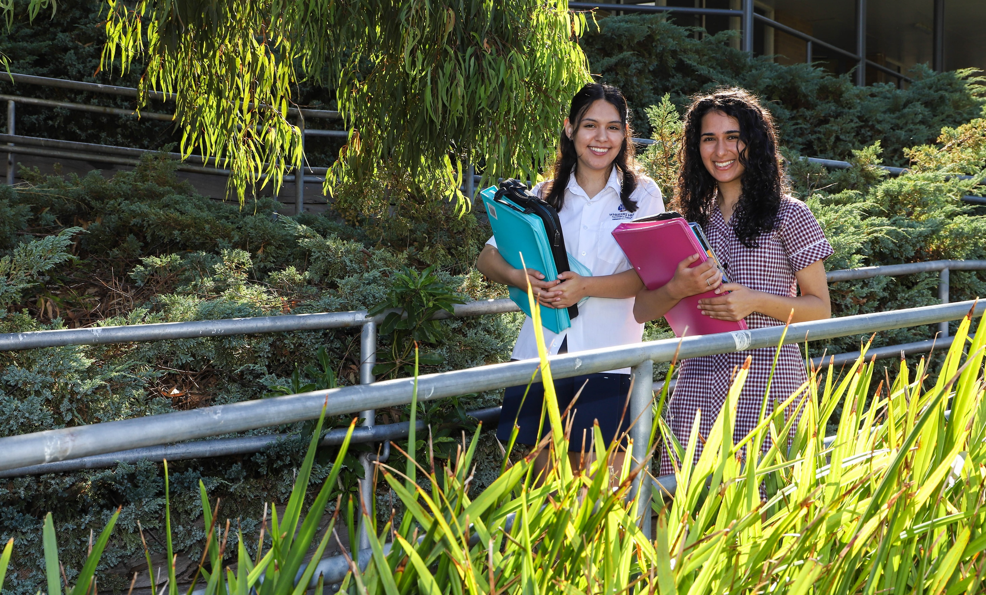
Visual Communication Design
Wheelers Hill Secondary College
Visual Communication Design
Visual Communication Design

Slide 2
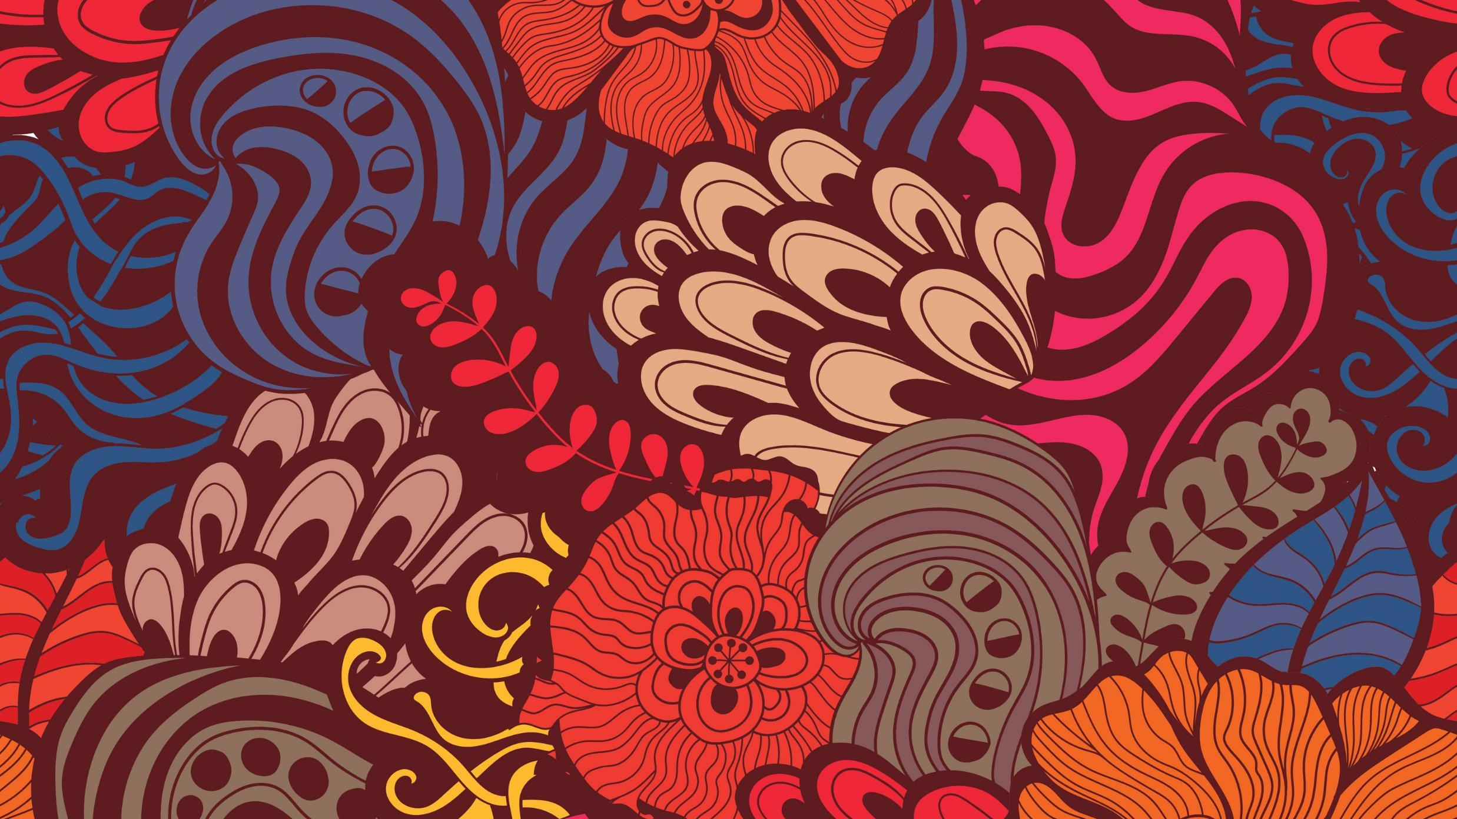
Visual Communication Design
Wheelers Hill Secondary College
Visual Communication Design 2024 -2028
2024 - 2028

Slide 3
What is Visual Communication Design
Wheelers Hill Secondary College
Visual Communication Design 2024 -2028
The 3 different forms of Visual Communication
Communications Field
In our study we sort them into three different categories.
They are known as fields of design. Each design field has a set of distinguishing characteristics.
These characteristics that distinguish between each field, refer to the ways designers work, the conventions they follow and the kinds of designs they produce.
Industrial Field
Environmental Field

Slide 4
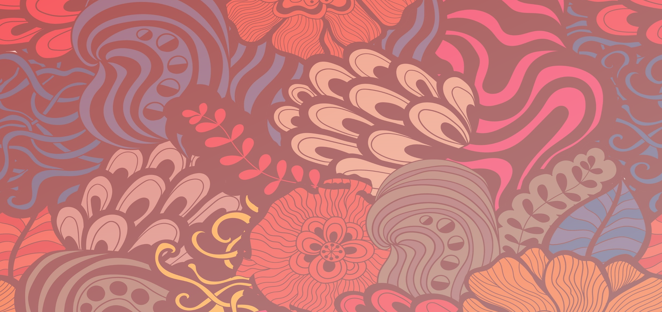
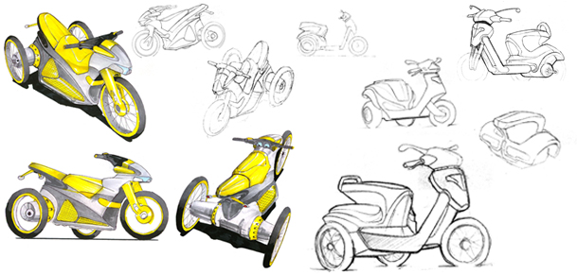
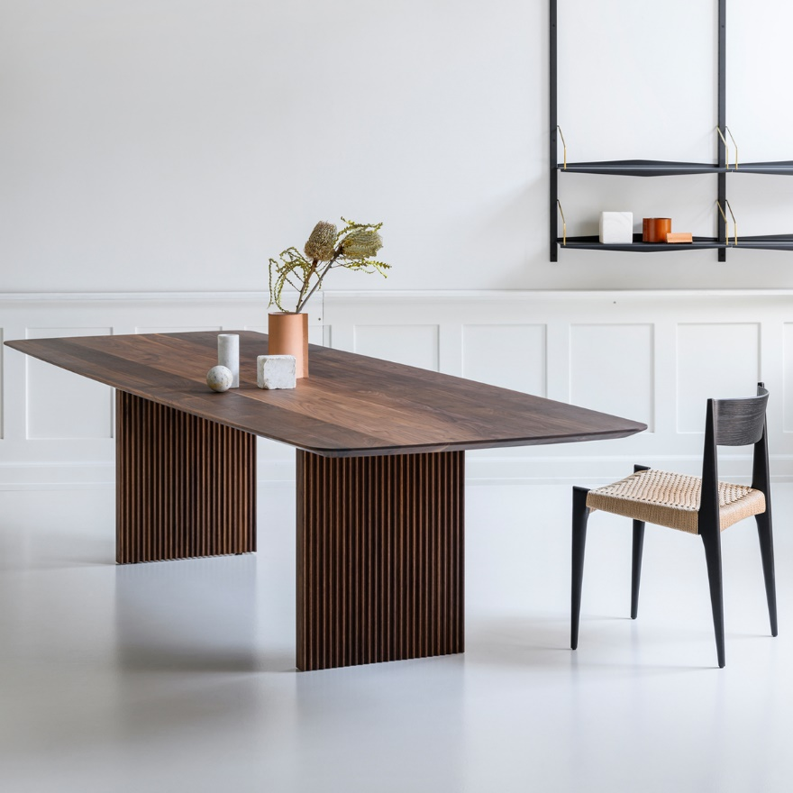
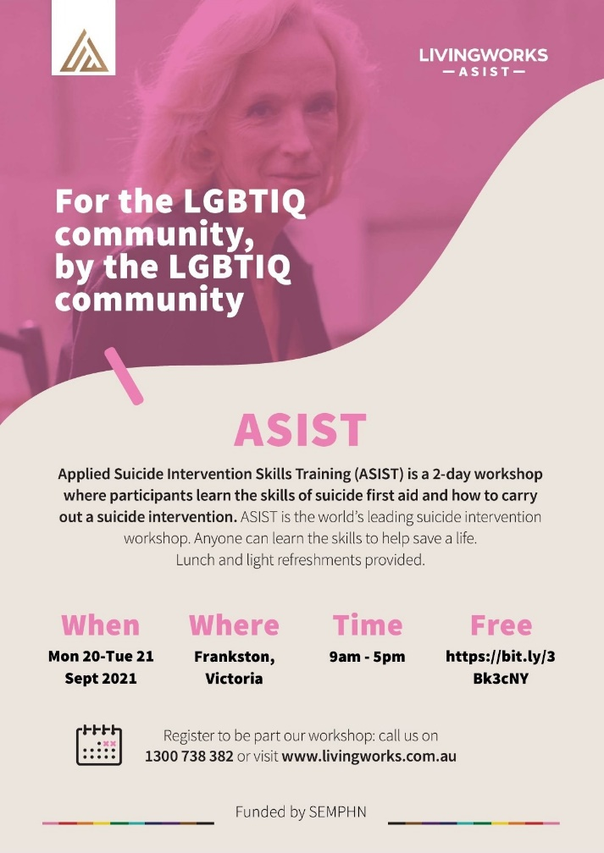
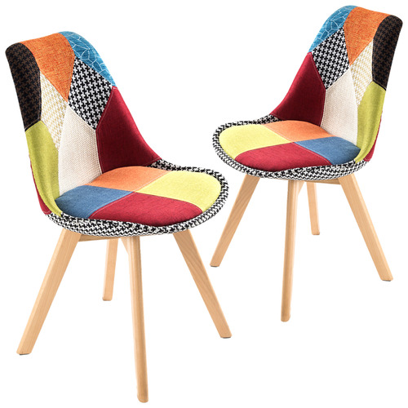
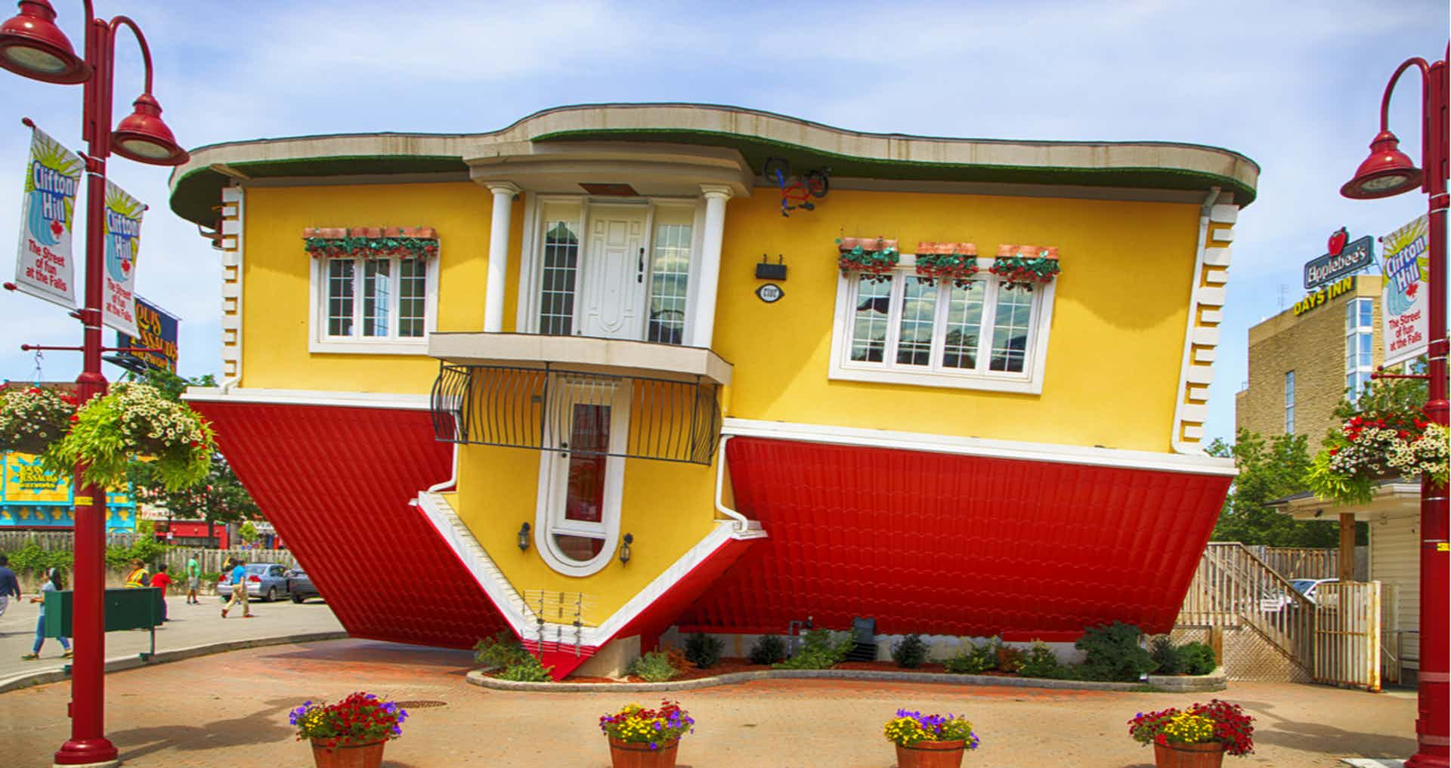
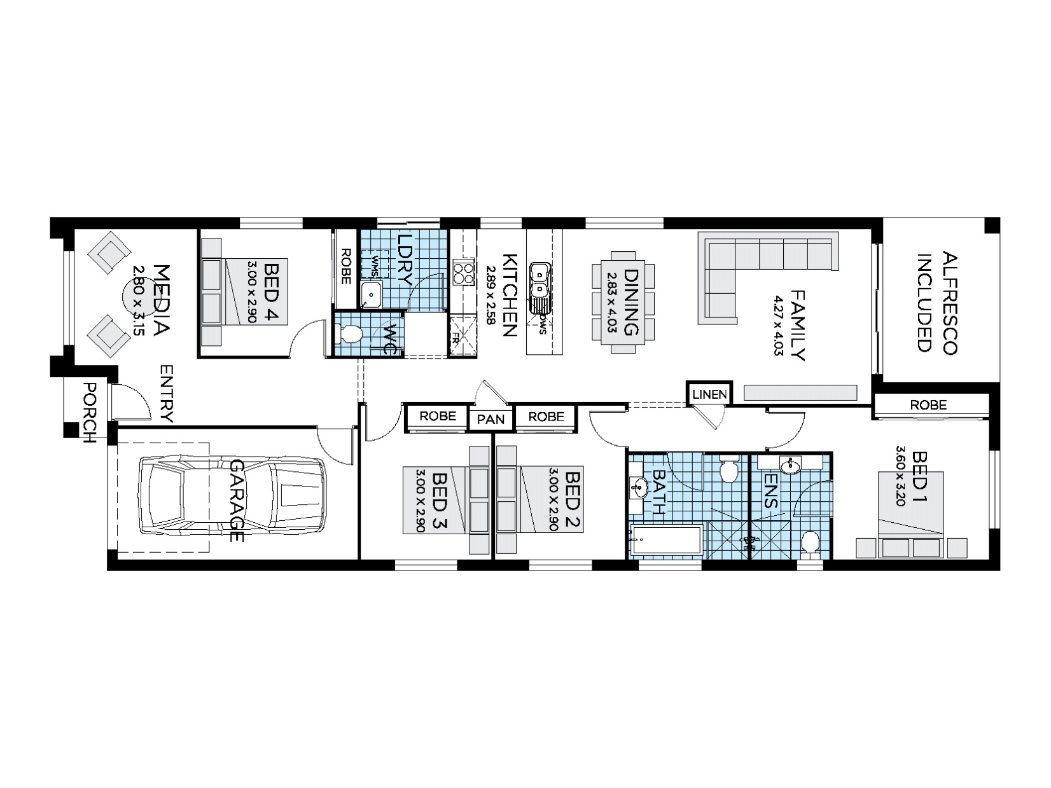
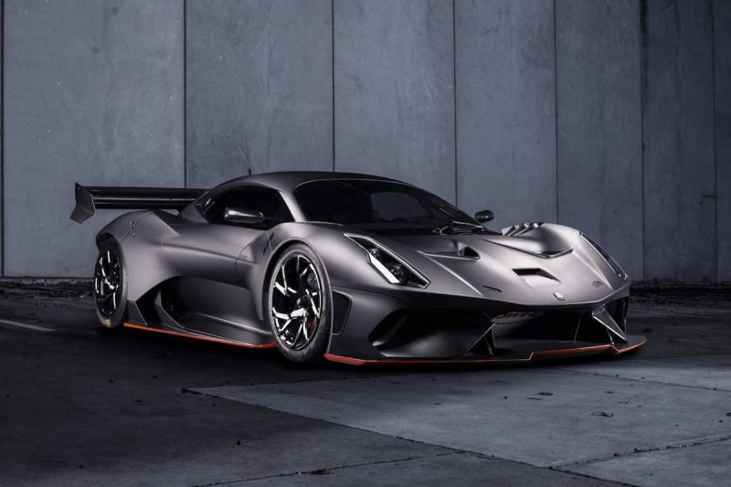
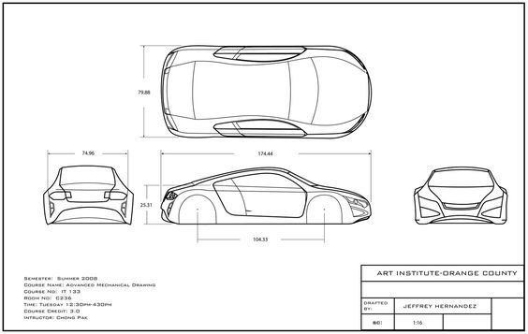
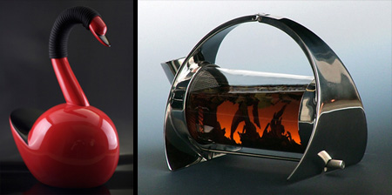
Design Fields
The study of Visual Communication Design looks at a variety of design areas.
This means everything from tickets, posters, mobile phone apps, web sites, dispensers, packaging, kitchen appliances, tools, furniture, cars, boats to houses, offices and sky scrapers.

Slide 5
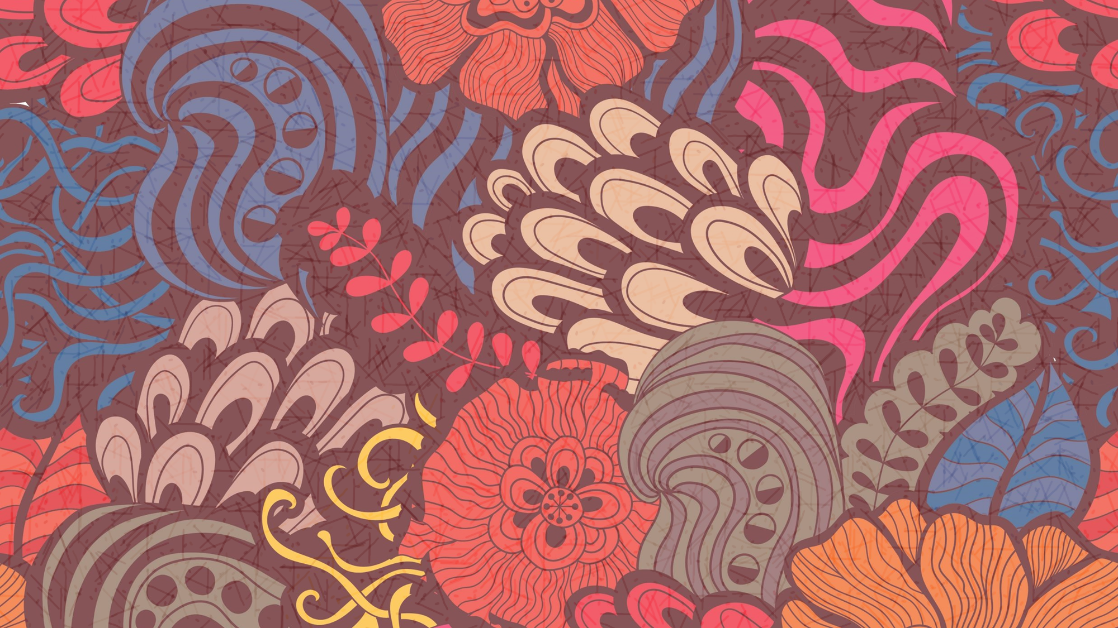
HOW DESIGNERS WORK
Wheelers Hill Secondary College
Visual Communication Design 2024 -2028
OUR DESIGN PROCESS
The 6 stages of Design Thinking Journey
Students of Visual Communication Design study the ways designers work.
Although there are many different kinds of designers who work in the different design fields, they all seem to follow a similar pathway to propose solutions to problems posed by their clients.
This pathway is called the Design Process.
In our study, there is a formal model that students must use in both their practical work and in written analysis.

Slide 6
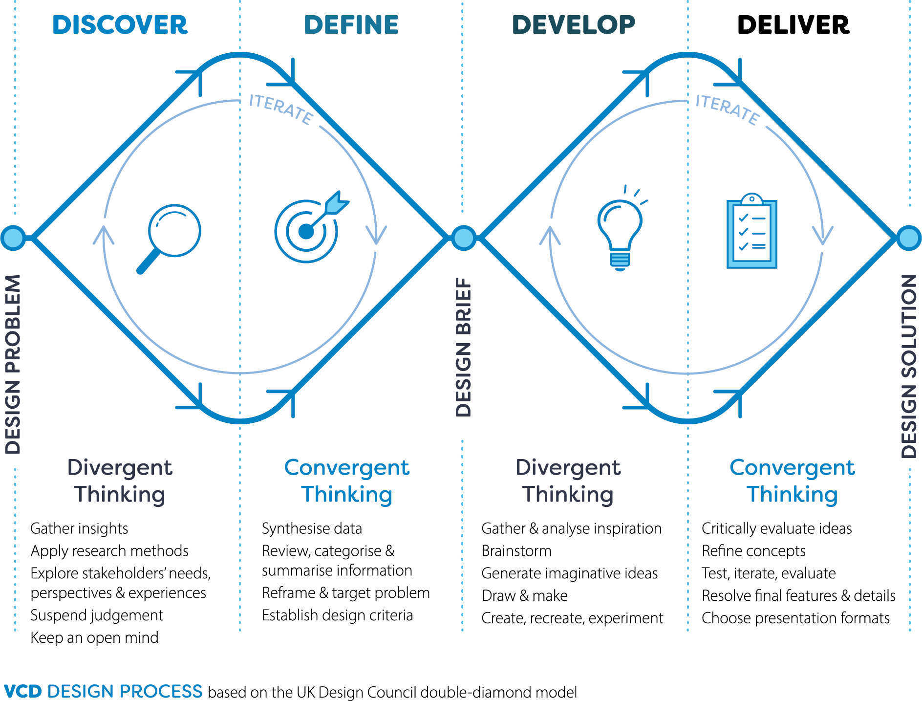
HOW DESIGNERS WORK
Wheelers Hill Secondary College
Visual Communication Design 2024 -2028
The VCD Design Process
A design process is both relational and situational, and designers tailor their approach in response to the problem at hand.
However, there are modes of thinking and phases of development common to the practice of design, and these have been captured in various design process models devised by academics, companies and professional organisations.
Students of VCE Visual Communication Design apply an iterative design process based on the Double Diamond model, passing through and revisiting the four distinct phases of Discover, Define, Develop and Deliver.
In the context of this study, this process is referred to as the VCD design process.

Slide 7
Wheelers Hill Secondary College
Visual Communication Design 2024 -2028
Unit 1 – Finding, Reframing and Resolving Design Problems
Area study 1 – Reframing Design Outcome 1 – On completion of this unit student should be able to to use human-centred research methods to reframe a design problem and identify a communication need. Area Study 2 – Solving Communication Design Problem Outcome 2 – On completion of this unit the student should be able to create visual language for a business or brand using the Develop and Deliver stages of the VCD design process.
Area Study 3 – Design’s influence and influences on design Outcome 3 – On completion of this unit student should be able to develop a sustainable object, considering design’s influence and factors that influence design.

Slide 8
Wheelers Hill Secondary College
Visual Communication Design 2024 -2028
Unit 2 – Design contexts and connections
Area study 1 – Design, place and time Outcome 1 – On completion of this unit student should be able to present an environmental design solution that draws inspiration from its context and a chosen design style.
Area Study 2 – Cultural ownership and design Outcome 2 – On completion of this unit student should be able to apply culturally appropriate design practices and an understanding of the designer’s ethical and legal responsibilities when designing persona iconography.
Area Study 3 – Designing interactive experiences Outcome 3 – On completion of this unit student should be able to apply the VCD design process to design an interface for a digital product, environment or service.

Slide 9
Wheelers Hill Secondary College
Visual Communication Design 2024 -2028
Unit 3 – Visual Communication Design Practices
Area study 1 – Professional design practice Outcome 1 – On completion of this unit student should be able to compare the ways in which visual communication practices are used by contemporary designers, using research methods and practical exploration.
Area Study 2 – Design analysis Outcome 2 – On completion of this unit student should be able to compare and analyse design examples from selected field(s) of design practice, describing how aesthetic considerations contribute to the effective communication of information or ideas.
Area Study 3 – Design process: defining problems and developing ideas Outcome 3 – On completion of this unit student should be able to identify two communication needs for a client, prepare a brief and develop design ideas, while applying the VCD design process and design thinking strategies.

Slide 10
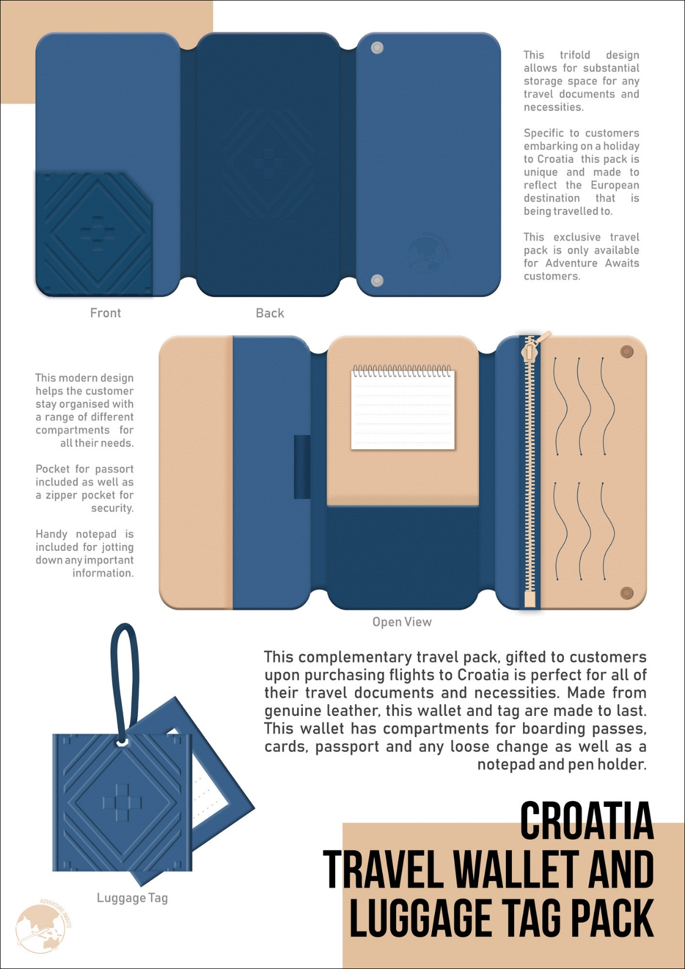
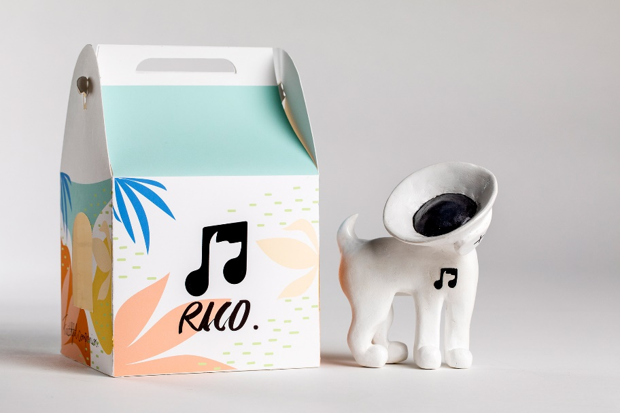
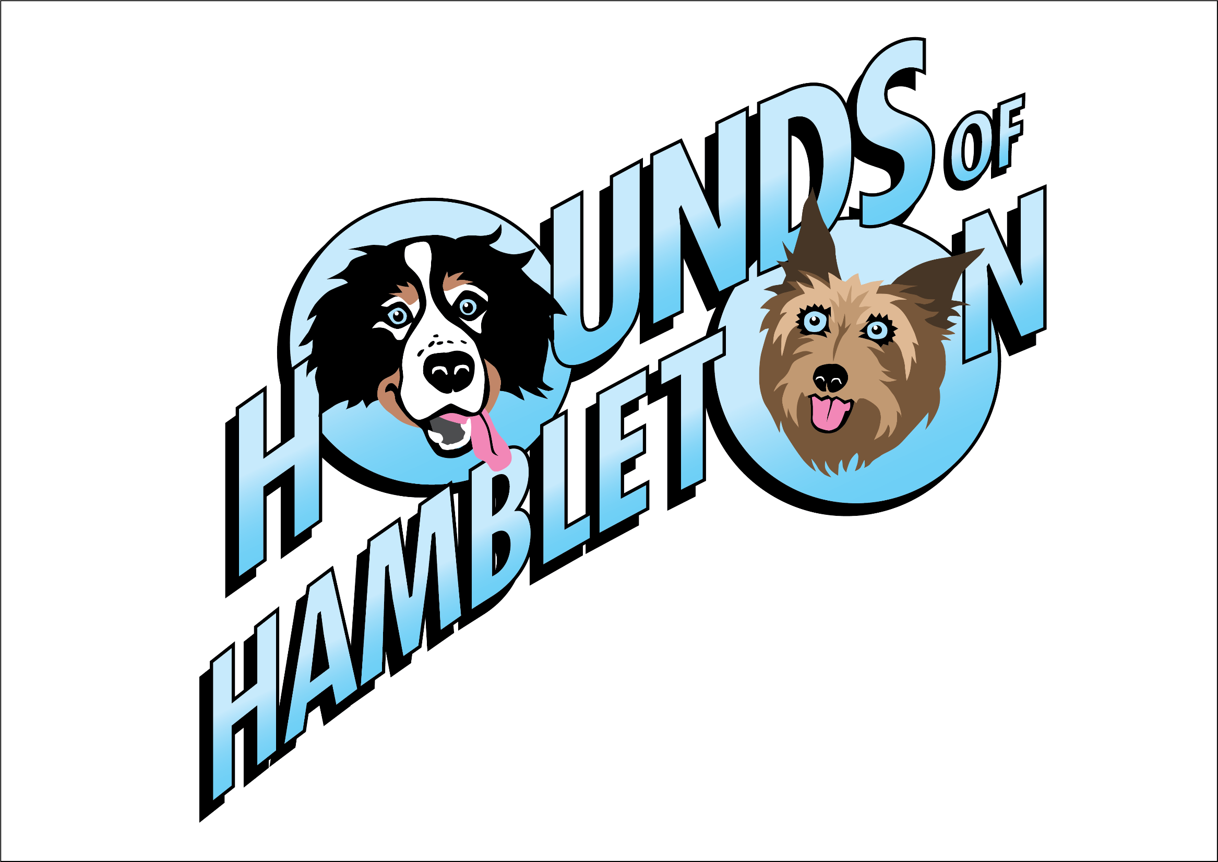
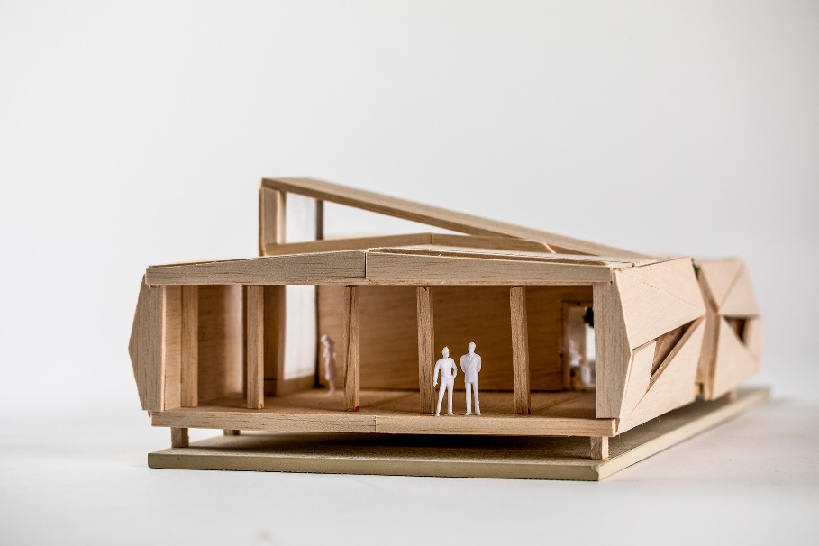
SAT – School Assessed Task Development of Design FOLIO and Final PRESENTATION
Congratulations. You've made it! Finally, you have reached the stage where you can design exactly what you want in class.

Slide 11
Folio Development
This part of VCD, spread over Unit 3 and 4 and It is the big, practical design component
of your course
UNIT 4 Delivering design solutions
Area Study 1 - Design process: refining Outcome 1 and resolving design concepts On completion of this unit the student should be able to refine and resolve distinct design concepts for each communication need, and devise and deliver a pitch to communicate concepts to an audience or users, evaluating the extent to which these meet the requirements of the brief.
Area Study 1 - Presenting design solutions Outcome 2
On completion of this unit the student should be able to the student should be able to; develop distinctly different concepts for each communication need and devise a pitch to present concepts to an audience, evaluating the extent to which these concepts meet the requirements of the brief.

Slide 12
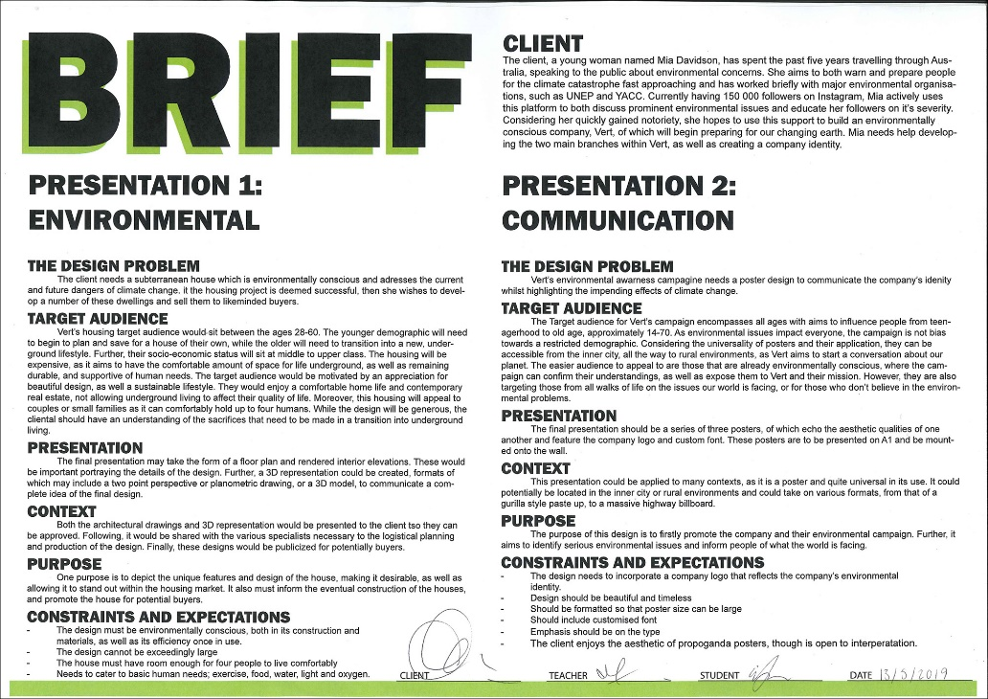
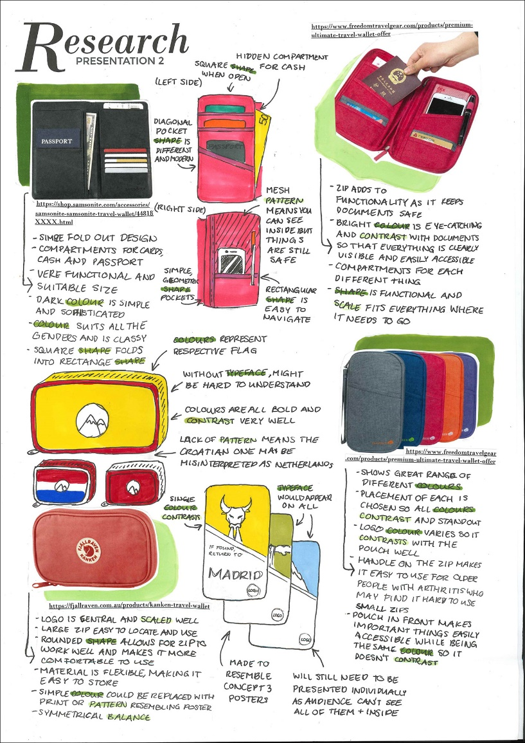
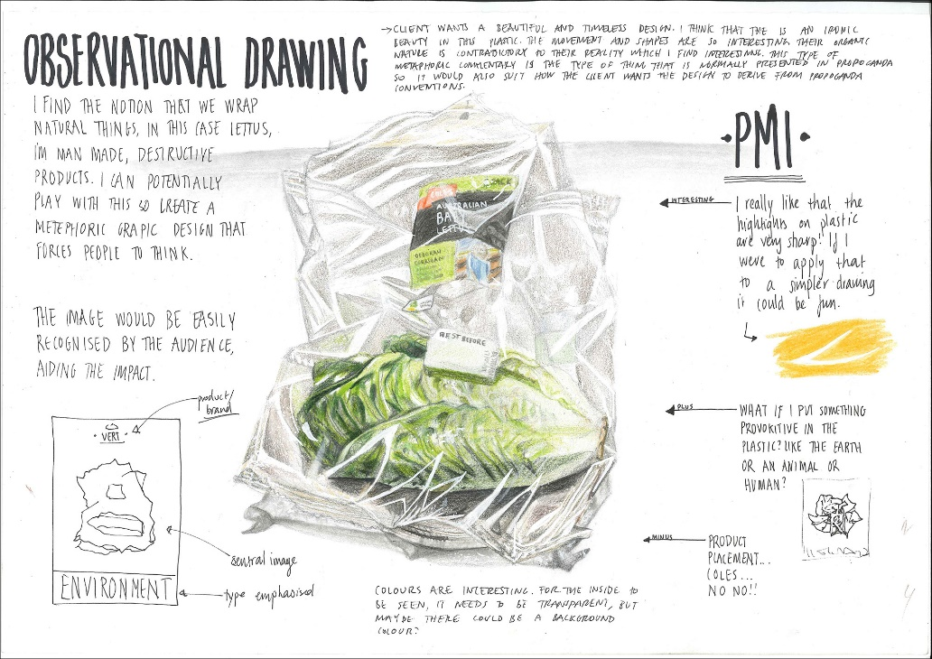
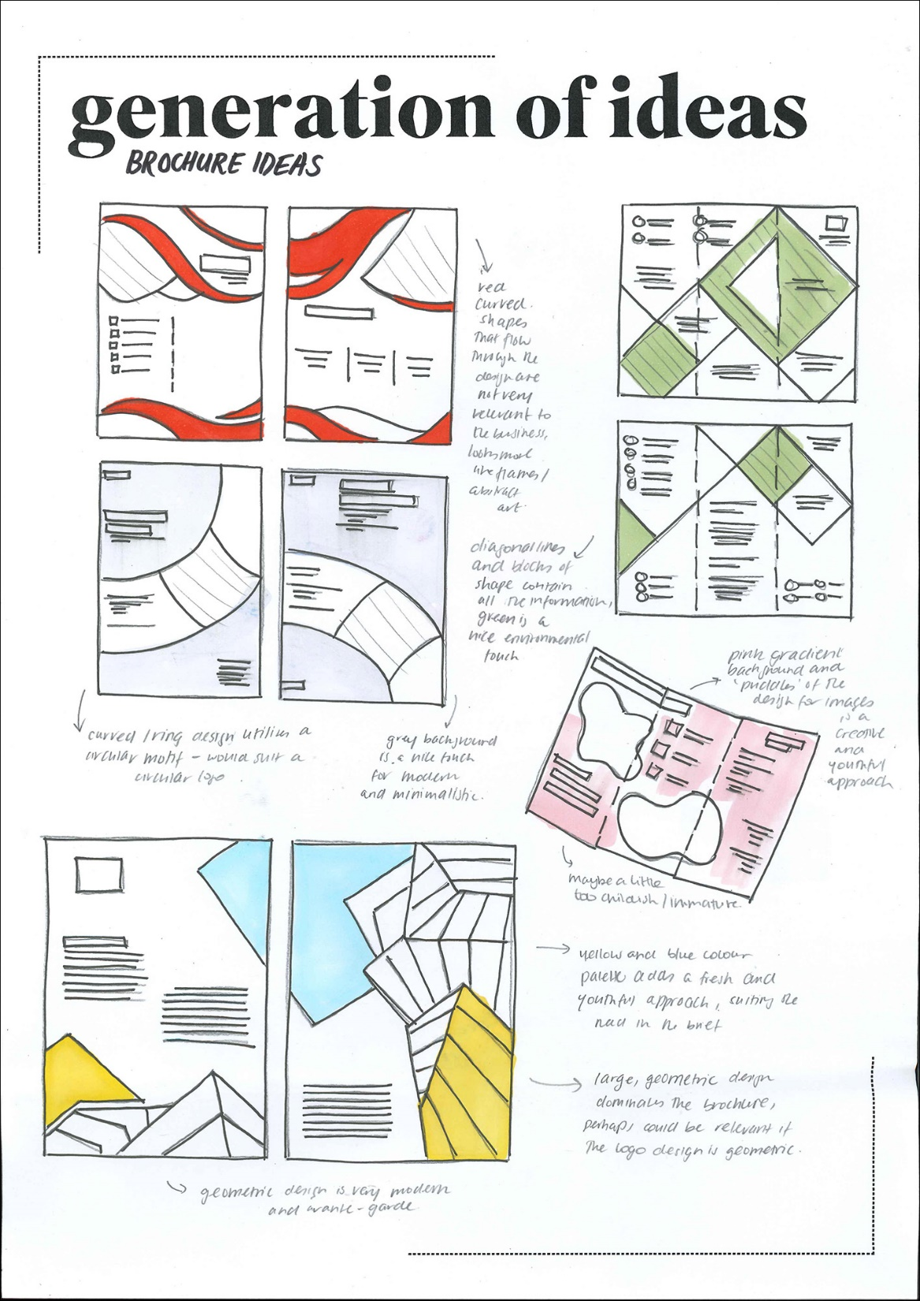
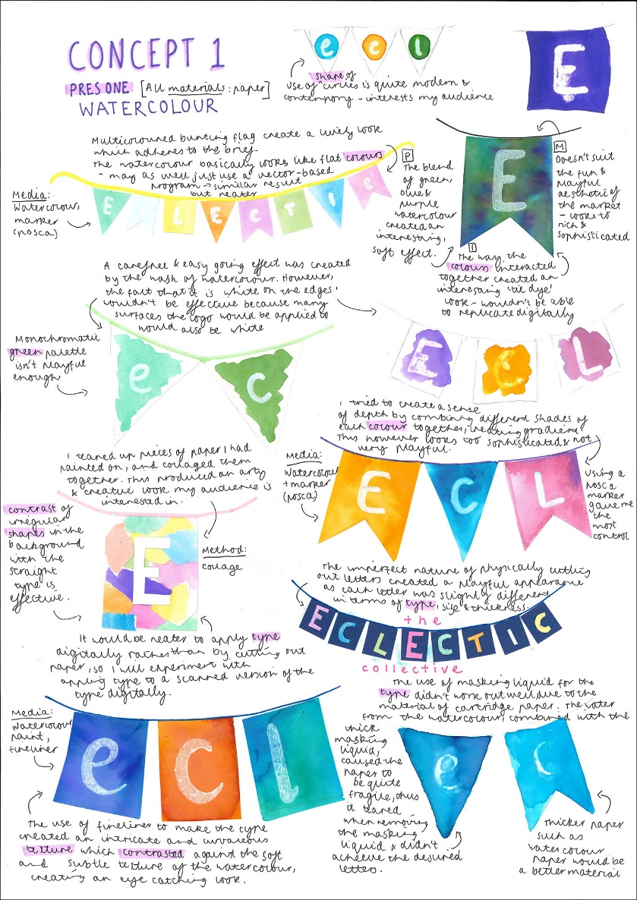
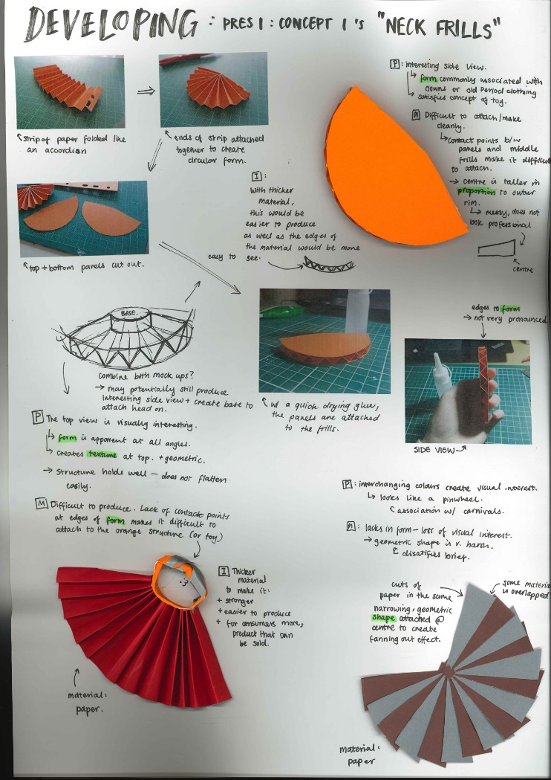
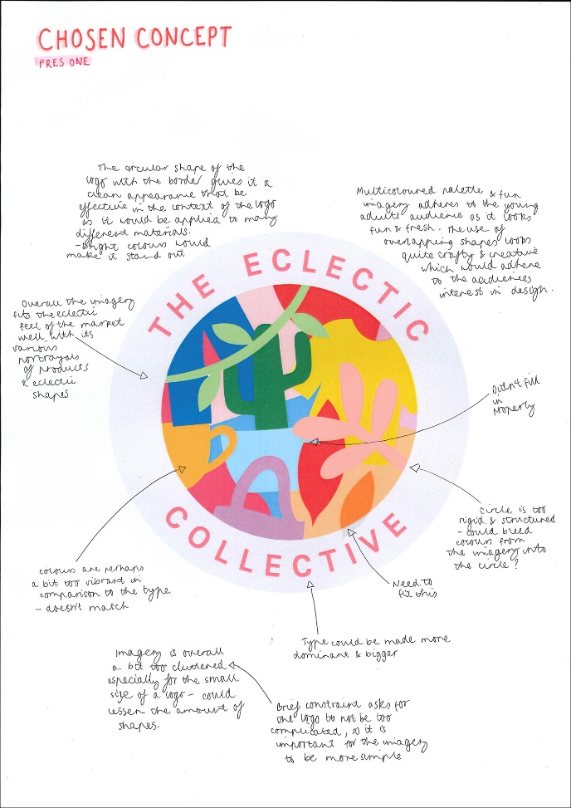
Folio Presentation

Slide 13
Careers in Visual Communication Design
COMMUNICATION DESIGN
INDUSTRIAL DESIGN
ENVIRONMENTAL DESIGN
JOBS IN THIS FIELD
Graphic design
Art director
Information design
Digital and Web design
Advertising
Illustration
Book design
Typographic design
Package/ surface design
Logo, Corporate and Brand Identity design
JOBS IN THIS FIELD
Product/ Industrial design
Engineering design
Furniture design
Automotive design
Aeronautic design
CAD engineer
Model maker
3D printer
Computer programmer
Software developer
Engineer
JOBS IN THIS FIELD
Architectural design
Interior design
Landscape design
Theatre set design
Exhibition/ display design
Nautical architecture
Draftsperson
Illustrator, Renderer
Model maker,
Laser cutter
Photographer

