Slide 1






Hello, Families,
Welcome back to another wonderful bright week.
_____________________________________________
Lunch Time Legends
We’re excited to invite you to our upcoming Lunchtime Legends event on March 7th at the TeamKids Portable! This fun-filled event will take place from 1:25 PM to 1:55 PM, where kids will have the chance to get creative with 3D ornaments or crafts.
At the end of the event, they'll get to take home their unique creations as a memorable keepsake.
Don’t miss out on this exciting and interactive experience. We look forward to seeing you there!
MINDFULNESS
SUSTAINABILITY
ADVENTURE
GARDENING
COOKING
0478752381
Wyndhamvalepsjunior@teamholiday.com.au
1300 035 000
info@teamkids.com.au

Slide 2
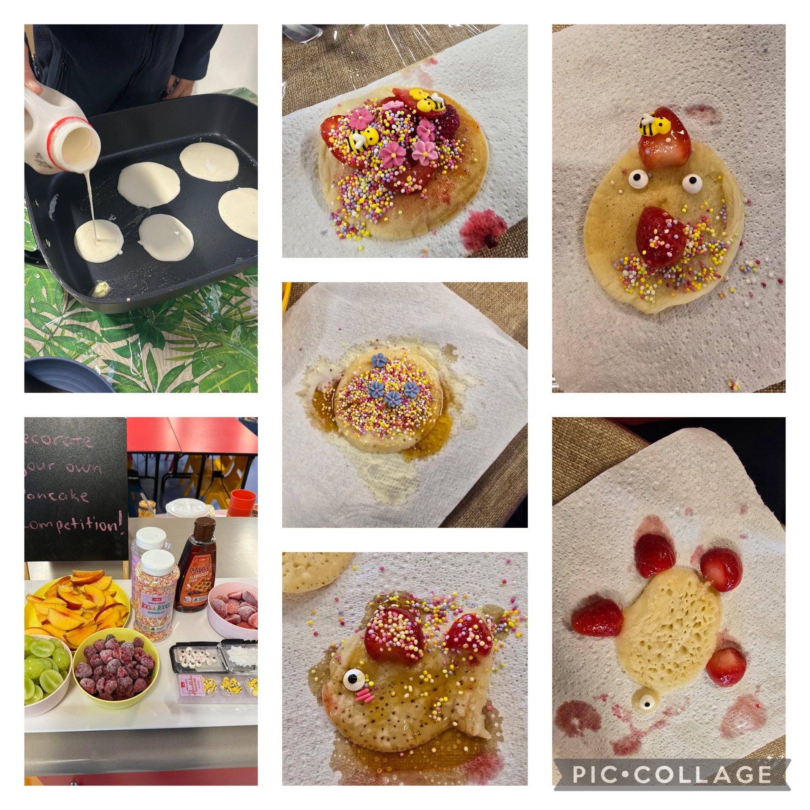
A Fun-Filled Pancake Decorating Event at TeamKids!
We had an amazing time at TeamKids with our recent Pancake Decorating event! The children had the opportunity to decorate their very own pancakes, and it was an absolute blast. The excitement and joy on their faces were truly priceless as they got creative with toppings and designs.
It was a wonderful, fun-filled experience that the kids won’t soon forget! We can’t wait for the next one!
MINDFULNESS
SUSTAINABILITY
ADVENTURE
GARDENING
COOKING
0478752381
Wyndhamvalepsjunior@teamholiday.com.au
1300 035 000
info@teamkids.com.au

Slide 3
Parent Involvement
TEAMKIDS CLUBS We’re excited to offer an opportunity for you to be part of our Community Club here at TK! We believe that parent involvement enhances the experiences of our children and strengthens the community within our program. There are many ways you can contribute, whether it’s volunteering for special events, hosting a workshop, or even sharing your culture or skills with the children. Your participation will not only enrich the children’s learning but also help create a more connected and supportive environment. If you’re interested in getting involved, please let us know by contacting us directly. Whether you’re available for a one-time event or can contribute in other ways, we’d love to have you! Thank you for your continued support, and we look forward to working together to create a fantastic term for the children!
Process for Sign in /Sign out
Please note that staffs cannot sign in or out a child instead of families.(Of course we can sign out children during BSC and sign in children in ASC)
Non-Arrival
If your child will not be attending afterschool on any of their scheduled days, please inform us by calling or texting. If we are unable to answer, kindly leave a message. This will help us avoid unnecessary follow-ups, allowing us to dedicate more time to engaging with the children. As you may know, we are a large service, and keeping track of absences can be time-consuming.
Thank you for your cooperation!
0478752381
Wyndhamvalepsjunior@teamholiday.com.au
1300 035 000
info@teamkids.com.au

Slide 4
