Slide 1
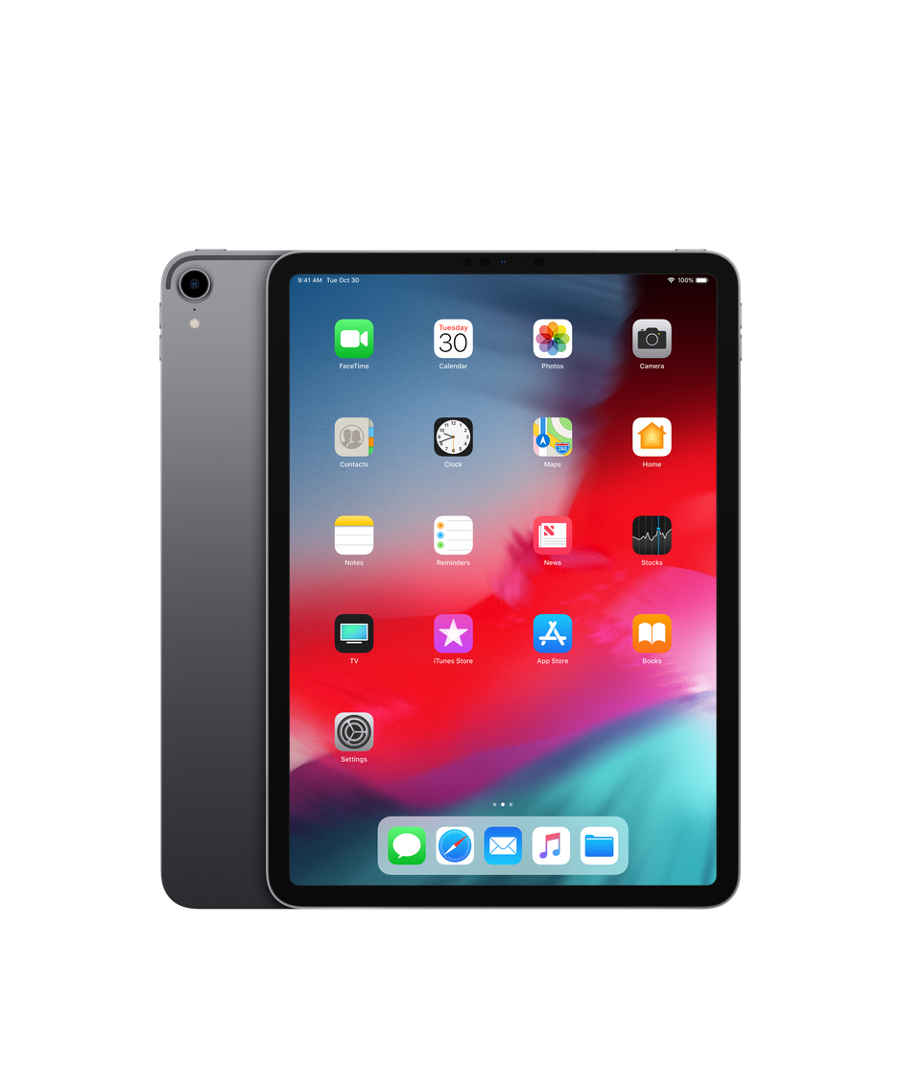
Frequently Asked Questions
Somerville Primary School B.Y.O.D iPad Program
2022

Slide 2
What is a B.Y.O.D iPad Program?
Our B.Y.O.D iPad program refers to students bringing their own device to school. Our 1:1 iPad program aims to ensure that each student in Years 5 and 6 will be able to access his or her own iPad for use at school and home as required. The school will provide the infrastructure to support students’ access to the wireless network. For a child to have access at home and school, parents will need to provide their child with an iPad and sign the Acceptable Use Agreement. The iPads will give students access to a range of tools to assist their learning, guided by the teacher.
OPTION 1: Existing iPad owner – iPad must run at least iOS 13,
OPTION 2: Private Purchase. Please refer to: iPad Purchase Recommendations

Slide 3
How will iPads improve learning?
1:1 iPads promote better learning in and out of school by encouraging:
Anywhere, anytime access to learning
Independent, self-initiated learning, eg promotion of problem solving skills, ability to ‘Google’ questions they have
Ability to teach students how to communicate appropriately and safely in social websites
Ability to access homework and school information online and offline
More time for teachers to educate students on how to use the internet appropriately as a tool to learn
Greater access to real-time information, digital learning resources and educational software
Working in online spaces, where students can access varied content to support their level of understanding in a subject area
Ability to digitally capture any learning, such as videos or photographs to create things such as digital stories
Immediate feedback on their learning, as students have the means to reflect instantly and not wait for their work to be corrected by the teacher
Opportunities to discuss cyber bullying as a real issue and discuss impacts of this as a class

Slide 4
What iPad should I buy?
The minimum expectation is that each student in the Senior school will have an iPad. The model (iPad 9th Generation), and the size (64Gb or greater) are entirely up to you.
It is the expectation that all iPads have the wi-fi only option. 3G/4G enabled iPads can bypass the filters set on our school network and thus cannot be monitored.
Therefore, they will not be allowed.
We also recommend that parents purchase the Apple Protection Plan for the iPad to extend the warranty and support period to two years.
Some examples are on the next page.

Slide 5
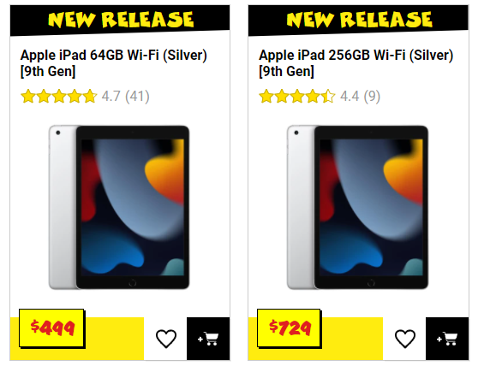
What iPad should I buy?
JB Hi-Fi
Prices as of 11/10/2021

Slide 6
Who will own the iPad?
The iPad will be the property of those parents who purchase an iPad privately, being used in conjunction with the school’s Acceptable Use Policy.

Slide 7
My child already has an iPad. Can that be used instead of buying a new one?
Yes. If your child already has an iPad 8th Generation or later model, he/she can use it as their BYOD device, so long as it runs iOS 13 or higher. If you are purchasing a new iPad we strongly recommend buying the latest model in order to get the most use from the device. Please be aware that traditionally Apple will only support the two most recent models of their devices (currently the iPad 9th generation), with software and hardware updates and support.

Slide 8
What if I don’t provide an iPad?
The iPad program is voluntary, but highly recommended.
Involvement in the BYOD program is seen to be very beneficial for students. Whilst we cannot make it compulsory, participation is strongly encouraged.
Students who do not have their own device will have shared access to school iPads during school hours.

Slide 9
What about warranty & insurance?
iPads brought to school ARE NOT covered by Somerville Primary School or the Department of Education’s insurance.
If the iPad is damaged at school it is the parents’ responsibility to pay the insurance excess. You may wish to check with your home and/or contents insurer if your existing cover extends to an iPad being brought to school by your child.
Before your iPad can come to school you will be required to complete a User Agreement confirming you understand it is not covered by the school or Department of Education insurance policy.
The student and their family/caregivers assume full financial responsibility for the iPad in the event of damage, loss, theft and any other instance of negligence and/or abuse.

Slide 10
What is the User Agreement?
A Digital Technologies Acceptable Use Agreement will go home at the end of this school year (2021). This relates to using all technology at Somerville Primary School. It needs to be signed by all students involved in the program and their parents.
Children cannot bring iPad’s to school until the student and parents have signed this form.

Slide 11
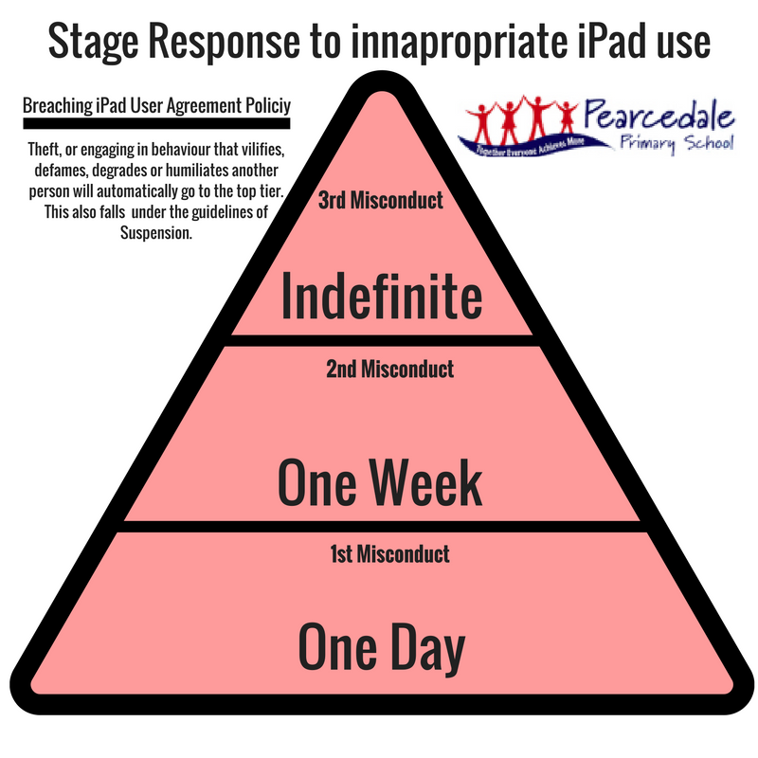
What if my child breaks the User Agreement?
A consequence will be enforced depending on the severity of the offence in accordance to our Stage Response to inappropriate Use outlined in the iPad information Handbook.
All offences will be investigated thoroughly with checks made to the child’s iPad and school account.
The time frame will vary according to the severity of the offence.

Slide 12
What apps do I need to download for my child’s iPad?
It is our recommendation that students organise their apps into folders to assist in locating specific apps but to also clearly categorise them into those to be used at school and those to be used outside of school.
A list of apps will be handed out with the Digital Technologies Acceptable Use Agreement.

Slide 13
Can parents regulate what apps are added and deleted?
Yes. Restrictions can be set by parents to regulate which apps are installed or deleted on the device, as well as access to the App store. Parents wishing to explore this can find useful guides online.
The school encourages trust and monitoring in the first instance with blocking being the final choice.

Slide 14
What technical support is there?
A positive feature of the iPads is the low maintenance and technical support they generally need. We do understand that issues can happen. The school employs one IT technician, who will be able to assist with connecting to the school’s network and most technical issues.
All Grade 5 and 6 teachers will be trained to solve most common technical issues relating to the iPads. They will also be supported by our Schools Specialist Technician. However, if major issues arise it will be the responsibility of the parents to repair and fix the issues.
Students are to inform their teacher immediately of any problems.

Slide 15
Where do the devices go when not in use?
When not in use, the devices will be locked within the classroom. Depending on the classroom, it will be stored in a locked cabinet, locked office or locked room depending on circumstances. Rest assured, the safety of your child's iPad is a high priority. No iPad is to be taken outside during recess or lunch times except for with the specific permission of a teacher for a learning activity.
Students will be able to place them inside at the start of the school day if their teacher is there. If not, they will need to remain in their bag until the rooms are unlocked.
Students will be strongly advised to keep their iPads in their zipped up school bag
when travelling between home and school.

Slide 16
Can students use the internet?
Use of the Internet by students is governed by the ‘Acceptable Use Agreement for the Internet and Digital Technologies’ that students and parents agree to for the use of digital technologies both within and outside the school each year.
Parents should familiarise themselves with this document.
Any inappropriate use of the Internet is unacceptable and is subject to disciplinary action and exclusion from the school network and resources.

Slide 17
How will you ‘police’ the iPads?
Teachers will supervise students as they would for any learning activity as they create and maintain a safe, comfortable and learning-focused classroom. Appropriate use of the Internet service within the DET network is closely monitored by a filtering system, which allows for inappropriate content blocking by a regularly updated list of categories and sites. This does not apply to use of devices outside of the school network.
At Somerville Primary School we place an emphasis on cyber awareness, digital citizenship and appropriate use of electronic devices beginning right from the first day of Foundation through to Year 6. Students in Year 5 and 6 are challenged to develop their own understanding in class of the agreements as they are taught about their online responsibilities and their ‘digital footprint’. In this way, they have a shared understanding and ownership over the standards that are expected at our school.

Slide 18
Who monitors usage at home?
That is the responsibility of the parents. When off school grounds, parents have an obligation and full authority to monitor device usage. Examples of this include:
Encourage use in a family or shared room and not in the bedroom or other private spaces.
Restrict use at certain times of the evening or weekend.
Regularly examine the documents, browsing history and other contents of the device.
An aspect of this program we are greatly looking forward to is the increased communication and cooperation between home and school in regards to online behaviours and device use.

Slide 19
Will students use iPads in every lesson?
Currently, iPads are available in every class at Somerville Primary School. However, they are not used for every lesson and will depend on the subject or topic being covered. The iPad is a multi-faceted tool that supports student learning. How much it is used will change depending on the learning tasks at hand.
Teachers will ensure that there is a balance between time ‘on’ and ‘off’ the iPad. “Anywhere, anytime… But not all the time”.
It is definitely NOT going to replace quality teaching. Students do not ‘go on to the iPads’ to do their learning. It is a tool to support students in their learning. It will be used across key areas of literacy and numeracy, the specialists program and during inquiry learning. Students will not use the iPad 100% of the school day. There will be sessions in the day where it is not used because it will not be the best tool for the task.

Slide 20
Will my child have to share their iPad with a student that doesn’t have one?
No. The iPad you supply for your child is theirs to have as a personal device that supports their learning. Students will be free to share as they wish, but will not be required to allow other students to use their iPad.

Slide 21
Is my child expected to take their iPad home every night?
YES. This forms an important part of the BYOD process. We want students learning beyond the boundaries of the school.

Slide 22
What if my child leaves their iPad at home?
Arrangements can be made to enable the student to participate in learning activities on one-off circumstances. Students will be encouraged to be responsible for their device and repeat forgetfulness will require follow up and communication with parents.

Slide 23
iTunes Accounts?
It is a requirement of Apple that a person must be over 13 years of age to have an iTunes account. It is recommended that parents set up the iTunes account with their child using the instructions provided by the school.
Parents can determine if children have access to the iTunes account password. It is recommended that students back up their iPad through iTunes a minimum of once a fortnight to avoid the loss of information.

Slide 24
Care & Maintenance
Caring For The iPad Screen
It is important to take good care of the screen. Here are some ways to protect your iPad screen.
Don’t drop it, it can break
Clean the screen with a soft, slightly damp, lint-free cloth
Do not clean it with window cleaners, glass cleaners, aerosol sprays, or abrasives
Always use a cover/case
You can also use a screen protector.

Slide 25
Care & Maintenance
Caring For Your Batteries
Part of caring for your iPad means caring for the batteries. The batteries in your iPad are lithium polymer (rechargeable) and they will eventually wear out. It will take a long time before that happens, but there are some things you can do to care for your batteries and get the most out of them.
Make sure you keep up on the latest iPad updates. This sounds odd but Apple will sometimes make adjustments to software, which helps with drain on resources and battery.
Caring For Your iPad: Environmental
There are also a few environmental ways to care for your iPad. Some of these are obvious while a few are not so obvious.
Keep the iPad out of heat for an extended length of time
Keep the iPad out of cold for an extended period of time
Keep it out of water or extremely humid locations
Do not dry it with an external heat source such as a hair dryer
It should also go without saying that part of caring for your iPad is to make sure you do not insert anything into the port connections other than the intended peripherals. Jamming things into the port connectors could render it unusable (and void the warranty).

Slide 26
How will I charge the iPad?
All iPads must be charged at home overnight and returned back to school fully charged at the beginning of every day. The iPad battery will last a typical school day.

Slide 27
What about handwriting?
Students will continue to complete handwritten writing tasks. The teachers at Somerville Primary School continue to view handwriting as an important skill.

Slide 28
How will teachers be trained & supported?
The school is committed to ensuring teachers receive up-to-date professional learning on the most effective ways to use digital technologies in the classroom.
We have already spent considerable time and resources into training staff and will continue to do so to ensure this will be implemented efficiently.

Slide 29
Does the iPad require a Passcode?
Our policy at Somerville is that students are encouraged not to have a passcode on their iPad.
We understand concerns about privacy, however teachers need to be able to access the iPads at all times and remembering 100+ passcodes is not practical.
Students are known to forget their passcodes occasionally.
However, we fully support the decisions of our students parents in this matter.
If you would prefer they have a passcode, then they can.

Slide 30
Will my child be able to use the iPad in subsequent years?
Yes, the students will use iPads in Year 6 2023.
Will my child be staring at a screen all day?
No. We understand the importance of positive social interaction and will promote this alongside the BYOD iPad program.
Will my child be staring at a screen all day?
No. Teachers, more than anyone understand the importance of postive social interaction.
What will happen to my childs handwriting? Will they forget how to write?
No. Teachers value handwriting. Perhaps even greater emphasis on handwriting skills in this current iPad world. It will still be a focus in the curriculum.
Is my child expect
ed to take their Ipad home every night?
This forms an important part of the BYOD process. We want kids learning beyong the boundaries of the school.
Can I recharge my iPad at school?
Please ensure the iPad comes to school charged.
What happens if my child leaves their iPad at home?
They will have access to a school owned iPad for the day?
How will my child learn to spell if they’re always being autocorrected?
No. If there is one set of people in the world who value good spelling, its teachers.

Slide 31
Will students have access to social media sites?
As the age of most social networking sites is 13+ , the use of social networking is not permitted during school hours.

Slide 32
How does my child backup information on the iPad?
The school encourages students to back up any data that they have stored on their device. They can do this through syncing their iPad to a computer, or using new technology such as iCloud, Dropbox, etc, to back up any data. This will be outlined when students receive their iPads.

Slide 33
Will students be permitted music and games on the iPad?
Students will be permitted to have legally downloaded music and games stored on the iPad. Parents are strongly encouraged to monitor the appropriateness of the games installed onto the iPad.
Any non-educational apps must be grouped into a 'Home' folder.

Slide 34
Are there many other schools with a B.Y.O.D Program?
Yes, there are many schools in the Mornington Peninsula and all around the world that have taken up a BYOD / 1-to-1 program.
In 2018, our teachers visited other schools and spoke with teachers who have successfully implemented such a program for a number of years.

Slide 35
What if my question isn’t answered here?
Please ask!
We understand that there may be some early confusion and you may have questions that have not been answered in this document. We welcome input from parents, students, and the community and would be grateful for any constructive criticism.
We will continue investigating how to best support you and your students in the ongoing implementation of this program.
If you have any further questions or concerns about the program please contact the school and we will endeavour to get back to you as soon as possible.

