Slide 1
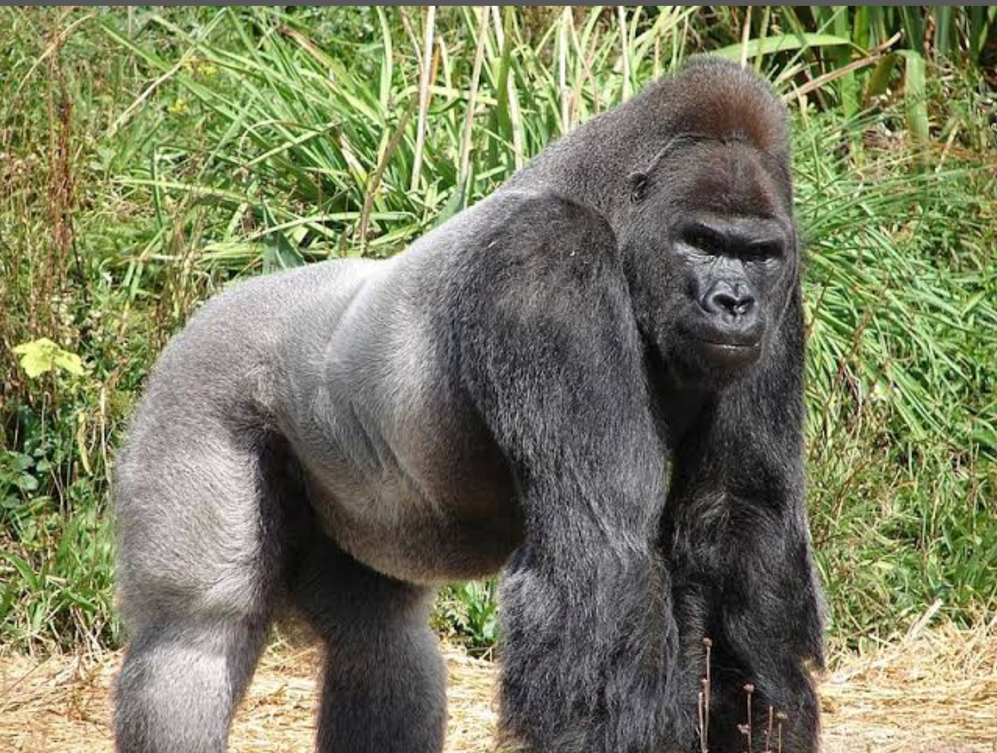
They’re calling on YOU

Slide 2



Save. The. Gorillas.
Wild Gorillas are losing their rainforest homes! Some are dying because they cannot find a home! But. For every good story, there’s always a twist. Here is the twist… there are people who try to save them!!! The Gorilla Doctors!!
They will try their very best to cure the gorillas’ diseases! To help them do this Melbourne Zoo is asking if we can donate old mobile phones for collection. Funds raised through the recycling of donated mobile phones will support Zoos Victoria and their conservation partners Gorilla Doctors.

Slide 3

What can you do to help?
Let’s help by collecting mobile phones. Every time we get at least ten phones, PhoneCycle will pick it up from my house for recycling! Funds generated by PhoneCycle will be transferred into the gorilla doctors’ bank account!! And that’s how it all works!

Slide 4

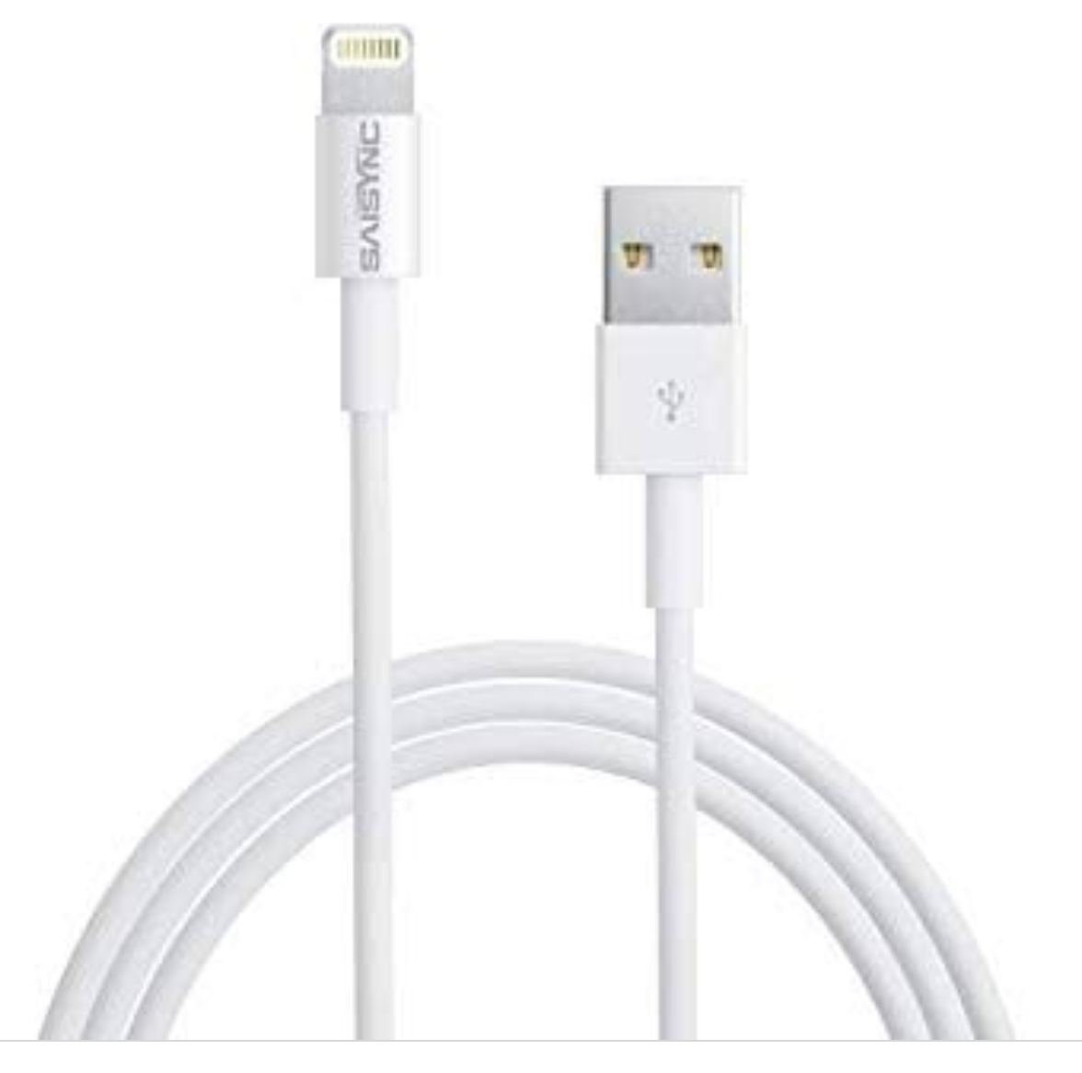
Things they need most!
MOBILE PHONES
SMART PHONES
TABLETS (Such as iPads)
ACCESSORIES (Such as chargers)
[They need accessories more than anything!]

Slide 5
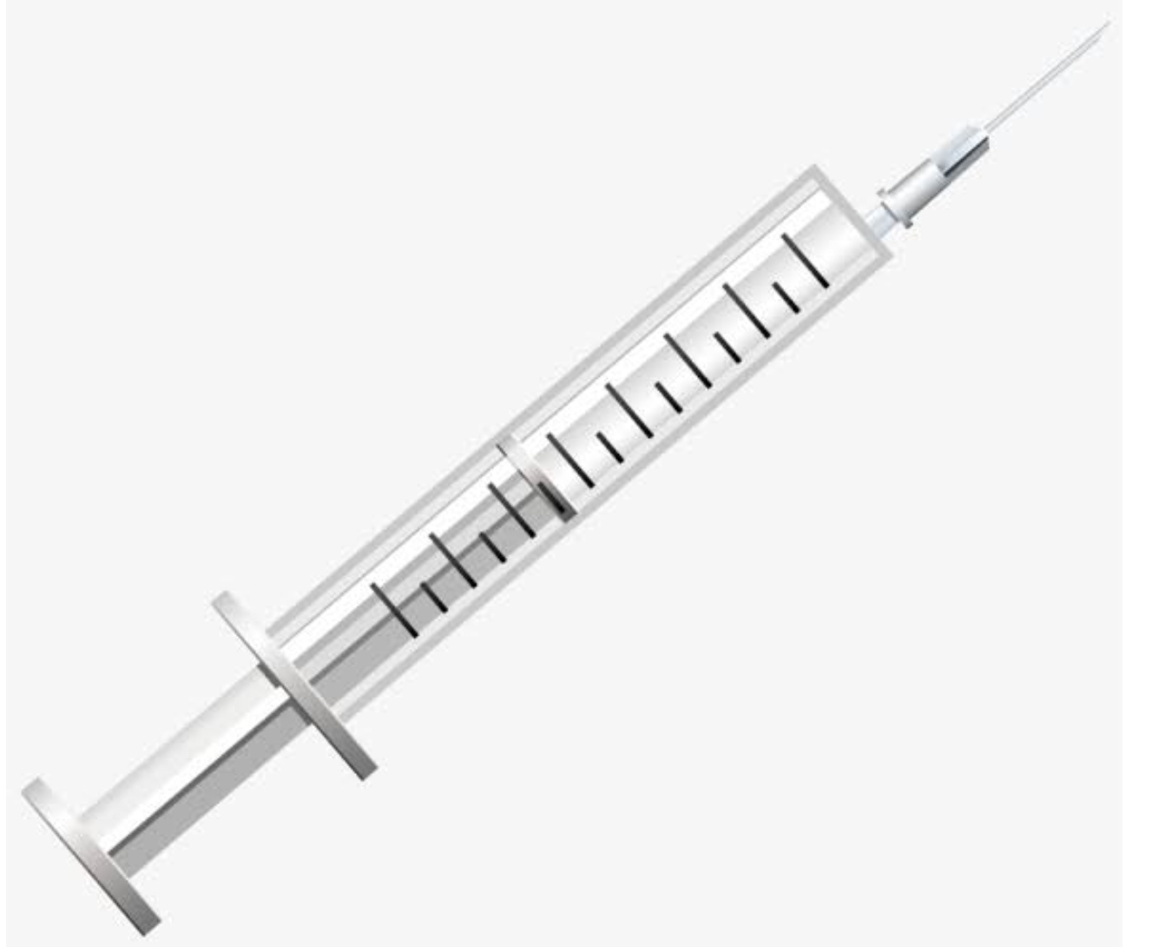




What you can do for them by donating!
5 Phones | A life-saving dose of antibiotics for an ill baby gorilla
10 Phones | Petrol needed for the Gorilla Doctors to reach the forest to monitor the health of gorillas
50 Phones | Anaesthetic to help provide veterinary care to an ill or injured gorilla
100 Phones | A full set of rain gear, allowing the Gorilla Doctors to work in bad weather
500 Phones | A computer for the gorilla doctors, helping to study health trends and predict diseases and their outbreaks

Slide 6
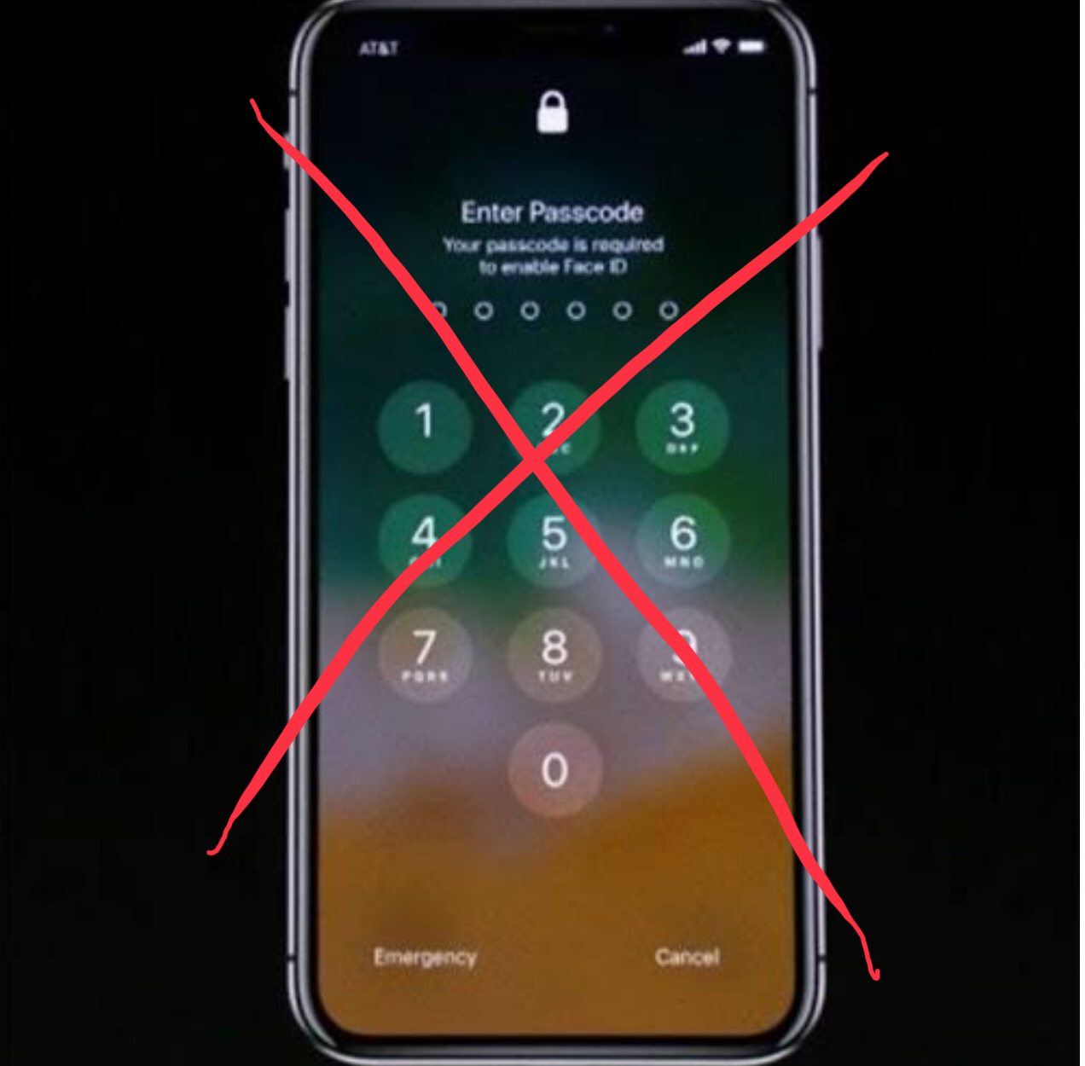
Oh, and make sure that the phone you bring in has NO PASSCODE ON IT!!
The phone cannot have a passcode on it because PhoneCycle has to conduct a factory reset so personal information can stay personal. If you want to, you can reset your settings at home before you bring in the phone, but still, make sure the phone still has no passcode on it.

Slide 7
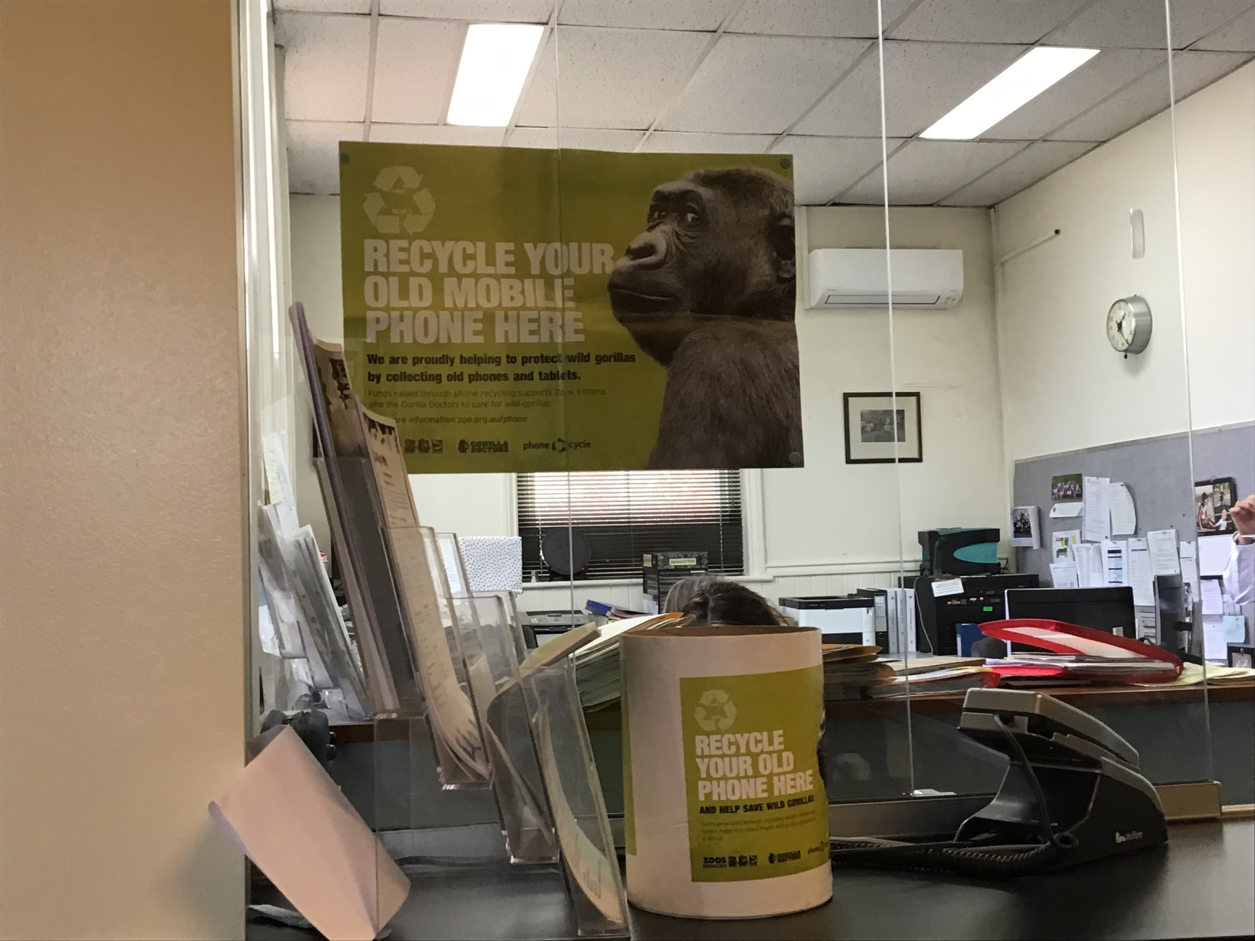
Where??
At the office window. You will often see the poster first.
Here is the drive!

Slide 8

THANK YOU
for answering their call
http://tiny.cc/CallingOnYouCHPS

