Slide 1

2024 Annual Report and 2025 Annual Implementation Plan

Slide 2
Develop students who are
literate and numerate.
Embed a whole-school approach to
health, engagement, and wellbeing
Embed systematic assessment practices to direct and improve student learning.
Strengthen teacher capacity to develop and implement high quality programs of learning.
Articulate and embed whole school wellbeing practices and approaches.
Develop whole school targeted intervention practices and protocols that promote attendance.
ACTIONS
Rubrics
Building Leadership Team and staff’s capacity on creating and using rubrics effectively to drive PLC.
Consistent Data Collection
Team Leaders able to facilitate conversations to identify outcomes in practice.
Spanish
Initiate Spanish Languages Assessments (Cervantes with Selected Students)
ACTIONS
Literacy
Writing intervention provided for students before school as a new model to support the Teacher Learner Initiative
Refine teachers thinking in relation to our Instructional models in Literacy
Numeracy
Create a new continuum, based on VicCurric 2.0 and the four proficiencies.
Create new assessments based on our new continuum incorporating rubrics.
ACTIONS
Wellbeing Team
Continue to strengthen the WET & TWT alignment.
Continue to build Wellbeing Team and their support in implementing Newlands Positive Behaviour Strategies.
Publish Wellbeing handbook for teachers and community.
Using Peer Observations to ensure consistent practices of Tier 1 Classroom Practices
Parent Capacity
Provide parent information sessions/workshops
Wellbeing information is delivered through newsletter.
ACTIONS
Review and update current attendance policy which ensures stronger processes to follow up student absences
OUTCOMES
Teachers use data more effectively to reflect on and inform the whole class teaching content.
Students in 5/6 use rubrics to identify strengths and next areas of growth as individual learning goals.
Teachers use rubrics to support individual and group learning needs
Teachers upload data to common point with data analysis tools to support local and DET assessments.
OUTCOMES
Stronger understanding of the four proficiencies
Consistent understanding of Literacy Practices
Building a sound knowledge of the new Maths 2.0 Vic Curriculum
OUTCOMES
Wellbeing Team
Wellbeing Team support and deliver professional learning to staff
Parent Capacity
parents are supporting their children to apply strategies for resilience
OUTCOMES
Unexplained absence are followed up with stronger parent/school relationship
Staff demonstrate stronger awareness oof process for students with absence of attendance.
Notes:
2024 AIP

Slide 3
2024 Academic Goals

Slide 4
Writing Goals
Reduce the percentage of Year 3 students in the developing category for Writing from 18% (2023) to 10%.
While we did not meet our goal, we successfully reduced the percentage from 18% to 13%.
Writing intervention programs in Term 3 & 4 have been prioritised to further improve outcomes, particularly for Grade 3 & 5 NAPLAN results in 2025.

Slide 5
Writing Goals
Increase the percentage of Year 5 students in the exceeding category for Writing from 10% (2023) to 15%.
The percentage increased to 14%, just shy of our target.
Refinements in instructional and organisational models have improved the mean score from 493 (2023) to 512 (2024).
Our NAPLAN results are now comparable to similar schools and above network and state averages.
Continued improvement is expected through the Writing Intervention morning program.

Slide 6
Numeracy Goals
Increase the percentage of Year 5 students in exceeding for Mathematics from 3% to 23%.
While we did not reach 23%, we achieved significant progress, moving from 3% to 17%.
A major instructional shift in Semester 2 (2023) ensured Spanish instruction focused on fluency and number concepts, allowing English instruction to emphasize problem-solving and reasoning.
The before-school Maths Club, running three days a week for over 40 students, has positively impacted student outcomes based on summative data (Essential Assessment).
"Facts on Fire" and Daily Reviews are expected to further support student understanding and overall numeracy results.

Slide 7

Creation of Newlands Teaching and Learning Booklet

Slide 8
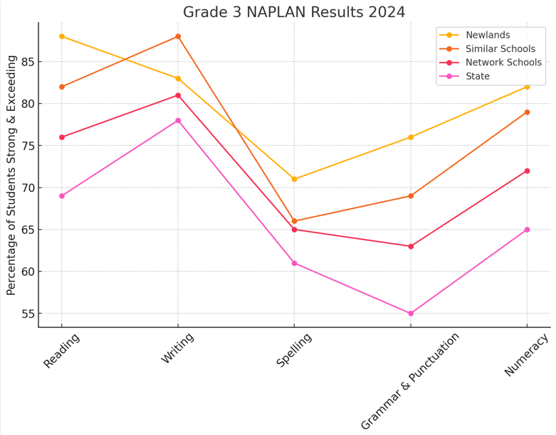
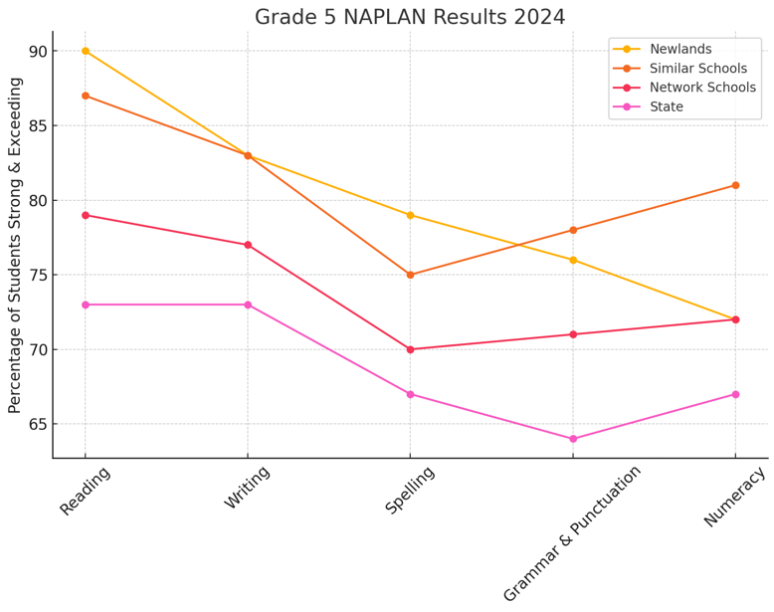
Our 2024 NAPLAN Results

Slide 9
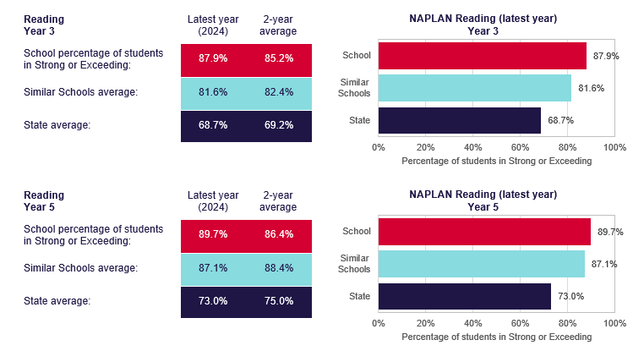
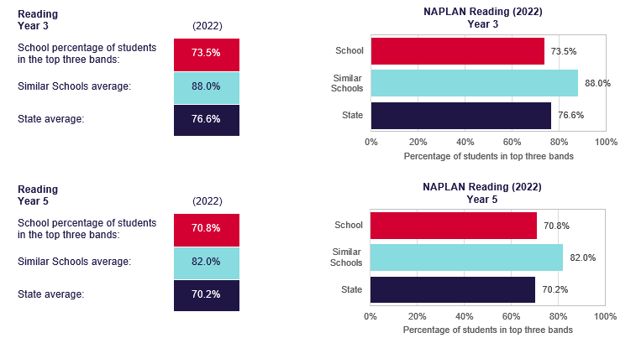
Our 2022 - 2024 Reading NAPLAN Comparison

Slide 10
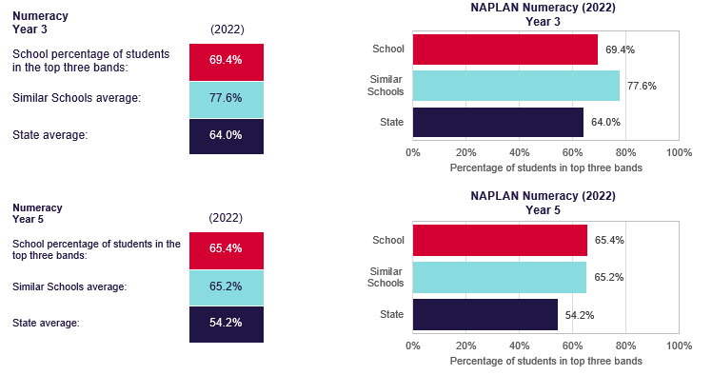
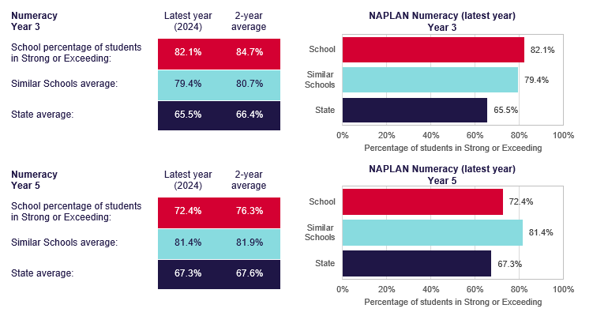
Our 2022 - 2024 Mathematics NAPLAN Comparison

Slide 11
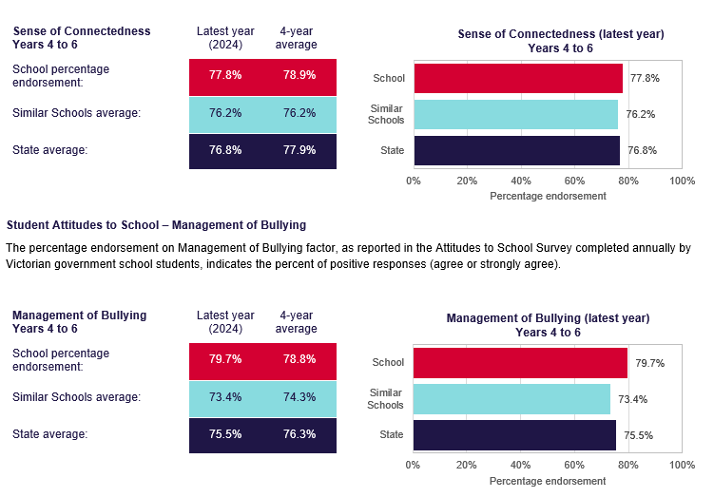
Our 2024 Wellbeing Indicators

Slide 12
2024 Wellbeing Goals

Slide 13
Creation of a Wellbeing Team
Team Established (2024): Led by Wellbeing Coordinator, focused on student and staff mental/emotional health.
Key Tasks:
  Creation of Newlands Wellbeing Handbook for consistent wellbeing practices.
  Professional Learning Sessions for teachers on these practices.
  Rubric Matrix: A tool for peer observations to guide feedback and improve wellbeing strategies.
Future Steps:
  Official unveiling of handbooks and workshops for parents in 2025.

Slide 14
Supporting Parents in Developing Child Resilience
Parent Information Sessions & Workshops:
Organised multiple sessions throughout the year, including collaborations with:
  'Talking the Talk'
  The Preston Police on Internet Safety
  The Resilience Project
Attendance varied across workshops.
Wellbeing Page & Newsletter:
Regularly updated with articles, information, and updates on school practices.
Frequently accessed by families, indicating strong engagement.

Slide 15
Supporting Teachers in Enhancing Student Resilience
Professional Learning & Behaviour Support:
Developed a comprehensive bank of resources during whole-school professional learning.
Resources cater to Tier 1, Tier 2, and Tier 3 behaviours, assisting teachers in:
  Creating individualised student plans.
  Accessing classroom support materials.

Slide 16

Creation of Wellbeing handbook for community & 90 Page Version for Teachers

Slide 17
Decrease in Students Reporting Low 'Resilience'
Target: Reduce the percentage of students reporting low 'Resilience' from 38% to 20%.
Current Status: Decreased from 38% to 35%.
Actions Taken:
  Wellbeing Hour Focus: Targeted class needs through dedicated Wellbeing hour for each class.
  Rockin’ Resilience Forum (Term 4): Strategy session for parents and students.
  Wellbeing Handbook: Focused on wellbeing practices, with more deliberate implementation planned for 2025.
Outcome: Continued improvement expected with deeper integration of strategies in 2025.

Slide 18
Increase in 'Confidence and Resilience' (Parent Survey)
Target: Increase confidence and resilience from 68% to 80%.
Result: Achieved 83% (exceeded goal).
Family Feedback:
  Families report stronger confidence through Tier 1 Wellbeing strategies.
  Parents feel students are supported to persist when learning is challenging, especially through conferences and intervention programs.

Slide 19
2024 Student Attendance & Absenteeism performance
Reduce student absenteeism exceeding 20 days per year from 36% to 25%.
Outcome:
Achieved a reduction to 31% absenteeism in 2024.
While the goal wasn't fully met, this represents a 5% improvement from the previous rate.
Comparison with Peers:
Newlands' absenteeism rate is lower than:
  Similar Schools: 35%
  Network Schools: 37%
  State Average: 39%
High Attendance Achievements:
30% of Newlands students attended 95% or more of the time.
This surpasses attendance rates of:
  Similar Schools: 27%
  Network Schools: 27%
  State Average: 26%.

Slide 20
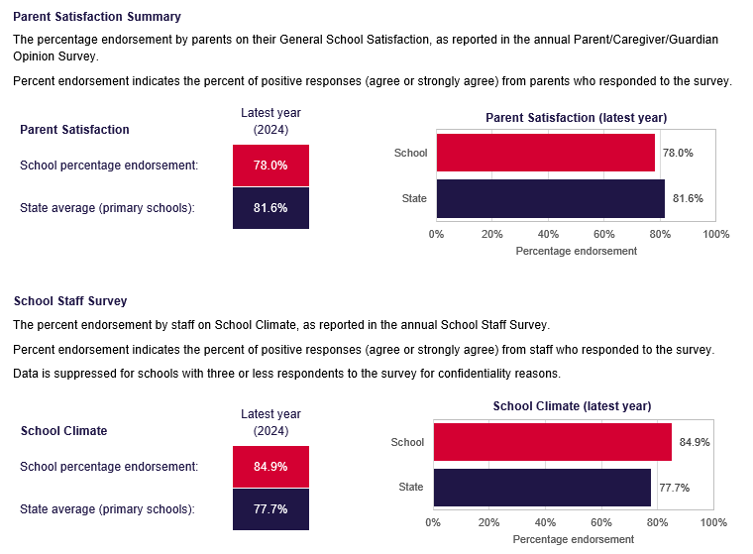
Parent and Staff Satisfaction Summary

Slide 21
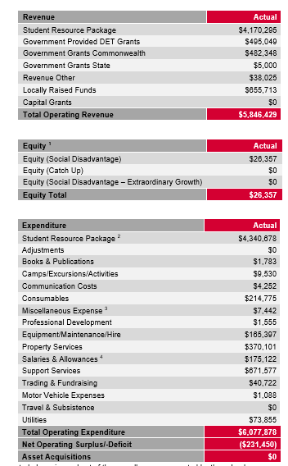
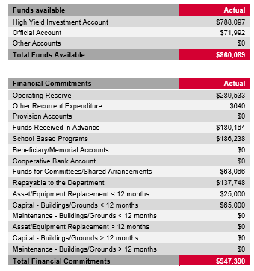
Financial Position

Slide 22

Financial Position
Current Financial Position:
Managed Deficit: The school is operating with a managed deficit of $137,748.00.
Bank Balance: As of December 31, 2024, the reconciled bank account balance stood at $860,088.99, indicating a healthy financial position moving into 2025.
Extraordinary Revenue in 2024:
Out of Hours Care Program: Generated $721,914.00.
Government Grants: Received $186,283.00 from the School Saver Bonus ($400 per child) and the Camps, Sports, and Excursions Fund (CSEF), allocated for ongoing family support.
Parents & Friends Association (PFA): Raised $48,845.00.
Total Extraordinary Revenue: $957,042.00
Extraordinary Expenditure in 2024:
Building Works: Spent $184,067.00 on projects including the staff room, bag racks, and gym doors.
Furniture: Invested $85,514.00 in staff room and learning world furniture.
Casual Relief Teachers: Expenditure of $176,244.00.

Slide 23

2024 Highlights
Newlands Primary School has had a vibrant and eventful year, marked by numerous activities that foster community engagement and student development.
Year Highlights:
Spanish Fiesta: The year commenced with the lively Spanish Fiesta, celebrating our bilingual program and immersing students in Spanish culture.
Whole School Production: "El Viaje Mágico" captivated audiences, showcasing the remarkable talents of our students.
Year-Round Activities:
School Camps and Excursions: Students participated in enriching camps and excursions, enhancing their learning experiences beyond the classroom.
Interschool Sports Competitions: Our students actively engaged in sports, promoting teamwork and physical well-being.
Incursions and Excursions: A variety of educational visits and guest sessions broadened students' horizons throughout the year.
Parents and Friends Association (PFA) Events:
Welcome Back Picnic: The year began with a picnic that brought families together, fostering a sense of community.
Outdoor Cinema: An outdoor movie night provided a fun and relaxed environment for families to enjoy together.
Comedy Gala: The PFA hosted a successful Comedy Gala on September 14, 2024, featuring performances by talented comedians and raising funds for school initiatives. newsletters.naavi.com
School Fete: On November 9, 2024, the "Fete de la Primavera" celebrated spring with inflatables, petting zoos, face painting, arts and crafts, diverse food offerings, and live performances, uniting the community in a day of fun and festivity.
Community Engagement:
Newlands Primary School thrives on active community participation, offering numerous opportunities for families to engage in educational, social, and fundraising activities. Our calendar is filled with events that cater to diverse interests, ensuring there's always something exciting for families to contribute to and enjoy, reinforcing our status as a central hub in the community.

Slide 24
2025
Annual Implementation Plan

Slide 25
Develop students who are
literate and numerate.
Embed a whole-school approach to
health, engagement, and wellbeing
Embed systematic assessment practices to direct and improve student learning.
Strengthen teacher capacity to develop and implement high quality programs of learning.
Articulate and embed whole school wellbeing practices and approaches.
Develop whole school targeted intervention practices and protocols that promote attendance.
ACTIONS
Numeracy & Writing
Creation of Whole School P-8 Rubrics in Number Concepts aligned with Mathematics 2.0 & Literacy 2.0.
Build stronger triangulation of assessment data in Writing through the implementation of Elastik
Spanish
Utilise recognised assessments to track student and school growth in Speaking, Listening and Reading.
Progression points assigned for Spanish Reading, Writing, Speaking and Listening
ACTIONS
Numeracy & Literacy
Introduction of Response to Intervention model in Numeracy (Begins Term 2)
Consolidate the implementation and monitoring of Facts on Fire and Daily Review
Implementation of Daily Review
Align the sequence of learning with the Literacy program structure (Literacy Block)
Spanish
Creation of Onboarding program for new Spanish teachers at Newlands
Publishing revised Spanish Continuums (inclusive of external assessments)
ACTIONS
Upskilling Leading Teachers involving the school's and DET Wellbeing practices
Embedding consistent practices driven by the Principles and Processes Wellbeing Handbook
External DIP Training for Leading Teachers
Whole School Professional Learning
Refining Induction/onboarding processes
ACTIONS
To embed the attendance policy and procedures for staff
To communicate and promote high attendance with school community
OUTCOMES
Creation of Whole School P-8 Rubrics in Number Concepts aligned with Mathematics 2.0 & Literacy 2.0.
Students tracked using scope & sequence, continuum tracker and rubrics
Teacher know students’ understanding of the four proficiencies
Teachers know students’ understanding of the six writing traits
Community has a better understanding of students assessment and home support
Identify the gaps in our Spanish program in relation to International accreditation
OUTCOMES
Tier 2 Intervention model established in Numeracy
Students making growth in Numeracy due to Tiered Intervention
Students are making significant growth in Numeracy due to fact fluency understanding
Students are able to engage in higher order problem solving learning experiences
English Literacy
Teachers design Scope and Sequence for interleaved retrieval practices (Daily Review)
Quicker transition and understanding of Newlands Instructional Practices
Stronger confidence for staff to contribute to Newlands Professional Learning Model.
Spanish
Revised Spanish Continuums
Creation of Onboarding program for new Spanish teachers at Newlands
OUTCOMES
Leading Teachers have a deeper understanding of student wellbeing needs
Leading Teachers have a deeper understanding of the Teacher Support required
New staff are supported in developing an understanding of NPS wellbeing principles, practices, and procedures
All staff are further supported in embedding NPS wellbeing principles, practices, and procedures
OUTCOMES
Consistent procedures to document, track and monitor student attendance
Increased communication between teachers and parents regarding attendance
Increased parent awareness of the impact that high student absence has on learning
Creation of Return to School plans to support families
Notes:
2025 AIP

Slide 26

Writing
2025 Academic Targets
2025 AIP Goals
Reduce the amount of students in Grade 3 'Developing' from 13% in 2024 to 8% in 2025.
Raise the amount of students in Grade 5 'Exceeding' from 14% in 2024 to 20% in 2025.

Slide 27
Numeracy
2025 Academic Targets
2025 AIP Goals
Raise the amount of students in Grade 3 'Exceeding' from 21% in 2024 to 30% in 2025.
Raise the amount of students in Grade 5 'Exceeding' from 17% in 2024 to 23% in 2025.

Slide 28
Wellbeing Targets
Decrease in students reporting low 'Resilience' from 35% in 2024 to 20% in 2025.
Increase in 'Student Voice and Agency' factor from 70% in 2024 to 80% in 2025.
The percentage of students being absent from school for over 20 days in a calendar year will have decreased from 34% to 25%.

Slide 29
Staff Opinion Survey
'Staff seek feedback to improve practice' will increase from 68% in 2024 to 80% in 2025.
'Have time to share pedagogical content knowledge' will increase from 64% in 2024 to 75% in 2025.

Slide 30
2025 Financial Focus
Out Of Hours Care Space upgraded
B-Block refurbishment in preparation for 2026 with 6 X 5/6 Classes
Oval being fixed to allow for more space for students to utilise during recess and lunchtime

