Slide 1

Parent Information Session
Year 3/4
Notes:
Sophia

Slide 2
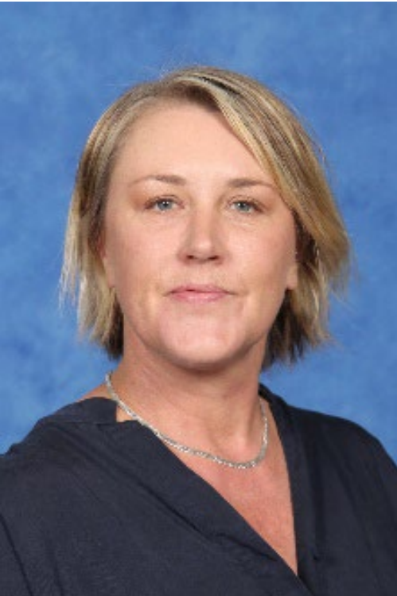
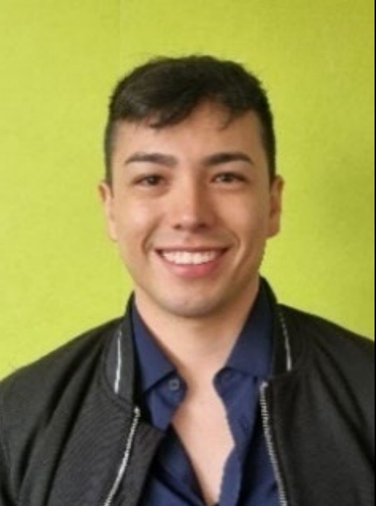
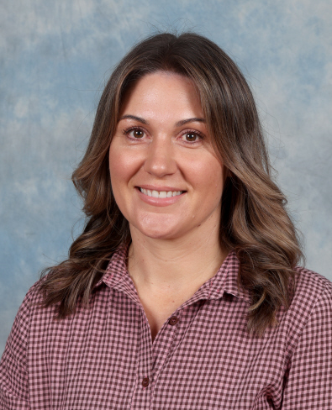
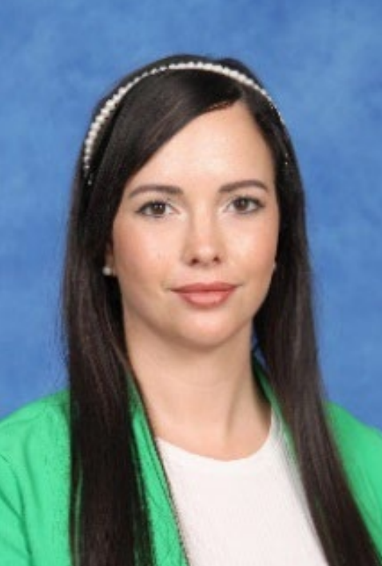
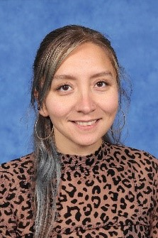
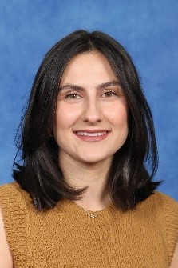
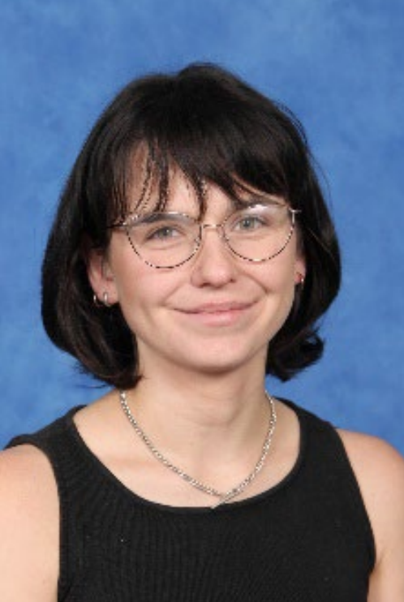
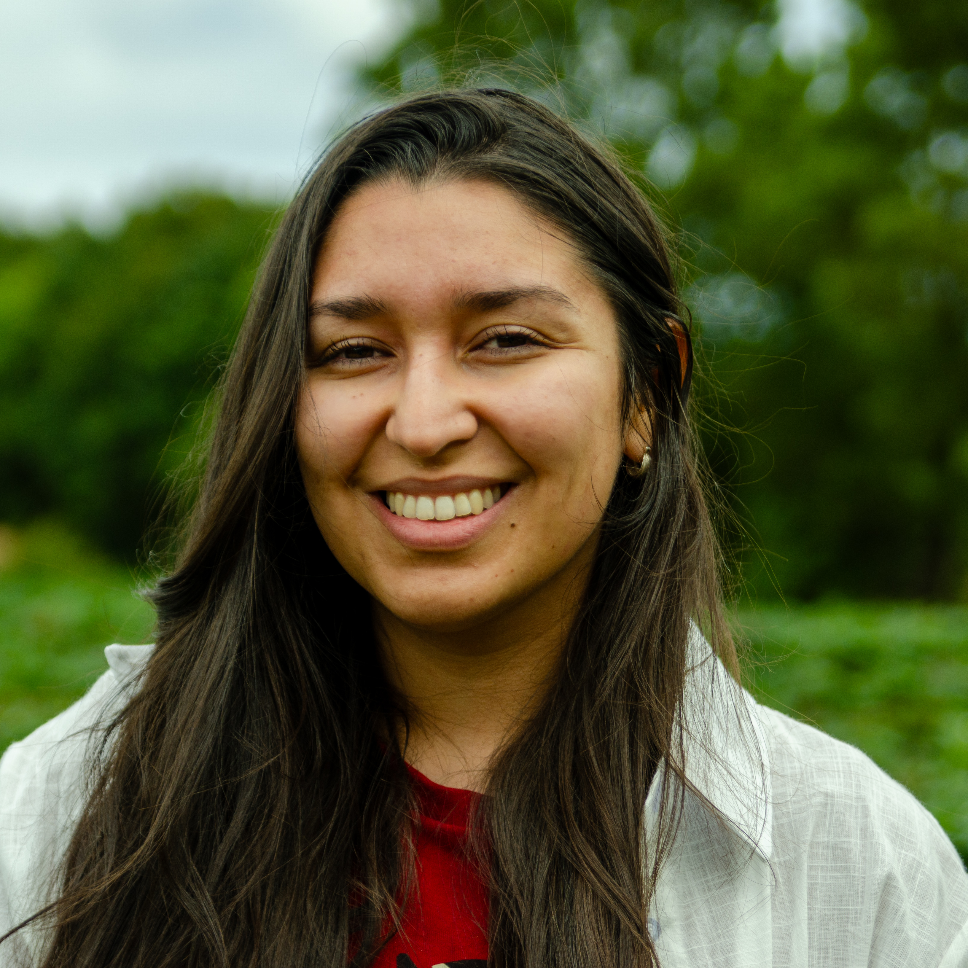
¾Team
Sophia
Lisa
Diego
Lucinda
Angelica
Team Leader 34AB
34AB
34CD
34CD
Courtney
Connie
Steph
Sophia
34EF
34EF
34 Education Support
34 Leading Teacher
Notes:
Sophia

Slide 3





The Learning Community Leader
Sophia
Learning Community Leaders primary role is to Build Effective Professional Learning Teams that support and develop the teachers and students within their team.
Running morning
Writing/ Maths programs
(with teachers)
Leading Newlands Planning Model in all subject areas
Visibility in cohort classrooms and supporting teachers with individual students when needed
Mentoring and coaching classroom teachers
Visible and accessible before and after school during yard duty
Notes:
Sophia
This year, we’re excited to introduce Learning Community Leaders who are now assigned to each cohort, making things even more connected and collaborative! In the past, we had subject-based leaders like the Literacy Leader or Numeracy Leader, but these roles sometimes felt a little disconnected from the classroom. With our new approach, the focus is all about building stronger relationships and creating a more hands-on impact in coaching, mentoring, and supporting both teachers and students. It’s all about teamwork and making learning even more exciting!
In 2025, our goal is all about tapping into the strengths of each team and individual teachers, facilitating planning sessions for greater impact, and really focusing on the unique needs of each cohort. Our Learning Community Leaders are at the heart of this mission, building strong teams, running our before school writing and math programs (along with other passionate teachers), and leading the Newlands Planning Model across all subjects.
They’ll be in the classrooms, supporting teachers, and working side-by-side with them through mentoring, coaching, and collaborative teaching. It’s all about making sure both teachers and students thrive and grow together!

Slide 4
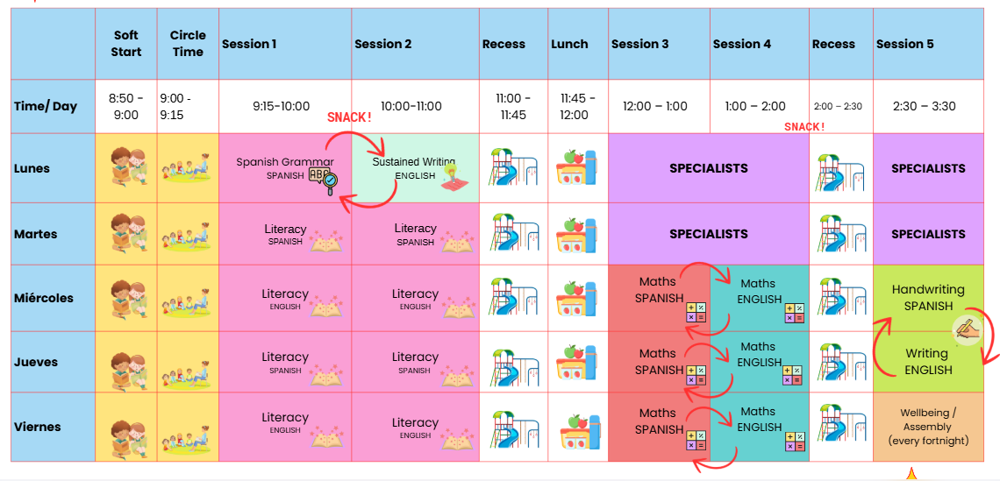
34 Term 1 Timetable
Angelica
Notes:
Angelica

Slide 5

Communication Flowchart
Sophia
Teachers
The teachers are the first point of contact. Contact for day to day questions, non urgent updates or concerns.
Learning Community Leader
Contact Sophia when requiring further support. This may include, setting up formal meetings, wellbeing, targeted support.
If the issue has not been resolved at the previous levels, or if it involves a school-wide concern (e.g., bullying, major academic challenges, safety), the Principal or Assistant Principal should be contacted.
Principals
Notes:
Sophia

Slide 6

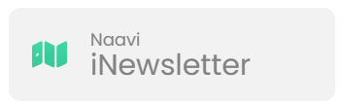


School / Parent Communication
Lisa
  School Communication
  Payment and Permissions
  Absence Management
  Notifications and Notices
  Parent/Teacher Interview Booking.
  Access to School Calendar
  Semester Reports
  Published weekly (Friday)​
  Essential school-based communication​
  Upcoming events, classroom news, community news, school initiatives and ensures families stay up to date with essential and current happenings at Newlands.
Ensure urgent/timely communication goes via the office
  Payment and Permissions
  Absence Management
  Communicate medical/health care plans
  Visibility into learning experience to support and celebrate learning.
  Assessment posts/recording.
Notes:
Sentral -
School Communication: Send and receive messages from your child’s homeroom, specialist teachers, and LCL
Payment and Permissions: Provide permission and make payments for camps, excursions, and incursions.
Absence Management: Easily communicate and respond to unexplained absences, as well as submit future absence requests.
Notifications and Notices: Receive timely notifications for community events, absence alerts, and school notices sent directly to your device.
Parent/Teacher Interview Booking.
Access to School Calendar: View and sync the school calendar with your phone to keep track of important dates and events.
Semester Reports: Stay informed by viewing your child’s individual learning plans and end-of-semester reports.

Slide 7
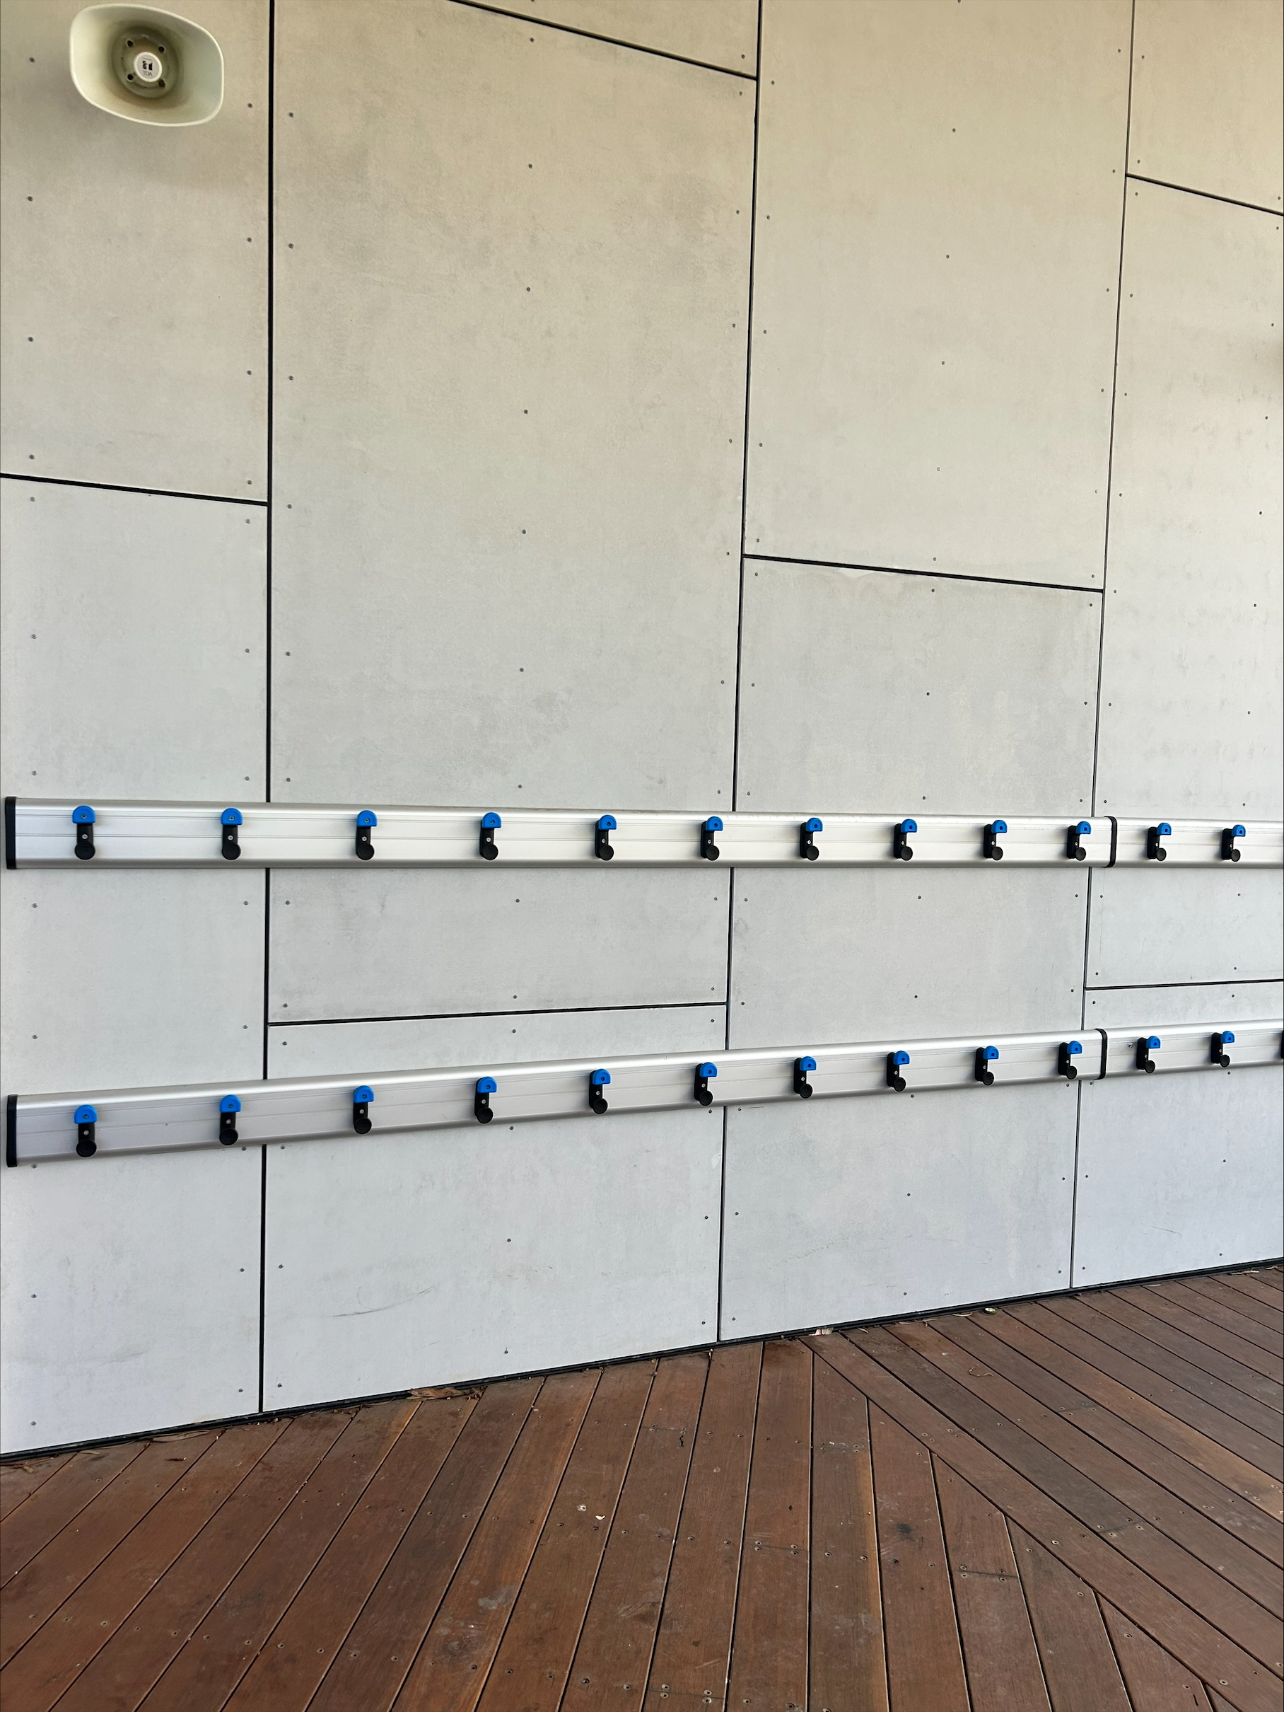
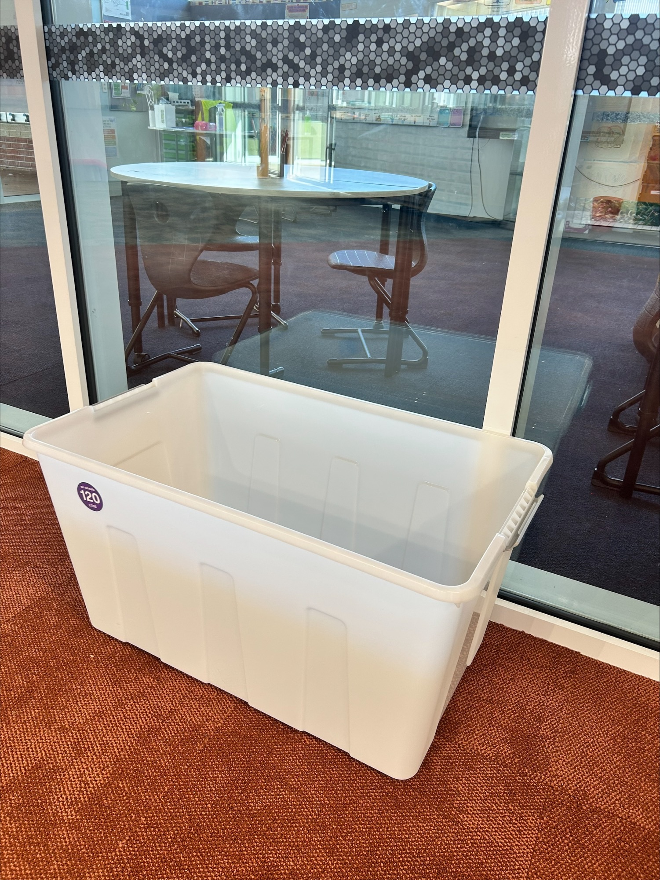
Bags/Lunchboxes
Lisa
Bags
Bags should be on the bag hooks attached to the classroom your child starts the day with.
Bags should not be left on the ground.
Lunch boxes
Lunch boxes in Term One are to be taken out of bags in the mornings
and left in the communal room tubs.
They will be returned to the student's bags at the end of day in pack up time.
Notes:
Lisa

Slide 8

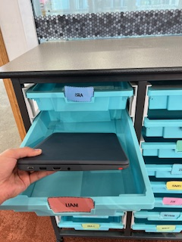
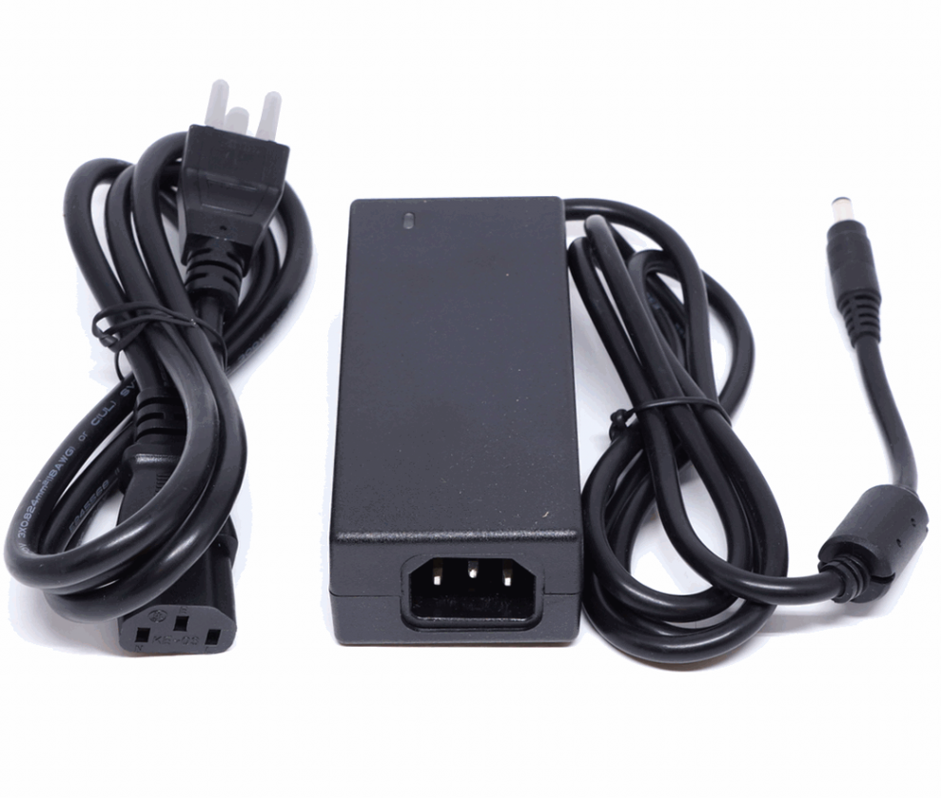
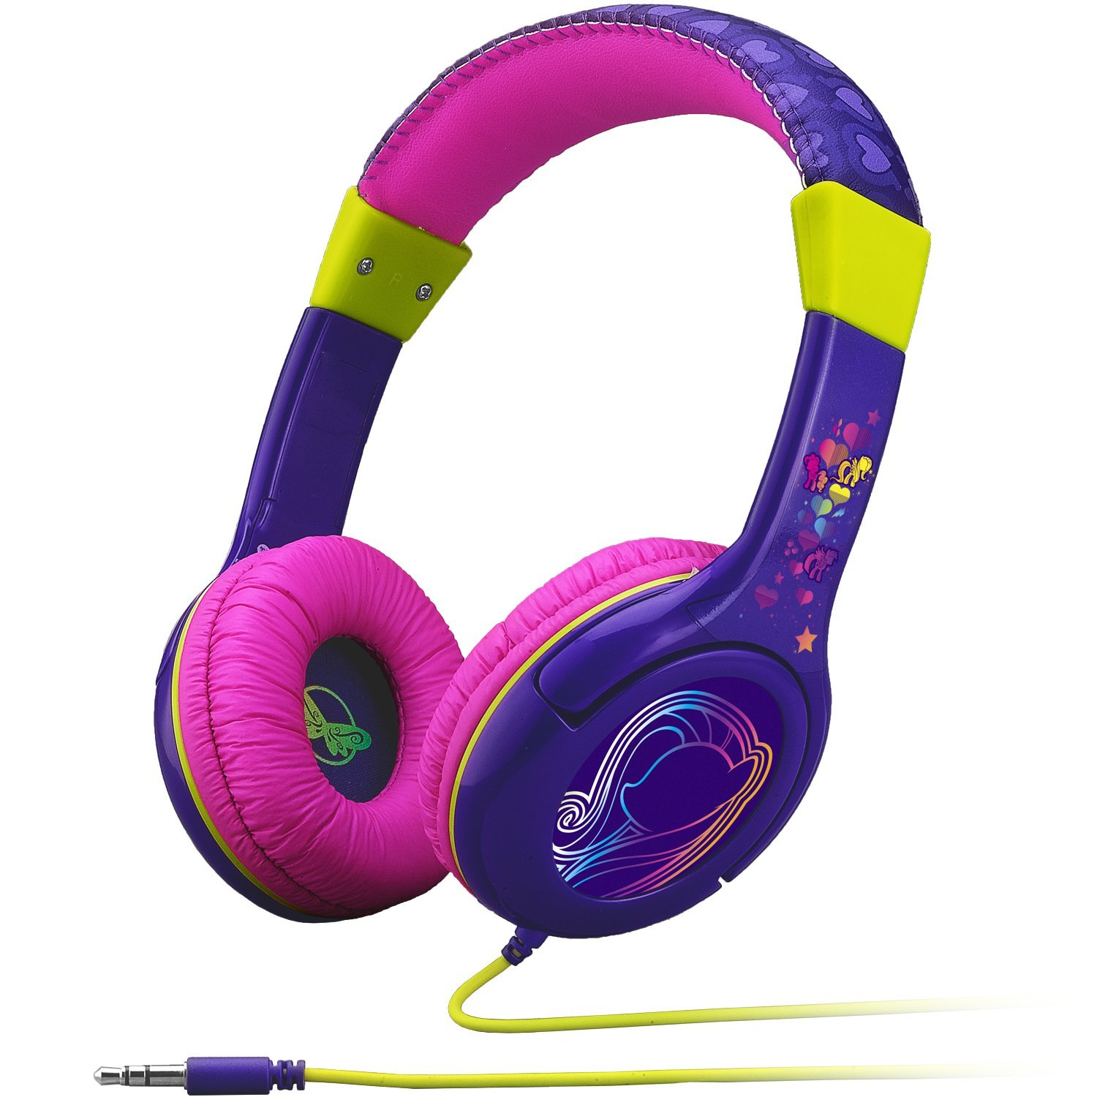
Laptops
Angelica
Each morning, laptops need to be stored in their laptop trays
It is each students' responsibility
to look after their laptops.
Laptops should come to school charged and ready to go.
Headphones will need to be provided by families. ​​​​
Notes:
Angelica

Slide 9
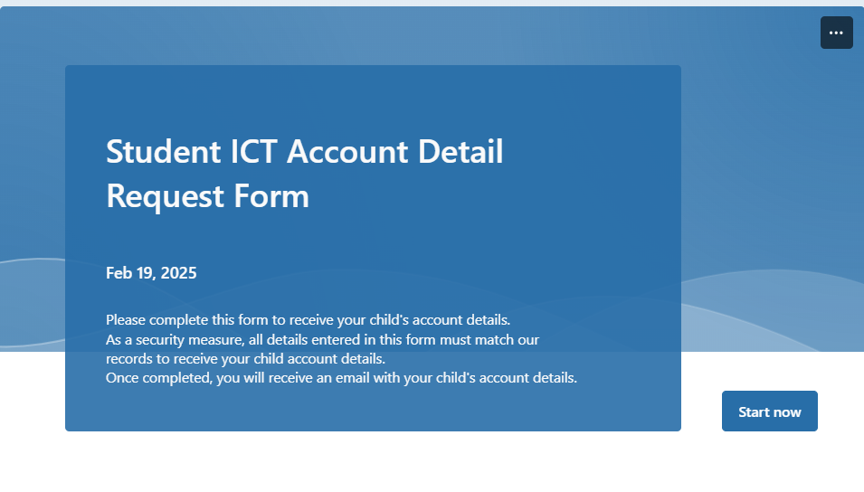
Student ICT Account Details
Angelica
Student ICT account details are emailed at the start of each school year.
You can also request your child’s account details by completing the Student ICT Account Details Form on the school's website.
Please contact the classroom teacher if you are having trouble signing into any platforms.
Notes:
Angelica

Slide 10
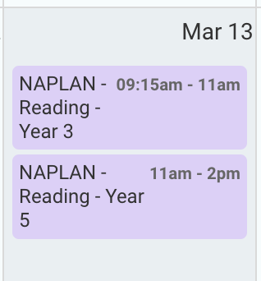
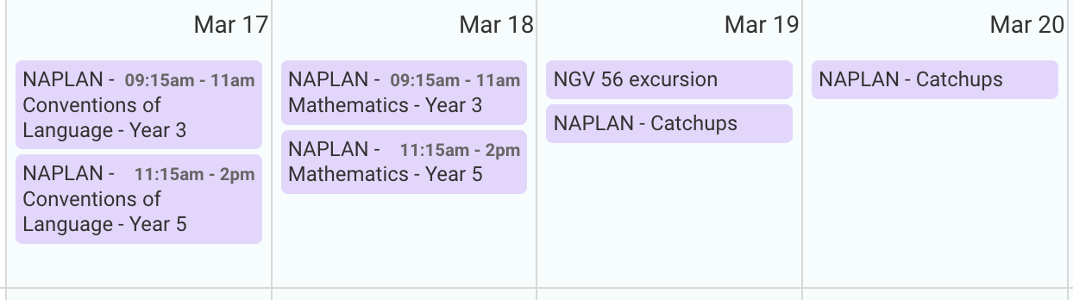
NAPLAN
Lisa
Starts week 7
Students will be with English teacher during the NAPLAN times
Students will need their laptops; they will be using these for their tests. The only written test is the Writing test.
They will have to have a NAPLAN test program put onto their laptops (Jose has begun organising this). Please keep this on their computers.
The students will need headphones for their tests – we have a communal collection at school; however, you may like to bring your own
Tests are around an hour long.
We have been preparing with them over the last couple of weeks.
Notes:
Lisa

Slide 11
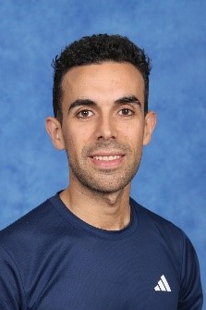
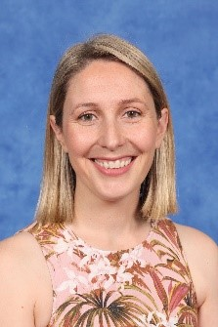
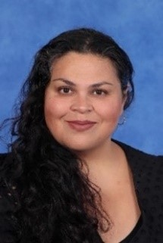
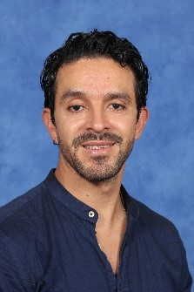
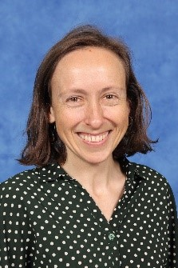
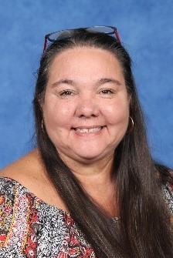
Specialist Team
Margaret – Visual Arts
Raul - HPE
Raema - STEAM
Felipe – Performing Arts
Nerida - Inquiry
Karren - Wellbeing
Notes:
Raema

Slide 12






Specialist
What do we teach?
Specialist teachers can be messaged on Sentral
Pick up at the quadrangle at 3.30pm
Whole School Events 2025
 | Monday |  |  | Tuesday
 | 12:00 | 1:00 | 2:00 | 12:00 | 1:00 | 2:00
3/4A | Visual Art | STEAM | HPE | Inquiry | Wellbeing | Performing Arts
3/4B | STEAM | Visual Arts | Performing Arts | Wellbeing | Inquiry | HPE
3/4C | Performing Arts | HPE | Inquiry | Visual Arts | STEAM | Wellbeing
3/4D | HPE | Performing Arts | Wellbeing | STEAM | Visual Arts | Inquiry
3/4E | Inquiry | Wellbeing | Visual Arts | HPE | Performing Arts | STEAM
3/4F | Wellbeing | Inquiry | STEAM | Performing Arts | HPE | Visual Arts
Notes:
Raema
STEAM: The science and digital and design technologies curriculums are covered.
Students:
engage in experiments
code using robots and online sites.
create solutions related to their learning
Art is weaved throughout all of this.
The HPE program helps
-children stay active,
-learn about their bodies, and
-develop lifelong movement skills.
Through fun games and sports:
-we promote teamwork,
- well-being, and
-healthy habits for a strong and active future.
Inquiry – We are inquiring into some of the big issues that
define who we are and how we fit in,
drawing on Ethics and Philosophy to assist our
inquiries and to further understand our interactions with each other.
Wellbeing - This year, we’re diving into
-positive self-talk, resilience, and
-coping strategies to help us navigate challenges with confidence!
Most of what we do is based on the
-Resilience Program,
-Berry Street, and
-Safe Schools, as well as what you need.
Through fun activities, teamwork, and reflection, we’ll build skills:
- to stay strong,
-support each other,
-and thrive. Get ready for an exciting journey of growth, kindness, and self-discovery!
Performing Arts
Music and dance as subjects
focuses on developing foundational music skills
F-2 qualities of the sound. Dynamics and contrasts (*loud/soft*, *high/low*).
explicit teaching, hands-on instrument practice, group collaboration, and reflective activities
incorporates cultural exploration and creative expression to enhance musical understanding and appreciation.
Visual Art
The Art Program focuses on develop students' abilities as an artist:
- Exposed to a range these Visual Arts mediums; clay, drawing, collage, painting, sculpture and textiles.
They'll be learning about art elements, art movements and artists
Students artwork displayed throughout the school and there will be Biannual Art Show during October.
EVENTS
Ride2School Day, Specialist Day Celebration.
Term 2: Colour Run.
Term 3: Athletics Carnival.
Term 4: Art Show, swimming program (explain this year swimming is only for year 6s)

Slide 13
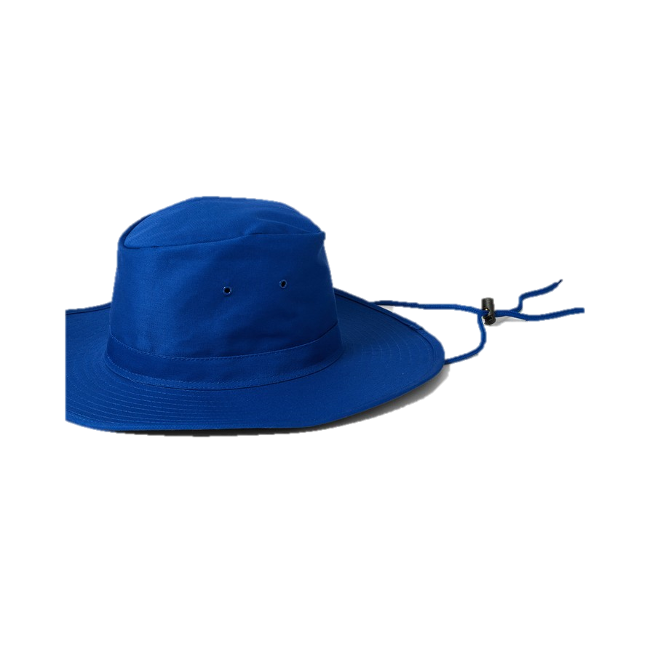
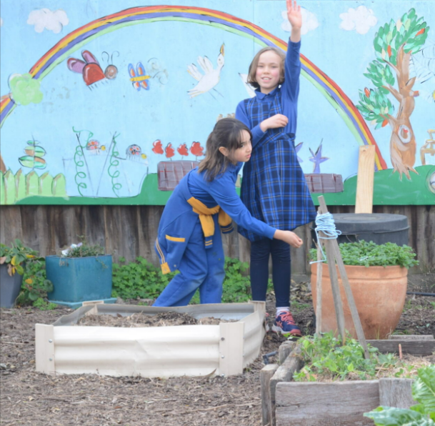
Angelica
Uniform, Hats and
Lost Property
Lost Property
Small tubs are located in the 3/4 common rooms.
At the end of each week unclaimed items will be moved to C block outside the STEAM classroom.
Hats
Wide brim hats are compulsory to wear in Term 1 and 4. We are setting up a Wellbeing Hub where students can go if they don't have a hat.
Uniform
Ensure all uniform/ personal items are clearly labelled. We encourage runners on PE days.
Notes:
Angelica

Slide 14
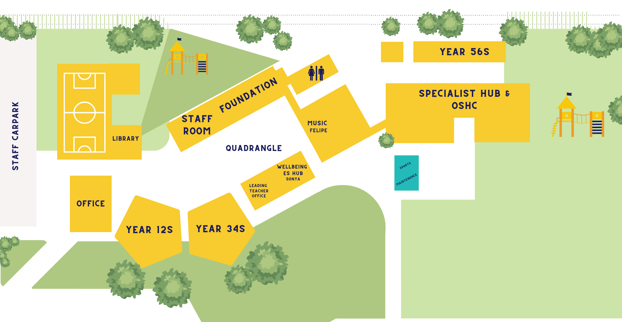
Play Areas
Angelica
Out of Bounds
Notes:
Angelica

Slide 15
Attendance
Sophia
Student Late Arrivals
Students that arrive at school later than 9:10 am, must sign in at the office. If a student arrives between 9:00 and 9:10am are to be marked as present by the classroom teacher.
All students who are late to school or are collected early are required to sign out at the office.
If your child is leaving early, we ask that it is not between 3:00- 3:30 or during playtime.
Notes:
Sophia

Slide 16
Soft Start
Lisa
The purpose of our soft start at NPS is to support students to smoothly transition from home to the classroom environment, and to mentally prepare for focused leaning.
8.50 – 9am students enter the learning space, and we ask that families say adios at 8:50am.
The activities our students engage in as part of the soft start include reading, drawing, and writing.
Four days a week the soft starts will be in your child's classroom.
One day a week they will be in the library. Children are to drop their bags off in classroom and then make their way to library.
Library
Lisa & Diego: Mondays
Lou and Angelica: Fridays
Connie & Courtney: Thursdays
Notes:
Lisa

Slide 17
Take Home Literacy Program
Lisa
Students to bring their reader bags to change their books every Friday
Students take 2 English books (readers, classroom library) and 2 Spanish readers
Expectation that students are reading 15 minutes each night
A booklet has been provided for students to record the books they are reading at home with a parent initial
Students have access to RazKids and Nessy online to support their reading and spelling
Facts on Fire will also be provided for further practice on Fridays in student reader bags.
Notes:
Lisa

Slide 18
Parent Helper Program
Angelica
Our parents' helpers are incredible!
A link was sent out on the newsletter week 2, if you still want to help contact your class teacher.
Parent help will with reading in English and Spanish if possible. From 9:15am – 10am.
Your classroom teacher will provide you with a list of students to read with.
If you can’t come on the day, contact your classroom teacher.
Notes:
Angelica

Slide 19


Reporting / Parent Teacher Interviews
Sophia
Termly Parent Teacher Interviews
Reports published Semester 1 and Semester 2
Alternate between Spanish and English teacher
Term 1 with both teachers​
Term 2-4 with one teacher
Notes:
Sophia

Slide 20
Camps, Excursions and Incursions
Sophia
Each term we will have an excursion/incursion. This is an opportunity to link our learning to a fun collaborative experience.
Term 1 – March 14th Supreme Incursions 'Team Building'
Term 2 – Excursion (Cultural Studies Focus: Indigenous Perspectives and History)
Term 3 – 3/4 Camp (September 15th – September 17th)
Term 4 – Excursion (Cultural Studies Focus: Bolivia and Ethical Capabilites)
Notes:
Sophia

Slide 21
Local Excursions / Photography
Sophia
A Permission Slip has been published on Sentral to obtain consent for all local excursion and photography that may take place in 2025.​
If you do not want to give consent for local excursions, please indicate this on the Sentral Permission Slip. ​
Local excursions may include walking local kindergartens, parks and community spaces. ​
Parents and Caregivers will be notified of any upcoming local excursion beforehand. ​
You may withdraw consent for local excursions at point in the year by calling the school on (03) 9354 2928 or emailing the school at newlands.ps@education.vic.gov.au.
Notes:
Sophia

Slide 22
Community Events
Lisa
NAPLAN week 7 and 8
Parent teachers interviews Friday 28th March
School photos March 31st
Cultural week assembly 4th April 1:30 –2:30
Bilingual Fiesta 4th April 3-6
Last day of the term 4th April School finishes at 2:30
Notes:
Lisa

Slide 23
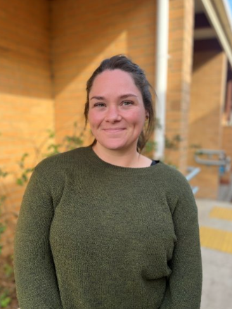
Outside of School Hours Care
Sophia
Newlands Primary School offers a nationally accredited before and after school care program.
Care is provided from 7:00am until 8.50am each day, and until 6:00 pm after school from Monday to Friday.
OSHC Phone Number: 0491 273 710
You are able to book in advance for the whole term, or book in casually.
Registrations are be completed online. The link can be found on our website.
Most families are eligible for a fee reduction through the child care subsidy system.
Example Activities: Arts and craft, sport, cooking, relaxation and quiet corners.
Notes:
Sophia

Slide 24

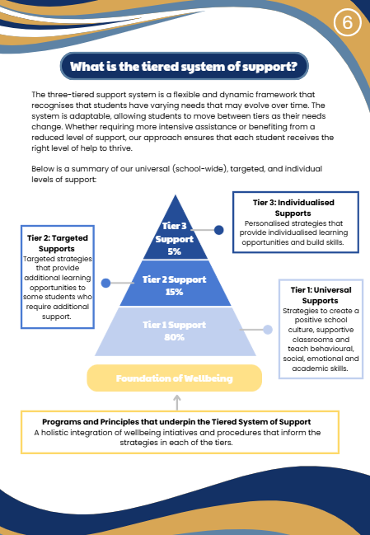
Supporting Your Childs
Wellbeing at School
Notes:
Sophia

Slide 25
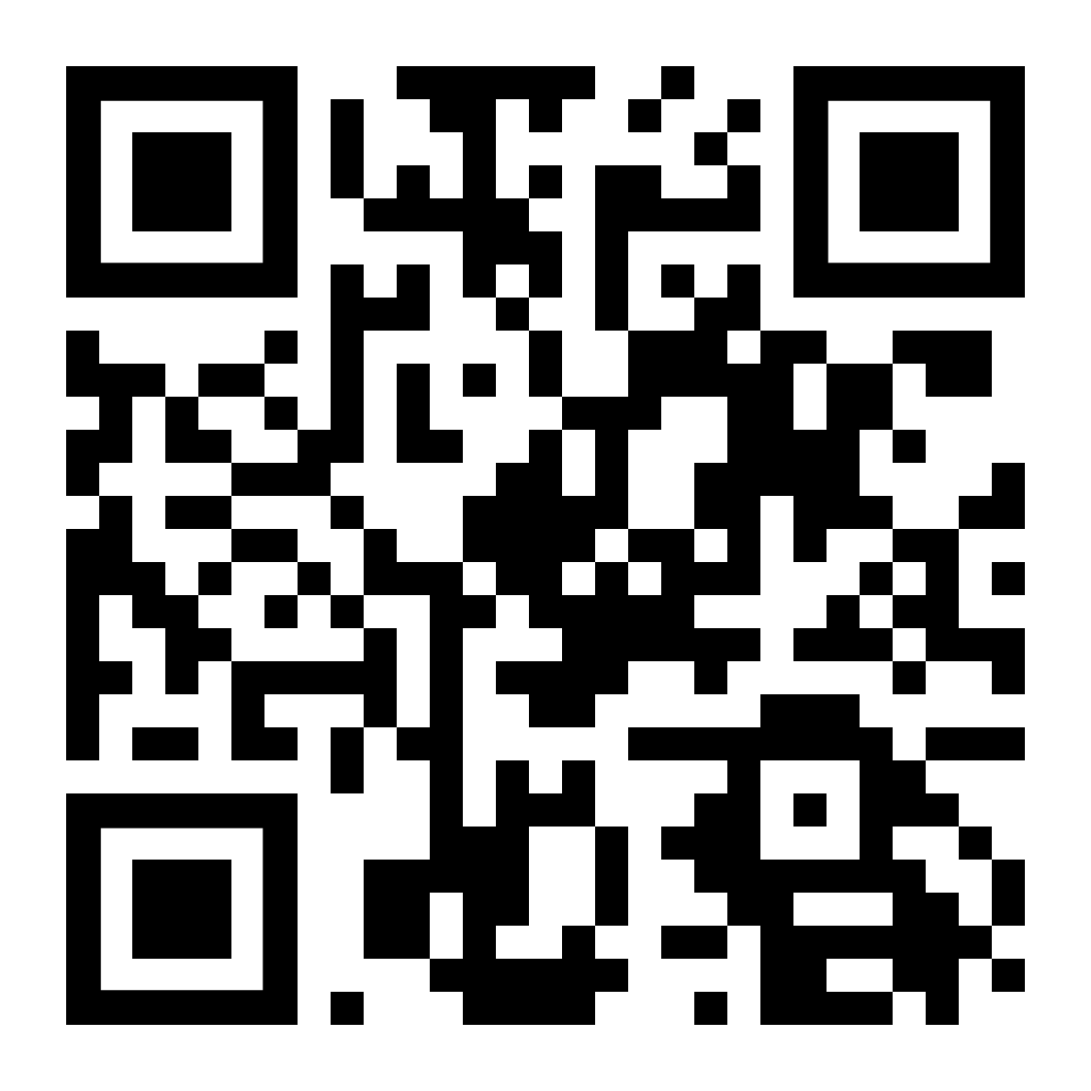
Parent Involvement
Sub-Committees
Parent & Friends Association - Community Events & Fundraising
Education Sub-Committee
Buildings and Grounds Sub-Committee
Finance Sub-Committee (School Council Members Only)
OSHC Sub-Committee
Reconciliation Action Plan Group (RAP)
Spanish Sub Committee
School Council
Notes:
Sophia

Slide 26

2026 Sibling Enrolments
If your child is currently in kindergarten and will be joining us next year, please complete the enrolment form on our school website, and send it to the school via email or directly to the office.
Notes:
Sophia

Slide 27
Want to Know more about Learning at NPS?
Who: Parents and families interested in knowing more about teaching and learning at Newlands are invited to a presentation.
What: A presentation from our Learning Community Leaders regarding:
Instructional Model
Assessments / Rubrics
Tiered Learning Model
When: Thursday, 20th of March
Where: Staffroom
Notes:
Sophia

Slide 28
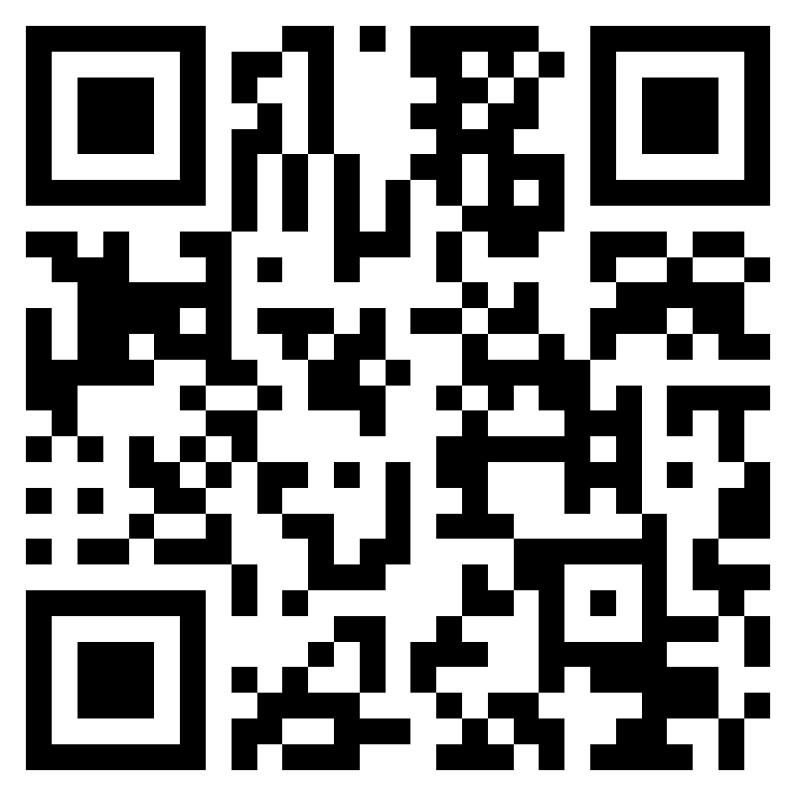
Further Questions
If you have a question that hasn't been addressed, please ask away in the QR code.
All responses will be published in next weeks newsletter.
Notes:
Sophia

