Slide 1
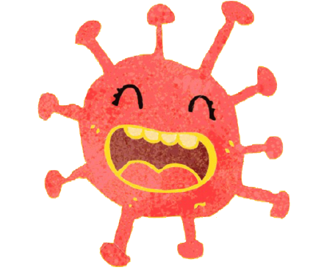
Coronavirus Story

Slide 2
The coronavirus is like the flu or a bad cold.

Slide 3
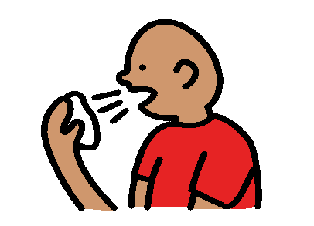
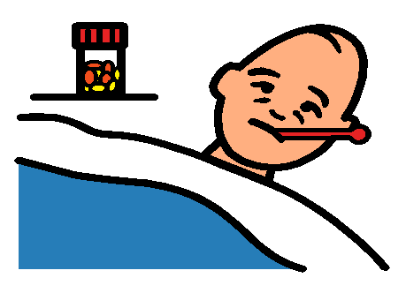
When people are sick with coronavirus, they might have a cough, a fever and find it hard to breathe. This is okay.

Slide 4

Not everyone who is sick has coronavirus. They may just have a cold.

Slide 5

Most people get better from the virus after a short time.

Slide 6

Most people do not need to go to the hospital.

Slide 7

Coronavirus has made things a bit different. This is okay. Things will go back to normal soon.

Slide 8

I need to stay home from school for a few weeks. This is okay.

Slide 9

I can do my school work at home and I will go back to school soon. This is okay.

Slide 10

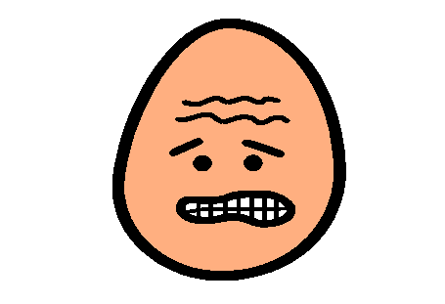

When I hear about coronavirus, I might feel:
confused
worried
scared
This is normal. This is okay.

Slide 11

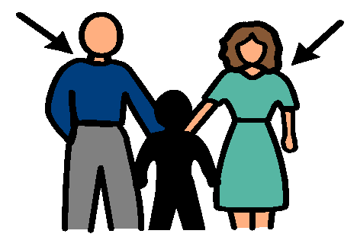
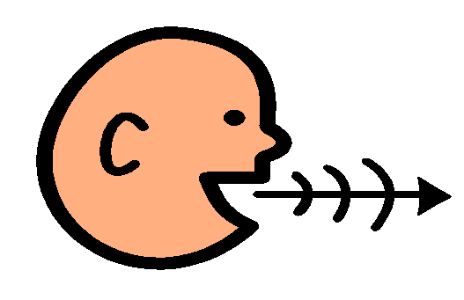
If I feel worried about the coronavirus, I can tell my parents. This is a good idea.

Slide 12
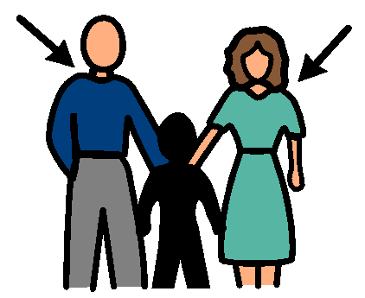

My parents can help me when I feel worried. This is a good idea.

Slide 13
Coronavirus might make things a bit different. This is okay. Things will go back to normal soon.

