Slide 1
Peter McCallum
Hospital Fundraiser, 2023
‘’Every donation makes a life-saving difference to people with cancer’’

Slide 2
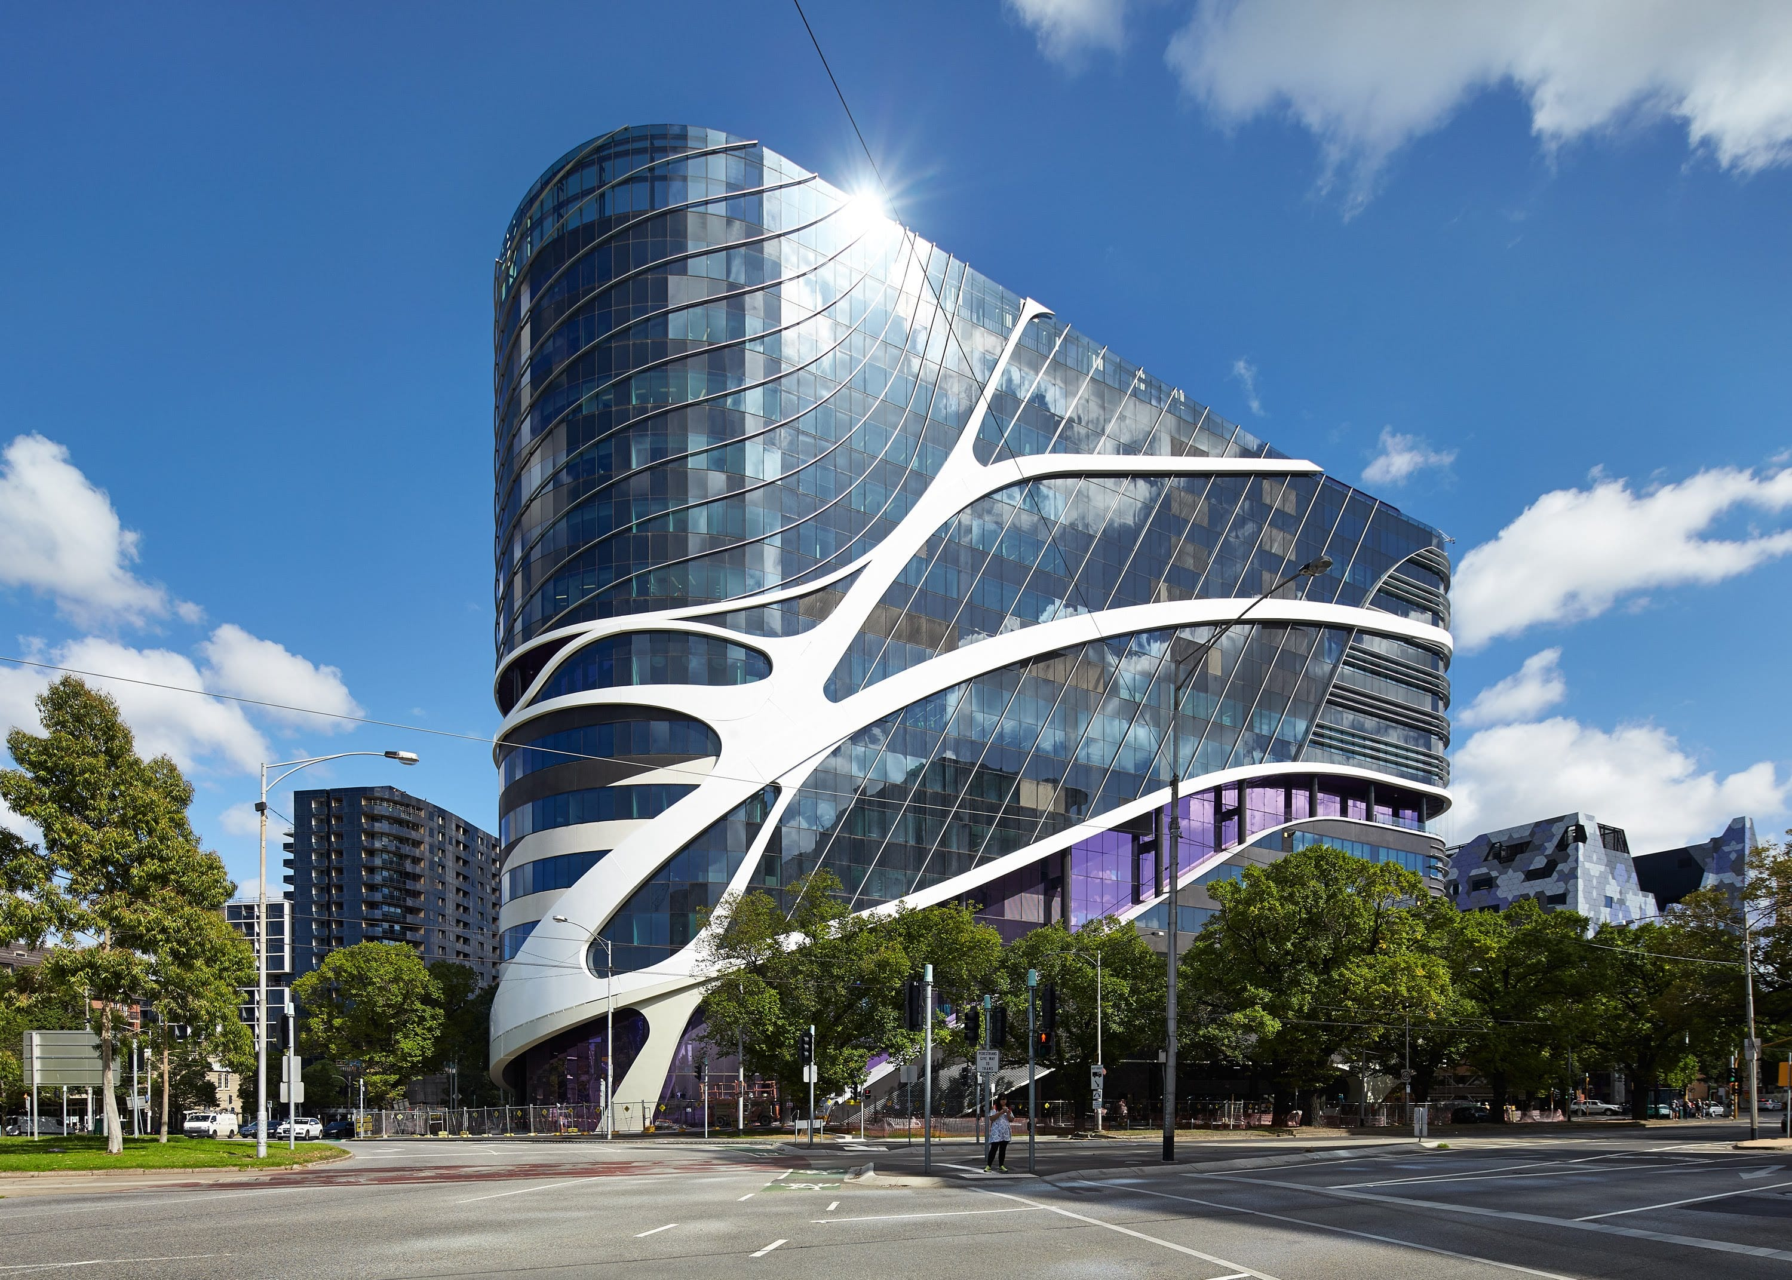
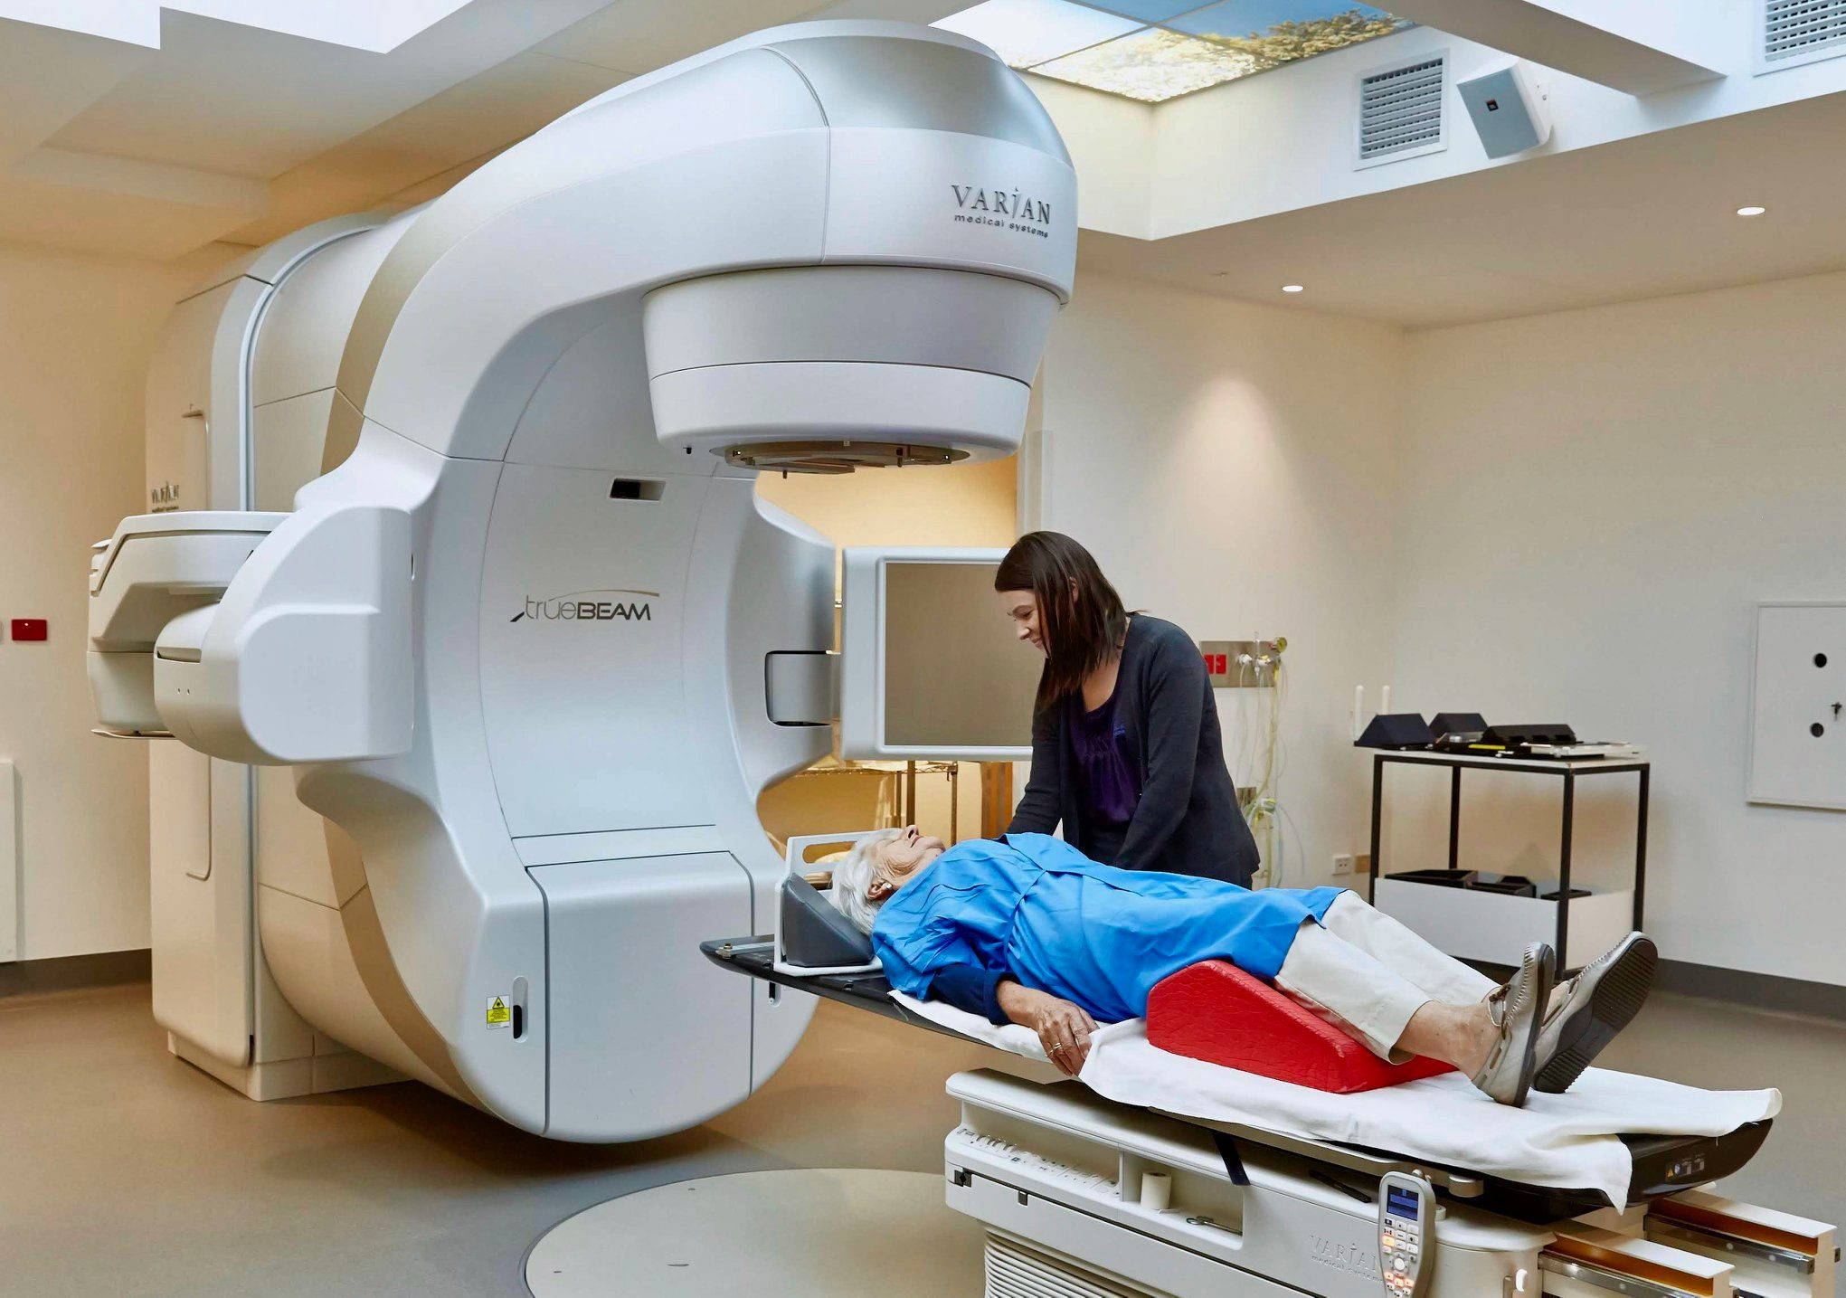
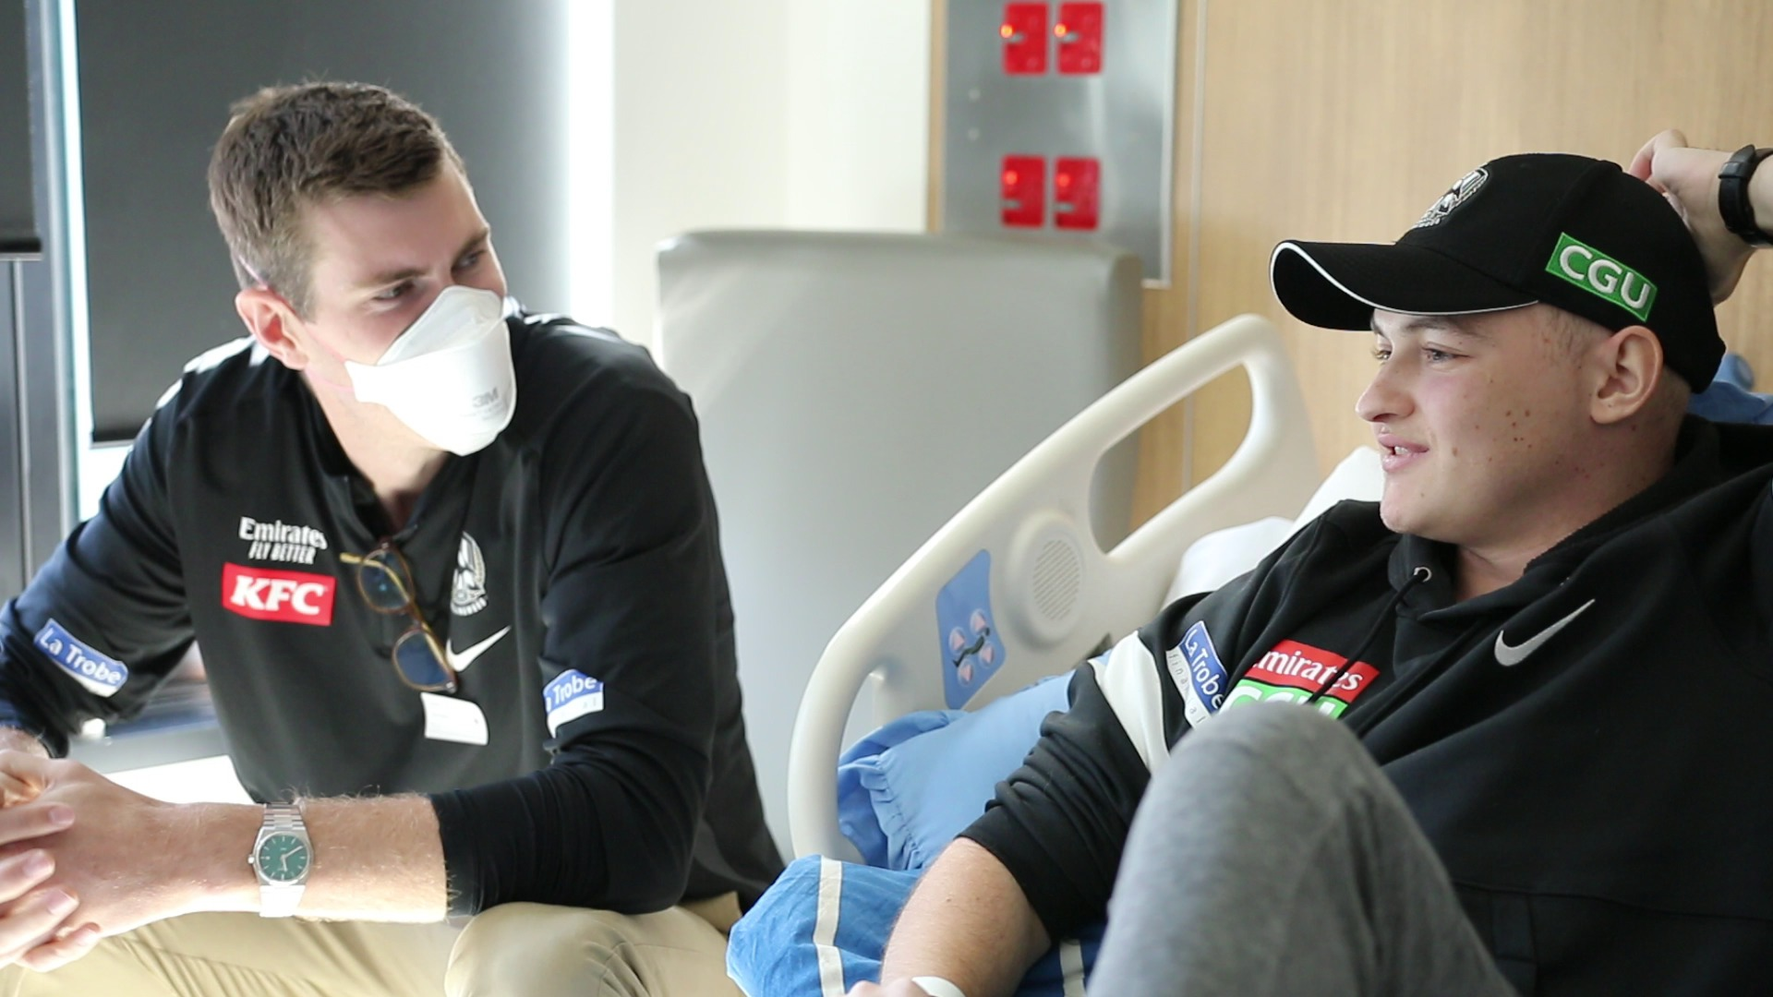
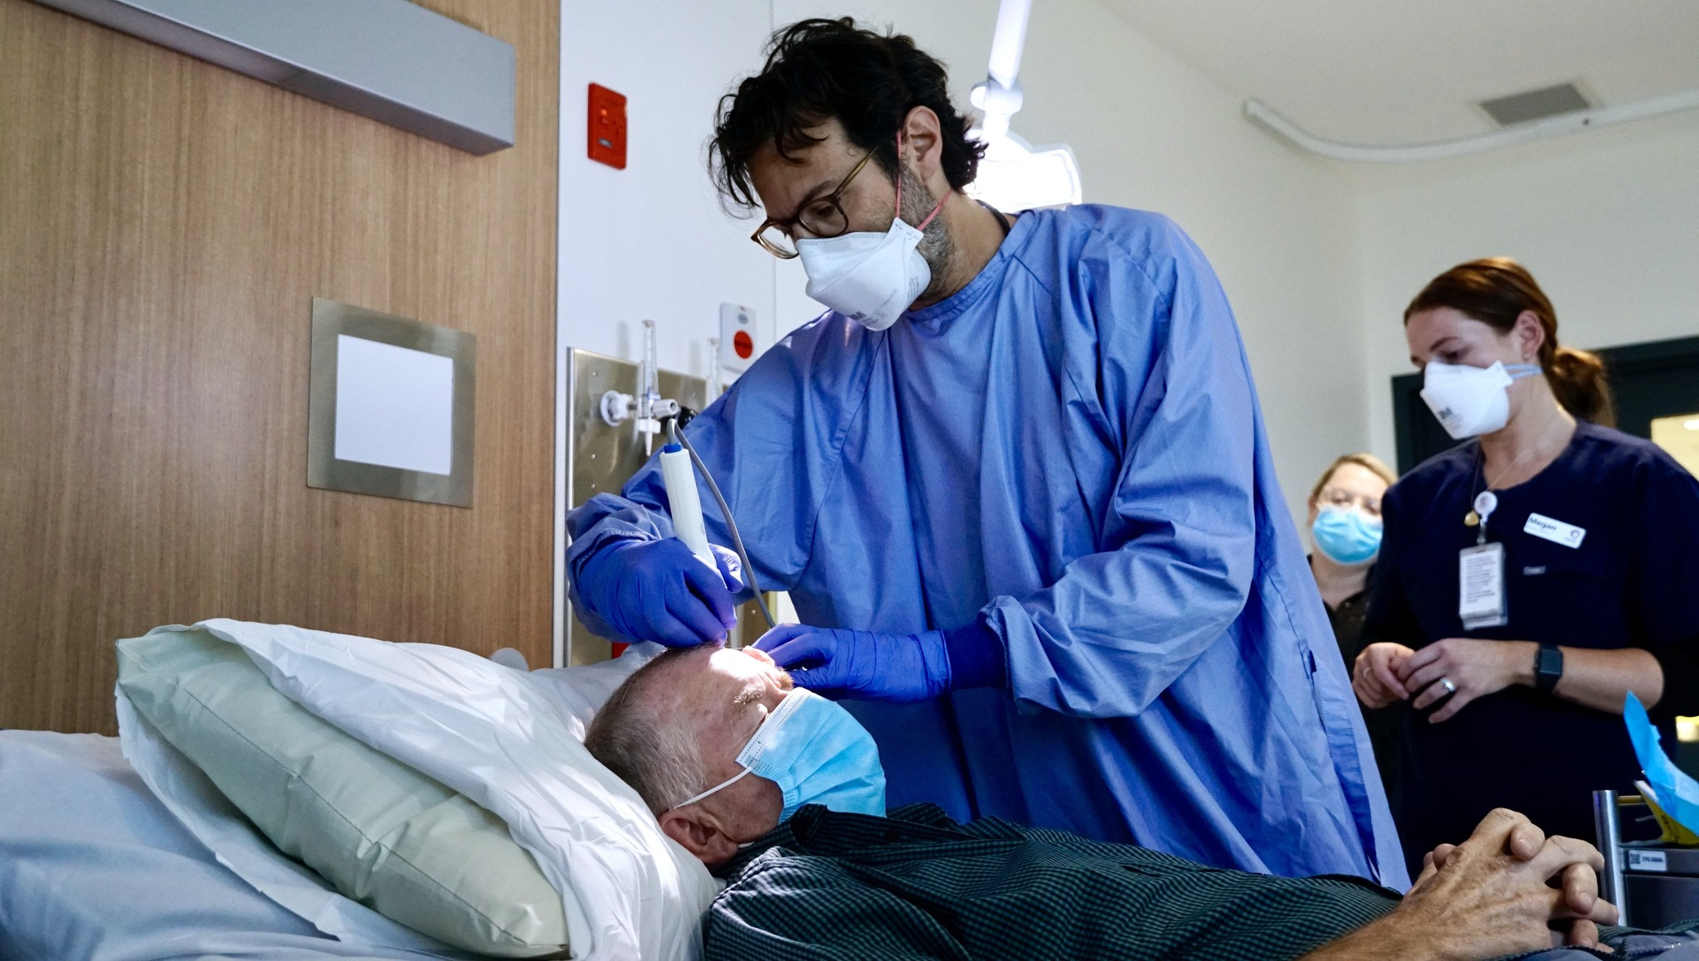

Slide 3
What is the Peter Mac center?
Peter Mac is Australia’s only public hospital solely dedicated to cancer research and treatment
It is the home of Australia’s largest cancer research group, with over 750 researchers working together at Peter Mac. Donations from the public play a critical role in making our work possible.
View the snapshot video: https://foundation.petermac.org/about-us

Slide 4
What do donations help with?
Donations like play a crucial role in cancer research:
Give leading researchers access to the specialised resources they need to discover cancer cures
Recruiting the brightest research minds from across the globe to accelerate the search for new treatments
Translating new laboratory findings from over 600 clinical trials into life-saving treatments for people with cancer
Funding the purchase of new clinical technologies so that Peter Mac patients have access to cutting-edge treatments that offer the best chance of survival

Slide 5


Why yellow today?
Our very own Maddi Fitzpatrick has been a regular visitor to the Peter Mac Hospital. Maddi’s diagnosis of ‘Sarcoma’ is a rare form of cancer affecting connective tissues such as fat, muscle, blood vessels, nerve, bone, deep skin and cartilage.
The colour yellow encourages Sarcoma awareness and all donations today will go to Peter Mac, supporting further research, helping youth like Maddi.

