Slide 1

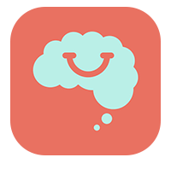






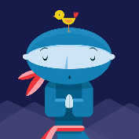



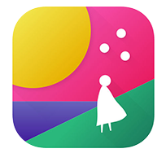




DIGITAL HEALTH APPS
SMILING MIND
A popular, free mindfulness app designed to help users cope with daily stress and improve calmness.
BEYOND NOW
Is an app to create a safety plan for when you’re feeling unsafe or suicidal.
RECOVERY RECORD
can help you manage your journey to recovery from eating disorders.
DAYLIO
Is a diary app that allows for goal setting, mood tracking and routine notifications.
BLACK DOG INSTITUTE ClearlyMe
Designed for teens aged
12-17 who are experiencing depressive symptoms
or psychological distress.
BREAKUP SHAKEUP
provides ideas for fun, easy things to do to help you cope after a breakup.
HAPPIFY
No matter how you’re feeling, this app has effective tools & programs to help you take control of emotional wellbeing.
SLEEP NINJA
A digital tool for improving sleep in adolescents.
MELLO
A mental health app helping young minds say goodbye to negative thinking loops.
SUPER BETTER
is a tool designed by game designers to help you build resilience and get stronger, happier and healthier.
HEALTH TAP
Offers trustworthy answers and healthy tips collected from more than 50,000 health professionals.
FABULOUS
A motivational app that uses challenges to help build physically and mentally healthy routines.
MOST
is more than an app – it’s a world of mental health support at your fingertips.
BUNYARABUGALMA YOUTH for First Nations people aged 12-25. The app includes information about emotions and practical ways of managing them.
AETHERIA
A mental health toolkit allowing users to get info on certain mental illnesses, find resources and use tools to cope with day-to-day life.
I AM SOBER
Is an addiction buddy
useful for quitting any activity or substance.

