Slide 1
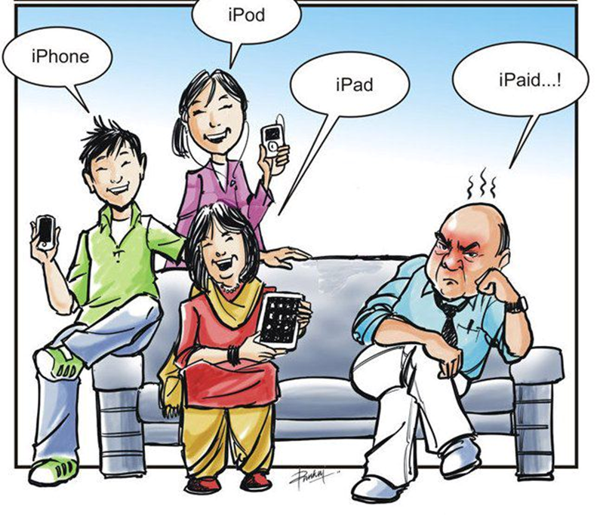
Cyber Ed…
The Workshop k.wilde@theworkshop.org.au

Slide 2
Quiz
1. Aussie kids spend an average of 5 hours a day watching TV or on the computer – what is the recommended maximum amount of time they should be spending? (2 hours max)
2. Who is more likely to cyber bully?
a) Boys
b) Girls
c) Boys and girls equally
3. What percentage of Australian parents/carers do not actively monitor their children’s activity online?
a) 15% b) 25% c) 40% d) 60%

Slide 3
Quiz
4. In 2016 the TikTok app had been downloaded 60 million times - how many times has it been downloaded now
100 million b) 1.3 million c) 2 billion
5. When talking about the internet – what is a ‘troll?’
Someone who uses the internet to harass and/or provoke or agitate others – usually anonymously
6. What percentage of Australian families say that technology is one of the biggest sources of conflict for them?
a)25% b) 33% c) 66% d) 75%
7. True or False - Australian police recommend that people should not put their photos on Facebook? True

Slide 4
Cyber Safety
Common Issues for children & teens online:
        Digital reputation
        Cyberbullying
        Inappropriate content
        Unwanted contact
        Addiction

Slide 5

Family Scenario
Your child got a new device/console for their birthday. They love it and want to spend more and more time on it, including in their bedroom. They get moody when you ask them to do other things and have less interest in the things they used to enjoy. There has also been some increase in conflict with their siblings and/or with you.
1. What might the parent/carers be thinking or feeling?
2. What might the child be thinking or feeling?
3. Are their any concerns/issues?
4. What are some possible solutions/ways to handle this? (try and think of at least 2 or 3 ideas)

Slide 6
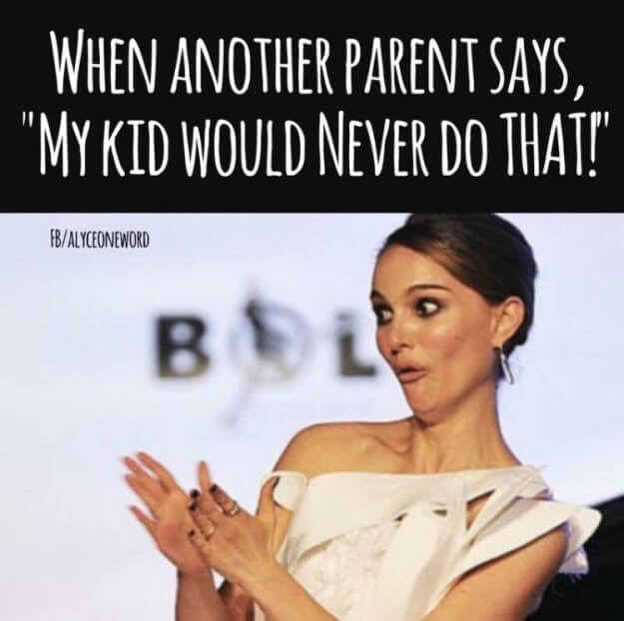
Parent/carer quiz
1. Which of these news stories is FALSE:
a)Parent pretends to be teenage boy online to bully a girl in her daughter’s class
b)Person on twitter welcomes celebrity baby: “Aw (…….) gave birth to a baby. Is it fat and handicapped lol”
c)American family Facebook photo used on advertising billboard in another country (ALL TRUE)
2. Based on ‘Family Zone’ Internet filter data installed on children’s devices in several Sydney schools, how many students under 8 y.o had attempted to access online pornography?
a) 5% b) 15% c) 25% d) 33%

Slide 7
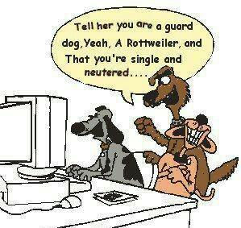
Strategies:
Set limits and STICK TO THEM
Have ‘technology free’ or ‘sacred space’ times
Model the internet/technology use you want
Use technology to help you (i.e. OurPact, PlayTime, etc)
Have a family media plan (check aap.org – children and media tips)
Let tech be your friend - look at reviews from other parents (commonsensemedia.org)

Slide 8
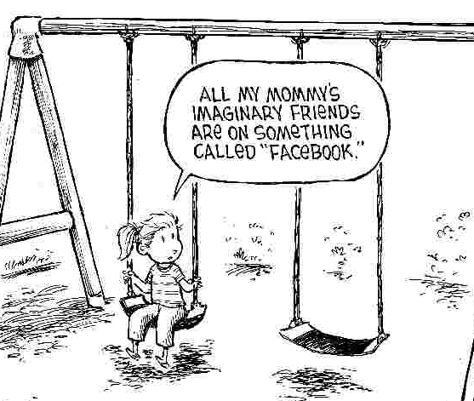
Some of the
Essentials:
Educate yourself
Co-share Social Networking
Use family contracts
Remove technologies in logical, expected and reasonable ways
Talk and ask – keep communication lines open
Don’t be slow to ask for advice/help
Play along – don’t judge!

Slide 9
Family Contracts
Child’s agreement
I understand the internet is a public place and to stay safe online I need to use it responsibly. I will:
• keep my personal information (including name, phone number and address) to myself and not share it with others on the internet.
• choose a username or screen name that doesn’t reveal my identity and is not rude or suggestive.
• not send photos or video clips of myself over the internet without checking with my parents.
• never meet an online friend in real life without telling my parents first, unless they come with me to meet that person.
• keep my passwords secret from everyone, except my parents.
• tell my parents straightaway if someone asks me to do something I don’t like.
• tell my parents straightaway if I see or receive something on the internet that I don’t like.

Slide 10
Family Contracts
Parent’s agreement I understand that the internet is a public place but is very useful for my child and I wish to help them stay safe when using it. I will:
Empower
• take an interest in what my child is doing online and encourage them to use the internet wisely.
• listen to any problems my child has on the internet and understand that things can happen by mistake.
Educate
• learn ways my family can stay safe online.
• teach people in my family ways to stay safe online.
Supervise
• supervise my child when they are on the internet.

Slide 11
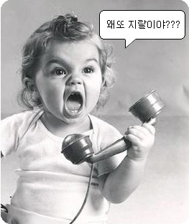
Parenting: The 4 styles…
Authoritarian parenting - LOW LOVE – HIGH LIMITS
Parent has all the power.
Decisions made for the child, without discussion or explanation.
Parenting cold and firm.
Indulgent parenting – HIGH LOVE & LOW LIMITS
Children to have a lot of power.
Boundaries not set or enforced.
Warm and soft.
Notes:
Low love and low limits
High love and low limits
High love and high limits

Slide 12
Parenting: The 4 styles…
Indifferent parenting- LOW LOVE & LOW LIMITS
  Life is centred on the parent.
  Swings between indulgent and authoritarian styles, lack of consistency
  Children don't know how to behave or what to expect.
  Not much interest in the child's needs.
Authoritative parenting – HIGH LOVE & HIGH LIMITS
  Parents set clear boundaries and children are allowed some power within those boundaries
  Warm and firm.
  Been shown to have the best outcomes for children

Slide 13

Technology can be used for good as well as for evil!
www.commonsensemedia.org : Objective entertainment and technology recommendations and reviews for families including platforms, games, streaming services, etc.
Podcasts: Easy to access whilst exercising, cleaning, driving, anything! Australian examples are:
  ‘Everyday Motherhood’
  ‘DadPod’
  ‘Parental as Anything’
  ‘Happy Families’
Apps that help with putting a break on the tech: i.e. ‘OurPact’, ‘FamilyTime’, ‘Net Nanny’, etc.

Slide 14

More Resources:
www.esafety.gov.au (GREAT resource for kids, teachers and families)
www.raisingchildren.net.au
www.kidshealth.org (information parents and kids)
TED Talk: Adam Alder : “Why our screens make us less happy”
ONLINE PORNOGRAPHY: www.itstimewetalked.com.au
PODCAST: ‘How the iPhone rewrote the teenage brain’ (ABC ‘Conversations, David Gillespie)

Slide 15


GET IN TOUCH?
Want to get in touch?
THE WORKSHOP (Kate Wilde)
k.wilde@theworkshop.org.au
@theworkshopmelbourne
theworkshopmelbourne

