Slide 1

Parent Information Session
Year 3/4
Notes:
Sophia

Slide 2
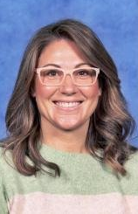
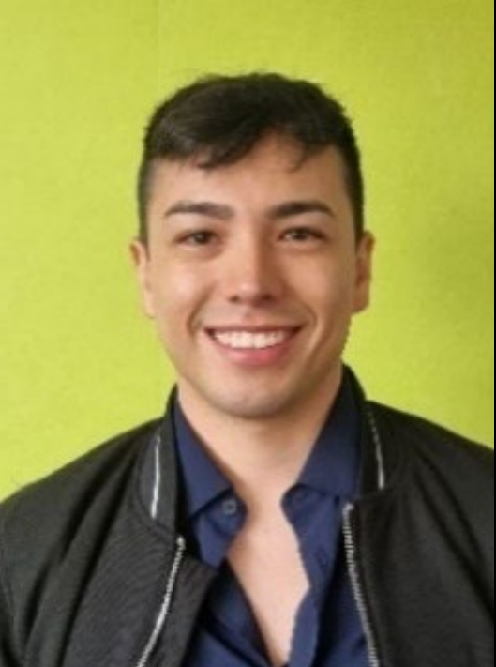
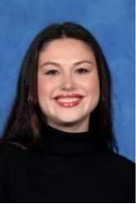
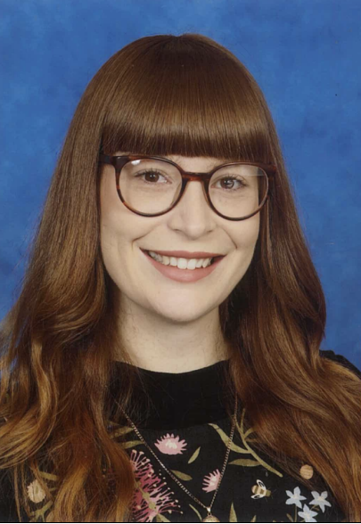
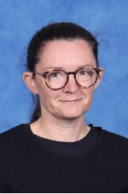
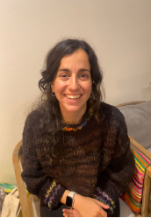
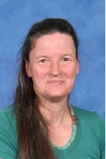
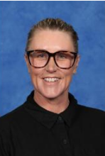
The ¾ Team
Lisa
Lucinda
Diego
Sole
Alysha
Team Leader 34AB
34AB
34CD
34CD
Katherine
Carmen
Trish
Lisa
34EF
34EF
34 Education Support
3/4 Leading Teacher
Notes:
Sophia

Slide 3




The Learning Community Leader
Lisa
The LCL's primary role is to Build Effective Professional Learning Teams that support and develop the teachers and students within their team.
Intervention
Planning
Wellbeing & Behaviour support
Mentoring & Coaching
Lead small group intervention sessions.
Guide and implement the NPS planning/instructional model across all subject areas.
Support students to settle positively each morning and respond early to wellbeing or behavioural needs.
Mentoring and coaching teachers to strengthen practice, confidence and collaboration across the team.
Notes:
Sophia
This year, we’re excited to introduce Learning Community Leaders who are now assigned to each cohort, making things even more connected and collaborative! In the past, we had subject-based leaders like the Literacy Leader or Numeracy Leader, but these roles sometimes felt a little disconnected from the classroom. With our new approach, the focus is all about building stronger relationships and creating a more hands-on impact in coaching, mentoring, and supporting both teachers and students. It’s all about teamwork and making learning even more exciting!
In 2025, our goal is all about tapping into the strengths of each team and individual teachers, facilitating planning sessions for greater impact, and really focusing on the unique needs of each cohort. Our Learning Community Leaders are at the heart of this mission, building strong teams, running our before school writing and math programs (along with other passionate teachers), and leading the Newlands Planning Model across all subjects.
They’ll be in the classrooms, supporting teachers, and working side-by-side with them through mentoring, coaching, and collaborative teaching. It’s all about making sure both teachers and students thrive and grow together!

Slide 4

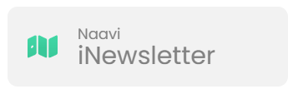


School / Parent Communication
Lucinda
  School Communication
  Payment and Permissions
  Absence Management
  Notifications and Notices
  Parent/Teacher Interview Booking.
  Access to School Calendar
  Semester Reports
  Published weekly (Friday)​
  Essential school-based communication​
  Upcoming events, classroom news, community news, school initiatives and ensures families stay up to date with essential and current happenings at Newlands.
Ensure urgent/timely communication goes via the office
  Payment and Permissions
  Absence Management
  Communicate medical/health care plans
  Visibility into learning experience to support and celebrate learning.
  Assessment posts/recordings.
Notes:
Sentral -
School Communication: Send and receive messages from your child’s homeroom, specialist teachers, and LCL
Payment and Permissions: Provide permission and make payments for camps, excursions, and incursions.
Absence Management: Easily communicate and respond to unexplained absences, as well as submit future absence requests.
Notifications and Notices: Receive timely notifications for community events, absence alerts, and school notices sent directly to your device.
Parent/Teacher Interview Booking.
Access to School Calendar: View and sync the school calendar with your phone to keep track of important dates and events.
Semester Reports: Stay informed by viewing your child’s individual learning plans and end-of-semester reports.

Slide 5

Communication Flowchart
Lisa
Teachers
The classroom teachers are the first point of contact. Contact for day to day questions, non- urgent updates or concerns.
Learning Community Leader
If you feel like there's an issue or wellbeing concern that requires further support, please reach out to Lisa.
If the issue has not been resolved at the previous levels, or if it involves a school-wide concern (e.g., bullying, major academic challenges, safety), the Principal or Assistant Principals should be contacted.
Principals
Notes:
Sophia

Slide 6
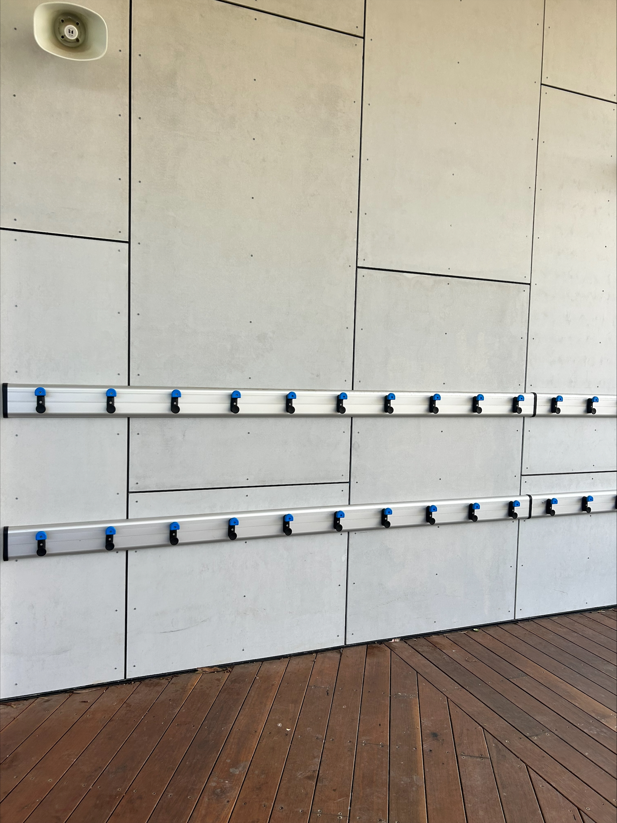
Bags/Lunchboxes
Lucinda
Bags
Bags should be on the bag hooks attached to the classroom your child starts the day with.
Bags should not be left on the ground.
Lunch boxes
Lunch boxes and drink bottles are to be taken out of bags in the mornings and left in the allocated spaces in the communal room.
They will be returned to the student's bags at the end of day in pack up time.
Notes:
Lisa

Slide 7
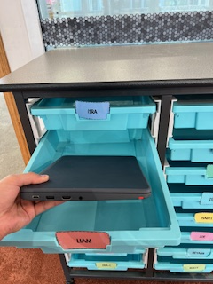
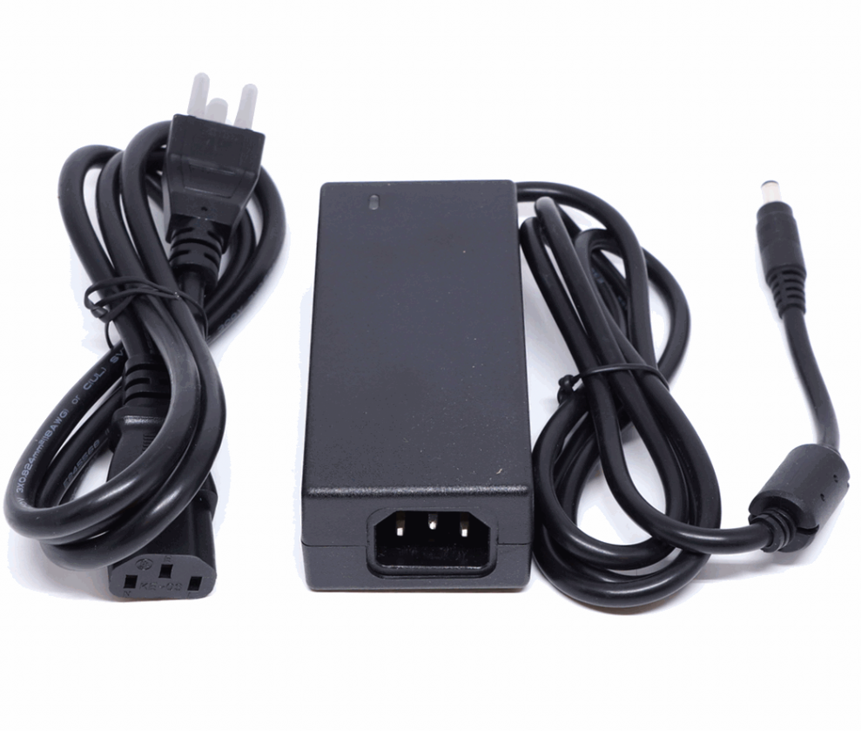
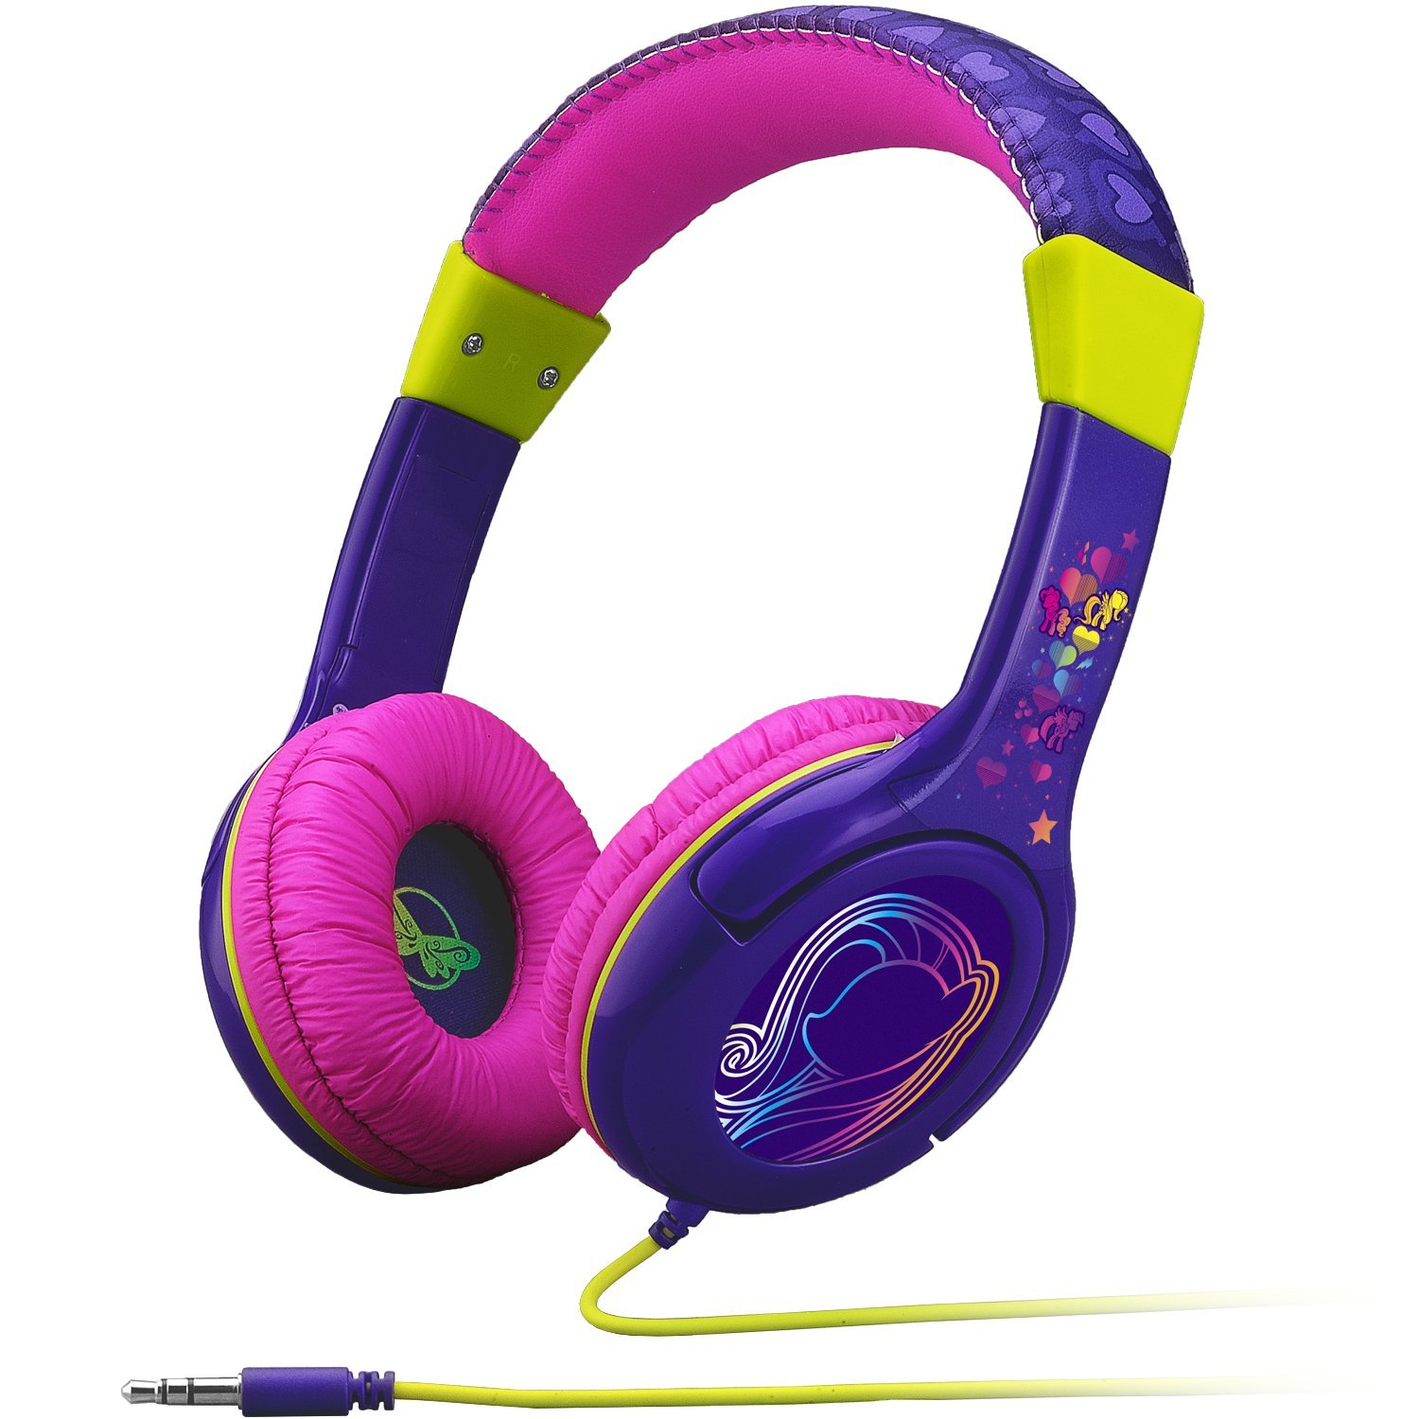

Laptops
Lisa
Each morning, need to be stored in their laptop trays
It is each students' responsibility
to look after their laptops.
Laptops and charger should come to school charged and ready to go.
Headphones will need to be provided by families. ​​​​
All devices and accessories must be clearly labelled with the student's name.
To ensure students understand how to use their technology responsibility at school an ICT contract will be send home for you to review and sign with your child.
All Grade 3 students will be provided a school device in week 2 – these devices will remain onsite.
Notes:
Angelica

Slide 8
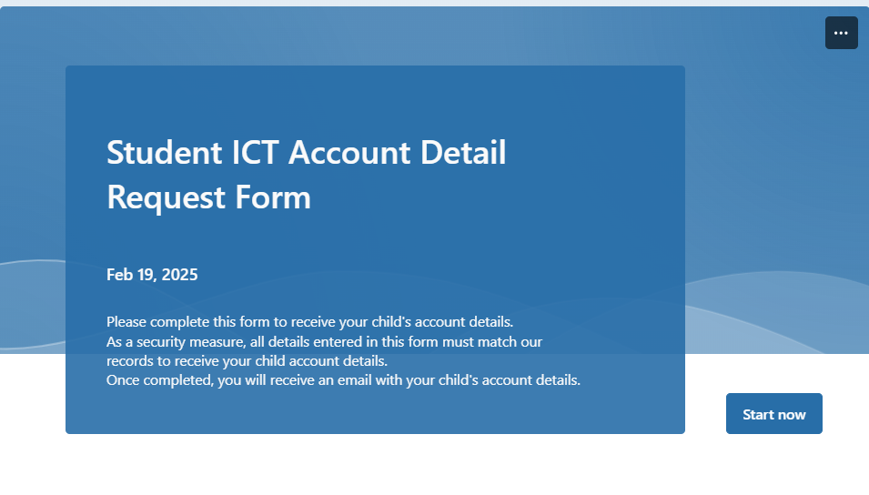
Student ICT Account Details
Student ICT account details are emailed at the start of each school year.
You can also request your child’s account details by completing the Student ICT Account Details Form on the school's website.
Please contact the classroom teacher if you are having trouble signing into any platforms.
Notes:
Angelica

Slide 9
Grade 3 NAPLAN
Lucinda
Testing starts week 7 and ends week 8.
Students will be with English teacher during the NAPLAN period.
The students will need headphones for their tests – we have a communal collection at school; however, you may like to bring your own.
Tests are around an hour long each.
You can support your students during this time by emphasising that this is just a moment in time. No pressure!
Notes:
Lisa

Slide 10
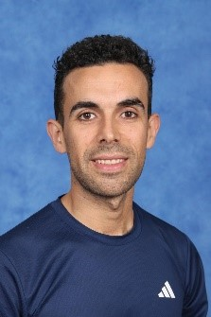
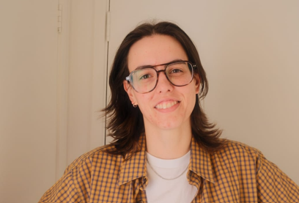
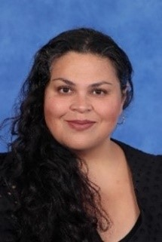
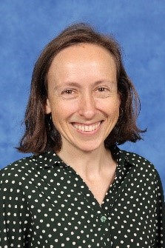
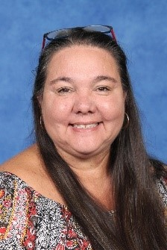
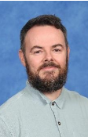






Specialist Team
Lisa
Margaret
Visual Arts
Rob
Music/Performing Arts
Jess
STEAM
Nerida
Inquiry
Karren
Wellbeing
Raul
HPE
2026 Specialist days are Wednesdays sessions 3 and 4, and Fridays sessions 1 and 2.​
Specialist teachers can be messaged on Sentral.​
Pick up at the quadrangle at 3.30pm​.
Whole School Events 2026 ( Whole School Production!)
Notes:
Raema

Slide 11
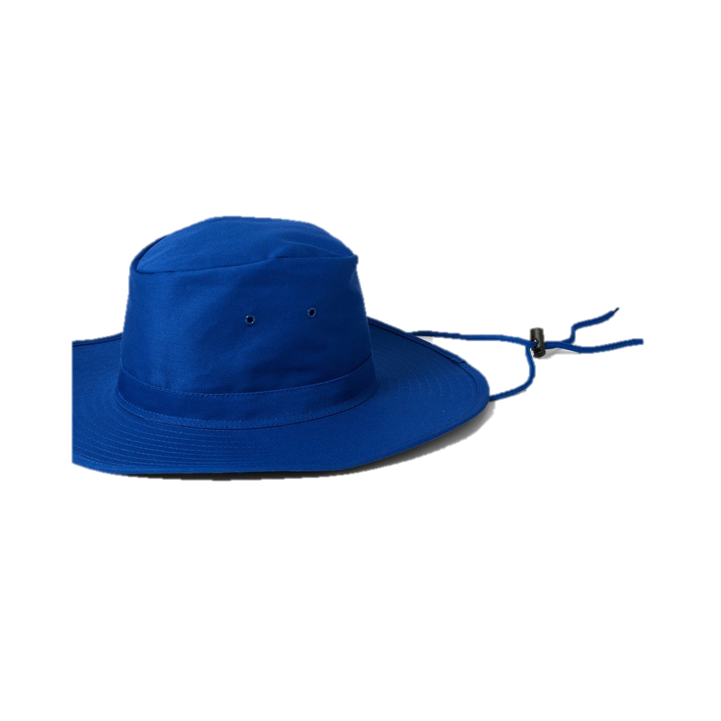
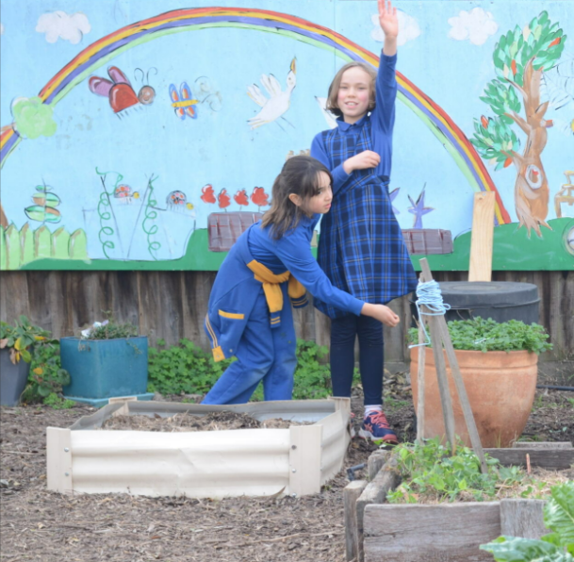
Lucinda
Uniform, Hats and
Lost Property
Lost Property
Small tubs are located in each of the 3/4 communal areas.
At the end of each week unclaimed items will be moved to C block outside the STEAM classroom.
Hats
Wide brim hats are compulsory to wear in Term 1 and 4.
Uniform
Ensure all uniform/ personal items are clearly labelled. We encourage runners on PE days.
Notes:
Angelica

Slide 12
Attendance
Lisa
Morning music will begin at 8:57am, at which time students should move to their classroom door and line up ready to enter.
Classes will commence at 9:00am. To minimise interruptions to learning, please ensure your child is ready and on time.
Student Late Arrivals
Students that arrive at school later than 9:10 am, must sign in at the office. If a student arrives between 9:00 and 9:10am are to be marked as present by the classroom teacher.
All students who are late to school or are collected early are required to sign out at the office.
If your child is leaving early, we ask that it is not between 3:00- 3:30 or during playtime.
Notes:
Sophia

Slide 13
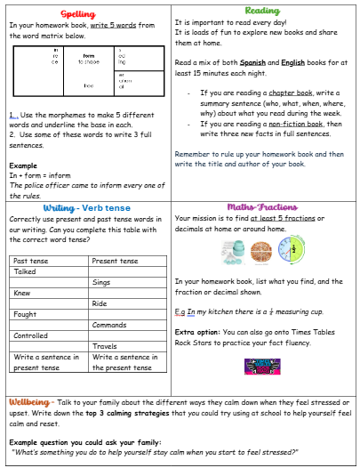
Supporting Learning at Home
(Homework)
Lucinda
Students will bring home a homework book with a fortnightly matrix of tasks that are designed to support and extend their learning at home. The matrix includes activities for Spelling, Reading, Writing, Math and Wellbeing.
Students are required to bring their homework book and reader bags every second Friday (assembly weeks).
Students will take home two English books (readers or classroom library texts) and two Spanish readers for homework reading.
Students also have access to online programs that support their learning. RazKids and Nessy are used for literacy, while Facts on Fire (worksheets), Numbots and Times Tables Rock Stars support mathematics.
Homework is designed to build on learning that has already been taught. Your support is most helpful when it focuses on encouraging positive routines and helping students feel confident as they work towards their homework goals.
Will begin on Friday of Week 3
Notes:
Lisa

Slide 14
Parent Helper Program
A link was sent out on the newsletter today.
This term our parent helpers will work with students in maths on their fluency.
If for some reason you are unable to come on the day, please contact your classroom teacher.
Notes:
Angelica

Slide 15


Parent Teacher Interviews, Meet the Teacher & Reporting Periods
Lisa
Termly Parent Teacher Interviews
Alternate between Spanish and English teacher
Reports published Semester 1 and Semester 2
Term 1 Meet the Teacher (Week 2)
Term 1 PTI with both teachers​
Term 2-4 PTI with one teacher
Notes:
Sophia

Slide 16

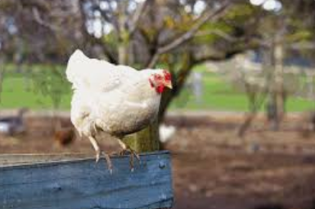
Camps, Excursions and Incursions
Lisa
Each term we will have an excursion/incursion. This is an opportunity to link our learning to a fun collaborative experience whilst building background knowledge for our students.
Term 1 – Bundoora Park farm ( Wednesday 18th February)
Term 2 – Grade ¾ camp 2 nights at The Ranch – Morning (17th-19th June)
Notes:
Sophia

Slide 17
Local Excursions / Photography
Lisa
A permission slip has been published on Sentral to obtain consent for all local excursion and photography that may take place in 2026.​
If you do not want to give consent for local excursions, please indicate this on the Sentral Permission Slip. ​
Local excursions may include walking to local parks and community spaces. ​
Parents and caregivers will be notified of any upcoming local excursion beforehand. ​
You may withdraw consent for local excursions at any point in the year by calling the school on (03) 9354 2928, or emailing the school at newlands.ps@education.vic.gov.au.
Notes:
Sophia

Slide 18
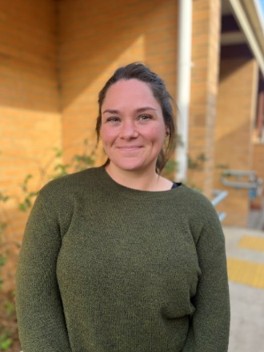
Outside of School Hours Care
Lucinda
Newlands Primary School offers a nationally accredited before and after school care program.
Care is provided from 7:00am until 8.55am each day, and until 6:00 pm after school from Monday to Friday.
OSHC Phone Number: 0491 273 710
You can book in advance for the whole term, or book in casually.
Registrations are be completed online. The link can be found on our website.
Most families are eligible for a fee reduction through the childcare subsidy system.
Example Activities: Arts and craft, sport, cooking, relaxation and quiet corners.
Notes:
Sophia

Slide 19

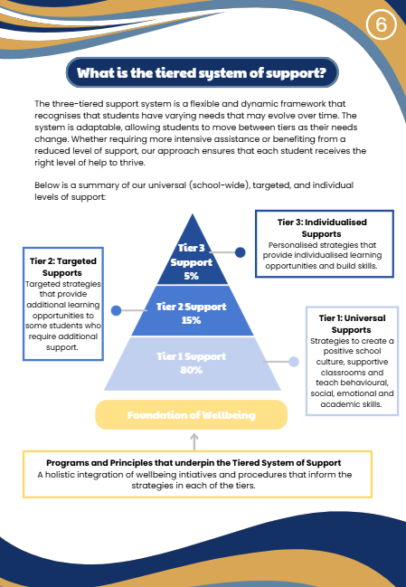
Supporting Your Childs
Wellbeing at School
Lisa
Notes:
Sophia

Slide 20
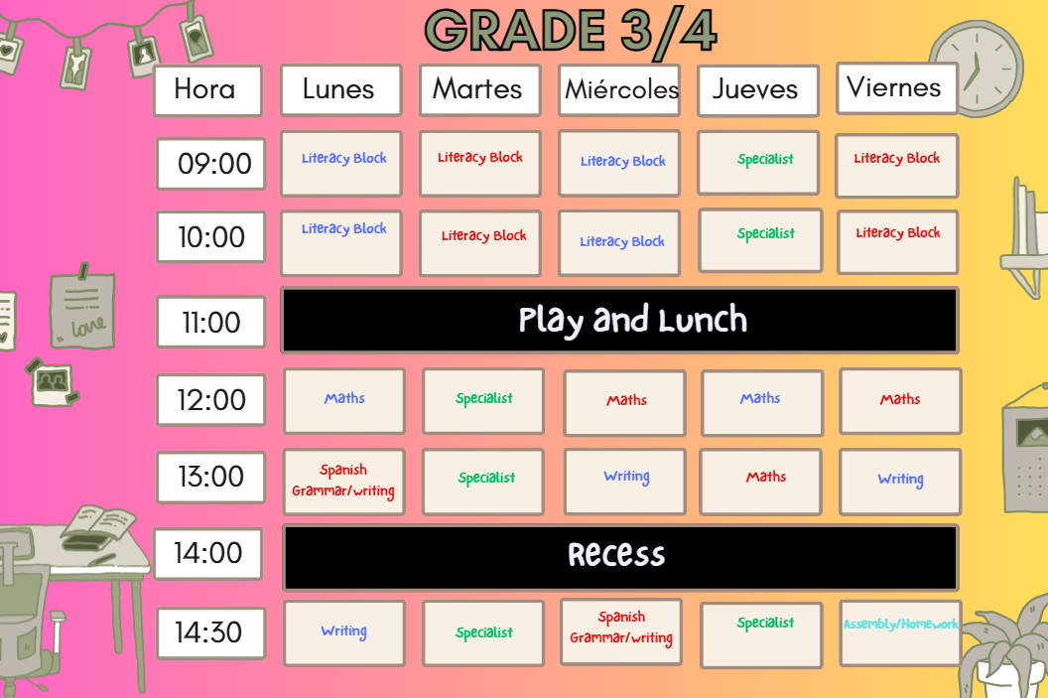
34 Term 1 Timetable
Lu
Notes:
Angelica

Slide 21



Fruit Snack
Lu
Every day at roughly 10am students will have a short 5 minute fruit snack.
It would be great please if you could pack this snack in a smaller, separate box so students are able to grab with ease.
Notes:
Sophia

Slide 22
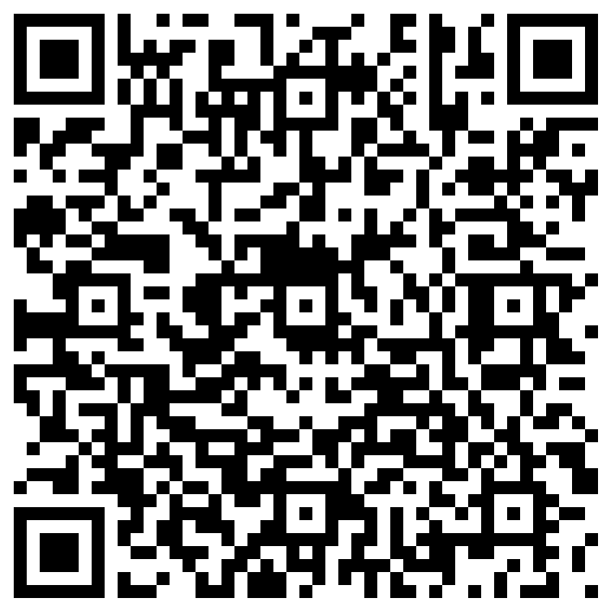
Further Questions
If you have a question that hasn't been addressed, please ask away in the QR code.
All responses will be published in next weeks newsletter.
Notes:
Sophia

