Slide 1
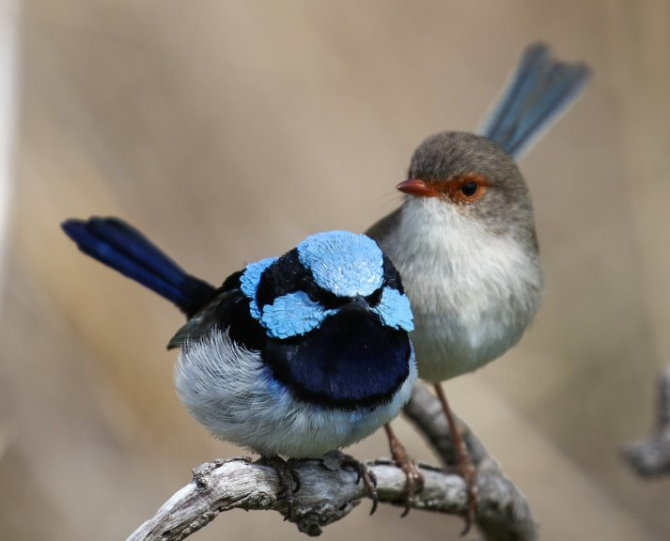
We chose ​the Superb Fairywren because of the nice shiny blue, black and white colours of the male bird.
Superb Fairywren

Slide 2
What it looks like
Superb fairywrens
14cm long
The male bird is blue, black and grey
The female is brown and grey
Eat lots of different insects
Live and nest in dense shrubs

Slide 3
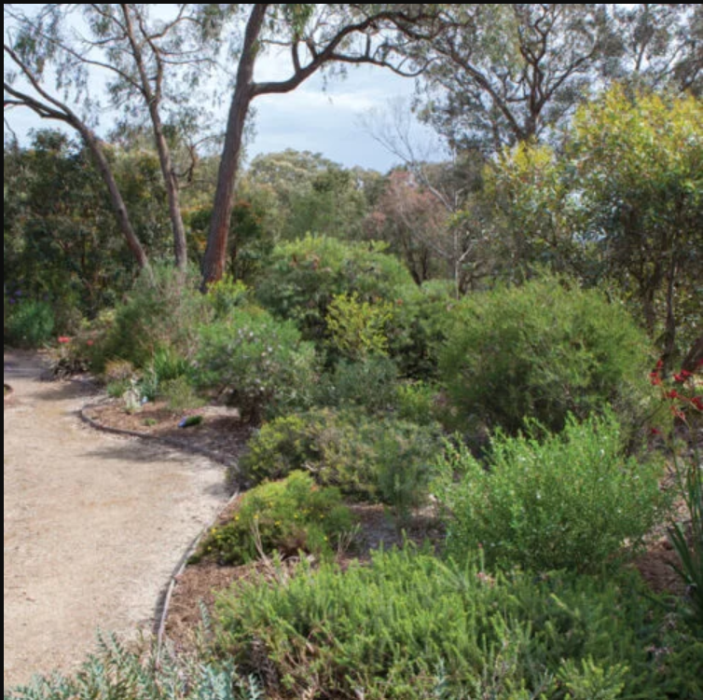
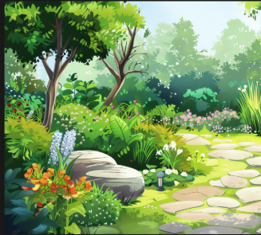
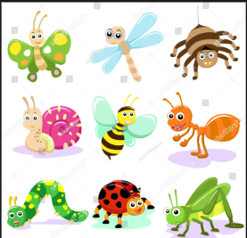
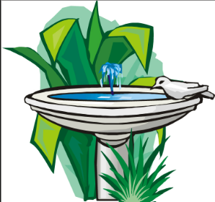
What it needs to thrive
Superb Fairywrens need:
Dense bushes to live
and nest
Insects and
Spiders to eat
Shallow clean water to drink and bathe

Slide 4
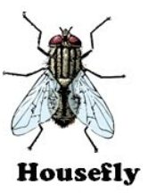
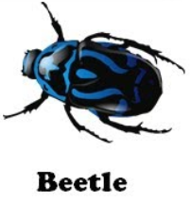
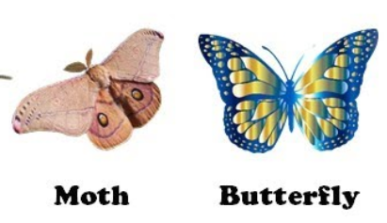
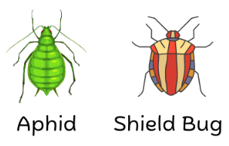
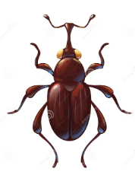
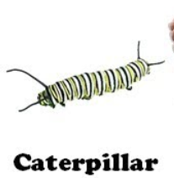
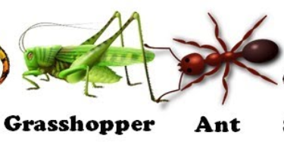
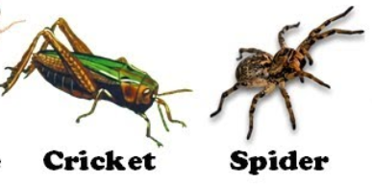
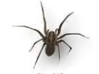
Insects and spiders eaten by Superb Fairywrens
​
Weevil

Slide 5
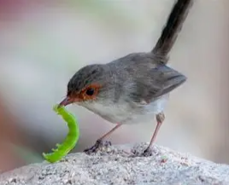
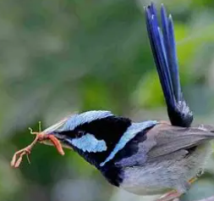
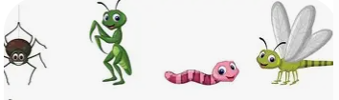
What could be improved in our school
We plan to improve insect habitat, so the Superb Fairywrens have lots of food to eat

Slide 6
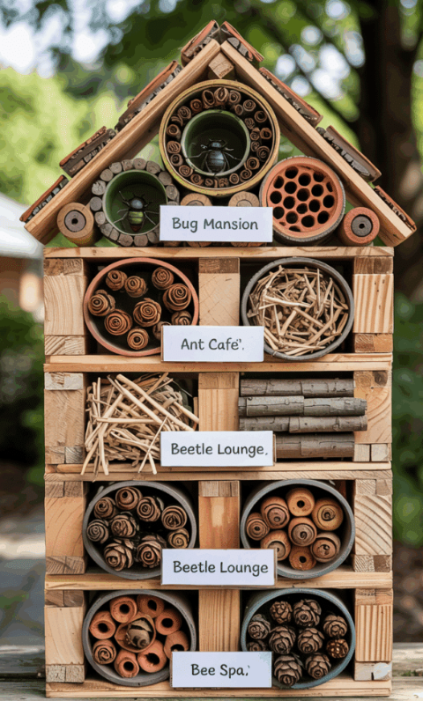
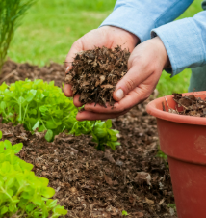
Our solution
To improve insect habitat in our school we propose to
Add mulch to gardens
Make bug hotels for the gardens

Slide 7
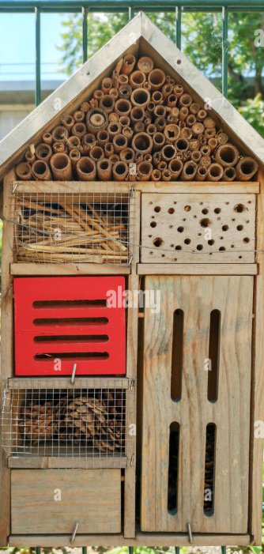
Our solution
Bug Hotels
Sunny spot near flowering plants
Different houses for different insects.
  Pinecones and seed pods
  Clay
  Bark and sticks
  Cardboard

Slide 8
Resources and references
Birdlife Australia
Australian Natural Museum
Backyard Buddies
Ecologist Explains How An Insect Hotel Will Benefit Your Backyard | Earth Matters | Scitech WA
How to make a bug hotel to attract beneficial insects
Insectaries | Sustainable Gardening Australia

