Slide 1
VCE Exams
2020

Slide 2
Exam Expectations
Arrive 30 minutes prior to the start of each exam.
Stay in exam centre for the duration of the exam.
Full school uniform
Mask
Student ID card/photographic ID

Slide 3
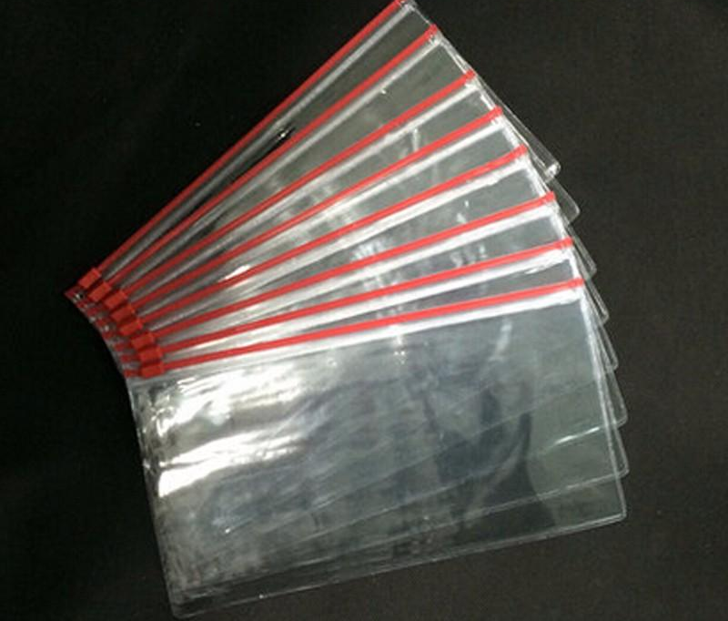
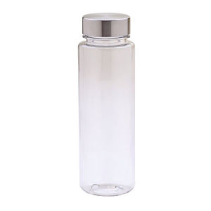
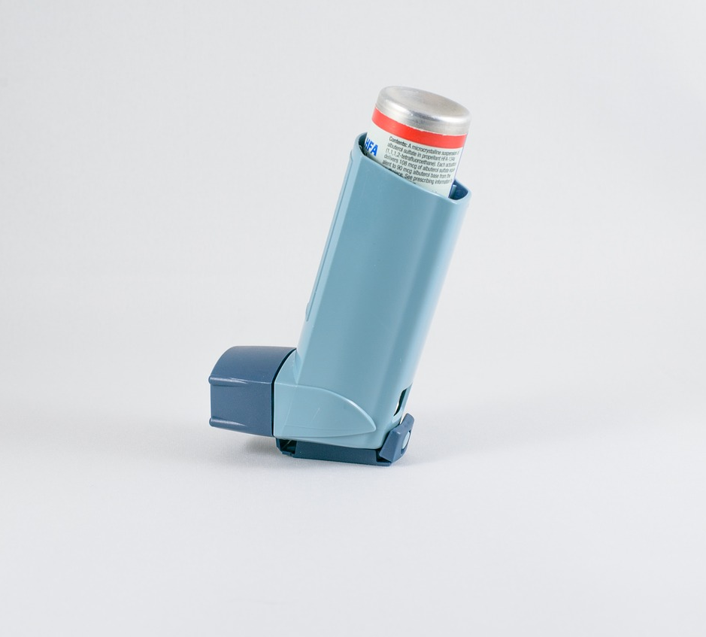
Permitted Materials
Clear plastic bag with stationery
Clear water bottle (no labels)
Dictionary (no protective cover)
Asthma inhalers

Slide 4


Prohibited Material
Mobile phones
Electronic devices – smart watch, earphones, ear pods etc.
Correction tape/fluid
Food
Opaque pencil cases
Textbooks
Blank paper

Slide 5

Important Information
Seating Plans – Compass – next week.
VCAA will send another confirmation email on 28th of October. See Mrs Chanter if you do not receive this.
Follow all instructions from supervisors.
Please do not communicate with another student once you enter the exam centre.

Slide 7

Best of luck!

