Slide 1

Design a Brick,
Leave Your Mark!
Our playground path fundraiser - every brick helps our school grow

Slide 2
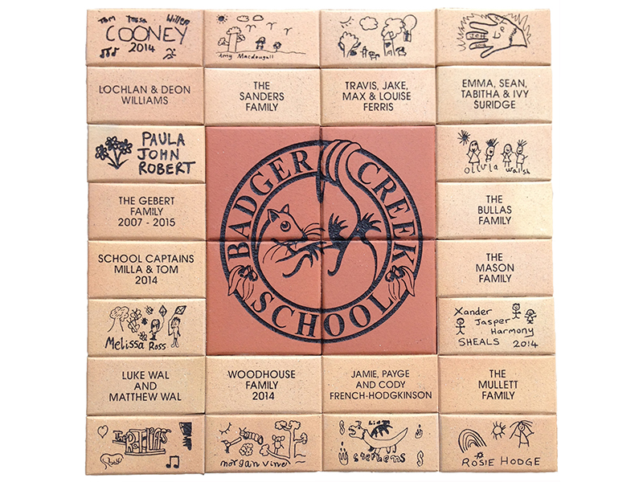
What's it all about?
You draw a picture - and it gets engraved onto a real brick.
All the bricks are laid together to make a new path in our playground.
Your design stays there for years and years - future Lucas kids will see it!
Every brick sold raises money for our school.
The pavers are made by Design a Brick, an Australian company that has made fundraising paths for schools all over Australia.

Slide 3
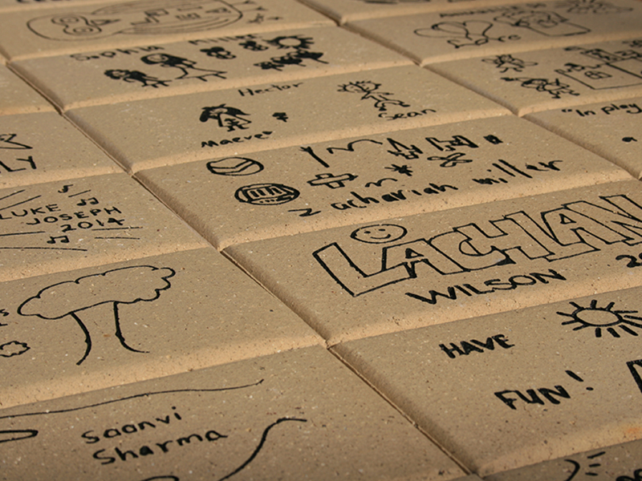
Look what other schools have made!
Real engraved bricks
Kids' hand-drawn bricks in a real path
A school path with logo, names and drawings
Your paver is 233mm x 115mm - your drawing gets engraved right into it!

Slide 4

1
Dream up your design
What do YOU want on your brick?
Your name in fancy letters
A self-portrait - draw your own face!
Your pet, favourite animal or favourite sport
Something from nature - a tree, flower or sun (just like our school logo!)
Anything that makes it feel like YOUR brick

Slide 5
Ideas for every grade
Prep - Grade 2
Grade 3 - 4
Grade 5 - 6
A big smiley sun
Your name + a star
A simple animal face
A rainbow or flower
You playing your sport
Your pet's portrait
A rocket or dinosaur
Bubble-letter name
A cool pattern or symbol
Fancy lettering
A scene from Lucas

Slide 6

2
Practise first!
Rough copies make the best bricks
Try your idea on scrap paper a few times.
Ask a friend, teacher or your family: "Can you tell what it is?"
Pick your best version before you do the real one.
Remember to keep it simple - simple looks great engraved!

Slide 7


3
Draw BOLD and simple
Use a BLACK marker at least 2mm thick - like an Artline 70 or Sharpie
DO
DON'T
Use a BLACK marker pen at least 2mm thick (Artline 70 or Sharpie)
Check your pen against the test line at the bottom of your sheet
Keep it large and simple - fill the space
Drew a pencil sketch first? Rub out every pencil mark
No ball point pens, pencils, crayons or coloured markers
No fine details - they won't appear on the paver
No colouring-in or shading
No digital or computer images - hand drawn only!

Slide 8
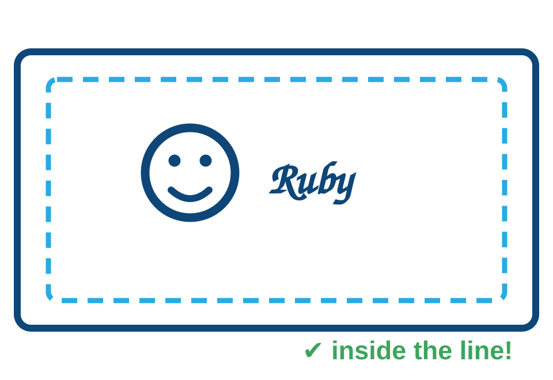
4
Stay inside the box
Your brick has a border - respect it!
Keep your whole drawing inside the border on your template sheet.
Anything outside the line gets cut off.
Write your name clearly - check your spelling!

Slide 9
5
Check it and hand it in
The final countdown!
Bold black dark lines?
Everything inside the border?
Name spelled correctly?
No smudges or rubbing-out marks?

Slide 10
Every brick builds our path!
Your drawing + everyone else's = one amazing playground path,
and money raised to make Lucas Primary School even better.

