Slide 1
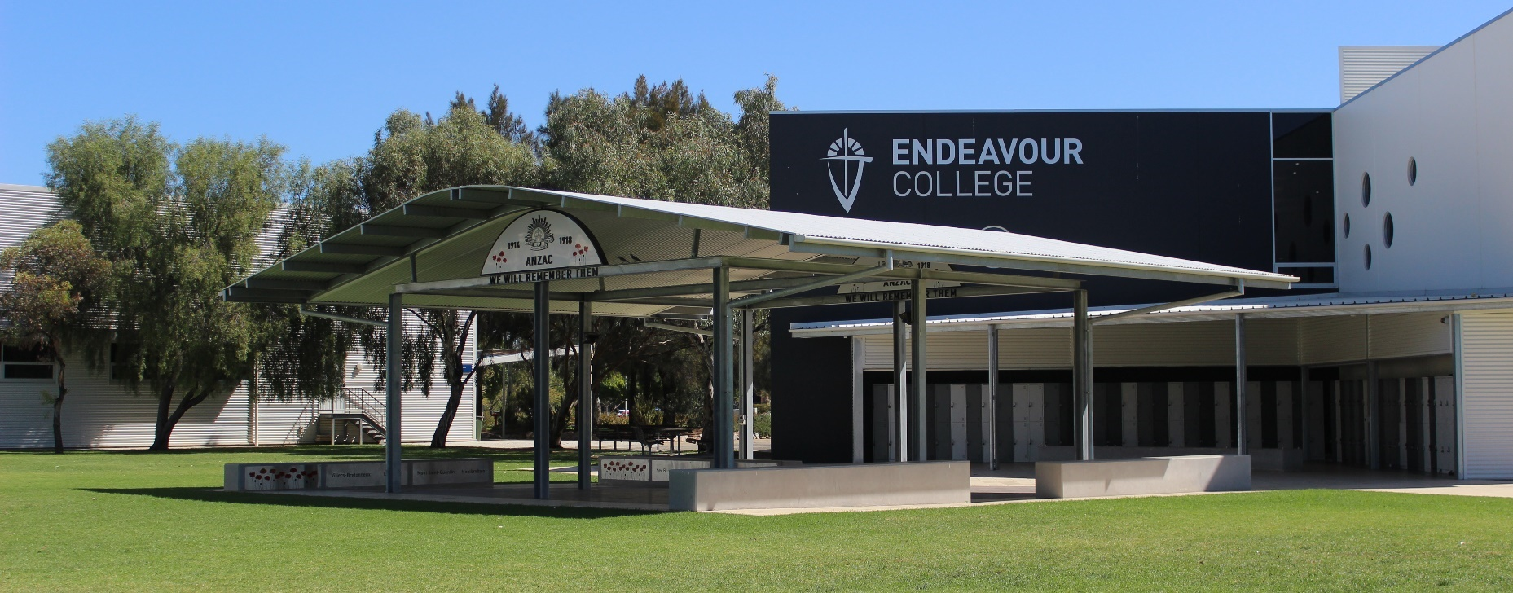
Senior Years Information Evening Year 12
Daniel Wooldridge, Year 12 Year Level Leader

Slide 2
Year 12 Support Team
Daniel Wooldridge - Year 12 Year Level Leader
Sharon Ward - Director of Senior Years
Sandra Barry - Director of Learning
Marni Harding - College Counsellor
Annie Fitridge - Pathways Leader and Career Counsellor
Innika Ackerley - SACE Coordinator
Course Counsellor
Your Care Group and subject teacher/s
Notes:
As you can see there is a team of teachers that are here to support the students as they start your senior year and we will be working closely with them through to the end.
I said to the students last week how as they come up through the years – I am sure they had found their relationships with staff had changed – as they have matured and progressed through the years staff naturally treat you slightly differently than the year before. It’s not planned but it generally does happen – and particularly in year 12.
Can I reassure you that we are all here for your child – to support and help them do the best they can and that our doors are never closed to them.

Slide 3
Communication via Edumate Parent Portal
Some of the features that parents/carers will have access to via the Portal will be:
Your child's Timetable and Calendar
School Calendar
Attendance records
The ability to see and update your child’s medical information
The ability to see and update your personal contact information
Upcoming assessments and results
Notes:
Edumate as most of you would know is the place to login to be able to update or access the listed features. As we move further to a more transparent and accessible system for sharing a students progress in each class, teachers will continue to upload tasks and due dates to Edumate as they are set. Within approximately 2 weeks of a due date parents and students can expect to find the results uploaded. For at least 2 assessment items per term, there will be a comment added to allow for a fuller explanation of the mark awarded. This is also an opportunity for a comment to be written on the student’s approach to their learning in that subject, for that unit of work. Our aim is that the ongoing nature of this feedback, will assist students and parents to track their progress in a more authentic way. As a result parents will receive the same end of semester printed report noting summary grades and attitudes, but there will be no need to be sending out an interim report at the end of terms 1 and 3. As has been the custom for many years, Learning Conversations will remain and provide families the valuable opportunity to meet with class teachers face to face. We are excited to be further down the path of this journey and look forward to it providing another way of connecting home and school to support student learning.

Slide 4
Communication via Edumate Parent Portal
We encourage parents to explore in that space.
Notes:
Families already have the required passwords, but if you have lost them please contact Jana Ponikvar in the front reception area for some new details.

Slide 5
Year Level Information
With the Endeavour Way as the foundation, Year 12 will provide students with the continued opportunity to develop into the people they want to be.
They will explore their values and choices, develop their leadership and independence to allow them to confidently step into their future.
Notes:
With the Endeavour Way as their foundation and the themes that run through from Year 10 to 12 – your children will have further
opportunity to develop into the person they want to be through exploring your own values and your choices in life.

Slide 6

Orientation & Student Leadership
Leadership
Unity/Teamwork
Gratitude
Notes:
More than 30 of the Year 12s are in official roles of leadership, that’s about 1/3 of the group – Village Leaders, SRC, Extra Curricula Leaders and Captains which is awesome. But they are all leaders of the school. Whether they like it or not – the younger kids look up to them and what they do, what they wear and how they relate to each other and our staff.
I have encouraged them all to see themselves as leaders – that it is not just about the badge!
When past Year 12’s spoke at the orientation night they encouraged the students to– get involved and enjoy as many activities and events that they can through out the year – to enjoy these times and participate with a good heart. Just by being at swimming carnival/athletics day – they are setting an example to the younger students by their actions as well as giving back to the College through their actions.
So we have encouraged them to participate, offer themselves even for the smallest tasks which will show leadership – live out the Endeavour Way.

Slide 7
Year 12 Events
MAX
Athletics Carnival @ SA Athletics Stadium (Wed 19 Feb)
Formal (Fri 20 March)
Year 12 Jumper (Term 2)
Mid-Year Examinations (Mon 29 June – Wed 1 July)
MAX Retreat (Wed 22 – Fri 24 July)
Drug Awareness Guest Speaker Paul Dillion (Term 3)
Final Breakfast and Assembly (Fri 23 October)
Final Examinations (Mon 2 Nov – Mon 16 Nov)
Valedictory Service (19 Nov)
Notes:
Of course we’ve already had Orientation and the Opening Service but here are a few more key dates for this year.

Slide 8

SACE Overview
Innika Ackerley
SACE Coordinator

Slide 9
Assessment
Assessment Policy Statements have been issued to all students.
Tear off slip to be returned ASAP, if not already.
Notes:
All students have been issued with an Assessment Policy statement which needs to have the tear off slip signed and returned. It is important that both parents and students understand these expectations. If you or your son/daughter do not understand any of the policy they should follow up with YLL to clarify before signing. It is a SACE requirement that all students acknowledge and adhere to the SACE Assessment Policy that is upheld at Endeavour.

Slide 10
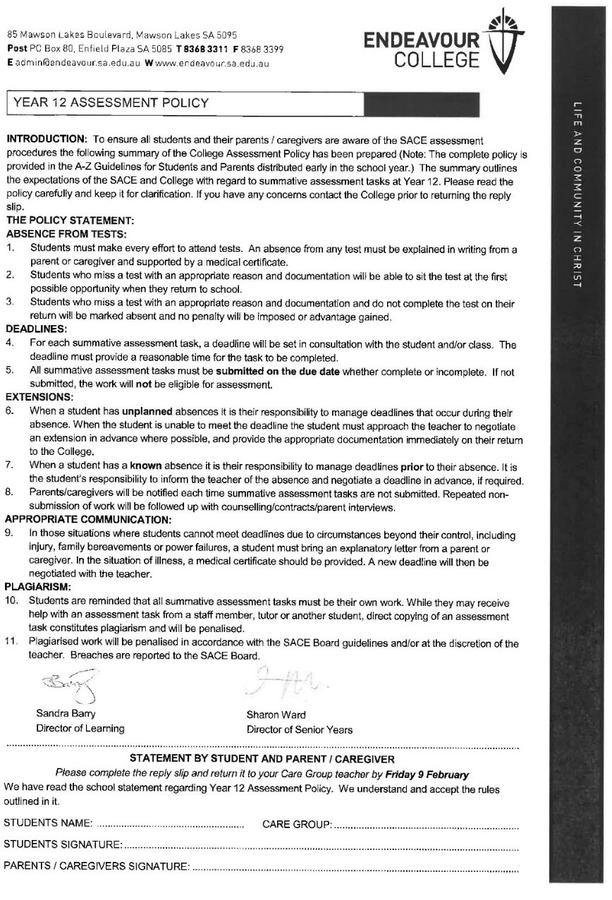
The Statement outlines…….
  Due dates and extensions
  Plagiarism
  Absences
Notes:
This document outlines the policy on a range of Assessment issues, including:
Deadlines and Extensions (at teacher discretion, upon early application, on an individual basis)
Plagiarism (dealt with severely. Students commit to submission of their own, independent work. Use of TurnItIn)
Medical Certificates (must be provided when summative assessment tasks are missed)
It is also worth noting that students and teachers need to be able to sign verification forms to agree that the work submitted is indeed the student’s own. One way teachers can verify a student’s work is through the sighting of drafts.
It is also important to note that, while some tasks encourage and require collaboration, there is a limit to how much students can give help to or receive help from their peers. If work is too similar to that of another student, penalties will apply.
There is also a limit to how much teachers can draft (Vision for learners – personal responsibility)
Organisation and meeting deadlines is imperative so that work doesn’t ‘snowball’

Slide 11
Assessment
A+ to E- grades in every subject
Performance standards make clear what students need to achieve for particular grade in each subject
Notes:
All Stage 2 subjects are assessed using A+ - E- grades and have Performance Standards (criteria) that define what students need to do to provide evidence of at each grade band.

Slide 12
Assessment
Moderation
School assessed part of each Stage 2 subject double-checked (moderated) by experts outside the school.
30 percent of every Stage 2 subject marked by experts outside of the school through examinations, practical projects, presentations etc.
Ensures A grade in one school is same standard as A grade in another
Notes:
70% of Stage 2 assessment tasks are marked by the teacher.
A sample of this work is sent to SACE for moderation (double checking)
This checks the consistency of marking for all subjects and all teachers.
30% of each Stage 2 subject is externally assessed by SACE. For many subjects this is an EXAM, but it could also be a practical task or performance.

Slide 13
Electronic Examinations
Electronic Examinations for 2020:
English Literary Studies
Modern History
Psychology
Geography
Biology
All taking place at the College during examination time.
Notes:
Over the last three years SACE has been introducing Electronic Exams. The SACE website provides familiarisation activities, including electronic practice exams that teachers will be using to prepare their students. So far, the feedback on completing electronic exams has been overwhelmingly positive.
IAC- also add that every effort is being made to ensure we have a system that will deliver a practice exam scenario similar to SACE experience. Later in the year there most likely will be a trial online exam set up and run by SACE Board when teachers can download class work.

Slide 14
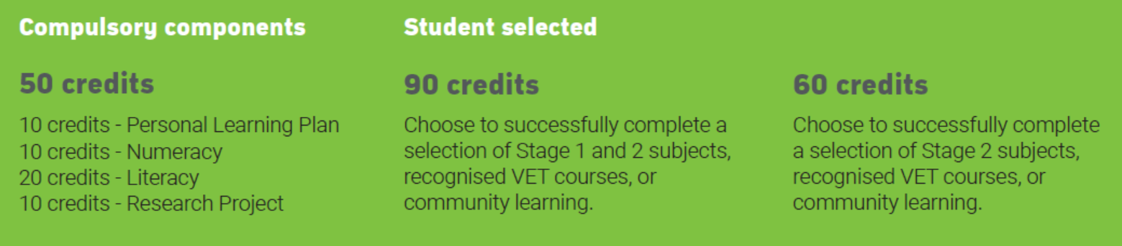
Achievement of SACE
Students wishing to receive a SACE grade:
Must achieve a C- or higher in 3 Stage 2 subjects or registered equivalent (eg VET)
Notes:
Achieving the SACE and achieving an ATAR are different. SACE requires the compulsory subjects (50 credits), completion of an additional 90 credits that can be from Stage 1 or 2 and a C grade or higher in 3 Stage 2 subjects as shown on the screen. This is a total of 200 credits. Many of our students will have more than the minimum 90 credits across Stage 1 and 2.

Slide 15
University Entrance
Students wishing to apply for university entry must:
Complete the SACE, including the Research Project
Complete 90 Stage 2 credits including at least four 20 credit Stage 2 subjects approved by universities
Complete prerequisite requirements for some courses
Note that the ATAR is a ranking
Notes:
To be eligible for an ATAR for University Entrance, students need to achieve their SACE and a total of 90 Stage 2 credits (4 year-long subjects and RP) will contribute to their ATAR. When our students complete 5 year-long subjects RP does not need to count to their ATAR. Students effectively have a ‘spare’ subject. Their lowest grade (whether that be RP or their fifth subject) automatically will not factor into their ATAR.
The ATAR stands for Australian Tertiary Admissions Rank. It’s a number between 0 and 99.95 that indicates a student’s position relative to all other students receiving an ATAR that year. An ATAR of 80, for example, means that the student has achieved in the top 20% of that cohort.

Slide 16
Scaling
Scaling is a mathematical process which provides the basis for comparing student performance in different SACE/ Stage 2 subjects.
Scaling adjusts the ‘raw scores’ of a subject, to allow the results for that subject to be fairly compared with the results of any other subject. Raw scores are the results of the individual assessment components of a subject.
There are thousands of possible combinations of subjects completed by SACE students. Scaling ensures that you are neither advantaged nor disadvantaged by choosing one combination of subjects over another.
Notes:
Scaling in a mathematical process that allows all subjects to be compared equally. This is so that a certain combination of Year 12 subjects does not offer students an advantage over another combination. Scaling is a procedure defined by the Universities. It allows subject ‘raw scores’ to be directly compared an can then be used by Universities to determine which students are offered a place in their programs. Scaling does not lower a student’s performance and their ranking in that subject, relative to others, does not change. Sometimes students will be overly concerned with whether their subjects will be ‘scaled up or down’. Scaling algorithms change every year and the effect of scaling is impossible to predict. Students should chose subjects based on their interests and abilities – this is much more likely to lead to a higher ATAR. However, the higher your marks in the subjects you choose, the lesser the impact of scaling.

Slide 17




Interstate University Options
Going interstate?
Interstate Universities often require English at Stage 2
Check carefully each University's requirements
Notes:
Some students may wish to study interstate. Carefully check the University prerequisites to ensure you have chosen the correct Year 12 subjects.
Many of these universities also require Stage 2 English which may differ from South Australian universities.
Later in the year, Annie Fitridge, our Pathways leader, will run a SATAC evening as part of the Year 12 Learning Conversations. This will provide you with all the necessary information regarding University and TAFE applications. All students will also receive individual counselling and assistance in preparing their SATAC application.

Slide 18
Health and Wellbeing
Senior School
Online Reputation Year 10
Sexting (SAPOL) Year 10
Partying and Violence (Sammy D Foundation) Year 10
Cyber safety (Carly Ryan Foundation) Year 10 and 11
Mental Health (Headspace) Year 10, 11, 12
Safe use of Alcohol (Paul Dillion) Year 10, 11, 12
PARTY Impact of risk taking (Program ) Year 10 and 11
Road Safety (SAPOL) Year 11
Managing Examination Stress Year 10 , 11 and 12
Notes:
These are the various ‘programs’ that we have put in place to support and educate our senior students

Slide 19
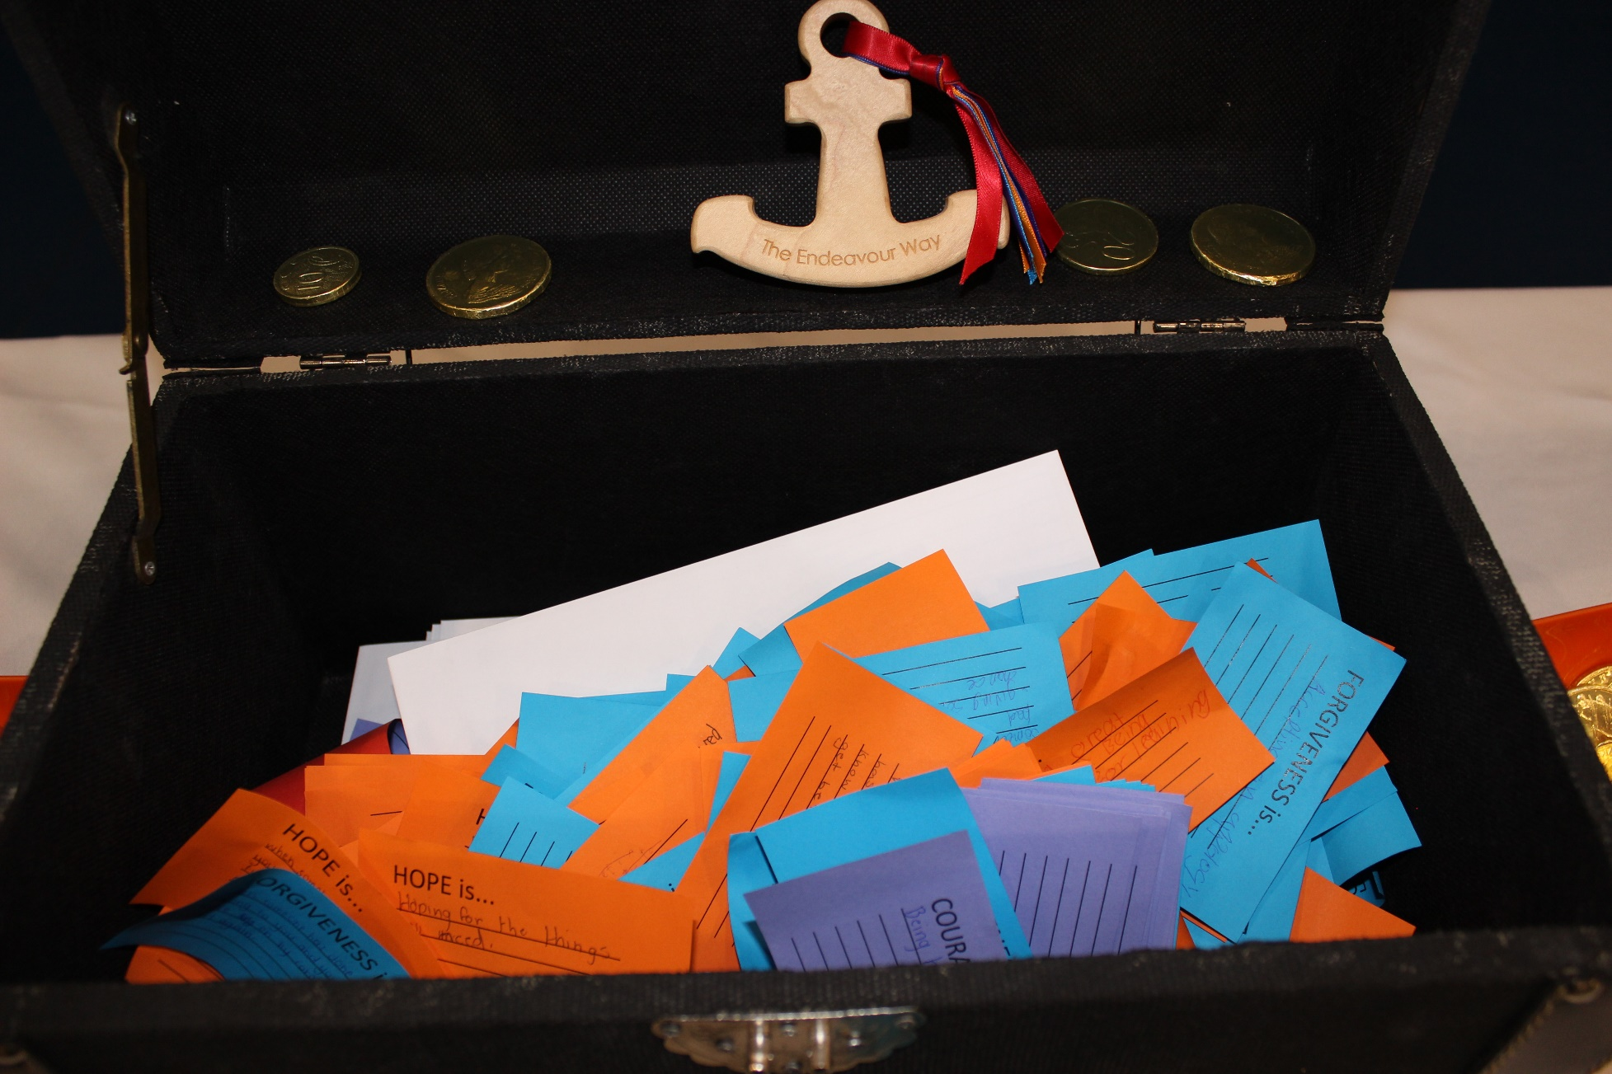
Reflection on The Endeavour Way
Daniel Wooldridge
Year 12 Year Level Leader
Notes:
Time for a little reminiscing…
We as staff are very proud of the culture the students have created by their participation in a variety of activities that have been developed over the last 4 years for them to live out the Endeavour Way.
In Year 8, the first transition days with circle work, anchors, ribbons and a treasure chest. A chance to build new friendships on Year 8 Camp, earning Endeavour Dollars for demonstrating the Endeavour Way in action. They also got to participate in Peer Support as Year 11s taught them the ropes about the Endeavour Way in action.
Year 9, the Voyage began. Students were involved in a number of ceremonies and activities. They went on the Voyage Camp where they showed their courage and were asked to spend 1 ½ hours on their own for reflection time while on camp and the development of ideas to put real examples of the Endeavour Way in action around the school.
Year 10 saw them involved in various Health & Wellbeing days where they heard from the Sammy D foundation, did First Aid and had the chance to do community service to help others out. Year 10 was also the first time the students met Paul Dillon.
Year 11 gave students an opportunity to lead Peer Support and teach others about the Endeavour Way. Year 11 Camp gave them an opportunity to develop their independence and reflect on and develop leadership they could show in their final year at school.

Slide 20

Year 12
Notes:
So what does Year 12 bring for them? Students have already been encouraged to be involved in activities and to participate on retreat and in care group to support the Endeavour Way.

Slide 21

LOVE
Courage
Forgiveness
HOPE

Slide 22
How can you be of support?
Relationship
Support school procedures – uniform, punctuality to school, assessment policy.
Encourage students to keep their work hours to around 10 hours.
Help students with their organisation and time management where needed.
Adequate time devoted to study.
Notes:
Your relationship with your child is really important – you are their parent, not their best friend and during these senior years – they still need guidance and boundaries.
We are offering more independence than ever here at the College and encourage you to be actively involved in checking in with the students on how they are going with that. It will be a big change for some!

Slide 23
THANK YOU
Notes:
So I wish you and your children all the best for your final year. They are young adults and we have encouraged them to give it all their best shot – have the courage to ‘have a go’, do the right thing by their friends, family, our community in general and particularly themselves.
As I said earlier, we are generally proud of what the students have developed with us through the journey of the End Way and look forward to the final journey.
Here’s to a great, exciting and fulfilling year ahead
You’re welcome to stay and ask me some questions and I encourage you to take a tour of the new building if you haven’t done so. Thanks

