Slide 1
VCE – HEALTH AND HUMAN DEVELOPMENT
(2025-2029 Study Design)

Slide 2
Focus of Health and Human Development
Focus of HHD:
EXPANDS HEALTH LITERACY
IMPROVE YOUR OWN HEALTH & WELLBEING
IMPROVE THE HEALTH & WELLBEING OF OTHERS
EVALUATE AND INTERPRET INFORMATION
School Office
Gymnasium
Sports grounds

Slide 3
INTRO
UNIT 1 & 2
UNIT 1: Understanding health and wellbeing
UNIT 2: Managing health and development

Slide 4
Unit 1 - Understanding health and wellbeing
AREA OF STUDY 1
Concepts of Health
TOPICS
Dimensions of health and wellbeing
Health status of Australia’s youth
Indigenous health and wellbeing
Factors influencing health outcomes
School Office
Gymnasium

Slide 5
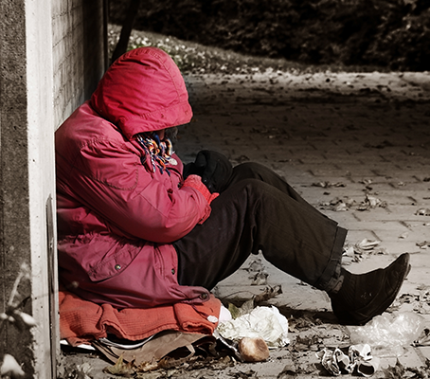
Unit 1 - Understanding health and wellbeing
AREA OF STUDY 2
Youth health and wellbeing
WRITTEN-REPORT
Students conduct independent research based on one area focus, that relates to a youth health problem or concern.
School Office
Gymnasium
Sports grounds outside Gym
Sports grounds

Slide 6
Unit 1 - Understanding health and wellbeing
AREA OF STUDY 3
Health and Nutrition
TOPICS
Macronutrients
Micronutrients
Nutritional imbalances
Food selection models/tools
Health promotion
Food marketing tactics
Food trends
Factors influencing dietary behaviours
School Office
Sports grounds outside Gym
Sports grounds

Slide 7
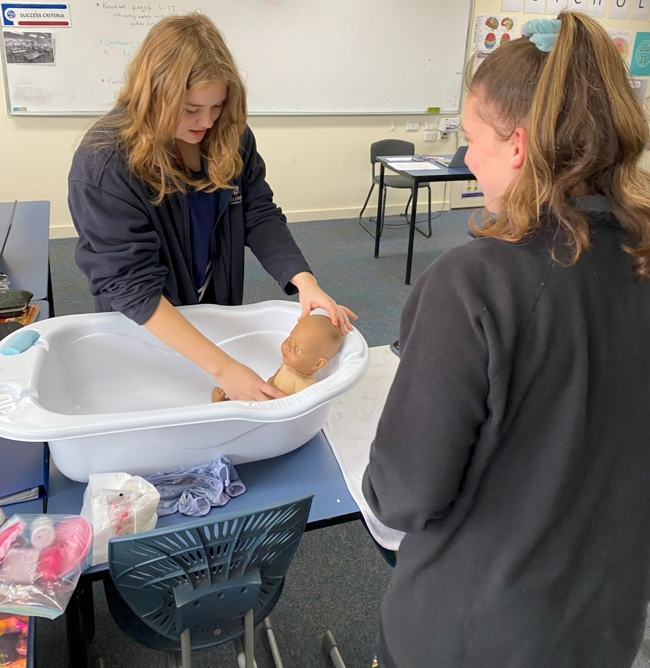
Unit 2 - Managing health and development
AREA OF STUDY 1
Developmental transitions
TOPICS
Developmental milestones across the human lifespan
Fertilisation and prenatal development
Factors influencing prenatal development
Development in infancy and childhood
Early life experiences
Parent responsibilities, programs and services
Healthy/unhealthy relationships
School Office
Gymnasium
Sports grounds

Slide 8
Unit 2 - Managing health and development
AREA OF STUDY 2
Youth Health Literacy
TOPICS
Medicare
Pharmaceutical Benefits Scheme
National Disability Insurance Scheme
Private Health Insurance
Factors influencing access to health services and information
Privacy and confidentiality of health information/data
Emerging health procedures and technologies
School Office
Gymnasium
Sports grounds

Slide 9
Unit 1 & 2 Assessment
Unit 1:
Assessment Task 1 – Structured Questions
Assessment Task 2 – Written Report
Assessment Task 3 – Case Study Analysis
Unit 1 Exam
Unit 2:
Assessment Task 1 – Portfolio & Quiz
Assessment Task 2 – Structured Questions
Unit 2 Exam
School Office
Gymnasium
Sports grounds outside Gym
Sports grounds

Slide 10
Unit 3 - Australia’s health in a globalised world
AREA OF STUDY 1
Understanding health and wellbeing
TOPICS
Dimensions of health and wellbeing
Health as a resource
Factors influencing health outcomes
Health status of vulnerable population groups within Australia
School Office
Gymnasium

Slide 11
Unit 3 - Australia’s health in a globalised world
AREA OF STUDY 2
Promoting health in Australia
TOPICS
Biomedical approach
Public health approach
Australia’s health system
Health promotion initiatives
School Office
Gymnasium

Slide 12
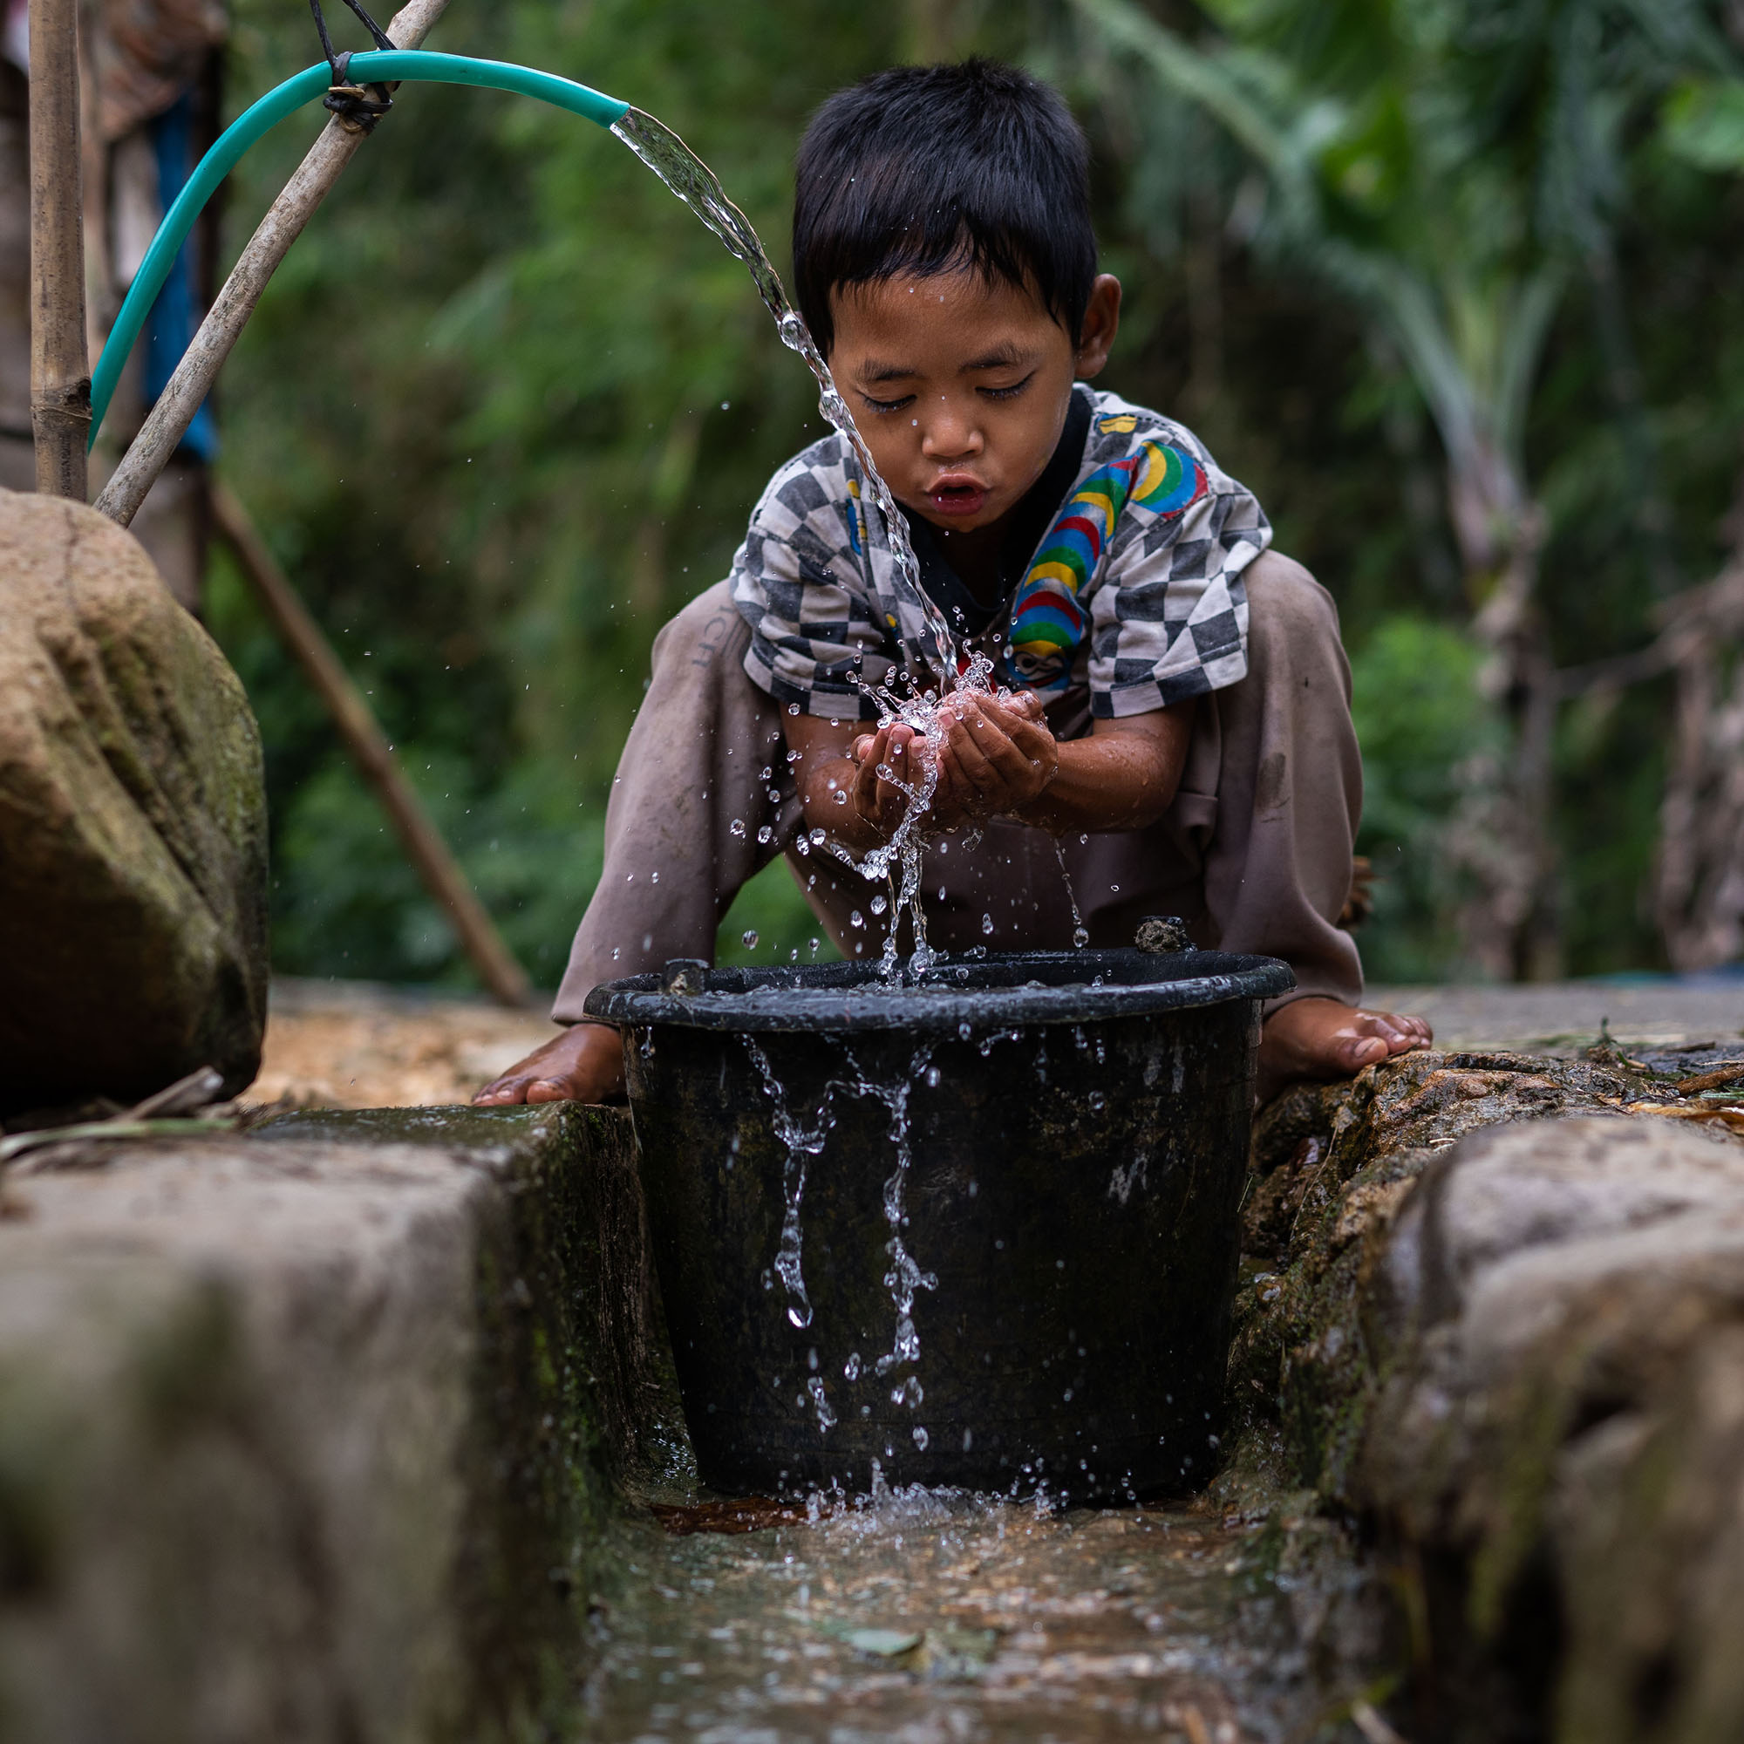
Unit 4 - Health and human development in a global context
AREA OF STUDY 1
Health and human development in a global context
TOPICS
Characteristics of high-, middle- and low-income countries
Factors contributing to global health differences
Global trends
Human development
Sustainability
School Office
Gymnasium
Sports grounds outside Gym
Sports grounds

Slide 13
Unit 4 - Health and human development in a global context
AREA OF STUDY 2
Health and the Sustainable Development Goals
TOPICS
Work of World Health Organisation (WHO)
Types of aid
Role of NGO’s (e.g. World Vision, Oxford, red Cross etc.)
Australia’s aid program
Features of effective aid programs
School Office
Gymnasium
Sports grounds outside Gym
Sports grounds

Slide 14
Unit 3 & 4 Assessment
Unit 3:
Assessment Task 1 – Structured Questions (Part A)
Assessment Task 2 – Structured Questions (Part B)
Assessment Task 3 – Case Study Analysis
Unit 4:
Assessment Task 1 – Structured Questions
Assessment Task 2 – Case Study Analysis
Unit 3 & 4 Exam
School Office
Gymnasium
Sports grounds outside Gym
Sports grounds

Slide 15
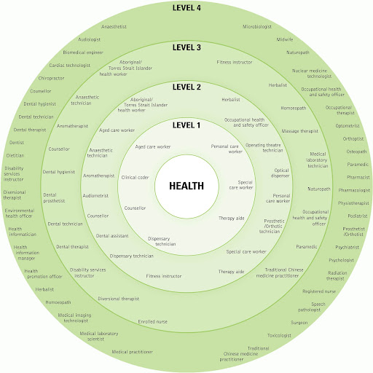
Leads to…
There are many job opportunities in the health industry.
Many healthcare professionals have moved towards a holistic health approach that takes all aspects of health and wellbeing into account.
School Office
Gymnasium
Sports grounds outside Gym
Sports grounds

Slide 16
CONTACT US…
For more information contact:
Ms Simpson Email: natasha.simpson@education.vic.gov.au
Ms Mandarino Email: melissa.mandarino@education.vic.gov.au

