Slide 1

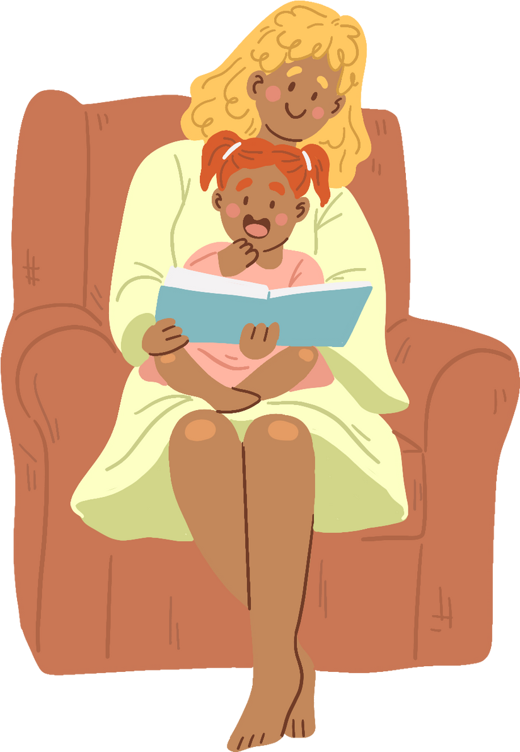





The Roles She is...
Significant Women in our Lives
Happy Mothers’ Day

Slide 2

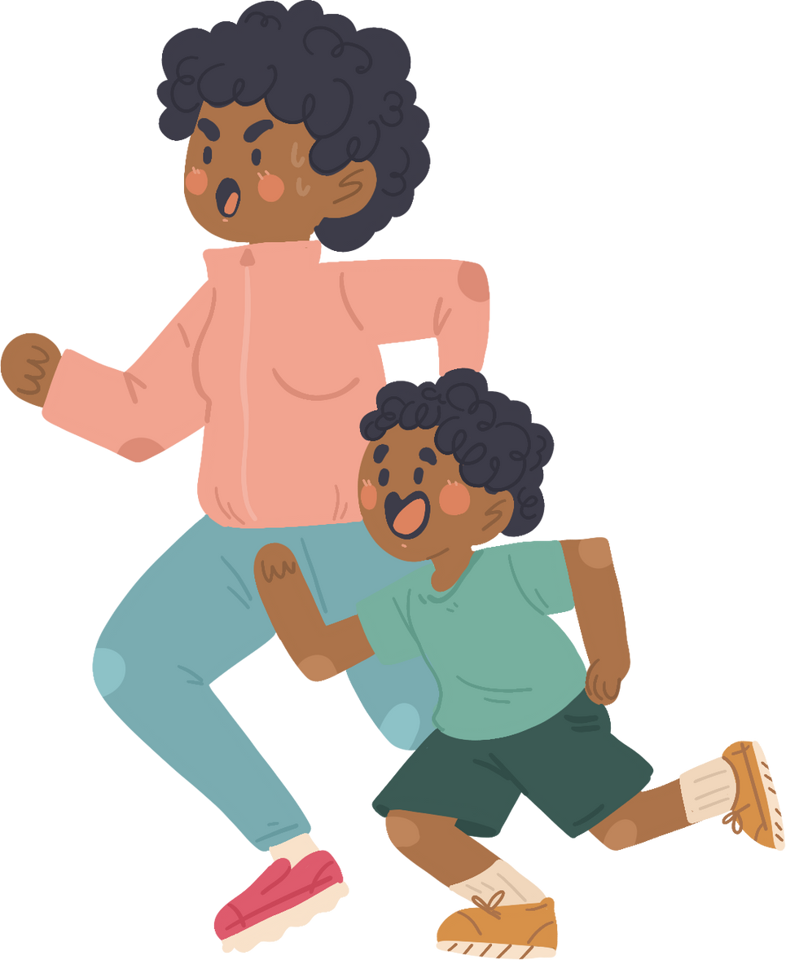


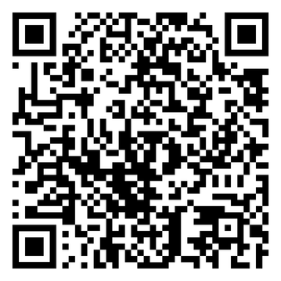
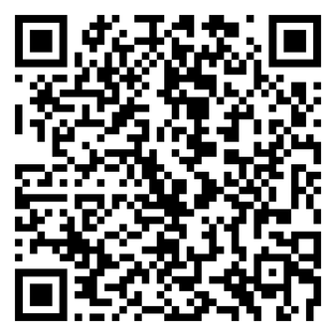


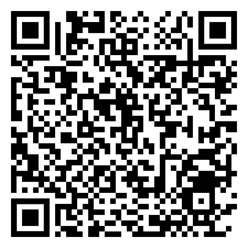
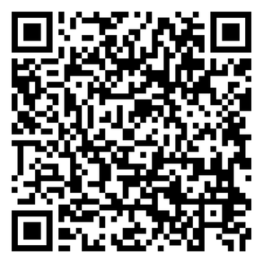

Primary Reads

Slide 3
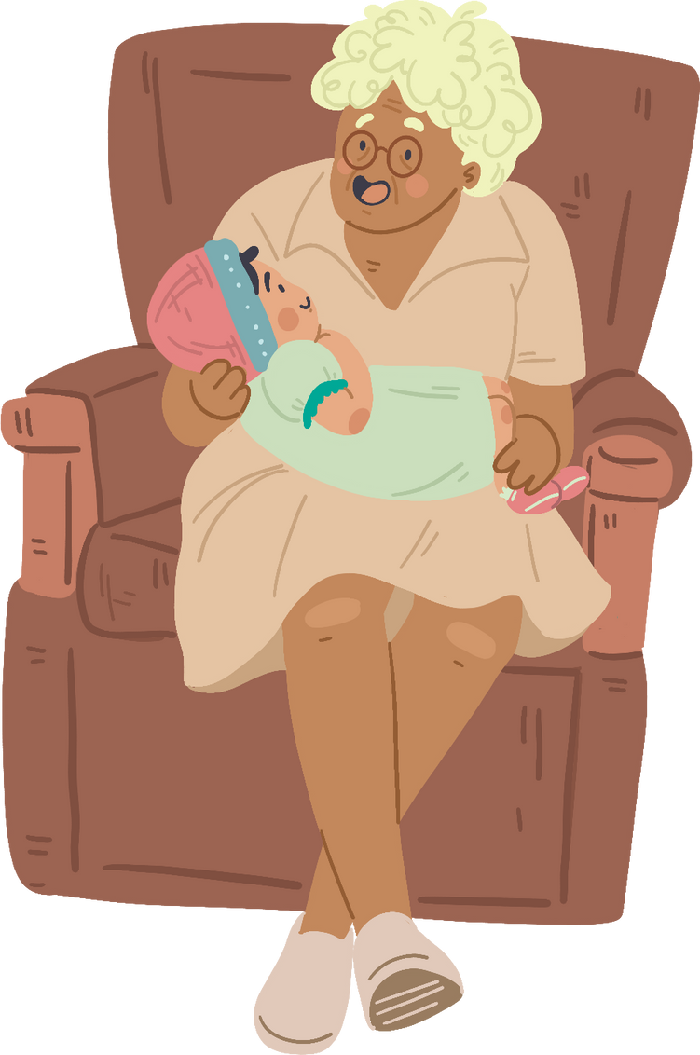

She is a Companion
She’s my true companion.
She keeps me safe.
She lifts me up when I am down,
She knows what to say & how to help
She encourages me to succeed.

Slide 4








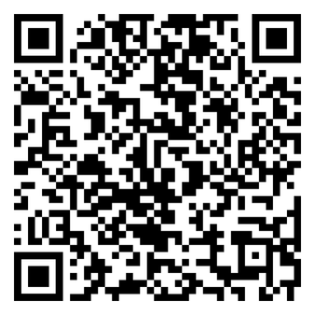

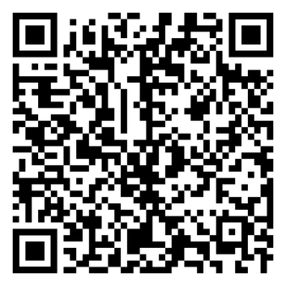
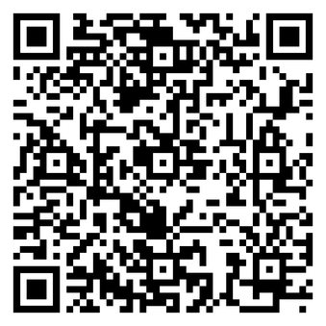
Secondary Reads

Slide 5


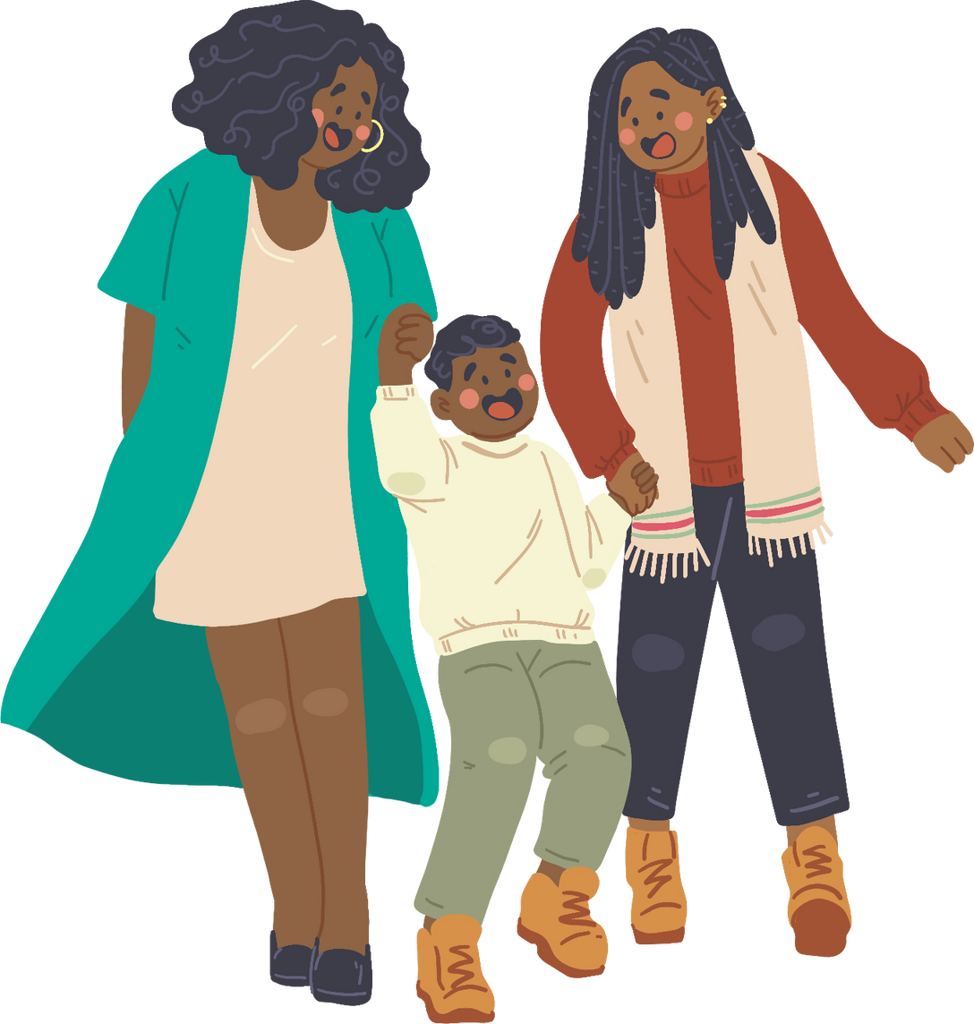
She is Real
She sees the real me, even if I can’t.
Accepting me without judgement.
Guides me to be brave & confident.
With me on my journey in life, love and self-discovery.

Slide 6





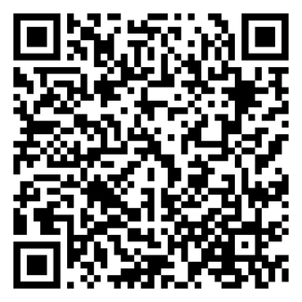
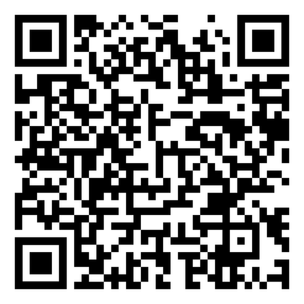

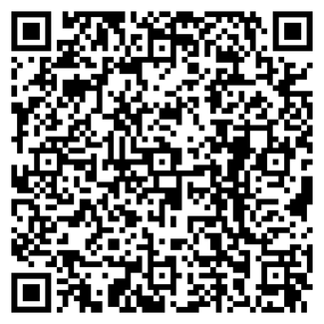
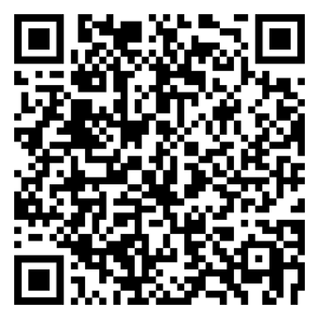
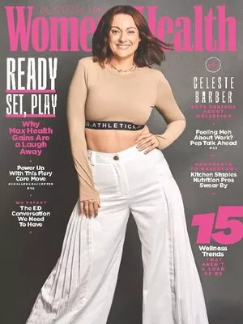


Staff Reads

Slide 7



She is a Keeper
With her by our side, I can achieve anything.
She’s lights up the way.
She is my comfort and care.
Teaching me life’s tips and tricks.

Slide 8

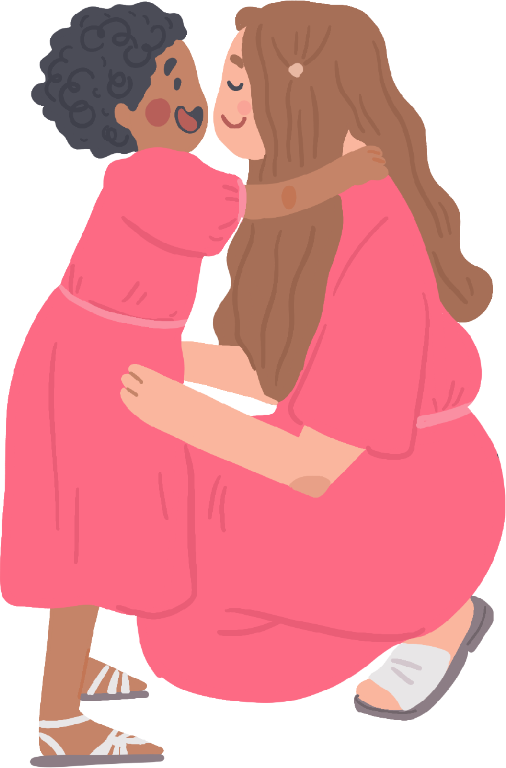
Happy Mother's Day
To all those women in our lives, we are who we are because of you.
Thank you!

