Slide 1



ART CREATIVE PRACTICES
RACT

Slide 2
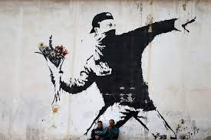
Teacher: Ms Ford

Slide 3
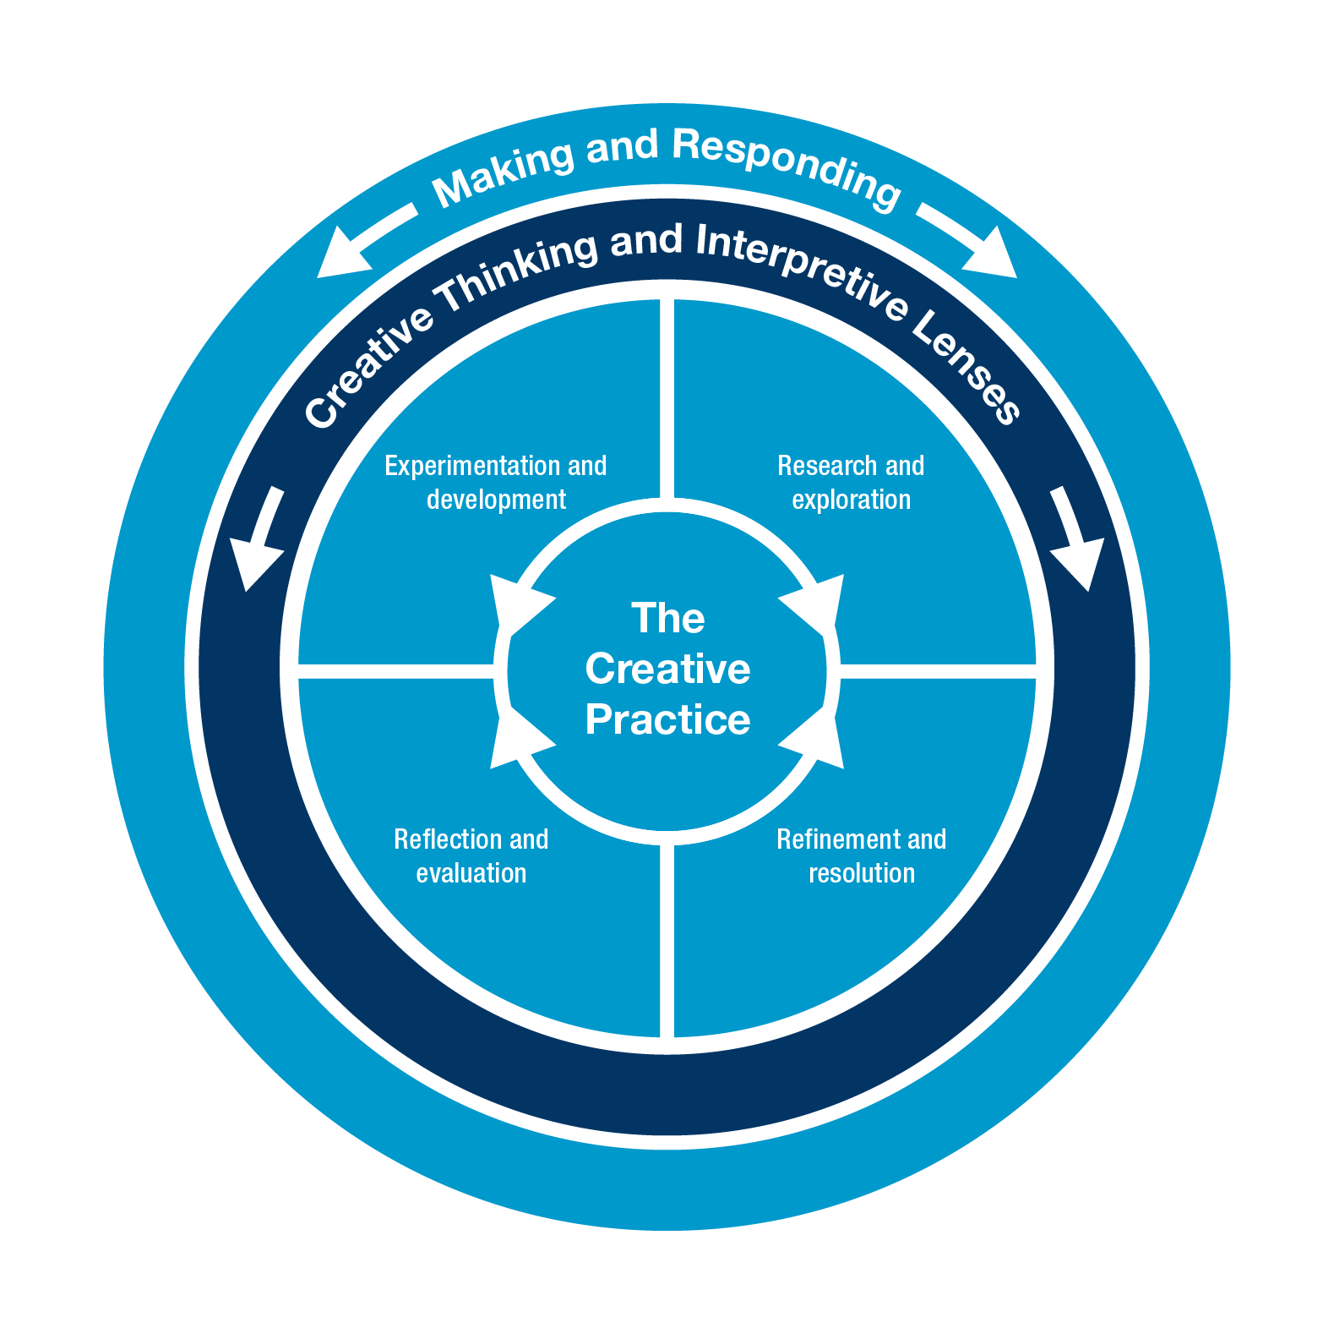
Experimentation and Development
Research and Exploration
Reflection and Evaluation
Refinement and Resolution

Slide 4
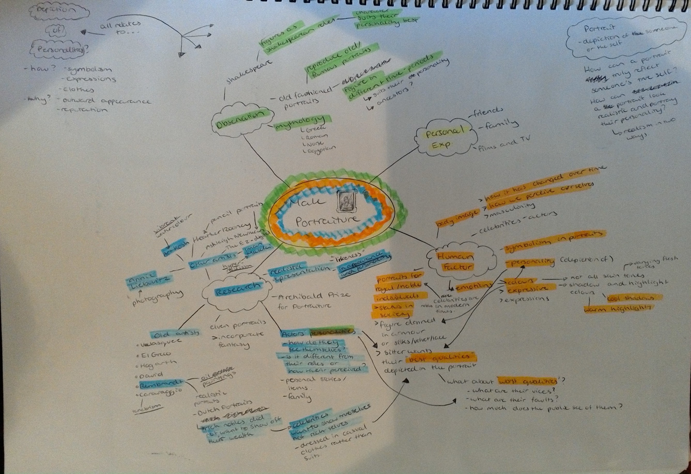
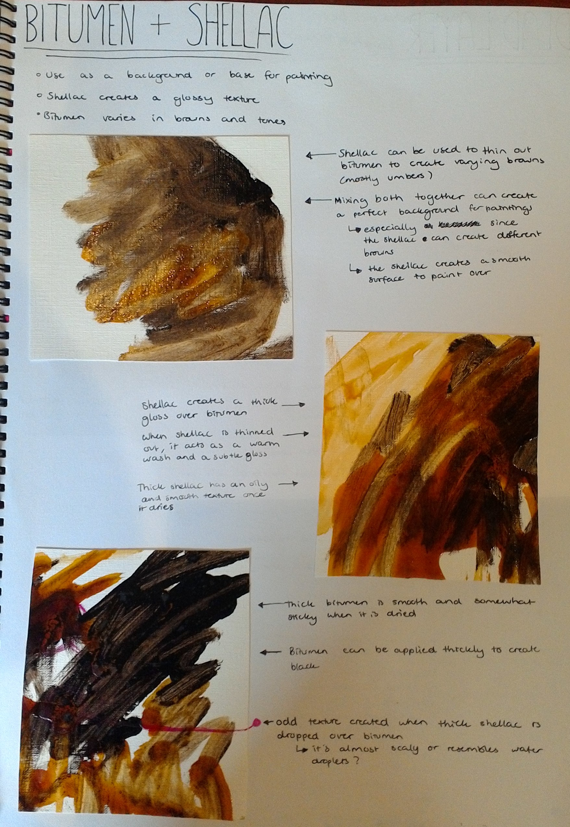
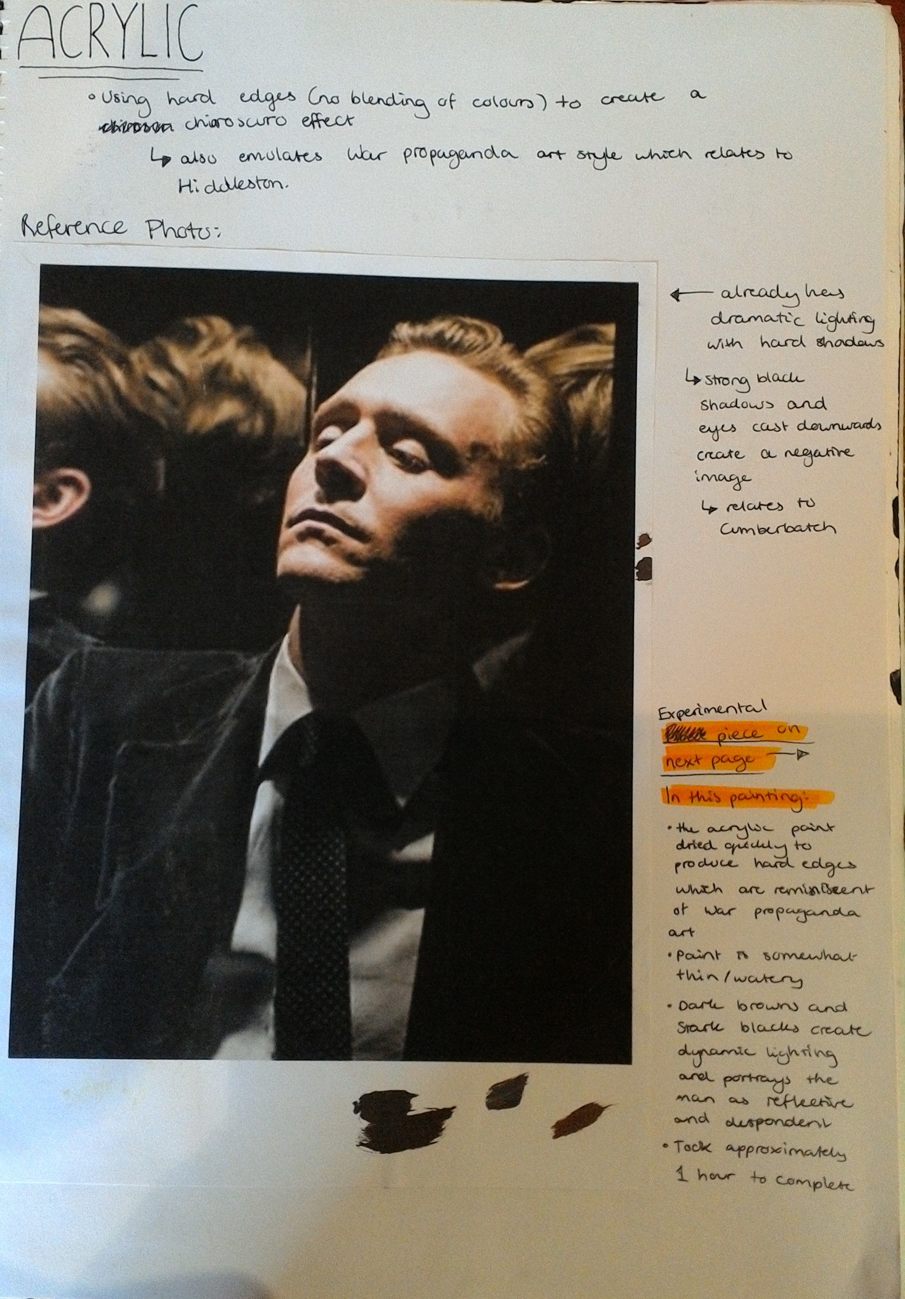
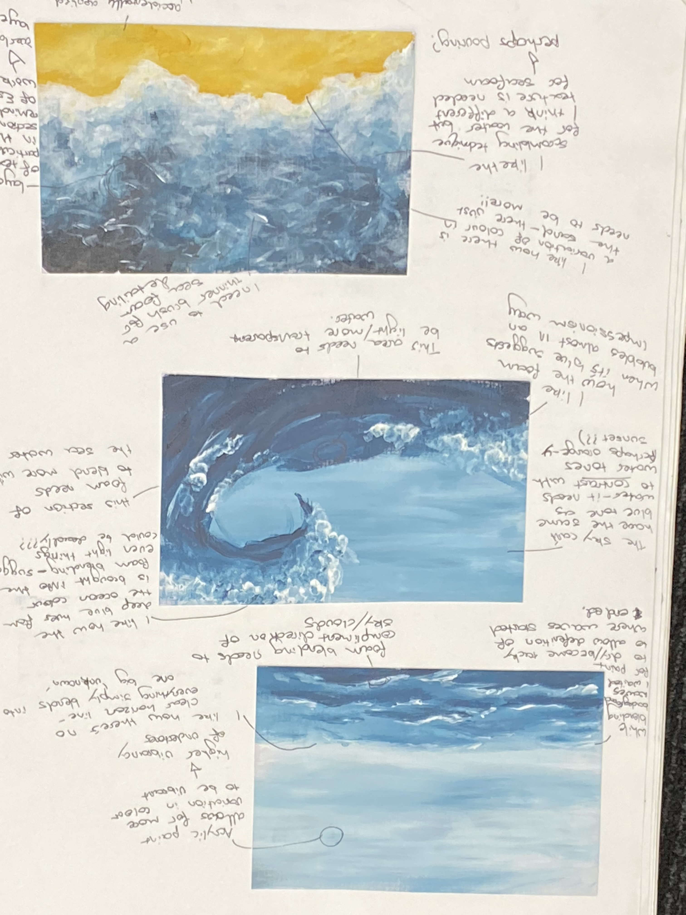
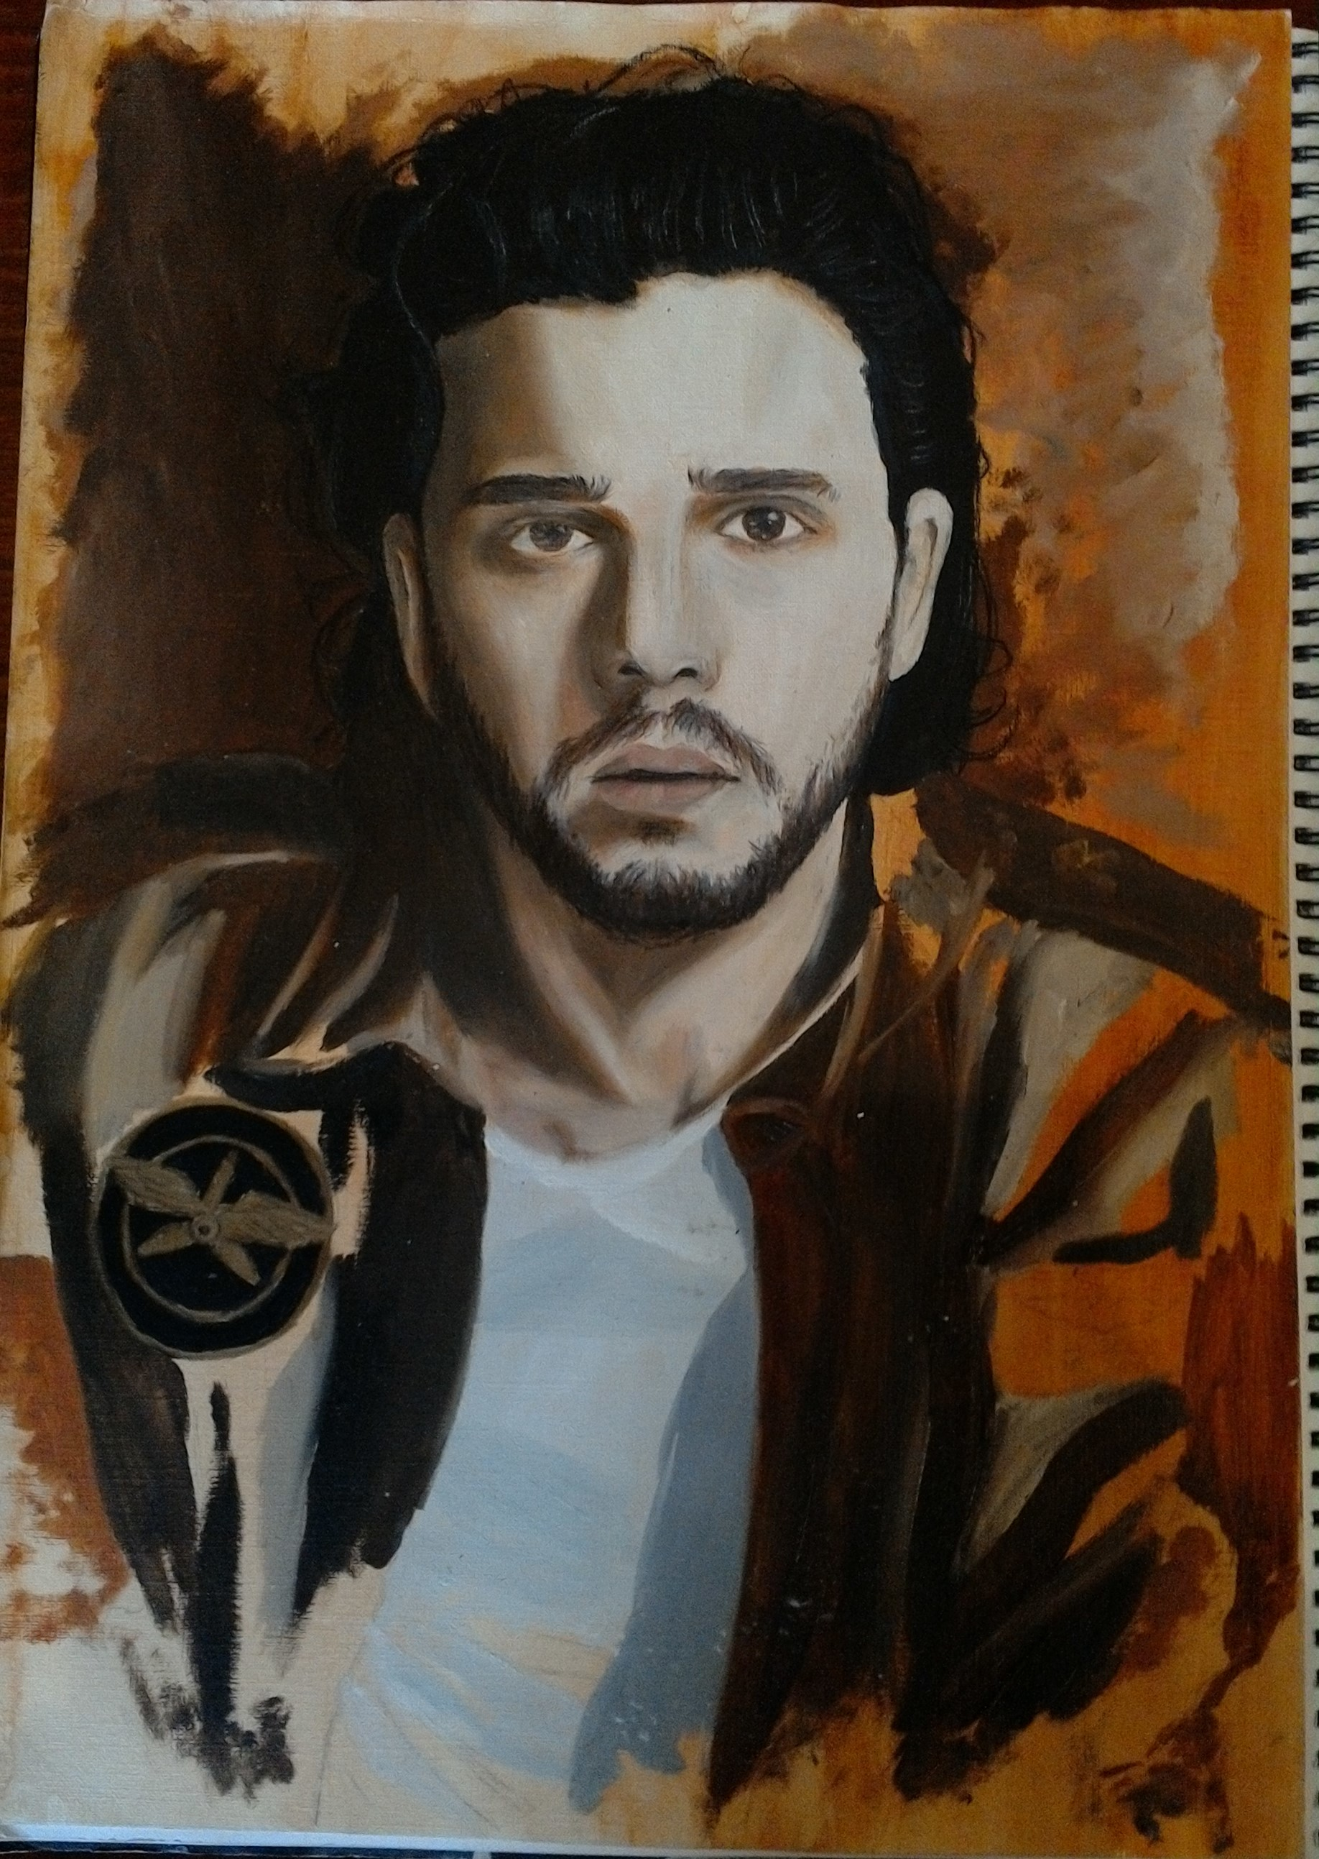
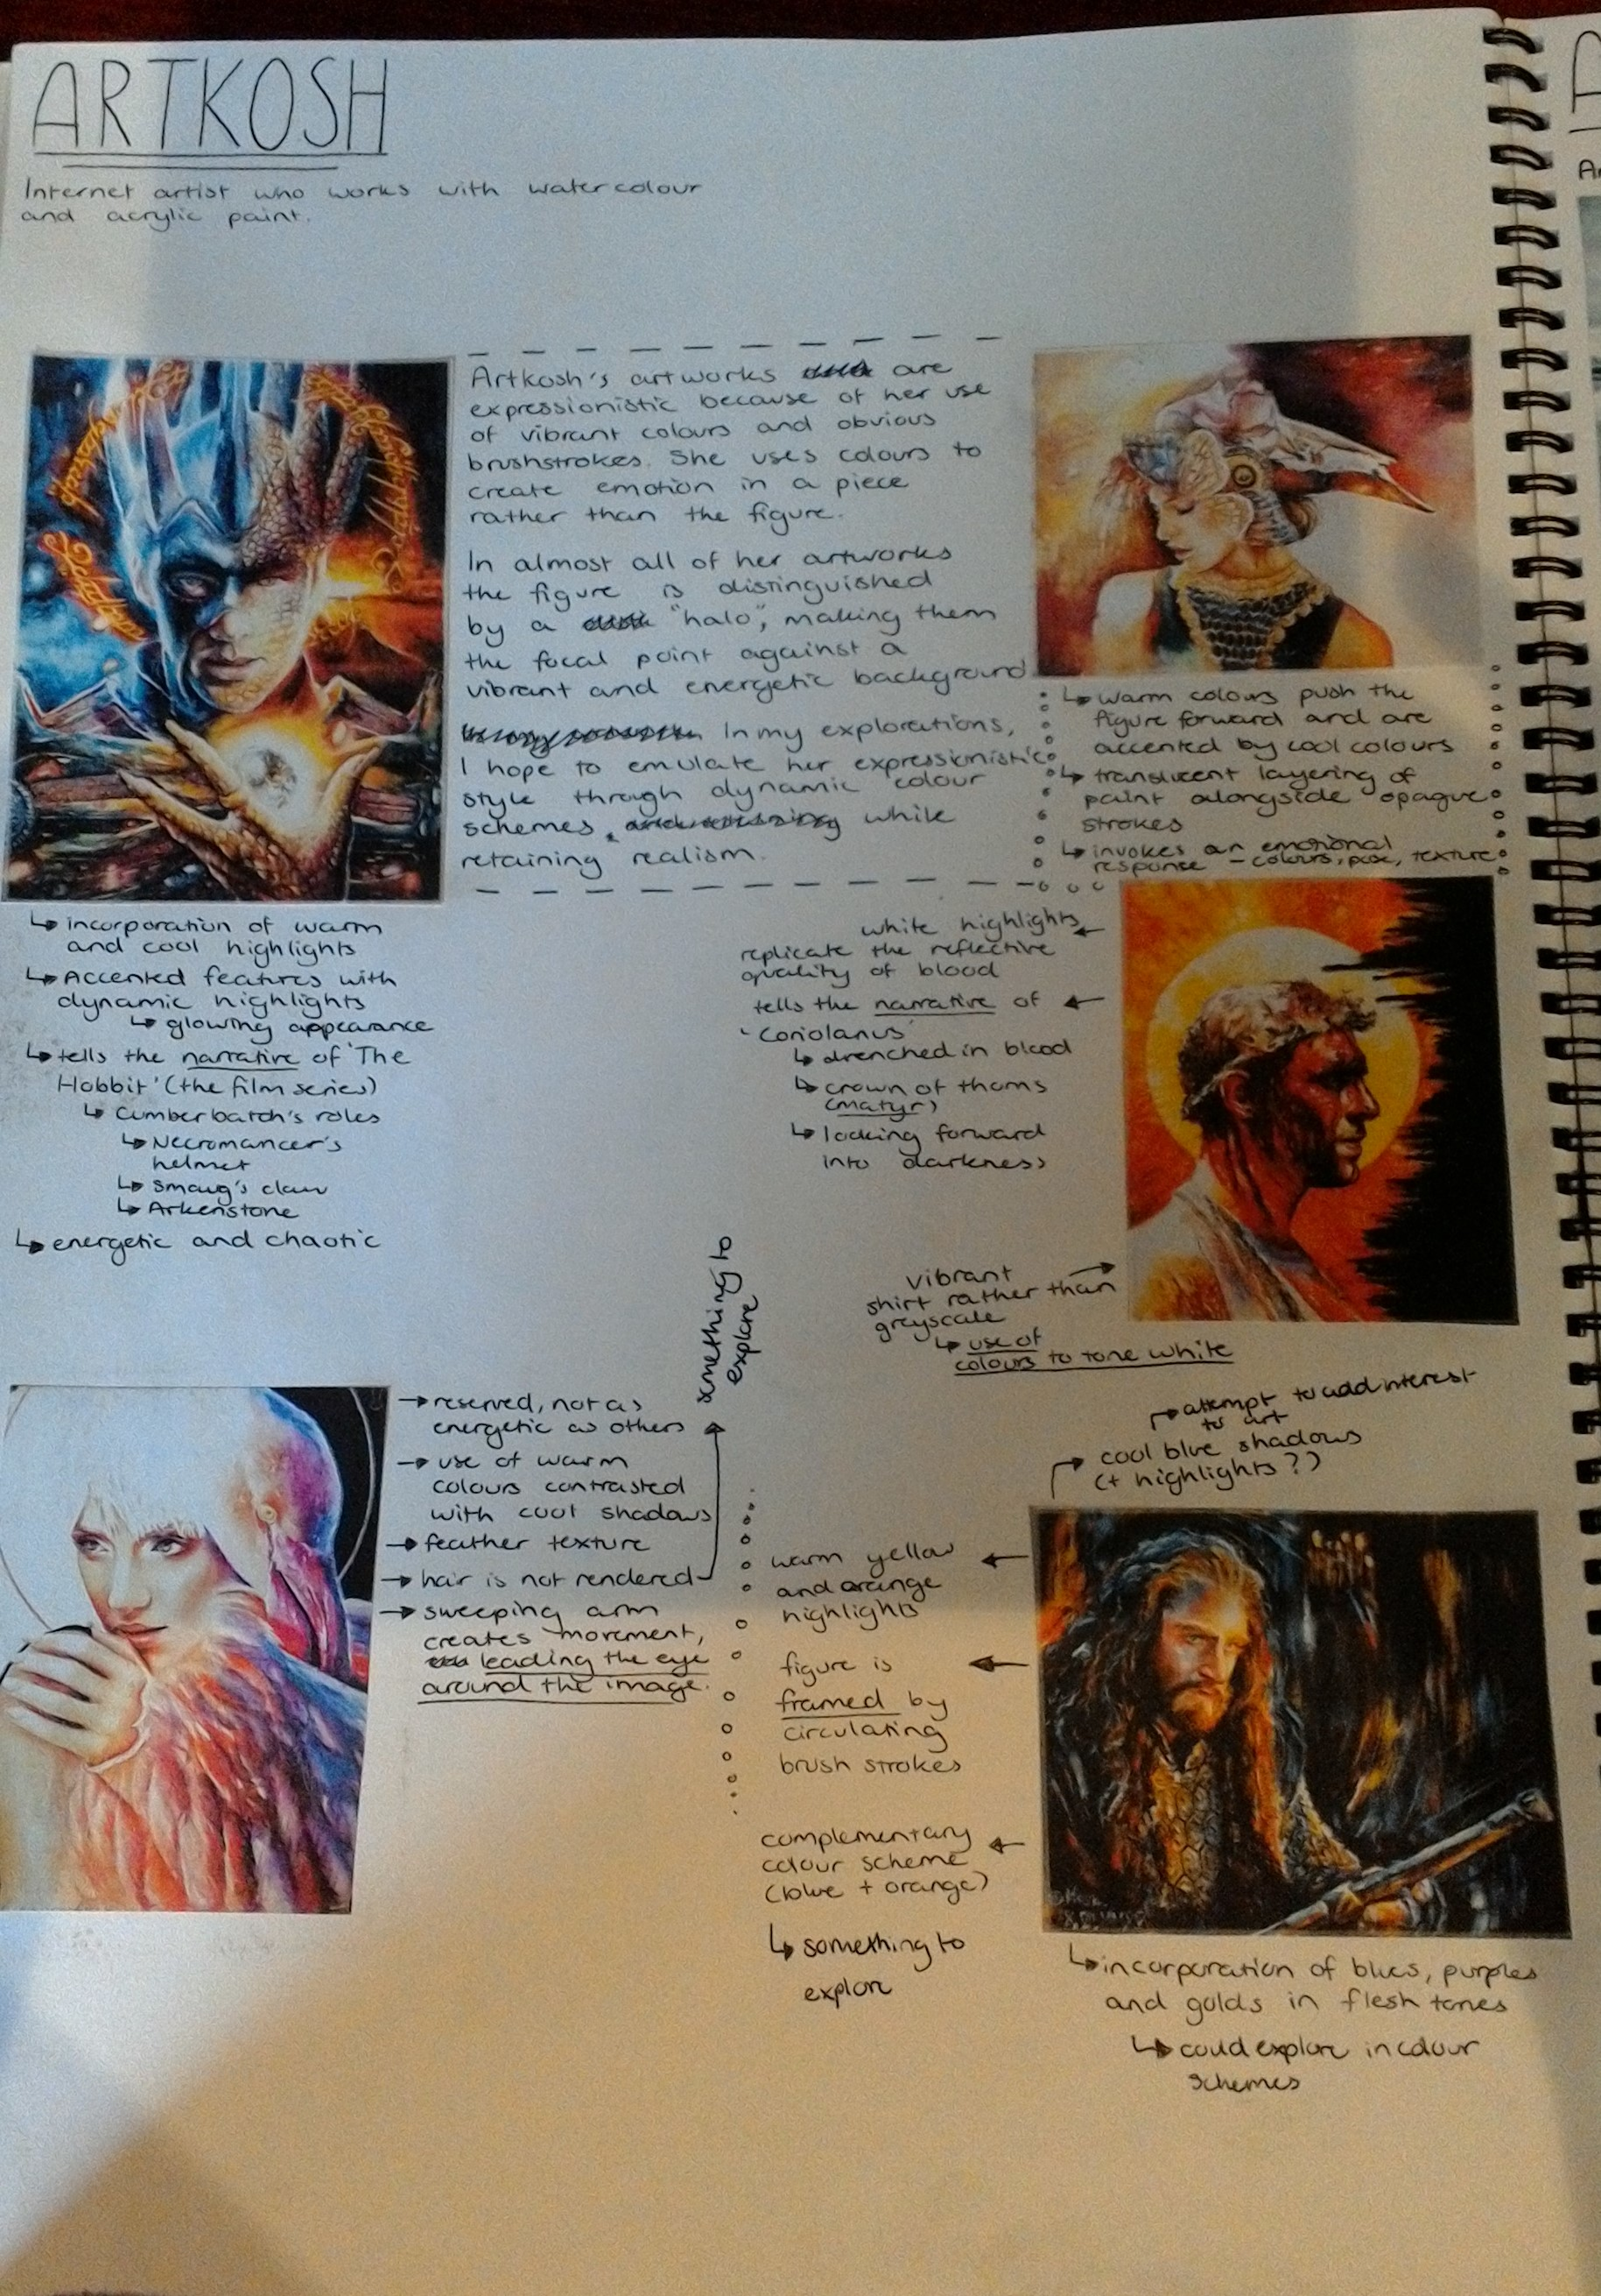
Research and Exploration
Experimentation and Development

Slide 5
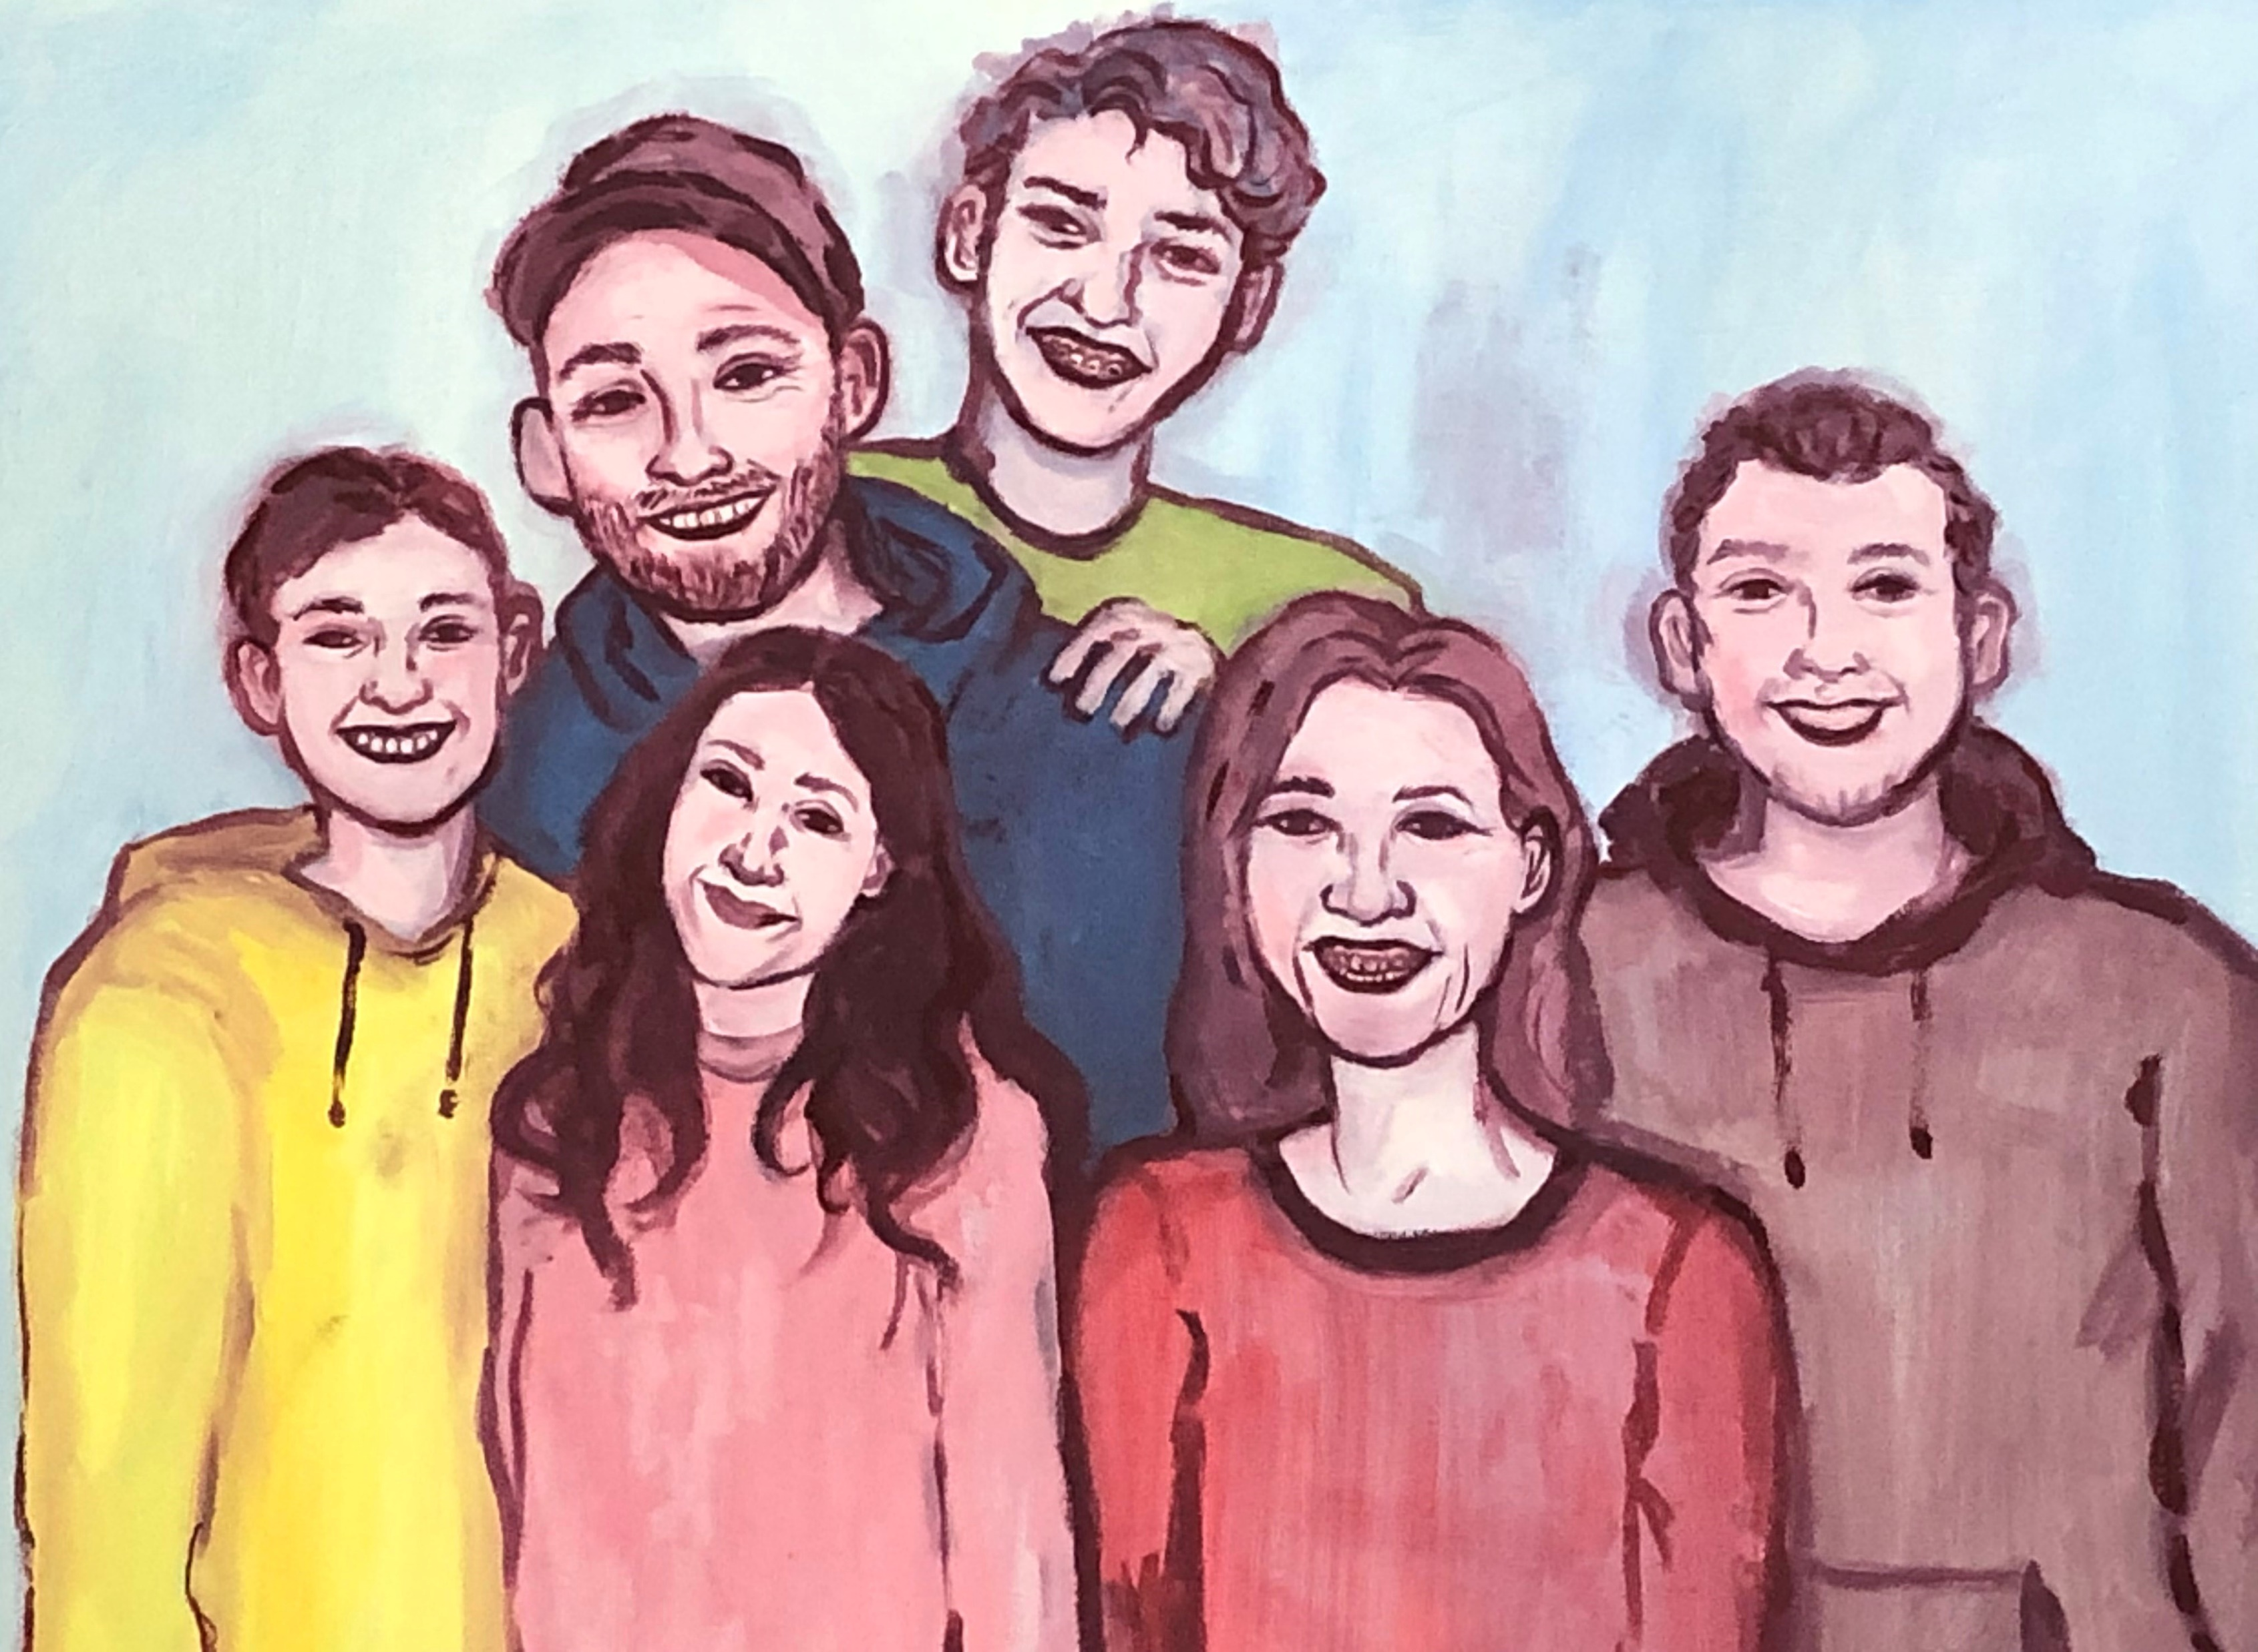
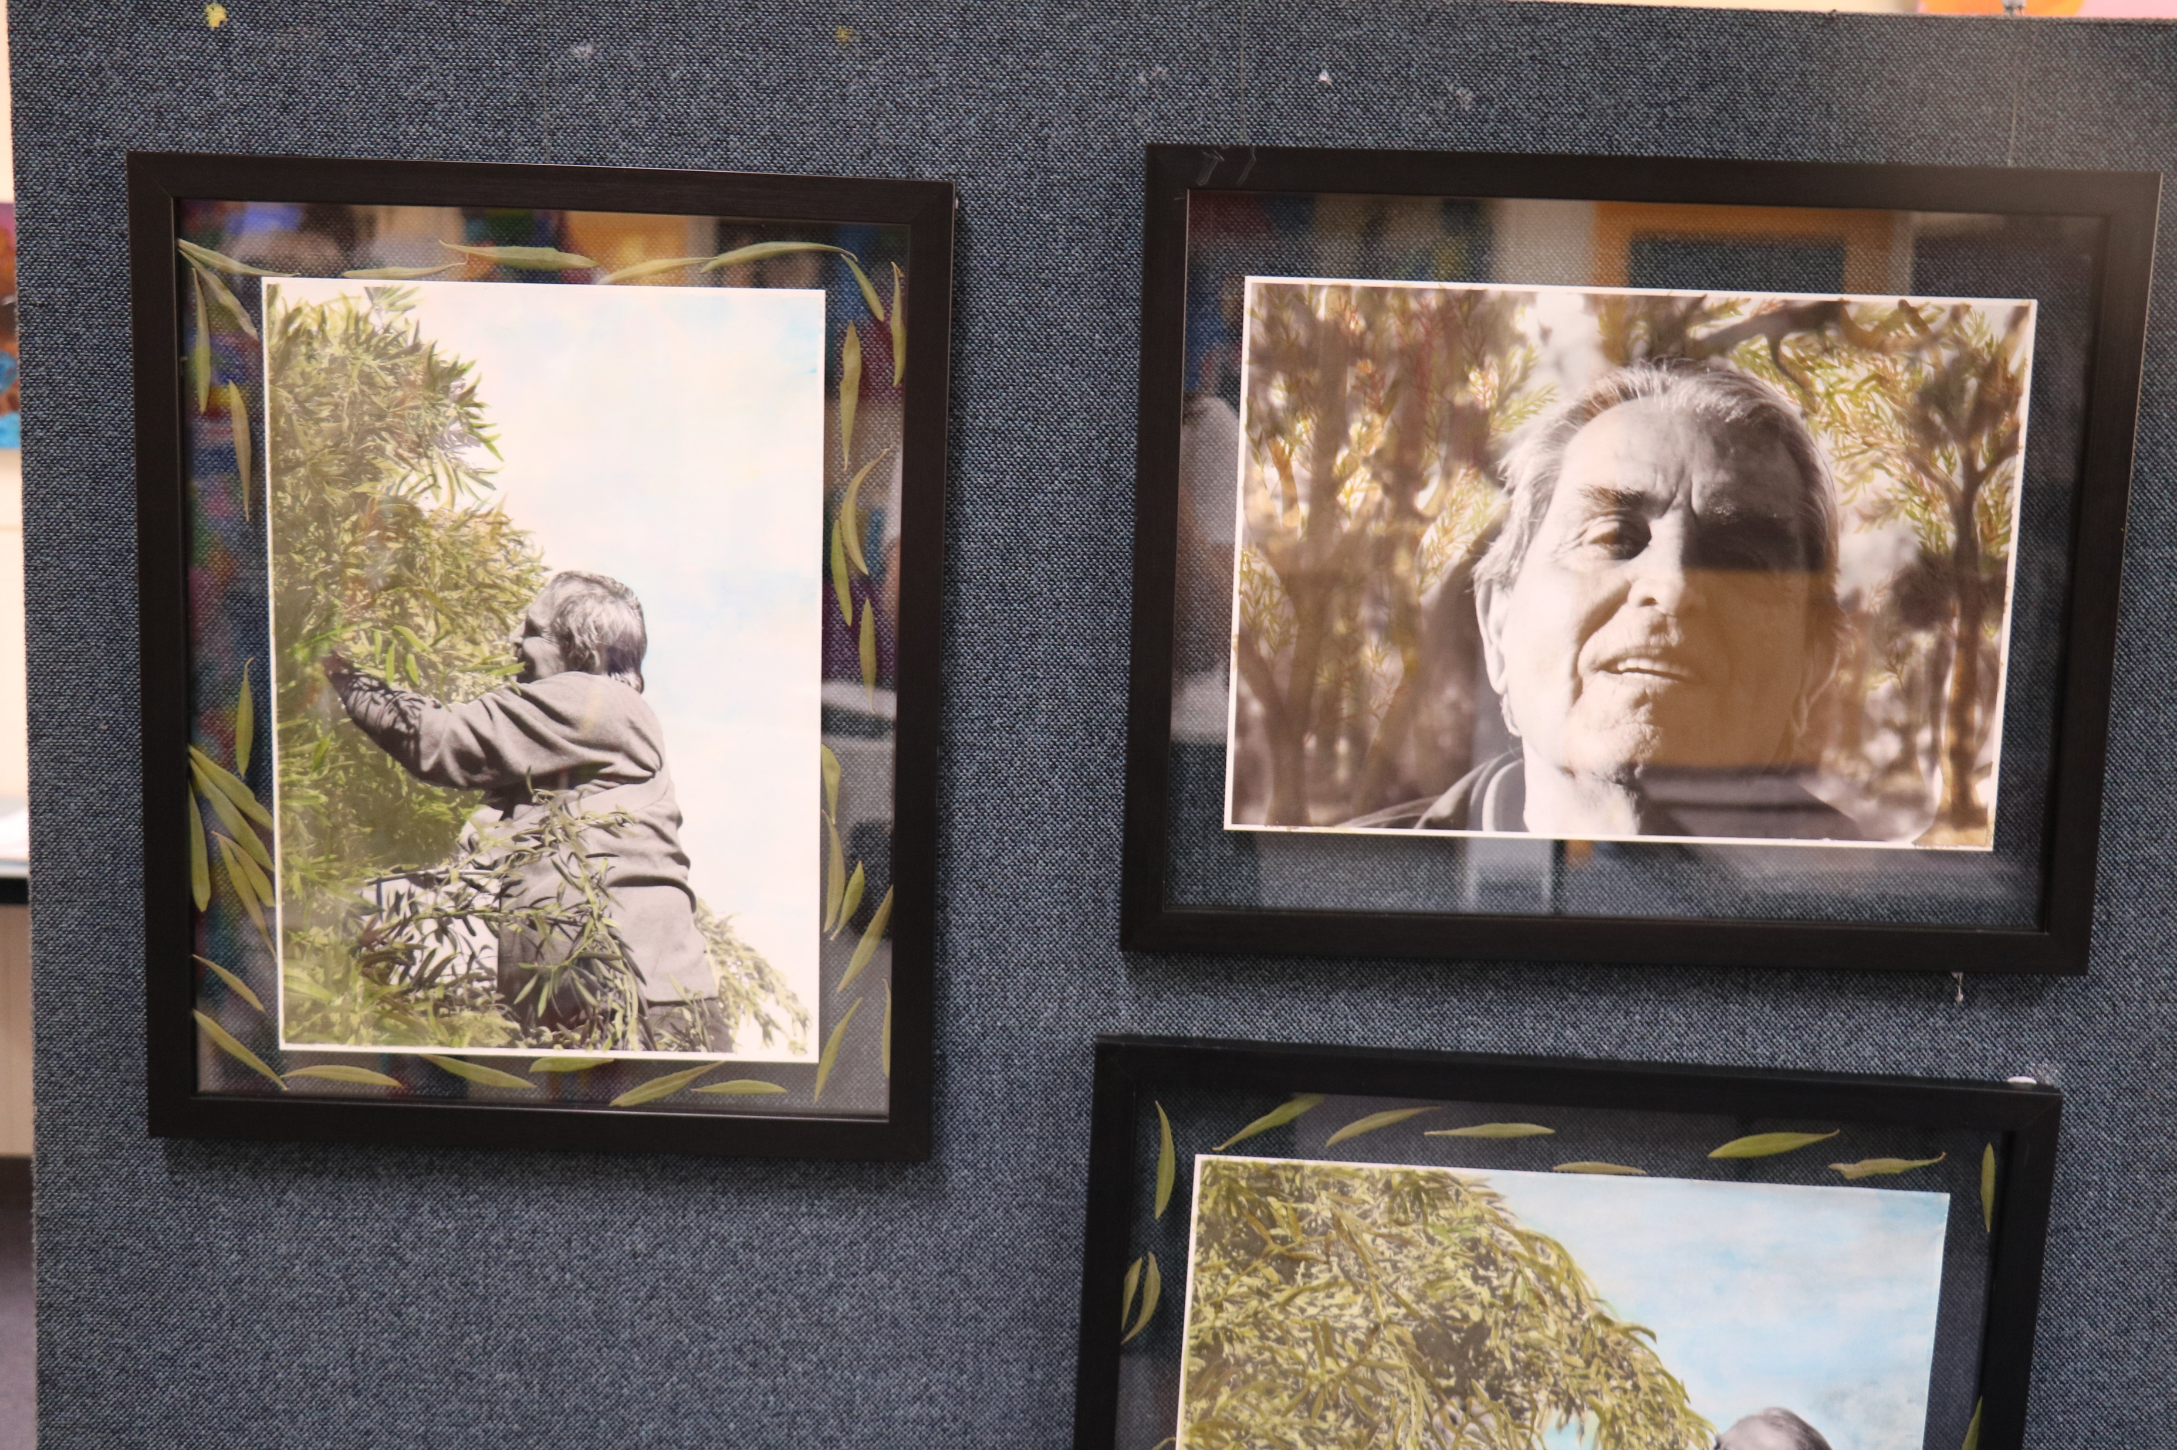

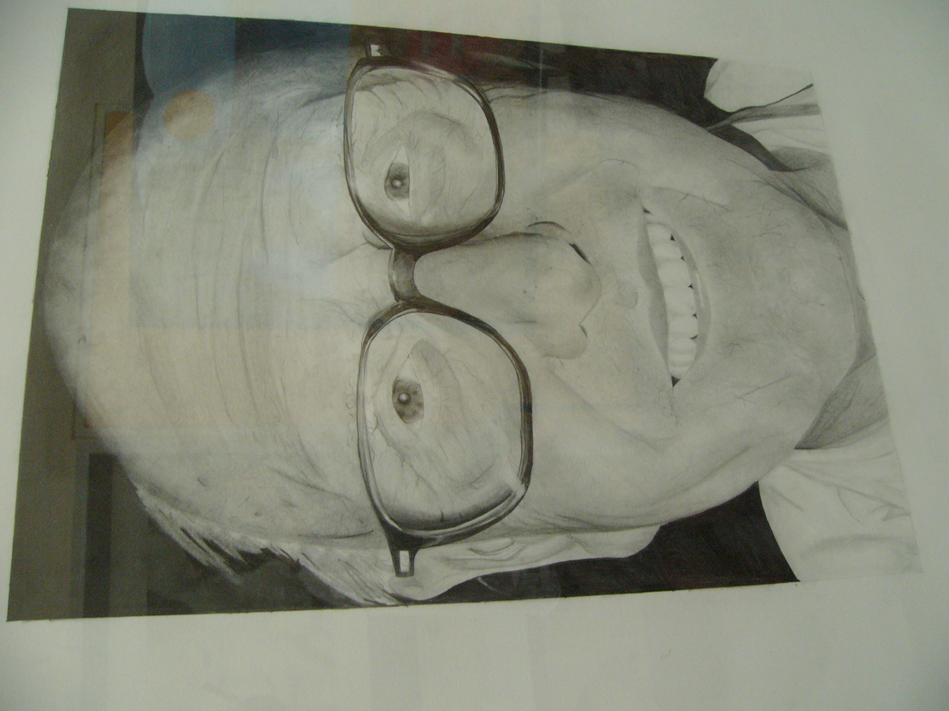
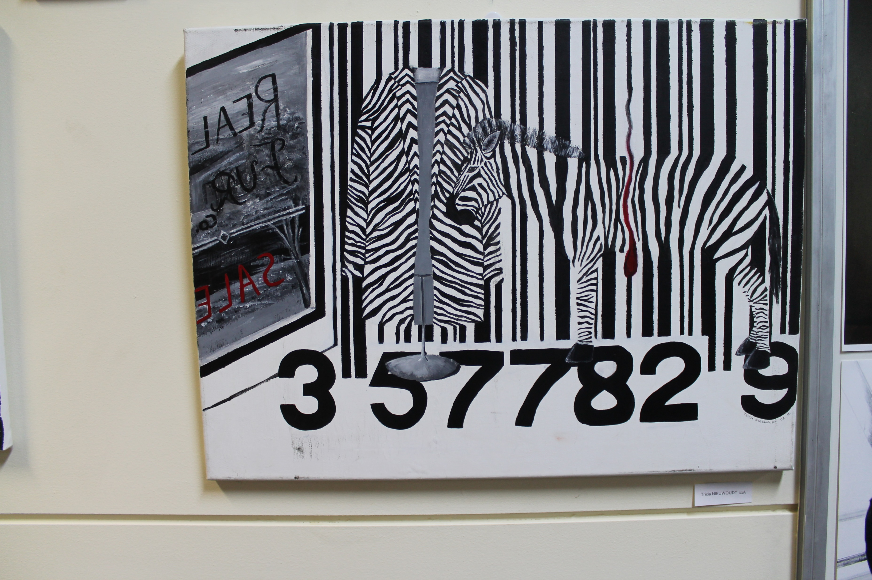
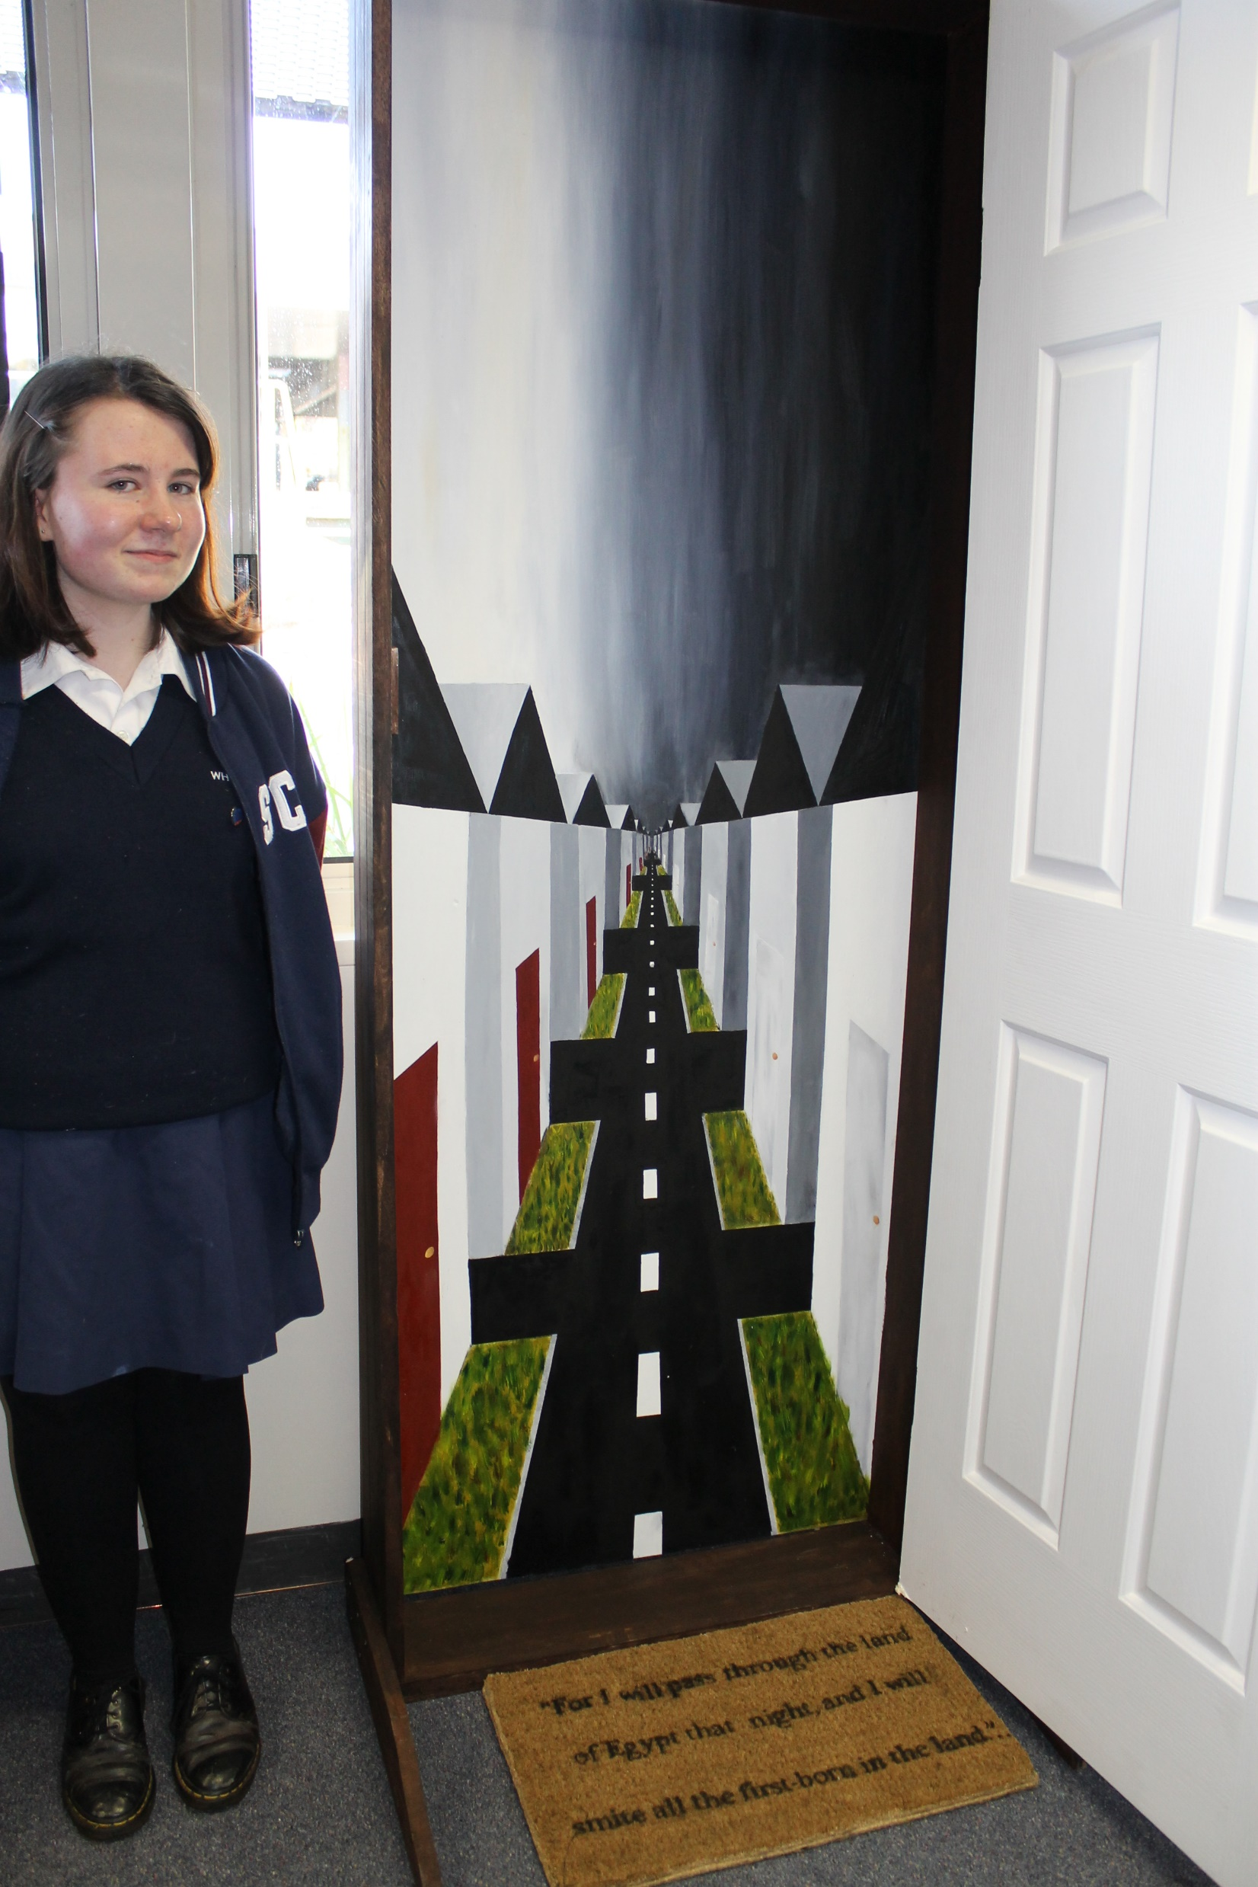
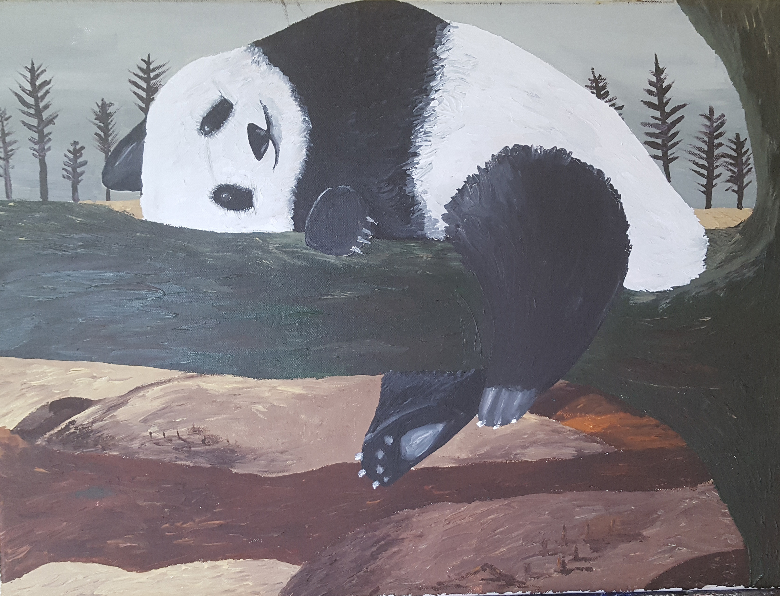
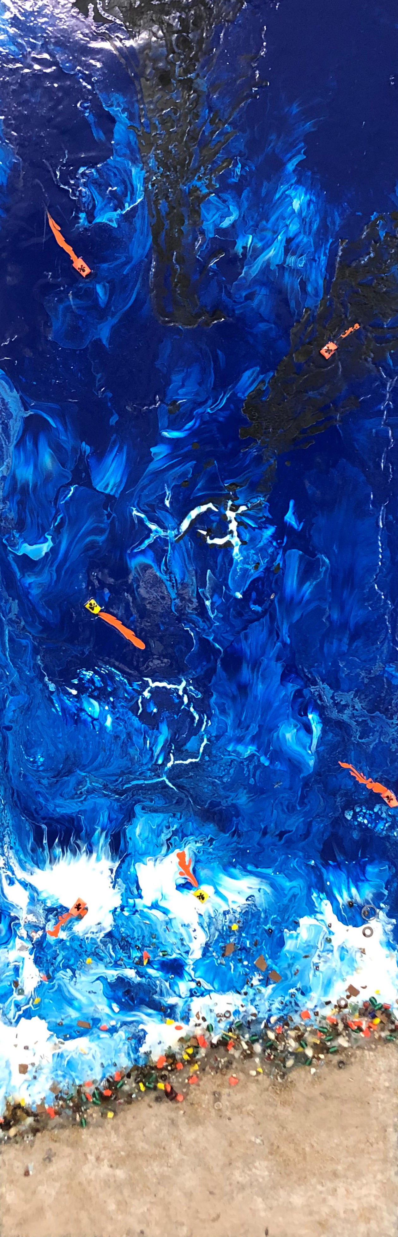
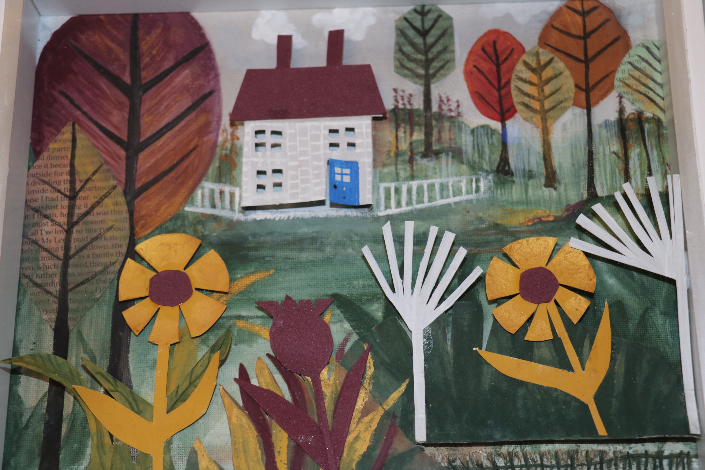
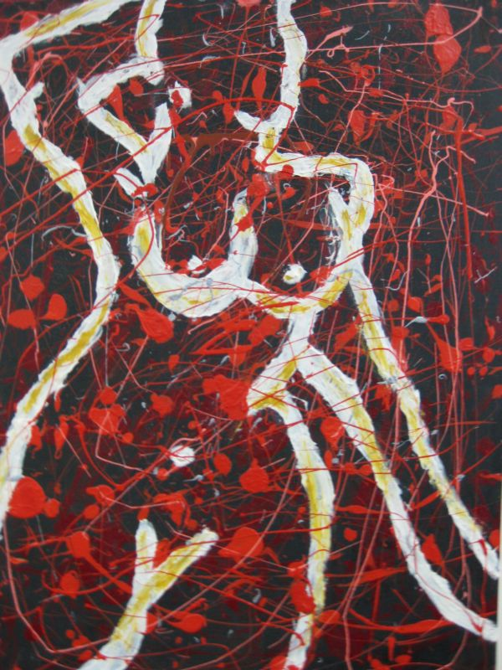
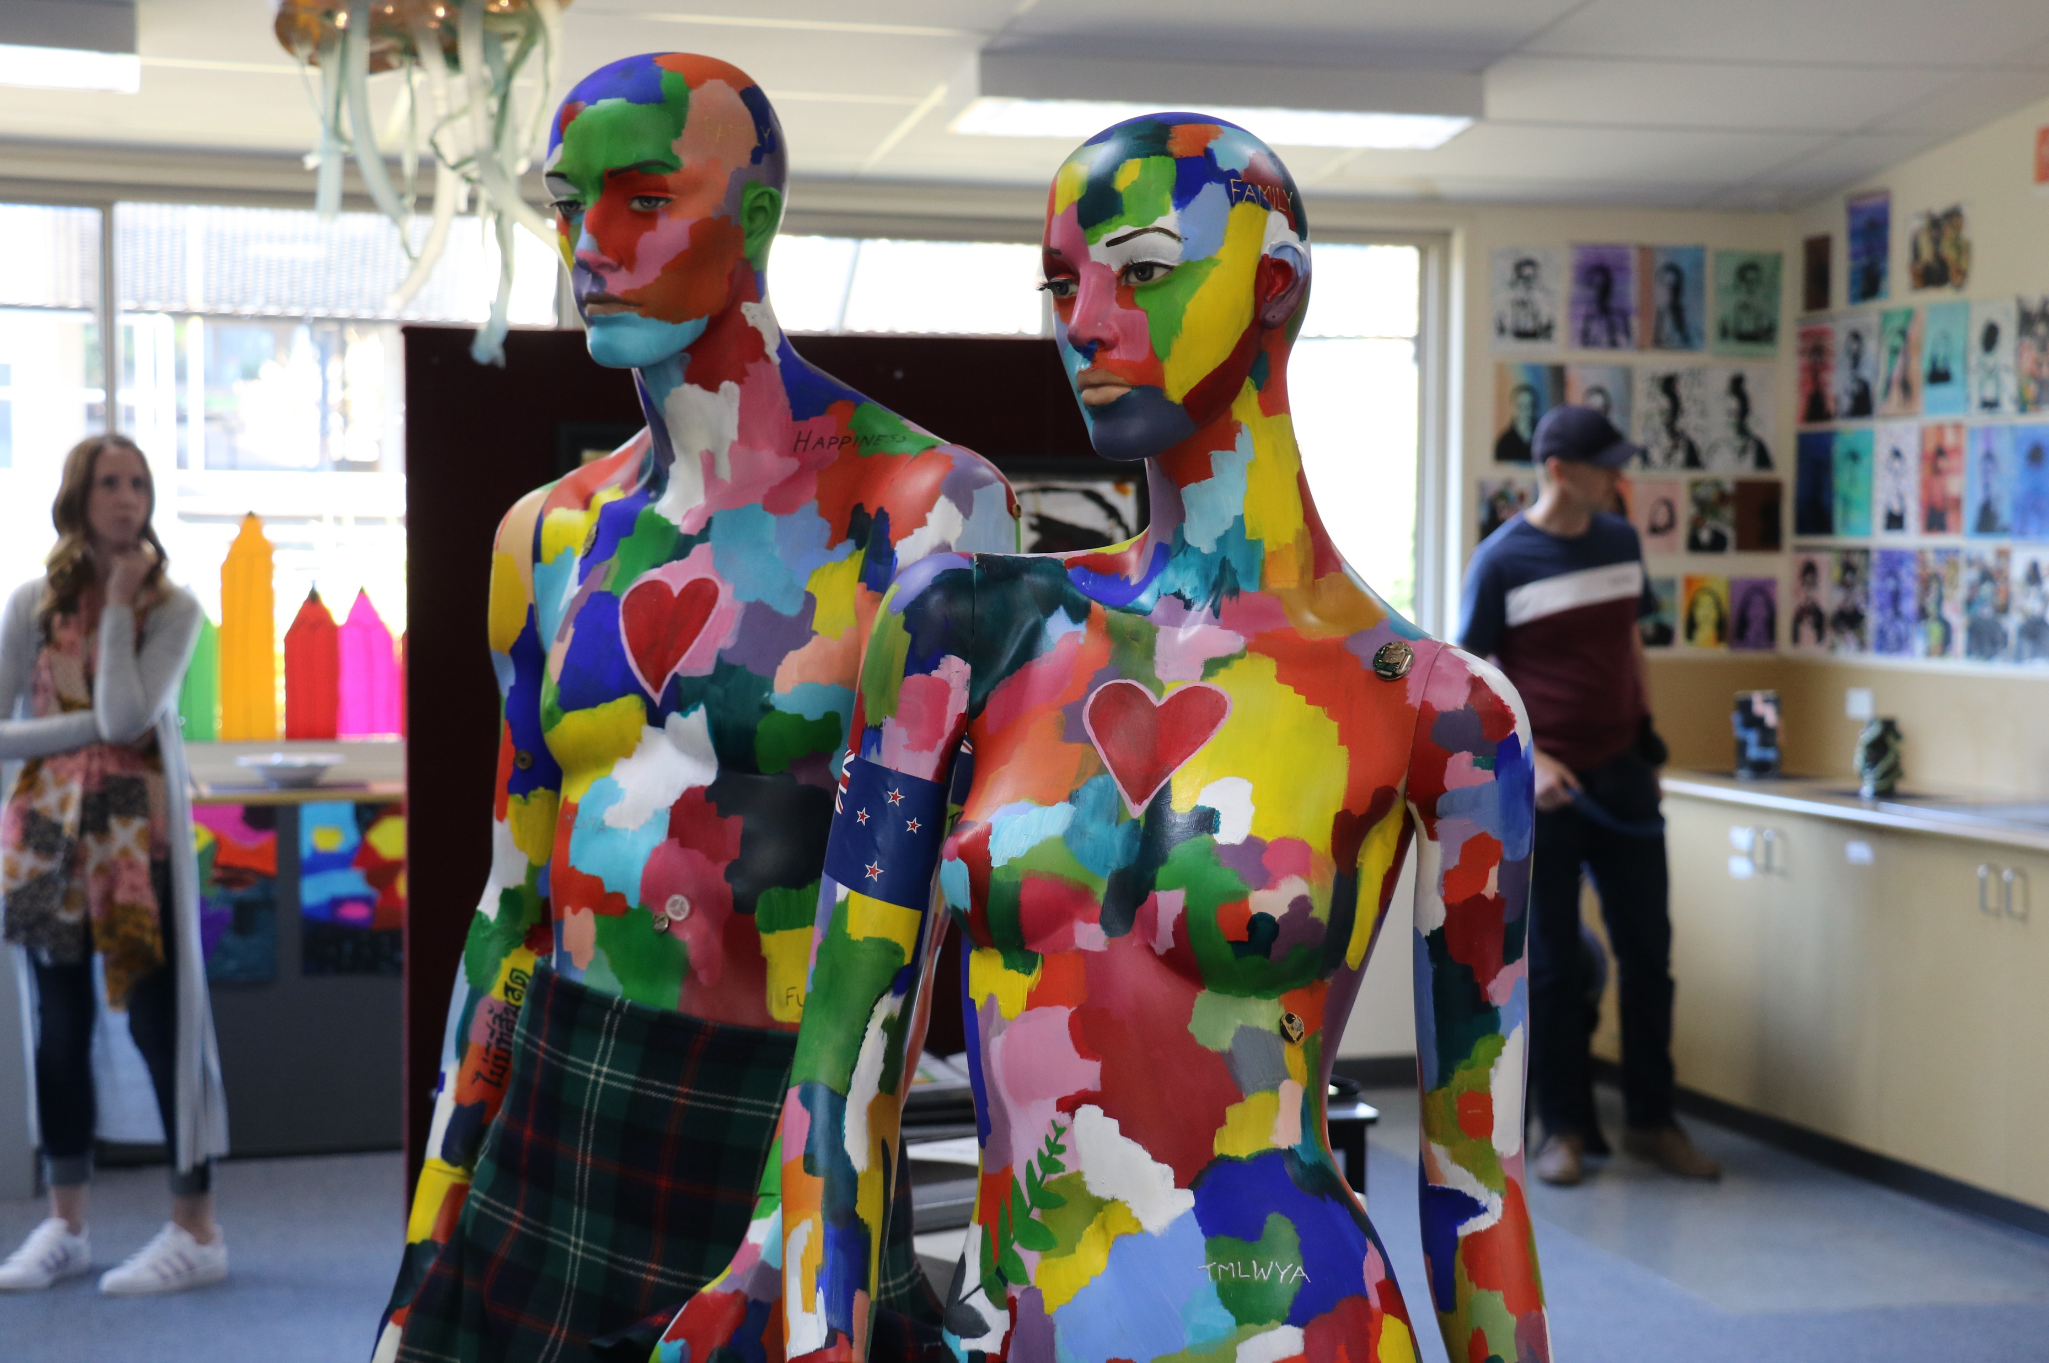
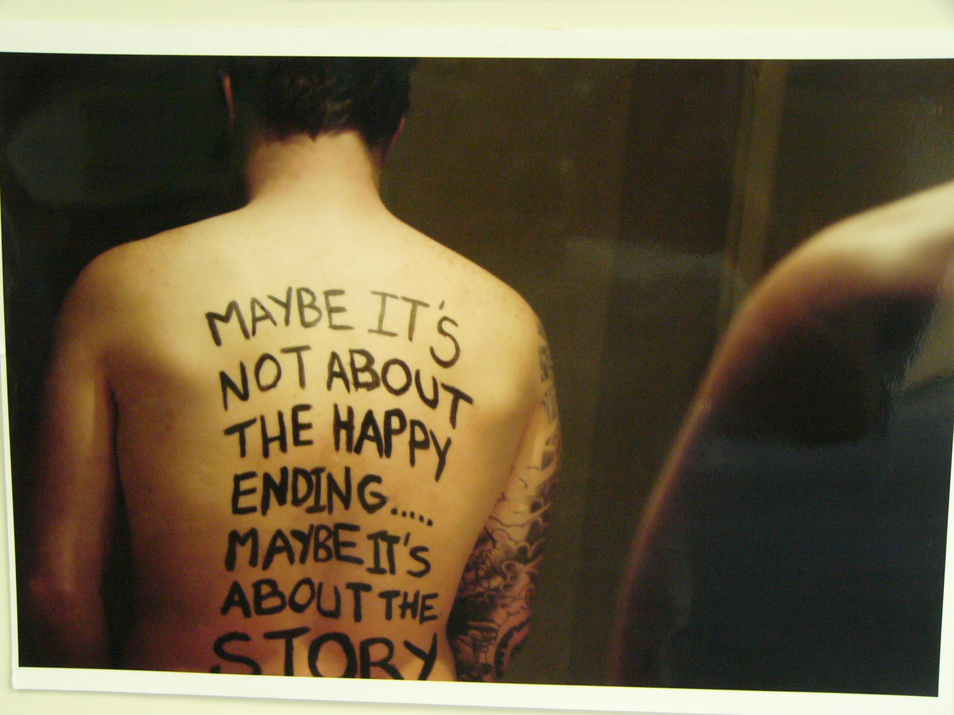
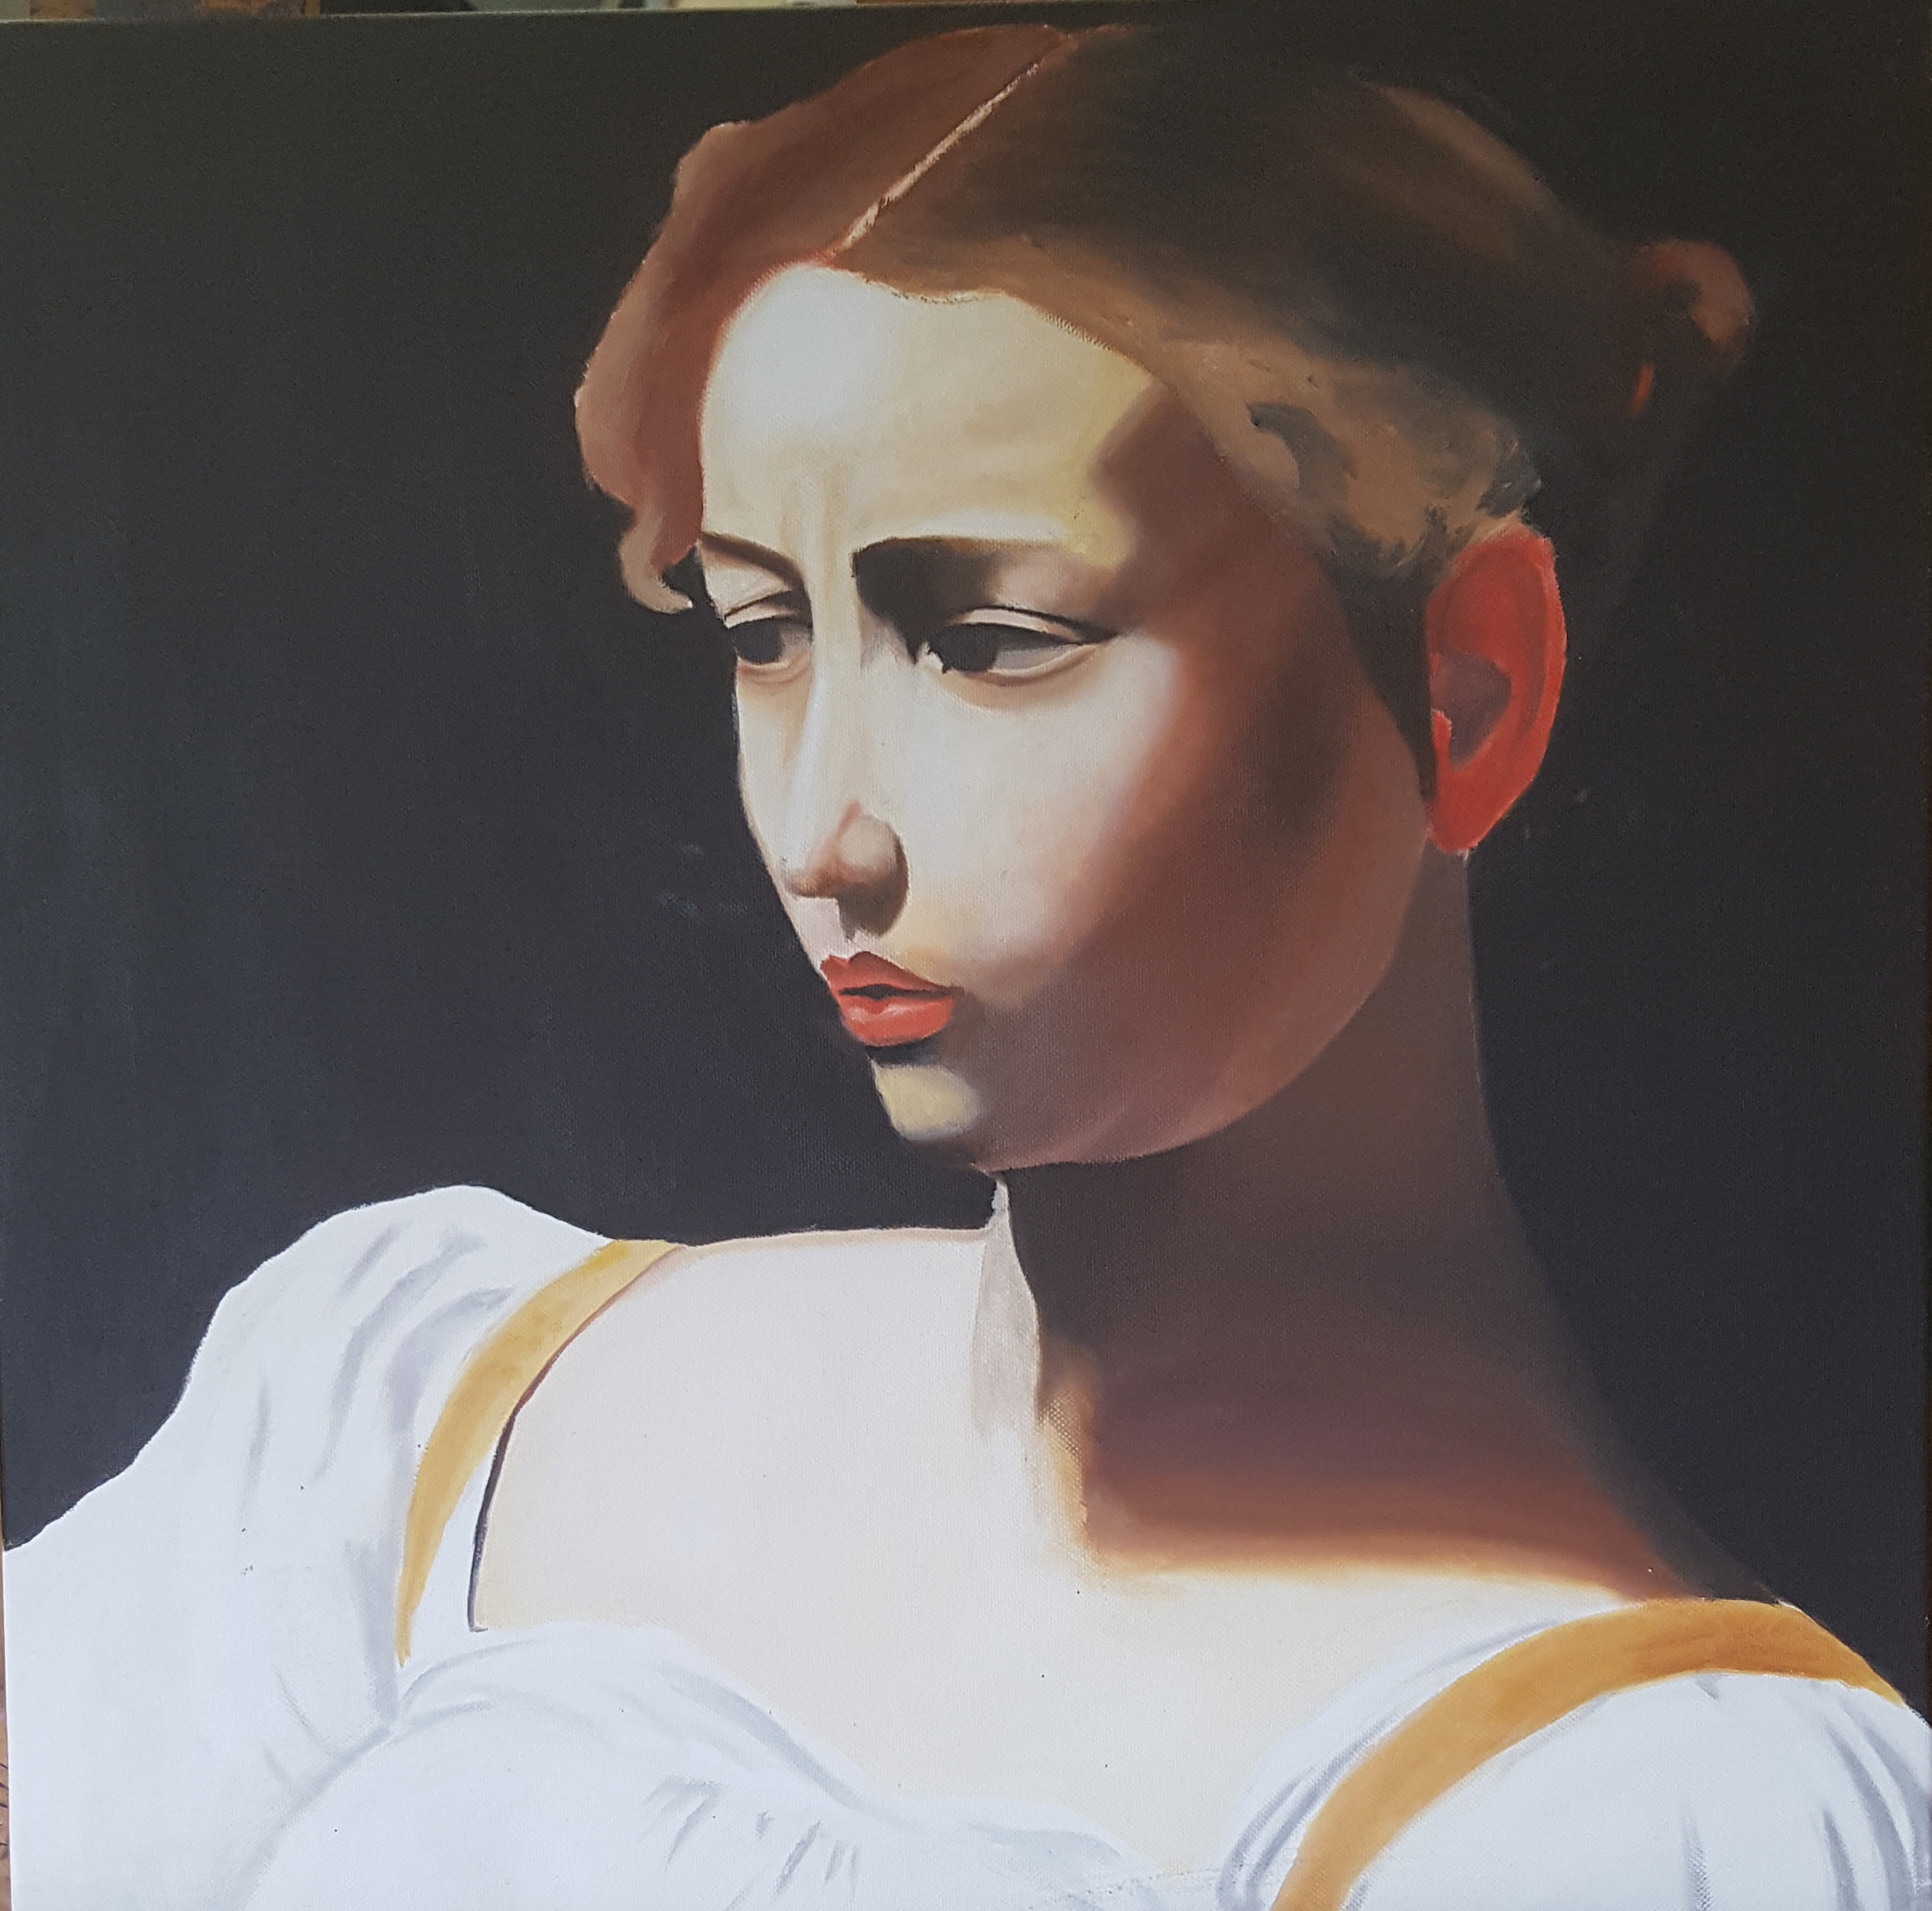
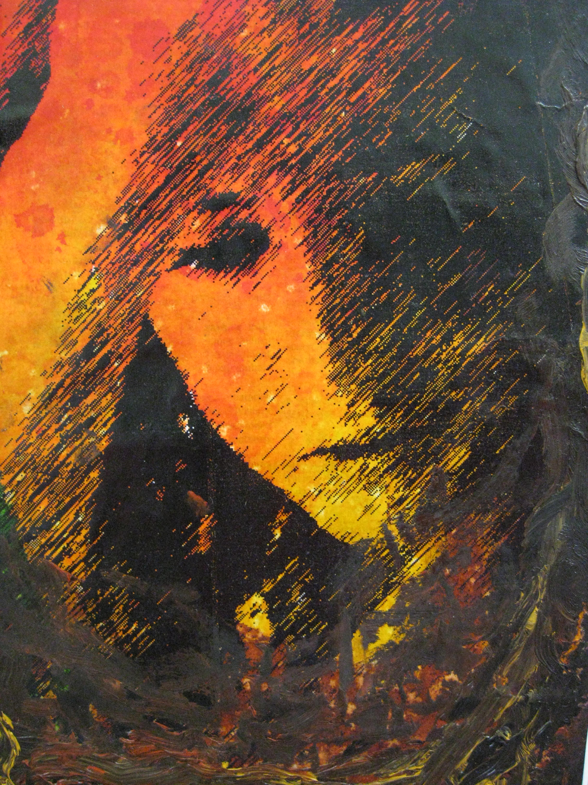
Refinement and Resolution
Communicating ideas
Exploring personal ideas and experiences
Communicating Meanings
Reflection and Evaluation

Slide 6

Unit 1
Interpreting Artworks
Exploring the Creative Practice
Researching 3 different Artists
  You have a choice of which artists to write about
  Use them to inspire you
Completing 3 artworks using different media.
  You have a choice of media
  For each artwork there is a theme
Evaluation and Reflection (including Annotations)

Slide 7
Unit 2
Interpreting Artworks
Developing Creative Practice
Artist, Society, Culture - Australian
      Analysing artists who work Collaboratively
      The Creative Practice
        Completing artworks Collaboratively
Evaluation and Reflection (including Annotations)

Slide 8
UNIT 3 and 4 are so far away all you need to know right now is…..
Unit 3
Investigation, Ideas, Artworks
and the Creative Practice
In Unit 3 starting points for completing the
Creative Process is by being inspired by an artist and from this you get to explore your own ideas and ways to create, make and present a final artwork.
You then get to do lots of experimentation and exploration of ideas, media and aesthetic qualities.

Slide 9
Unit 4
Interpreting, resolving and presenting artworks and the Creative Practice.
In Unit 4 you build further on the Creative Practice begun in Unit 3, developing ideas through to resolutions, ie finished artworks called a Body Of Work.
You will need to research artists and compare their practices.

Slide 10
ASSESSMENT
The Creative Practice
  Idea Development
  Experimentation and Exploration
  Completed Artworks
  Reflection and Evaluation
Analysis of Artists
SAT’s, SAC’s and the Exam

Slide 11
Ideas for
CAREERS just to name a few…
Designers | Fashion, Landscaping, Industrial, Interior, Stage/Theatrical, Urban Planning, Illustrator
Construction | Architecture, Engineering, Cabinet making, Painter and Decorator
Advertising | Marketing, Media, Sign Writer, Merchandising
Digital | Gaming, Animation, Film, Photography, Web Page Design,
Other | Beauty Industry - Hair dressing, Make-up, Tattooist, Floristry, Curating

Slide 12
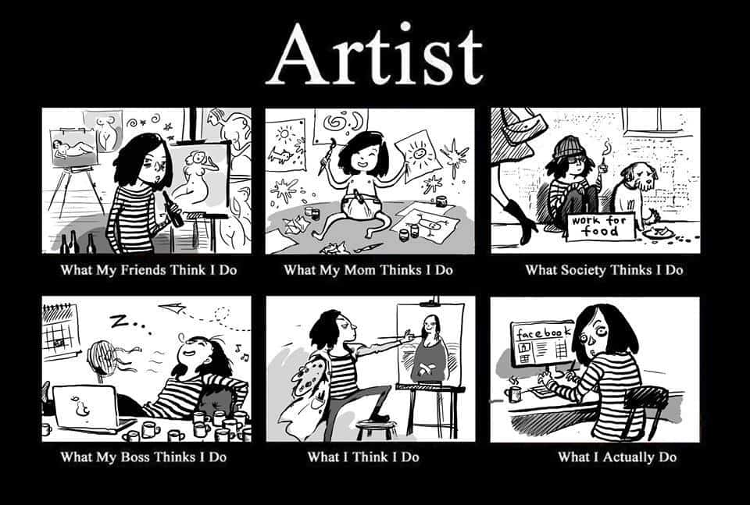
Why do ART?......
CREATIVITY is a 21’st Century skill
You RESPOND to the world
around you
You can be YOURSELF
It’s CHALLENGING
It’s REWARDING
It’s FUN

