Slide 1
Section A
Literacy and numeracy skills
One writing task with two parts
50 numeracy multiple-choice questions
50 reading multiple-choice questions

Slide 2
Section A Writing task will be in two parts. Students are presented with a stimulus (for example an image or text) and asked to respond to two prompts. The first part will be of a short answer type, with the second part allowing for a more detailed response. Both parts will take about 30 minutes to complete – 10 minutes for Part 1 and 20 minutes for Part 2.
Students will be will assessed on the effectiveness of the writing for the audience and purpose appropriate to the task; ideas; and, structure and cohesion. In addition, mechanical aspects of writing including, grammar, punctuation and spelling will be assessed.

Slide 3
Section A Multiple-Choice questions
cover numeracy and literacy (reading)
questions are based on a range of contexts including those you may encounter in daily life
there is 45 minutes allocated to each multiple-choice section. (90 minutes in total)

Slide 4
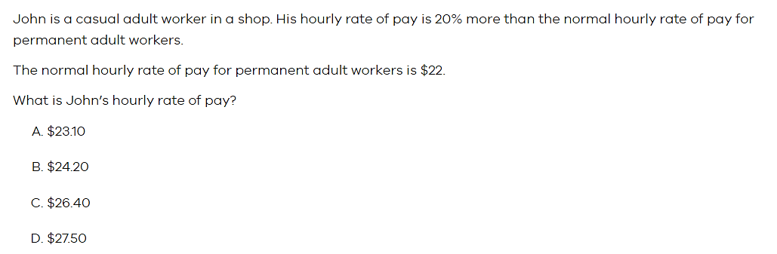
Section A (morning exam) sample question (numeracy)
The answer is C.

Slide 5
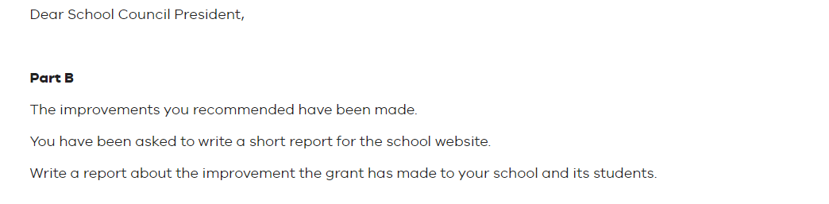
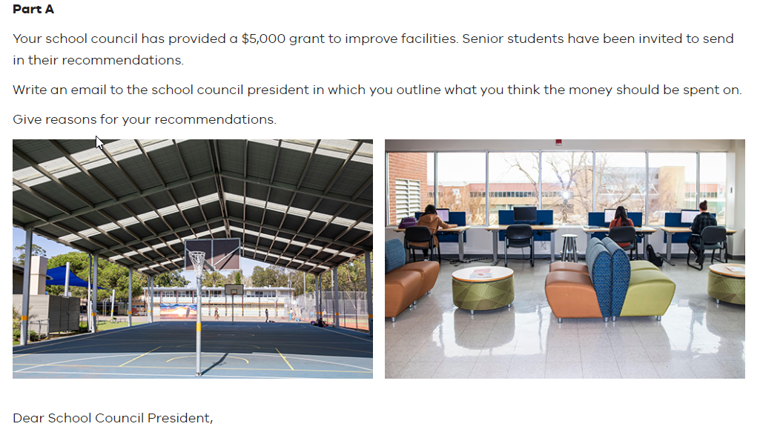
Section A (morning exam)
sample writing question (literacy)

