Slide 1
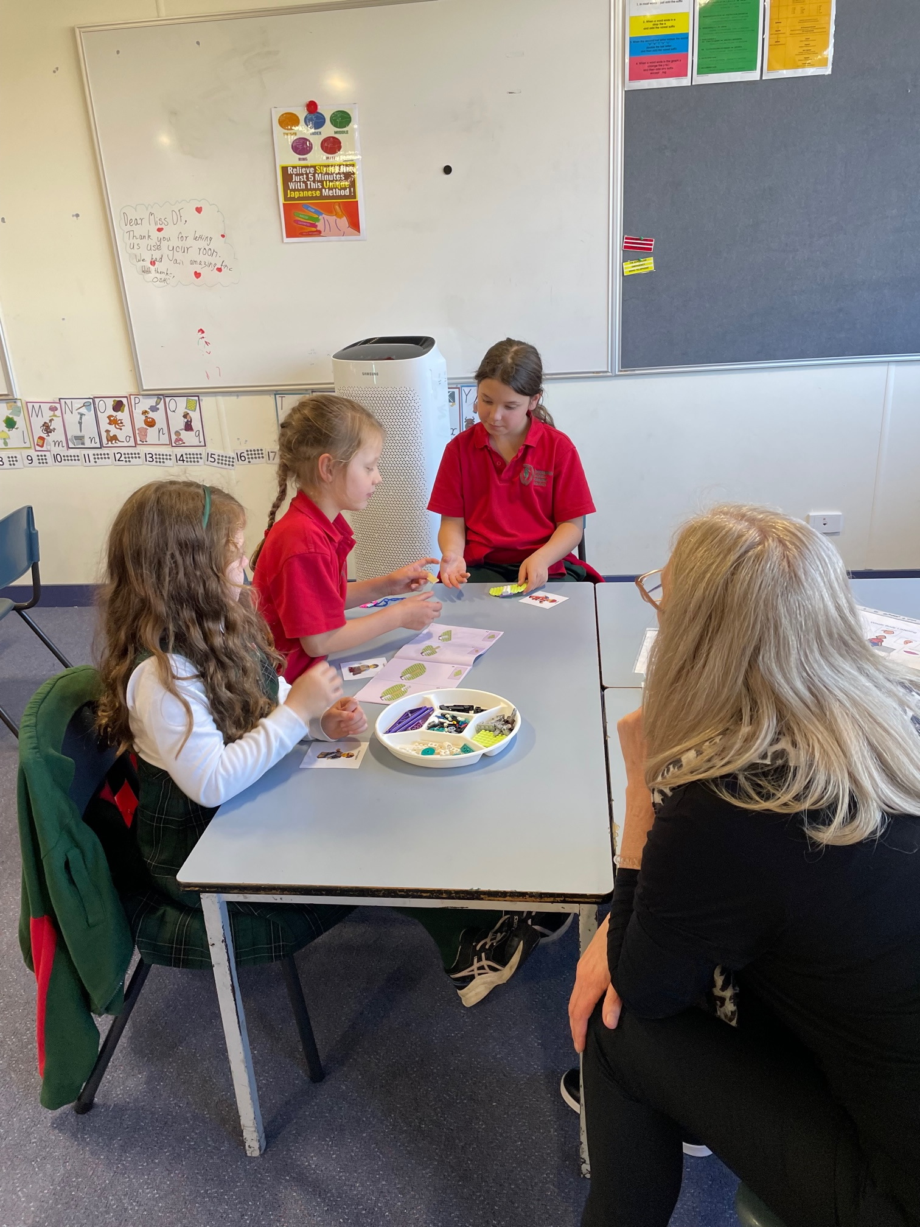
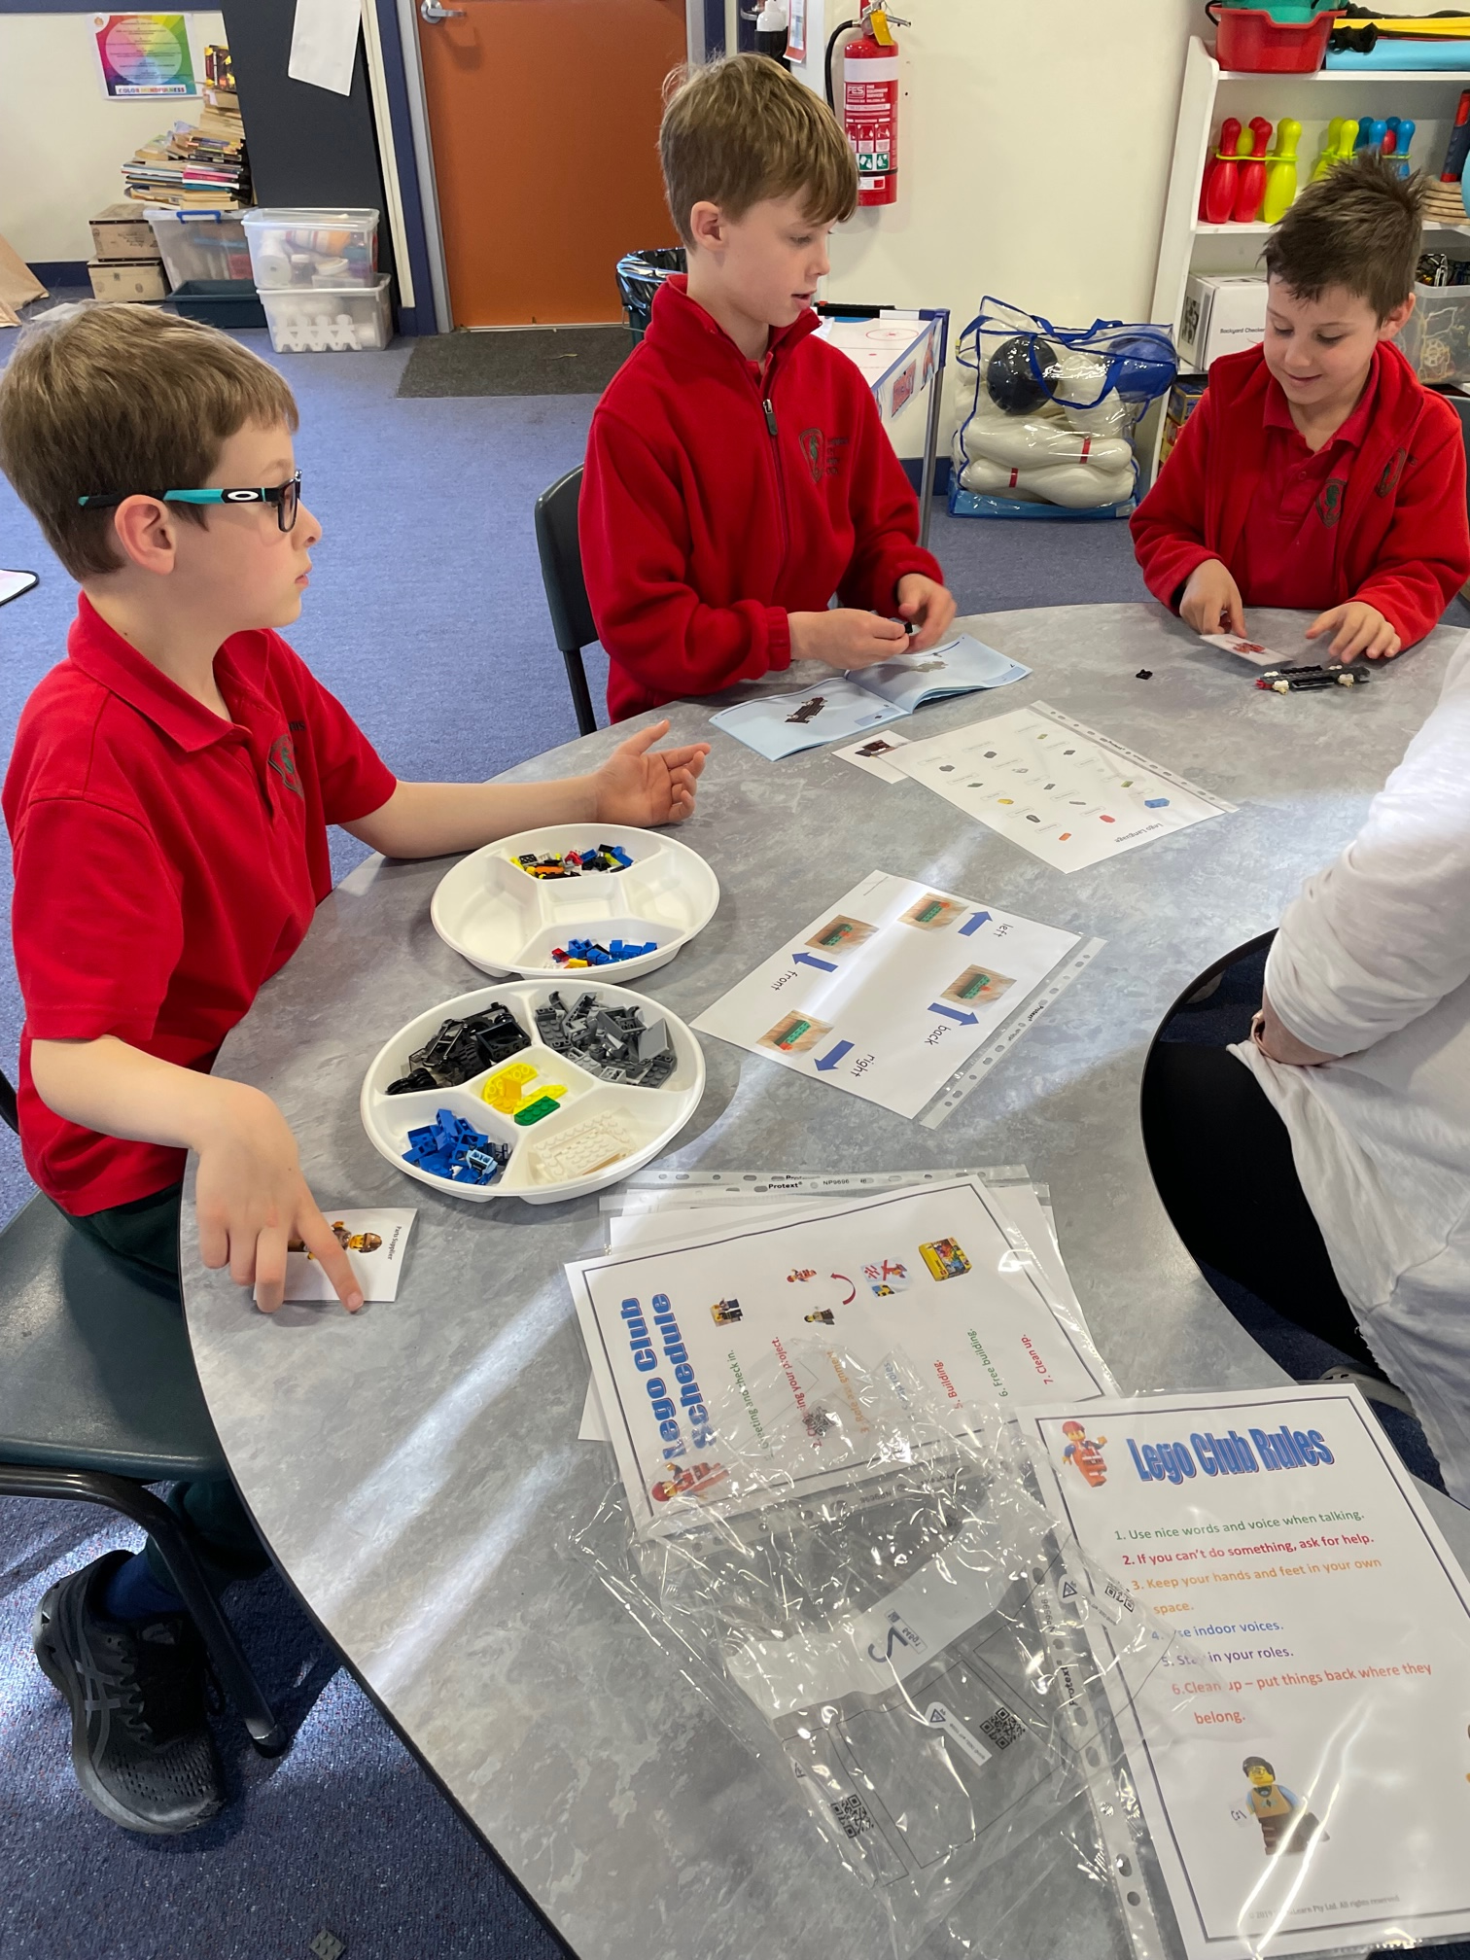
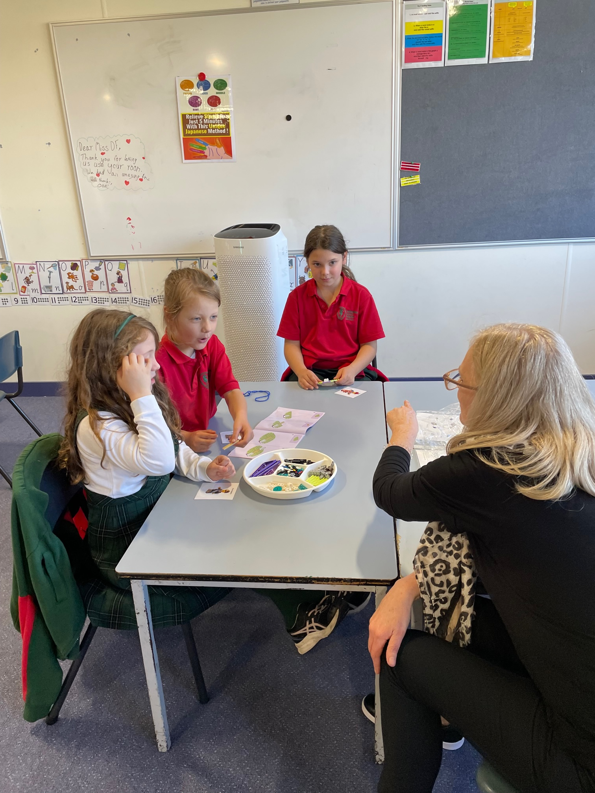
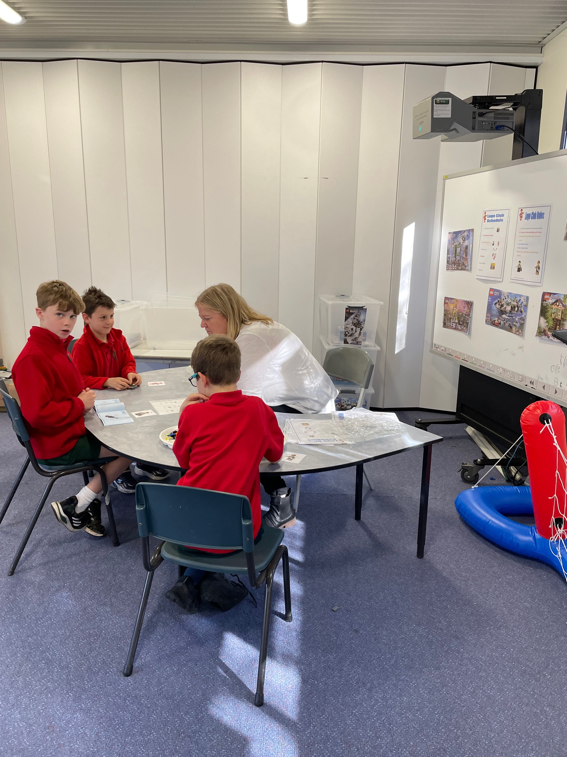
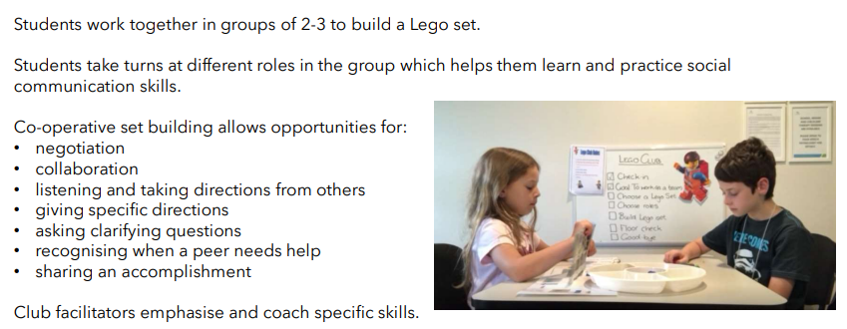
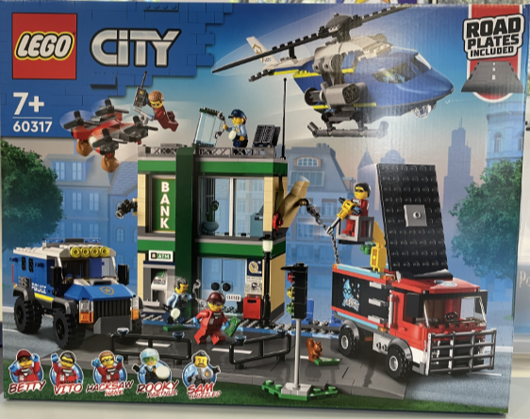
Jenny and Janine are excited to share their knowledge and experience with a variety of students throughout the school.
We have been fortunate enough to be given the opportunity to fund a Lego Club to assist children in increasing motivation to participate and interact with their peers.
Together with the Wellbeing Team we look forward to having fun and creating a new world to explore with Lego and our new found friends.

