Slide 1

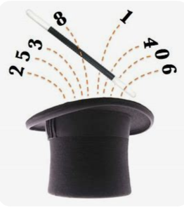
Holy Family Lindfield
Connect - Parent Engagement
Representing Number
Maths Magic

Slide 2
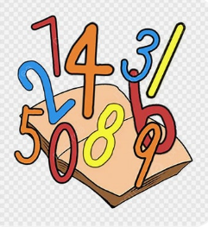
Why is Number Knowledge Important?
Numerical knowledge is vital to everyday life- work, health, social, community
Life decisions are often based on numbers
Numbers are the basis of other mathematical strands
Confidence in numbers leads to confidence in
Mathematics and academic learning in general

Slide 3
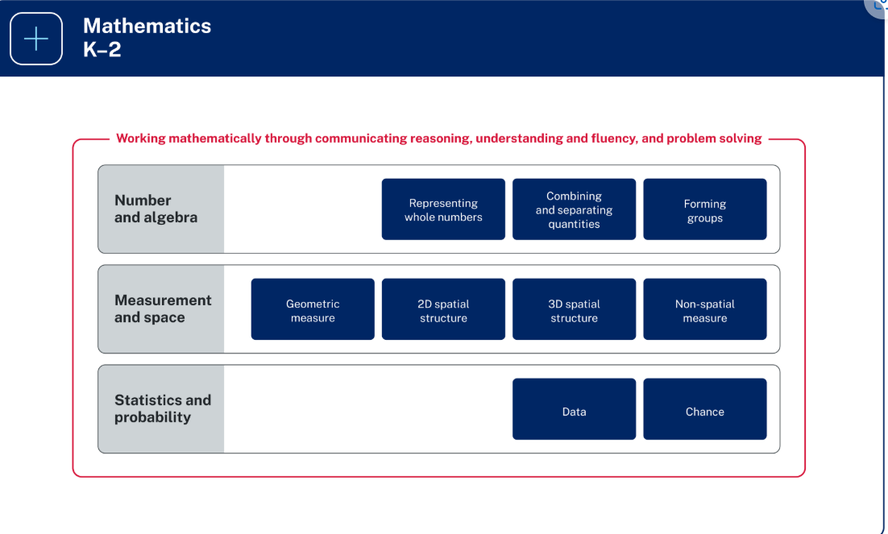
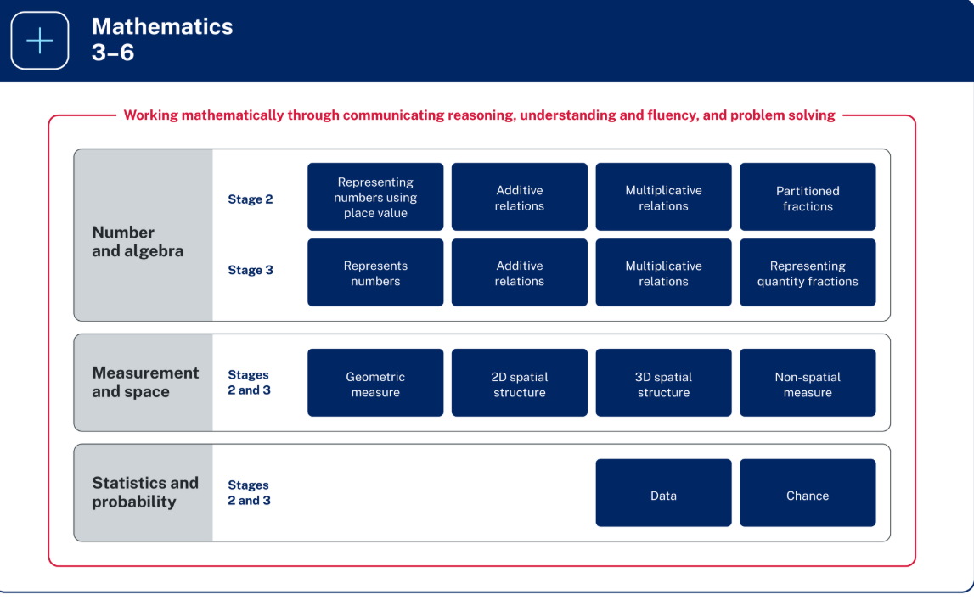
NSW Mathematics Syllabus
Early Stage One – Kindergarten
Stage One – Year One and Year Two
Stage Two- Year Three and Year Four
Stage Three – Year Five and Year Six

Slide 4

Big Ideas in Mathematics- Number
Kindergarten to Year Two
Smaller numbers can be found hiding in bigger numbers
Collections of ten are really useful
Numbers can be shown in different ways
Year Three to Year Six
The number system extends to very large numbers and very small numbers

Slide 5
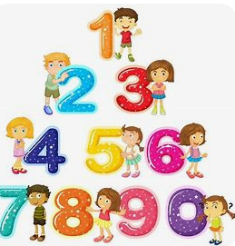
Student Expectations- Number
Early Stage One – Kindergarten
Instantly name the number of objects within small collections
Use the counting sequence of ones flexibly
Count forwards to at least 30 and state the number after or before a given number, without needing to count from one
Identify and distinguish the ‘teen’ numbers from multiples of ten with the same initial sounds
Count backwards from a given number 20 or less
Identify the number before as 'one less' and the number after as 'one more’ than a given number
Recognise number patterns - Recognise dice and domino dot patterns
Connect counting and numerals to quantities
Count with one-to-one correspondence, recognising that the last number name represents the total number in the collection
Count out a specified number of objects (from 5 to 20) from a larger collection, keeping track of the count
Read numerals to at least 20, including zero
Represent numbers as quantities to at least 20 using objects (such as fingers), number words and numerals
Compare and order numbers to 20

Slide 6
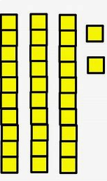
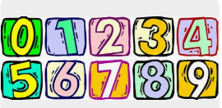
Student Expectations- Number
Stage One – Year One
Use counting sequences of ones with two-digit numbers and beyond
Identify the number before and after a given two-digit number - Count forwards and backwards by ones from a given number to at least 120
Continue and create number patterns
Model and describe 'odd' and 'even' numbers using items paired in two rows - Count forwards and backwards by twos from any starting point
Represent numbers on a line
Sequence numbers and arrange them on a line by considering the order and size of those numbers
Represent the structure of groups of ten in whole numbers
Recognise that ten ones is the same as one ten
Use 10 as a reference in forming numbers from 11 to 20
Count large sets of objects by systematically grouping in tens
Partition two-digit numbers to show quantity values
e.g. 36 = 3 tens and 6 ones
Stage One – Year Two
Use counting sequences of ones and tens flexibly
Identify the number before and after a given three-digit
number
Count forwards and backwards by tens, on and off the decade, with two- and three-digit numbers
Identify how many more to the next multiple of ten within two- and three-digit numbers
Form, regroup, and rename three-digit numbers
State the quantity value of digits in numbers of up to three digits (Reasons about quantity)
Identify the nearest hundred to a number
Recognise units of 100
Use place value to partition and rename three-digit numbers in different ways
Estimate, to the nearest hundred, the number of objects in a collection and check by grouping and counting

Slide 7
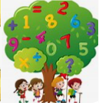
Student Expectations- Number
Stage Two – Year Four
Whole numbers: Order numbers in the thousands
Arrange numbers in the thousands in ascending and descending order
Recognise and describe how rearranging digits changes the size of a number
Identify the nearest thousand, 10 thousand or 100 thousand to numbers
Whole numbers: Apply place value to partition, regroup and re name numbers up to 6 digits
Name thousands using the place value grouping of ones, tens and hundreds of thousands
Use place value to expand the number notation
Whole numbers: Recognise and represent numbers that are 10, 100or 1000 times as large
Recognise the number of tens, hundreds or thousands in a number
Decimals: Extend the application of the place value system from whole numbers to tenths and hundredths
Divide a length representing one whole into 10 equal parts and label the divisions using decimal notation
Use the decimal point as a marker to identify the position of the ones digit when expressing tenths as decimals
Recognise that 10-tenths is recorded as 1.0 and regroup when using decimal notation
Represent and compare tenths as decimals using linear representations (Reasons about relations)
Subdivide tenths into 10 equal parts and record hundredths using place value
Express decimals as both tenths and hundredths
Locate and order decimals representing tenths and hundredths on a number line describing their relative size
Distinguish between the role of zero in various positions
Stage Two – Year Three
Whole numbers: Read, represent and order numbers to thousands
Group physical or virtual objects to show the structure of tens, hundreds and a thousand
Regroup numbers flexibly, recognising one thousand as 10 hundreds and one hundred as 10 tens or 100 ones
Count forwards and backwards by tens and hundreds on and off the decade
Represent numbers up to and including thousands using physical or virtual manipulatives, words, numerals, diagrams and digital displays
Read and order numbers of up to at least 4 digits
Identify the number before and after a number with an internal zero digit
Whole numbers: Apply place value to partition and regroup numbers up to 4 digits
Record numbers using standard place value form
Partition numbers of up to 4 digits in non-standard forms (Reasons about quantity)

Slide 8
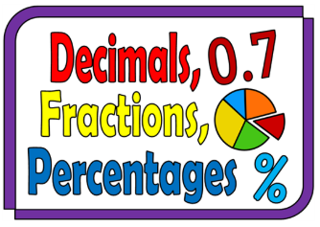
Student Expectations- Number
Stage Two – Year Five
Whole numbers: Recognise, represent and order numbers in the millions
Name millions using the place value grouping of ones, tens and hundreds
Arrange numbers in the millions in ascending and descending order using place value
Round numbers to a specified place value
Whole numbers: Apply place value to partition, regroup and rename numbers to 1 billion
Recognise 1000 thousands is 1 million and 1000 millions is 1 billion
Regroup numbers in different forms (Reasons about quantity)
Partition numbers to 1 billion in non-standard forms
Decimals and percentages: Recognise that the place value system can be extended beyond hundredths
Express thousandths as decimals
Interpret decimal notation for thousandths
Indicate the place value of digits in decimal numbers of up to 3 decimal places
Use place value to partition decimals
Decimals and percentages: Compare, order and represent decimals
Compare and order decimal numbers of up to 3 decimal places
Interpret zero digit(s) at the end of a decimal
Compare the place value of digits by determining numbers that are 10 or 100 times the original decimal number as well as or times the original decimal numbers
Approximate the size of decimals
Place decimal numbers of up to 3 decimal places on a number line
Stage Two – Year Six
Whole numbers: Locate and represent integers on a number line
Recognise the location of negative whole numbers in relation to zero and place them on a number line
Use the term integers to describe positive and negative whole numbers and zero
Interpret integers in everyday contexts
Recognise that negative whole numbers can result from subtraction (Reasonsabout quantity)
Decimals and percentages: Make connections between benchmark fractions, decimals and percentages
Recognise that the symbol % means percent and 100% is the whole amount
Recall commonly used equivalent percentages, decimals and fractions including, , and
Represent common percentages of quantities and lengths as fractions and decimals
Recognise that 10% is one-tenth of 100% and use this to find 10% of a quantity(Reasons about relations)
Decimals and percentages: Determine percentage discounts of 10%, 25% and 50%
Equate 10% to dividing by 10, 25% to finding a quarter by dividing by 4, and 50% to finding half
Use mental strategies to estimate discounts of 10%, 25% and 50%
Calculate the sale price of an item after a discount of 10%, 25% and 50%

Slide 9
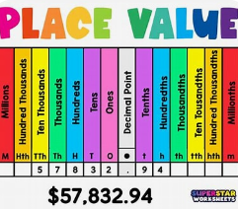
The Importance of Number Vocabulary
Correct pronunciation matters
One more – one less
The same as – equal
Partition – partitioning numbers
Standard and non standard
e.g. 364 = 3 hundreds 6 tens and 4 ones
Or 36 tens and 4 ones
Odd – even
On and off the decade
Number lines
Place value
Ascending and descending

Slide 10
How Can Parents Support The Learning of Number?
Speak positively about Mathematics
Use real life examples and involve children in real life examples
Model different ways to solve a problem – think of the big ideas
Break up numbers into different amounts
Count! On and off the decade – don't start at one and don't forget backwards counting
Estimation is an important skills
Invest in a pack of cards and some dice!
Make mathematics fun – games are better than drills (sometimes....)

Slide 11
Resources
Mathematics Syllabus - Mathematics K–10 - Content | NSW Curriculum | NSW Education Standards Authority
Syllabus Parent Packs- choose a language Helping your child with literacy and numeracy at home
Online Maths Dictionary A Maths Dictionary for Kids by Jenny Eather| Definitions | Free Math Posters and Charts | Maths Examples | Math Words | Math Glossary | Math Terms |
Basic Math Definitions
Mathigon – The Mathematical Playground

