Slide 1
Term 1 Induction Session 1: JSA Background/ IT Systems

Slide 2
Term 1 Induction Planner
Week 2 - JSA Background/IT Systems/Teaching and Learning/Excursions
Weeks 3-5 - Term 1 SSGS
Week 6 - Understanding Autism Practices
Week 7 - Facilitating Student Communication
Week 8 - Facilitating Student Regulation and Sensory Needs
Week 9 - Tier 1 ASD Practices - Environment
Week 10 - Tier 1 ASD Practices – Schedules, PBS Rewards

Slide 3
Term 1 Induction Planner
Week 2 - JSA Background/IT Systems/Teaching and Learning/Excursions
Weeks 3-5 - Term 1 SSGS
Week 6 - Understanding Autism Practices
Week 7 - Facilitating Student Communication
Week 8 - Facilitating Student Regulation and Sensory Needs
Week 9 - Tier 1 ASD Practices - Environment
Week 10 - Tier 1 ASD Practices – Schedules, PBS Rewards

Slide 4
JSA: Short History of the Site
- Arrangement for a dual campus/annex arrangement between Western Autistic School and Jacana Primary School (up until 2005)
- Northern School for Autism was established between 2006 and 2012
- Jacana School for Autism broke away from NSA in 2013 with 104 staff and 179 students in attendance
- 11 years later, we have approximately 120 staff and 220 students in attendance

Slide 5
Current Organisational Structure
JSA’s organisational structure is designed to provide both ‘teaching and learning’ and ‘autism supports’ for our students systemically throughout the school.
The Multi-Tiered Support System or MTSS is the framework we follow to understand how these supports are accessed and from whom.
It is stored on SharePoint via School Documents/Teaching and Learning Documentation.
Let’s discuss downloading documents from SharePoint shortly. ☺

Slide 6
Current Organisational Structure
PRINCIPAL CLASS TEAM
Sub School Leaders
MIDDLE LEADERSHIP
HR Manager
Learning Specialists
Therapy Leader
Safe and Well Leader
MHW Leader
TEACHERS
School Tutor
Classroom Teachers
Specialist Teachers
Social Worker
EDUCATION SUPPORT STAFF
Admin Team
MHW Practitioner
Kitchen Garden Coordinator
Maintenance Team
Community Support Officer
Finance Manager
Disability Inclusion Officer

Slide 7
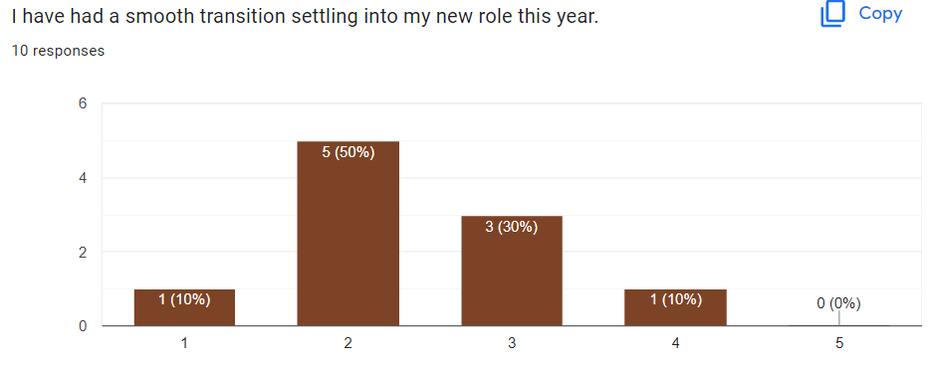
Term 1 Induction Survey Feedback Summary
1- Strongly Agree
5 - Strongly Disagree

Slide 8
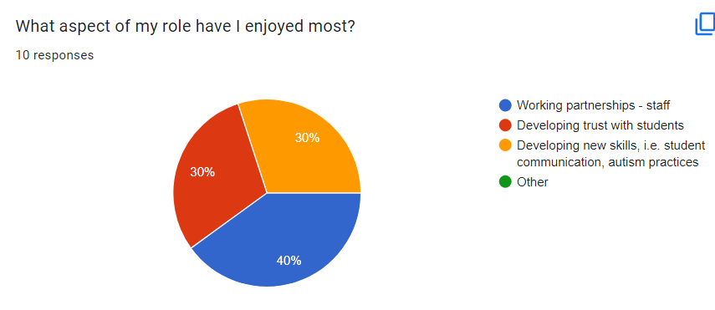
Term 1 Induction Survey Feedback Summary
An even spread of responses here.

Slide 9
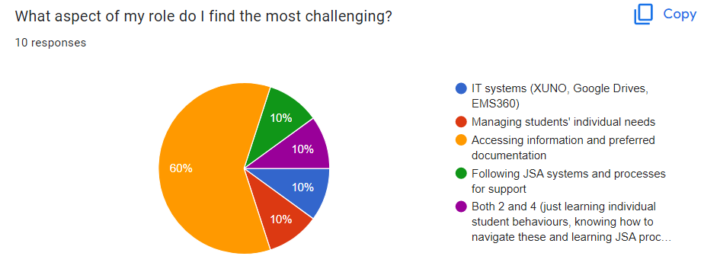
Term 1 Induction Survey Feedback Summary
70% majority underlines the importance of conducting today’s session topic: IT systems and access to documentation.

Slide 10
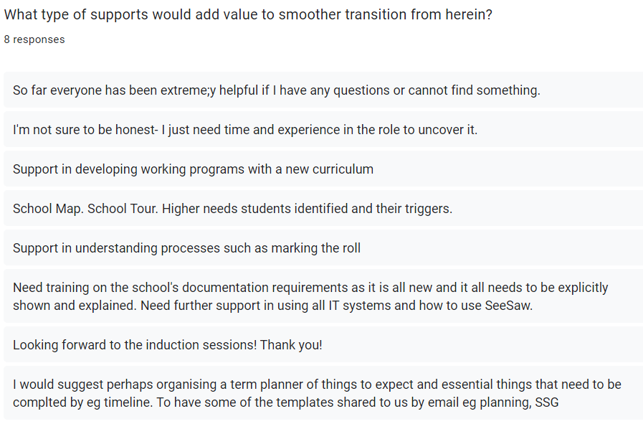
Term 1 Induction Survey Feedback Summary
A range of items have been addressed here. We will work through all of these by the end of these sessions this term.
Question time will be included after each session.

Slide 11
JSA IT Systems
EduPay
ESchools
GOOGLE DRIVE
SHAREPOINT
EduSafe Plus
Seesaw
XUNO

Slide 12
JSA IT Systems
EduPay
ESchools
GOOGLE DRIVE
SHAREPOINT
EduSafe Plus
Seesaw
XUNO

Slide 13
JSA IT Systems
SHAREPOINT
Key Features on SP Home Page:
School Documents: JSA policies, templates for JSA forms, teaching and learning documentation and more
Student Files: all confidential student data sorted by ‘Year/Sub School/Student Code’
Work Programs/Team Meetings: classroom team meeting minutes, teaching and learning programs and maintenance programs sorted by Year/Sub School/Class
Resource Bookings: you can schedule use of school buses for excursions, meeting rooms and IT equipment in this section

Slide 14
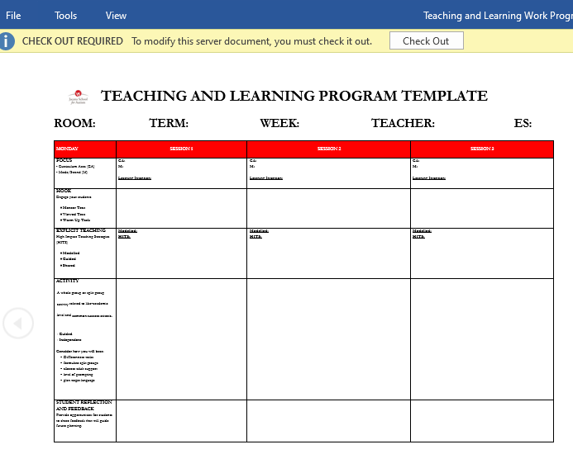
JSA IT Systems
SHAREPOINT
How do I view/edit a document?
Simply double-click the document and it will open. Click the ‘Check-out’ tab and you will have chief access to edit the document as needed. When completed, click ‘File’ then ‘Check-In’ and ‘OK’ to save your changes.

Slide 15
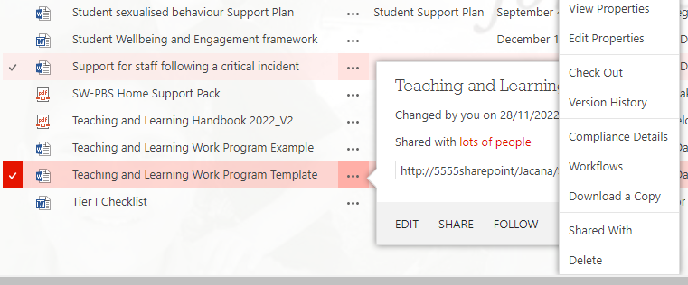
JSA IT Systems
SHAREPOINT
How do I download a document?
Right click the ‘…’ icon to the right of the file name to activate an icon balloon. Again right click the ‘…’ icon and a pull-down menu will appear. The 7th item on the menu is ‘Download a copy’, click and a copy will appear at the bottom of your screen.

Slide 16
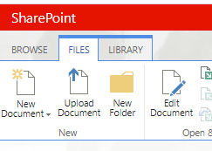
JSA IT Systems
SHAREPOINT
How do I upload a document?
Two ways. Click the red ‘+ new document’ in the folder you wish to save the document OR click ‘Files’ at the top left hand corner, click ‘upload document’ and follow the prompts.

Slide 17
JSA IT Systems
EduPay
is a great home page to access any and more than these key IT systems at JSA
ESchools
SHAREPOINT
EduSafe Plus
Seesaw
XUNO

Slide 18
JSA IT Systems
EduPay
is the DET site for your pay and PD requirements, including leave, payslips, e-learning modules and for uploading your PDP goals
ESchools
SHAREPOINT
Seesaw
EduSafe Plus
XUNO

Slide 19
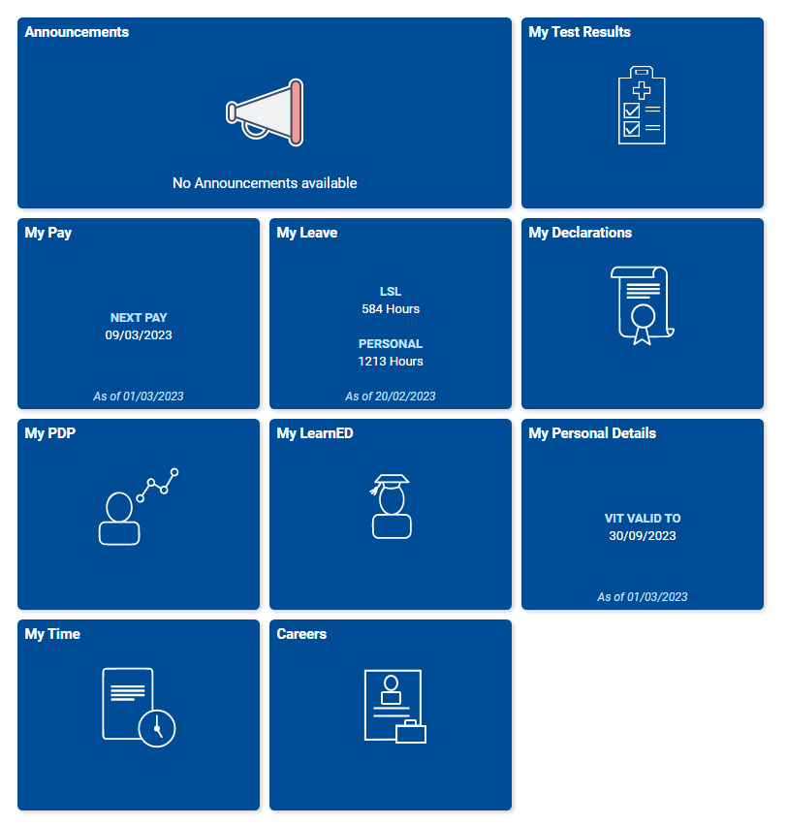
Edu Pay
Log in using your DET 8-digit TO number and password
On Edu Pay, you can access information related to your:
Personal details (including VIT status)
Pay
Leave entitlements
PDP
E Learning Modules
Recruitment Online
Test Details (including your Covid-19 and vaccination status)
Contact Michelle McMaster our HR Manager if you are experiencing initial issues in accessing this platform

Slide 20
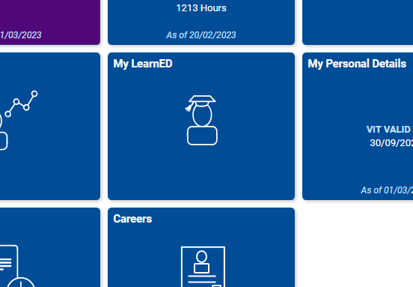
Edu Pay
IMPORTANT:
1 x E Learning Module
TO BE COMPLETED BY ALL INDUCTEES:
‘Protecting Children – Reporting and Other Legal Obligations (Mandatory Reporting)’
When completed, please email your certificate to Fiona Micelotta.

Slide 21
JSA IT Systems
EduPay
ESchools
is the DET site for lodging critical OHS reports pertaining to school wide health and safety
SHAREPOINT
Seesaw
EduSafe Plus
XUNO

Slide 22
EduSafe Plus
Log in using your DET 8-digit TO number and password
You may need to access EduSafe Plus for any of 4 different reasons:
Incident Report: lodging a personal STAFF injury
Hazard Report: lodging a work hazard here at JSA
Sick Bay Report: uploading record of first aid assistance provided to students
*These reports are outlined in your OHS Induction conducted by Mary (Safe and Well Leader)
Have you booked in with Mary to complete your OHS Induction?

Slide 23
JSA IT Systems
EduPay
ESchools
SharePoint
is the platform where teachers and leaders can access important student information, plans and reports pertaining to their learning and incidents involving them directly.
Seesaw
EduSafe Plus
XUNO

Slide 24
XUNO
Access intended for teachers and leaders only
An account is established after an email invite is forwarded directly to you
Log in using your DET 8-digit TO number and password
On XUNO, you can access vital information related to:
Personal, Staff, Student and Family details
Student Achievement and Wellbeing data
Student IEPs,
Semester Reports,
Incident Reports,
Access to Accelerus (develop IEPs and semester reports)
Contact Dan if you are experiencing initial issues in accessing this platform

Slide 25
JSA IT Systems
EduPay
ESchools
SHAREPOINT
is the platform where our parents can access footage of their children’s learning experiences at school.
EduSafe Plus
Seesaw
XUNO

Slide 26
Seesaw
Access intended for all JSA staff as Seesaw Teachers
An account is established after an email invite is forwarded directly to you
Log in using your DET Email Account and personal password
On Seesaw, you are granted access to classrooms that you teach, to upload:
Photos/videos of students with their peers and familiar staff
Upload photos/video of student work
Upload positive comments linked to any any student posts
Contact Ellen if you are experiencing initial issues in accessing this platform

Slide 27
JSA IT Systems
is the platform where we record any JSA purchase orders seeking approval by our JSA budget coordinators
EduPay
ESchools
SHAREPOINT
EduSafe Plus
Seesaw
XUNO

Slide 28
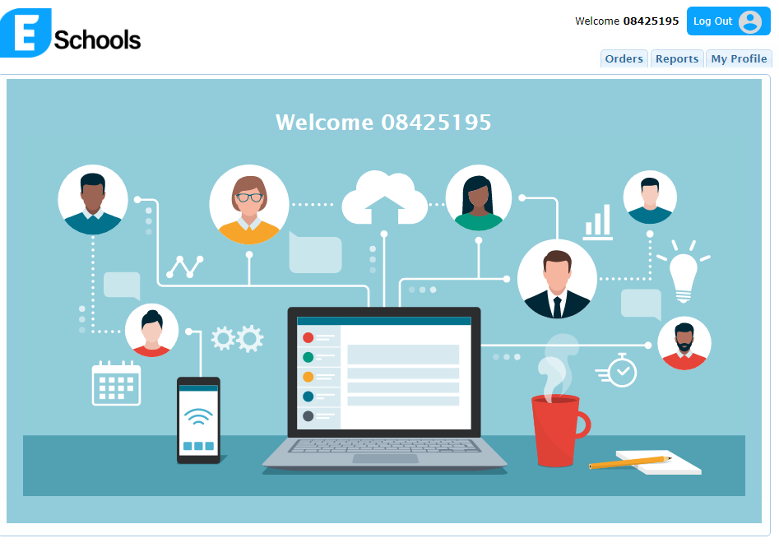
ESchools
Access intended for all JSA staff using the link via SharePoint called ‘School PO’
An account is established after an email invite is forwarded directly to you by Leigh O’Neill (Finance Manager)
Log in using your DET 8-digit TO Number and personal password
Please follow the 2023 JSA Purchasing Guide to complete a purchase order on SharePoint via School Documents/Finance Information
Contact Leigh if you are experiencing initial issues in accessing this platform

Slide 29
JSA IT Systems
is the storage space where we develop working documents
is not appropriate to key any material including confidential student information, including student names on documentation
EduPay
SHAREPOINT
ESchools
GOOGLE DRIVE
Seesaw
EduSafe Plus
XUNO

Slide 30
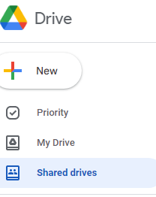
GOOGLE DRIVE
Access intended for all JSA staff via Google called ‘Google Drive’ (Shared Drives)
Fiona Micelotta oversees the management of all Google Drives (if a new drive is established, please routinely include Fiona at all times)
These drives are designed for storage and access to documentation in draft format
Tailored to your role, important drives include:
- PLCs
- Curriculum Teams
- PDPs
- Thursday Professional Practice
- Sub School Drives

Slide 31
JSA IT Systems
Questions??

