Slide 1
VCE INFORMATION
for parents and students
2023

Slide 2
VCE STUDY SCORES
To receive a study score students must receive an S for both Units 3 and 4.
The study scores for all Unit 3&4 studies are reported on a scale of 0 to 50 with 30 being the median study score.
The study score is actually a ranking or relative position which shows how a student performed in relation to all others who took that study in the same year.

Slide 3
A student with a study score of 30 is in the middle of the cohort, or has performed better than about half of all students who did that study.
EXAMPLE:
In 2022 around 40,000 students sat the English exam. Harry achieved a study score of 30.
This means that Harry performed better than 20,000 students. Well done Harry!

Slide 4
A student with a study score of 40 has performed better than about 91% of all students who did that study. Most of the study scores are between 23 and 37 (68%).
Each study score is calculated by using the total marks you received for each graded assessment in that study.
Eg. English has three graded assessments
(Standardised Unit 3 coursework score x 0.25) +
(Standardised Unit 4 coursework score x 0.25) +
(Standardised November examination score x 0.50
This is then converted to a study score(ranking) from 0 to 50
Study score | 20 | 25 | 30 | 35 | 40 | 45
Percentage of students on or above this position | 93 | 78 | 53 | 26 | 9 | 2

Slide 5
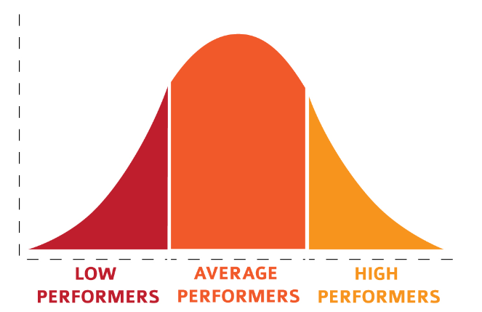
Why are subjects scaled?
Scaling ensures that it is equally easy to attain a high ATAR regardless of the combination of studies a student undertakes. So don’t get stuck with subjects you don’t like. Pick subjects that you are good at regardless of the scaling.
Scaling works on a bell curve with the majority sitting in the middle of the curve and decreases as you move away from the middle. A student with a VCE Study Score of 30 is in the middle of the cohort, or has performed better than about half of all students. A student with a VCE Study Score of 40 has performed better than about 91% of all students who did that study.

Slide 6
The study scores are adjusted so that the overall level of scores in that study matches the scores obtained by the same group of students in all of their studies.
For example, in Australian Politics in 2022 the average Study Score was 30, but the students who took Australian Politics averaged 31 for all their studies (including Australian Politics). This shows that the students who did Australian Politics in 2022 were of above average strength in their other studies. Therefore, the scaling process adjusted the Study Scores upwards so that the average VTAC Scaled Study Score for Australian Politics was set at 31.
The 2022 Business Management students averaged 26 in all their studies (including Business Management). So, the scaling process adjusted the Study Scores downwards so that the average VTAC Scaled Study Score for Business Management was 26.
Scaling is calculated each year and can change year by year.
Scaling over 50? Languages have special provisions due to government incentives and maths is scaled to take into account the different difficulty levels. This means that some Languages and Specialist Maths can scale over 50.

