Slide 1
Welcome to
Smile Squad
A guide for parents/guardians
Tracey
RFDS
Notes:
Welcome to the Smile Squad school dental program. My name is Tracey and I’m here to talk to you about this exciting program. Smile Squad will provide your child/children with free dental care – all without having to leave school grounds.

Slide 2
Acknowledgement of Country
Notes:
In the spirit of reconciliation, we acknowledge the Traditional Custodians of country throughout Australia and their connections to land, sea and community. We pay our respect to their elders past and present and extend that respect to all Aboriginal and Torres Strait Islander peoples today.
Illustration courtesy of Sarah Fuss.
Sarah Fuss is a Kambuwal/Gamilaroi woman.
She was born on Kaurna country in South Australia and grew up on Arrente country, Alice Springs. She has been living in Melbourne for the past two years. She has worked in remote communities in the Northern Territory including To Tree, Yuelamu, Yuendumu and Nyrripi.
She is currently undertaking the Human Resources Indigenous Traineeship at DHSV, where she is studying Certificate III in Business and working in the Corporate Office.
Artist’s description
The painting represents Indigenous and Non-Indigenous people coming together at DHSV. It also signifies my journey and role at DHSV. The yarning circles represent how DHSV has been working towards reconciliation. Reconciliation is important because acknowledging the past, heals the present, and allows us to walk together in the future.

Slide 3
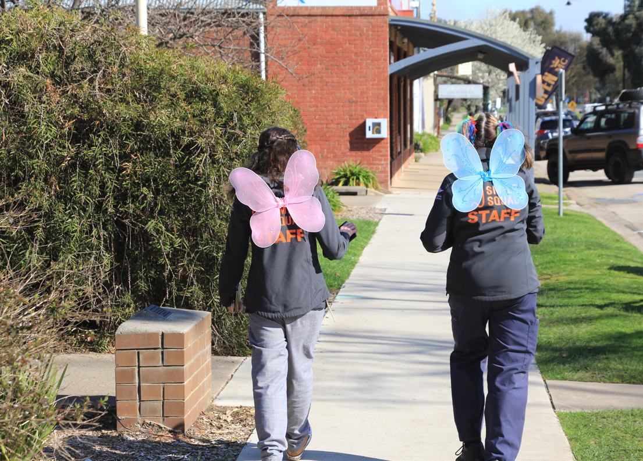
Meet the Smile Squad
Notes:
We would like to introduce you to our Smile Squad. These are the people in the vans who will be checking your child’s teeth and providing treatment if required. Up on the screen you can see some of our friendly team. Let’s talk about who they are and what kinds of things they will do as part of Smile Squad.
Dental therapists and oral health therapists are trained to check your child’s teeth, offer preventive care, oral health coaching, and carry out many of the follow up treatments included in the Smile Squad program. After the oral health assessment and diagnosis, they will discuss your child’s oral health needs with you and together you can agree on what happens next.
“What’s the difference between a dental therapist and an oral health therapist?”, you might be wondering…OHTs have an additional qualification in dental hygiene and can carry out further tasks such as scaling and cleaning teeth.
Dental assistants work with dental therapists, oral health therapists and dentists chair-side during procedures. They also carry out a variety of administrative tasks and help prepare students for their examination or treatment. Some Dental assistants have extra training to be qualified as an Oral Health Educator or Coach. OHEs can support the family to help look after their teeth, gums and general health. Some OHEs are also qualified to place fluoride varnish on your child’s teeth.
Finally, we have our dentists, who you might not see so much when Smile Squad visits your school as they often mostly work at our community dental clinics. Dentists can provide treatment of conditions affecting the mouth, teeth, jaws, and gums. They provide assessment, diagnosis, treatment, management, and preventive services to patients of all ages and take care of more complex oral health conditions.
Dental assistants, oral health educators, dental therapists, oral health therapists and dentists all make up part of the Smile Squad and work together closely as a team to provide the best possible care for your child. If needed they may need refer to your child to a dental specialist for care such as orthodontics.

Slide 4
The Smile Squad program
Smile Squad is a Victorian Government program
Free dental care for all Victorian public primary and secondary school students
Delivered via a mobile fleet
More than 500 dental health professionals
Services delivered by us – your community dental agency
Notes:
Smile Squad is a Victorian Government program that will provide free dental care for all Victorian public primary and secondary school students. The program will save parents time and money as examinations and any required treatment will be carried out on school grounds, during school hours.
Smile Squad is being led by the Department of Health (DH) and Dental Health Services Victoria (DHSV), with input from the Department of Education and Training (DET).
Services in schools are provided through us, your local community dental agency. We’re delighted to be here.

Slide 5
Notes:
Our vision for Smile Squad is the delivery of consistent, accessible, high-quality dental care, every time.
It won’t matter if a student is visiting an examination van in rural Victoria or a treatment van in central Melbourne – they will have a similar experience, wherever they are.
Students are quickly becoming familiar with our bright orange fleet, smart uniforms, our approachable staff, and the great customer care they provide.
With a strong focus on education and prevention, we want every student we see to walk away with the tools and knowledge they need to eat well, drink well and clean well – for life.
Look at the Smile Squad campaign advert to see how easy Smile Squad will be for you to access.

Slide 6
Did you know?
Across Australia, a quarter of all children have untreated tooth decay.
In Victoria, dental conditions are the highest single cause of preventable hospitalisations for children under 10.
Approximately one quarter of children and young people do not regularly visit the dentist.
More than 70% of children and young people are consuming more than the recommended amount of added sugars in their daily diet.
Developing healthy habits from an early age gives your child the best chance of maintaining good oral health into adulthood.
Notes:
We know how hard it is to find the time to visit the dentist. It can also be expensive. Smile Squad is here to help you and your family develop and maintain good oral health. Oral disease is one of the most common health problems in our country, but the good news is that it’s preventable.

Slide 7
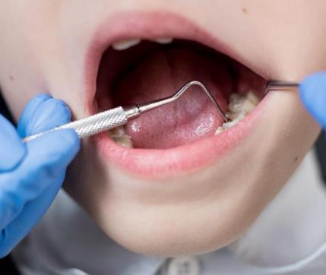
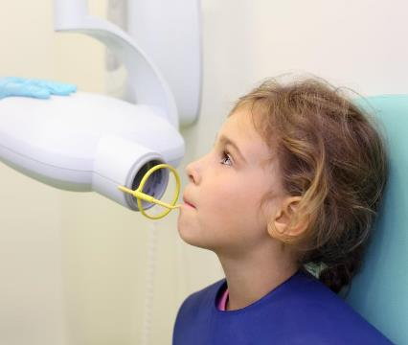
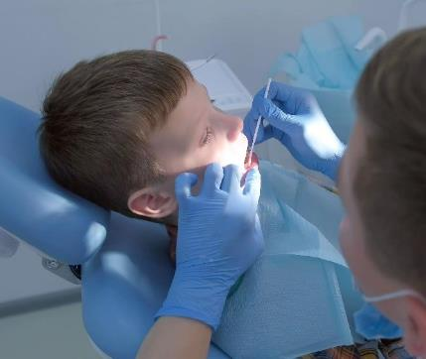
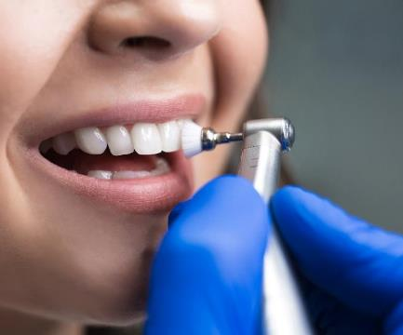
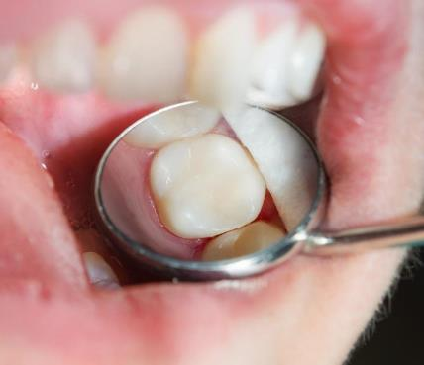
Notes:
Smile Squad services include:
Examination (check-up) and x-rays when required
Dental health and dietary advice
Application of fluoride varnish
Fissure sealants
Scale and clean
Restorations and simple extractions
Smile Squad offers a range of different services as part of the program. Not all these services will be relevant or recommended for your child, but they are available if needed.

Slide 8
What does Smile Squad provide for your child?
Free annual oral health check up for all students
Preventive and treatment services if required
Six month check in and fluoride varnish for those students who need it
Notes:
Smile Squad will visit your school at least once a year, to provide free dental services to you all. Depending on the needs of students, we may visit up to three times a year.
So, how does that work? Once every year, a Smile Squad exam van will come you your school to provide free check ups for all students.
During the check ups, some students will have fluoride varnish applied to help protect their teeth and reduce their risk of decay. Then, if there are any students who needed some extra help with keeping their teeth healthy after the exam van visit, a treatment van will come to provide some extra care for those students. If your child needs treatment, the team will call you to discuss and together you will agree on a care plan for your child.
Fluoride varnish works best if it is applied twice a year so the Smile Squad will come back in six months to re-apply fluoride varnish for some students. In some cases, the Smile Squad team will call you in six months to check in and see how everything is going with your child’s oral health.

Slide 9
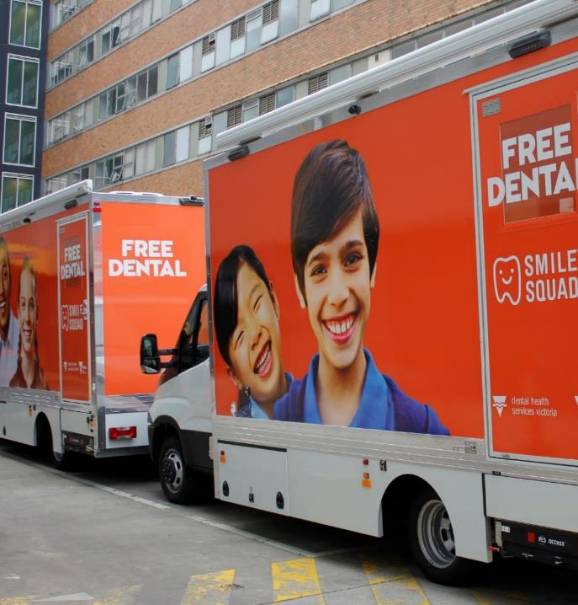
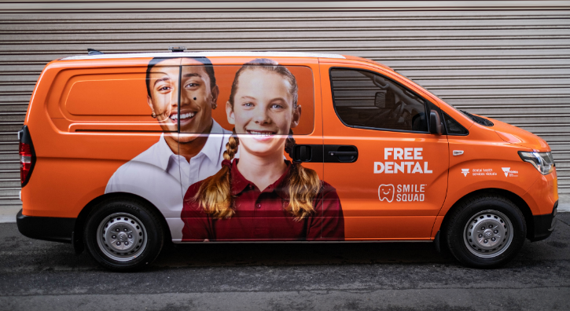
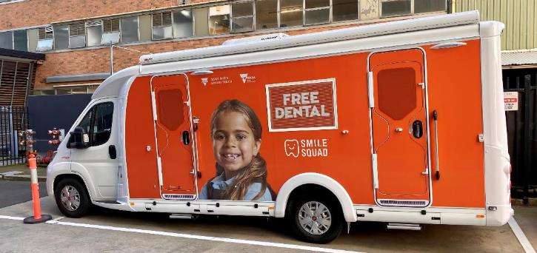
Notes:
Introducing our vehicles
You can expect to see two different types of vehicle arrive on your school’s grounds. We call these examination vans and treatment vans.
The smaller examination vans are unique because they house mobile equipment. The van will arrive at your school and the equipment is then uploaded and set up in a suitable room in the school. This set up allows us to see more than one student at a time.
These vans will be staffed by two clinicians and two dental assistants.
Sometimes we might have a problem securing a suitable room so we might also carry out examinations in the larger treatment van, or even back at our local clinic.
Follow up treatments will only take place in a treatment van set up on school grounds, or at our local clinic. These vans will be staffed by one clinician and one dental assistant. This mobile clinic is fully self contained. Treatments carried out will include scale and clean, stainless steel crowns, silver fluoride, fillings and simple extractions. More complex treatment will occur at our local clinic.

Slide 10
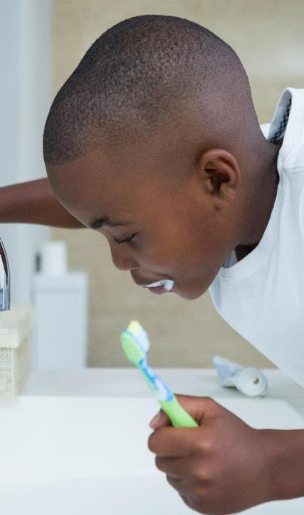
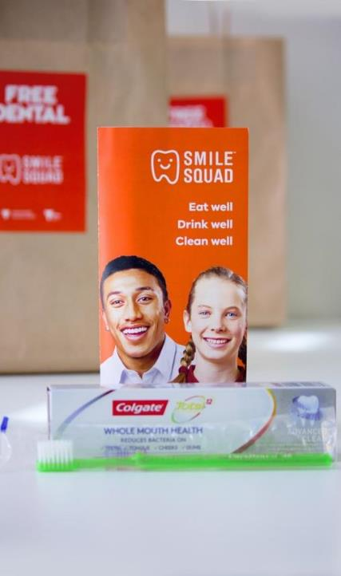
Notes:
Your child’s first check up
As you know, Smile Squad will visit your child’s school. First, they will come to provide every student with a free dental examination or check up. This involves a dental therapist or oral health therapist having a look at their mouth. They might take x-rays if they need a closer look inside their teeth. They might talk to your child about the foods they eat and what kind of food will be good for their teeth. They might talk to your child about other ways they can care for their teeth – making sure they are brushing them properly, and drinking plenty of water, or wearing a mouthguard if they play sport.
They might also offer preventive care such as fissure sealants, fluoride varnish and tooth cleaning. Fluoride varnish – this helps to protect your child’s teeth from decay and keeps them strong and healthy. If your child has fluoride varnish applied to their teeth, the examination team will come back in 6 months’ time to re-apply the fluoride varnish. They can also schedule a treatment visit if needed.
It’s not all about procedures. You might just need some dental health and dietary advice.
Every child will get a free dental pack consisting of a toothbrush, toothpaste and dental health information. We want to help you and your child keep their mouth healthy.

Slide 11
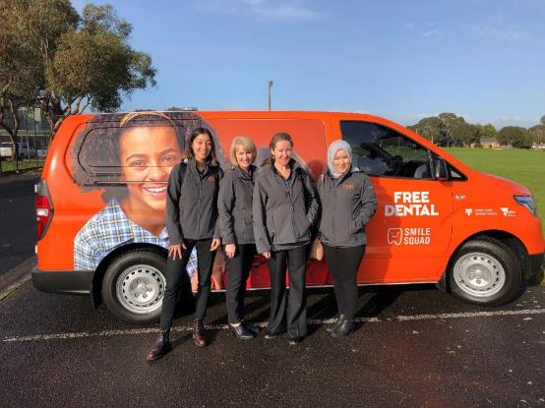
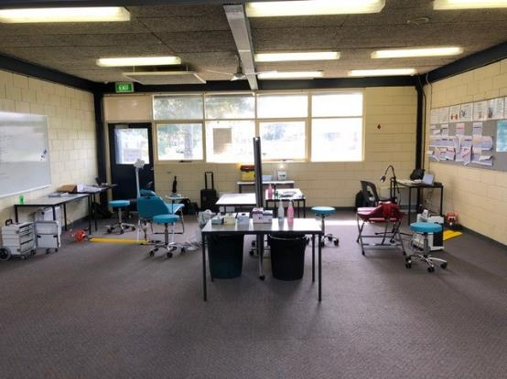
Examination procedures
Notes:
Let’s talk about some of those different things we mentioned that might happen during an examination visit. First of all, what does an examination or ‘check-up’ involve? A full dental check-up includes a check of teeth, gums, jaws, and the mouth. Check-ups are an excellent way to find problems early. Once we know what is happening, we can plan for follow-up care or treatment. We recommend regular dental check-ups for all children. During a check up, the Smile Squad team may need to do several different procedures, focusing on preventive care like fissure sealants and fluoride varnish.

Slide 12
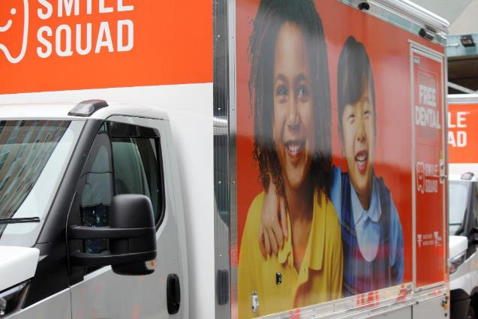
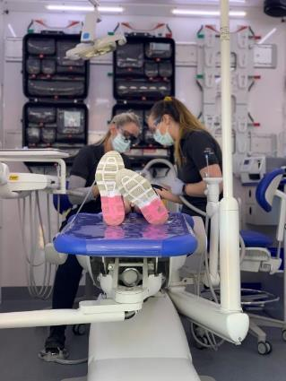
A bit more about treatment
Notes:
Following your child’s check up, they might need some further care to keep their teeth healthy, so the treatment van will visit. When the treatment van comes, we will only see students who need some extra help with their teeth. Dentistry is moving away from ‘drilling and filling’ so our clinicians will always choose the least invasive option available for your child. These techniques also help to prevent dental anxiety and phobias.
Some of the things staff in the treatment van will do include stainless steel crowns, silver fluoride and fillings. This can all happen inside the treatment van that you can see on the screen, which is just like a normal dental clinic but inside a van! In more complex cases, students may instead be transferred for treatment at the community dental clinic.
You can find more detailed information about the examination care and treatment we provide in the consent pack you receive when your child picks up their dental pack.

Slide 13
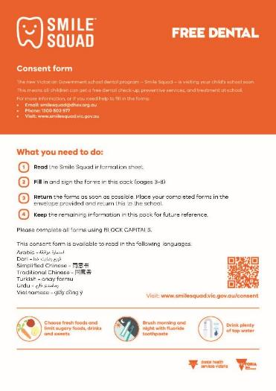
Signing up to Smile Squad
Notes:
Getting informed consent from a parent or guardian is an essential part of the Smile Squad process.
Consent forms will be sent home with students to be filled out and returned before we arrive at the school. It is important that consent forms are completed in full. If you are unsure about something on the form, please contact the Smile Squad for help (phone number and email address can be found in the consent pack). The consent form provides some background information on Smile Squad and answers some frequently asked questions. It asks you to consent to a dental exam (check-up) for your child, followed by some specific procedures.
It is important that you consent to the dental exam (check up) first, and then the other procedures. Without general examination consent our staff can’t provide any services to students. The consent form also asks for Medicare details and CDBS bulk billing consent. This is another key part of the consent form and we will explore the importance of CDBS shortly. There is also a medical and oral health questionnaire. Both of these are important and help to plan the services our team provide to your children – ensuring they are safe and of greatest benefit. The oral health questionnaire helps us to understand what matters most to you and your child about their oral health.

Slide 14
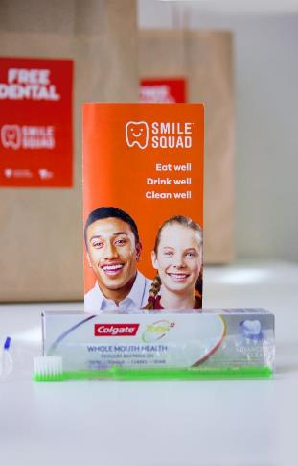
Your child’s free dental pack
Toothbrush
Toothpaste
Eat well, drink well, clean well brochure
Consent form
Notes:
We provide every student with a dental pack and this includes the consent form we just talked about. The dental packs also contain a toothbrush, toothpaste, and a brochure with some oral health information. These packs mean that all Victorian students will have access to the tools needed to have good oral hygiene to keep their teeth clean. These packs will be sent home before the vans visit your school – so they might also be a good reminder for some students to keep up the habit of brushing twice a day!

Slide 15
Explaining the Child Dental Benefit Scheme (CDBS)
The Child Dental Benefit Scheme (CDBS) is a dental benefits program for eligible children aged 2–17 years that provides benefits over two years to a child for basic dental services.
Medicare funded
Claiming CDBS helps secure the future of public dental services.
Notes:
We would like to talk to you about the Child Dental Benefits Scheme, also known as the CDBS, and what it means for Smile Squad.
Smile Squad is a free dental service for all Victorian public school students. There are no out of pocket costs for families, as all costs are covered by the state government and Medicare CDBS. The CDBS is Medicare funded and provides free dental care to eligible children aged 2-17 years. If you’re not sure about your eligibility, that’s ok! Smile Squad can find out for you. Even if you are not eligible for CDBS, all Smile Squad services are still free. We encourage you to use the CDBS funding if eligible as it helps us get extra funding to be able to provide more services to more students in Victoria. In short, the more people who fill out the CDBS bulk billing consent form, the more funding we receive to provide the best services for your children. Don’t worry if you go over your CDBS limits as care provided by Smile Squad will still be free, with no out of pocket costs. Please note: the CDBS does not cover specialist services, e.g. orthodontics.

Slide 16
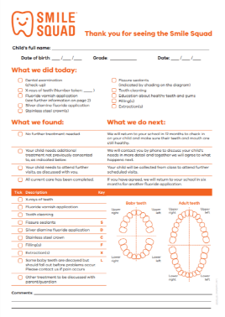
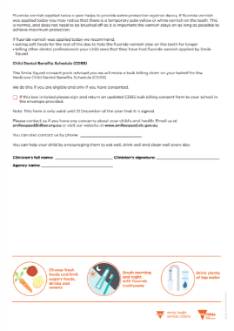
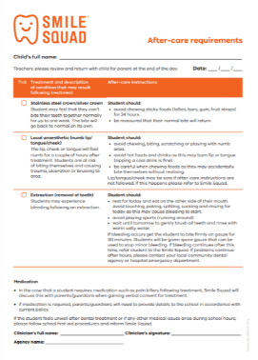
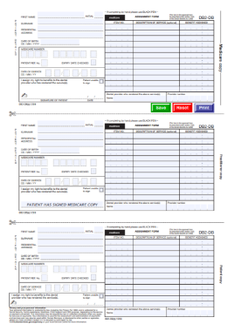
Materials sent home with your child
Post-care report
After-care requirements form
Medicare benefit assignment form
Notes:
Your child will arrive home with a Smile Squad dental pack and consent pack in the weeks before we arrive on site. Please fill in and return your consent forms to the school as soon as possible.
There are several different forms you can expect to see arrive home with your child. Here’s a handy list of the materials to look out for.
After your child has been examined, they will be given a post-care report. This form will provide you with enough information about what we did during the examination, what we found, and what happens next. Keep this report handy – if your child needs follow up care, our team will call you to discuss the report and together you will make plans for what happens next.
If you have given your consent for your child to receive treatment, they may bring home an after-care requirements form. When treatment includes a stainless steel or silver crown, local anaesthetic or an extraction, an after-care form will be completed. This form will be provided to your child’s teacher if they return to class before being taken home at the end of the day.
If your child is eligible for CDBS, they will be given a Medicare benefit assignment form after each dental visit. You will need to sign and date the form and return the Medicare and practitioner copies to your school.

Slide 17
Eat well
Drink well
Clean well
Notes:
Another important aspect of the Smile Squad program is the broader health promotion work that will be happening. You should start to see more of these messages around your school.
You can support your child to keep their smile healthy by helping them to eat well, drink well and clean well.
‘Eat well, drink well, clean well’ relates to the habits we mentioned earlier and the things you can change to prevent oral disease. Visiting the dentist regularly is one important habit for keeping a healthy mouth, but there are lots of other things you can do that are just as important, such as:
• Brushing twice a day with a fluoride toothpaste
• Choosing water over other sugary drinks – especially if it’s fluoridated tap water
• Eating more fresh foods and less processed foods with lots of sugar

Slide 18
Notes:
In order to eat well it’s important to eat a variety of healthy foods that are fresh and nutritious. It is also important to limit the amount of sugary foods that you eat.

Slide 19
Notes:
Healthy drinks are important for healthy teeth – things like fluoridated tap water, plain milk, or soy milk with calcium are healthy drinks that are good for your teeth. Make these drinks your first choice and try to limit sugary drinks.

Slide 20
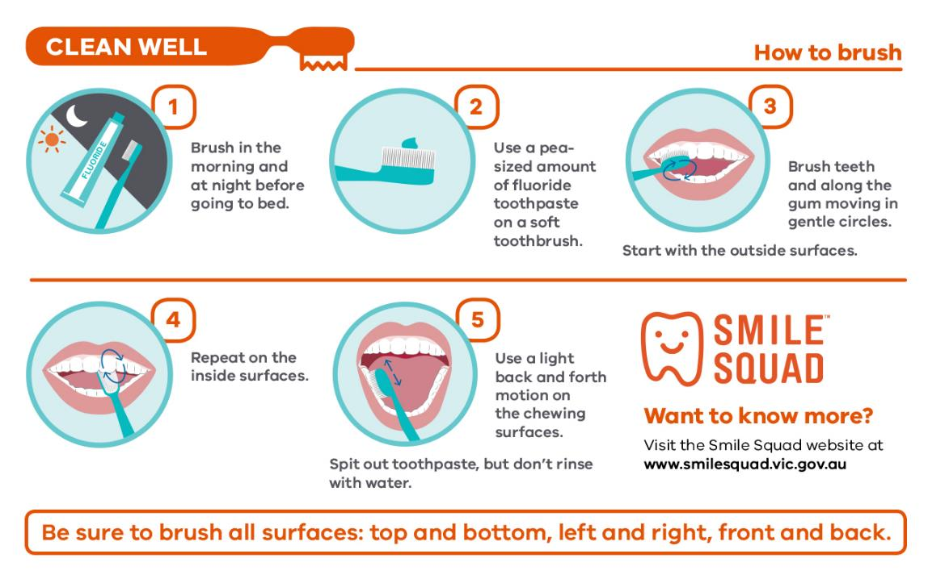
Notes:
Does your family have a routine that includes brushing your teeth morning and night?
Brushing for two minutes, twice a day, with fluoridated toothpaste will help to keep decay away.
This information is available in the brochure included in your child’s dental pack. You can also find it online at the Smile Squad official website.

Slide 21
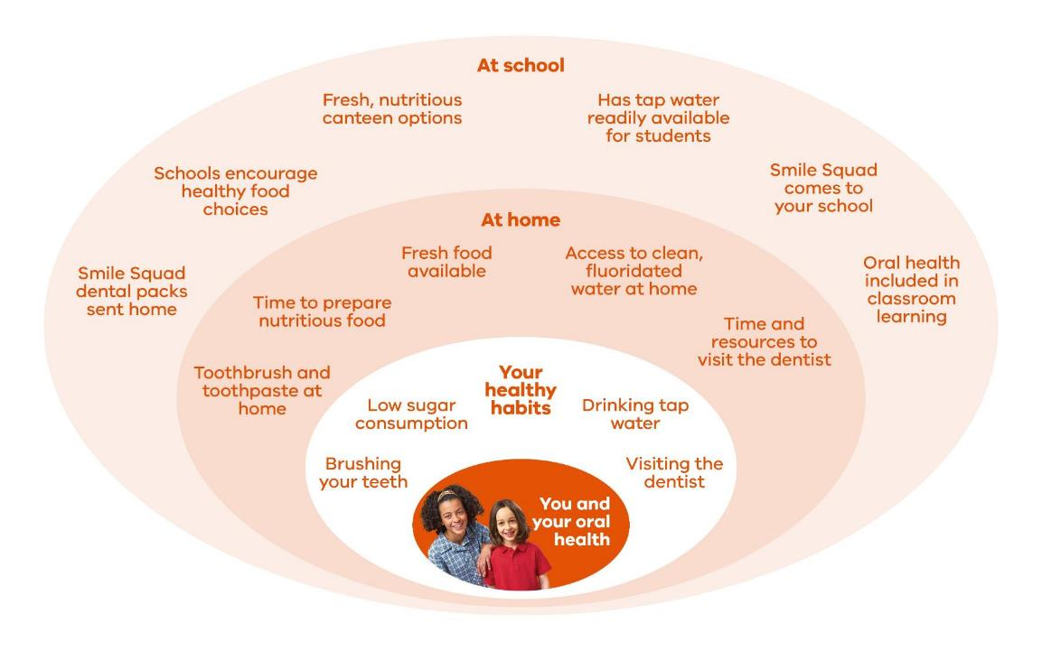
Notes:
Creating a healthy environment for teeth
There are many different things that can influence your oral health, the most obvious being some of your own habits. Things like whether you brush your teeth twice a day, if you eat or drink a lot of sugar, if you visit the dentist regularly, or if you drink fluoridated tap water on a regular basis. Whilst these might seem like choices only you can make, there are other things that can make these choices easier, or more difficult.
Your home and your school are two places where you spend large amounts of time, and different factors from both of those places can make these choices easier, or more difficult. Things like whether you can fill your water bottle up at school, what rules you have at your house for sugary drinks, whether you can buy a healthy lunch from the canteen, or if toothbrushing is part of your family’s routine.
All these different things impact your healthy habits. Smile Squad aims to make sure these healthy habits for healthy teeth are the easiest option for Victorian school students.

Slide 22
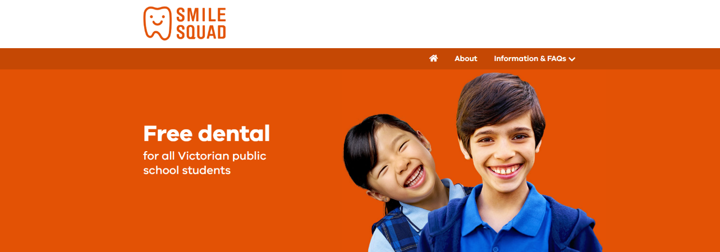
Want to know more?
Visit the Smile Squad website at www.smilesquad.vic.gov.au
Notes:
We will be available now if you would like to have a chat with us on 8412 0444, or you can visit the official Smile Squad website for more information.
Welcome again to Smile Squad.

