Slide 1
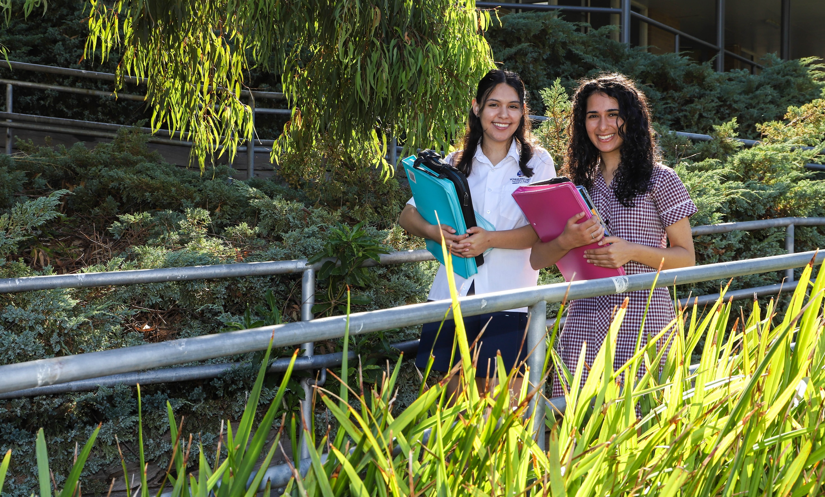
VCE ENGLISH / EAL

Slide 2
What is English/EAL?
EAL - English as an Additional Language
EAL - Students must be a resident of Australia for no more than 5 years and have been educated in a language other than English for fewer than 7 years. Please note that students must qualify as an EAL student to access this subject.
It is compulsory to choose at least ONE English subject from English, EAL and Literature. (You can choose both English and Literature; You can choose just Literature.)
It will be part of your ATAR calculation and there is a prerequisite for entering university (English > 25; EAL > 30).

Slide 3
Focus of VCE English/EAL
Most people can…
Read and understand a piece of writing
Compose or create a piece of writing in response to a topic
Understand that texts are ‘about’ something bigger than the plot
We look to improve…
Clarity of writing and speaking – using natural language and making your meaning clear
Understanding of how texts are constructed for meaning – the ‘about something’ becomes ‘saying something’

Slide 4
Focus of VCE English/EAL
Year 11: Unit 1 & Unit 2
Year 12: Unit 3 & Unit 4
Year 11 builds knowledge and skills in a safer environment – you can take risks, make mistakes, etc. It is a learning process.
Transferable skills – everything you learn in Year 11 can be applied in Year 12; you WILL read, write, and speak for life!

Slide 5
Unit 1: English / EAL
Outcome 1: Reading and Exploring Texts | Assessment | EAL options
Analyse how Little Miss Sunshine presents ideas, issues and themes and conveys the views and values of the author and make relevant personal connections | Personal response to Little Miss Sunshine | A note-form summary of key connections and ideas of Little Miss Sunshine

Slide 6
Unit 1: English / EAL
Outcome 2: Crafting Texts | Assessment | EAL options
Study and annotate THREE main mentor texts for effective and cohesive writing Observe the writing for its merits and literary devices that link to an idea (‘monsters’) | Two pieces of writing for a determined purpose and audience Commentary explaining writing choices and processes for each piece | Two pieces of writing for a determined purpose and audience SETS of annotations identifying qualities of effective writing

Slide 7
Unit 2: English / EAL
Outcome 1: Reading and Exploring Texts | Assessment | EAL options
Analyse how The Happiest Refugee presents ideas, issues and themes and conveys the views and values of the author | Analytical response to The Happiest Refugee | A detailed mind map of vocabulary, text structures, language features and ideas in The Happiest Refugee

Slide 8
Unit 2: English / EAL
Outcome 2 : Exploring Argument | Assessment | EAL options
Analyse the purpose and construction of the arguments in a variety of persuasive texts Develop a viewpoint on an issue that is debated in the media | Analysing Argument Essay Point of view oral presentation | -

Slide 9
Year 11 English/EAL Unit 1 Assessment
English | EAL
SAC 1 Personal Response to Miss Little Sunshine SAC 2 Crafting Text Part A – Writing Folio (TWO pieces) SAC 2 Crafting Text Part B – Commentary on Writing Process | SAC 1 Personal Text Response to Miss Little Sunshine OR A note-form summary of key connections and ideas of Little Miss Sunshine SAC 2 Crafting Text Part A – Writing Folio (TWO pieces) SAC 2 Crafting Text Part B – Commentary on Writing Process OR SETS of annotations identifying qualities of effective writing

Slide 10
Year 11 English/EAL Unit 2 Assessment
English | EAL
SAC 1 Analytical response to The Happiest Refugee SAC 2 Exploring Argument Part A – Argument Analysis Essay SAC 2 Exploring Argument Part B – Oral Presentation | SAC 1 Analytical response to The Happiest Refugee OR A detailed mind map of vocabulary, text structures, language features and ideas in The Happiest Refugee SAC 2 Exploring Argument Part A – Argument Analysis Essay SAC 2 Exploring Argument Part B – Oral Presentation

Slide 11
Year 12 Unit 3 & Unit 4 English / EAL
Newly implemented Study Design
2024 will be the first year for all Victorian English / EAL students and teachers to teach and learn.

Slide 12
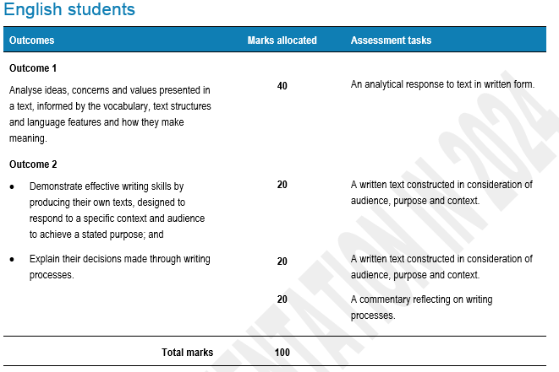
Unit 3: English / EAL

Slide 13
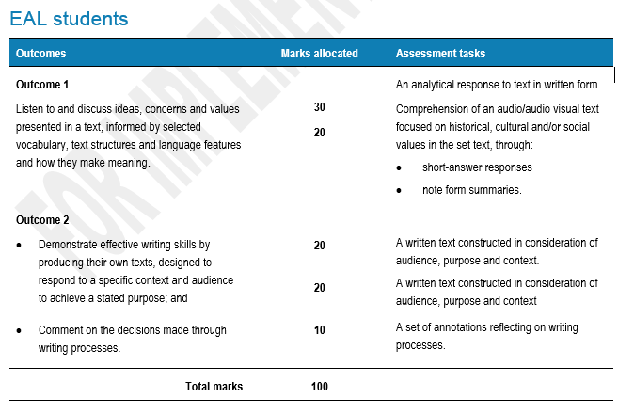

Slide 14
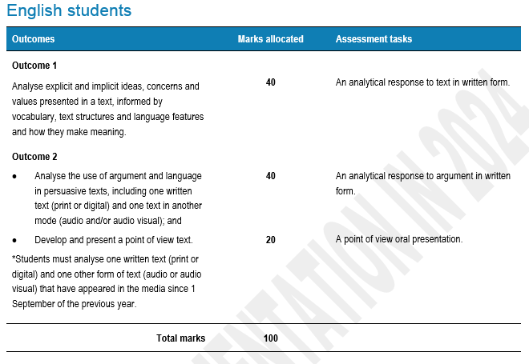
Unit 4: English / EAL

Slide 15
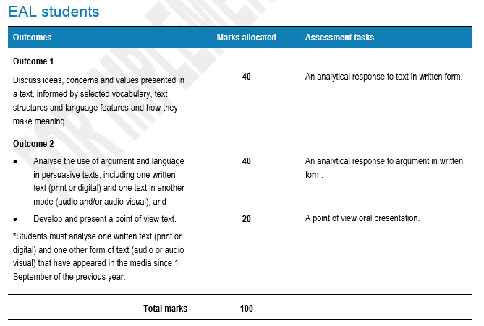

Slide 16
Passing English/EAL
To achieve an S for Units 1,2,3,4 you must pass all Outcomes
In order to pass each Outcome you need to demonstrate the skills and knowledge outlined in the Study Design.
You will be given multiple opportunities to demonstrate the skills and knowledge through completing classwork, homework and assessment tasks.
S for Assessment Tasks + Completion of the Coursework + Attendance

Slide 17
Fei.HU@education.vic.gov.au
VCE English Team:
(Year 11 2023) Ms Wilson, Ms Rainsford, Ms Athanasiou, Ms Fei
(Year 12 2023) Ms Wilson, Ms Graham-Prowse, Ms Zhu
VCE EAL: Ms Fei

