Slide 1
God’s creation of earth.
Genesis
Willow Walls, Amelia Rocca and Alisha Lylak

Slide 2
On day one God made light and dark
On day two God made the sky and earth
On day three God made plants and trees and land
On day four the sun and moon were created by God
On day five most creatures were created by God
On day six land animals and humans were made
On day seven God rested for his work was finished

Slide 3
Creation Prayer
Loving God,
You call us to be good stewards of this earthly home
Strengthen us to care for your creation
Forgive us for our greed
and our abuse to the Earth's beauty
and the damage we have done.
Empower us, through your Spirit
to look after nature and love the world,
May all creation sing to your glory.
Amen.

Slide 4
Bible Reading
A reading from the Book of Job
Ask the animals, and they will teach you,
or the birds in the sky, and they will tell you;
speak to the earth, and it will teach you,
or let the fish in the sea inform you.
All of these knows that the hand of the Lord has done this.

Slide 5
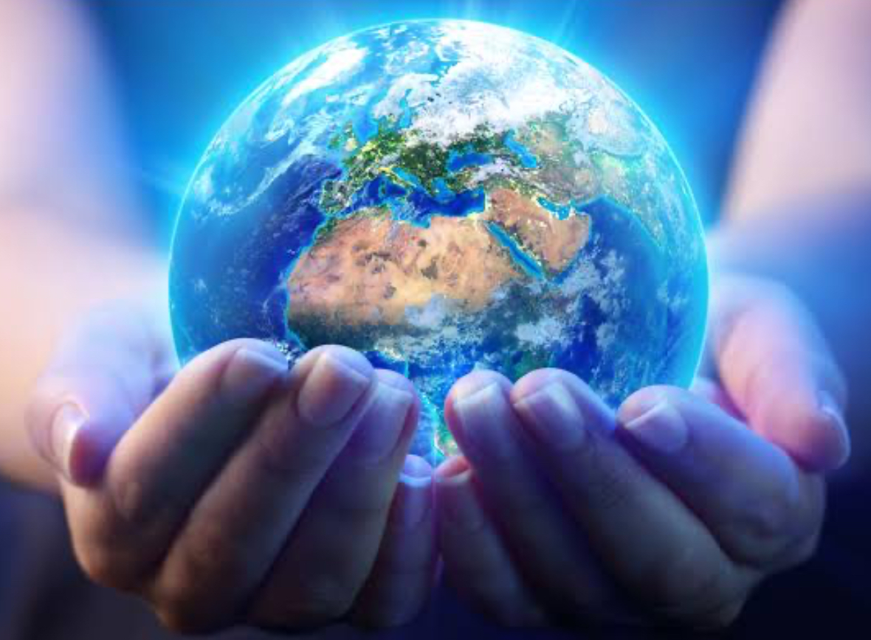
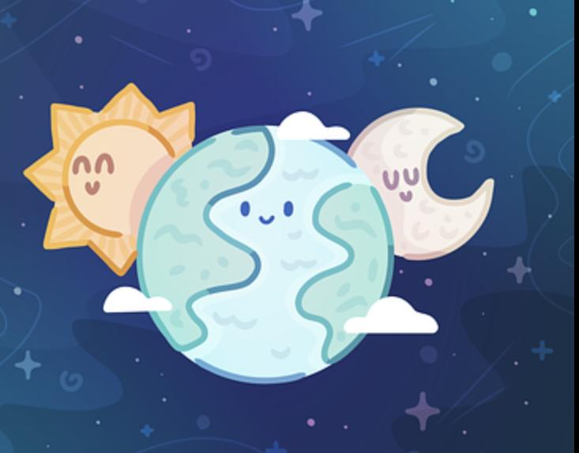
Think about something God has made. Think about God's creation.
Creation story

Slide 6
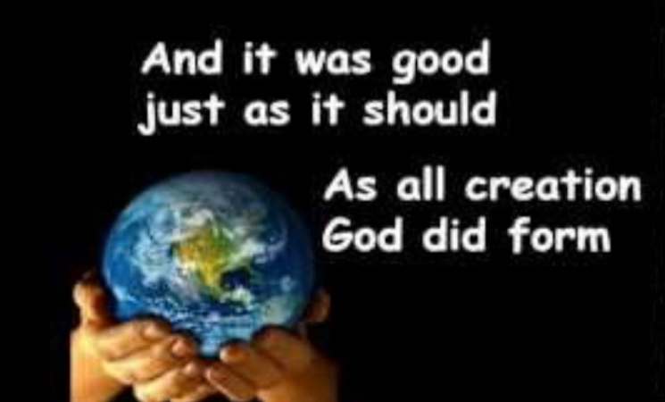
Music Prep-Y2

Slide 7
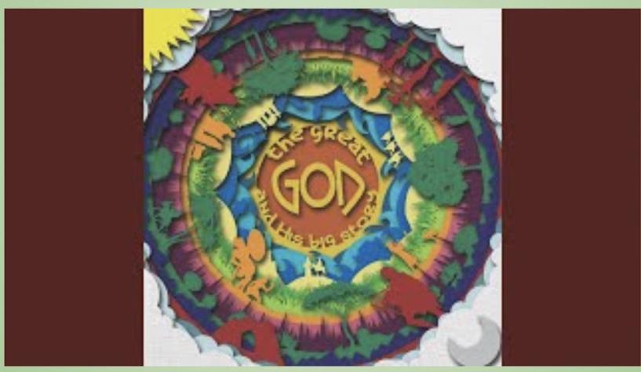
Music Y3-6

