Slide 1


Slide 2

Speaker name
Add speaker photo
or institution logo
Institution name
Notes:
EDITS REQUIRED:
Add speaker photo or institution logo in frame.
Edit speaker name and institution name.
Script:
Introduce yourself and explain why you are talking about R U OK?

Slide 3
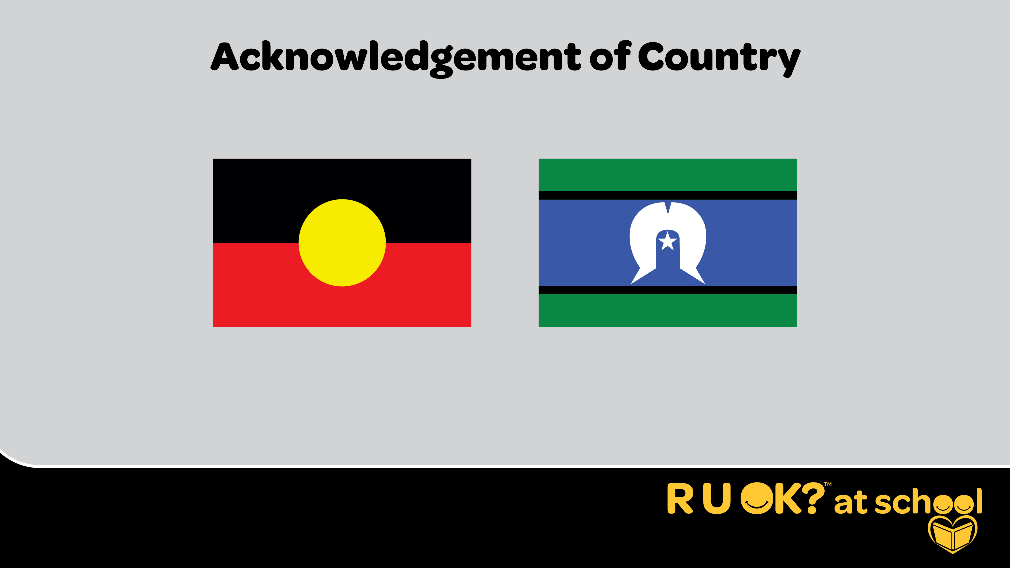
Notes:
Script:
I begin today by acknowledging the Traditional Custodians of the land on which we meet today, and pay my respects to their Elders past and present.
You may want to add:
I extend that respect to Aboriginal and Torres Strait Islander peoples here today.
Further notes:
[If you have a student, staff member or elder who is able to do a Welcome to Country, ask them to contribute to the presentation in this way.]
[You might have young people joining you from different areas. If you are presenting remotely you could ask them to share from what lands they are joining from.]

Slide 4
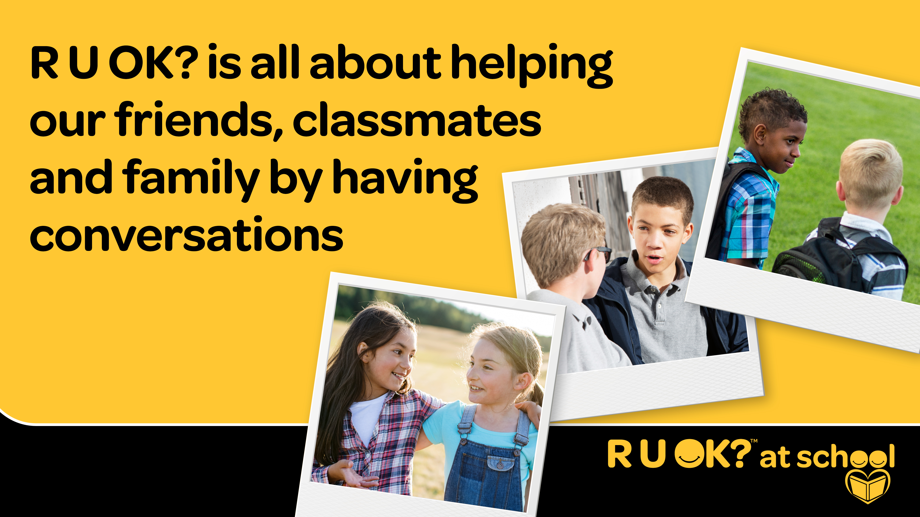
Notes:
Script:
R U OK? is a charity with a mission to get everyone having more conversations to check in with each other to see how they’re doing.
It’s about what we can all do to help our friends, classmates and family to get through tough times.

Slide 5
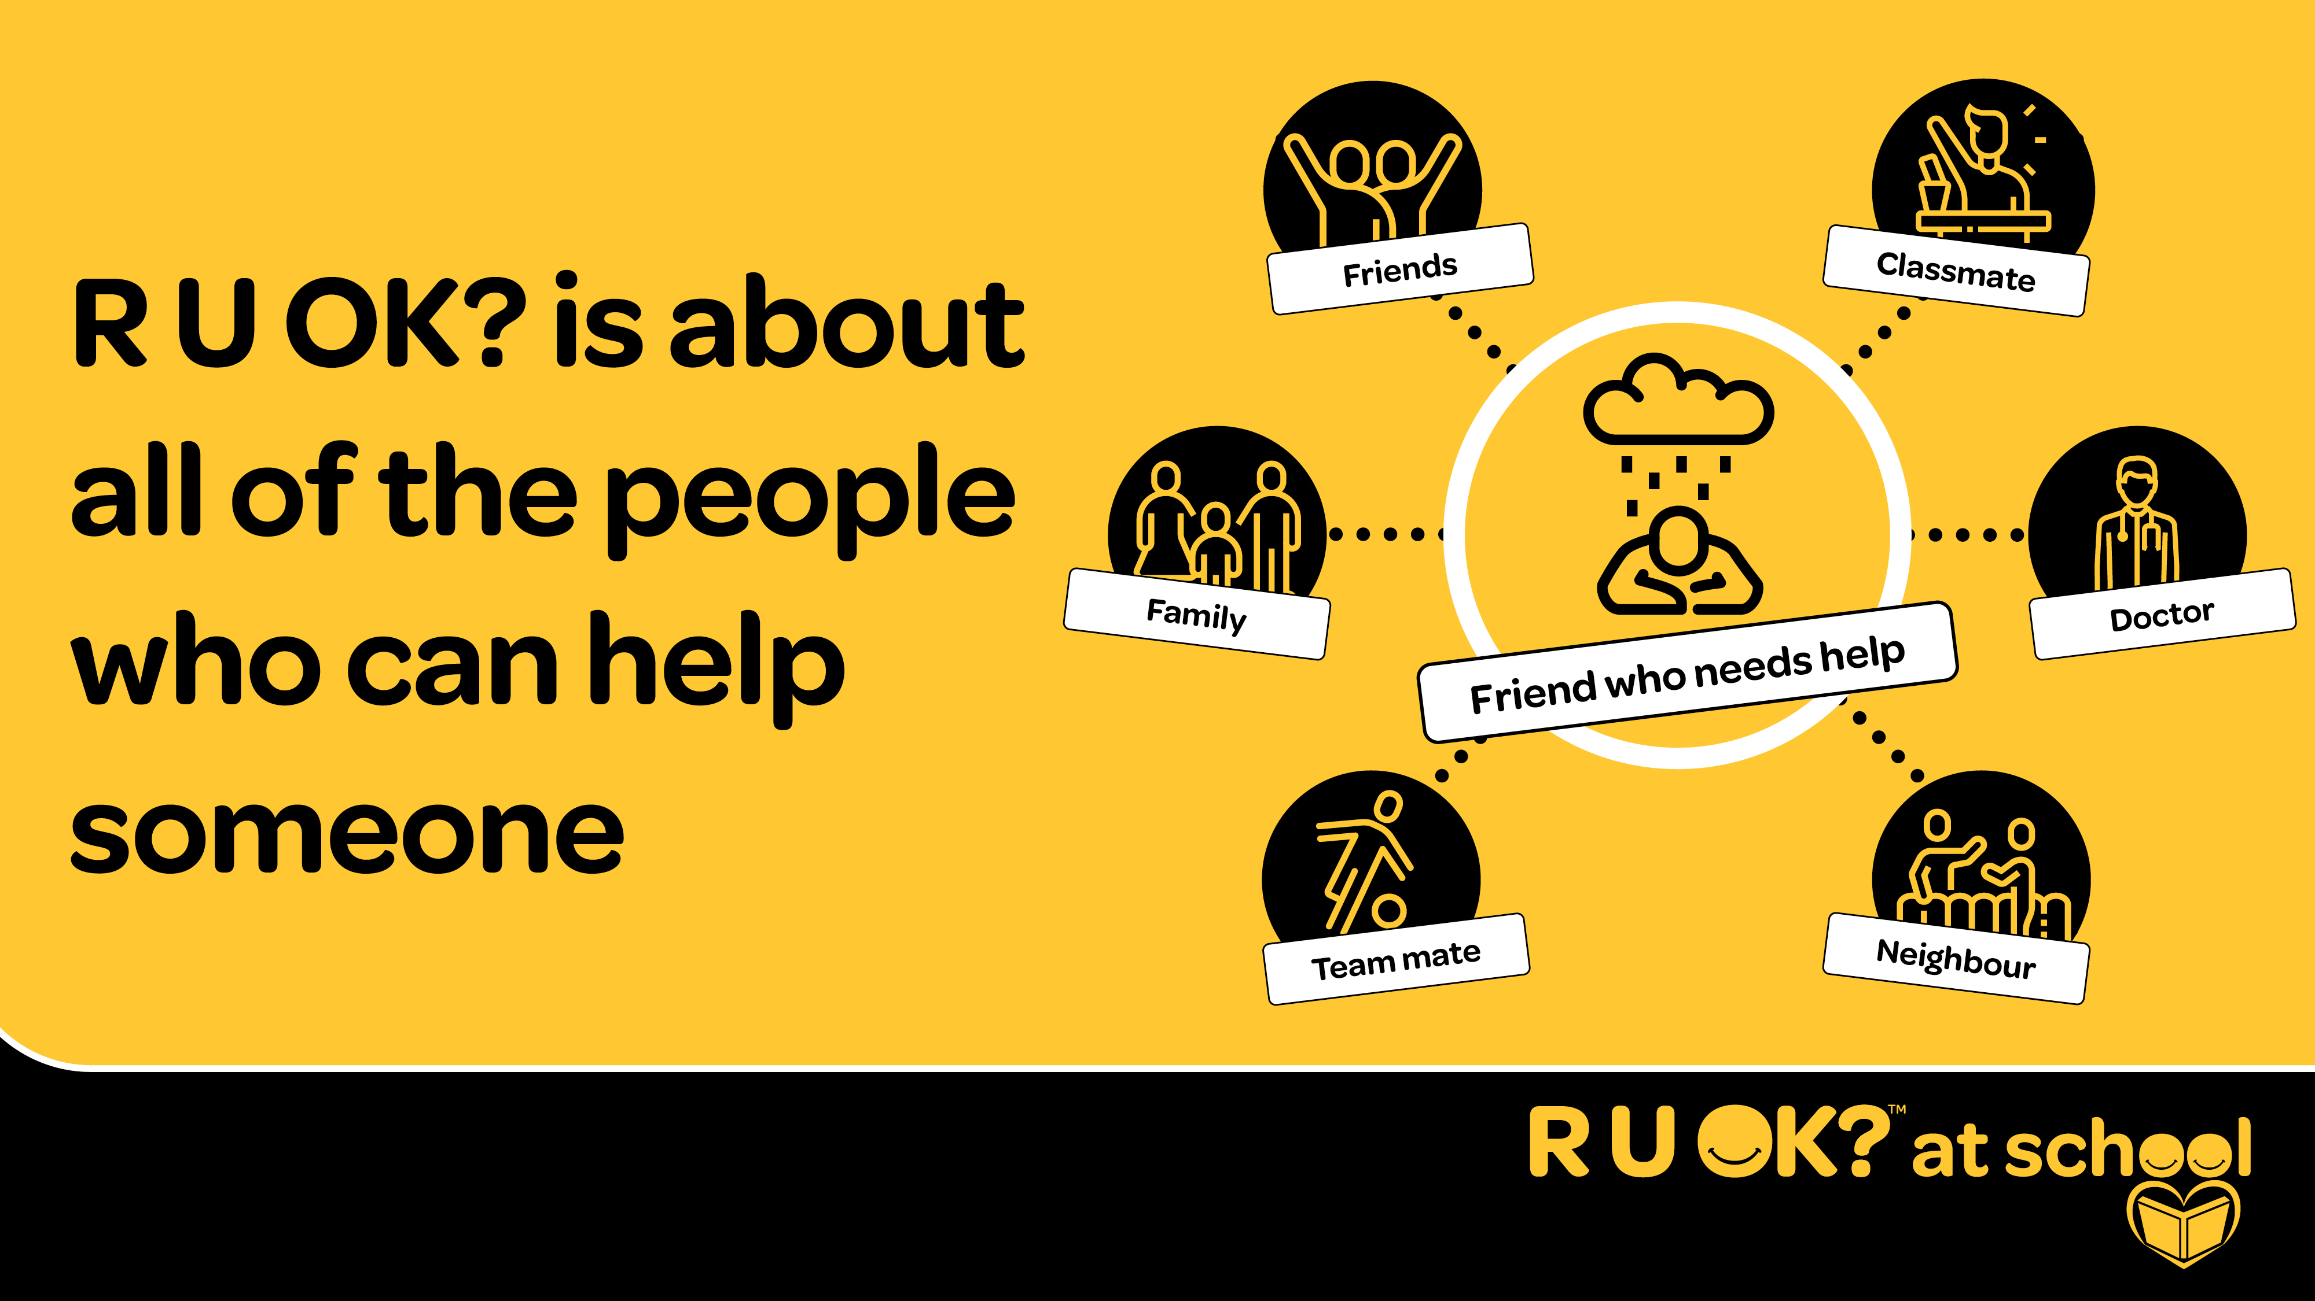
Notes:
Script:
The role of asking ‘R U OK?’ and helping someone who is struggling can be played by lots of different people – in the middle here there’s someone who needs help. This could be any of us at various times of our life. All the people around – friends, family, team mates, classmates, doctors, neighbours etc can all play that supporting role.
When someone is struggling it can be hard for them to reach out. That’s why we call on those around them who might notice, to start the conversation and encourage them to speak about what might be troubling them. This can help people feel like they have a friend supporting them, and prevent small things becoming bigger issues.

Slide 6
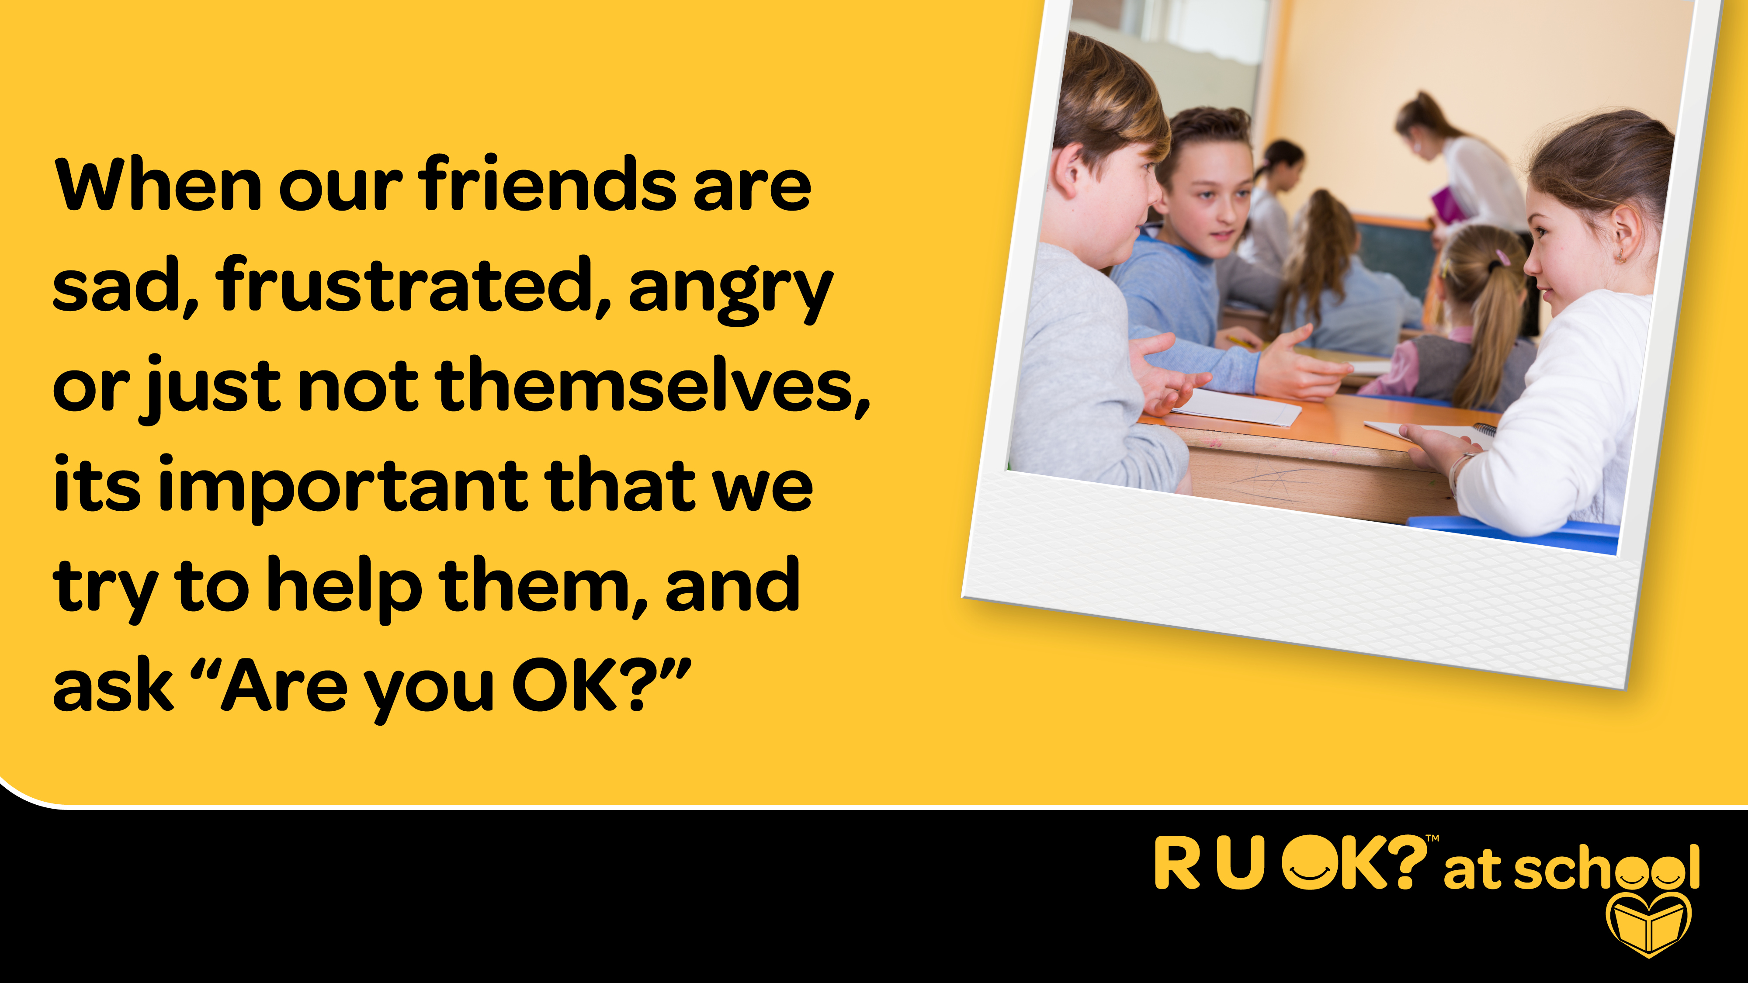
Notes:
Script:
When our friends are sad, frustrated or angry its important that we try to help them, and ask “Are you OK?”
Asking this can make a difference when someone is struggling – it can make them feel less alone and more supported. We want everyone to feel like people are there for them.
When someone does need help, it’s often easier for them to talk to someone they know. That’s why we’re going to talk through what to do if they are worried about someone.

Slide 7
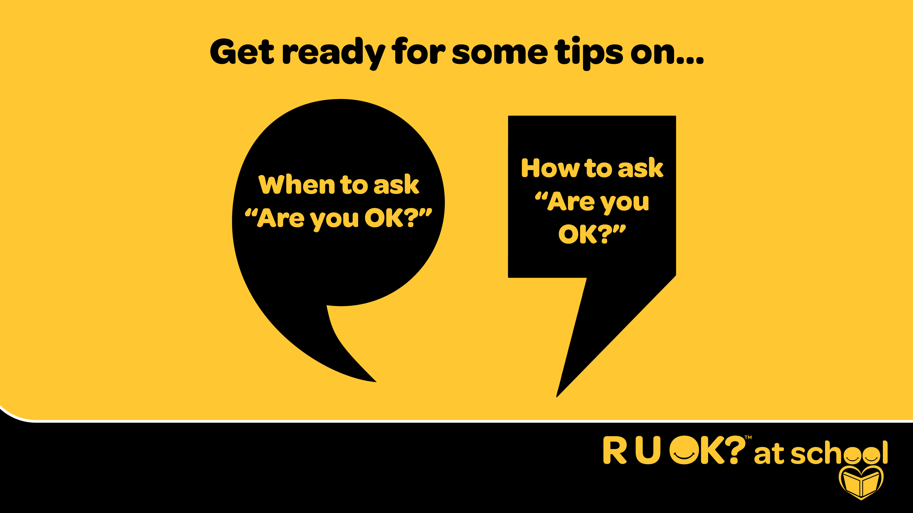
Notes:
Script:
Today you're going to get some tips on:
when to ask ‘Are you OK?’
and how to ask “Are you OK?”
so you can have a conversation whenever they think someone in your world might be struggling with something big or small.

Slide 8
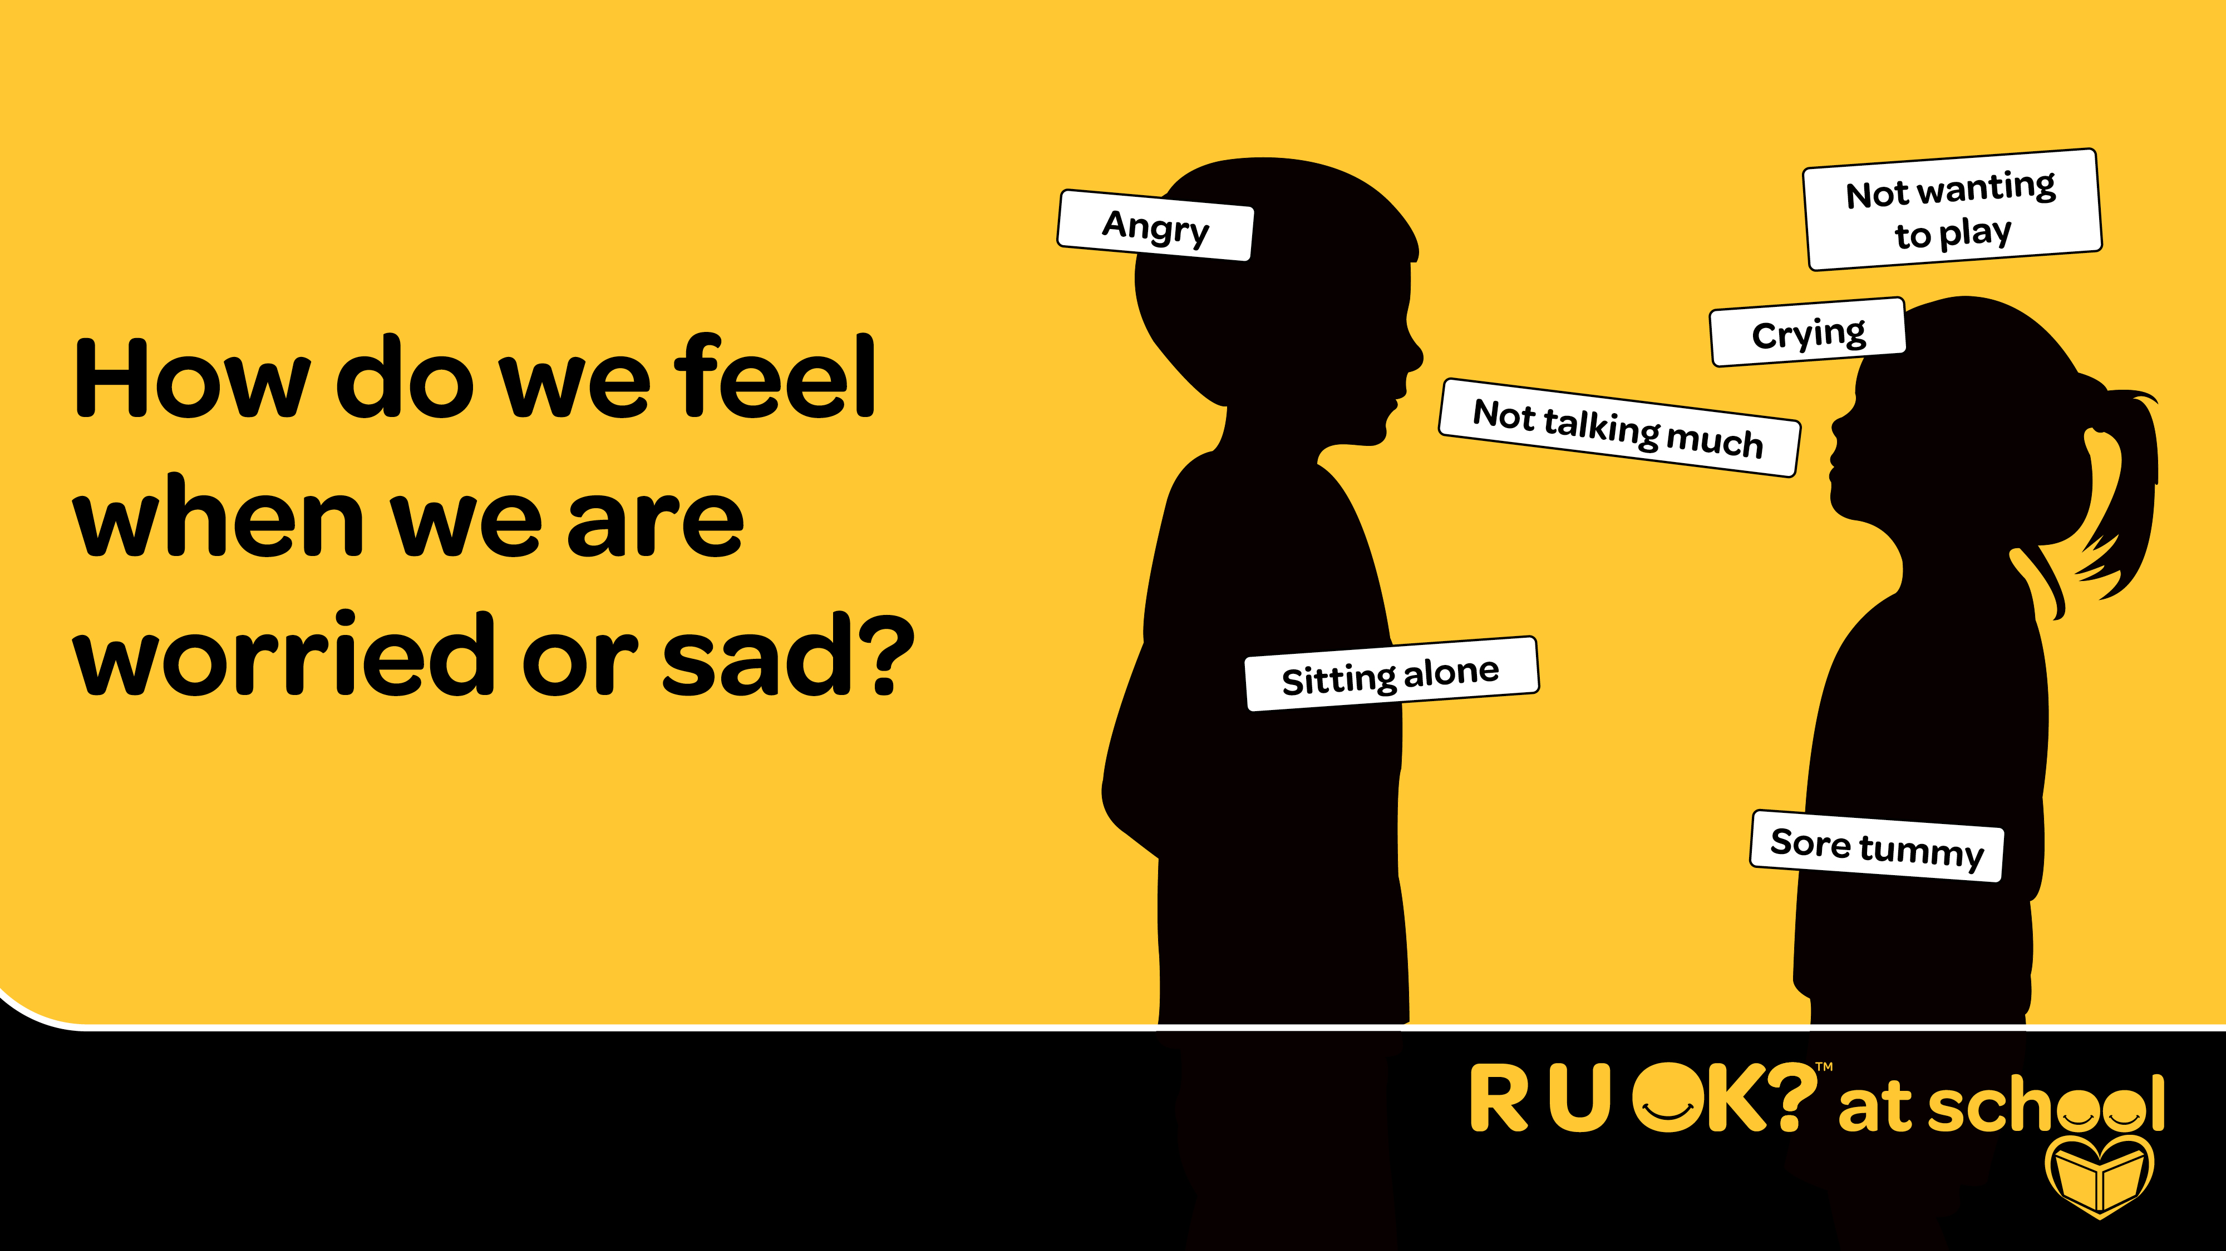
Notes:
Script:
How do we know when someone is worried or sad?
Crying
Sitting alone
Angry
Not wanting to play
Sore tummy
Not talking much
Script:
How do you know if someone is feeling like that?
You can look for changes in what they’re saying or doing or things that are happening in their life because that might indicate they are feeling not their best.
Look for signs in what they’re saying.
Look for signs in what they’re doing.
Think about what is going on in their life.
When you notice a change, no matter how small, it’s time to ask R U OK?
Question for the audience:
This is how that person is feeling on the inside, but what are some of the changes we might be able to spot? What might someone be saying or doing and what might be going on in their life that could be a sign that they need support?
You might notice that they:
Suddenly become a lot quieter
Get angry or upset a bit more easily
Cry or become emotional
Lose interest in activities and things they usually love
Losing their appetite
The most important thing is to trust your gut. If you just feel that something’s not quite right with your friend, it’s a good idea to ask.
When we see our friends like this, we can help. That’s when we can help by asking ‘Are you OK’?

Slide 9
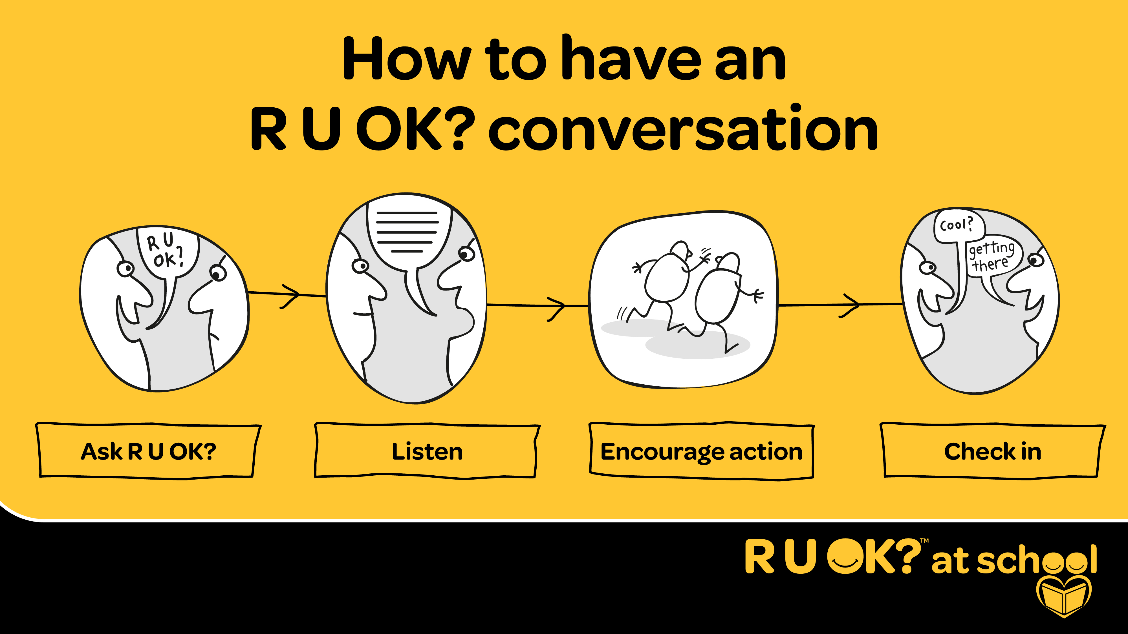
Notes:
Script:
Now I’ll share some tips on the steps of an ‘Are you OK?’ conversation and what to say after you ask the question.
– Ask R U OK?
– Listen
– Encourage action
– Check in

Slide 10
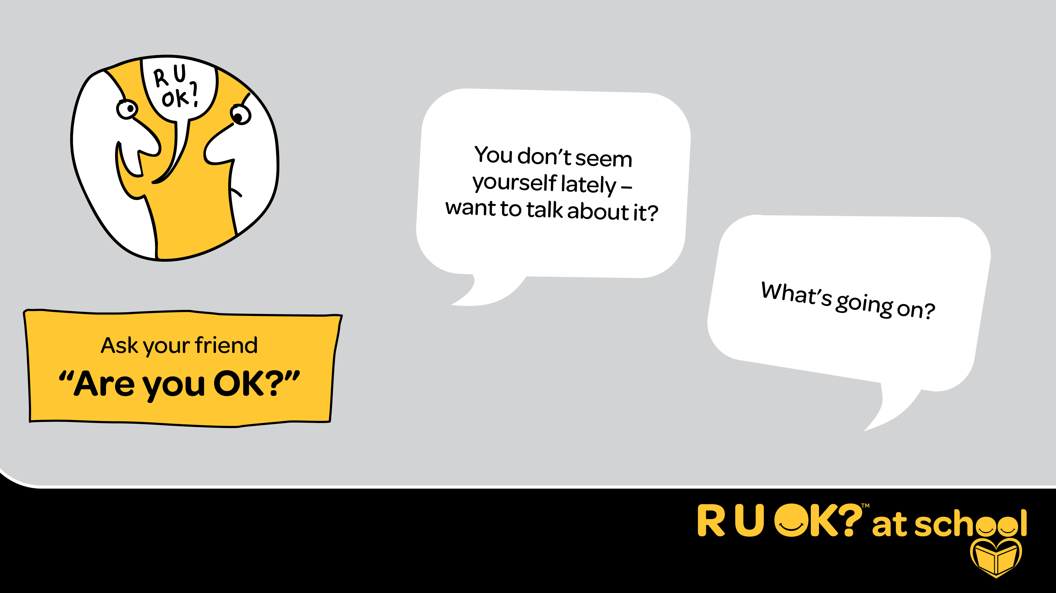
Notes:
Script:
As we’ve been saying, by starting a conversation to check in, you could help a family member, friend or peer open up about what’s troubling them.
It’s best to pick a quiet time when you’re alone with them if you can, not in front of everyone.
Approach them in a relaxed and friendly way, it doesn’t have to be a big deal, just a casual conversation.
If they say they don’t want to talk right now, see if they want to talk another time, or ask if there’s someone else they’d like to talk to for support.
You don’t have to specifically say “Are you OK?” – ask in whatever way feels right for you. You could say something like:
“How are you travelling?”
“You don’t seem yourself lately – want to talk about it?“
“You seem a bit sad lately, are you OK?”
“What’s going on?”

Slide 11
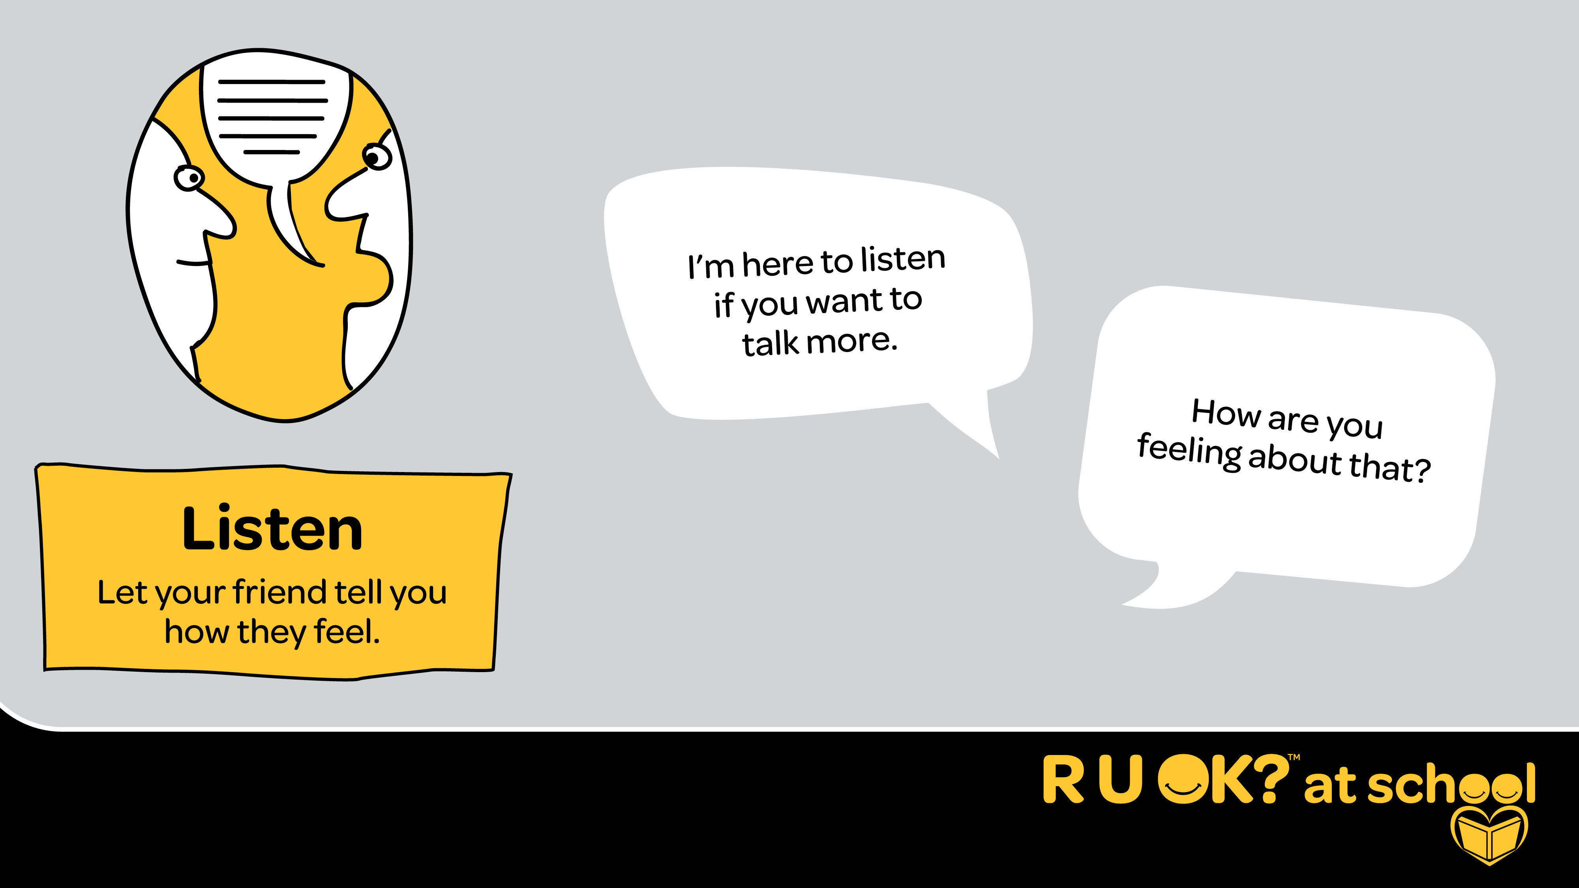
Notes:
Script:
Listening is the thing that can make the biggest difference for someone who needs help.
It can be tempting to rush or change the subject. It can also be hard to hear that one of your friends is sad or is struggling – but remind yourself that by listening, you are making a difference.
Remember that silence is ok too – you can just sit or walk together.
Give the person some space and quiet so they can find the words to express what they’re going through.
You could say:
I’m here to listen if you want to talk more.
“How are you feeling about that?”

Slide 12
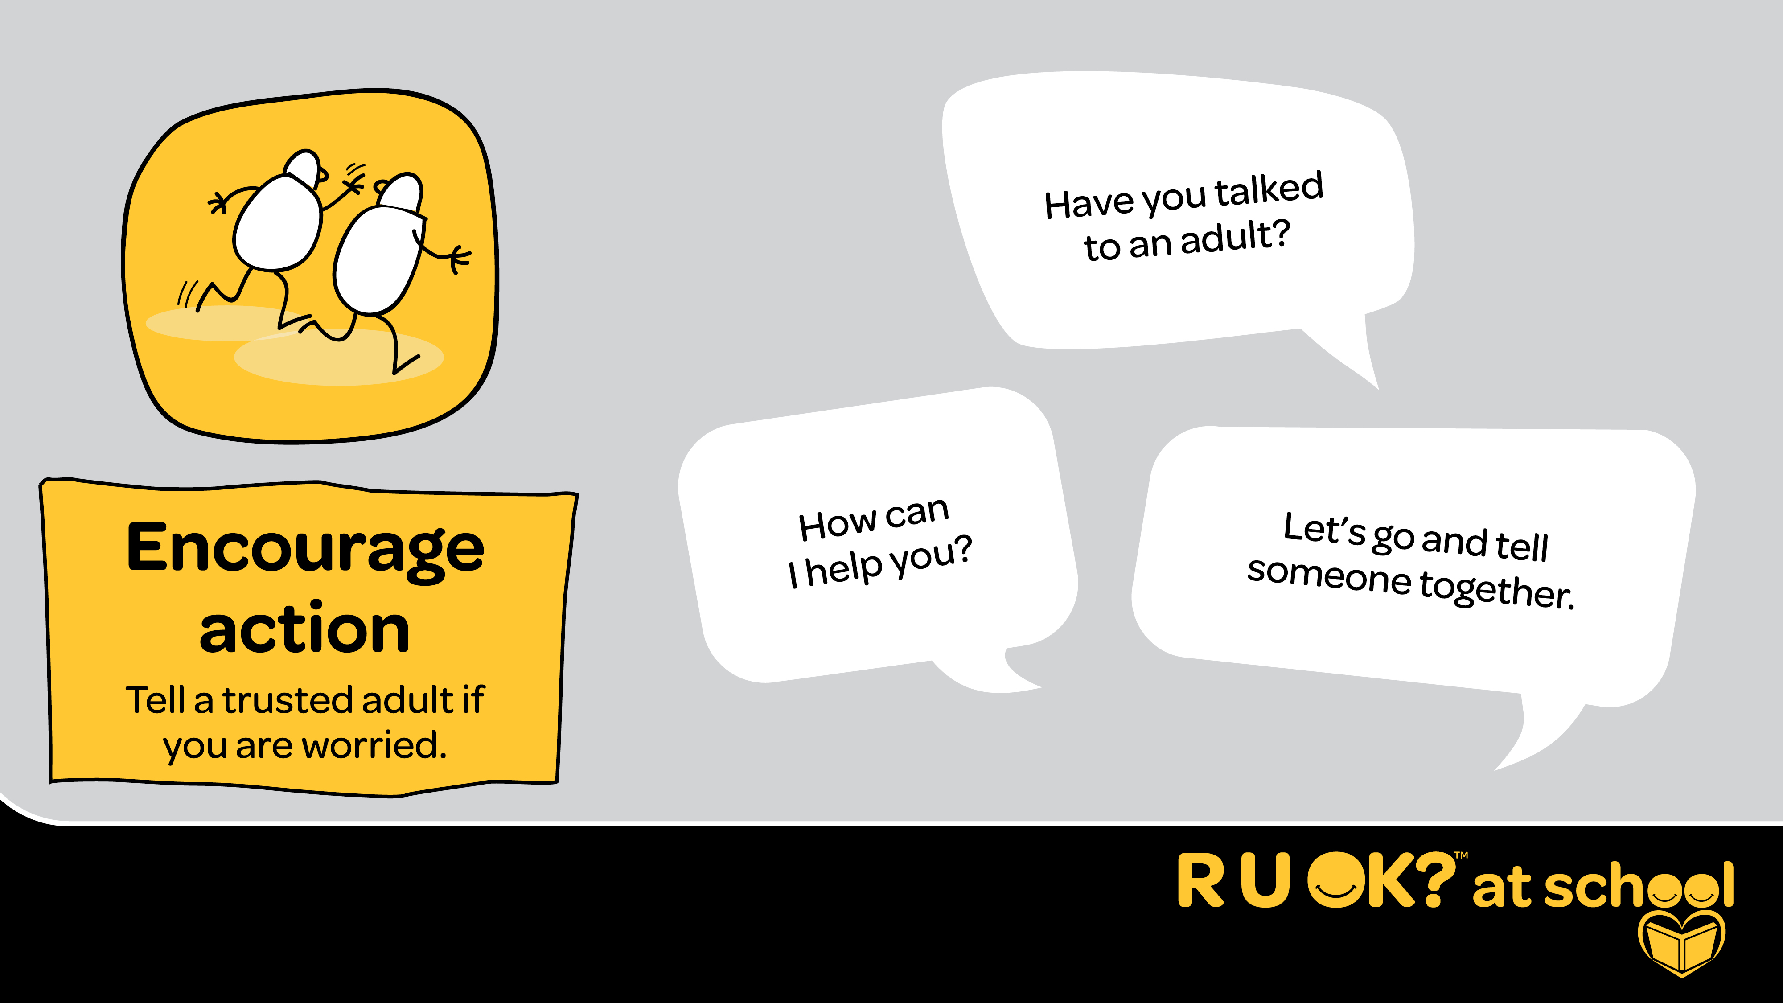
Notes:
Script:
Once they’ve shared why they are sad, worried or angry, you might suggest to them that they think about one small step they might be able to take.
You don’t have to have all the answers, and it can be really good to encourage them to share how they’re feeling with an adult they trust.
This could be a teacher, coach, parent, instructor, school counsellor or staff member.
Sometimes, just talking can help them feel better. But make sure you help them tell an adult if it’s a big thing, you can even go with them if they are happy for you to go.
You could say:
Have you talked to an adult?
“How can I help you?
“Let’s go and tell someone together”
OR
“Did you know that you can get free and confidential support online or over the phone from places like Kids Helpline

Slide 13
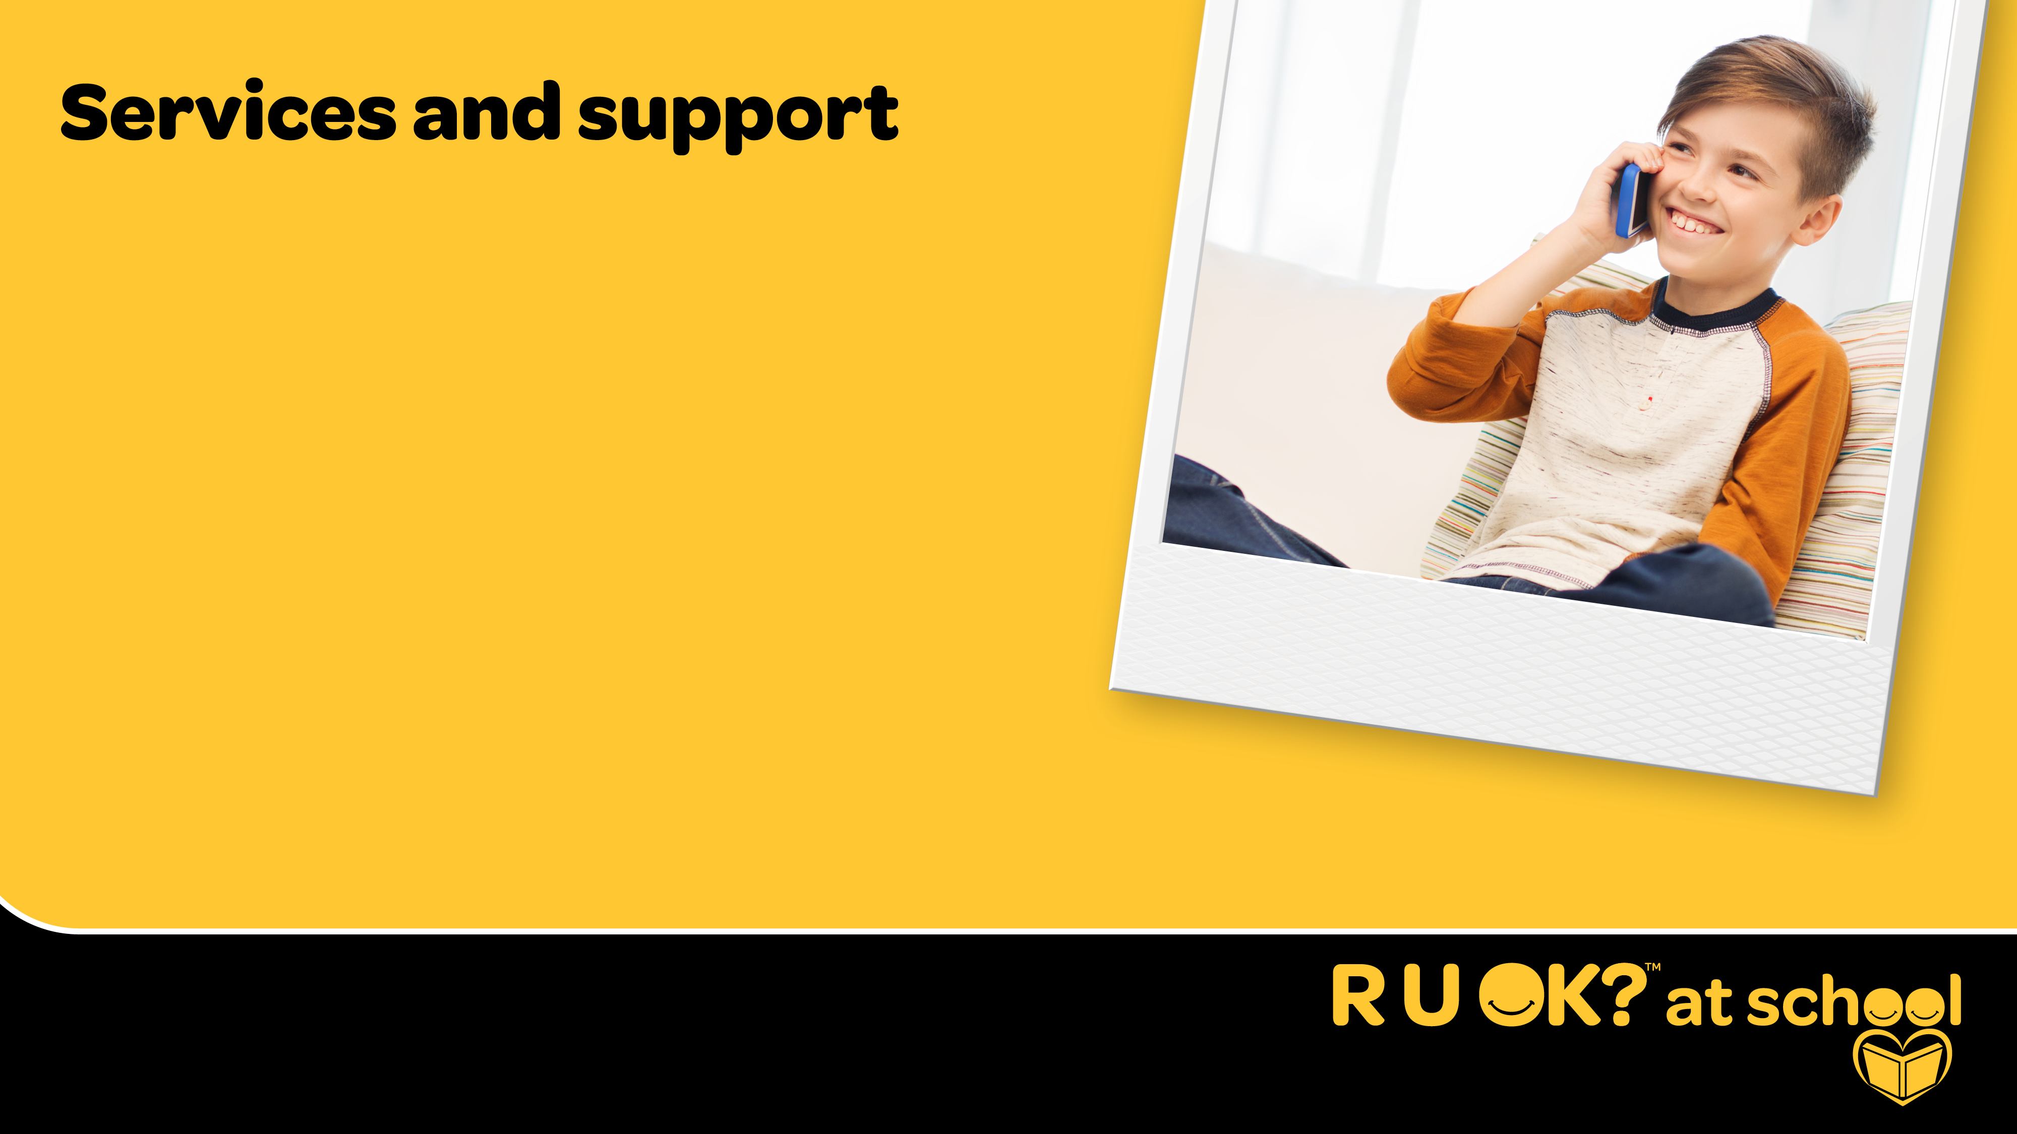
Kids Helpline (24/7)
1800 55 1800
kidshelpline.com.au
Include services available to students at your
school and how students can access them.
Notes:
EDITS REQUIRED:
Add any services that are available specifically at your institution or in your local area.
Script:
Another way you can encourage action is by encouraging your friend to call the kids helpline, where they can speak to an adult who is trained to have supportive conversations with kids. These conversations can be confidential which means they won’t tell anyone and it’s just a place to share how you’re feeling and get some free advice.
Kids helpline you can call at any time of the day, no matter how late or early it is.
If you are worried about a friend, you can call the kids helpline yourself to ask questions and find out more about what you could do to support them.

Slide 14
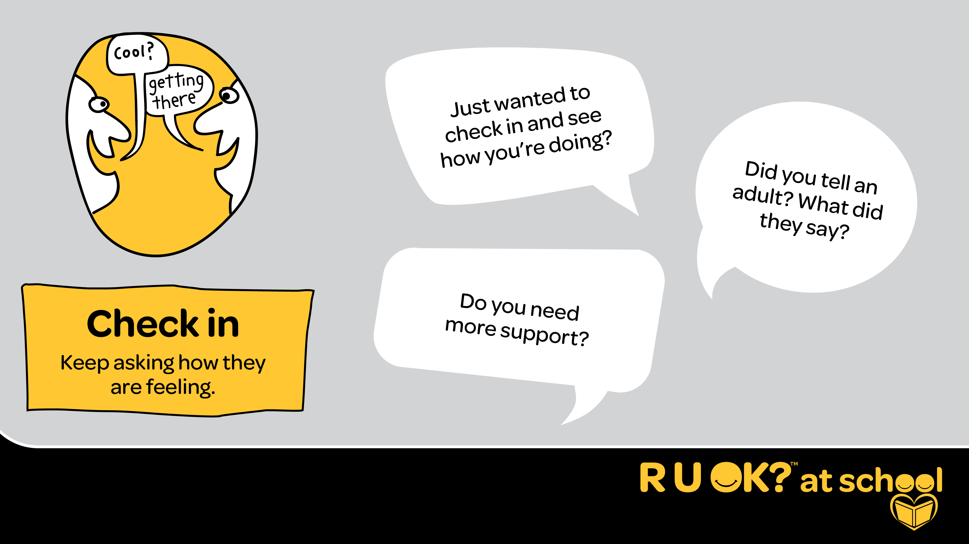
Notes:
Script:
After the conversation make sure you don’t ignore what happened - keep checking in. It’s important to continue showing care so that they continue feeling supported and so they know they can always come to you if they feel that way again.
When you check in you could:
Ask them about activities they like to do and help them make plans to do them or offer to do them together.
Arrange group catch-ups to help them connect with others.
You may consider asking the audience how they stay connected with the people in their world.
When you check in you could say:
“Just wanted to check in and see how you’re doing?”
“Did you tell an adult? What did they say?”
“Do you need more help?”
"How are you today?"

Slide 15
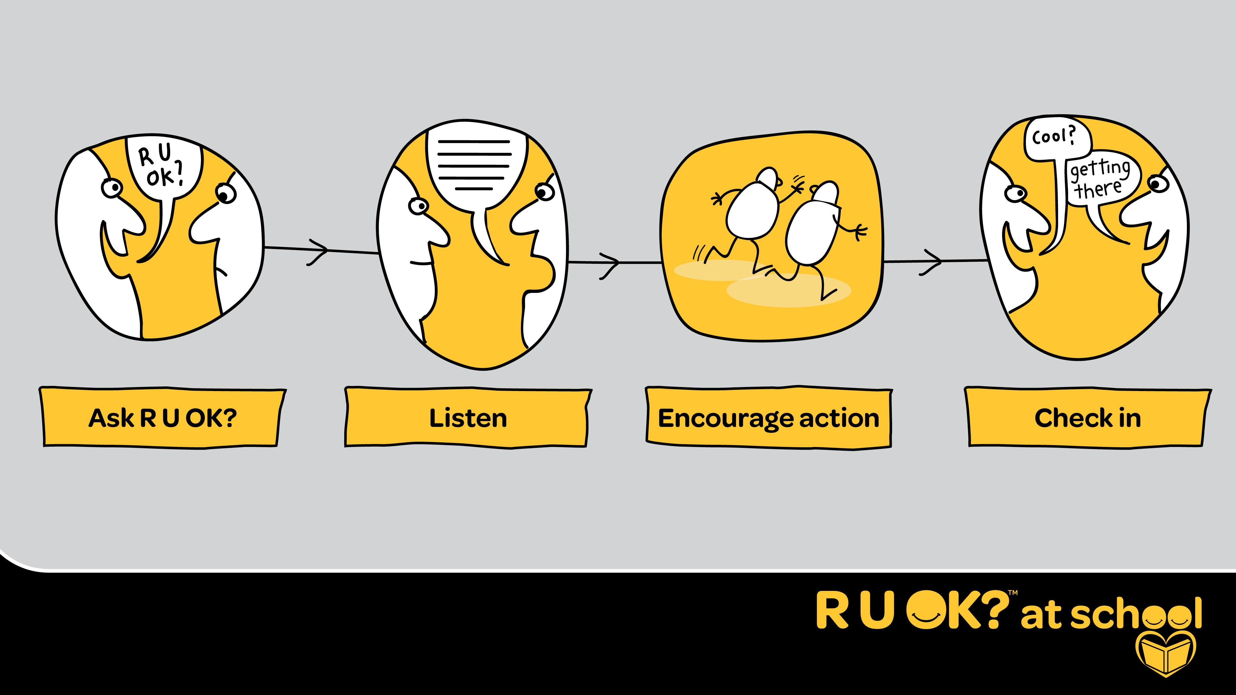
Notes:
Script:
By asking R U OK? then listening, encouraging action and checking in, your conversation could change a life.

