Slide 1
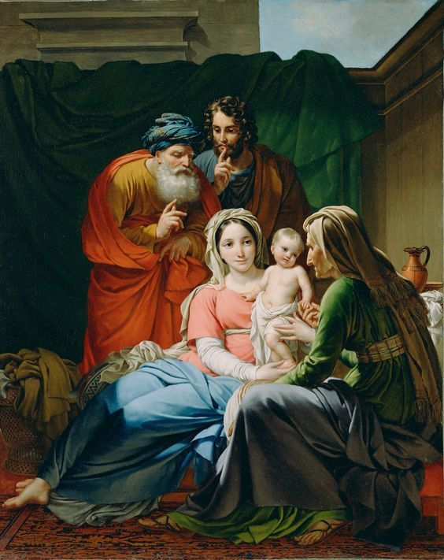
St Anne and Joachim,
Grandparents of Jesus.
Pray and Protect
All Grandparents.
AMEN

Slide 2
I love when my Yiayia makes me homemade pizza and when my Pappous gives my brother and I chocolate.
Angelina 10

Slide 3
When my cousins and I get together we sometimes drive my nanna crazy! But we love baking cakes with her.
Emilia 8

Slide 5
When my grandpa visited me from England he would bring me lots of things.
Oliver 6.5

Slide 6
My grandpa is very kind and helped lots of people.
Noah 6

Slide 7
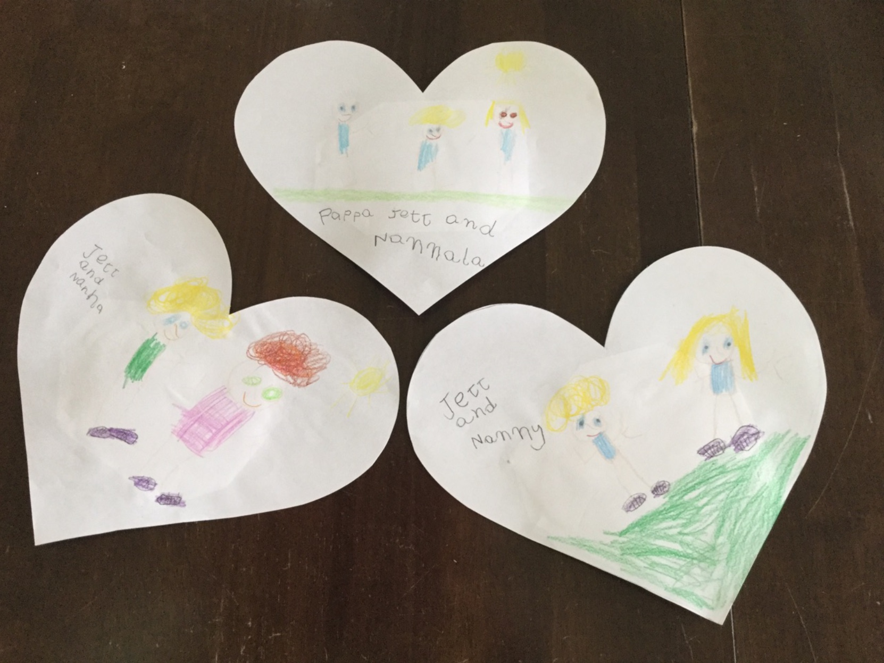

Slide 8
My grandpa lives with me and helps me build things.
Jacob 6

Slide 9
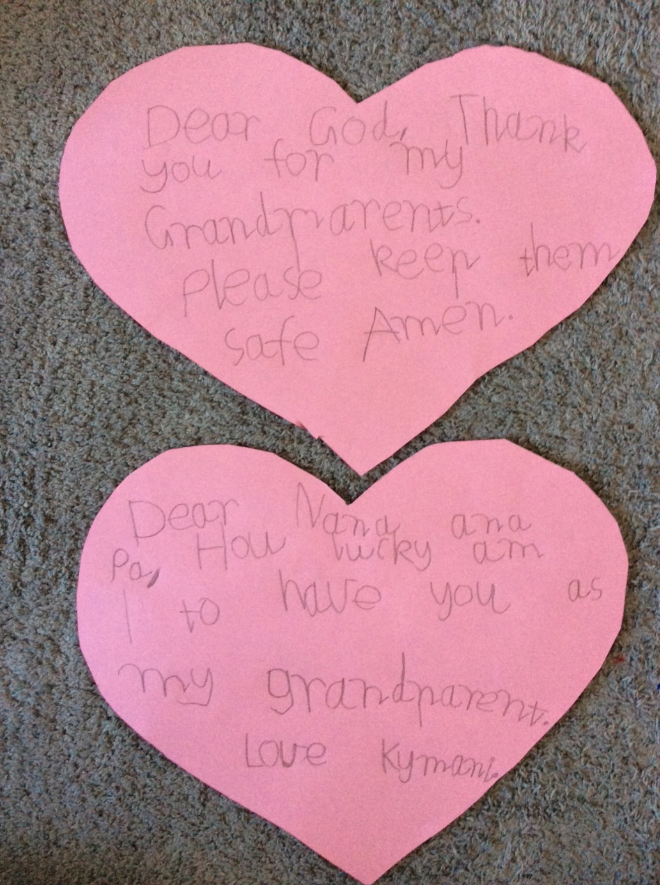
My grandparents spoil me when they teach me how to make traditional food.
Ava 12

Slide 10
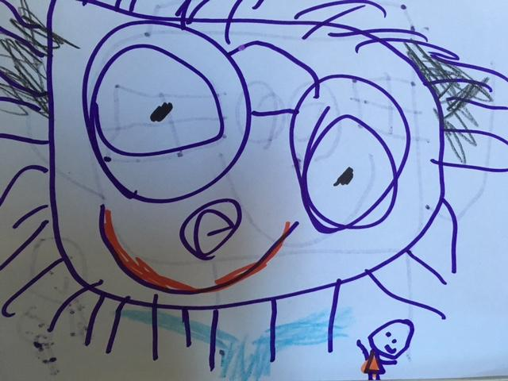
Me and my Nonno.
Oliver 5

